Slide 1
2022 MCM PROBLEM A · UCLA MATH 142 · GROUP 4
Power Profile of a Cyclist:
Optimal Pacing for the Time Trial
3 courses · 4 rider profiles · finishing within ~7–12% of the 2021 winners
Group 4 · Ben Miller · Carter Dandridge · Prannay Veerabahu · Dennis Lee
Notes:
We model how a time trialist should spend power over a course, then let an optimizer find the fastest legal plan.

Slide 2
02
MOTIVATION
The Problem
Riders of equal fitness are separated by how they spend power, not how much.
■ Same fitness: the race is won on how power is spent
■ No one can hold a single power the whole way
■ Hills, descents, wind: every metre changes speed-per-watt
THE CORE QUESTION
Distribution of effort, not total effort. That is what separates riders of equal capacity.
Power Profile of a Cyclist
02 / 14
Notes:
The core question is distribution of effort, not total effort — that’s what separates riders of equal capacity.

Slide 3
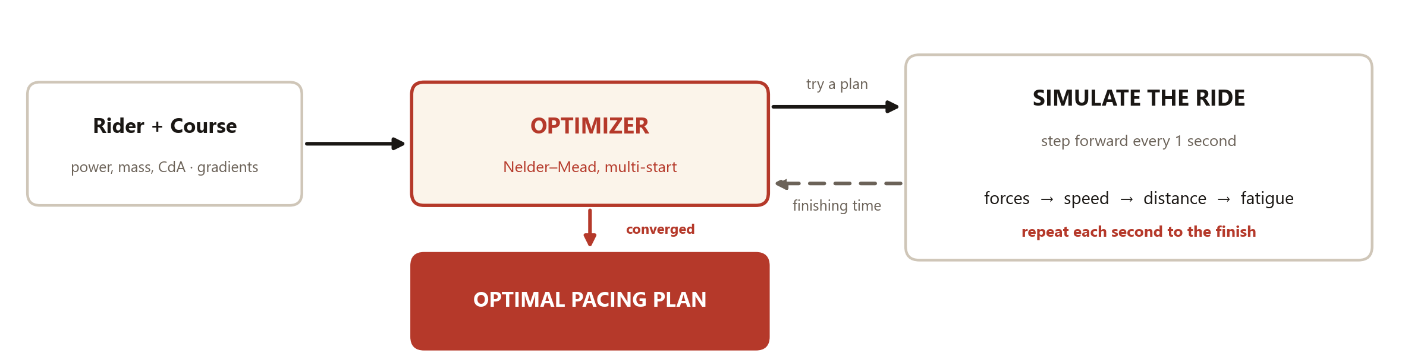
03
METHOD OVERVIEW
Our Approach
How the model works: simulate the ride, then let an optimizer find the fastest plan.
Power Profile of a Cyclist
03 / 14
Notes:
Two design choices drive everything: forward-Euler stepping, and reducing strategy to just two interpretable knobs.
Detail: 1-second forward-Euler steps; two pacing knobs (hill_factor, flat_boost); optimized with multi-start Nelder–Mead per rider/course.

Slide 4
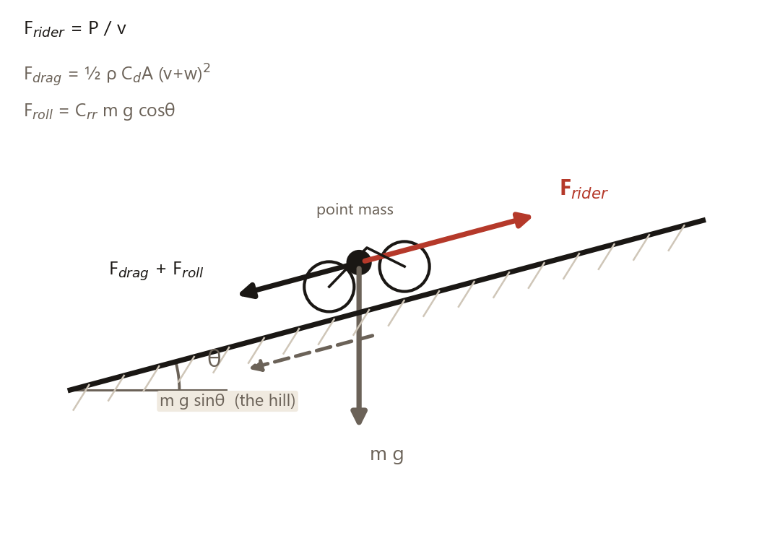
04
THE MODEL
Forces & the Discrete Update
■ Net force = drive − drag − gravity − rolling resistance
■ Drag grows with the square of speed + wind
■ Each second: net force → new speed (forward-Euler)
DISCRETE UPDATE
Power Profile of a Cyclist
04 / 14
Notes:
Four forces, one update rule — every force is in newtons, divide by mass and multiply by dt to get the velocity change.

Slide 5
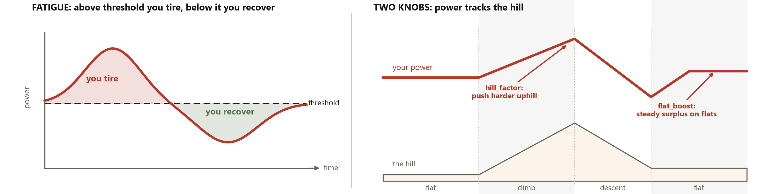
05
THE MODEL
Fatigue & the Two Pacing Knobs
■ Fatigue builds above your threshold, recovers below it
■ Two knobs, hill_factor and flat_boost, set the whole plan
Power Profile of a Cyclist
05 / 14
Notes:
Fatigue is a single threshold rule, and the whole strategy collapses to two numbers the optimizer tunes.
Detail: P_base = 0.93·P_threshold, ceiling P_max = 1.5·P_threshold; recovery rate ≈ 20% of the fatigue rate; CdA ≈ 0.20–0.23 m² (TT) / 0.24–0.27 m² (climbers), female ≈ −10%.

Slide 6
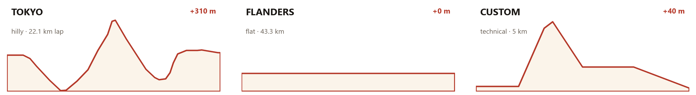
06
SETUP
Courses & Riders
COURSE 01 · HILLY
COURSE 02 · FLAT
COURSE 03 · TECHNICAL
Tokyo 2021 ITT
Flanders 2021 Worlds
Custom loop
22.1 km lap, men 2 laps = 44.2 km, women 1 lap.
Flat, fast, men 43.3 km, women 30.3 km.
5 km, 4 sharp turns, one steep ramp.
Male TT specialist
Female TT specialist
Male climber
Female climber
Heavier, more powerful
Lower absolute power
Lighter, better W/kg
Lightest, biggest drag share
Power Profile of a Cyclist
06 / 14
Notes:
Three courses chosen to span the spectrum — hilly, flat, and technical — against four rider archetypes.
Detail: Tokyo lap 22.1 km, Flanders men 43.3 km, custom 5 km; bike ≈ 8 kg (of a sourced 7–14 kg range); W/kg from Valenzuela et al. 2022 (male) and Mateo-March et al. 2022 (female).

Slide 7
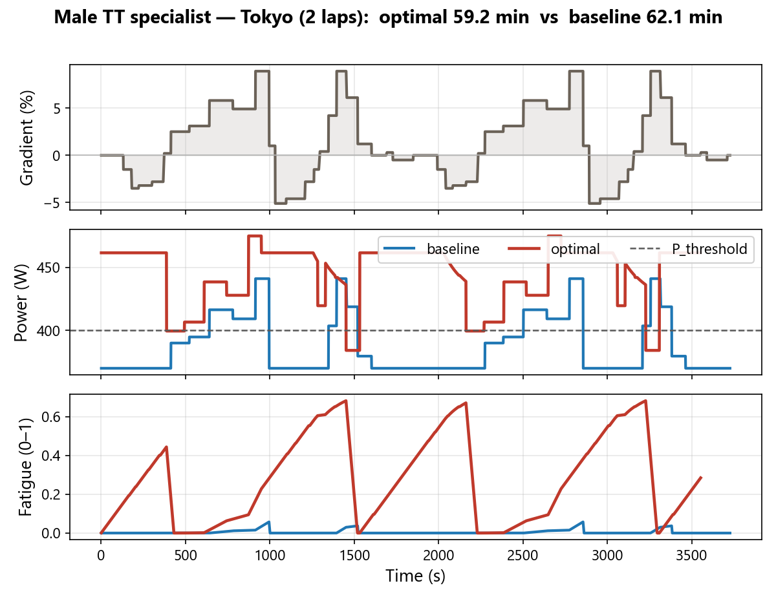
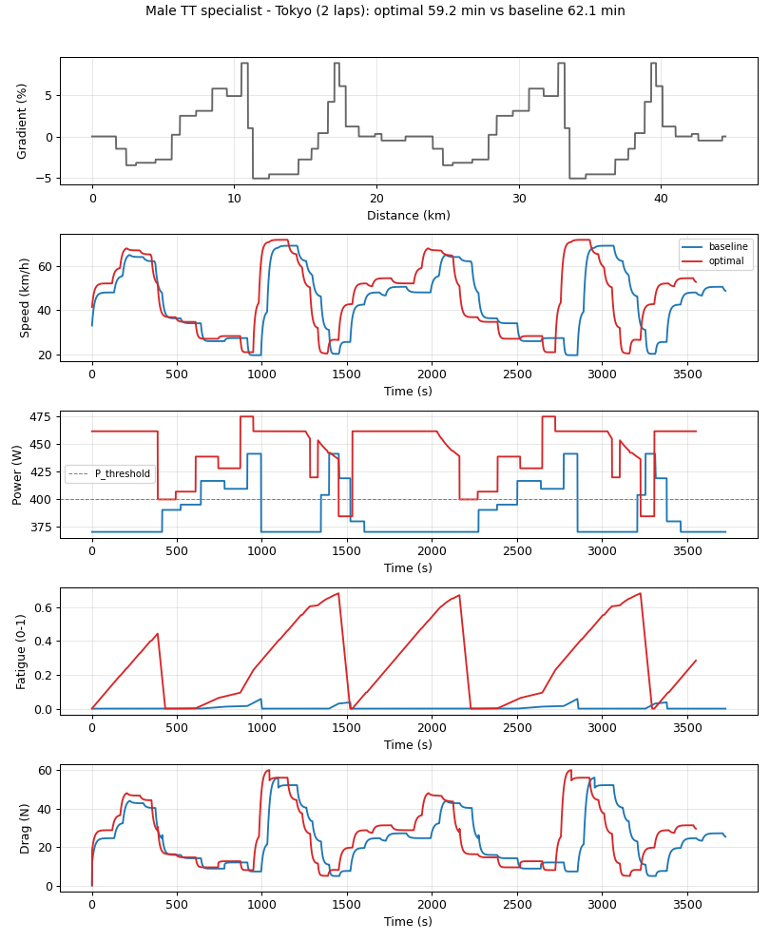
07
RESULTS
Optimal Pacing: The Diagnostic
■ Gradient, power and fatigue, all vs time
■ Baseline (blue) vs optimal (red), male TT
■ Above threshold on climbs, eased on descents
KEY TAKEAWAY
Recovers the intuitive strategy, unprompted.
Optimal vs baseline pacing, male TT specialist, Tokyo (2 laps)
Power Profile of a Cyclist
07 / 14
Notes:
Read the power panel against the threshold line — the optimizer spikes on climbs and eases on descents without being told to.
Numbers: hill_factor 800→1180, flat_boost 0→90 W; time 62.1→59.2 min (≈ 3 min saved); climb power ≈ 450 W, P_threshold 400 W, P_max ≈ 600 W.

Slide 8
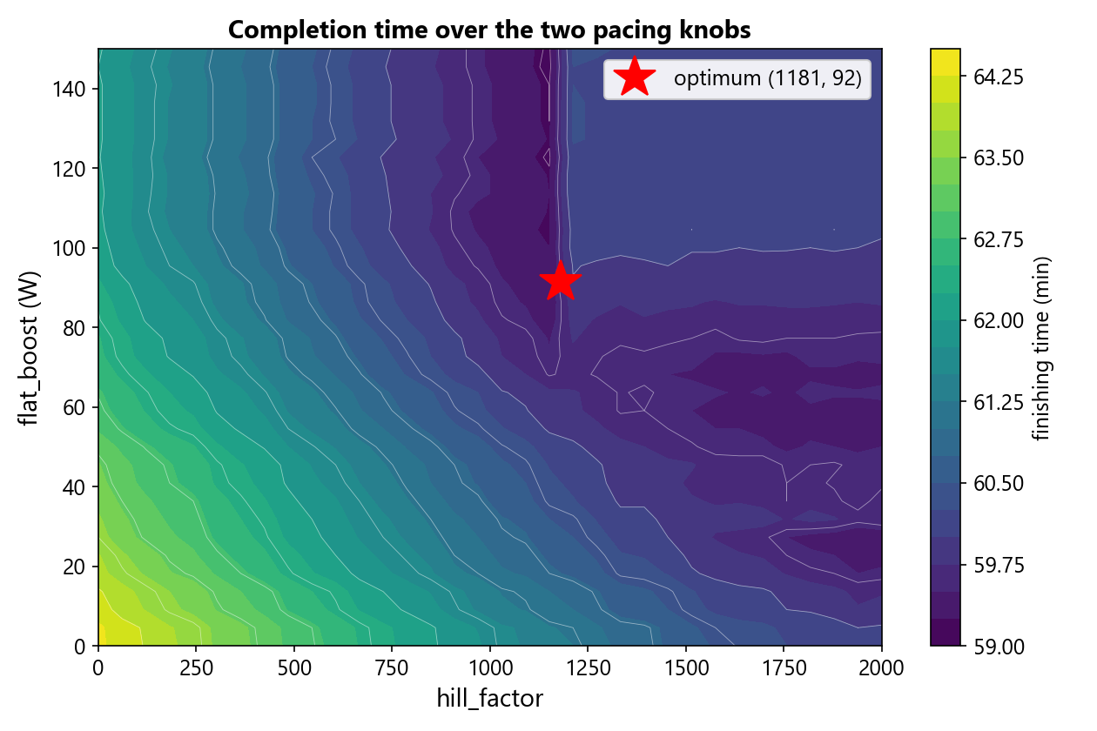
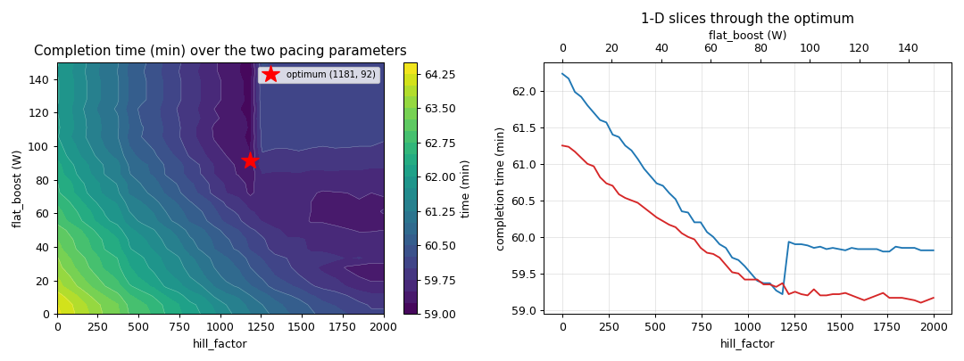
08
RESULTS
The Optimization Landscape
■ Completion time over the two knobs
■ Broad dark basin: many plans nearly tie
■ Strategy shape matters more than the exact numbers
What this shows: darker = faster; the wide dark zone means many knob settings nearly tie.
Power Profile of a Cyclist
08 / 14
Notes:
The flat basin is the headline of this slide: many plans tie, so the exact knob values matter less than the strategy shape.
Numbers: optimum hill_factor ≈ 1180, flat_boost ≈ 90 W; search bounds 0–2000 / 0–150; steady flat speed ≈ 50 km/h; removing fatigue entirely would cut ≈ 2 more minutes. (The dropped 1-D slices showed a flat valley confirming the basin.)

Slide 9
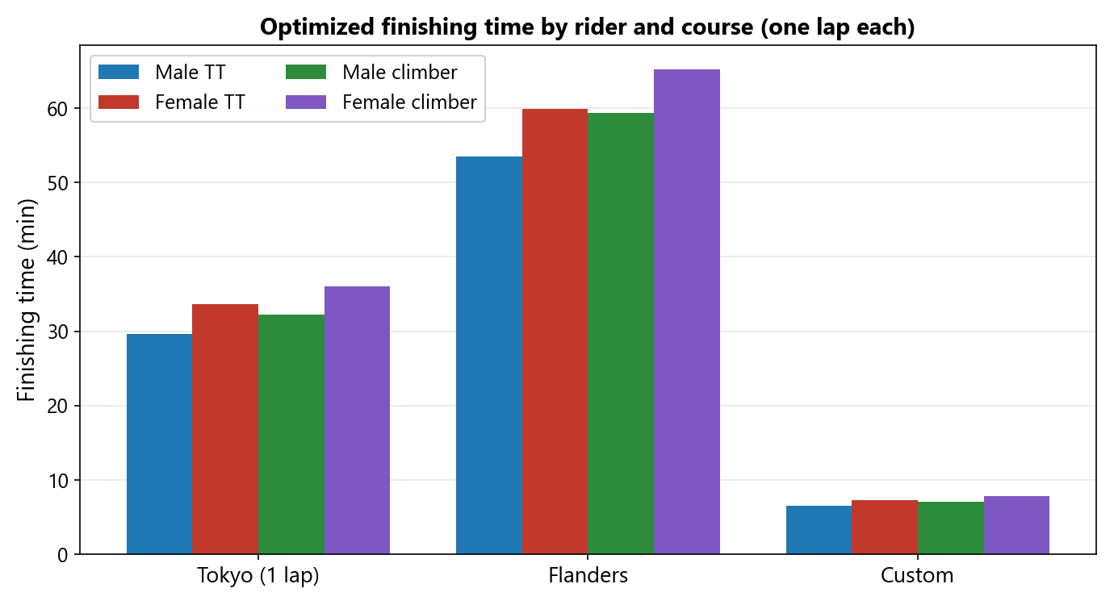
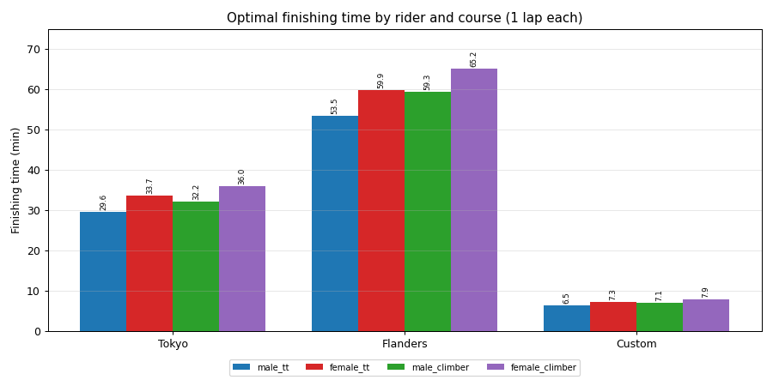
09
RESULTS
Results Across Riders & Courses
■ All 4 riders × 3 courses, one lap each
■ TT beats climber; men ahead of women
■ Climbers lose time on flats (more drag)
Power Profile of a Cyclist
09 / 14
Notes:
Ordering is consistent across every course: TT > climber within gender, male > female — exactly what the physics predicts.
Numbers (one lap, min) — Tokyo: 29.6 / 33.7 / 32.2 / 36.0; Flanders: 53.5 / 59.9 / 59.3 / 65.2; custom: 6.5 / 7.3 / 7.1 / 7.9 (male_tt / female_tt / male_clm / female_clm).

Slide 10
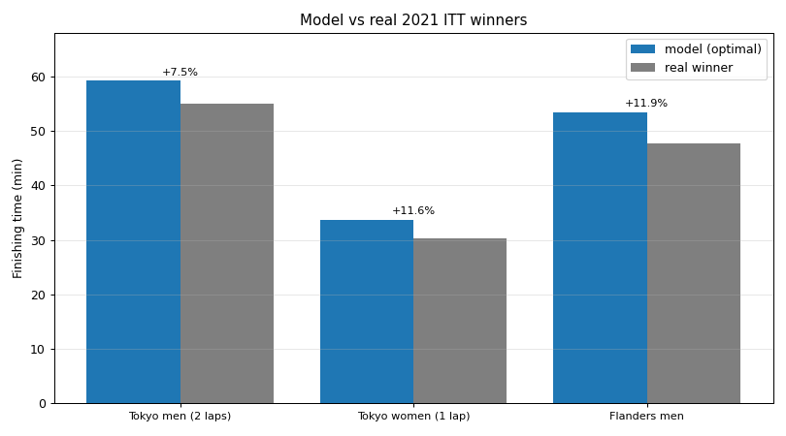
10
RESULTS
Validation vs the 2021 Winners
Model vs real 2021 winner, with percentage error above each pair, real race configuration
■ Each specialist run at the real race setup
■ Within ~7 to 12% of the 2021 champions
■ A transparent model should trail the very best
Roglič Tokyo ITT (men): 59.2 vs 55:04 (+7.5%)
van Vleuten Tokyo ITT (women): 33.7 vs 30:13 (+11.6%)
Ganna Flanders ITT (men): 53.5 vs 47:48 (+11.9%)
Power Profile of a Cyclist
10 / 14
Notes:
We’re a few percent slow, consistently — which is the right direction: a transparent model shouldn’t out-ride a world champion.
Numbers: Tokyo men 59.22 vs Roglič 55.07 (+7.5%); Tokyo women 33.73 vs van Vleuten 30.22 (+11.6%); Flanders men 53.47 vs Ganna 47.80 (+11.9%). Roglič = Olympic champion; van Vleuten = Olympic champion; Ganna = world champion.

Slide 11
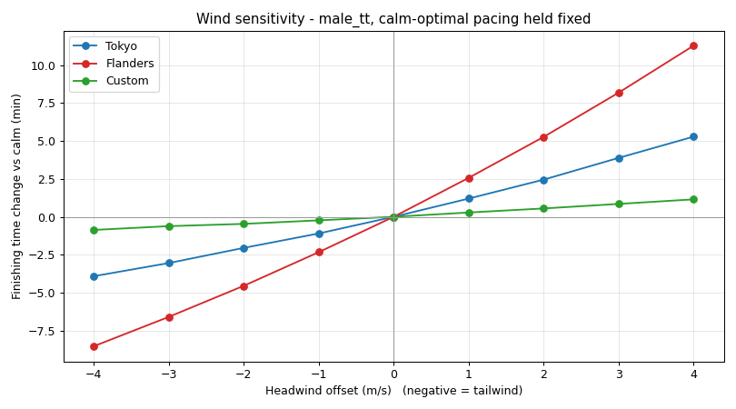
11
SENSITIVITY
Sensitivity: Wind
■ Wind acts only through drag
■ Flat Flanders is the most exposed
■ No wind direction, strength only
Finishing-time change vs a uniform headwind (−4…+4 m/s, negative = tailwind), three courses
Power Profile of a Cyclist
11 / 14
Notes:
Flanders’ slope is roughly double Tokyo’s and ten times the loop’s — on a flat course, wind is the dominant external variable.
Numbers: ≈ 150 / 70 / 16 s per +1 m/s (Flanders / Tokyo / custom). Flanders +4 m/s = +11.28 min, −4 m/s = −8.53 min; Tokyo +4 = +5.28 min; custom +4 = +1.15 min.

Slide 12
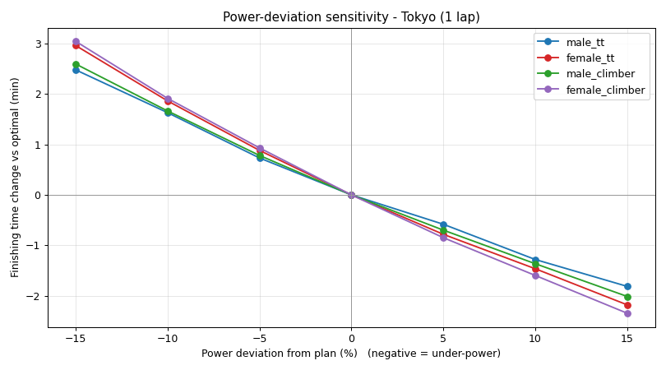
12
SENSITIVITY
Sensitivity: Power Execution & Parameters
■ Scale the power plan ±5 / 10 / 15%
■ Mild penalty, robust to pacing error
■ Threshold power is the trait that matters
Finishing-time change vs power deviation from plan (−15…+15%), four riders
Power Profile of a Cyclist
12 / 14
Notes:
Two takeaways: execution error is forgiving, and threshold power is the single parameter worth training — about two minutes per 10%.
Numbers: 10% power shortfall ≈ 1.6–2.0 min (Tokyo). Re-optimizing ±10%: threshold power 63.0 / 59.2 / 57.1; CdA 57.4 / 59.2 / 61.0; mass 58.0 / 59.2 / 60.5 min.

Slide 13
13
DISCUSSION
Limitations & Alternatives
■ Headwind has strength but no direction
■ Corner penalty is fixed, not speed-dependent
■ Female CdA scaled from male, not measured
■ One simple fatigue rule (cf. critical-power / W′)
TRADE-OFF
We traded physiological detail for transparency. Each limitation maps to a known refinement.
Power Profile of a Cyclist
13 / 14
Notes:
We traded physiological detail for transparency and speed; each limitation maps to a concrete, known refinement.
Detail: female CdA ≈ −10% vs male (assumption). Refinements: direction-dependent wind u = u₀·cos(α−β); physical (speed-dependent) cornering; a critical-power / W′ fatigue model (Ding et al. 2022).

Slide 14
14
CONCLUSION
Conclusion
The optimizer rediscovers good pacing on its own, and lands within a few percent of the best riders in the world.
■ Point mass + a fatigue rule + a 2-knob optimizer
■ Push climbs, recover descents, hold steady on flats
■ Within ~7 to 12% of the real 2021 winners
Thank you, Questions?
Power Profile of a Cyclist
14 / 14
Notes:
One line to remember: the model rediscovers good pacing on its own and gets within a few percent of the best riders in the world.
Close: ≈ 3 min saved vs the baseline plan; wind dominates flat courses; the plan is robust to ordinary execution error.

Slide 15
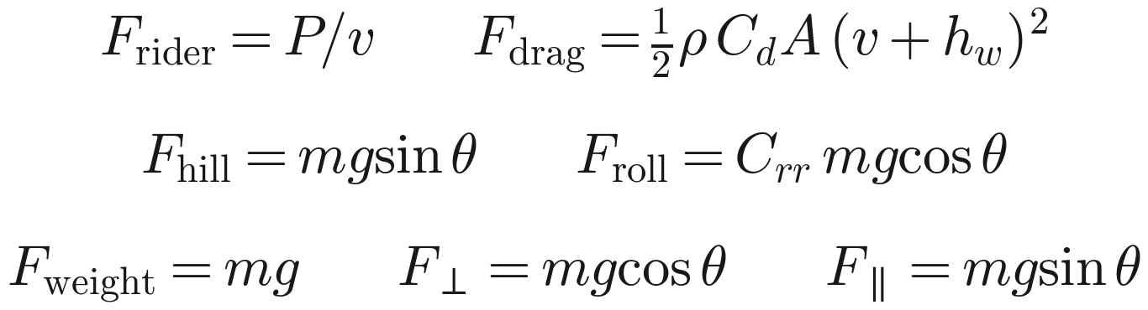
B1
BACKUP
Model Derivation
■ Start from Newton's second law: a = F / m
■ Build F from the four force terms
■ Substitute each force, then step in time
■ Units check: forces in N → m/s after ÷m, ×Δt
FULL UPDATE
Power Profile of a Cyclist · Backup
B1
Notes:
The full step-by-step for the methods-curious in Q&A — it’s just Newton’s second law applied per second.

