Slide 2
Data Loss Prevention Disclaimer
https://www.linkedin.com/company/wocsa/ https://www.youtube.com/@WOCSA-rx2mn/
Disclaimer
The following demonstration is for educational purposes only.
We do not promote or encourage illegal activities.
Knowing your enemy is a half-won battle
La connaissance n'est réellement profitable que lorsqu'elle est partagée
https://github.com/wocsa

Slide 3
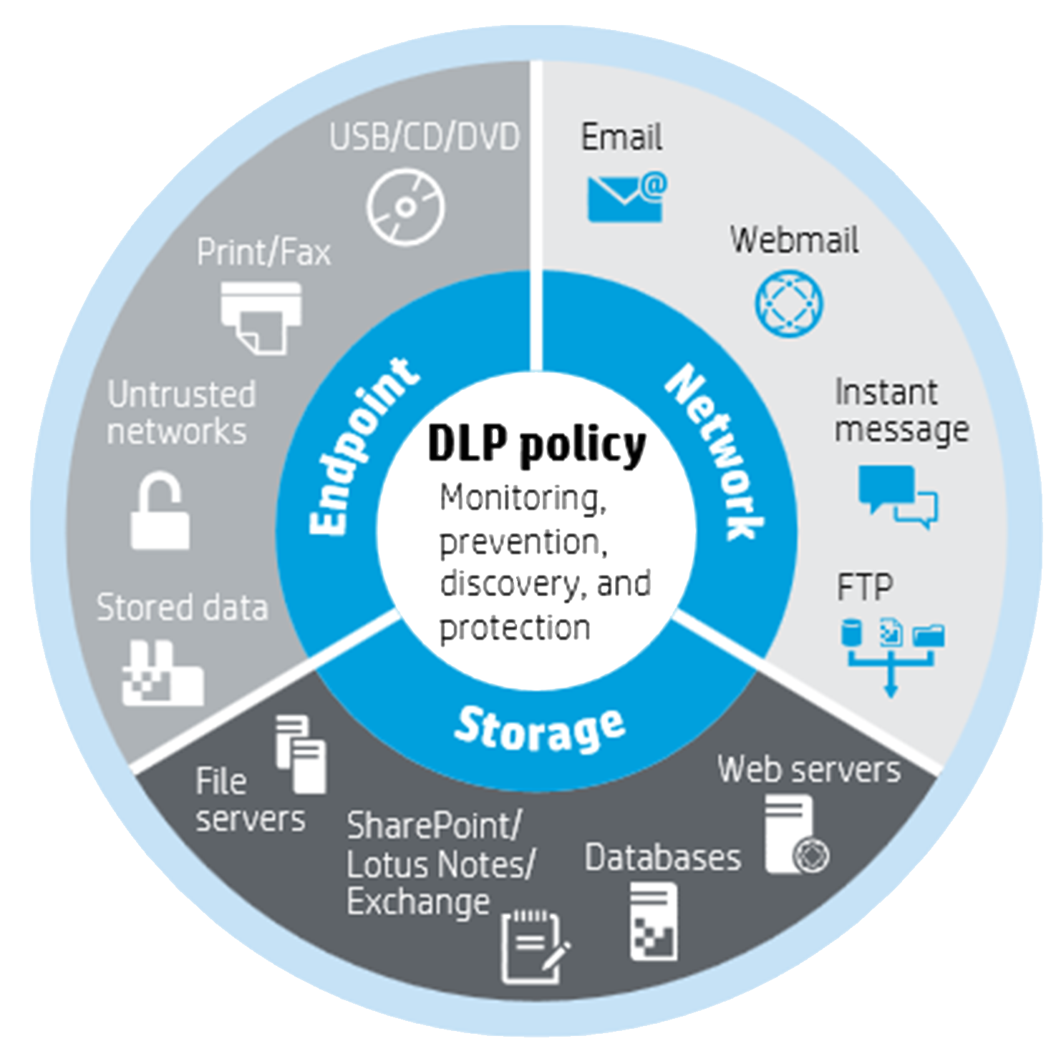
Data Loss Prevention Agenda
https://www.linkedin.com/company/wocsa/ https://www.youtube.com/@WOCSA-rx2mn/
What is DLP?
Quick explanation on how to proceed
AI for/against DLP
Time to hands on
https://github.com/wocsa

Slide 4
What is DLP?
11/06/2026

Slide 5
Data Loss Prevention What is DLP?
https://www.linkedin.com/company/wocsa/ https://www.youtube.com/@WOCSA-rx2mn/
DLP is a core component of data security, focused on protecting sensitive information from unauthorized access, exposure, or exfiltration.
By identifying and monitoring data across endpoints, networks, and cloud environments, DLP helps organizations enforce policies that control how data is used and shared.
This makes it an essential tool for reducing risk, supporting compliance, and safeguarding both business and customer data.
https://github.com/wocsa

Slide 6
Data Loss Prevention What is DLP?
https://www.linkedin.com/company/wocsa/ https://www.youtube.com/@WOCSA-rx2mn/
Endpoint DLP (On local machines):
A software agent installed directly on the employee's workstation.
Example: Blocking unauthorized file transfers to a USB drive or disabling the
"Copy/Paste" function for confidential corporate documents.
Network DLP (On the network infrastructure):
A dedicated system or appliance that monitors outgoing network traffic (emails, web requests, cloud uploads).
Example: Automatically blocking an outgoing email if its attachment is detected
to contain credit card numbers or sensitive customer data patterns.
Application AI Proxy (Our Lab 4!):
A software interceptor (middleware or API gateway) strategically
deployed between the user and the Large Language Model (LLM).
Example: Real-time filtering of incoming prompts to neutralize jailbreaks,
and scanning AI-generated outputs to redact secrets before they are displayed.
https://github.com/wocsa

Slide 7
Quick explanation on how to proceed
11/06/2026

Slide 8
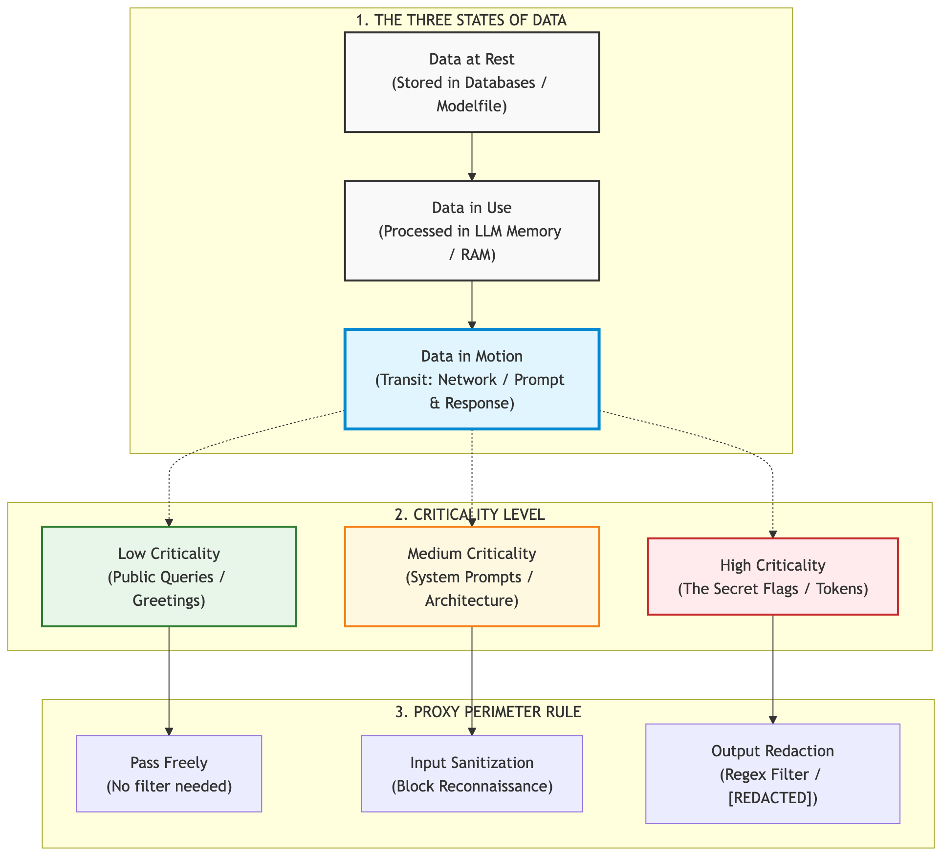
Data Loss Prevention Quick explanation on how to proceed
https://www.linkedin.com/company/wocsa/ https://www.youtube.com/@WOCSA-rx2mn/
https://github.com/wocsa

Slide 9
AI for/against DLP
11/06/2026

Slide 10
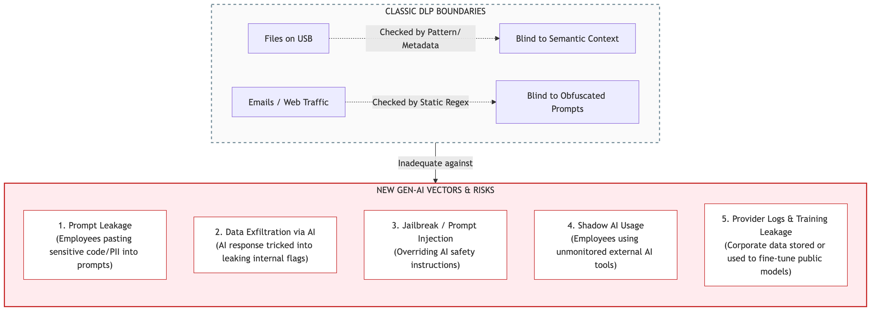
Data Loss Prevention AI for/against DLP
https://www.linkedin.com/company/wocsa/ https://www.youtube.com/@WOCSA-rx2mn/
https://github.com/wocsa

Slide 11
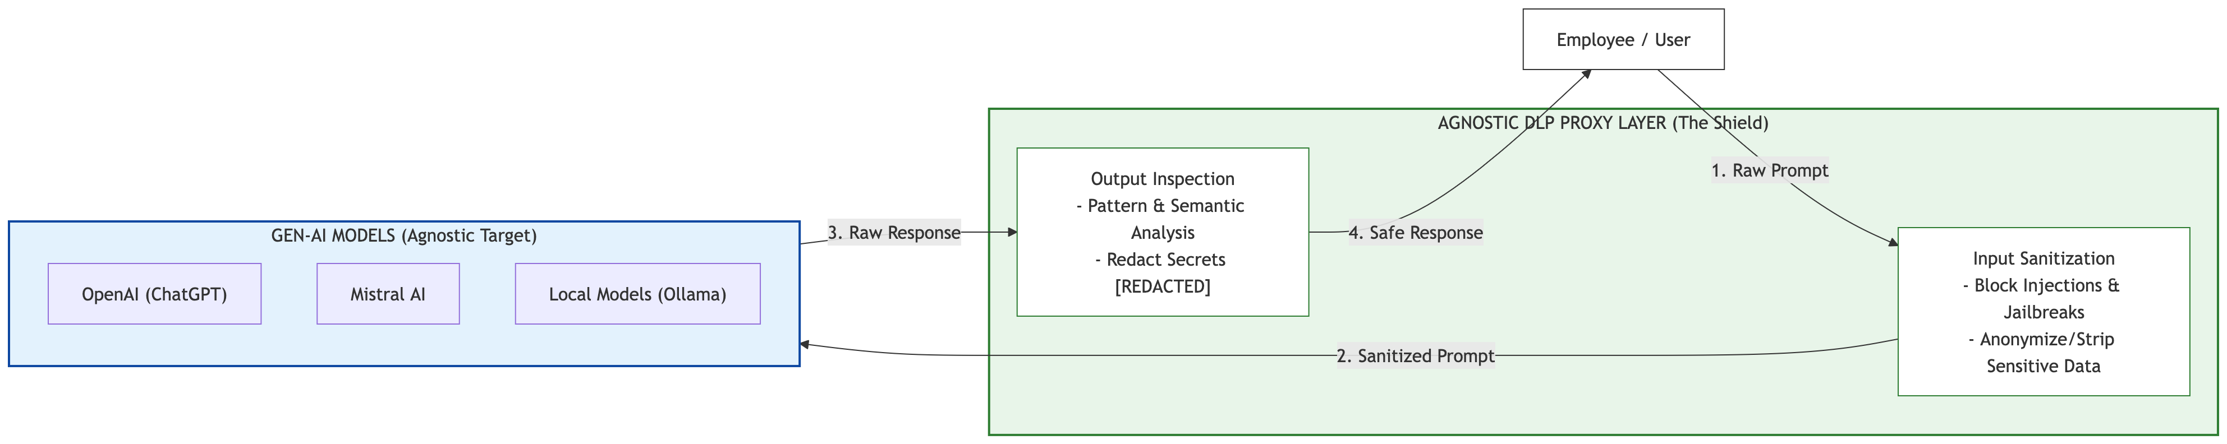
Data Loss Prevention AI for/against DLP
https://www.linkedin.com/company/wocsa/ https://www.youtube.com/@WOCSA-rx2mn/
https://github.com/wocsa

Slide 12
Time to hands on
11/06/2026

Slide 13
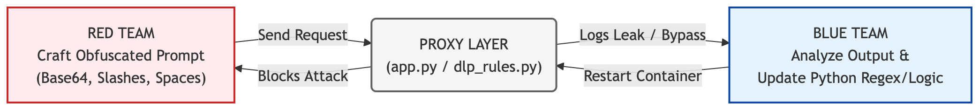
Data Loss Prevention Time to hands on
https://www.linkedin.com/company/wocsa/ https://www.youtube.com/@WOCSA-rx2mn/
https://github.com/wocsa

Slide 14










Join us to change the digital world: https://www.helloasso.com/associations/wocsa/adhesions/bulletin-d-adhesion-2 Please provide your feedback for our quality check process: https://www.wocsa.org/qcheck.php
11/06/2026
www.wocsa.org
@wocsa
@wocsa_asso
@wocsa
contact@wocsa.org
Join Us!
@WOCSA-rx2mn
https://discord.gg/pDunje3tpb

