Slide 1
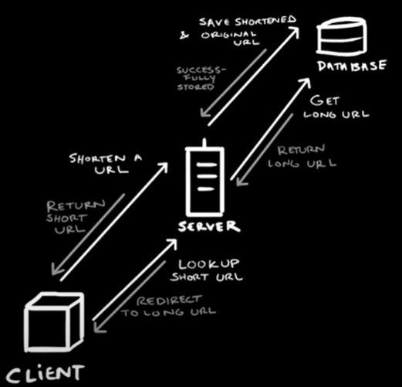
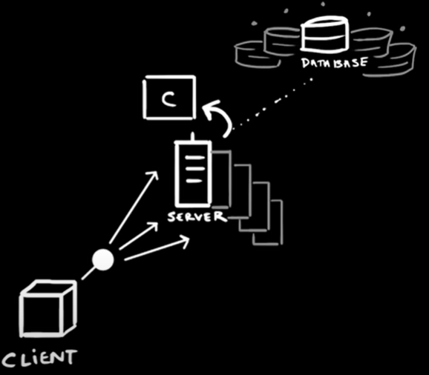
Design a URL-shortening service, TinyURL
Cache system to reduce the load on the database
Shard the database to handle huge amounts of object data
Create Short URL
Increase amounts of replica of the web server
Load Balancer

