Slide 1
Version Control with Git

Slide 2
AGENDA
What is version control?
What is git?
Setting up git (installation of the Git software).
Git command line basics (using Git bash).
Intro to github.

Slide 3
VERSION CONTROL SYSTEM
Version Control System (VCS) is a software that helps software developers to work together and maintain a complete history of their work.
Listed below are the functions of a VCS:
Allows developers to work simultaneously.
Does not allow overwriting each other’s changes.
Maintains a history of every version.
Following are the types of VCS:
Centralized version control system (CVCS). E.g. CVS, SVN.
Distributed/Decentralized version control system (DVCS). E.g. Mercurial, Git.

Slide 4
BRIEF HISTORY OF GIT
Git is a distributed revision control and source code management system with an emphasis on speed. Git was initially designed and developed by Linus Torvalds for Linux kernel development. Git is a free software distributed under the terms of the GNU General Public License version 2.

Slide 5
ADVANTAGES OF GIT
Free and open source
Git is released under GPL’s open source license. It is available freely over the internet. You can use Git to manage propriety projects without paying a single penny. As it is an open source, you can download its source code and also perform changes according to your requirements.
Fast and small
As most of the operations are performed locally, it gives a huge benefit in terms of speed. Git does not rely on the central server; that is why, there is no need to interact with the remote server for every operation performed.
Implicit backup
The chances of losing data are very rare when there are multiple copies of it. Data present on any client side mirrors the repository, hence it can be used in the event of a crash or disk corruption.
Security
Git uses a common cryptographic hash function called secure hash function (SHA1), to name and identify objects within its database. Every file and commit is check-summed and retrieved by its checksum at the time of checkout. It implies that it is impossible to change file, date, and commit message and any other data from the Git database without knowing Git.

Slide 6
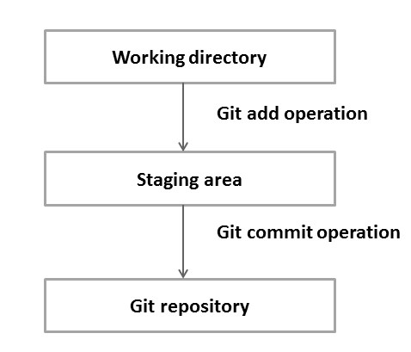
DVCS Terminologies
Local Repository
Every VCS tool provides a private workplace as a working copy. Developers make changes in their private workplace and after commit, these changes become a part of the repository
Working Directory and Staging Area or Index
The working directory is the place where files are checked out.
Basic workflow of Git.
Step 1: You modify a file from the working directory.
Step 2: You add these files to the staging area.
Step 3: You perform commit operation that moves the files from the staging area. After push operation, it stores the changes permanently to the Git repository.

Slide 7
Git command line basics(using Git bash)
$ git config --global user.name “”
$ git config --global user.email “”
$ git init
$ git log
$ git status
$ git add .
$ git commit –m “”

