Slide 1
Real-Time Production Line Sensor Dashboard
Si-Ware Systems – Product Engineer Technical Assessment
Gehad Mohamed Hassan
Notes:
Masaa’ el khair, ana Gehad Mohamed.
First of all, 7abbaa ashkor 7adaratko 3ala opportunity di w I’m really glad I’m here today.
3iza abl mbd2 a3araf nafsy shwaya.
I’d just recently graduated from the Faculty of Engineering, Ain Shams University, with a gpa of 3.4.
5elal l sanaten l fato 3mlt kaza internship, eddoni exposure 7lw awi le real projects, w 3alemoni 7agat keteer.
Fe Ejada Kont Data Management w Business Intelligence intern, esht8alt 3ala Informatica Powercenter w es5damet Oracle SQL Developer w mn 5elal l technologies d
eli edert abny multiple ETL workflows
fe DMS I built forecasting models w 3mlt dashboards 3ala Report server to get actionable insights from the forecasts w 3mlt Apache NiFi automated data pipelines, which handled data transformations.
B3d l experience de, le2ait eni ana more interested lel backend, APIs, w system integration. 3shan dol el core parts l y5alo l systems clean w reliable w scalable.
Soft skills wise, I’m a very organized person, ba7eb l problem solving, very structured in my thinking, w I like to communicate clearly and collaborate with the team.
I’m very interested in learning new technologies constantly.
W da 5alani a7es enno Application Integration Engineer role very aligned with what I want to do, which is why I’m excited to present to you today.

Slide 2
PROBLEM STATEMENT
Production lines require real-time monitoring
Multiple sensors must be handled concurrently
Faults must trigger immediate alarms
Engineers need remote access & notifications
Notes:
Sumerge msh mogarada a general software company w da l 5alany interested feha le2an elly bashoofo en Sumerge hia technology partner
Btesa3ed organizations zay el 7komat, banking, telecom, w large enterprises enohom y modernize l services w l systems bt3thom.
Sumerge has been operating since 2005, w 3la madar L senen 3mlt projects keteer across the Middle East w Africa

Slide 3
SYSTEM ARCHITECTURE
Notes:
Htkllm naharda 3n 3 main points.
Awalan 3n Sumerge, w fhmy leha wel services l bt2ademha. Saneyan l Application Integration Engineer role w mas2ooleyato.
W a7eran htkllm 3n the value I bring mn 5elal l technical background bt3ti w taree2t sho8ly w ezay h contribute
to your integration team in the short & long run.
Hawada7 le 7adaratko men 5elal l presentation di how I think about integration, ezay b deal with challenges,
w leh ana mota7amesa eni a grow my career hena fe Sumerge.

Slide 4
MULTITHREADING MODEL
One thread per sensor
GUI runs on main thread
No direct GUI updates from workers
Signals/queues ensure thread safety

Slide 5
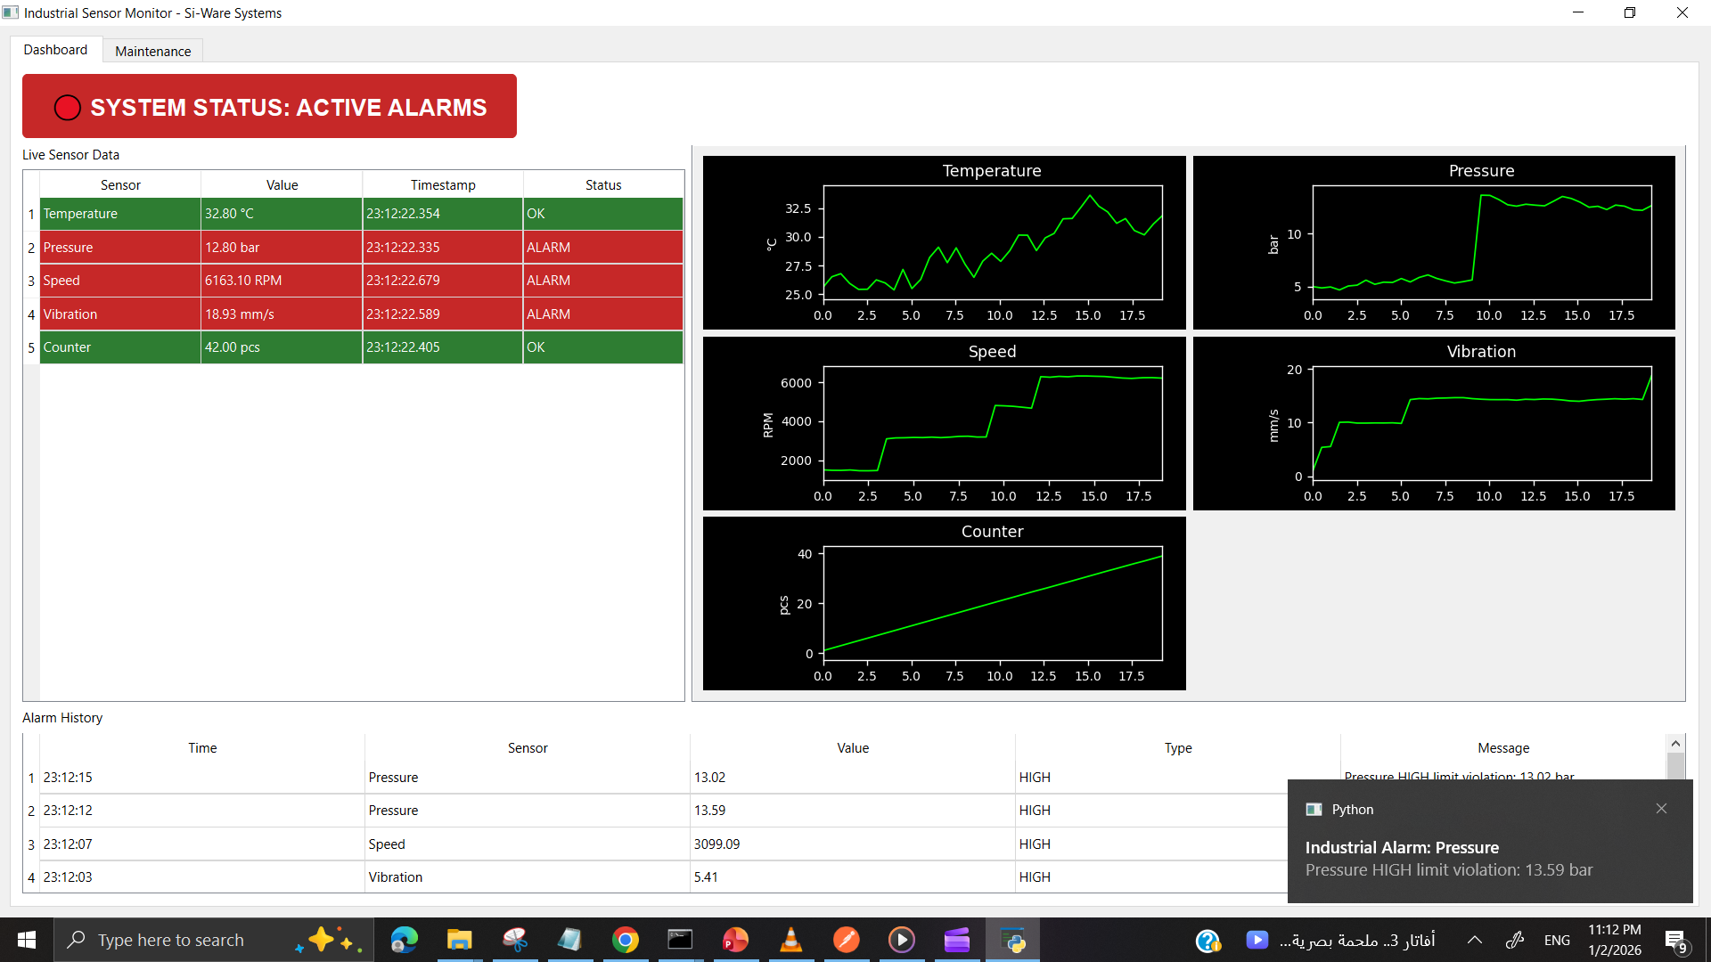
MAIN DASHBOARD (GUI)
Notes:
What’s quite unique is that Sumerge bit focus 3ala enaha t ensure business
effectiveness w efficiency msh bas enaha t deliver code.

Slide 6
REAL-TIME PLOTTING
Per-sensor rolling plots
Last 10–20 seconds
Auto-refreshing
Non-blocking rendering

Slide 7
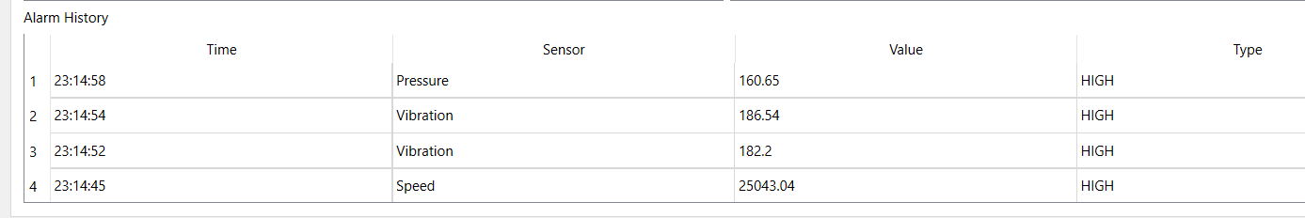
ALARM LOGIC
Configurable LOW / HIGH limits
Alarm triggered when limits exceeded
Logged with:
Time
Sensor
Value
Alarm type
Notes:
Sumerge sa3det fe 12+ e-services integrated fel app bta3 Tawakkalna l tabe3 l wezarat l mawared l bashareya w L tanmeya L egtema3eya.
Sumerge sa3dthom y scale quickly regardless of tight timelines.
L projects d 5aletni ashoof en Sumerge msh betebni standalone applications, enama betebni integration heavy platforms
that connect banks, ministries, channels in a reliable way.

Slide 8
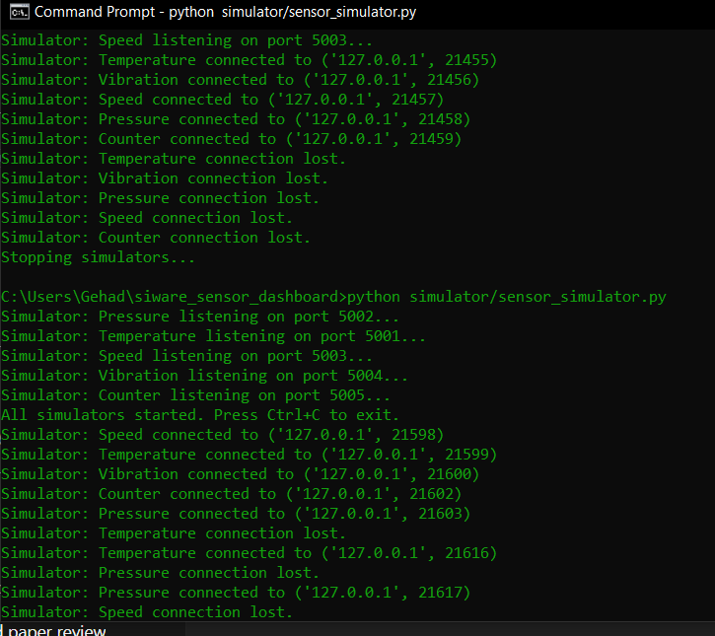
SENSOR SIMULATOR
Mimics real hardware sensors
TCP-based communication
Randomized values
Periodic fault injection
Notes:
Sumerge sa3det fe 12+ e-services integrated fel app bta3 Tawakkalna l tabe3 l wezarat l mawared l bashareya w L tanmeya L egtema3eya.
Sumerge sa3dthom y scale quickly regardless of tight timelines.
L projects d 5aletni ashoof en Sumerge msh betebni standalone applications, enama betebni integration heavy platforms
that connect banks, ministries, channels in a reliable way.

Slide 9
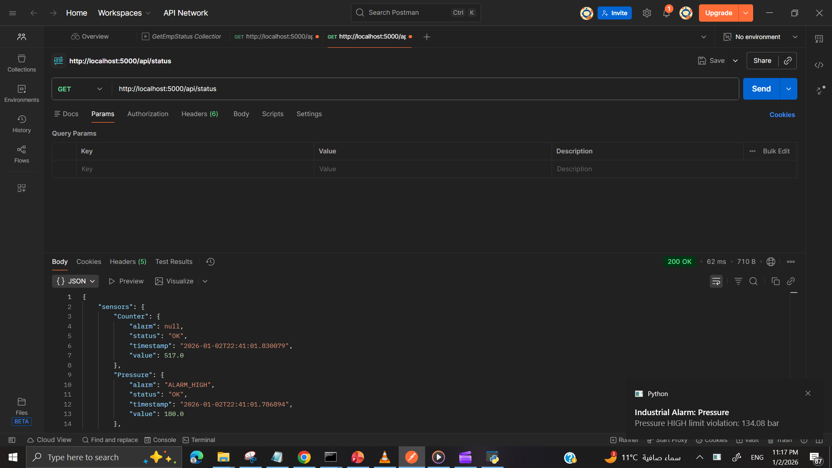
REMOTE ACCESS / API
REST API endpoints
Fetch live sensor data
Fetch alarm history
JSON responses

Slide 10
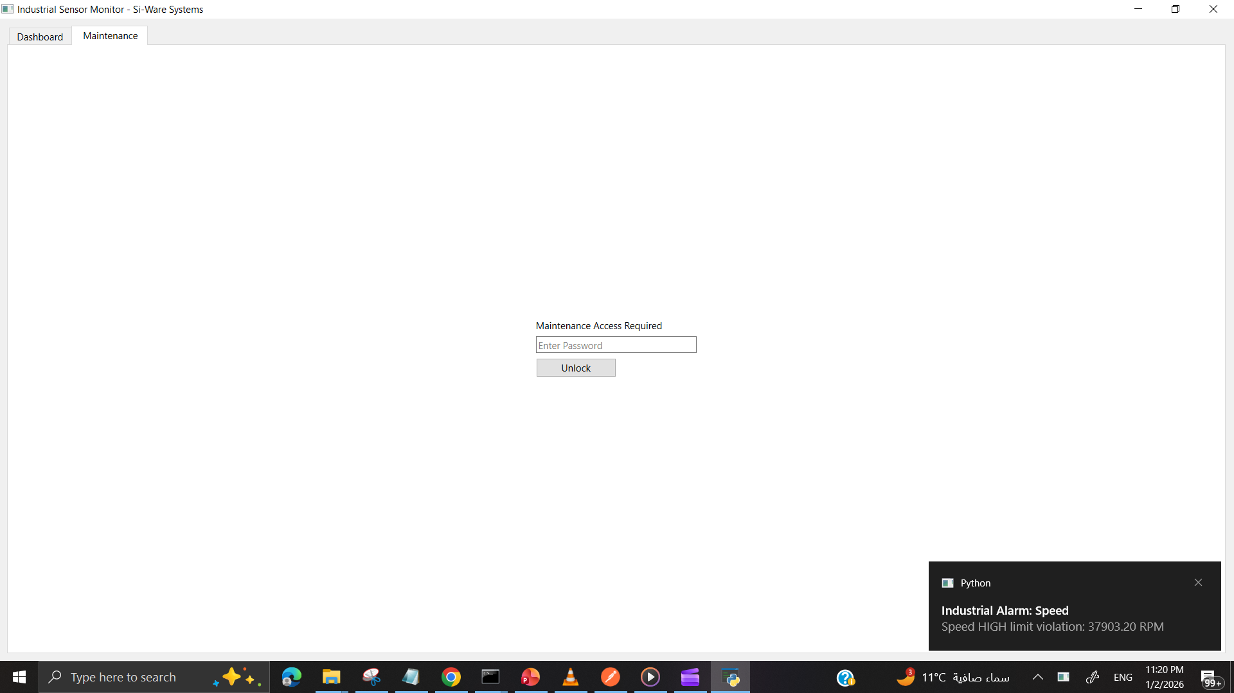
MAINTENANCE CONSOLE (BONUS A)
Protected access (password)
Notes:
El mission bt3t Sumerge enha t2adem high-end software solutions w services that improve business operations,
while building strong long-term relationships with customers w maintaining service quality.
Your vision is to be one of the leading technology and software solution providers fel region
that can serve the global market w last over time w t have a real impact
W da msh kalam t3beery– le en Sumerge 3mlt projects kteer hntklm 3la shwaya mnhom odam.

Slide 11
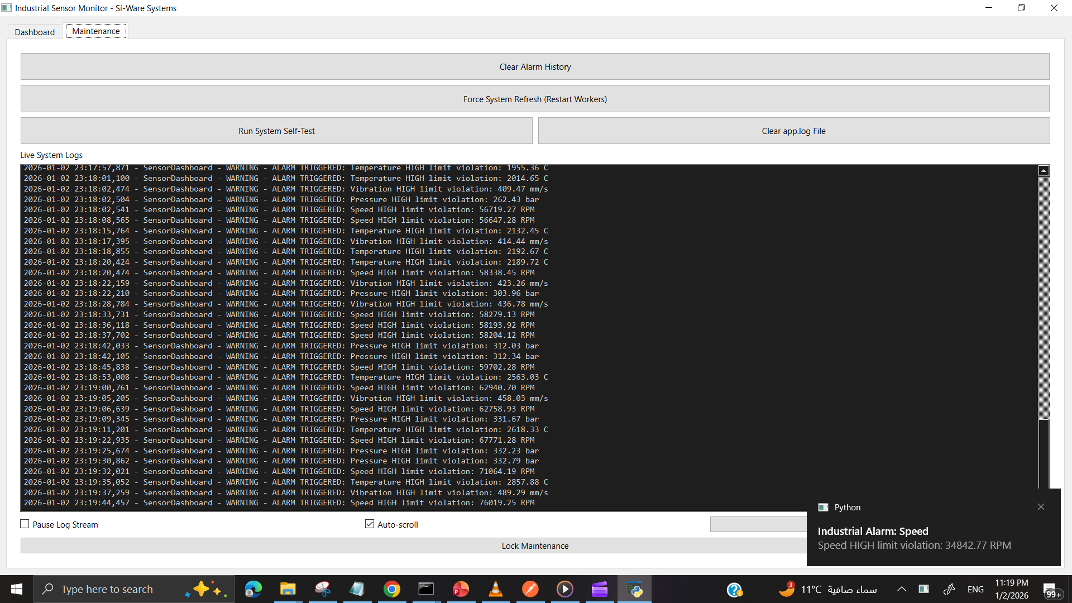
MAINTENANCE CONSOLE (BONUS A)
Protected access (password)
Live log viewer
Force refresh
Clear alarms
Run self-test
Notes:
El mission bt3t Sumerge enha t2adem high-end software solutions w services that improve business operations,
while building strong long-term relationships with customers w maintaining service quality.
Your vision is to be one of the leading technology and software solution providers fel region
that can serve the global market w last over time w t have a real impact
W da msh kalam t3beery– le en Sumerge 3mlt projects kteer hntklm 3la shwaya mnhom odam.

Slide 12
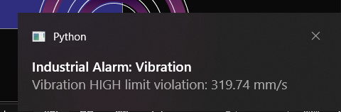
ALARM NOTIFICATIONS (BONUS B)
Desktop notifications
Alarm-based triggering
Immediate engineer awareness
Notes:
Ana shyfa n Sumerge btdi value through a mix of solutions w services.
Mn 7es l solutions side, Sumerge btsht8l 3la Analytics & Data Management, Business Process Automation,
Connectivity and System Integration, Enterprise Content Management, Enterprise Portals & Mobility.
Mn 7es l services, Sumerge bt provide Cloud Apps & Microservices, Application Development, IT consultancy, testing services.
El mix da by5ali Sumerge t2dr tesa3ed l clients enohom y7asseno their digital experience, w y automate processes, w yst5dmo el data in their decision making.
Teb3an da mohem awy fel banking wel government w telecom 3shan L processes btkon complex gedan w
el expectations mel end-users btb2a 3alya awy.

Slide 13
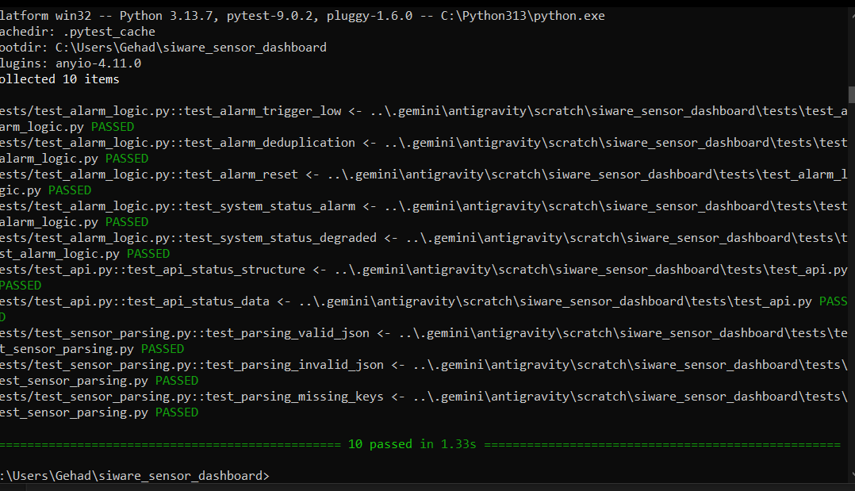
TESTING
Unit tests for:
Sensor parsing
Alarm logic
Manual integration testing
Notes:
3shan afham Sumerge aktr w ywd7 3la ard l waq3 ttbee2 I vision f3ln, lazem nshoof shwyt case studies le Sumerge…
Awel project Bank Al Inmaa2. Sumerge sa3det fe transforming their corporate banking to a modern microservices based platform.
El platform l gdeed b2a bydom aktr mn 120 feature w by serve aktr mn 200,000 users,
w edret Sumerge tn2l el data smoothly w t go-live men 8er ay disruption fel services.

Slide 14
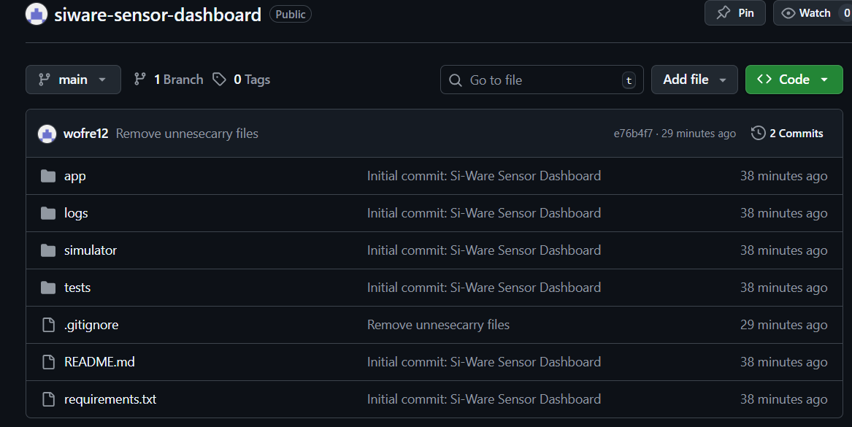
PROJECT STRUCTURE
Notes:
Ebank fe masr
Sumerge esht8lt 3la digital banking-as-a-service platform b est5dam IBM Cloud Pak for Integration w IBM Cloud Pak for Business Automation on Red Hat OpenShift.
W da 3ml foroo2 kteer mn demnha eno 2alel l time to market w 7assen l transfer times b shakal kbeer:
L internet banking transfers kanet bt5od w2t 10 minutes w dlw2ty it lasts just 2 minutes ya3ni 5 times faster.
w L interbank transfers improved drastically mn transfer by5od 4 minutes le 50 transfers per minute 7aleyan.

Slide 15
THANKS!
Do you have any questions?
Notes:
Thank you so much for your time and attention.
I hope I was able to give you a clear view of how I understand **Sumerge, role, and how i can contribute to your integration team.
I’m genuinely excited about the possibility of joining Sumerge and working on integration projects.
I’d be very happy now to answer any questions you may have.

