Slide 1
Application of ML algorithms for predicting Next Lever

Slide 2
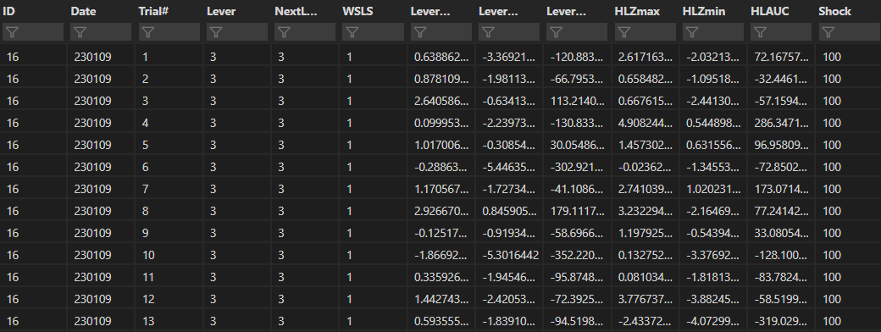
Input data (100to300behavior.csv)
4983 by 13 dataframe taken from 5-days of 100-300uA RDT behavior from 6 rats
WSP29 is removed for low signal, Trials where NextLever is omitted are removed and Last trials in a block are removed
Lever press is binarized (0=small, 1=large)
Results in a 2345 by 13 dataframe

Slide 3
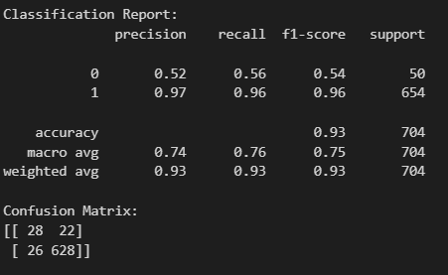
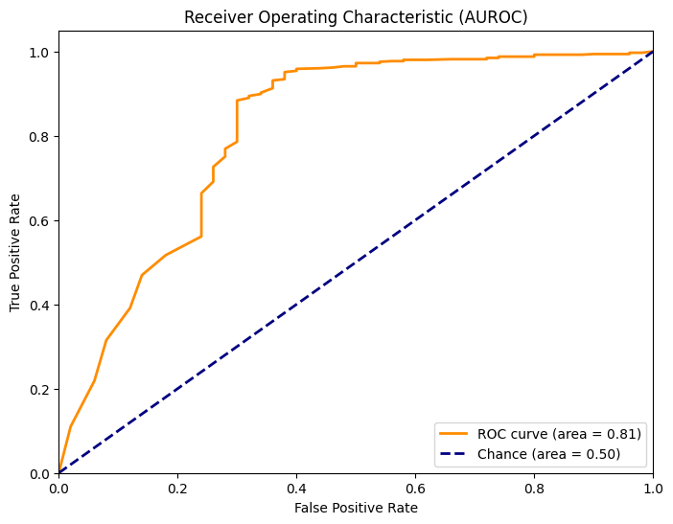
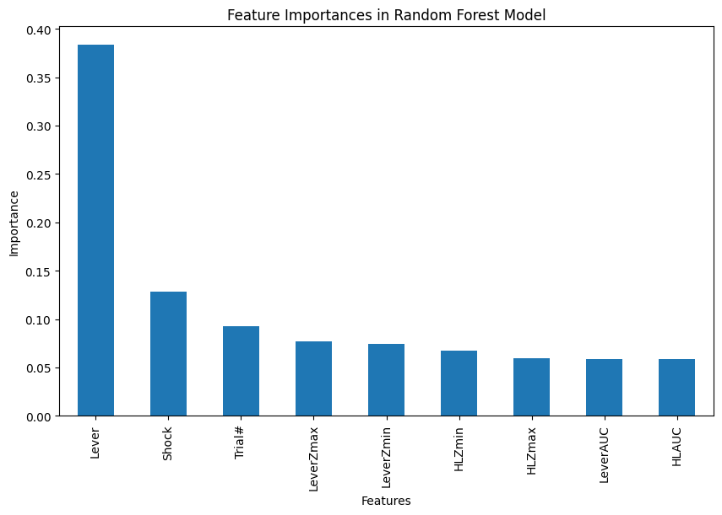
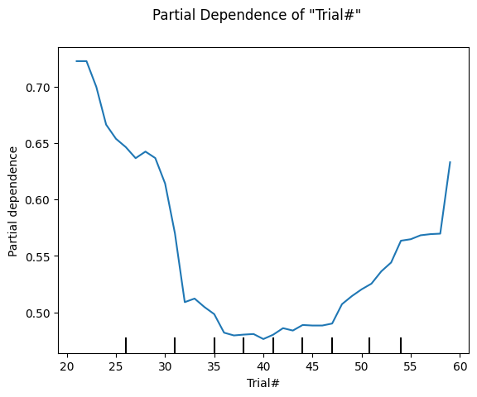
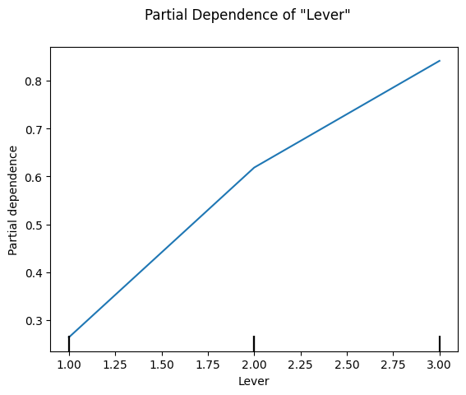
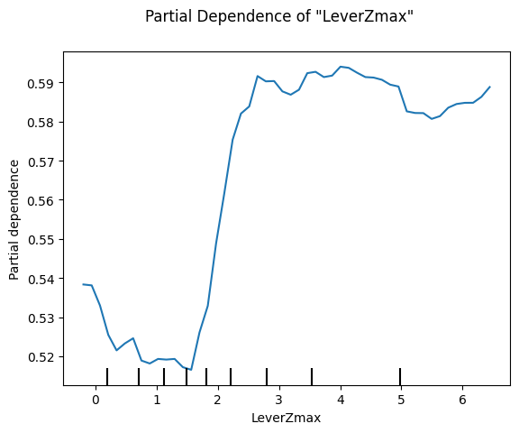
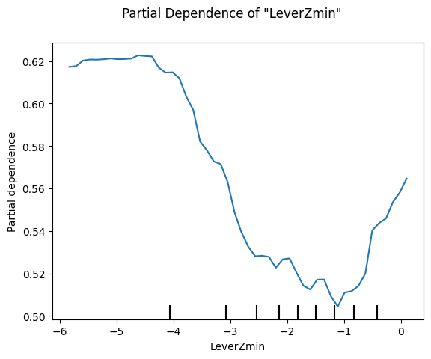
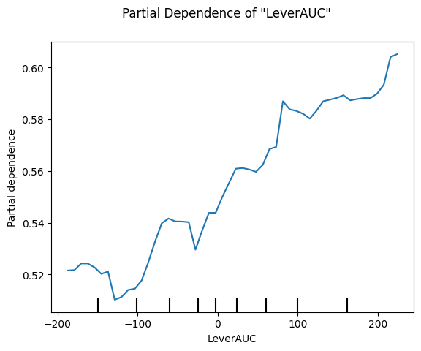
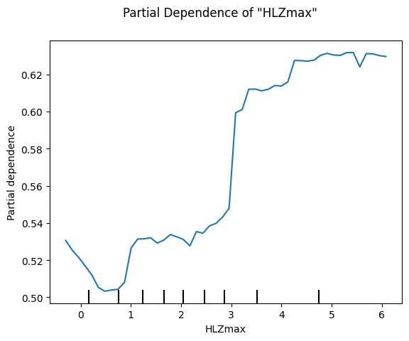
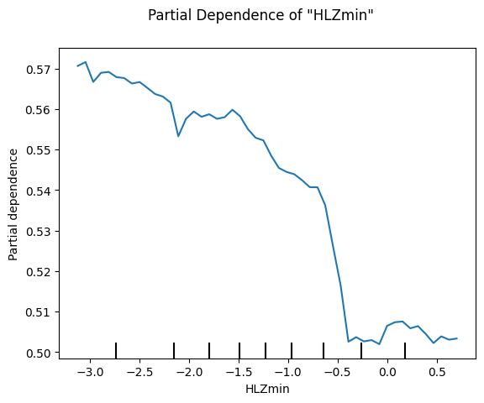
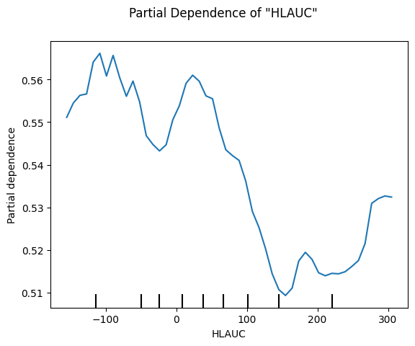
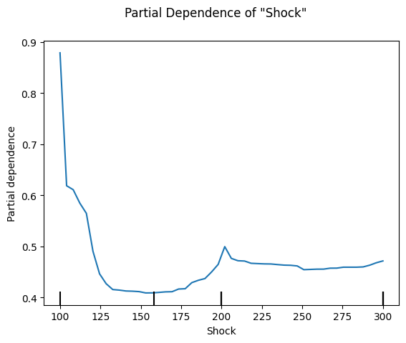
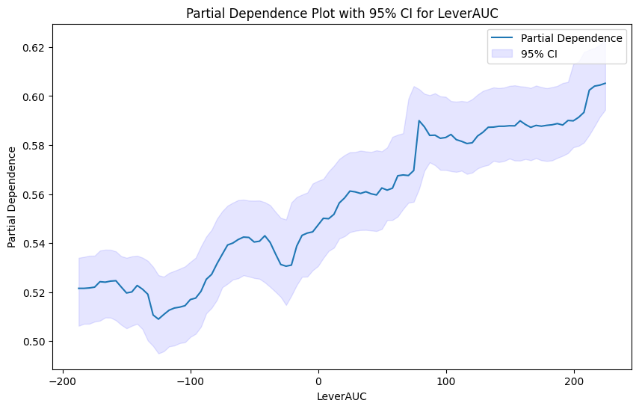
Random Forest
Features: ['Trial#','Lever','LeverZmax','LeverZmin','LeverAUC','HLZmax','HLZmin','HLAUC','NextLever','Shock']
Due to imbalance within the NextLever classes (small=179, large = 2166), I opted for Random Forest + SMOTE oversampling

Slide 4
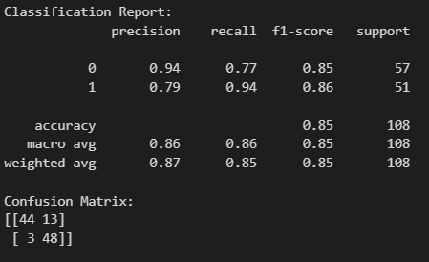
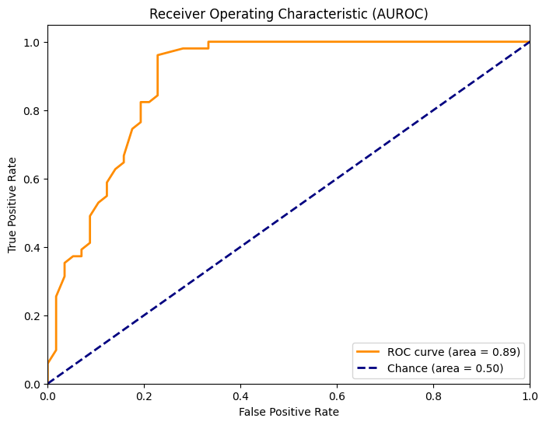
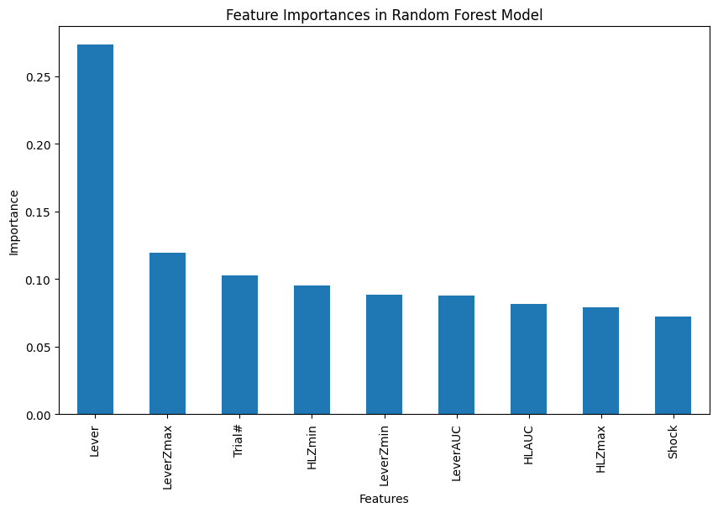
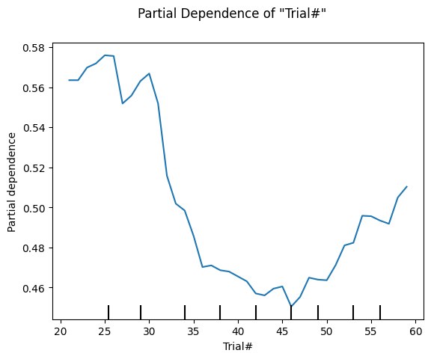
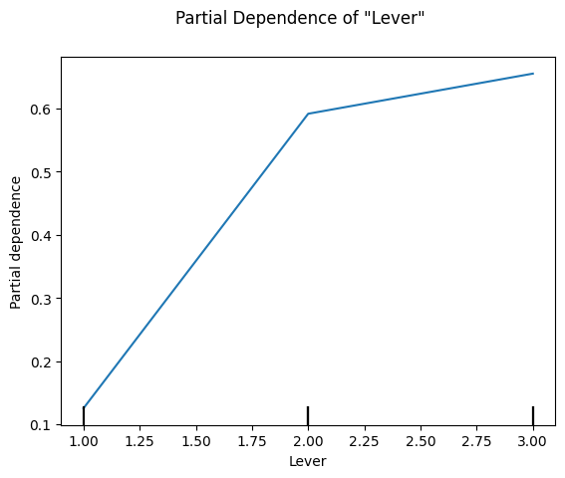
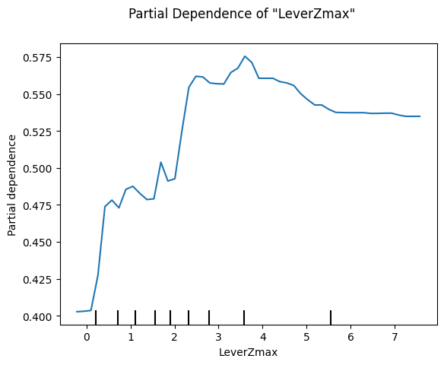
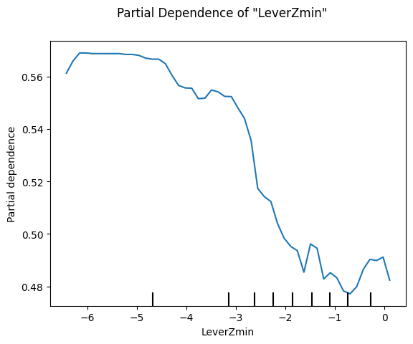
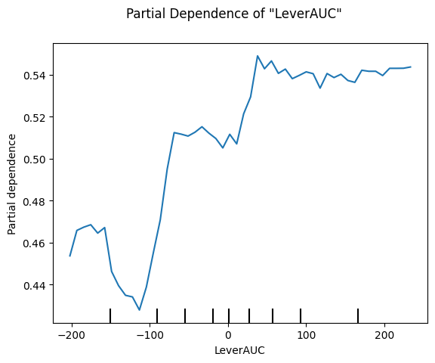
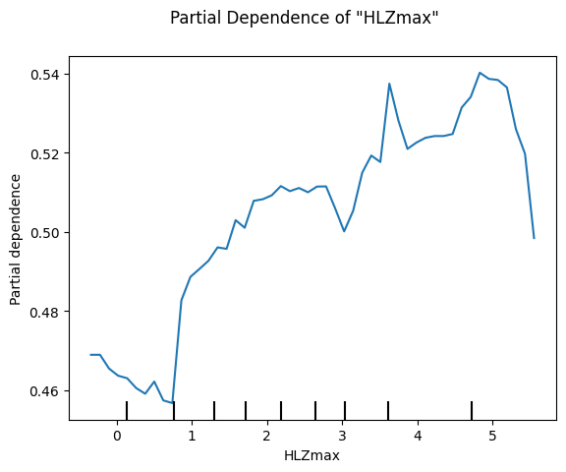
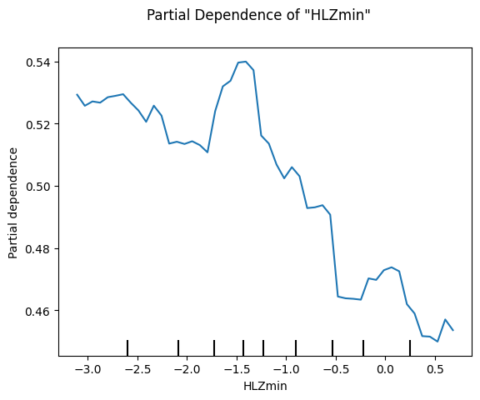
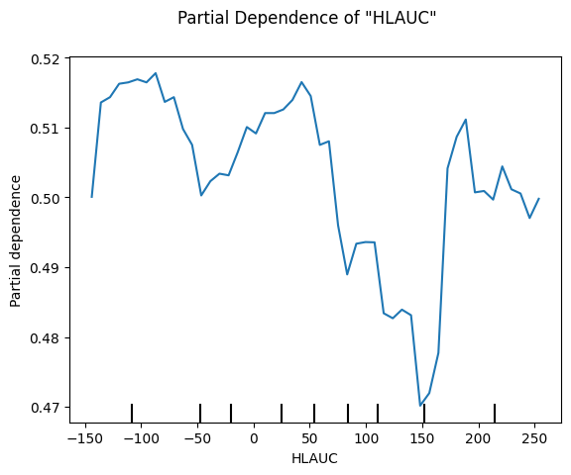
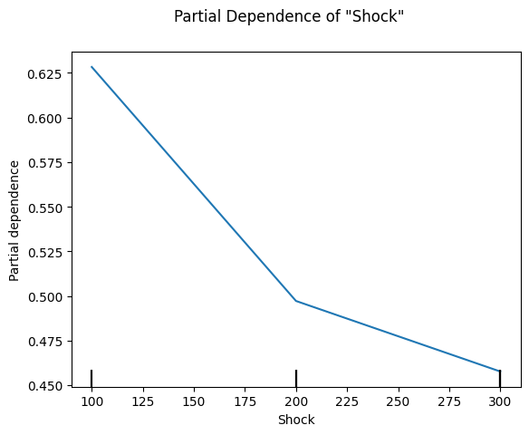
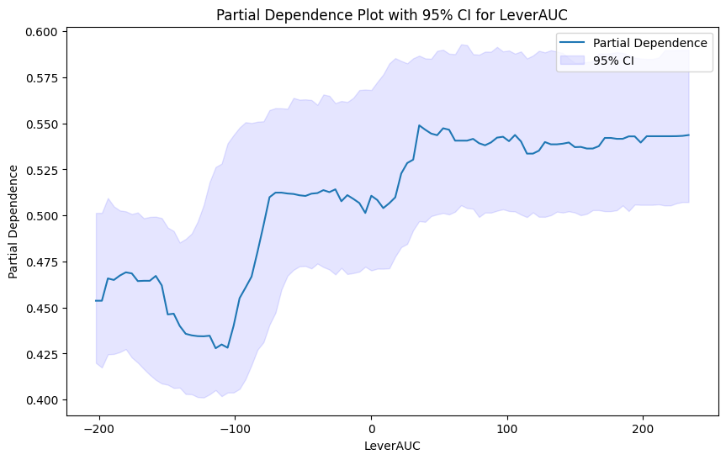
Random Forest w/ resampling to minority class
Features: ['Trial#','Lever','LeverZmax','LeverZmin','LeverAUC','HLZmax','HLZmin','HLAUC','NextLever','Shock']
Due to imbalance within the NextLever classes (small=179, large = 2166), I downsampled NextLever=1 to be the size of NextLever=0 (179)

