Slide 1
Application of ML algorithms for predicting Next Lever

Slide 2
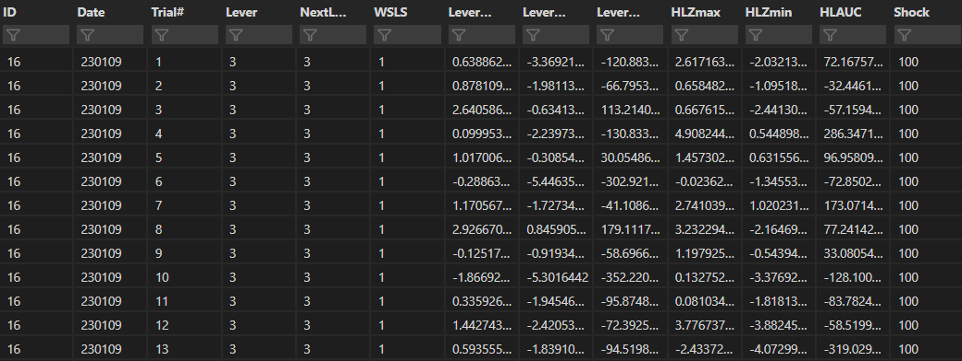
Input data (100to300behavior.csv)
4983 by 13 dataframe taken from 5-days of 100-300uA RDT behavior from 6 rats
WSP29 is removed for low signal, Trials where NextLever is omitted are removed and Last trials in a block are removed
Lever press is binarized (0=small, 1=large)
Results in a 2345 by 13 dataframe

Slide 3
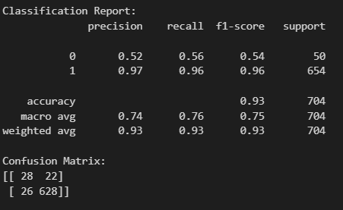
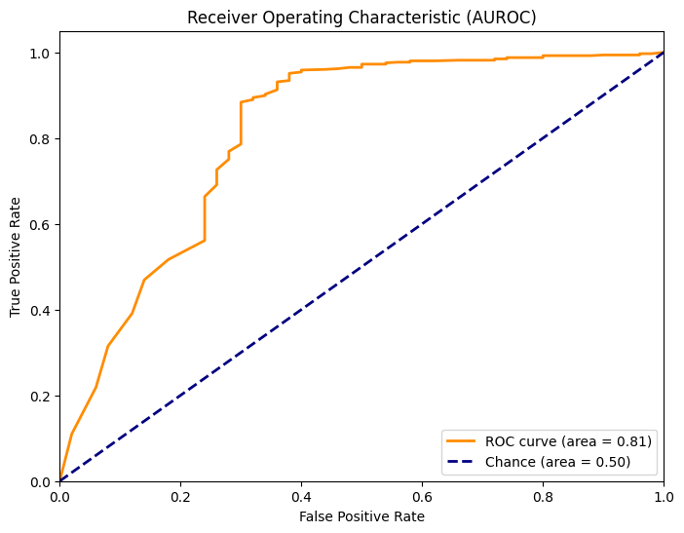
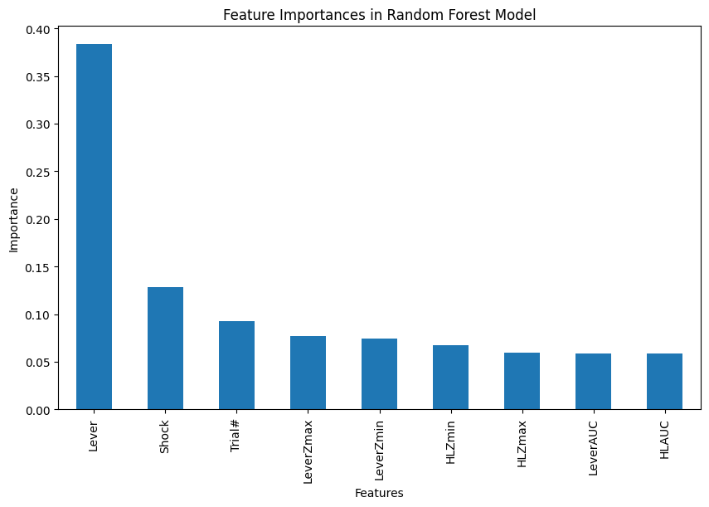
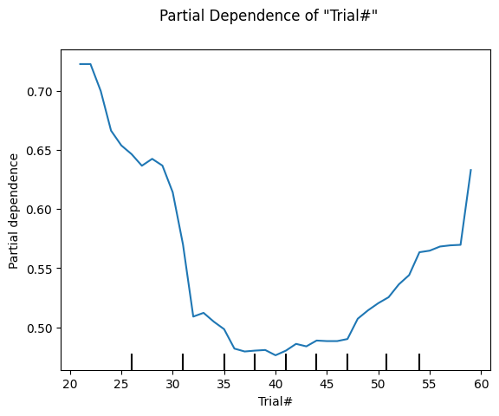
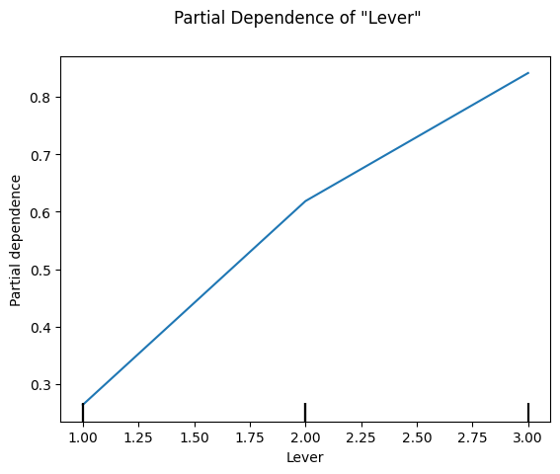
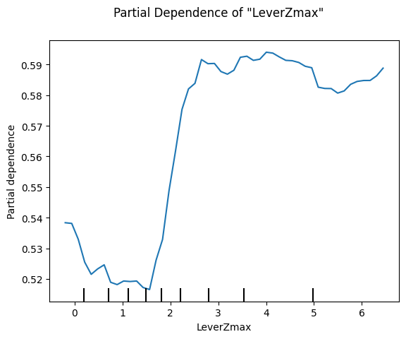
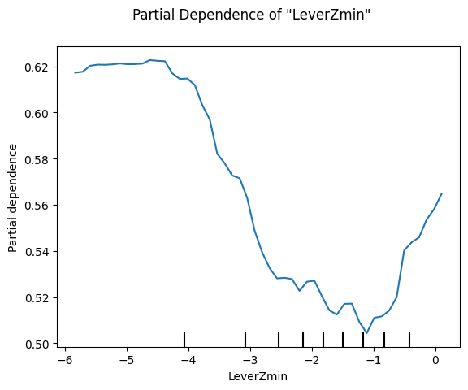
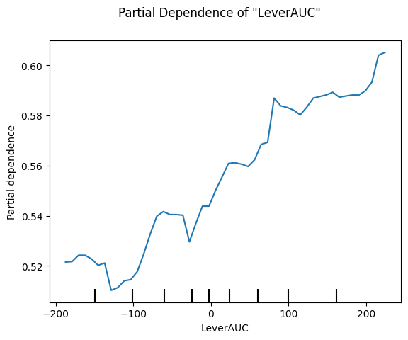
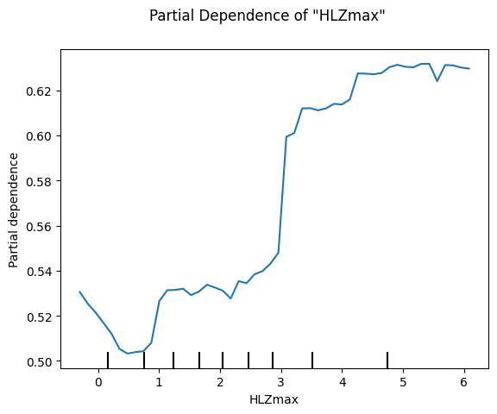
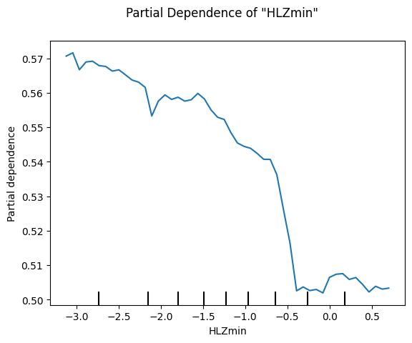
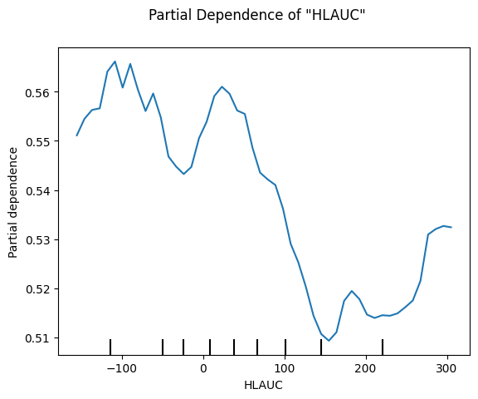
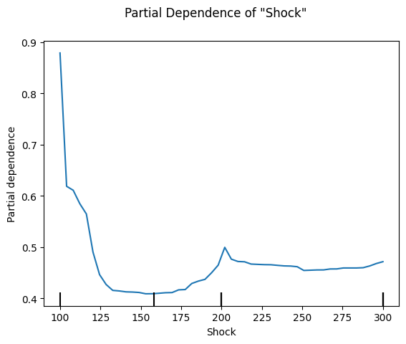
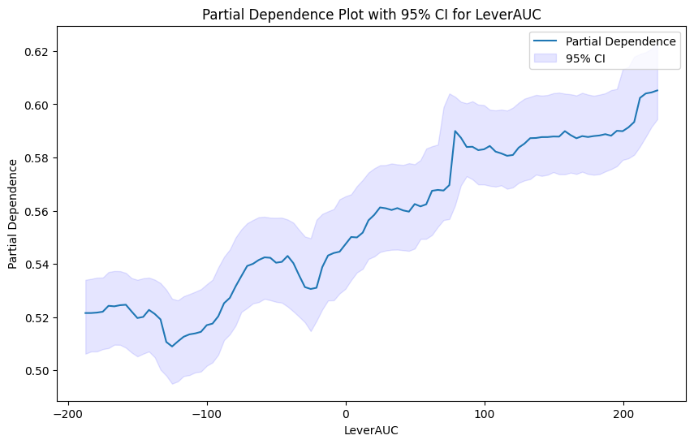
Random Forest w/ SMOTE
Features: ['Trial#','Lever','LeverZmax','LeverZmin','LeverAUC','HLZmax','HLZmin','HLAUC','NextLever','Shock']
Due to imbalance within the NextLever classes (small=179, large = 2166), I opted for Random Forest + SMOTE oversampling

Slide 4
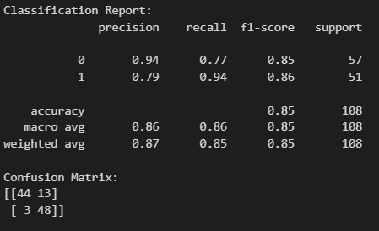
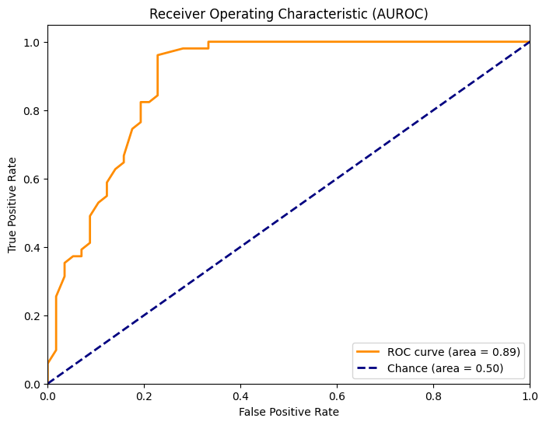
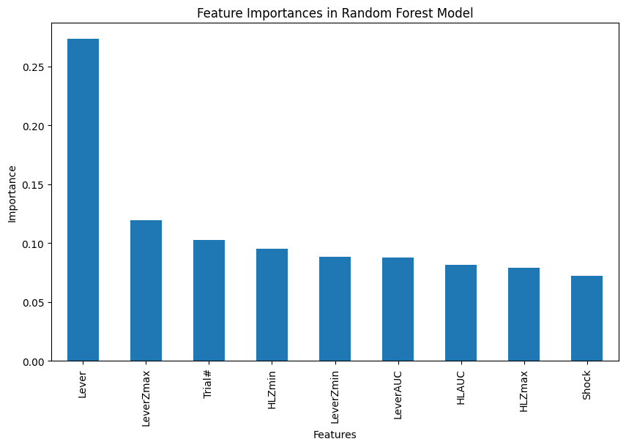
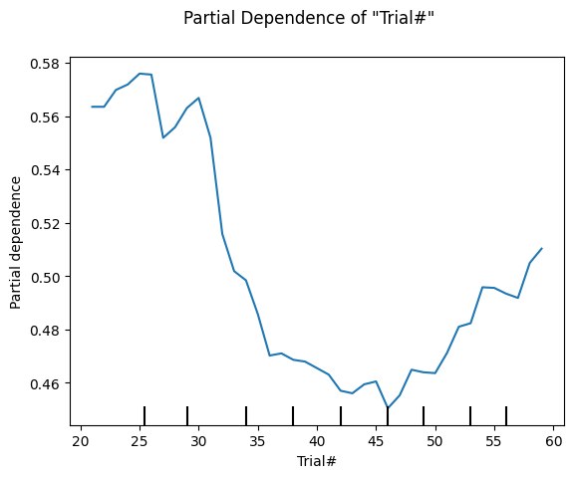
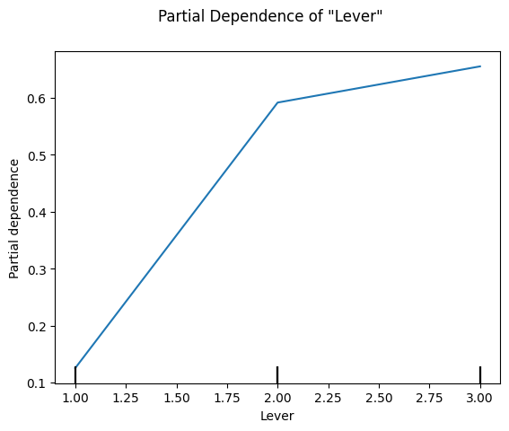
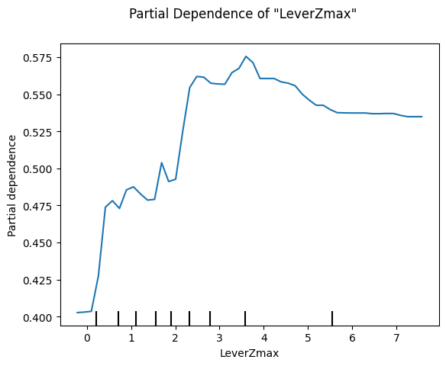
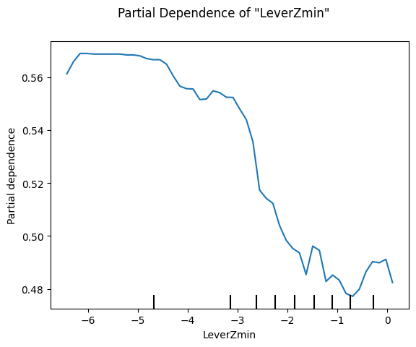
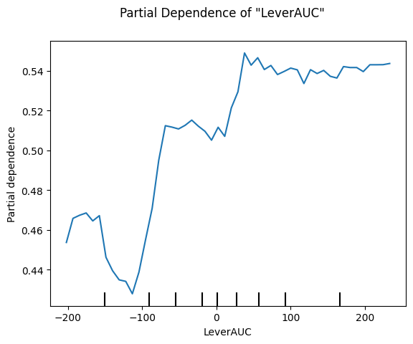
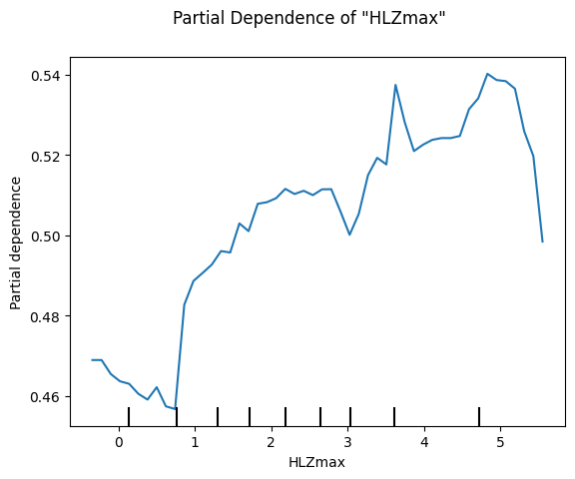
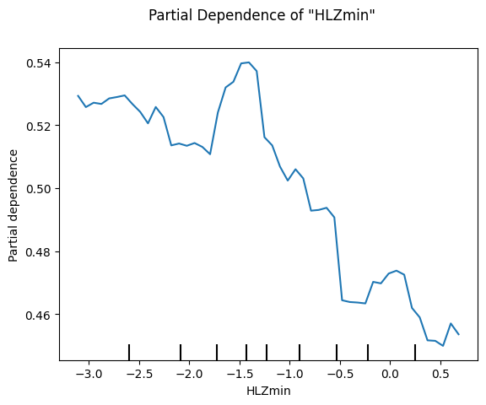
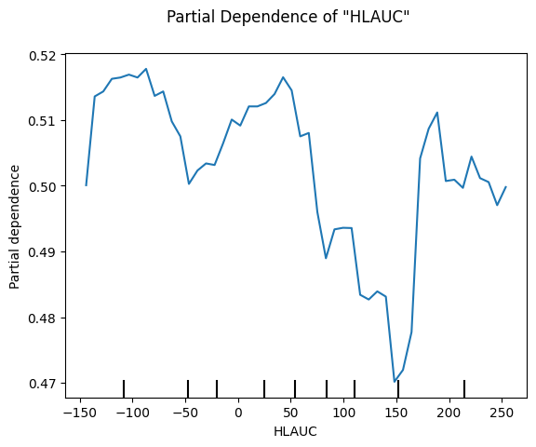
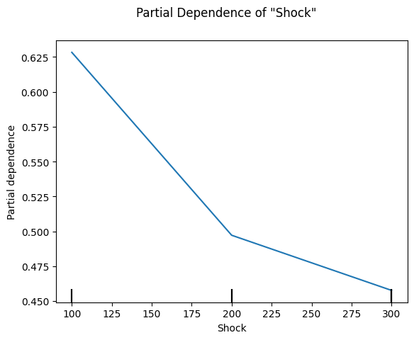
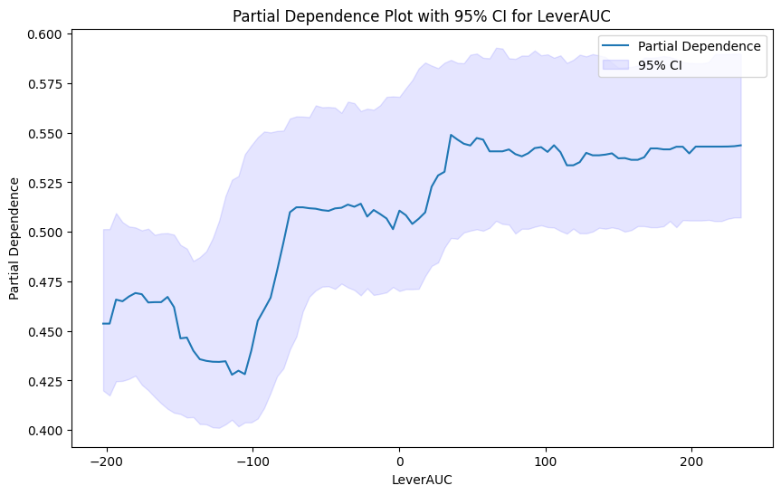
Random Forest w/ manual resampling to minority class
Features: ['Trial#','Lever','LeverZmax','LeverZmin','LeverAUC','HLZmax','HLZmin','HLAUC','NextLever','Shock']
Due to imbalance within the NextLever classes (small=179, large = 2166), I downsampled NextLever=1 to be the size of NextLever=0 (179)

Slide 5

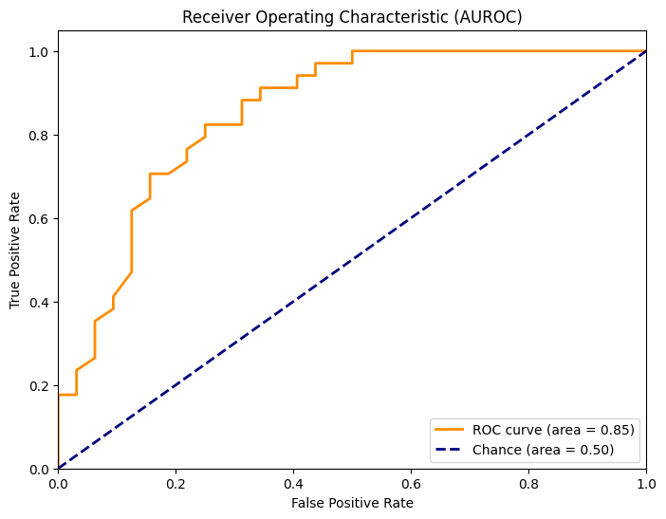
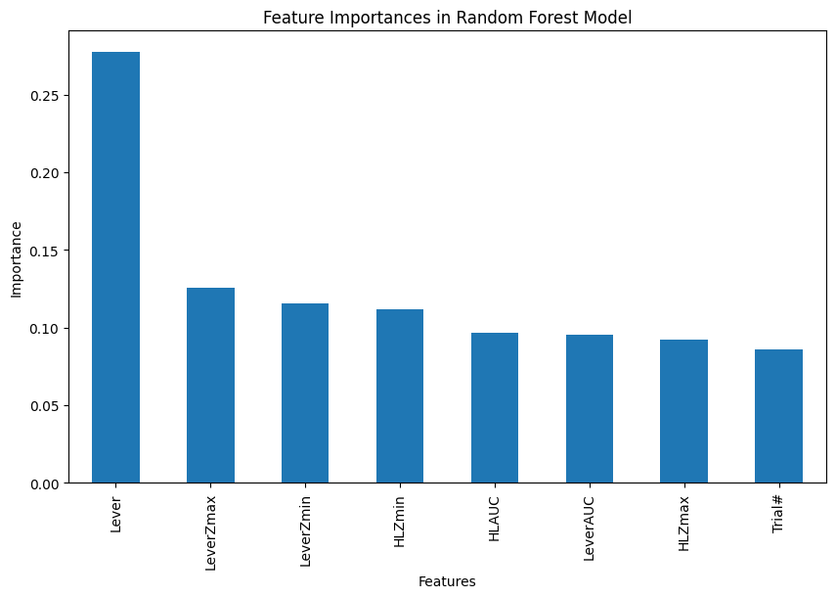
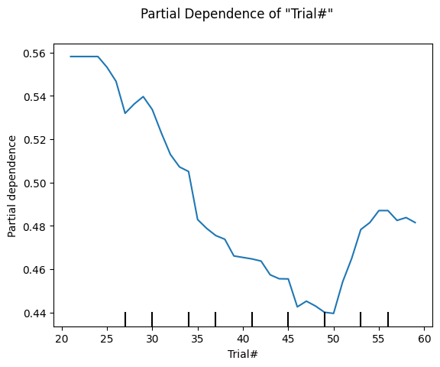
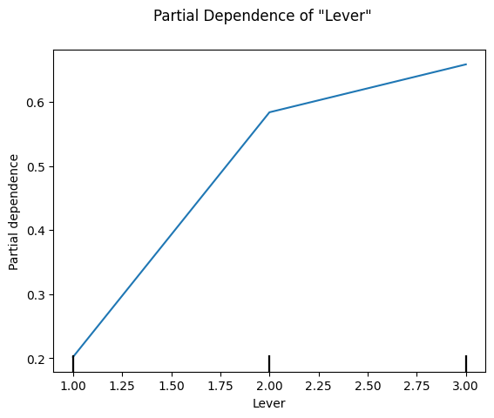
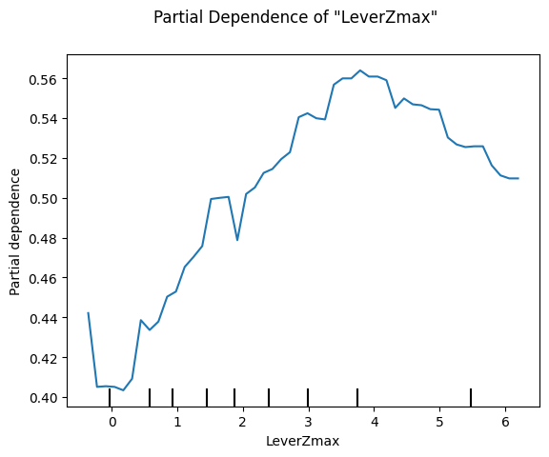
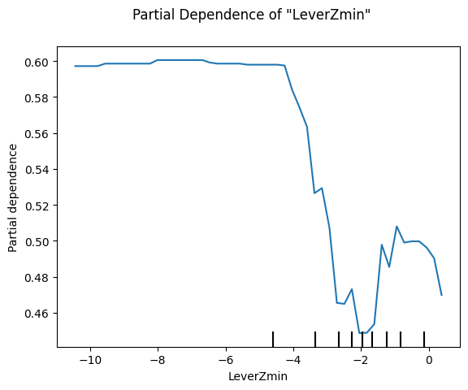
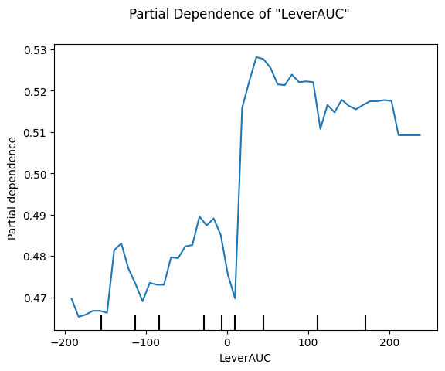
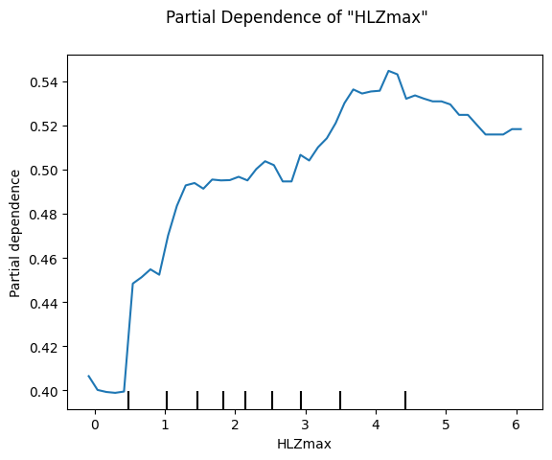
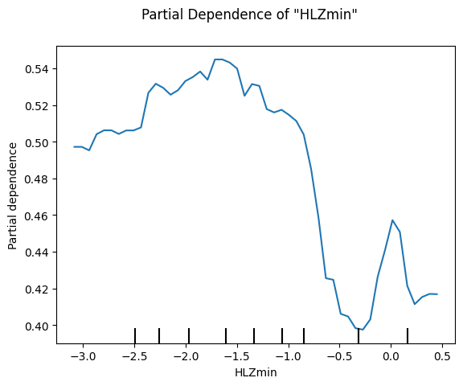
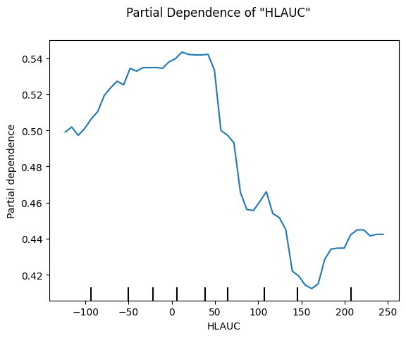
Random Forest w/ manual resampling to minority class and only 300uA data
Features: ['Trial#','Lever','LeverZmax','LeverZmin','LeverAUC','HLZmax','HLZmin','HLAUC','NextLever’]
Due to imbalance within the NextLever classes (small=109, large = 678), I downsampled NextLever=1 to be the size of NextLever=0 (109)
rf = RandomForestClassifier(n_estimators=100, random_state=42, class_weight='balanced')

Slide 6
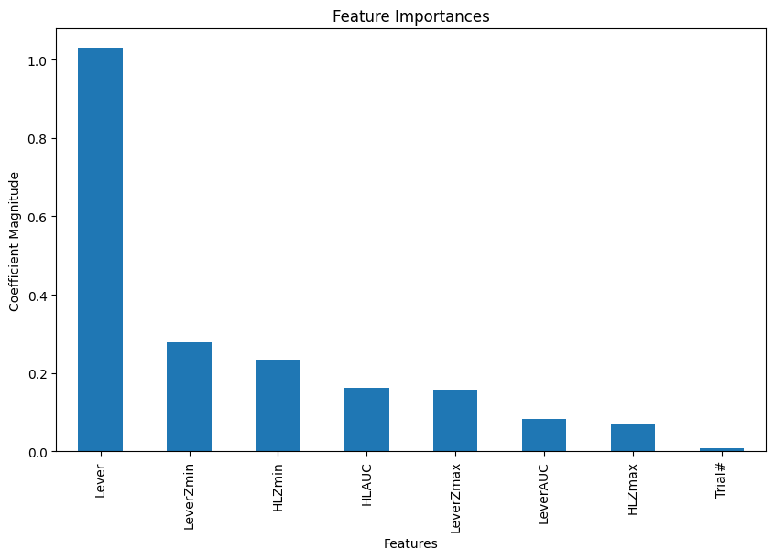
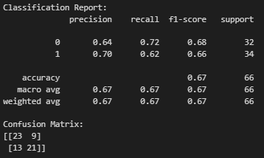
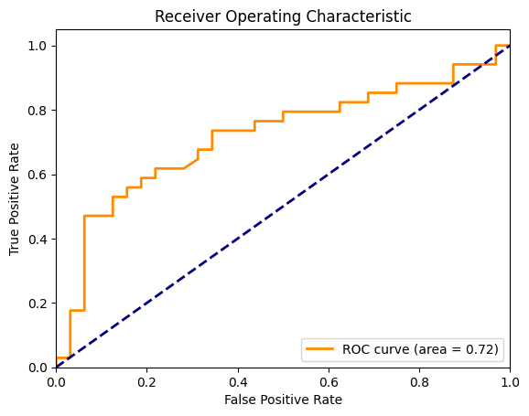
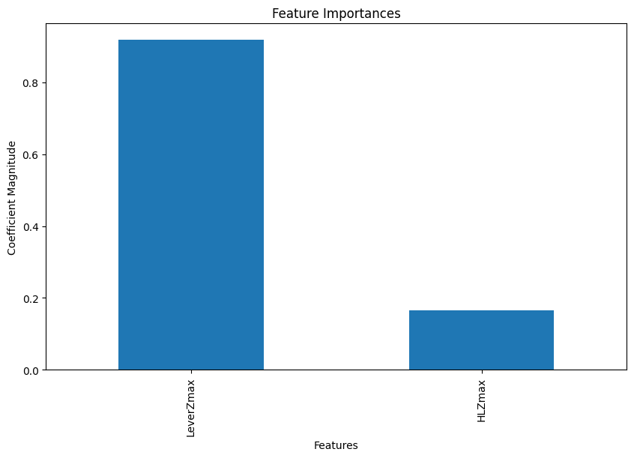
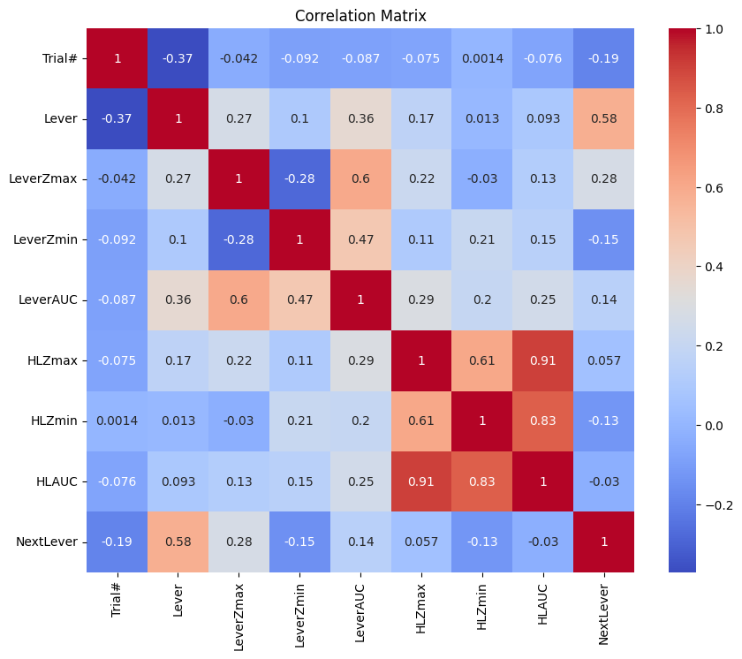
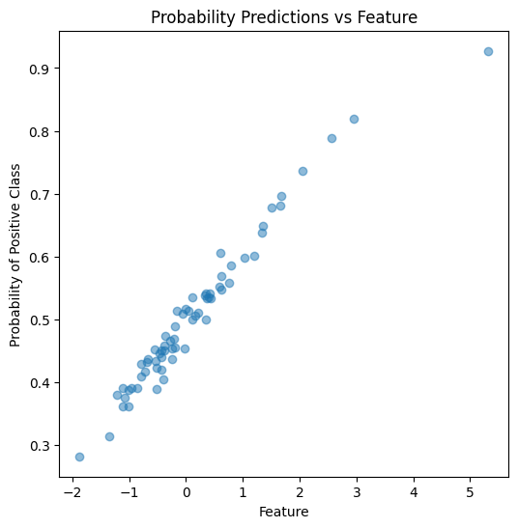
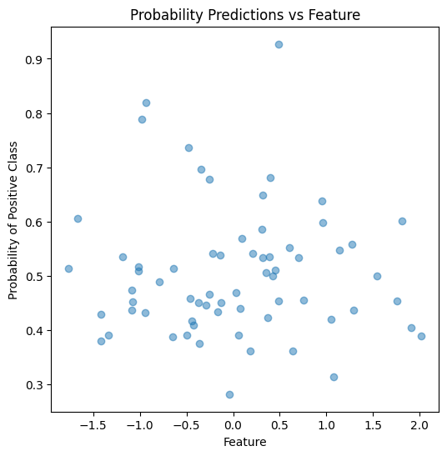
SVM w/ manual resampling to minority class and only 300uA data
feature_names = ['LeverZmax','HLZmax','NextLever’] (‘Trial#’ excluded due to concerns of overfitting (too specific to this data))
Due to imbalance within the NextLever classes (small=109, large = 678), I downsampled NextLever=1 to be the size of NextLever=0 (109)
Dataframe was normalized (StandardScaler()) prior to model training
svm_model = SVC(kernel='linear', class_weight='balanced', probability=True)

