Slide 1
Energy-Aware Query Processing: A Case Study on Join Reordering
Ladjel Bellatreche
LIAS/ISAE-ENSMA Poitiers, France
Wojciech Macyna
Wroclaw University of Technology
Poland
Fouad Djellali
ESI, Sidi Bel Abbes,
Algeria
Carlos Ordonez
University of Houston
USA

Slide 2
Outline
Motivation and focus the tutorial
Energy and related concepts
Hardware
Software
Research Agenda

Slide 3
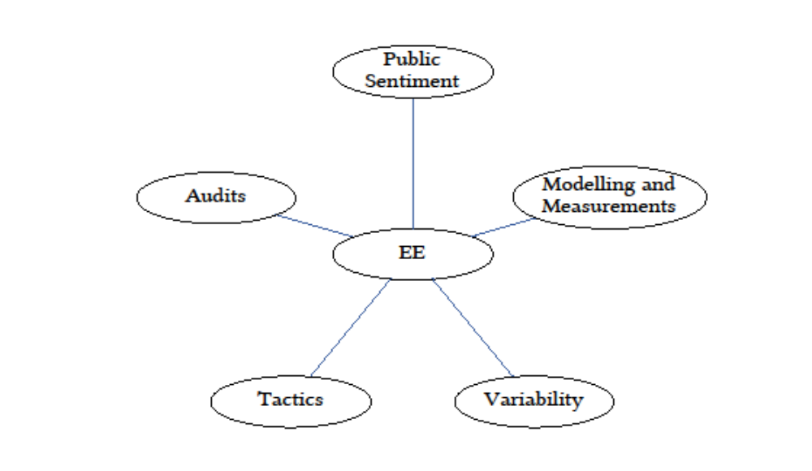
SATM2V Framework
<number>/87

Slide 4
Join Ordering
SELECT c_nation, s_nation, d_year, sum(lo_revenue)
FROM customer CU, lineorder LO, supplier SU, dates DA
WHERE lo_custkey = cu_custkey (J₁)
AND lo_suppkey = su_suppkey (J₂)
AND lo_orderdate = da_datekey (J₃)
AND cu_region = 'AMERICA’ (S₁)
AND su_region = 'AMERICA’ (S₂)
AND da_year ≥ 1993 and da_year ≤ 1998 (S₃)
GROUP BY cu_nation, su_nation, da_year
ORDER BY da_year asc, lo_revenue desc;
<number>/87
Notes:
https://drawsql.app/teams/myteam-725/diagrams/muy

