Slide 1


Predicting Syrian Refugee Migration in Europe
Lukasz Pietrasik & Sylvia Schumacher & Wojciech Witon
Could the 2015 European refugee crisis and the refugee spread among Europe have been predicted with the use of Stouffer’s Theory of Mobility before it has happened?

Slide 2
Agenda
Model description and implementation
Forecasting 2015 migration flows
Conclusion
Quelle: delta Karlsruhe GmbH
Notes:
Zu beachten:
Der aktuelle Agendapunkt sollte einen Rahmen von 2pt Stärke besitzen.
Der Rahmen kann mit der Funktion „Format übertragen“ leicht vertauscht werden.
Alle Agendapunkte sollte über die Funktion „Vertikal verteilen“ den selben Abstand zugewiesen bekommen.

Slide 3
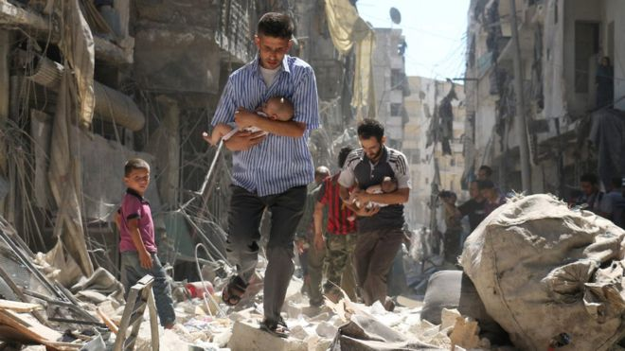
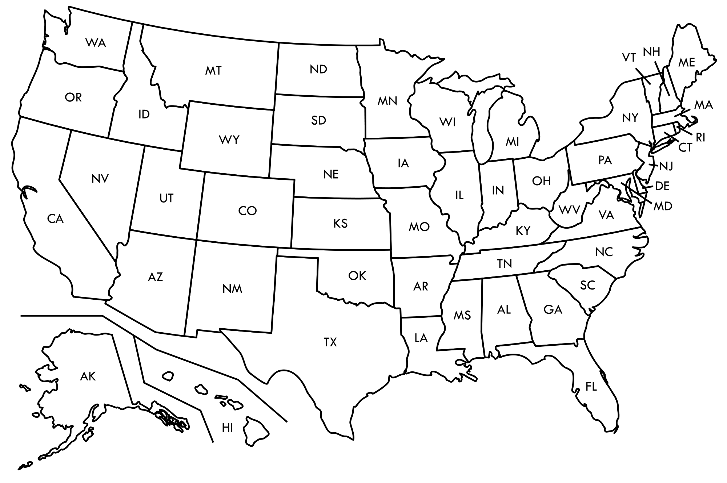
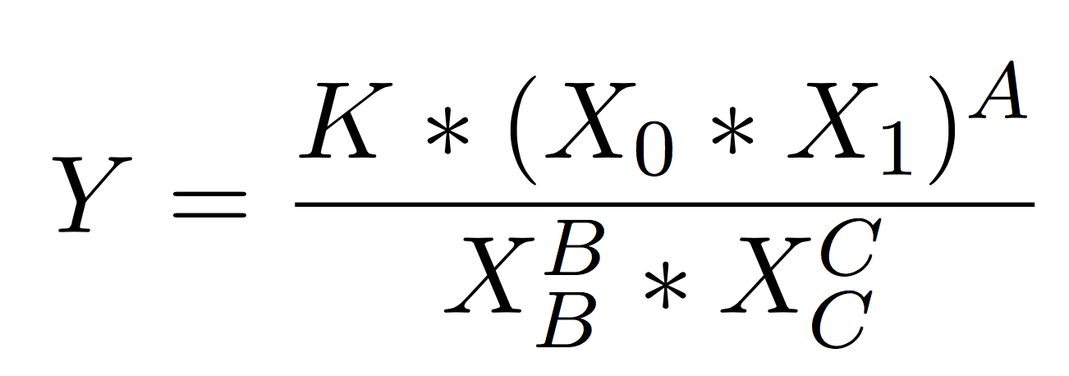
Proposal of the migration model: Stouffer‘s Theory of mobility
Original application: Modeling intercity migration flows in the US from 1935-1940
Variable | Description in Stouffer‘s Theory of mobility (1960)
Y | Number of migrants from city 1 to city 2 for a specified time interval
X_0 | All migrants from city 1
X_1 | Number of opportunities in city 2
X_B | Opportunities intervening between city 1 and city 2
X_C | Number of migrants competing for opportunities in city 2

Slide 4
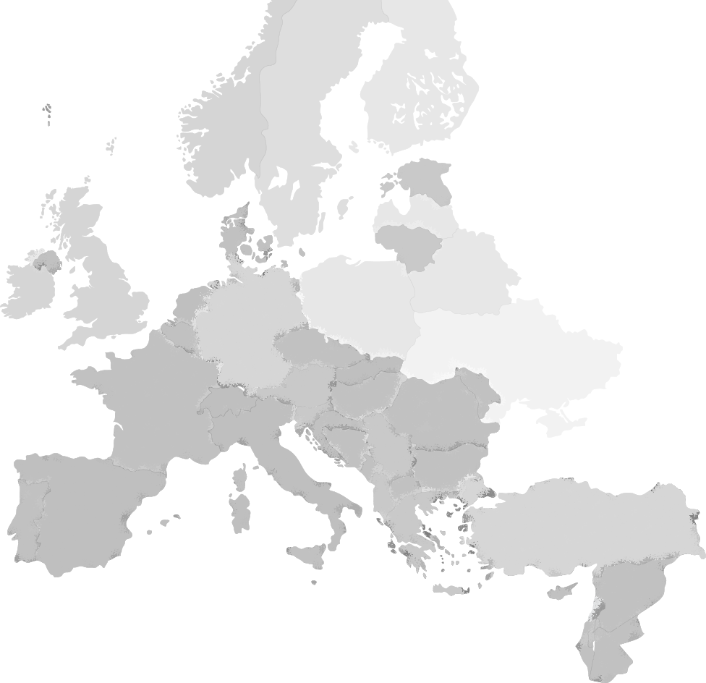

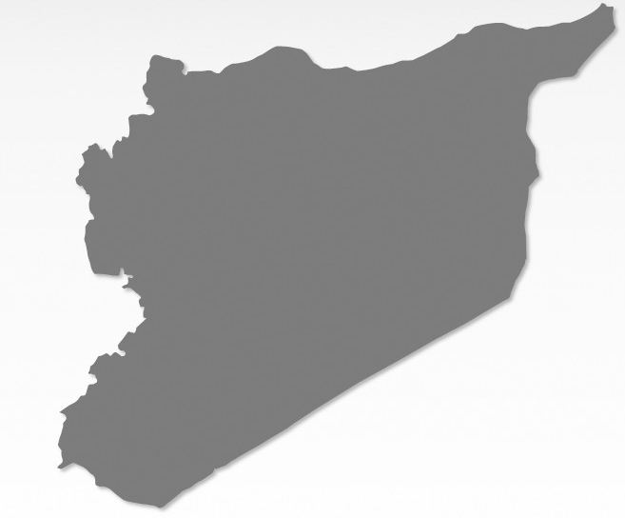
Our target variable: Estimating the number of migrants in a given country
Europe
Syria
Y
Expected number of migrants
 | In Stouffer‘s Theory of mobility (1960)
Y | Expected number of migrants
X_0
X_1
X_B
X_C
?
?

Slide 5
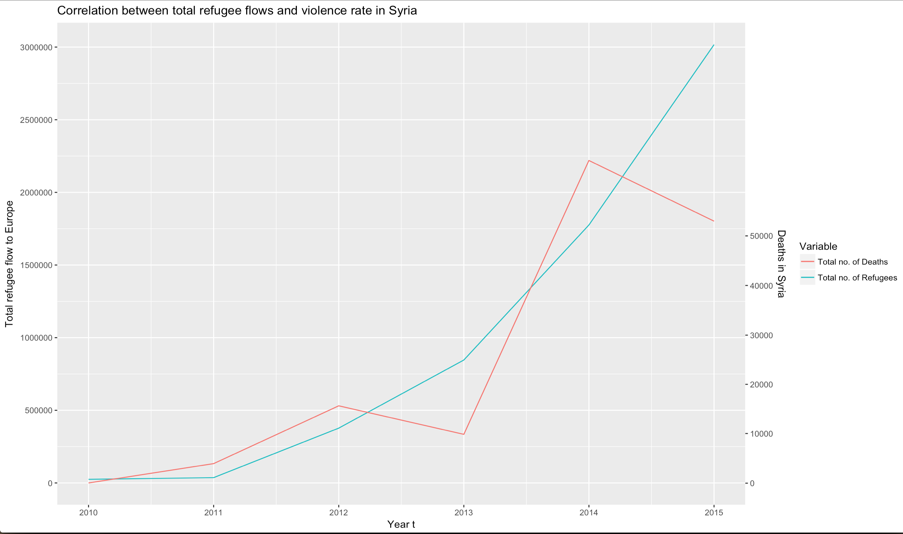
Correlation between total number of Syrian refugees and deaths in Syria
3.000.000
r=0.85
2.500.000
2.000.000
50.000
Total Syrian refugee flow to Europe
Total number of deaths in Syria
1.500.000
40.000
1.000.000
30.000
20.000
500.000
10.000
0
0
Year t
2010
2011
2012
2013
2014
2015

Slide 6

Correlation between total number of Syrian refugees and deaths in Syria
3.000.000
r=0.85
2.500.000
2.000.000
50.000
Total Syrian refugee flow to Europe
Total number of deaths in Syria
1.500.000
40.000
1.000.000
30.000
20.000
500.000
10.000
0
0
Year t
2010
2011
2012
2013
2014
2015
Constants
Total number of people leaving Syria
Constant
Total deaths in Syria

Slide 7
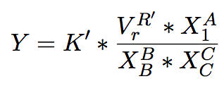
Stouffer‘s Theory of Mobility applied to our problem setting
Europe
Syria
Y
Expected number of migrants
 | Adaption of Stouffer‘s Theory of mobility (1960) to our problem setting
Y | Expected number of migrants in a given country
V_r | Number of deaths in Syria
X_1 | GDP of the given country
X_B | Sum of the GDPs of the countries on the way to the destination
X_C | Sum of Syrian refugees already in the country
Push factor
Pull factor
Intervening opportunities
Competing migrants

Slide 8
Remember our research question:
Europe
Syria
Y
Expected number of migrants
Could the 2015 European refugee crisis and the refugee spread among Europe have been predicted with the use of Stouffer’s Theory of Mobility before it has happened?
?

Slide 9
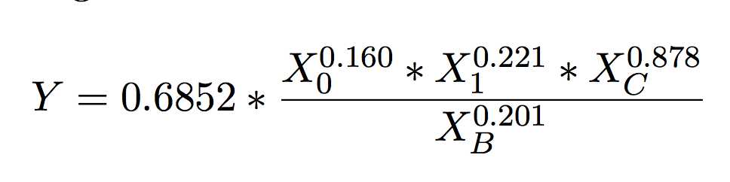
Results of the model estimation for annual training data from 2010-2014:
Variable | Explanation | Estimate | SE | T Statistics | p Value
Y | Scaling factor K | -0.378 | 0.112 | -3.360 | 0.001
X_0 | Total deaths | 0.160 | 0.022 | 7.296 | 0.000
X_1 | GDP | 0.221 | 0.060 | 3.714 | 0.000
X_B | GDP between | 0.201 | 0.045 | 4.484 | 0.000
X_C | Cumulative number of refugees | -0.878 | 0.039 | -22.683 | 0.000
All p-values significant

Slide 10
Results of the model estimation for annual training data from 2010-2014:
Variable | Explanation | Estimate | SE | T Statistics | p Value
Y | Scaling factor K | -0.378 | 0.112 | -3.360 | 0.001
X_0 | Total deaths | 0.160 | 0.022 | 7.296 | 0.000
X_1 | GDP | 0.221 | 0.060 | 3.714 | 0.000
X_B | GDP between | 0.201 | 0.045 | 4.484 | 0.000
X_C | Cumulative number of refugees | -0.878 | 0.039 | -22.683 | 0.000
Numerator instead of denominator.

Slide 11
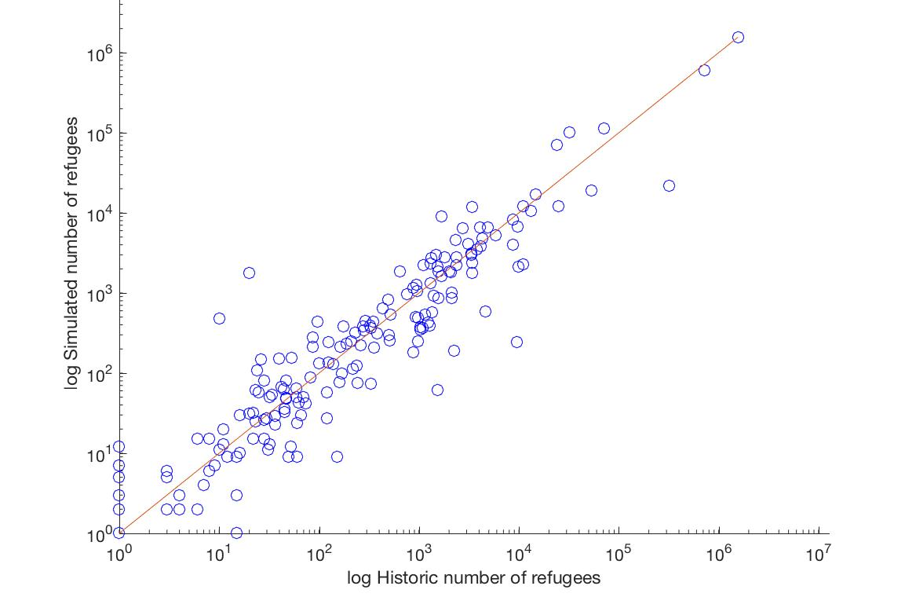
Scatterplot (in-sample) of historic vs. predicted number of refugees 2010-2014
In-sample:
model is well fitted.
Coefficient of
determination:
R² = 0.873
R² = 0.870.
adjusted

Slide 12
Agenda
Model description and implementation
Forecasting 2015 migration flows
Conclusion
Quelle: delta Karlsruhe GmbH

Slide 13
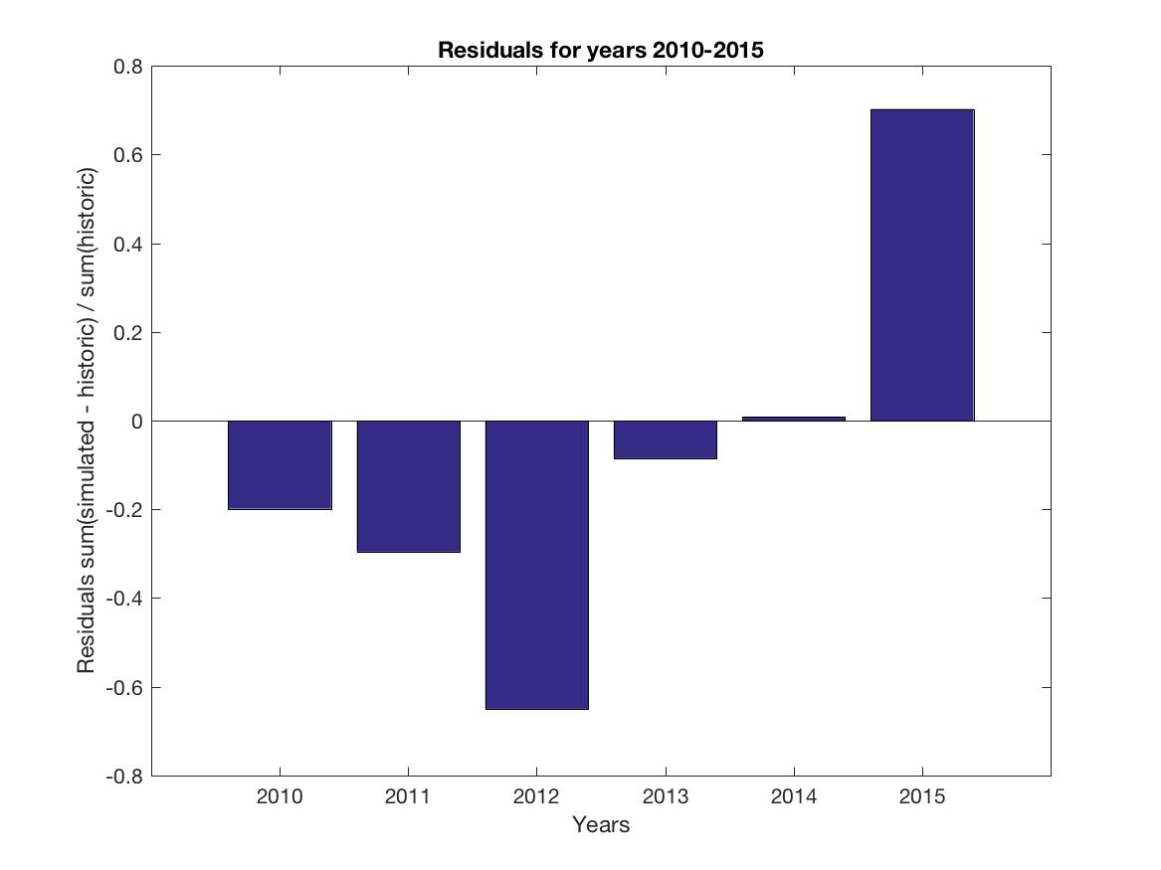
Forecasting migration flows for 2015
Residuals / Observed migration flow
0.8
0.6
Overestimation of overall migration flow 2015: 70.3%
0.4
0.2
0
-0.2
-0.4
-0.6
-0.8
Year t
2010
2011
2012
2013
2014
2015

Slide 14
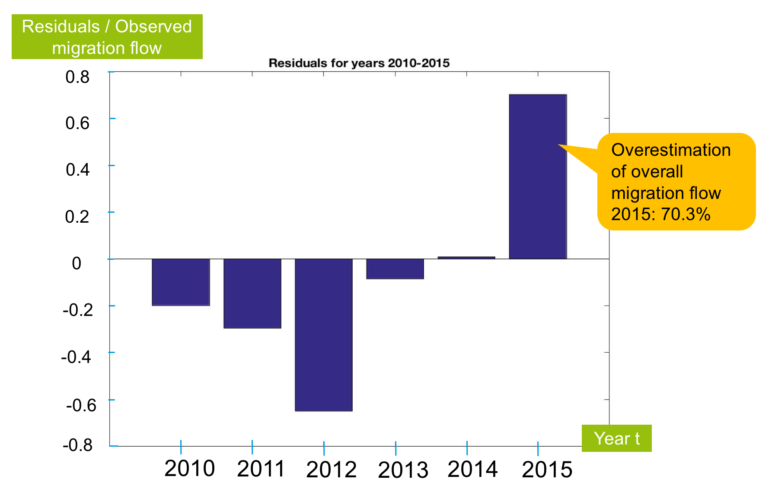
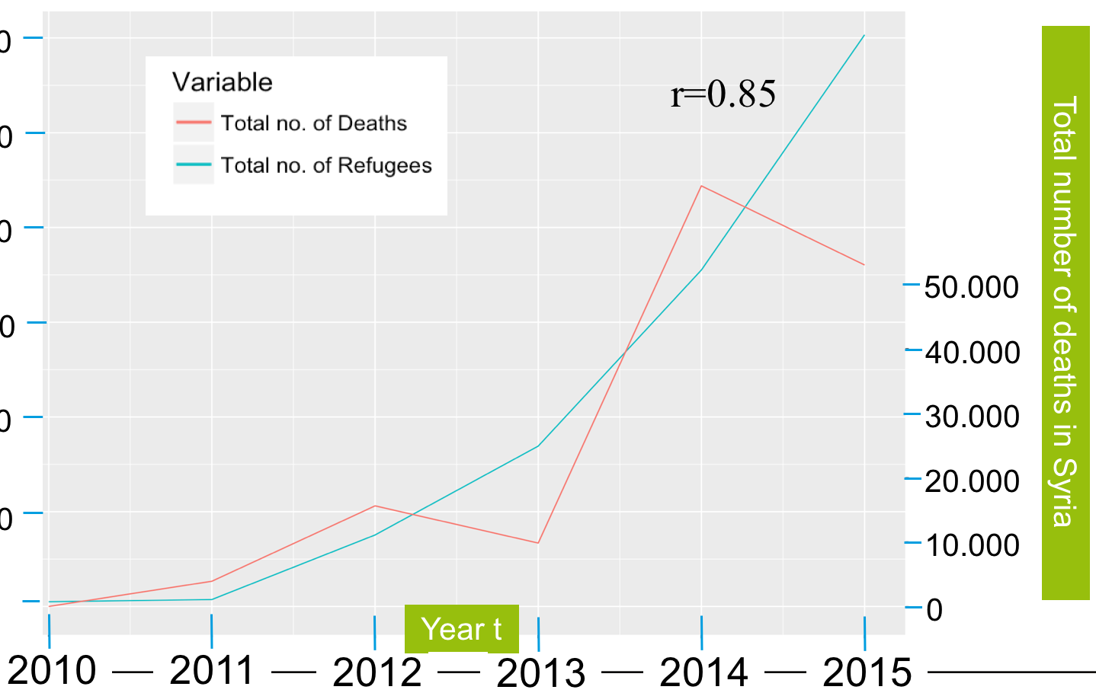
Analyzing the overestimation of our 2015 forecast:
1
Extreme value of indicator

Slide 15
Analyzing the overestimation of our 2015 forecast:
Countries | Historic Value | Predicted Value | Deviation
Overall migration flow to Europe | 2.989.613 | 5.089.830 | +70.3%
... excluding Turkey | 485.767 | 386.485 | -20.4%
Turkey | 2.503.846 | 4.703.345 | +87.8%
2
„Turkey takes them all“

Slide 16
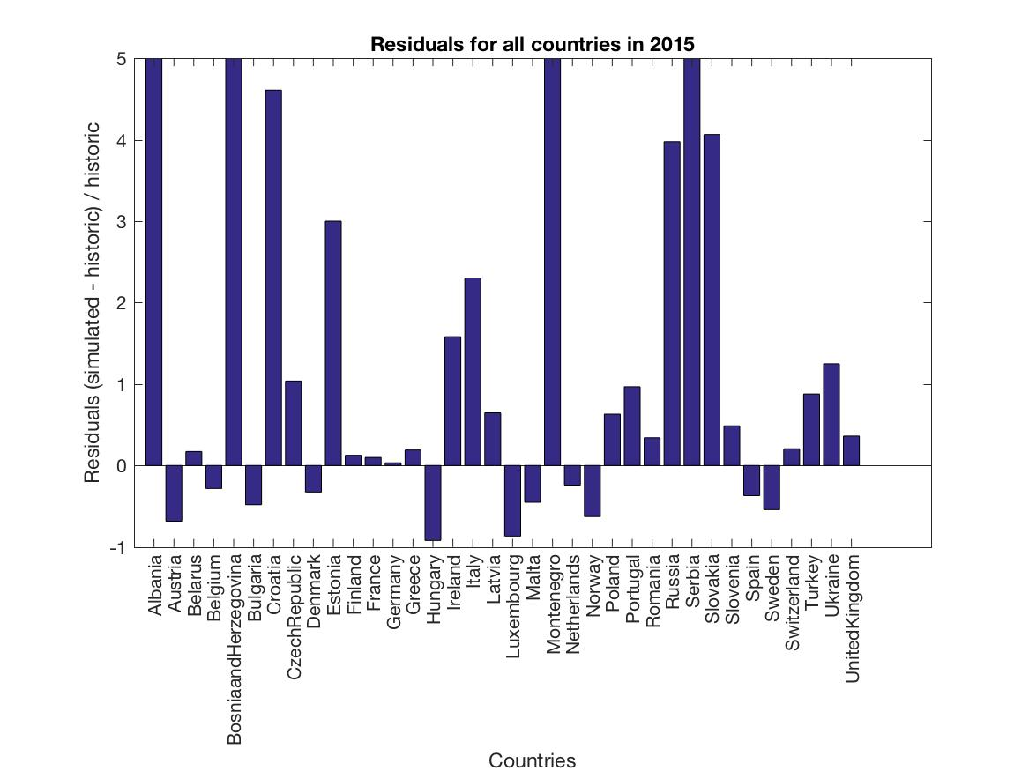
Analyzing the spread of refugees among Europe:
Goodness of fit:
R² = 0.908
χ2 = 55372, p-value: < 2.2e−16
For most countries: overestimation of values
Residuals / Observed migration flow

Slide 17
Analyzing the spread of refugees among Europe:
Underestimated countries (#11):
High ranks of KPI GDP/Refugee flow
Countries known for welcoming refugees; high overall proportion of migration flow
1
Residuals / Observed migration flow

Slide 18
Analyzing the spread of refugees among Europe:
Best predicted countries:
Countries have average ranks of KPI GDP/Refugee flow
Geographical spread between Western and Northern Europe.
1
Residuals / Observed migration flow
2

Slide 19
Analyzing the spread of refugees among Europe:
Worst predicted countries:
South-East of Europe (and thus close to Turkey)
Residuals / Observed migration flow

Slide 20
Agenda
Model description and implementation
Forecasting 2015 migration flows
Conclusion
Quelle: delta Karlsruhe GmbH
Notes:
Zu beachten:
Der aktuelle Agendapunkt sollte einen Rahmen von 2pt Stärke besitzen.
Der Rahmen kann mit der Funktion „Format übertragen“ leicht vertauscht werden.
Alle Agendapunkte sollte über die Funktion „Vertikal verteilen“ den selben Abstand zugewiesen bekommen.

Slide 21





Model improvements
Add further variables:
border policy
welfare plans for asylum seekers
Competing migrants:
Include asylum seekers from other nations into the competing migrants indicator
Route matrix:
Different starting points
Various routes
Shorter time intervals:
(on a quarterly or monthly basis) to account for seasonality
Example
Route Matrix
From | Crossed | Turkey | Bulgaria | Romania
Turkey |  | 1 | 0 | 0
Bulgaria |  | 1 | 1 | 0
Romania |  | 1 | 1 | 1

Slide 22
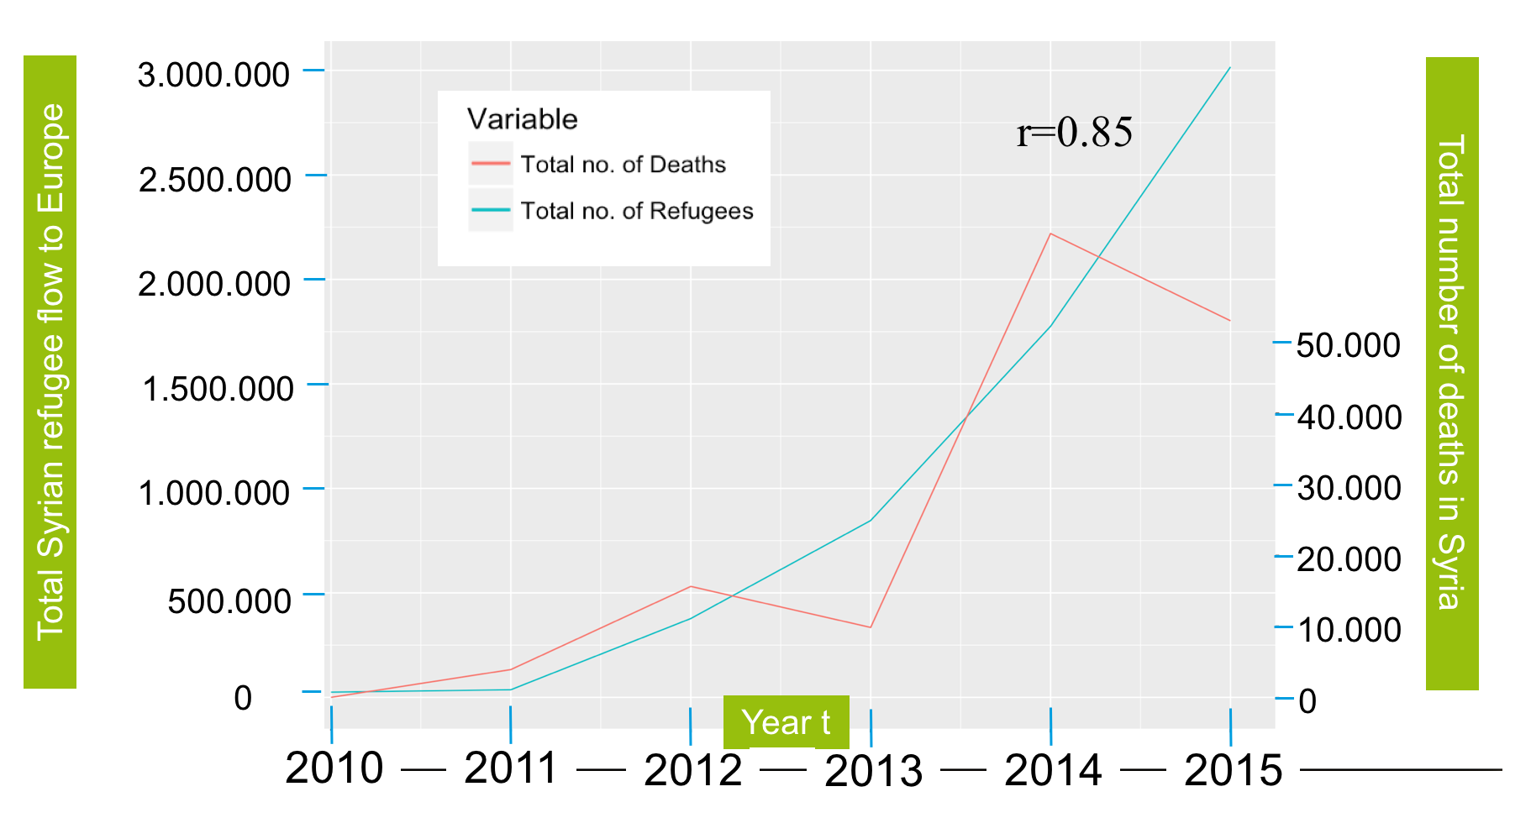
Conclusion
Overall migration flow
However
Our prediction did predict the European refugee crisis concisely
Further model improvements are necessary
Our in sample fit was very good
We are convinced (and will observe in the future), if Stouffer‘s Theory of Mobility can well predict non-crisis years
“We are facing the biggest refugee and displacement crisis of our time. Above all, this is not just a crisis of numbers; it is also a crisis of solidarity.”
Ban Ki Moon, United Nations Secretary General
Prioritize the actions that aim to stabilize the region and protect the Syrian population in the future.

Slide 23
Conclusion
“We are facing the biggest refugee and displacement crisis of our time. Above all, this is not just a crisis of numbers; it is also a crisis of solidarity.”
Ban Ki Moon, United Nations Secretary General
Prioritize the actions that aim to stabilize the region and protect the Syrian population in the future.

