Slide 1
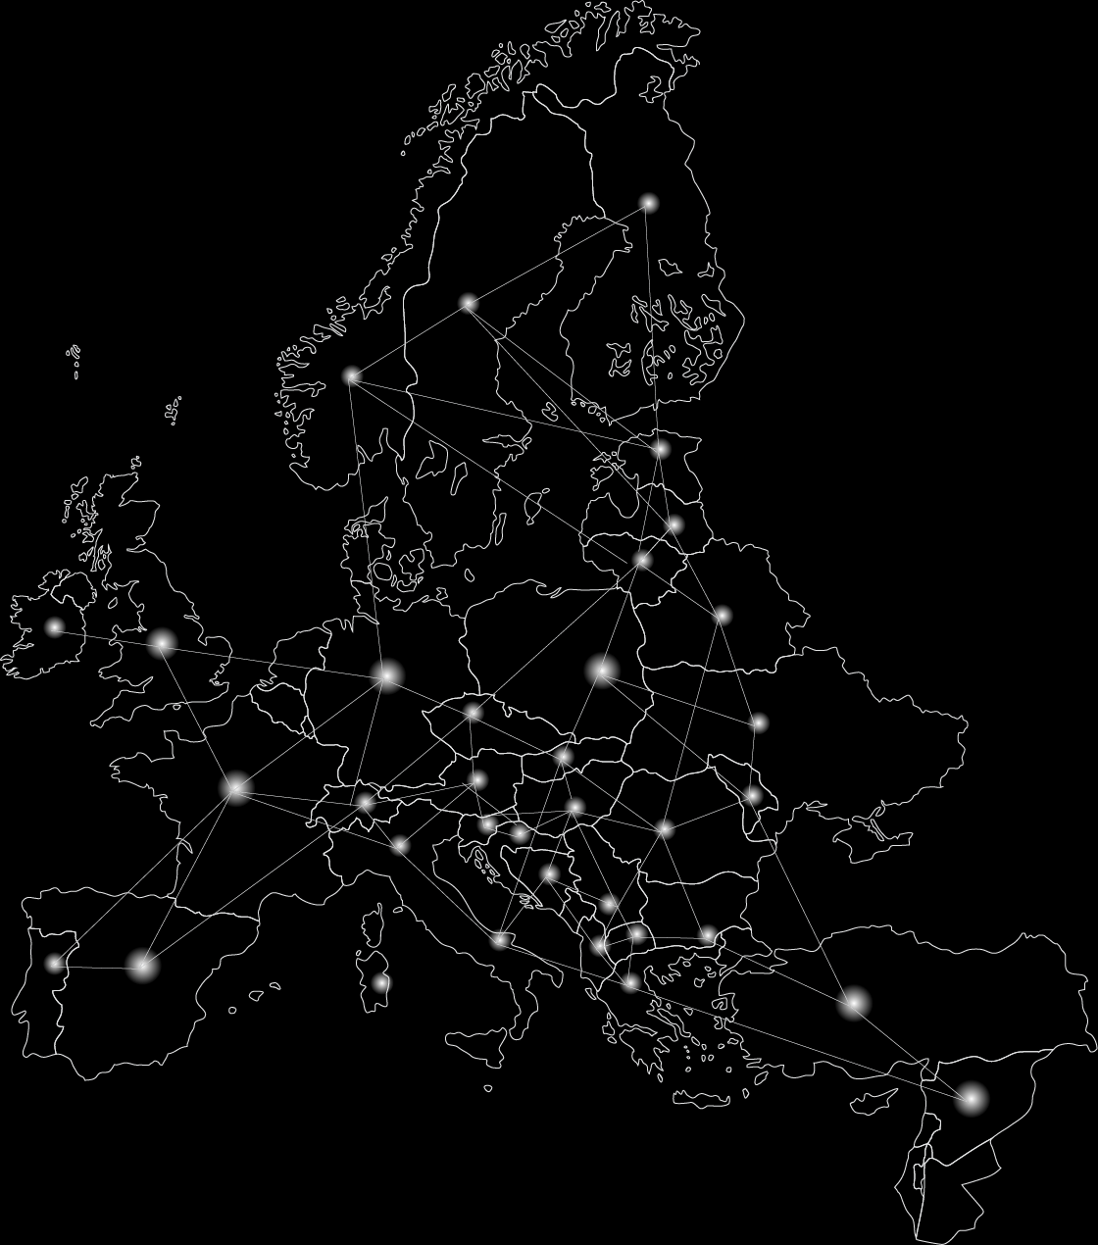


Syrian Refugees movement modelling
How do the Syrian refugees distribute among European countries depending on violence rate in their country?

