Slide 1
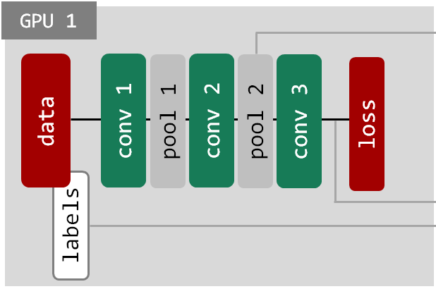
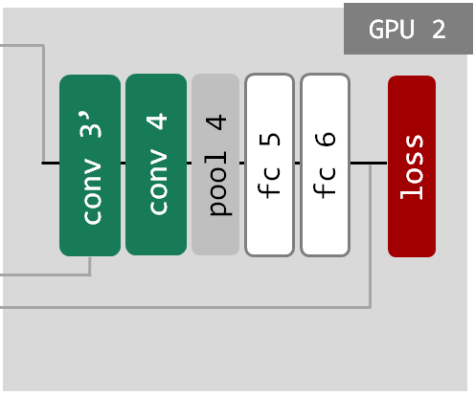
for number_iterations:
net1.forward
save pool2.data
...
...
...
...
...
load conv3’.data
calculate loss = ||conv3-conv3’||^2
net1.backward
for number_iterations:
...
...
load pool2.data
net2.forward
calculate loss = ||labels-fc6||^2
net2.backward
save conv3’.data
...
...
...

