Slide 1
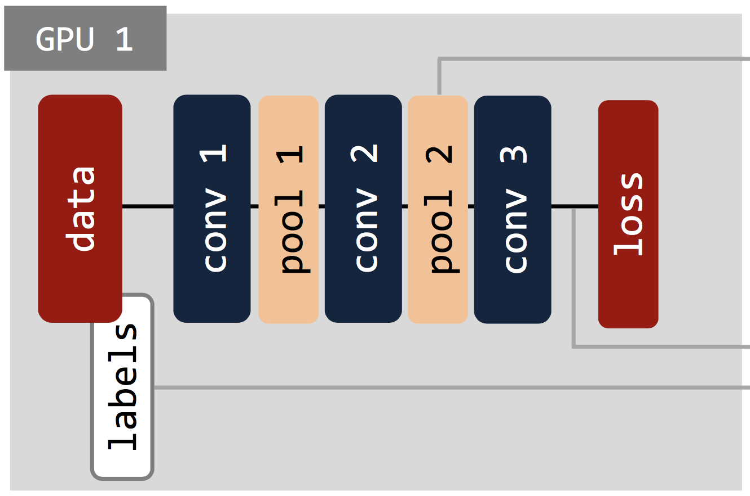
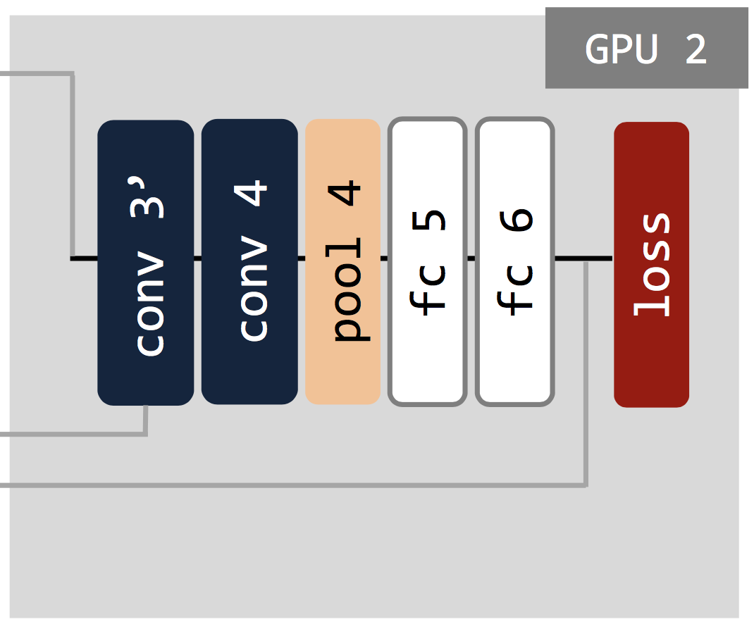
for number_sequences:
load conv3’.data
for number_net1_epochs:
net1.forward
calculate loss=||conv3-conv3’||^2
net1.backward
save pool2.data
...
...
...
...
...
...
for number_sequences:
...
...
...
...
...
...
load pool2.data
for number_net2_epochs:
net2.forward
calculate loss = ||labels-fc6||^2
net2.backward
save conv3’.data

