Slide 1

Distributed Neural Network Training
Final Year Project
CA2 Presentation
Wojciech Dziwulski

Slide 2
schedule
machine intelligence
deep learning
space constraint
distribution
ADMM
frameworks
algorithm
problems
summary
future outlook

Slide 3



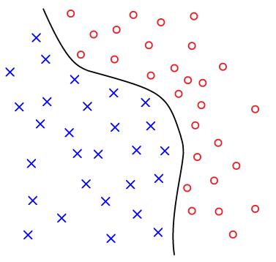
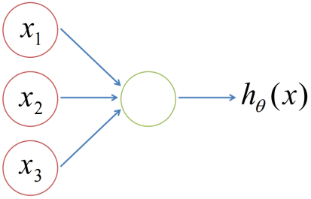
(1) machine intelligence
abundance of data
volume produced and stored increases exponentially
images, speech, market trends
1
need for segmentation
learn the patterns, find the boundaries
linear? quadratic? usually highly complex
2
appropriate toolkit
plenty of algorithms to choose from but…
the tasks are wildly different (images vs speech)
3

Slide 4
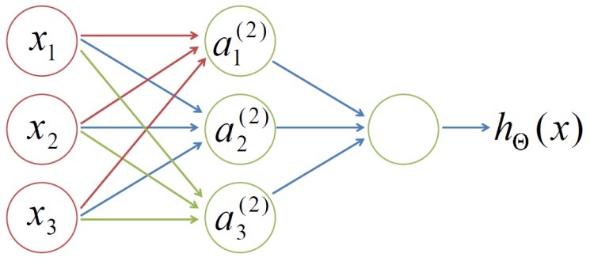
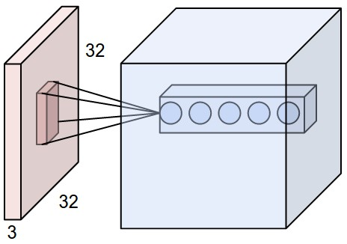
(2) deep learning
f(x) that can be compactly represented by depth (l) network might require an exponentially large number of nodes in a depth (l-1) architecture

Slide 5






(3) space constraint
CPU
=
GPU
=
GPU
GPU
GPU

Slide 6
(4) distribution
data
conv 1
pool 1
conv 2
pool 2
conv 3
conv 4
pool 4
fc 5
fc 6
loss
labels
GPU 1
GPU 2
data
conv 1
pool 1
conv 2
pool 2
conv 3
loss
conv 3’
conv 4
pool 4
fc 5
fc 6
loss
labels

Slide 7










(5) ADMM
$$\min_{x}{L\left(x\right)=f\left(x\right)+g(x)}$$
⇓
$$\min_{x,y}{L\left(x,y\right)=f\left(x\right)+g(y)}$$
$$\text{subject} \text{to} x=y ⇔x−y=0$$
$$\min_{x,y}{\max_{λ}{L\left(x,y\right)+λ^{T}\left(x−y\right)+β{\left|\left|x−y\right|\right|}^{2}}}$$
$$using Lagrange multipliers…$$
$$iteratively…$$
while not converged do:
1) fix y, λ, β and update x
2) fix x, λ, β and update y
3) fix x, y, β and update λ
4) update β as β(t+1) = 10*β(t)
$$x$$
$$y$$

Slide 8

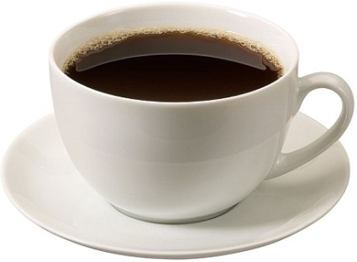
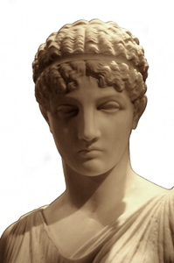
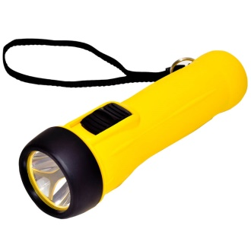
(6) frameworks
stable
(a little bit) better documented
(quite) easy to understand

Slide 9
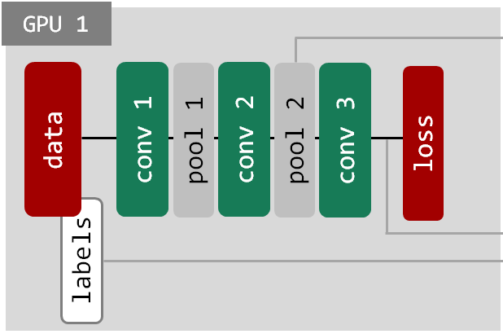
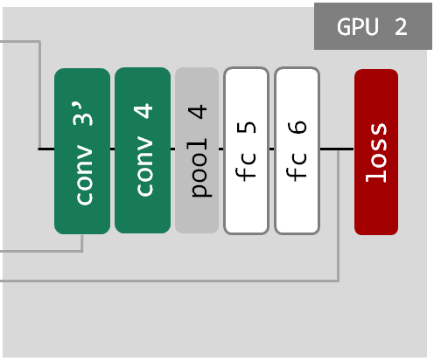
(7) algorithm
for number_iterations:
net1.forward
save pool2.data
...
...
...
...
...
load conv3’.data
calculate loss = ||conv3-conv3’||^2
net1.backward
for number_iterations:
...
...
load pool2.data
net2.forward
calculate loss = ||labels-fc6||^2
net2.backward
save conv3’.data
...
...
...

Slide 10

(8) problems
GPU 1
GPU 2
data
conv 1
pool 1
conv 2
pool 2
conv 3
loss
conv 3’
conv 4
pool 4
fc 5
fc 6
loss
labels
breaking up forward and back propagation
terribly hard to update
loss oddly calculated
foolproof communication

Slide 11
(9) summary
so far:
carried out an extensive literature review
researched neural networks, deep learning and optimization techniques
evaluated various deep learning frameworks
reviewed caffe architecture and its python interface
designed an ADMM dual net algorithm for high computation distribution
implemented the ADMM dual net algorithm using caffe

Slide 12

(10) future outlook
performance comparison
comparing the dual and single net performance
measuring the accuracy, time of convergence, space constraints and more
crash tests
feeding very big image batches to both single and dual nets
verifying if the dual nets handle it better
more nets
parallelizing the architecture further into a bigger number of subnets

Slide 13
thank you!
Distributed Neural Network Training
Final Year Project
CA2 Presentation
Wojciech Dziwulski

