Slide 1

FINAL REPORT
DEEP LEARNING
Convolutional neural networks
Authors: Jan Wojtas, Mikołaj Zalewski

Slide 2
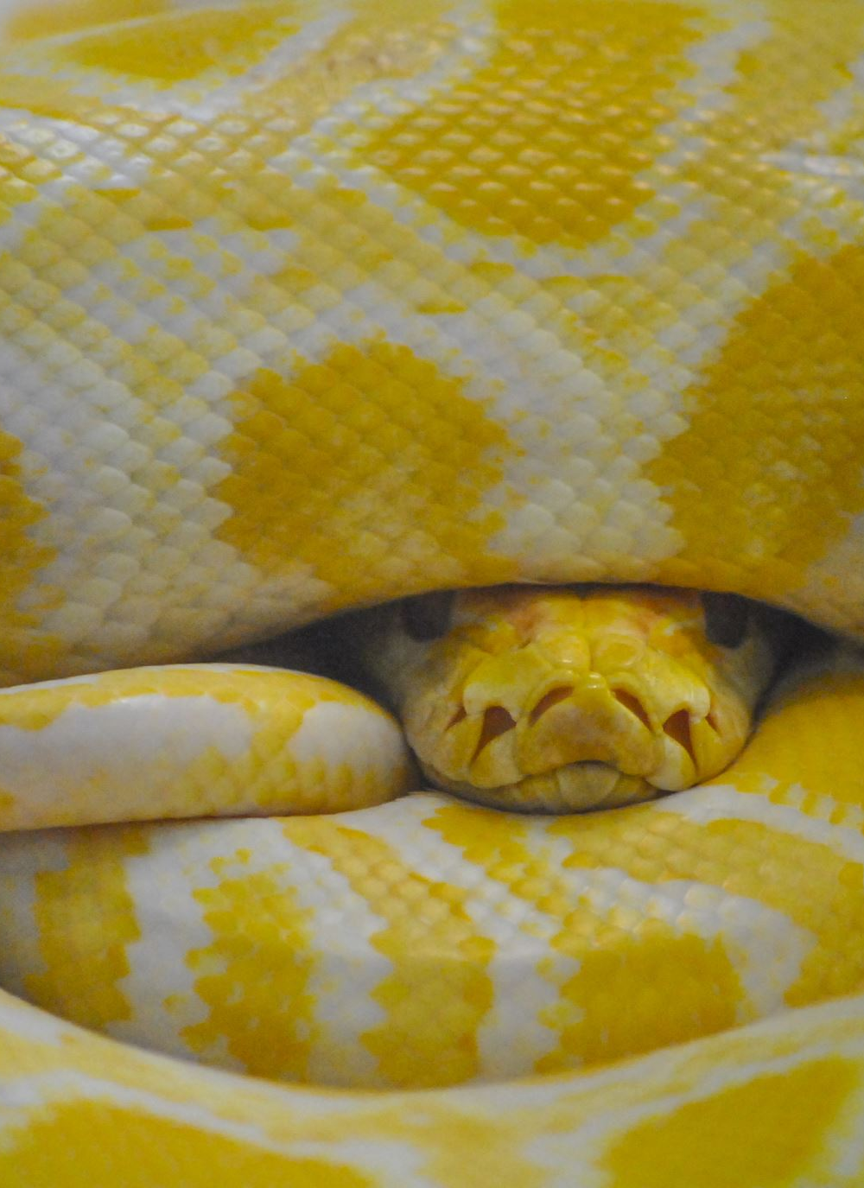
Project environment
Chosen programing language:
Python
Chosen framework:
Pytorch
Versioning
https://github.com/mikolajzalewski/Deep_Learning

Slide 3

DATASETS

Slide 4
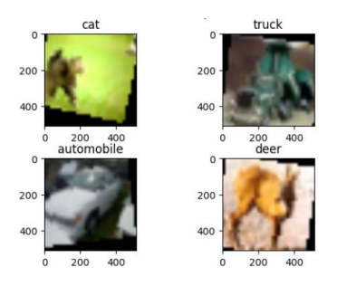
Basic data augmentation
-Random rotation
-Color Jitter
-Random Crop
-Gaussian Noise
-Random flip

Slide 5
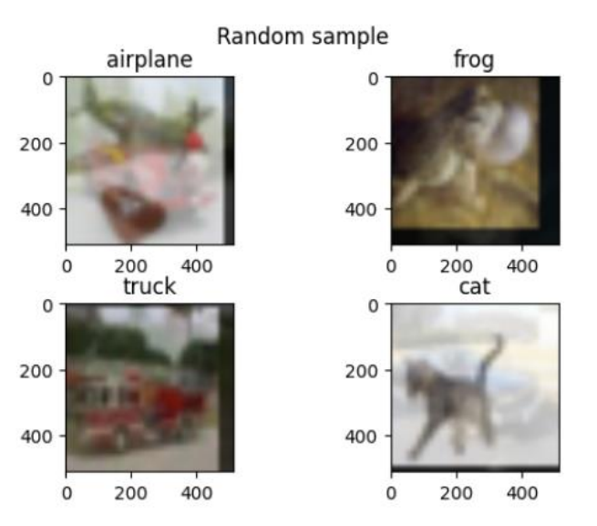
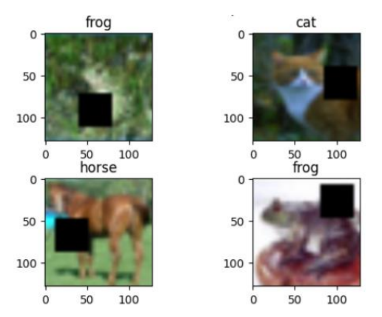
More advanced techniques
Mixup Cutout

Slide 6

Convolutional Neural Networks

Slide 7
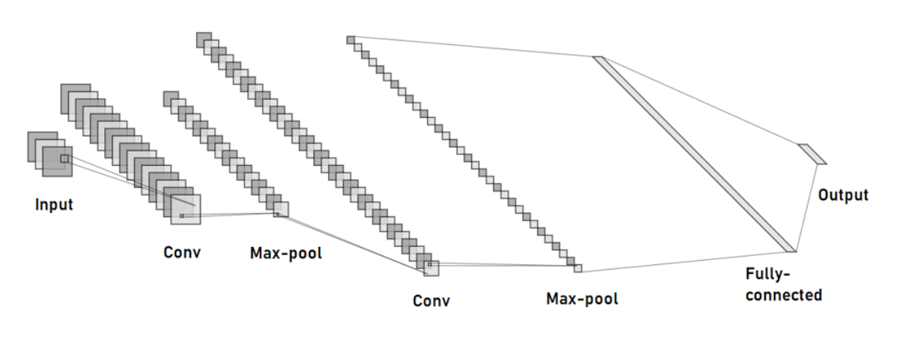
CNN with auto scaling layers

Slide 8

-Learning rate -Batch size -Weight decay -Dropout -Number of filters in each layer -Number of neurons -Number of epochs

Slide 9
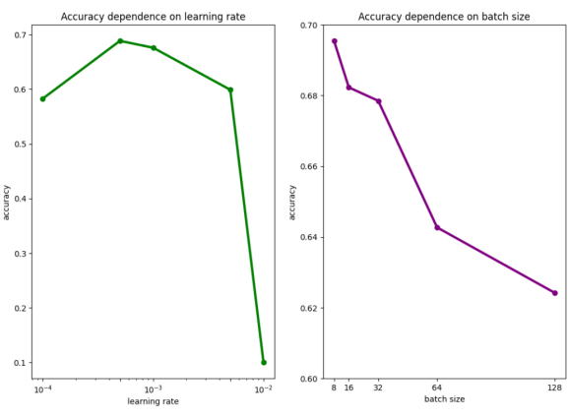
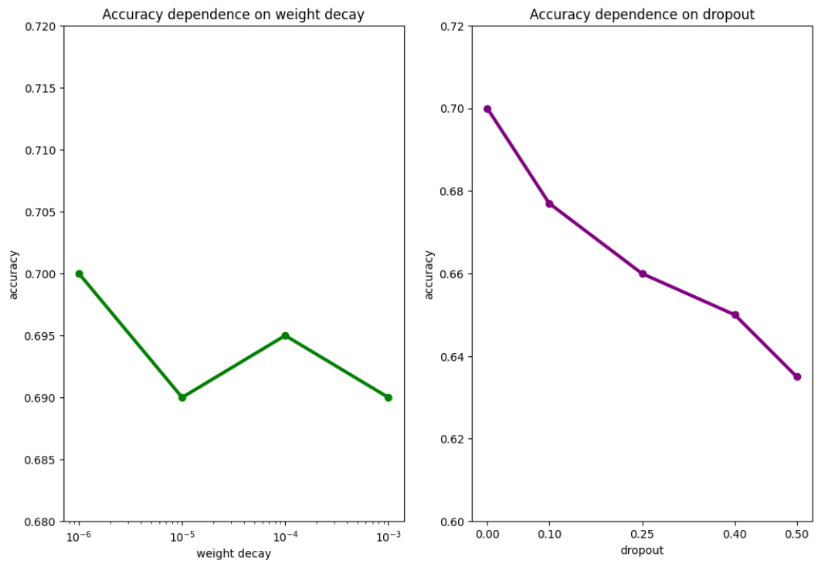
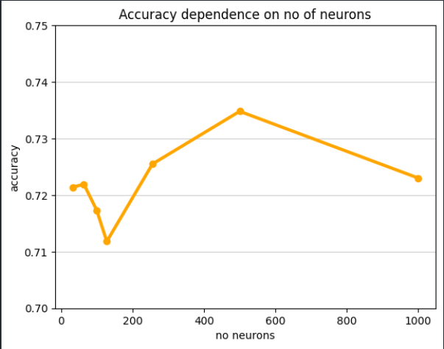
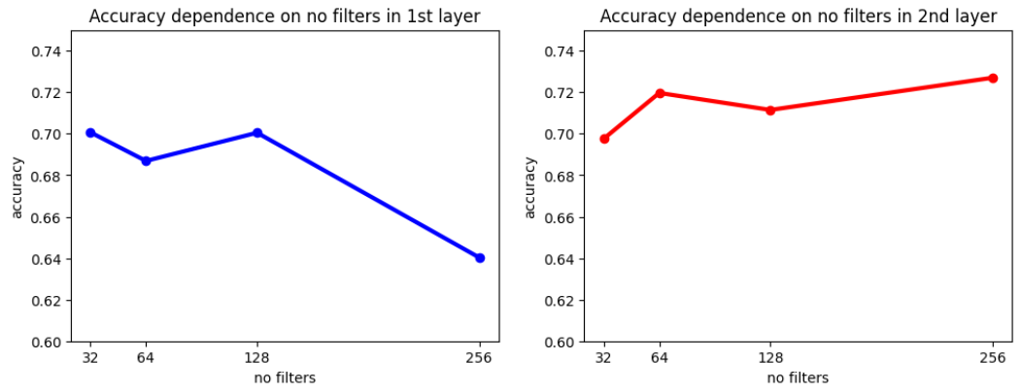

Slide 10
Pretrained CNN - AlexNet
In this part, we focused on tuning two important hyperparameters: batch size and learning rate. As the network architecture was fixed, we didn't change e.g. the number of neurons in the layers.

Slide 11
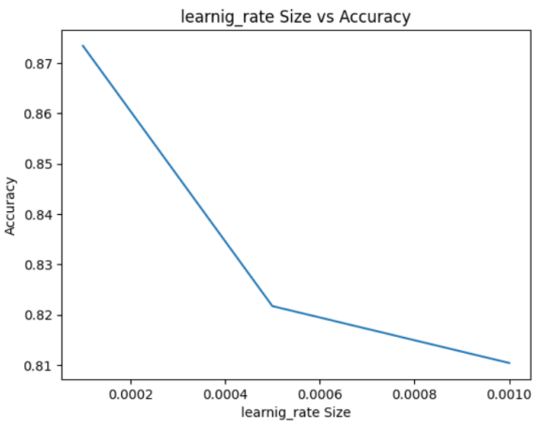
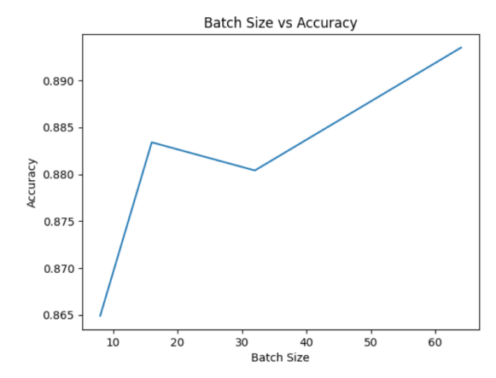

Slide 12
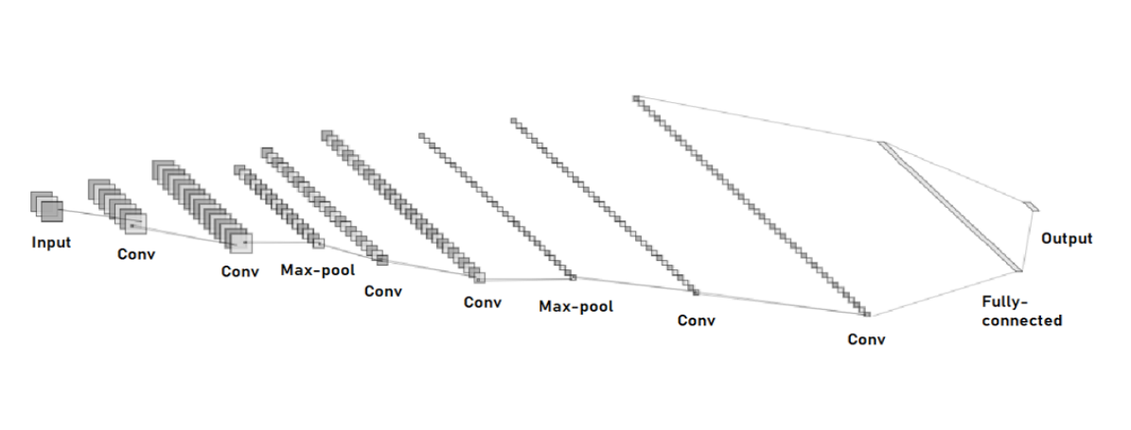
CNN with adjusted size of layers

Slide 13
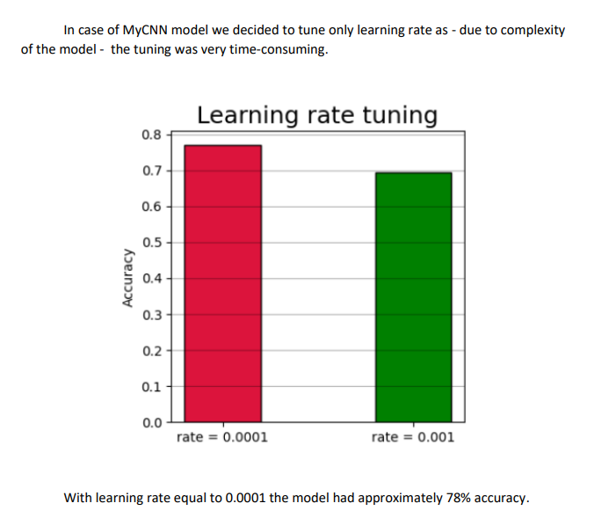

Slide 14
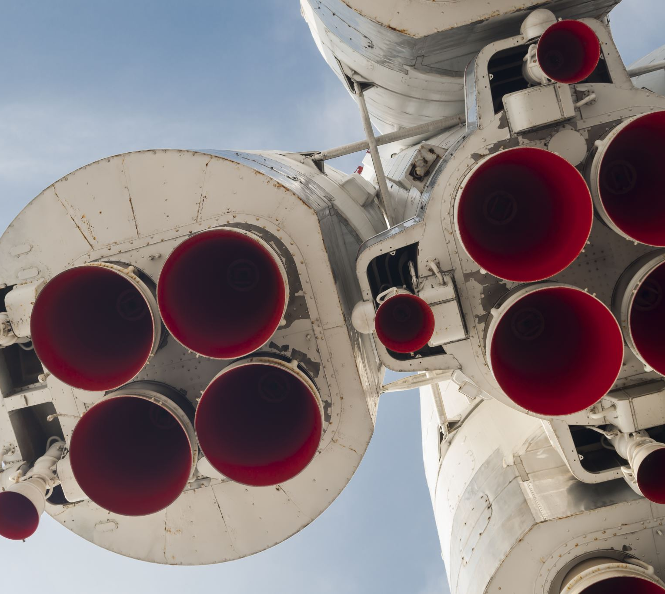
Experiments

Slide 15
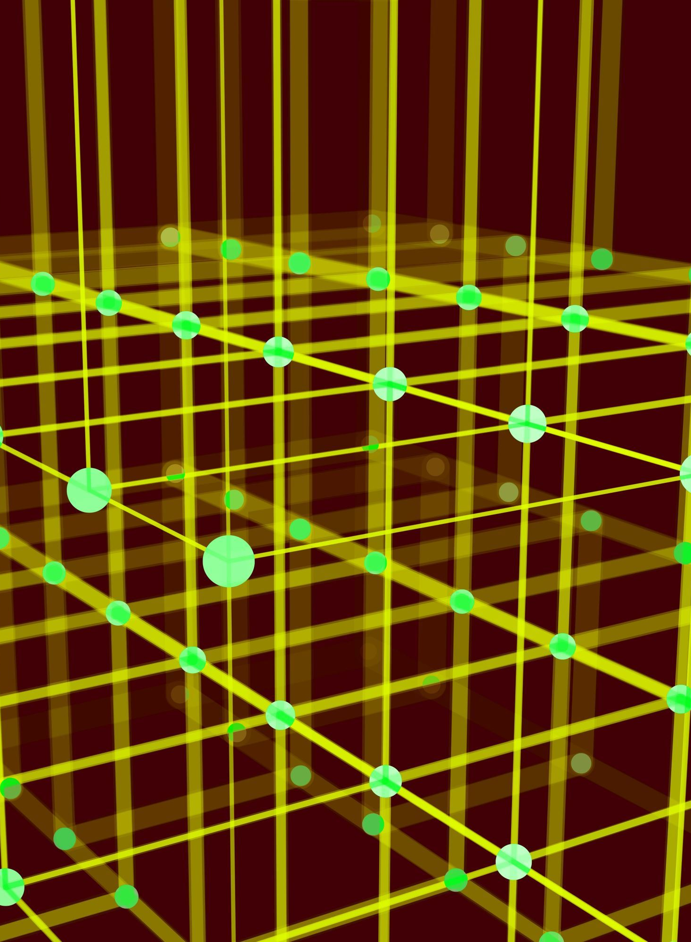
Augmentation

Slide 16
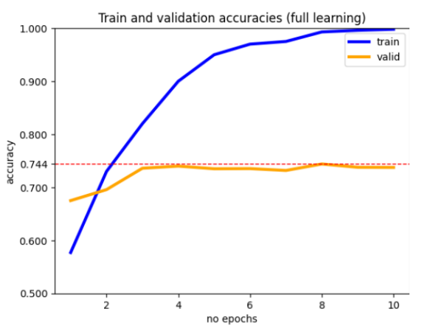
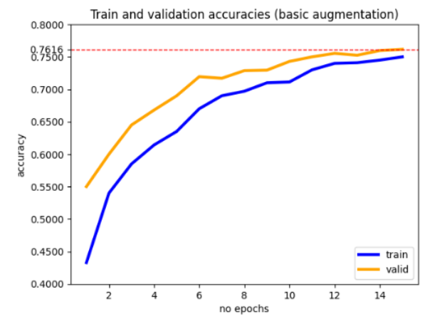
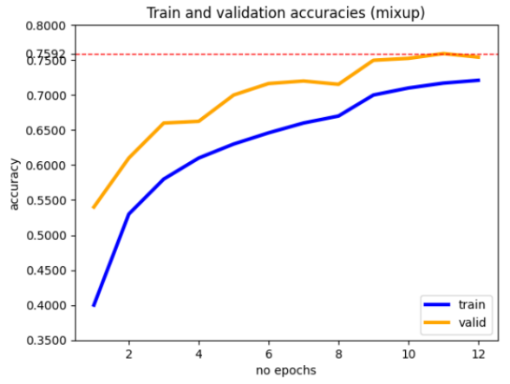
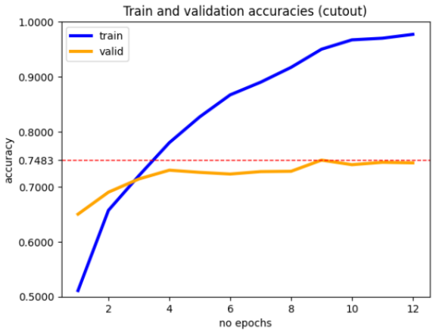
Results before and after augmentation

Slide 17
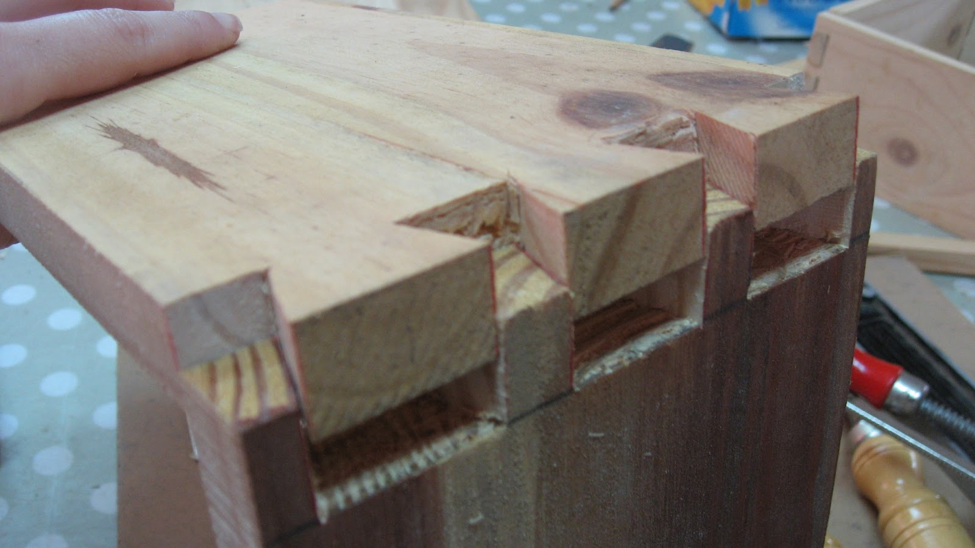
Ensemble Models
This Photo by Unknown author is licensed under CC BY-NC-ND.

Slide 18
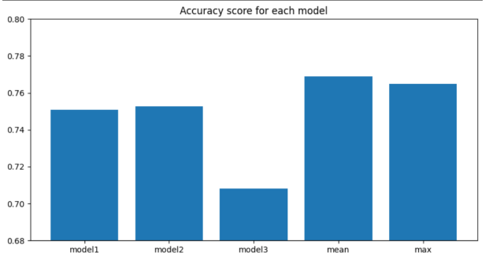

Slide 19
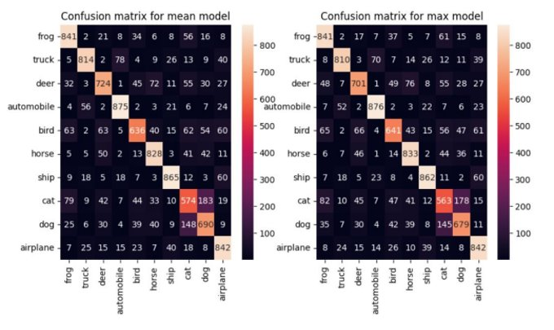

Slide 20
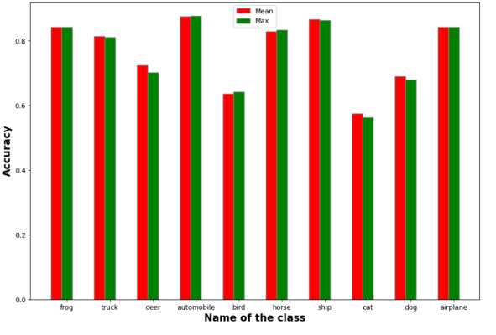

Slide 21
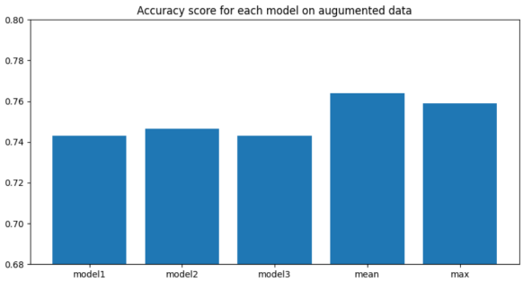

Slide 22
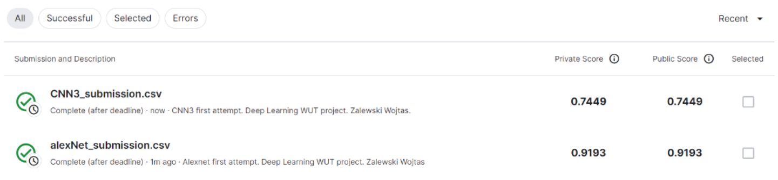
Kaggle scores

Slide 23
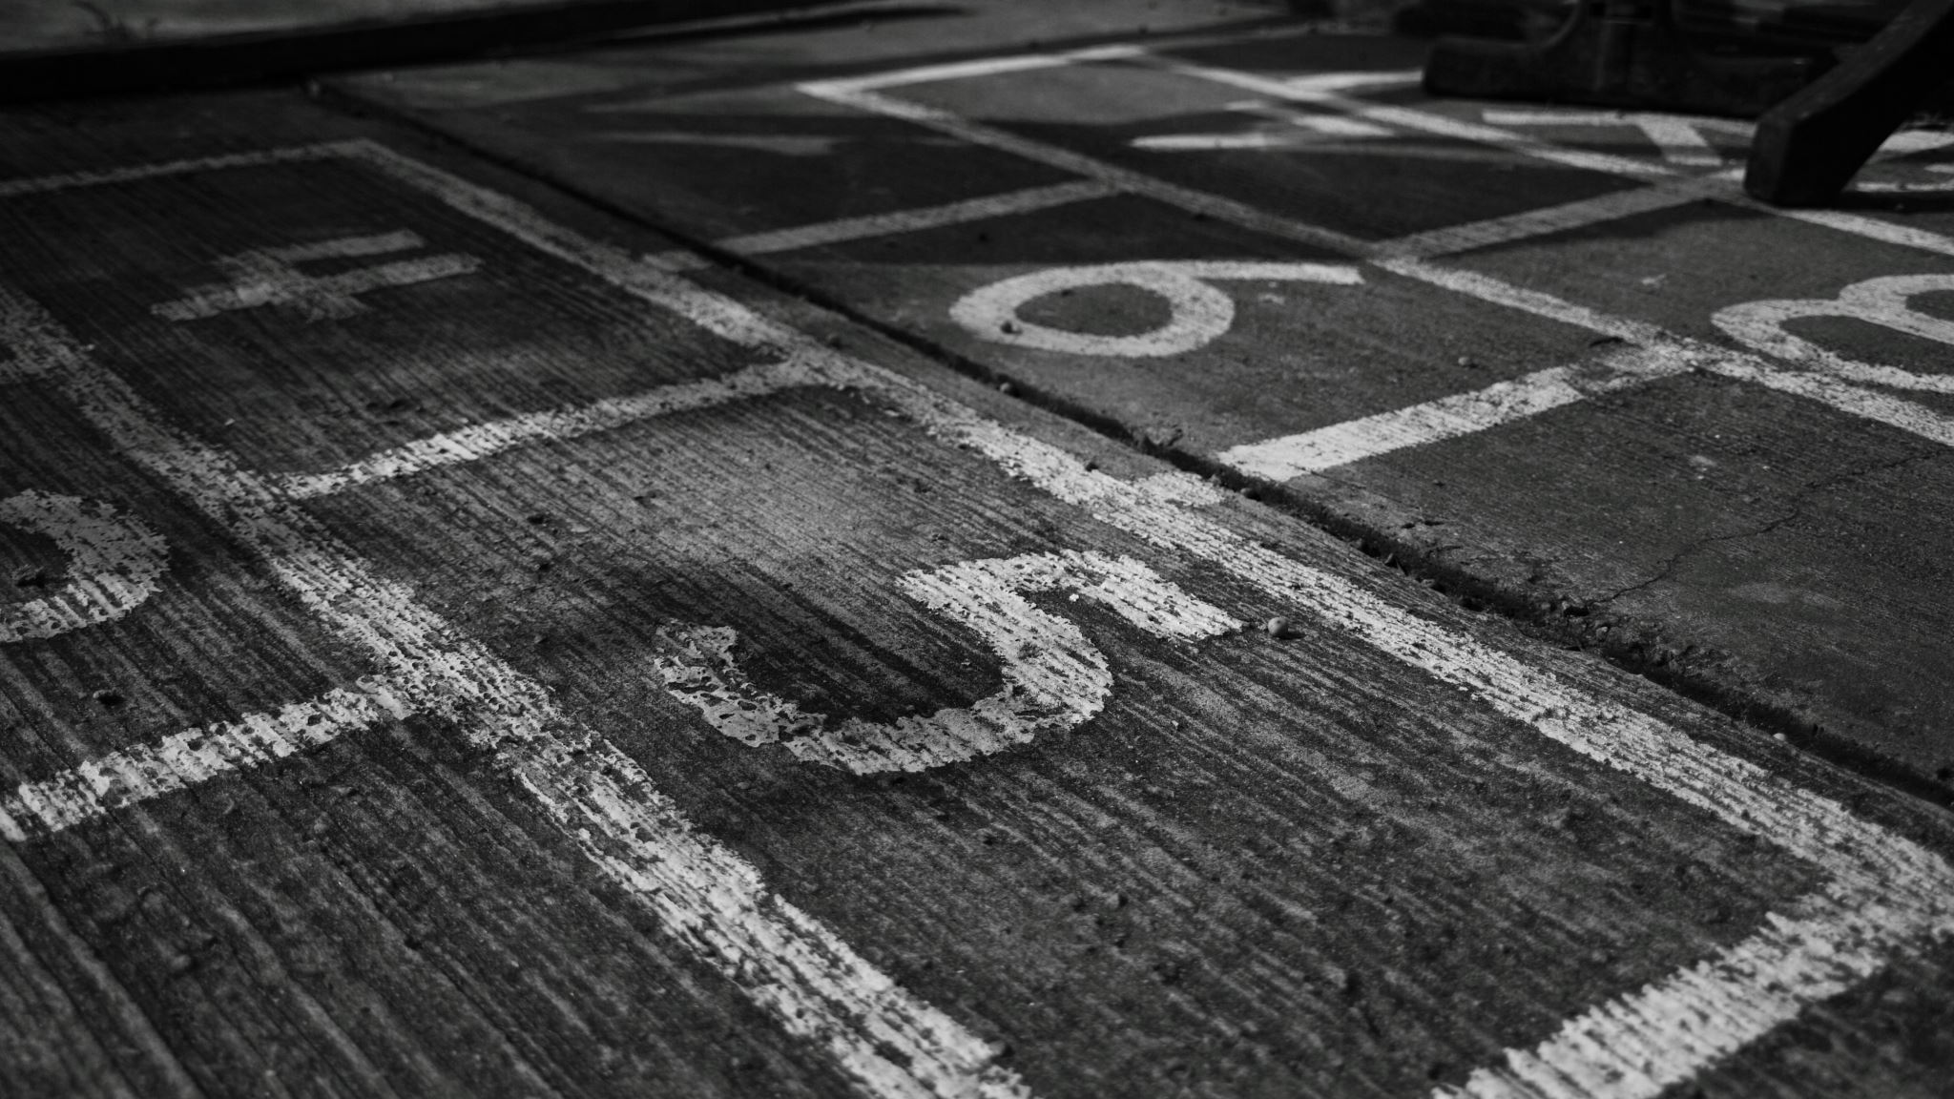
THE END

