Slide 1

FINAL REPORT
DEEP LEARNING
Recurrent neural networks
Authors: Jan Wojtas, Mikołaj Zalewski

Slide 2
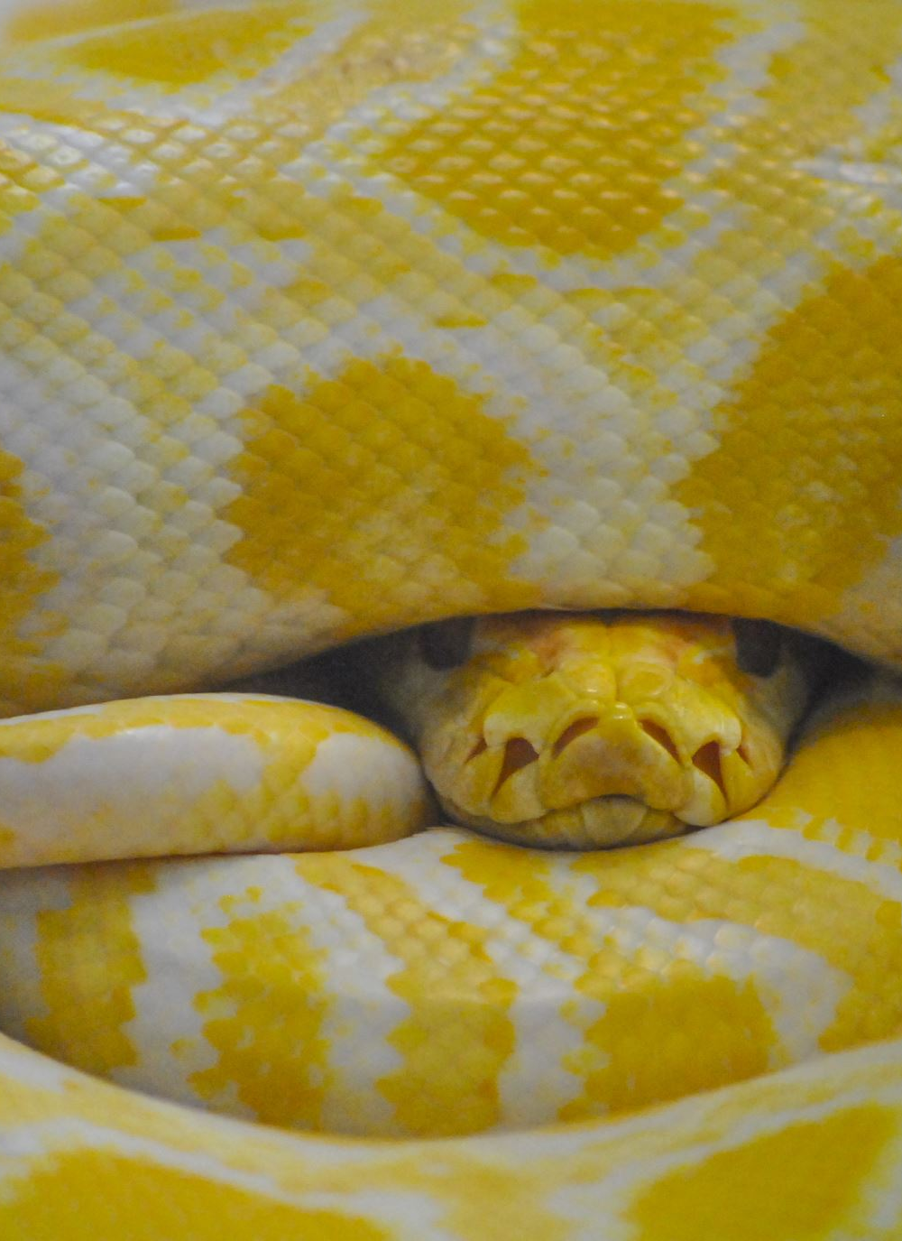
Project environment
Chosen programing language:
Python
Chosen framework:
Keras
Versioning:
https://github.com/mikolajzalewski/Deep_Learning/tree/main/RNN

Slide 3
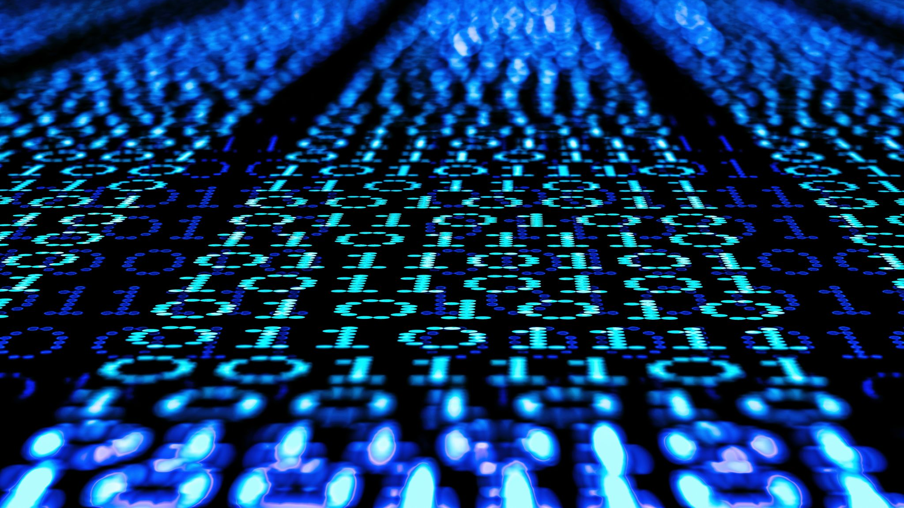
DATASET

Slide 4

TensorFlow Speech Recognition Challenge Dataset
Train + validation parts - 64,727 clips
Test part - 150, 000 clips
One-second long audio files of spoken words in English.
Goal:
Predict one of 10 labels from: yes, no, up, down, left, right, on, off, stop, go
Otherwise predict either 'unknown' or 'silence'

Slide 5

Signal preprocessing
WOW
original
VAD (Voice Activity Detection)
Padding
Resampling
https://www.kaggle.com/code/davids1992/speech-representation-and-data-exploration/notebook
processed
DOG
original
processed

Slide 6
Feature extraction
13 MFCCs (Mel - Frequency Cepstral Coefficients)
13 delta coefficients
13 delta-delta coefficients
Input shape: (39, 44)
LSTM: A Search Space Odyssey - https://arxiv.org/pdf/1503.04069.pdf

Slide 7
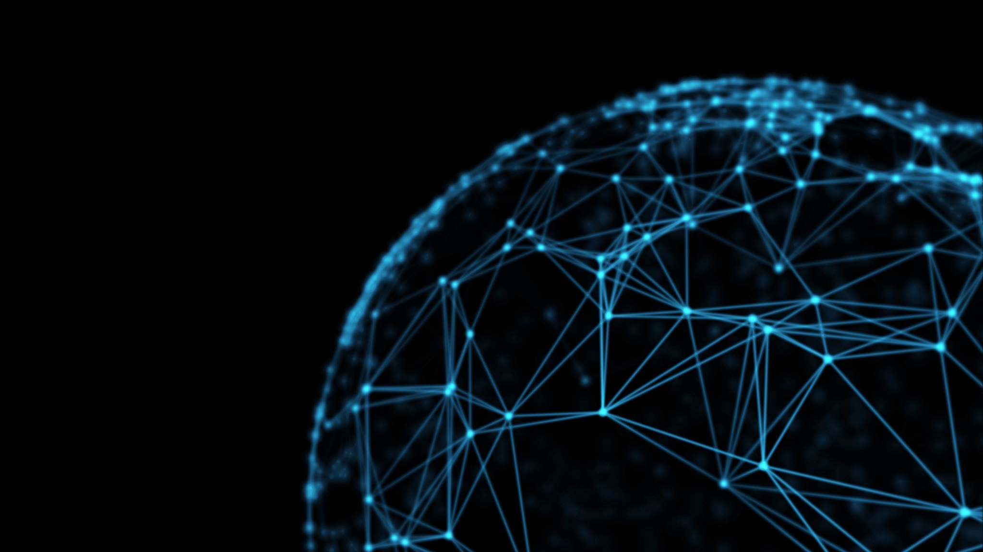
Reccurent Neural Networks

Slide 8
RNN architectures
LSTM Long short-term memory
GRU (Gated recurrent unit) network
Transformer

Slide 9
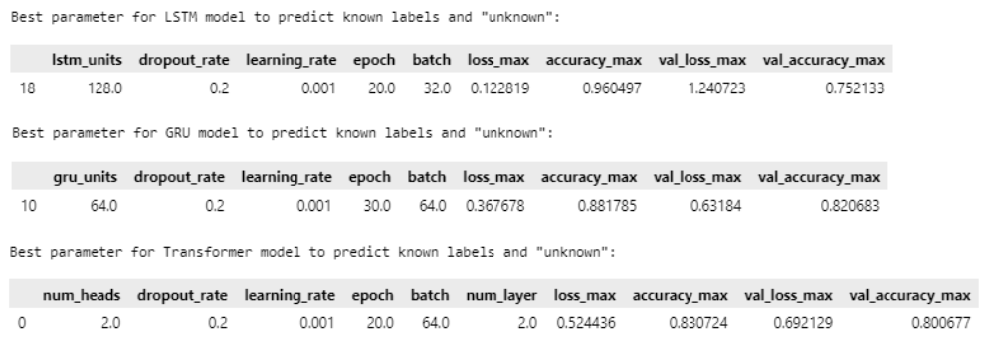
Results for basic models – grid search

Slide 10
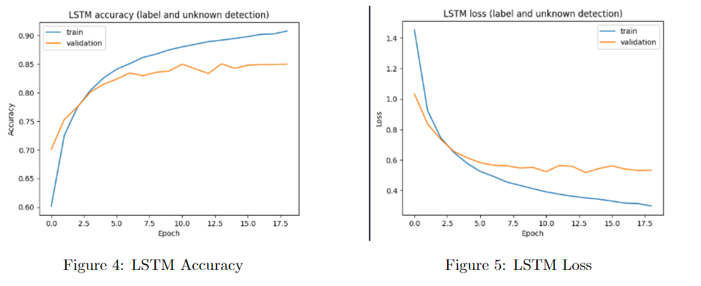
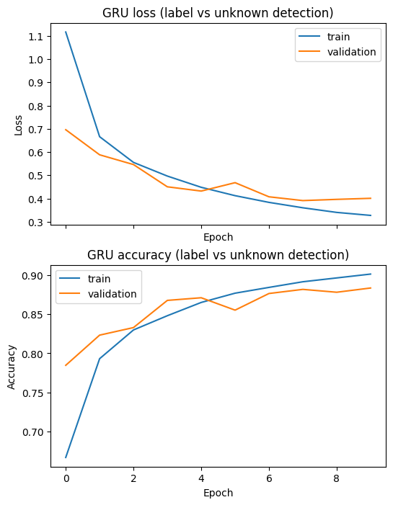
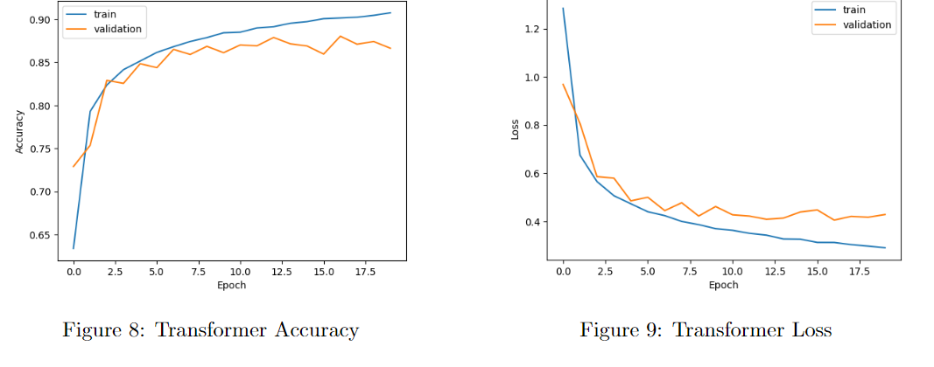
Training plots for basic models – random search

Slide 11
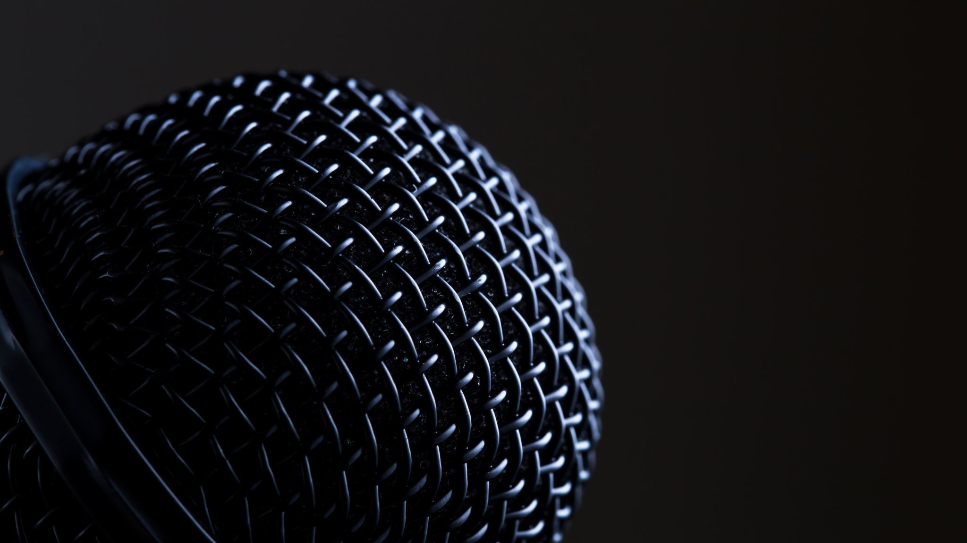
SILENCE DETECTION

Slide 12
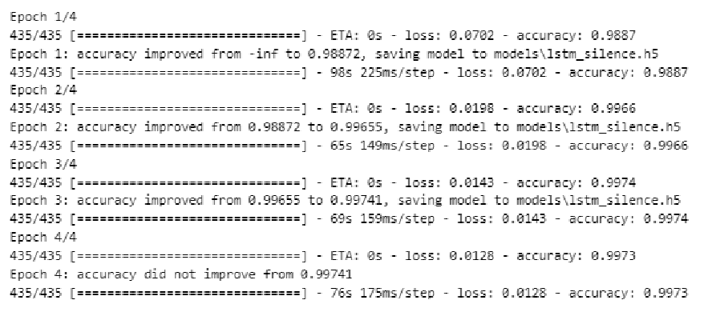
LSTM model to predict silence audio

Slide 13
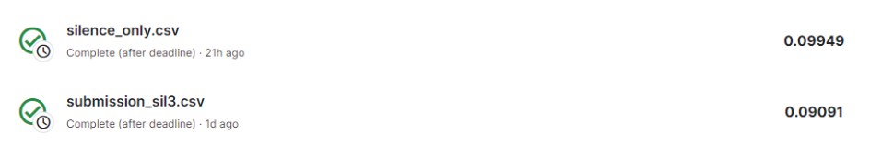
VAD preprocessing – silence detection

Slide 14
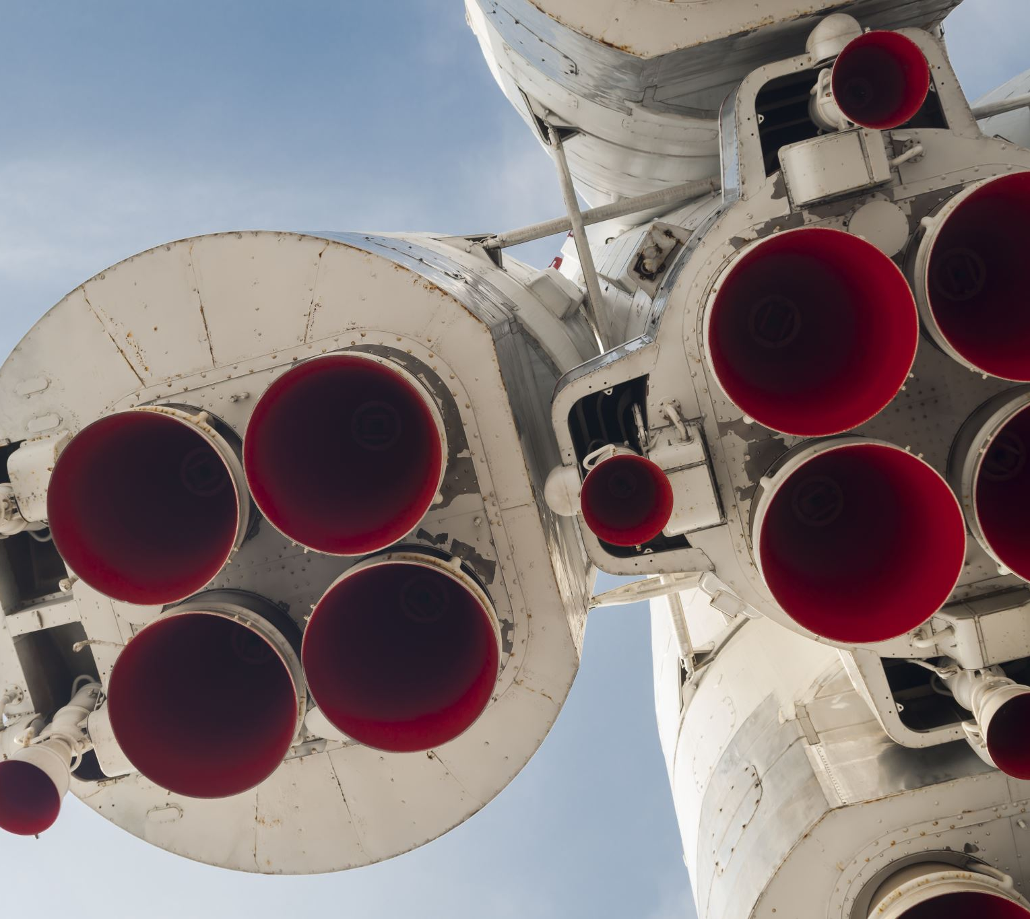
Experiments

Slide 15

Two approaches
SKL
SL
Silence + Known/unknown + Labels ( only known )
Silence + Labels
(known and 'unknown')

Slide 16
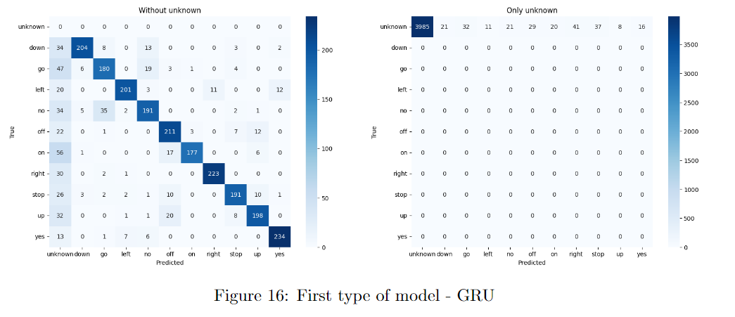
Confusion matrix for best SL network

Slide 17
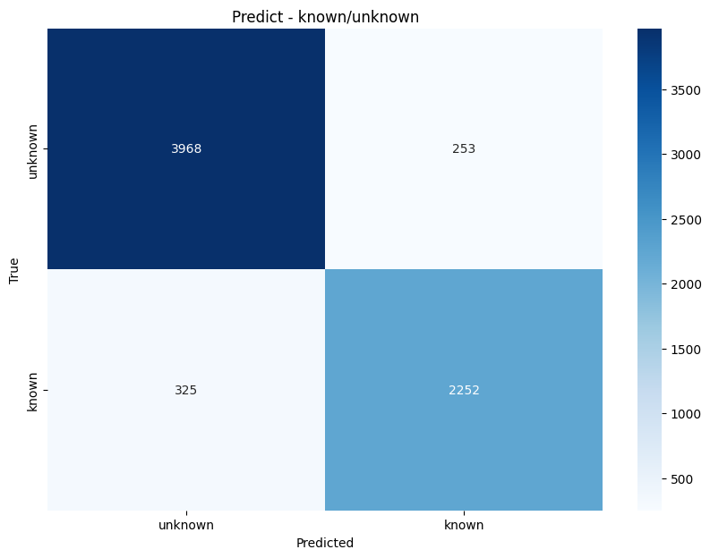
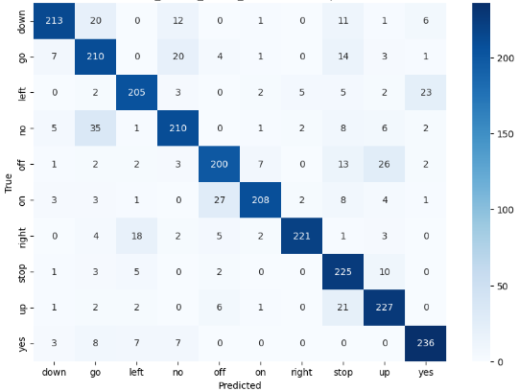
Confusion matrices for best SKL networks

Slide 18
Final results – best models Kaggle scores
Best SKL - GRU
Best SKL – GRU & Transformer
ENSEMBLE MAX & MEAN

Slide 19
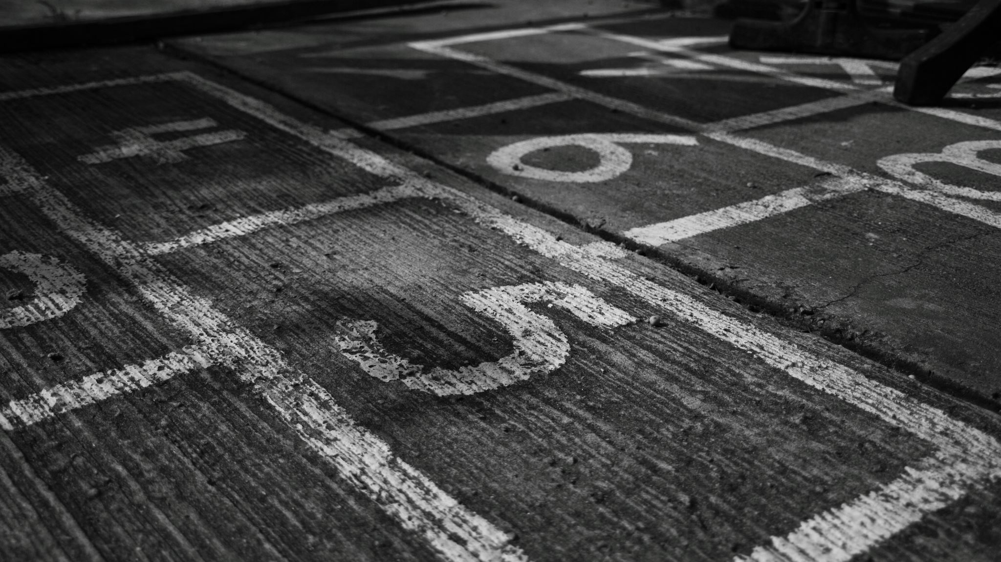
THE END

