Slide 1
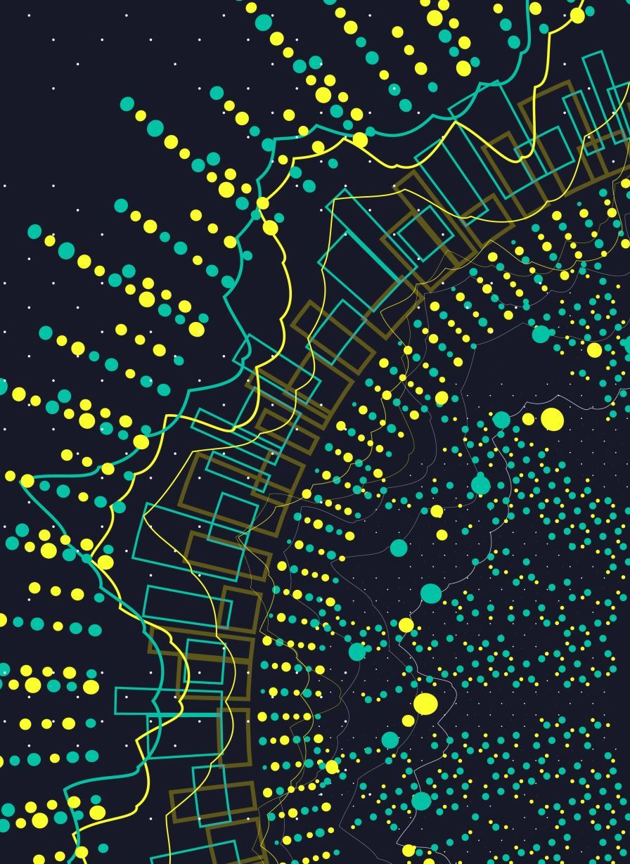
Beyond the playlists: Exploring the web of artists on Spotify
Jan Wojtas

Slide 2
About the project
Spotify data set from 2017 (https://www.aicrowd.com/challenges/spotify-million-playlist-dataset-challenge#dataset)
1 milion playlists with different artists and songs
Considered network: co-occurrence network of artists (inspiration from https://medium.com/@jonatas.santos.700/spotify-network-analysis-e79acb5f8359)
Artists are nodes of the network
Edge exists between two artists, if they appear in the same playlist (weight of the edge is number of such co-occurrences)

Slide 3
Network metrics
Metric | Value
Number of nodes | 2100
Number of edges | 458331
Average degree | 436.5
Density | 0.21
Average shortest path | 1.84
Diameter | 5
Assortativity | -0.075
Clustering coefficient | 0.6

Slide 4
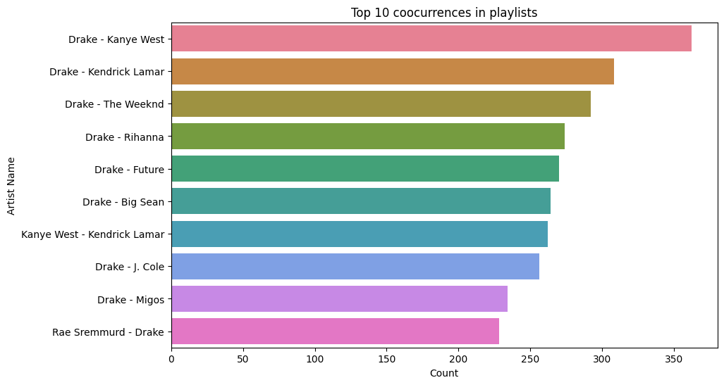

Slide 5
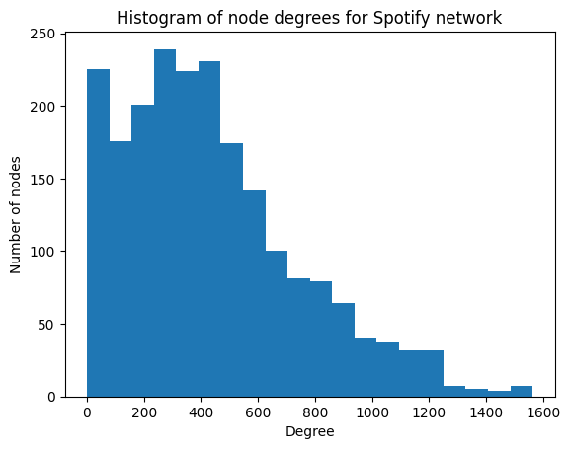

Slide 6
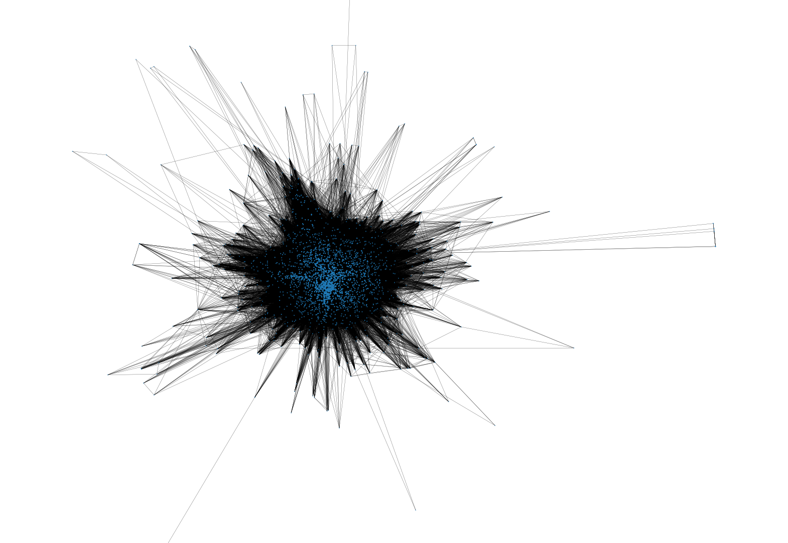
Largest connected component

Slide 7
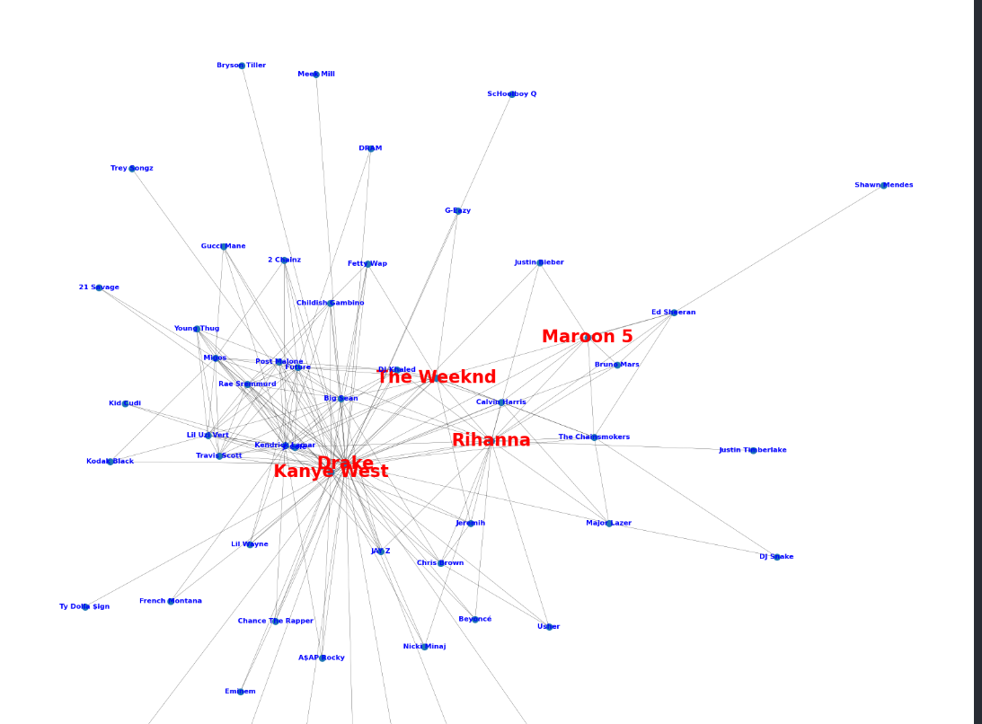
Top 200 edges
Red nodes – highest pagerank score

Slide 8
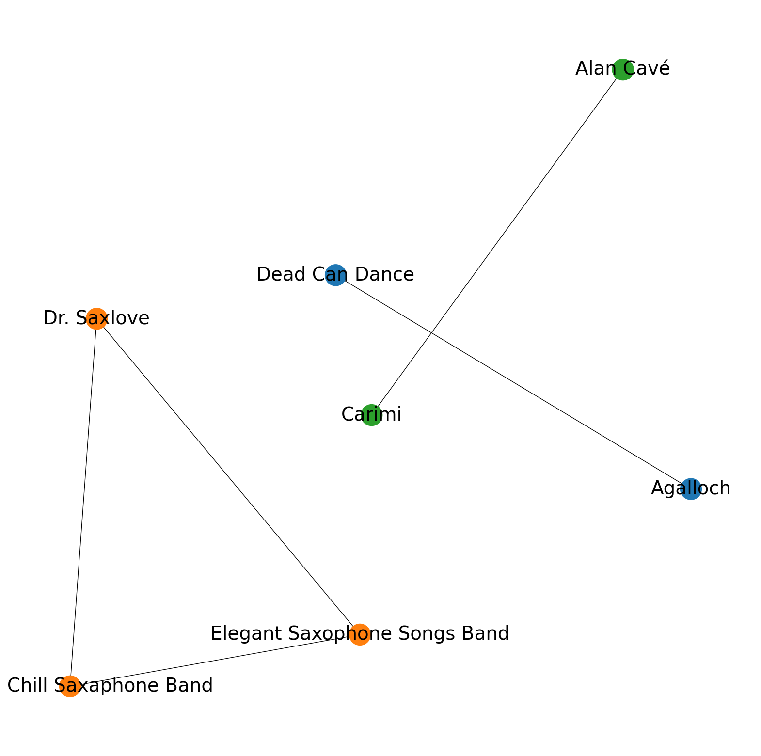
Other components: jazz, metal and alternative rock

Slide 9
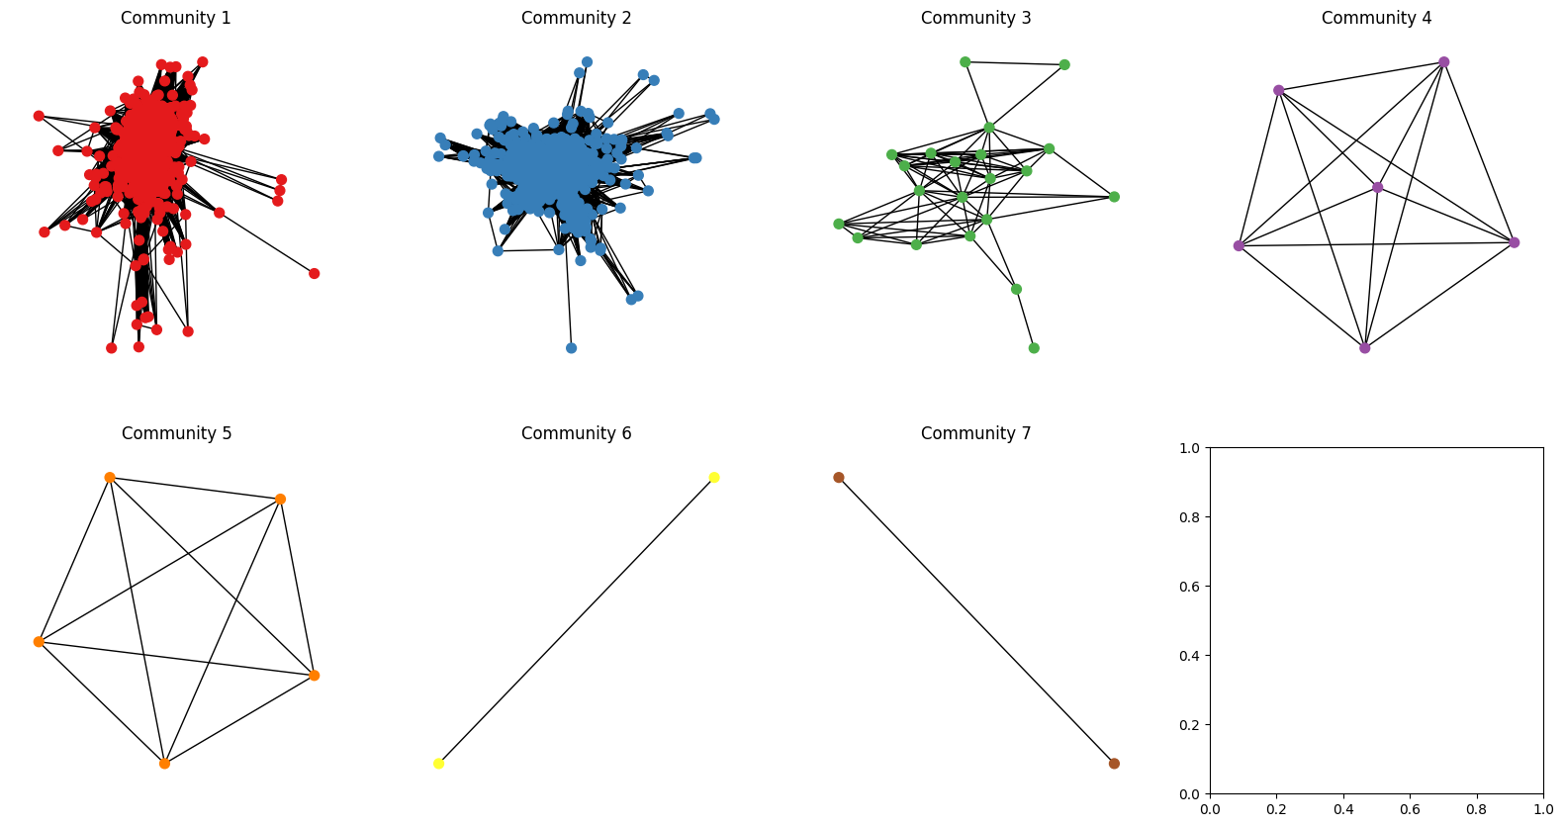
Community detection – identifying music genres

Slide 10
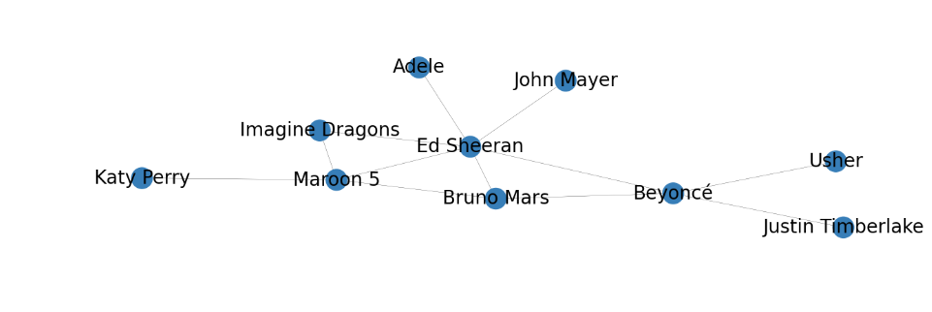
Community 2: Pop (?)

Slide 11
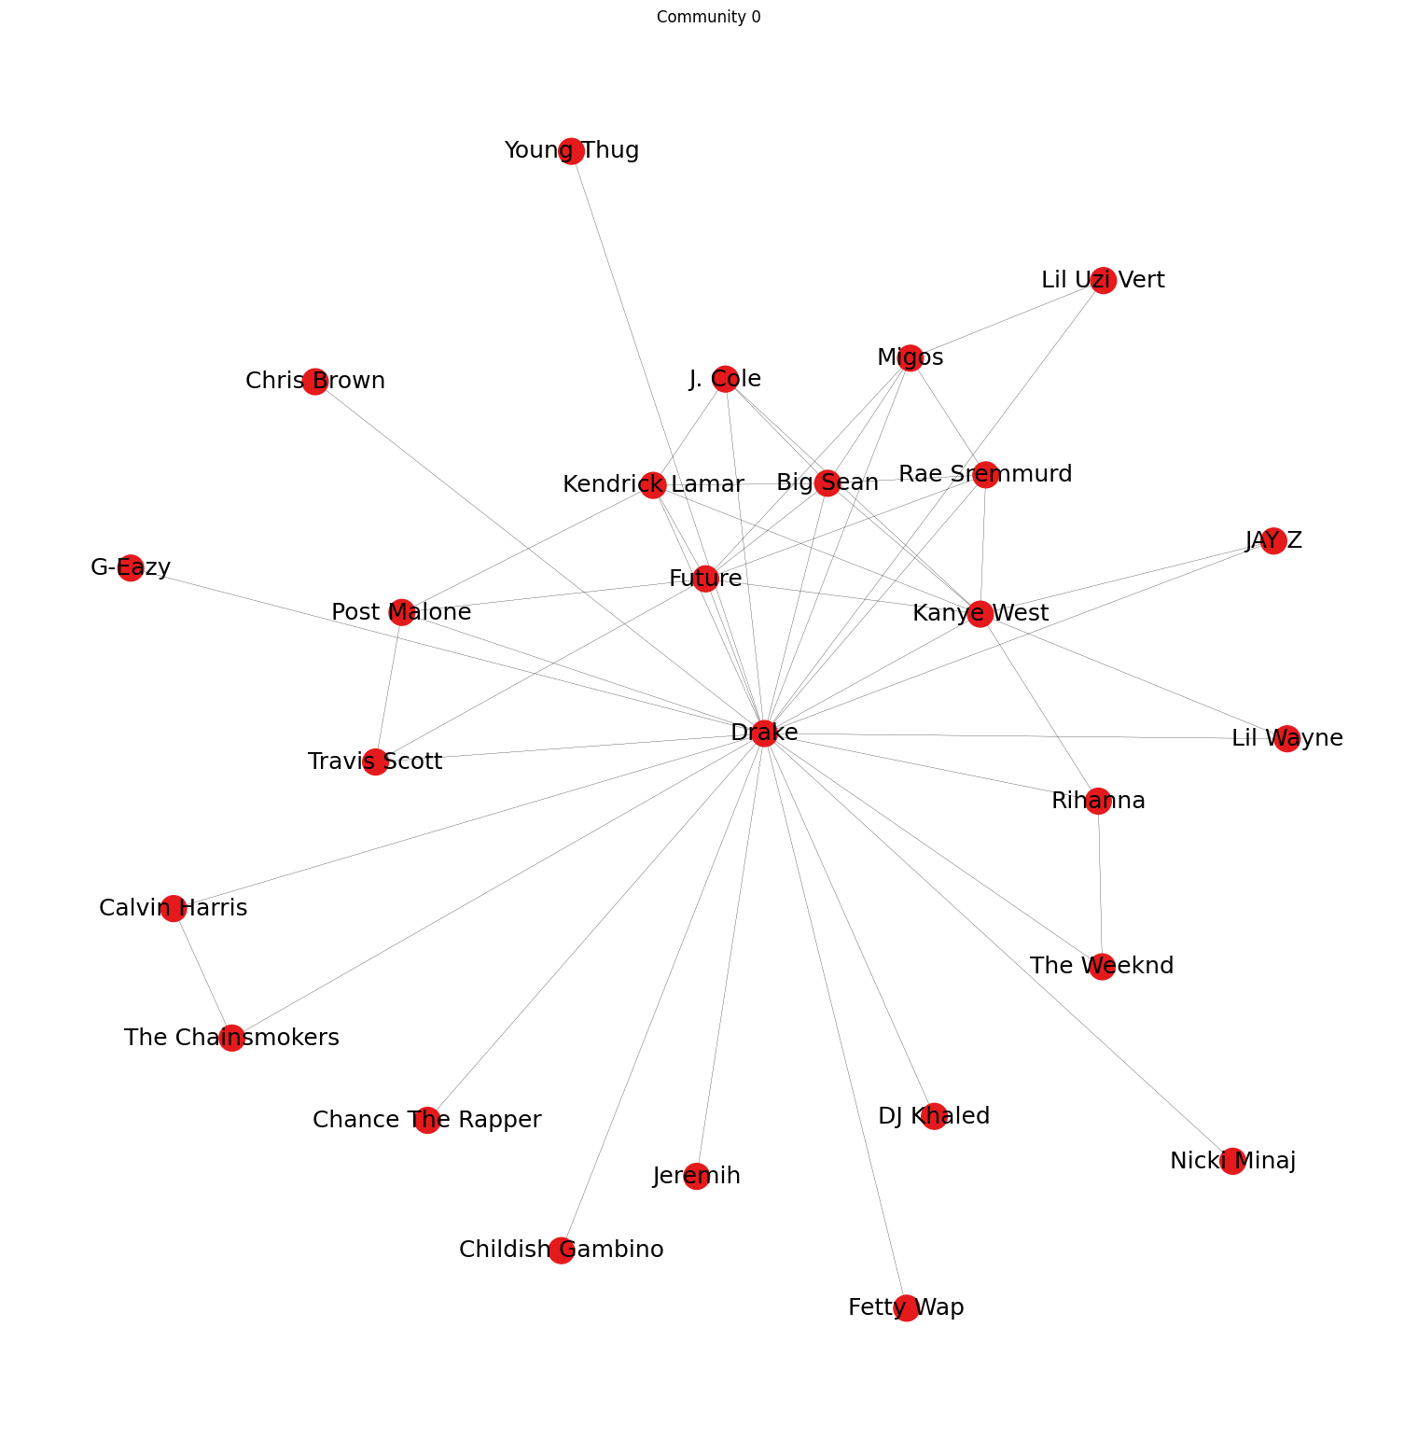
Community 1: Rap

Slide 12
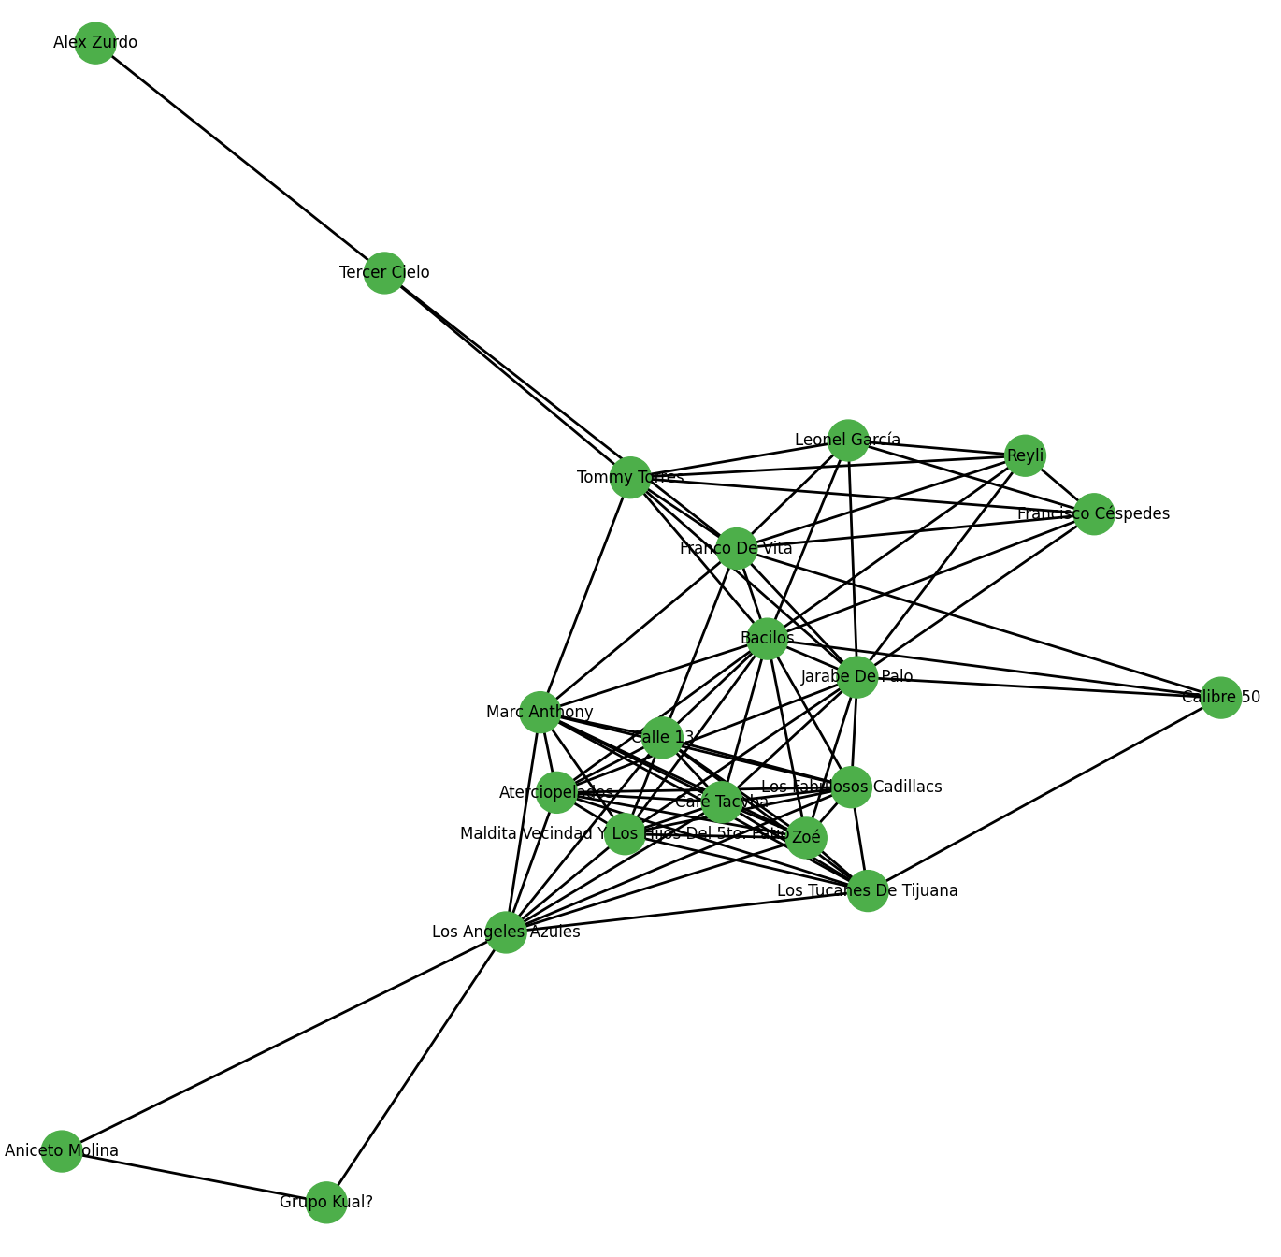
Community 3: latin american, spanish

Slide 13
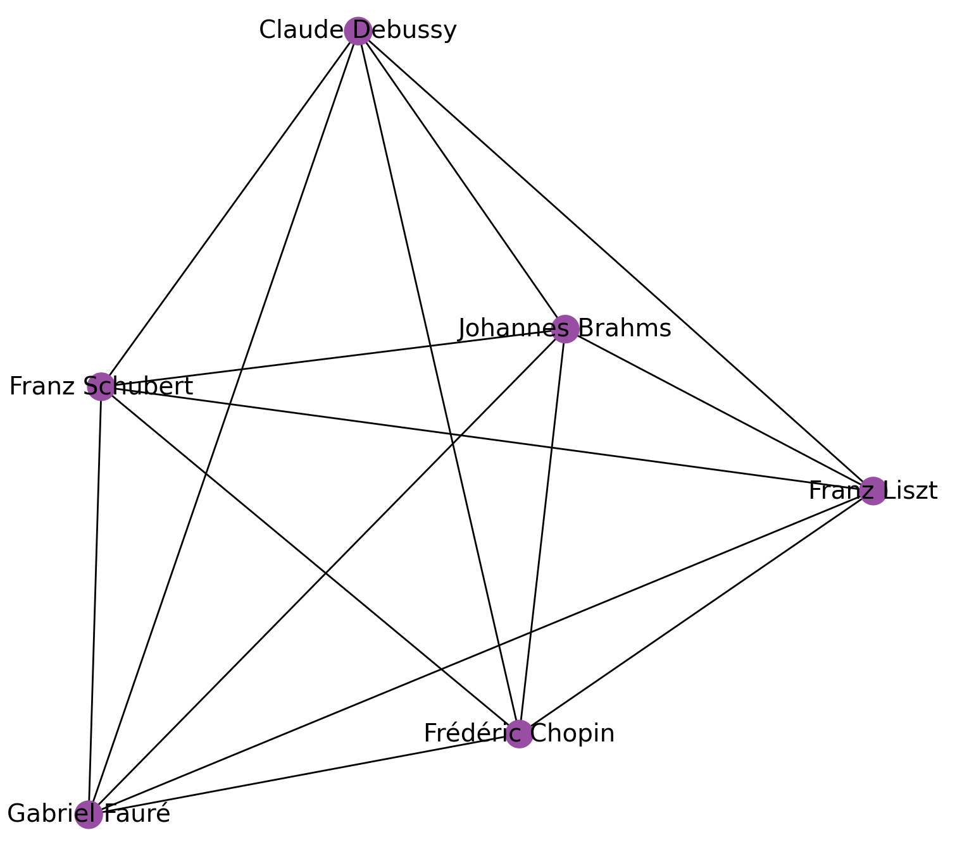
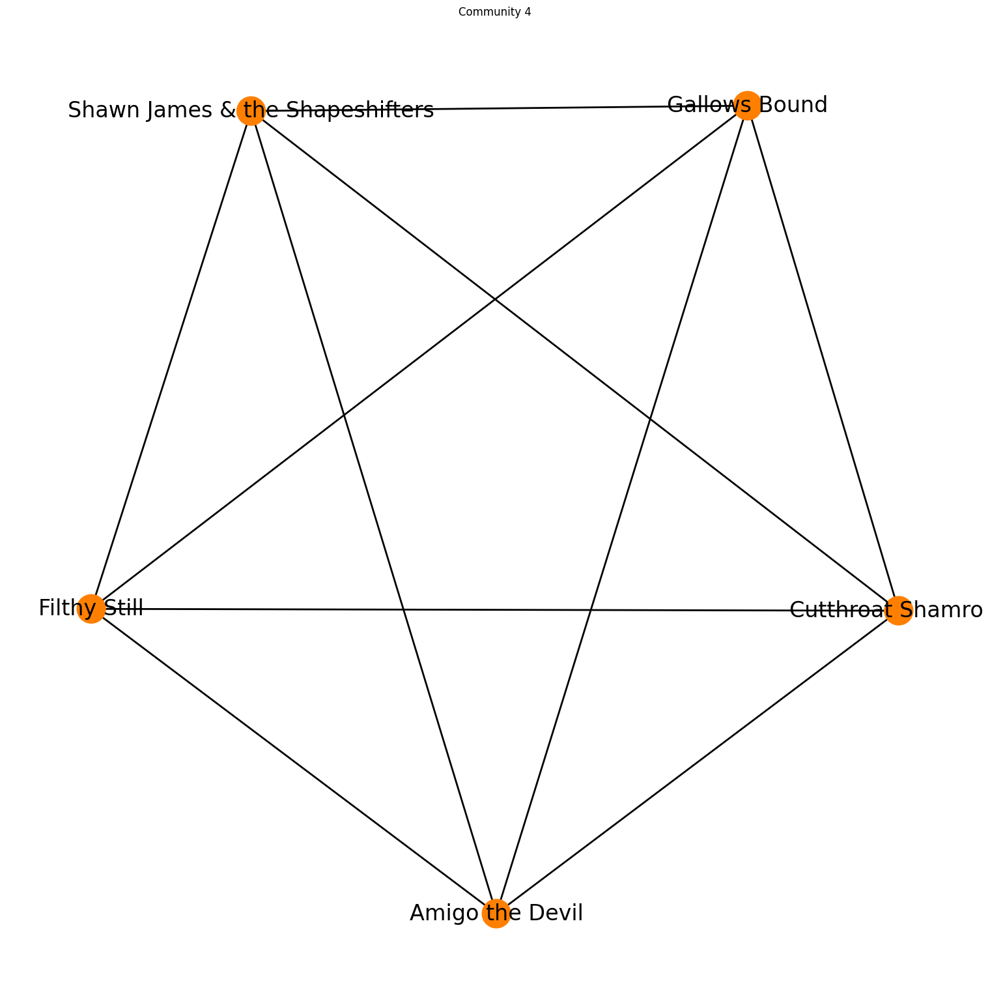
Community 4: Classical music
Community 5: Country, rock and folk fusion

Slide 14
Artist recommendation system
Two custom playlists, with 5 artists in each one
Recommendation based on Jaccard Coefficient
Similarity between set of neighbors of given node and the custom playlist
With and without consideration of edge weights

Slide 15
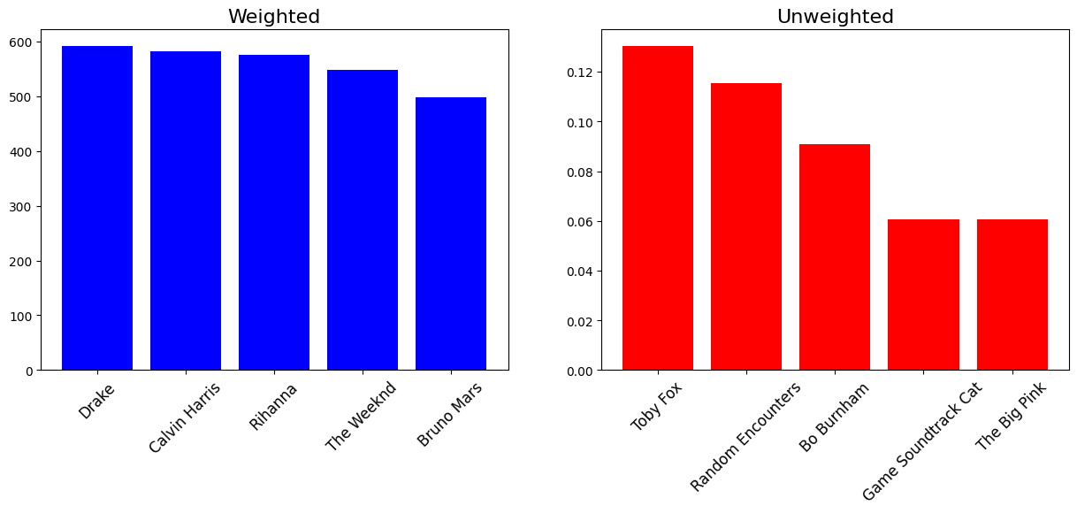
Pop (rock) playlist: Maroon 5, Ed Sheeran, Imagine Dragons, Twenty One Pilots

Slide 16
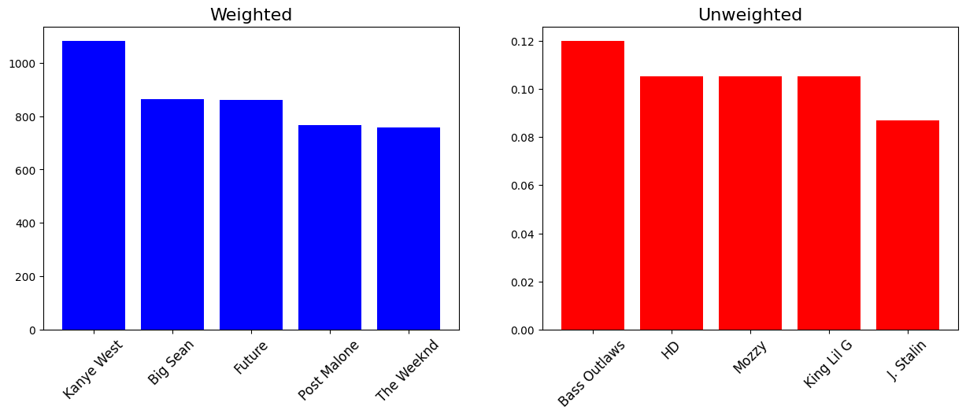
Rap playlist: Eminem, Drake, Kendrick Lamar, Travis Scott, J. Cole

Slide 17

Thank you for attention!

