Slide 1

Calculating Haven’s ratio
Wojciech Grunwald

Slide 2
Introduction
A useful tool to study ionic conductivity mechanisms in fast-ion conductors is the molecular dynamics (MD) simulation performer on finite simulation cells with periodic boundary conditions.
It was found that cell sizes influence extracted thermodynamic and kinetic characteristics in different ways with magnitude ranging from weak to strong.

Slide 3
Diffusion and conductivity
Crystals with good ionic conduction have always a high concentration of monovalent ions that are acting as charge carriers. Because of this high concentration, ionic transport is determined not only by interactions between the ions and the crystal network but also by correlations between the moving ions themselves.
Ion motions are considered in the light of general aspects of transport processes in solids such as interactions of moving ions with the surrounding network or with other mobile ions and the influence of structure on the geometry of transport pathways.

Slide 4
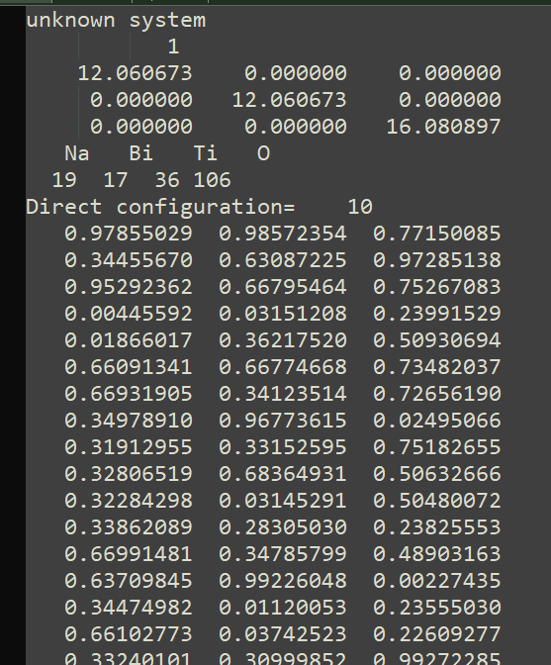
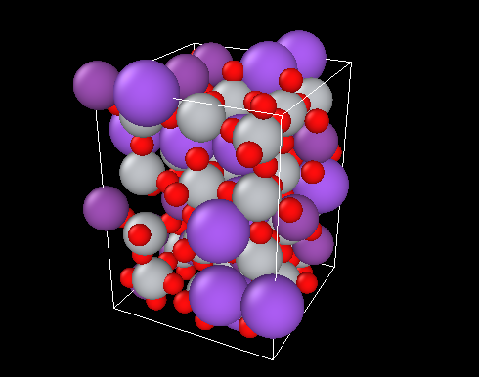
Data/structure
In the file we have coordinates of 178 atoms in subsequent time steps
POSCAR

Slide 5
Periodic boundary conditions (PBC)
When we are doing an MD simulation, we should ideally be using a large simulation box so you can study the properties of the system. However, this is easier said than done, because of the computational resources that would be required to study the dynamics of very large systems.
So we instead take simulation boxes of trackable size, and assume periodic boundary conditions so that you are essentialy simulating a very large system.

Slide 6
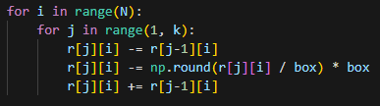
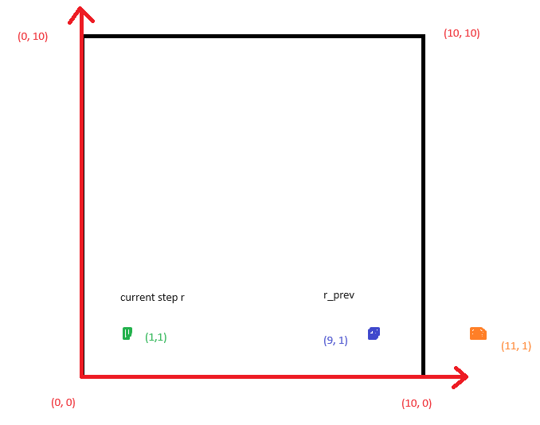
This simulation was done using PBC (periodic boundary conditions), which means that when a particle leaves the simulation box at one of the ends, an equivalent particle enters the box from the other end. We need to unwrap the coordinates to calculate various properties using molecular dynamics techniques.
Algorithm:
Example:

Slide 7
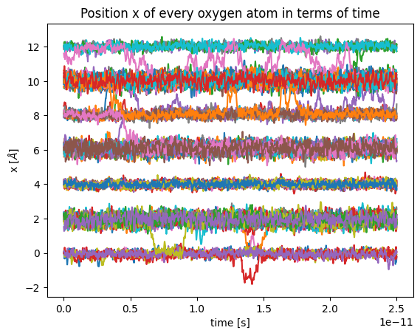

Slide 8

Haven’s ratio
$$H_{R}=\frac{D^{∗}}{D_{σ}}$$
$D^{∗}$- tracer diffusion
$D_{σ}$ - d.c. ionic conductivity

Slide 9

More about Haven ratio
Haven ratio is a measure for correlation in the system. In case of completely uncorrelated tracer diffusion, $D^{∗}$ equals $D_{σ}$ and $H_{R}$ is unity. As soon as tracer correlation is present in the system, $H_{R}$ decreases linearly with the strength of tracer correlation.

Slide 10
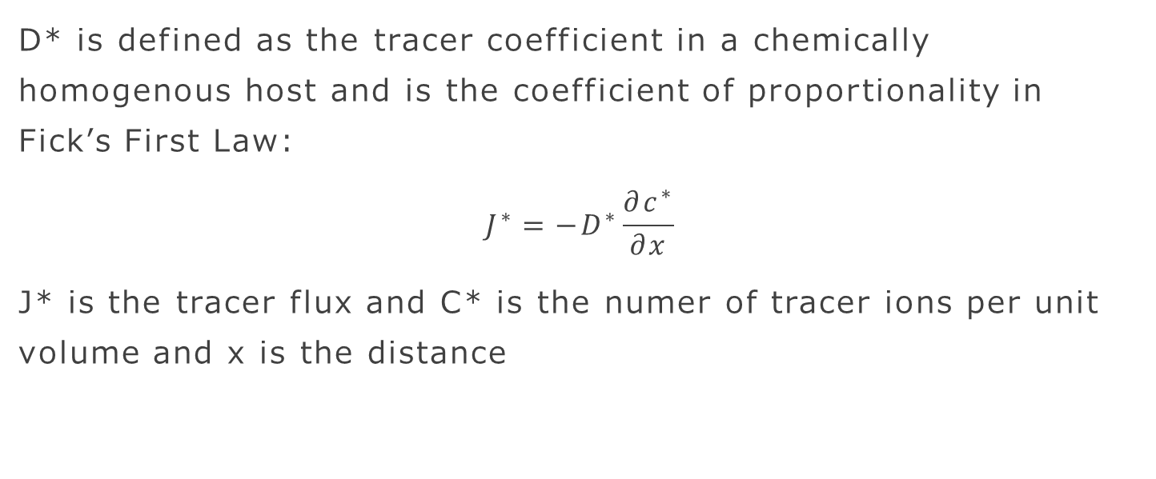
Tracer diffusion
D* is defined as the tracer coefficient in a chemically homogenous host and is the coefficient of proportionality in Fick’s First Law:
$$J^{∗}=−D^{∗}\frac{∂c^{∗}}{∂x}$$
J* is the tracer flux and C* is the numer of tracer ions per unit volume and x is the distance

Slide 11
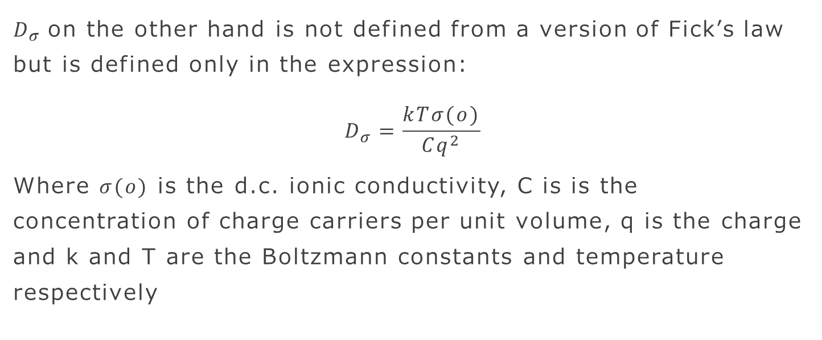
D.C. ionic conductivity
$D_{σ}$on the other hand is not defined from a version of Fick’s law but is defined only in the expression:
$$D_{σ}=\frac{kTσ(o)}{Cq^{2}}$$
Where $σ(o)$ is the d.c. ionic conductivity, C is is the concentration of charge carriers per unit volume, q is the charge and k and T are the Boltzmann constants and temperature respectively

Slide 12
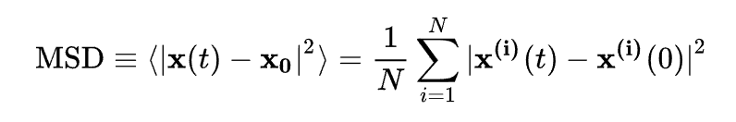
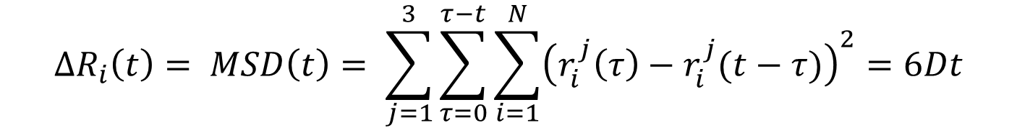
MSD (Mean Squared Displacement)
In statistical mechanics the mean squared displacement is a measure of the deviation of a particle’s position from a reference position over time. This is the most common measure of the spatial extent of random motion and can be thought of as a measurement of the part of the system „explored” by the random wanderer
$$∆R_{i}\left(t\right)= MSD\left(t\right)= \sum_{j=1}^{3}{\sum_{τ=0}^{τ−t}{\sum_{i=1}^{N}{{\left(r_{i}^{j}\left(τ\right)−r_{i}^{j}(t−τ)\right)}^{2}=6Dt}}}$$

Slide 13
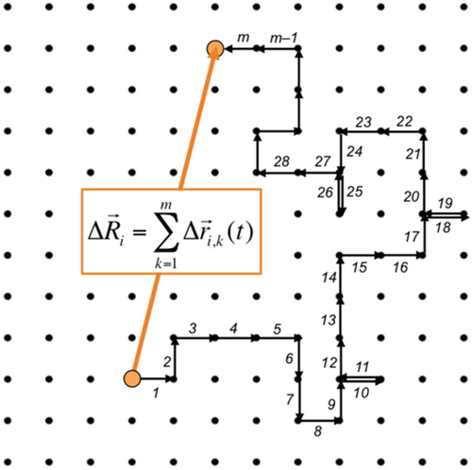
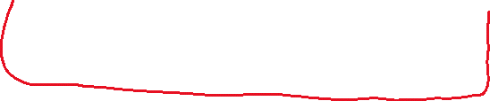
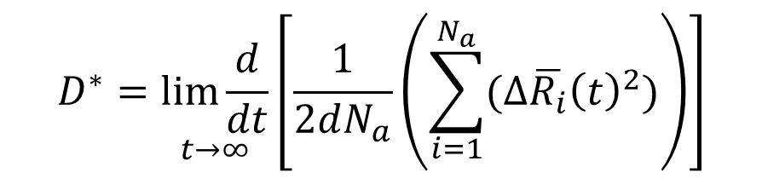
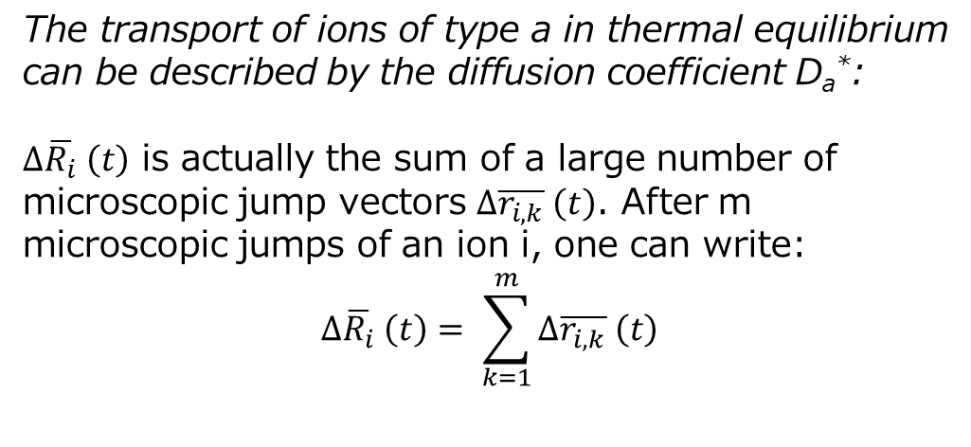
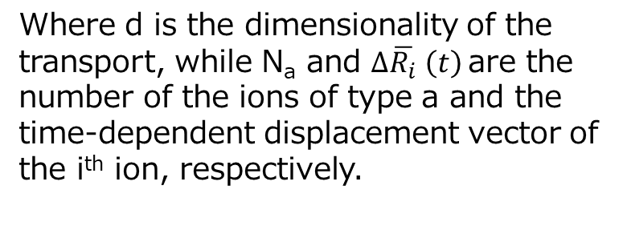

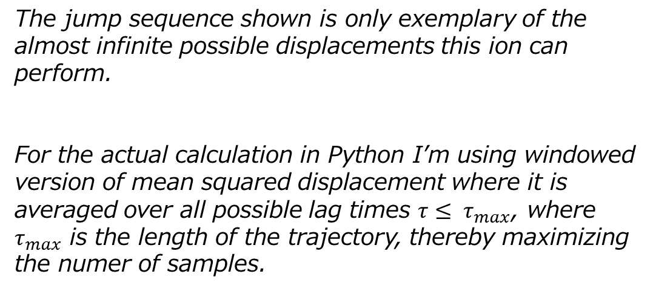
The transport of ions of type a in thermal equilibrium can be described by the diffusion coefficient D_{a}*:
$∆\overline{R_{i}} \left(t\right)$ is actually the sum of a large number of microscopic jump vectors $∆\overline{r_{i,k}} \left(t\right)$. After m microscopic jumps of an ion i, one can write:
$$∆\overline{R_{i}} \left(t\right)= \sum_{k=1}^{m}{∆\overline{r_{i,k}} \left(t\right)}$$
$$D^{∗}=\underset{t→∞}{lim\frac{d}{dt}}\left[\frac{1}{2dN_{a}}\left(\sum_{i=1}^{N_{a}}{(∆\overline{R_{i}}{\left(t\right)}^{2})}\right)\right]$$
Where d is the dimensionality of the transport, while N_{a} and $∆\overline{R_{i}} \left(t\right)$are the number of the ions of type a and the time-dependent displacement vector of the i^{th} ion, respectively.
The jump sequence shown is only exemplary of the almost infinite possible displacements this ion can perform.
For the actual calculation in Python I’m using windowed version of mean squared displacement where it is averaged over all possible lag times $τ≤ τ_{max}$, where $τ_{max}$ is the length of the trajectory, thereby maximizing the numer of samples.

Slide 14


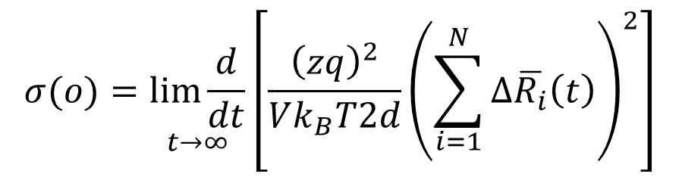
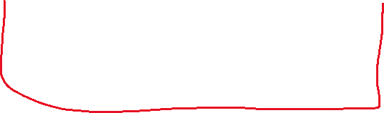
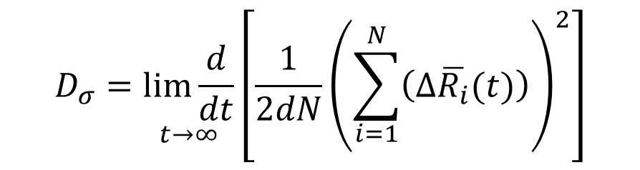
The bulk ionic conductivity can be calculated from the ion displacement vectors in thermal equilibrium in such a way (we assume single-ion conductivity with N mobile ions of the same type):
Often the Nernst-Einstein equation is used to define a conductivity diffusion coefficient:
$$σ(o)=\frac{N_{V}{\left(ze\right)}^{2}}{k_{B}T}D_{σ}$$
$$σ(o)=\underset{t→∞}{lim\frac{d}{dt}}\left[\frac{{\left(zq\right)}^{2}}{Vk_{B}T2d}{\left(\sum_{i=1}^{N}{∆\overline{R_{i}}\left(t\right)}\right)}^{2}\right]$$
Where N_{V} denotes the number density of ions.
Combining these two equations we obtain the expression for calculating d.c. ionic conductivity coefficient:
Where x and V are the charge number of the ions and the sample volume, respectively, while k_{B} and T denote Boltzmann’s constant and the temperature, respectively.
Note that for for the calculation of the tracer diffusion coefficient the displacement vectors are first squared and then added up, whereas the calculation of the ionic conductivity, the displacement vectors are first added up and then the sum vector is squared. This implies that directional correlations between the jump vectors of different ions influence the conductivity, but not the tracer diffusion coefficient.
$$D_{σ}=\underset{t→∞}{lim\frac{d}{dt}}\left[\frac{1}{2dN}{\left(\sum_{i=1}^{N}{\left(∆\overline{R_{i}}(t)\right)}\right)}^{2}\right]$$

Slide 15
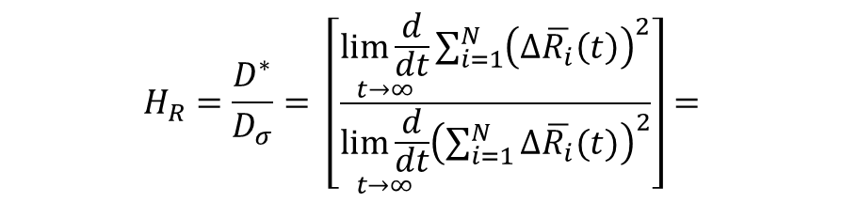
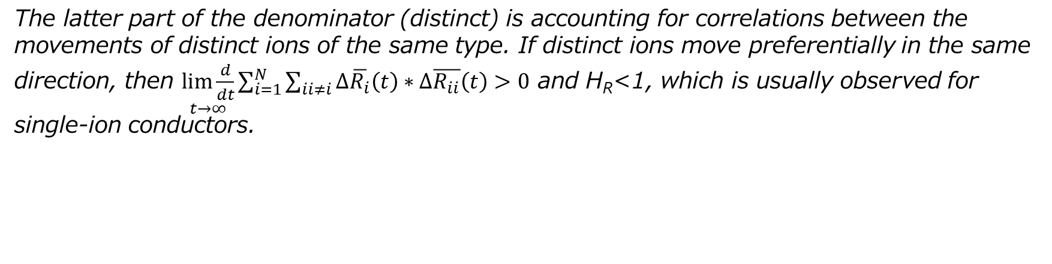

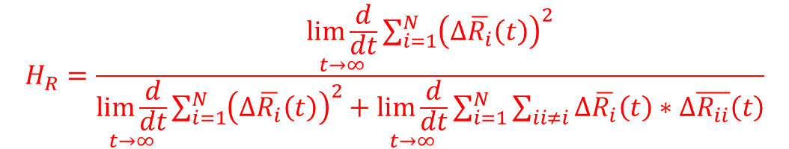
$$H_{R}=\frac{D^{∗}}{D_{σ}}= \left[\frac{\underset{t→∞}{lim\frac{d}{dt}}{\sum_{i=1}^{N}{{\left(∆\overline{R_{i}}\left(t\right)\right)}^{2}}}}{\underset{t→∞}{lim\frac{d}{dt}}{{\left(\sum_{i=1}^{N}{∆\overline{R_{i}}(t})\right)}^{2}}}\right]=$$
Dividing the tracer diffusion coefficient by the conductivity diffusion coefficient gives the Haven ratio:
$$H_{R}=\frac{\underset{t→∞}{lim\frac{d}{dt}}{\sum_{i=1}^{N}{{\left(∆\overline{R_{i}}\left(t\right)\right)}^{2}}}}{\underset{t→∞}{lim\frac{d}{dt}}{\sum_{i=1}^{N}{{\left(∆\overline{R_{i}}\left(t\right)\right)}^{2}}}+\underset{t→∞}{lim\frac{d}{dt}}{\sum_{i=1}^{N}{\sum_{ii≠i}{∆\overline{R_{i}}\left(t\right)∗∆\overline{R_{ii}}\left(t\right)}}}}$$
The latter part of the denominator (distinct) is accounting for correlations between the movements of distinct ions of the same type. If distinct ions move preferentially in the same direction, then $\underset{t→∞}{lim\frac{d}{dt}}{\sum_{i=1}^{N}{\sum_{ii≠i}{∆\overline{R_{i}}\left(t\right)∗∆\overline{R_{ii}}\left(t\right)}}}>0$ and H_{R}<1, which is usually observed for single-ion conductors.

Slide 16

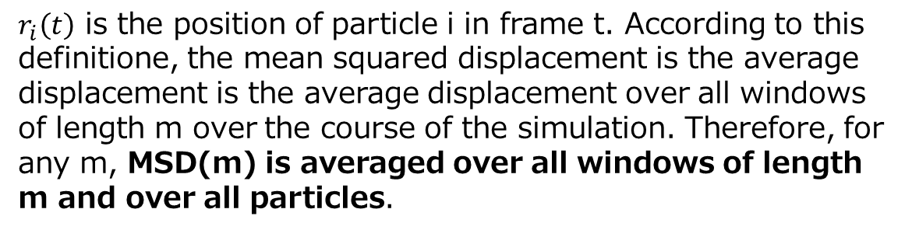
MSD calculation for actual usage in Python
$r_{i}\left(t\right)$ is the position of particle i in frame t. According to this definitione, the mean squared displacement is the average displacement is the average displacement over all windows of length m over the course of the simulation. Therefore, for any m, MSD(m) is averaged over all windows of length m and over all particles.

Slide 17
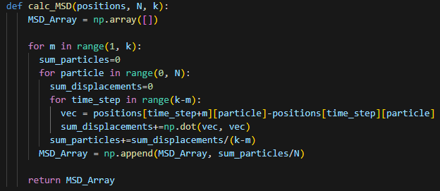
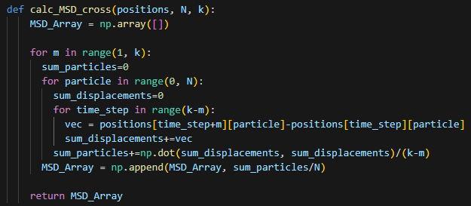
Code

Slide 18
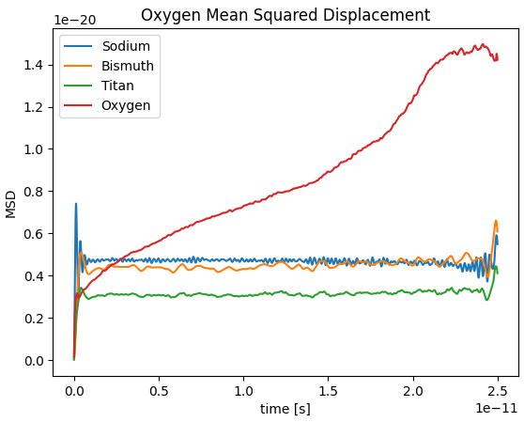
Tracer diffusion coefficients for every species of atoms
You can see that the atom responsible for ionic conductivity is oxygen

Slide 19
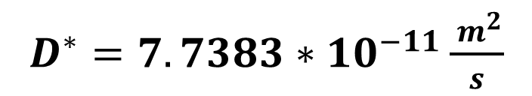
Tracer diffusion
$D^{∗}=7.7383∗10^{−11}\frac{{ m}^{2}}{s}$

Slide 20
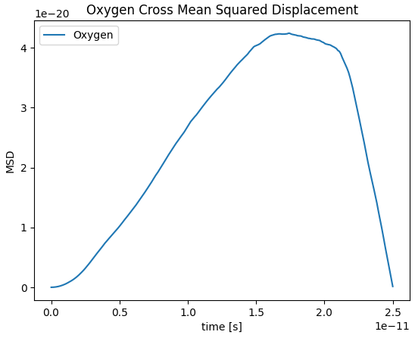
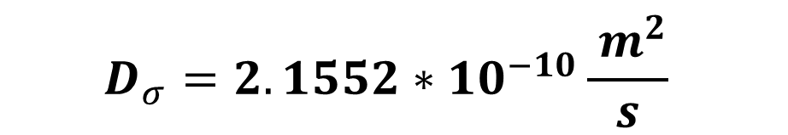
Ionic conductivity (tracer diffusion part + cross terms)
$$D_{σ}=2.1552∗10^{−10}\frac{{ m}^{2}}{s}$$

Slide 21
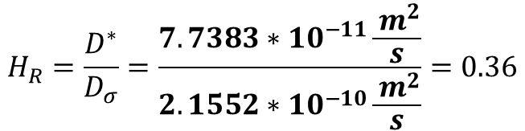
So the haven ratio from MSD/Einstein formalism is:
$$H_{R}=\frac{D^{∗}}{D_{σ}}=\frac{7.7383∗10^{−11}\frac{{ m}^{2}}{s}}{2.1552∗10^{−10}\frac{{ m}^{2}}{s}}=0.36$$

Slide 22
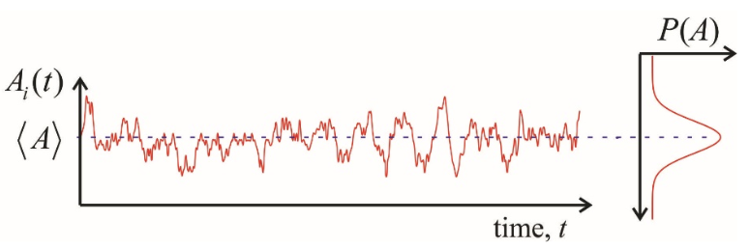
Auto-correlation functions/Green Kubo

Slide 23
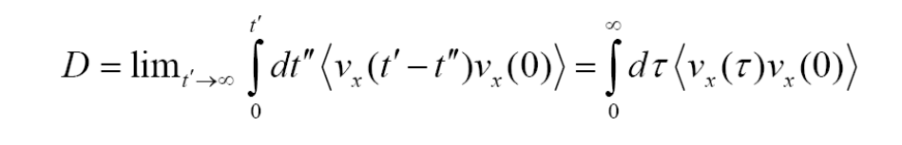
Green Kubo
The Green-Kubo formalism relates macroscopic properties (e.g. the diffusion coefficient) to microscopic properties (fluctuations of the equilibrium distribution).
Velocity-velocity autocorrelation function:

Slide 24
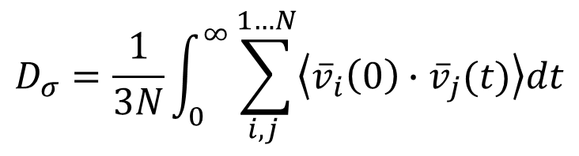
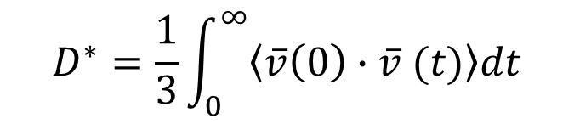
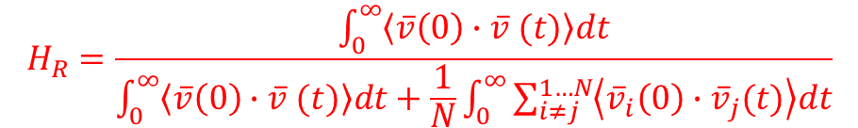
Ions move in some kind of collective fashion along fluctuating or predetermined pathways. There is continuing debate concerning the nature of these pathways regarding, for example, which structural features of the network are important, whether or not actual channels exist, and what kind of site relaxations may occur during the processes of ion transport. The simplest view, in the sense of making, the fewest assumptions is that these pathways are formed through a statistical selection proces, which is influenced but NOT ENTIRELY CONTROLLED by local variations in network structure. This seems to us to be a good starting point for the discussion of the observed pressure effects.
We identify three recurring features:
There are relatively few empty cation sites in glass
„Vacancy-like” mechanism
„Fast hopping” of ions relies to some extent on there being synergy between successive hops, which in turn implies a strong degree of CORRELATION between these bops
$$D^{∗}=\frac{1}{3}\int_{0}^{∞}{\left\langle \overline{v}\left(0\right)∙\overline{v} (t)\right\rangle dt}$$
$$D_{σ}=\frac{1}{3N}\int_{0}^{∞}{\sum_{i,j }^{1…N}{\left\langle {\overline{v}}_{i}\left(0\right)∙{\overline{v}}_{j}(t)\right\rangle dt}}$$
This denotes the vectorial velocity of ion number j at time t and N is the numer of MOBILE IONS in the system.
$$H_{R}=\frac{\int_{0}^{∞}{\left\langle \overline{v}\left(0\right)∙\overline{v} (t)\right\rangle dt}}{\int_{0}^{∞}{\left\langle \overline{v}\left(0\right)∙\overline{v} (t)\right\rangle dt}+\frac{1}{N}\int_{0}^{∞}{\sum_{i≠j }^{1…N}{\left\langle {\overline{v}}_{i}\left(0\right)∙{\overline{v}}_{j}(t)\right\rangle dt}}}$$
The experimental finding that the value of H_{R} is considerably smaller than unity proves the importance of the cross terms in the velocity correlation function

Slide 25
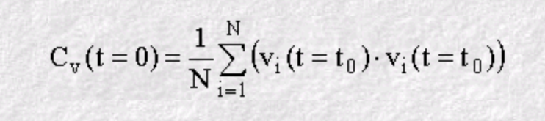
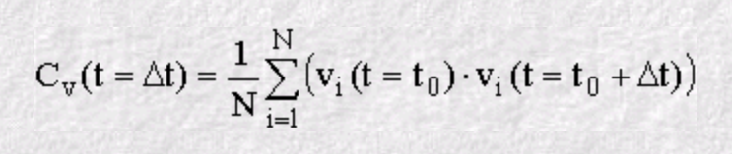
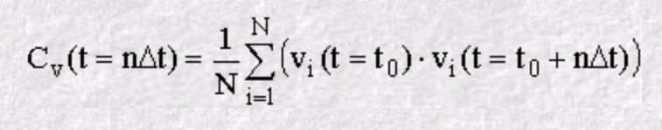
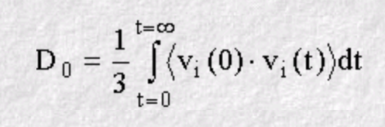
1.
Calculating velocity-velocity autocorrelation function step by step
2.
n.
We are dealing with 3 dimensions

Slide 26
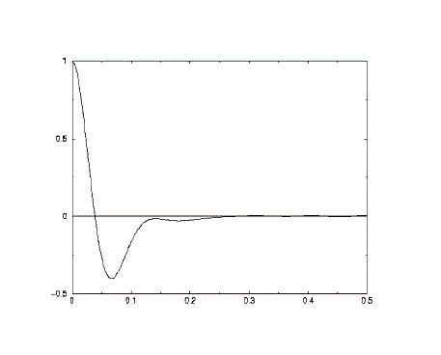

Velocity autocorrelation function
Consider a single atom at time zero. At that instant the atom (i) will have a specific velocity v_{i}. If the atoms in the system did not interact with each other, the Newton's Laws of motion tell us that the atom would retain this velocity for all time.
This of course means that all our points C_{v}(t) would have the same value, and if all the atoms behaved like this, the plot would be a horizontal line. It follows that a VAF plot that is almost horizontal, implies very weak forces are acting in the system.
On the other hand, what happens to the velocity if the forces are small but not negligible? Then we would expect both its magnitude and direction to change gradually under the influence of these weak forces. In this case we expect the scalar product of V_{i}(t=t₀) with V_{i}(t=t₀+nΔt) to decrease on average, as the velocity is changed. (In statistical mechanics we say that the velocity decorrelates with time, which is the same as saying the atom 'forgets' what its initial velocity was.) In such a system, the VAF plot is a simple exponential decay, revealing the presence of weak forces slowly destroying the velocity correlation. Such a result is typical of the molecules in a gas.
$$\text{C}\text{v}\text{(}\text{t}\text{) = < }\text{vi}\text{(0) . }\text{vi}\text{(}\text{t}\text{) >.}$$

Slide 27
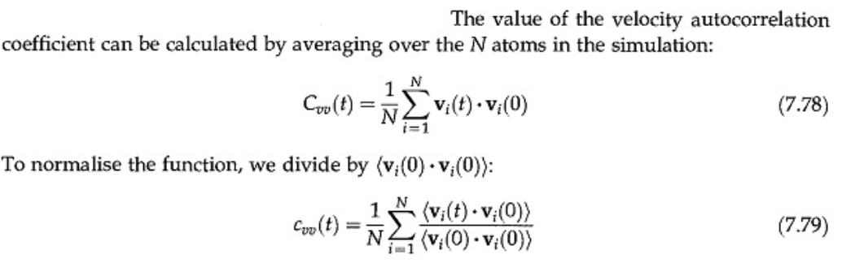

Slide 28
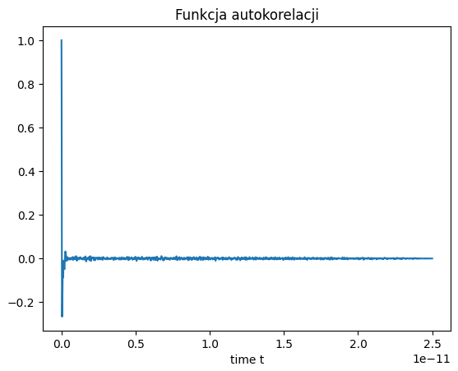

Tracer diffusion
autocorrelation
$$D^{∗}=9.53∗{10}^{−11}\frac{m}{s^{2}}$$

Slide 29
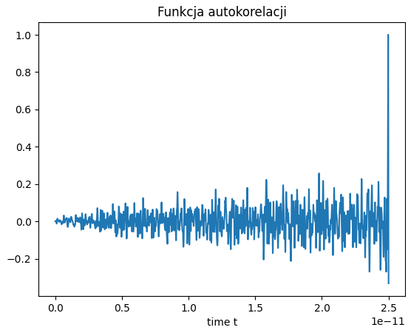

D.C. ionic conductivity
(tracer diffusion part + cross terms)
$$D_{σ}=4.24∗{10}^{−15}\frac{m}{s^{2}}$$

Slide 30
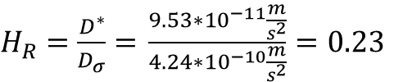
So the haven ratio from Green-Kubo formalism is:
$H_{R}=\frac{D^{∗}}{D_{σ}}=$ $\frac{9.53∗{10}^{−11}\frac{m}{s^{2}}}{4.24∗{10}^{−10}\frac{m}{s^{2}}}=0.23$

Slide 31
Bibliography
Salrin, T. C., Johnson, L., White, S., Kilpatrick, G., Weber, E., & Bragatto, C. (2023). Using LAMMPS to shed light on Haven’s ratio: Calculation of Haven’s ratio in alkali silicate glasses using molecular dynamics. In Frontiers in Materials (Vol. 10). Frontiers Media SA. https://doi.org/10.3389/fmats.2023.1123213
Imre, Á. W., Staesche, H., Voss, S., Ingram, M. D., Funke, K., & Mehrer, H. (2007). Pressure-Dependent Diffusion Coefficients and Haven Ratios in Cation-Conducting Glasses. In The Journal of Physical Chemistry B (Vol. 111, Issue 19, pp. 5301–5307). American Chemical Society (ACS). https://doi.org/10.1021/jp070478q
Kahnt, H. (1996). Ionic transport in glasses. In Journal of Non-Crystalline Solids (Vol. 203, pp. 225–231). Elsevier BV. https://doi.org/10.1016/0022-3093(96)00354-7
MURCH, G. (1982). The haven ratio in fast ionic conductors. In Solid State Ionics (Vol. 7, Issue 3, pp. 177–198). Elsevier BV. https://doi.org/10.1016/0167-2738(82)90050-9
Vargas‐Barbosa, N. M., & Roling, B. (2019). Dynamic Ion Correlations in Solid and Liquid Electrolytes: How Do They Affect Charge and Mass Transport? In ChemElectroChem (Vol. 7, Issue 2, pp. 367–385). Wiley. https://doi.org/10.1002/celc.201901627
https://www.ucl.ac.uk/~ucfbasc/Theory/vaf.html

Slide 32
Bibliography
Haarmann, L., & Albe, K. (2021). From ionic to superionic conductivity: The influence of cation order on sodium diffusion in Na3Zr2Si2PO12. In Solid State Ionics (Vol. 363, p. 115604). Elsevier BV. https://doi.org/10.1016/j.ssi.2021.115604
Maginn, E. J., Messerly, R. A., Carlson, D. J., Roe, D. R., & Elliot, J. R. (2020). Best Practices for Computing Transport Properties 1. Self-Diffusivity and Viscosity from Equilibrium Molecular Dynamics [Article v1.0]. In Living Journal of Computational Molecular Science (Vol. 2, Issue 1). University of Colorado at Boulder. https://doi.org/10.33011/livecoms.1.1.6324
Marrocchelli, D., Salanne, M., & Watson, G. W. (2013). Effects of Li-ion vacancies on the ionic conduction mechanism of LiMgSO4F. In Modelling and Simulation in Materials Science and Engineering (Vol. 21, Issue 7, p. 074003). IOP Publishing. https://doi.org/10.1088/0965-0393/21/7/074003
Vargas‐Barbosa, N. M., & Roling, B. (2019). Dynamic Ion Correlations in Solid and Liquid Electrolytes: How Do They Affect Charge and Mass Transport? In ChemElectroChem (Vol. 7, Issue 2, pp. 367–385). Wiley. https://doi.org/10.1002/celc.201901627
Mehrer, H. (2007). Diffusion in Solids. In Springer Series in Solid-State Sciences. Springer Berlin Heidelberg. https://doi.org/10.1007/978-3-540-71488-0
Varshneya, A. K., & Mauro, J. C. (2019). Permeation, diffusion, and ionic conduction in glass. In Fundamentals of Inorganic Glasses (pp. 383–424). Elsevier. https://doi.org/10.1016/b978-0-12-816225-5.00014-6
Terai, R., & Hayami, R. (1975). Ionic diffusion in glasses. In Journal of Non-Crystalline Solids (Vol. 18, Issue 2, pp. 217–264). Elsevier BV. https://doi.org/10.1016/0022-3093(75)90022-8

Slide 33
Bibliography
Kahnt, H. (1996). Ionic transport in glasses. In Journal of Non-Crystalline Solids (Vol. 203, pp. 225–231). Elsevier BV. https://doi.org/10.1016/0022-3093(96)00354-7
Sasaki, R., Gao, B., Hitosugi, T. et al. Nonequilibrium molecular dynamics for accelerated computation of ion–ion correlated conductivity beyond Nernst–Einstein limitation. npj Comput Mater 9, 48 (2023). https://doi.org/10.1038/s41524-023-00996-8
Kubisiak, P., & Eilmes, A. (2020). Estimates of Electrical Conductivity from Molecular Dynamics Simulations: How to Invest the Computational Effort. In The Journal of Physical Chemistry B (Vol. 124, Issue 43, pp. 9680–9689). American Chemical Society (ACS). https://doi.org/10.1021/acs.jpcb.0c07704
Klenk, M. J., & Lai, W. (2016). Finite-size effects on the molecular dynamics simulation of fast-ion conductors: A case study of lithium garnet oxide Li7La3Zr2O12. In Solid State Ionics (Vol. 289, pp. 143–149). Elsevier BV. https://doi.org/10.1016/j.ssi.2016.03.002

