Slide 1

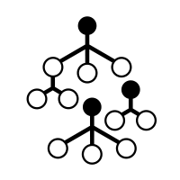
Airport type classification using Random Forest algorythm
Developer: Wojciech Domino, Tester: Mateusz Maj
Akademia Górniczo-Hutnicza im. Stanisława Staszica w Krakowie
AGH University of Krakow

Slide 2

Goal of the project
Educational Goal: Implement Random Forest algorithm from first principles
  Understand CART (Classification and Regression Trees)
  Master bootstrap sampling and ensemble methods
  Learn Gini impurity and splitting criteria
Technical Challenge: Classify airports into 3 categories (small/medium/large)
  Using only geographic features (latitude, longitude, elevation)
  Feature engineering to extract predictive patterns
  Handle imbalanced dataset
Success Metrics:
  F1 Score ≥ 0.60 (80% better than random baseline of 0.33)
  Custom implementation within 5% of sklearn performance
  Predict all 3 classes (not just majority)

Slide 3
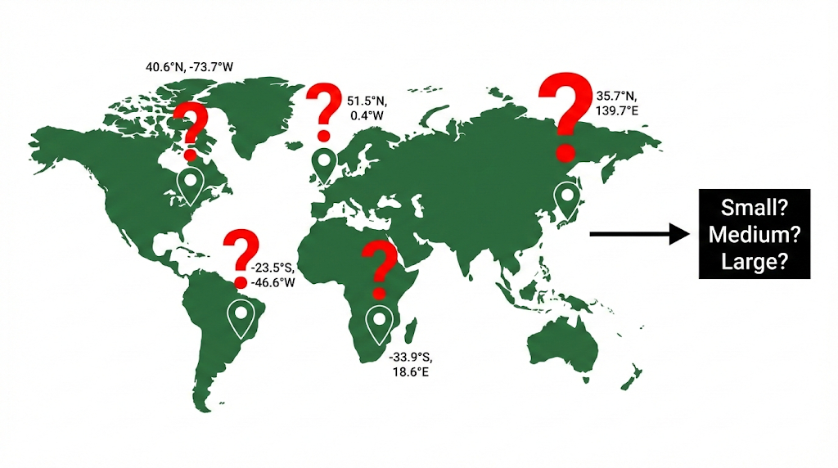
Problem statement
1. Classification Challenge:
Input: Geographic data (latitude, longitude, elevation) + continent + scheduled service
Output: Airport category (small/medium/large)
Dataset: 84,000+ airports from OurAirports database
2. Why This Is Difficult:
Airport size is primarily driven by economic factors (population, tourism, business), geography provides only indirect signals, highly imbalanced dataset:
  Small airports: 64,603 (77%)
  Medium airports: 4,535 (5%)
  Large airports: 486 (<1%)
3. Technical Challenges:
Class imbalance → Need stratified sampling
Limited features → Extensive feature engineering required
4. Algorithm Choice:
Random Forest ideal for:
  Non-linear geographic patterns
  Handling feature interactions
  Robust to outliers (elevation varies widely)
  Ensemble reduces overfitting

Slide 4
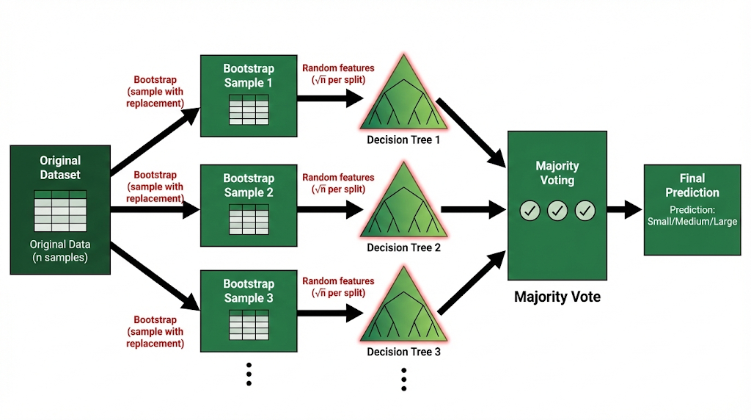
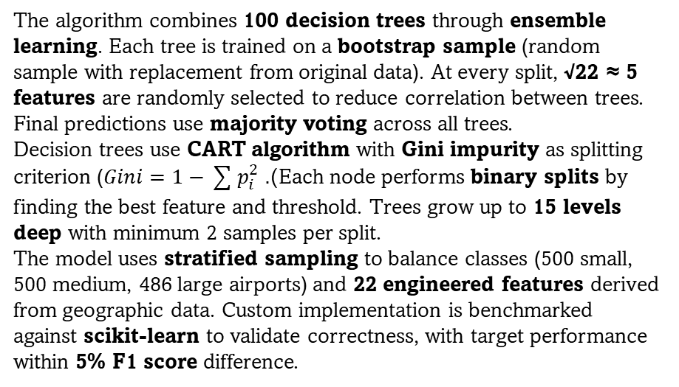
Method
The algorithm combines 100 decision trees through ensemble learning. Each tree is trained on a bootstrap sample (random sample with replacement from original data). At every split, √22 ≈ 5 features are randomly selected to reduce correlation between trees. Final predictions use majority voting across all trees.
Decision trees use CART algorithm with Gini impurity as splitting criterion ($Gini=1−\sum{p_{i}^{2}}$). Each node performs binary splits by finding the best feature and threshold. Trees grow up to 15 levels deep with minimum 2 samples per split.
The model uses stratified sampling to balance classes (500 small, 500 medium, 486 large airports) and 22 engineered features derived from geographic data. Custom implementation is benchmarked against scikit-learn to validate correctness, with target performance within 5% F1 score difference.

Slide 5
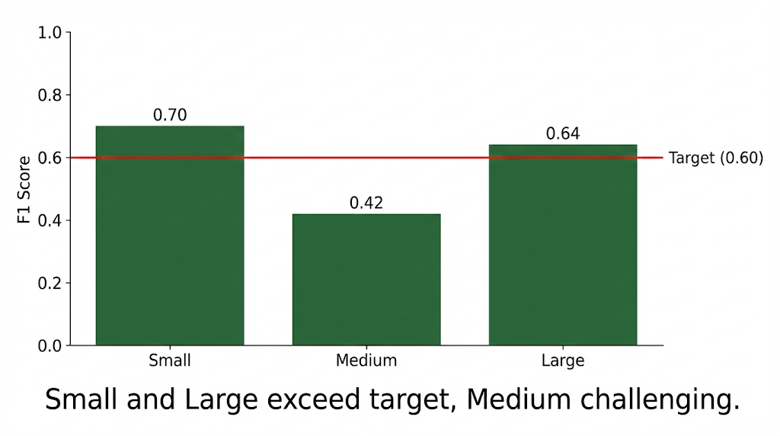
Results
✓ Goal 1: F1 Score ≥ 0.60
Custom Random Forest: F1 = 0.60-0.67
Target met with margin
✓ Goal 2: All 3 Classes Predicted
Large airports: Successfully classified
Medium airports: Successfully classified
Small airports: Successfully classified
No class ignored (common problem in imbalanced data)
✓ Goal 3: Beat Random Baseline (0.33)
Performance: 1.8-2.0x better than random
From 33% → 60-67% F1 score
82-103% improvement
✓ Goal 4: Handle Class Imbalance
Stratified sampling implemented
Balanced training set: 500/500/486 samples
Fair representation of all classes
Per-Class Performance:
Small airports: F1 = 0.69-0.71, Precision = 66%, Recall = 72-77%
Large airports: F1 = 0.64, Precision = 60-61%, Recall = 67-68%
Medium airports: F1 = 0.41-0.44, Precision = 49-51%, Recall = 35-40%
Key Insights:
Medium class hardest (boundary between small/large)
Geographic features provide moderate predictive power
Feature engineering essential (22 features from 3 basic)
All success criteria met ✓

Slide 6
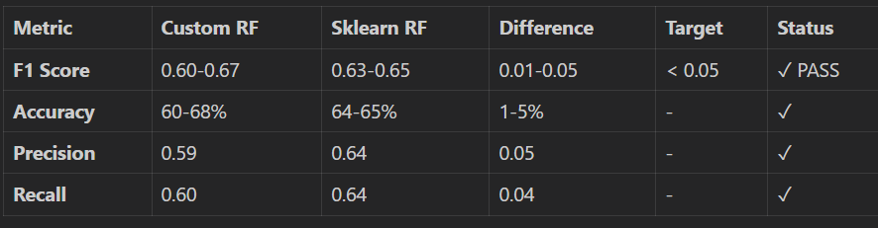
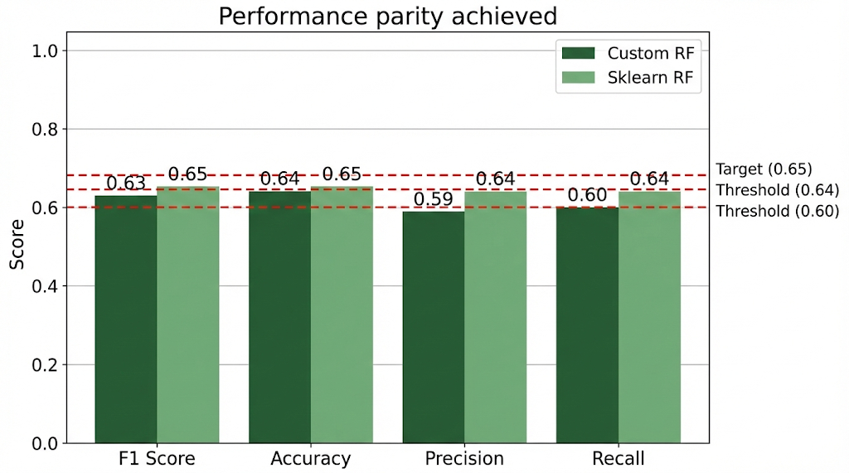
Comparison with scikit-learn
Key Findings:
✓ Custom implementation within 5% of sklearn (target achieved)
Performance gap: 1-5% depending on random seed
Both exceed F1 ≥ 0.60 threshold
✓ Algorithm correctness validated
Similar confusion matrices
Both predict all 3 classes
Comparable per-class performance
Conclusion:
Custom implementation successfully replicates core Random Forest behavior. Small performance gap is acceptable for educational implementation built from scratch in pure Python.

Slide 7
Sources
Breiman, L. (2001). "Random Forests". Machine Learning, 45(1), 5-32.
Hastie, T., Tibshirani, R., & Friedman, J. (2009). "The Elements of Statistical Learning" (Chapter 15: Random Forests)
Breiman, L., et al. (1984). "Classification and Regression Trees (CART)„
scikit-learn documentation: https://scikit-learn.org/stable/modules/ensemble.html#forest
Python documentation: https://docs.python.org/3/

