Slide 1
Designing courses that minimize cognitive overload in learners
William Okech, PhD
Digital Research Academy (TTT)
29/08/2023

Slide 2
Overall Goal
To outline a methodology for designing courses that
minimize cognitive overload in learners
Notes:
Intro

Slide 3
Outline
Part I: Theories of Memory Processing and Learning
Information Processing Theory
Cognitive Load Theory
Part II: Cognitive Load Theory and Course Design
Identify Learner Personas / Types
Mental Models
Formative Assessments
Improving Course Content and Delivery

Slide 4
Learning Objectives
Describe the main types of cognitive load and the limits of human memory.
Explain the differences between various learner types / personas.
Define mental models and create concept maps.
Create formative assessments that diagnose flawed mental models.

Slide 5
Part I: Theories of Memory Processing and Learning

Slide 6
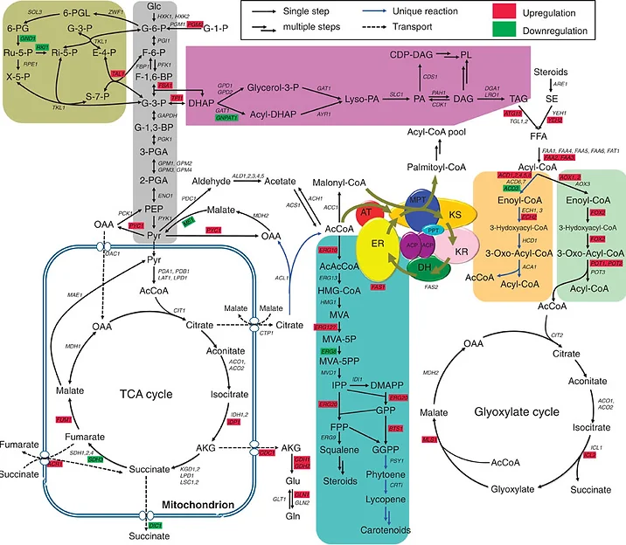
Prof. X’s Biochemistry 101 Lecture
Today we will learn about
metabolic pathways!
Prof. X
1. https://monicanasseri.wixsite.com/biochemical-pathways/biochemical-pathways

Slide 7
Information Processing Theory
and Cognitive Load

Slide 8
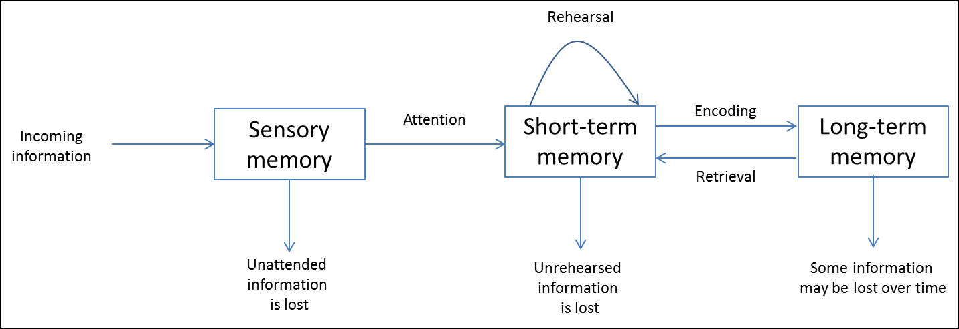
1. Information Processing Theory
A framework for understanding how information is encoded into memory
1. Atkinson and Shiffrin (1968) Psychology of Learning and Motivation (2) 89-195
2. https://www.simplypsychology.org/multi-store.html

Slide 9
2. Cognitive Load
Available amount of information that the working / short-term memory can hold at a specific time (7 +/- 2 chunks of info at a time)
1. Atkinson and Shiffrin (1968) Psychology of Learning and Motivation (2) 89-195
2. https://www.simplypsychology.org/multi-store.html

Slide 10
3. Cognitive Load Theory
Describes how the human mind processes new information
3 Main Types of Cognitive Load
Intrinsic
Extraneous
Germane
Sweller, J. (1998) Cognitive Science 12(2): 257-285
https://mcdreeamiemusings.com/blog/2019/10/15/the-good-the-bad-and-the-can-be-ugly-the-three-parts-of-cognitive-load

Slide 11

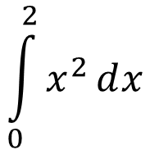
3. Cognitive Load Theory
Intrinsic
Innate difficulty of a task and complexity of new information.
Influenced by age and/or educational background.
Example: High School Math Student
$$\int_{0}^{2}{x^{2}ⅆx}$$
$$2×4=8$$
Increasing Load
Low Load
High Load
Sweller, J. (1998) Cognitive Science 12(2): 257-285
https://mcdreeamiemusings.com/blog/2019/10/15/the-good-the-bad-and-the-can-be-ugly-the-three-parts-of-cognitive-load

Slide 12
3. Cognitive Load Theory
Extraneous
Load due to poorly designed instructional material.
Distracts working memory from processing the required information.
Sweller, J. (1998) Cognitive Science 12(2): 257-285
https://mcdreeamiemusings.com/blog/2019/10/15/the-good-the-bad-and-the-can-be-ugly-the-three-parts-of-cognitive-load

Slide 13

3. Cognitive Load Theory
Extraneous
Examples
Useless Animations
Use of unnecessarily complex words
Sagacious vs. Wise
Memes
Other forms of load:
Software freezing
Files not loading
Links not working/paywalls
Internet and connectivity issues
Sweller, J. (1998) Cognitive Science 12(2): 257-285
https://mcdreeamiemusings.com/blog/2019/10/15/the-good-the-bad-and-the-can-be-ugly-the-three-parts-of-cognitive-load

Slide 14
3. Cognitive Load Theory
Germane
Mental capacity used to integrate new information with existing knowledge
Effort required to learn and retain the material
Influenced by level of training (Math Professor vs 1st grader)
Sweller, J. (1998) Cognitive Science 12(2): 257-285
https://mcdreeamiemusings.com/blog/2019/10/15/the-good-the-bad-and-the-can-be-ugly-the-three-parts-of-cognitive-load

Slide 15
3. Cognitive Load Theory
Summary
Intrinsic
Simplify
Extraneous
Reduce
Germane
Maximize
1. https://mcdreeamiemusings.com/blog/2019/10/15/the-good-the-bad-and-the-can-be-ugly-the-three-parts-of-cognitive-load

Slide 16
Formative Assessment
Link in zoom chat
https://app.sli.do/event/oURSecWo4Su1juP7z13aKW

Slide 17
Extra credit: Short test of working memory
https://miku.github.io/activememory/
Can try during your free time / breaks
Notes:
Link in

Slide 18
Break
5 minutes

Slide 19
Part II: Cognitive Load Theory and Course Design

Slide 20
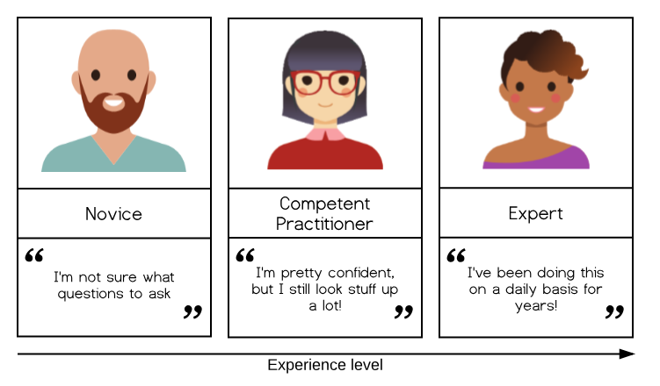
1. Identify Learner Personas / Types
Learners can be distinguished by the mental models
they use to solve problems
1. https://carpentries.github.io/instructor-training/
2. Benner P. (2004) Bulletin of Science, Technology & Society, 24(3), 188–199

Slide 21
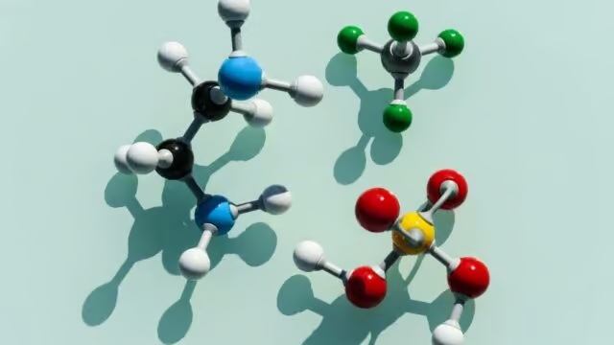
2. Mental models
“A simplified representation of the most important parts of some problem domain that is good enough to enable problem solving.”
Limitations
Simplified representation.
Atoms are not balls and sticks are not bonds.
Ball-and-stick model
https://commoncog.com/teaching-tech-together/
https://education.riaus.org.au/a-better-way-to-see-molecules/

Slide 22
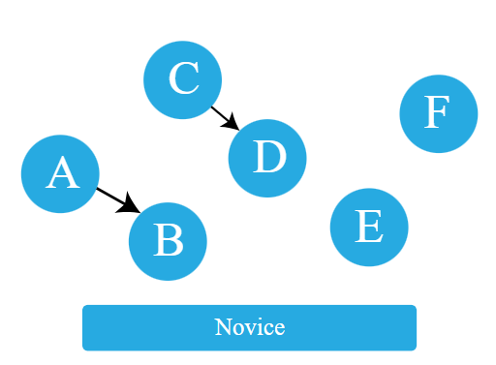
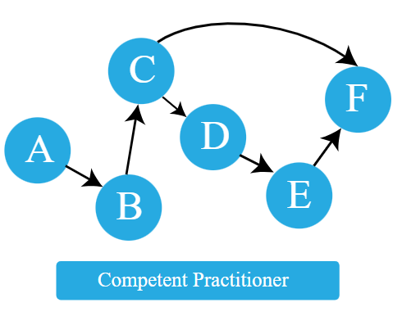
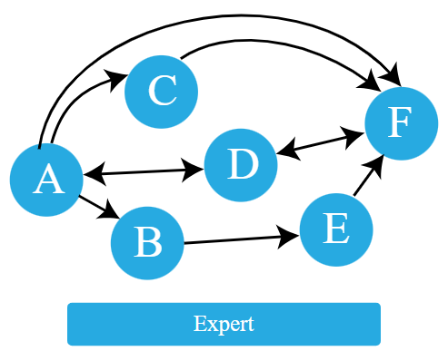
2. Mental models
1. https://carpentries.github.io/instructor-training/

Slide 23
2. Mental models
Easy task for expert
Difficult for Novice
Symptoms
A
B
C
Diagnosis
Normal task for competent practitioner

Slide 24
3. Formative Assessments
Help to identify common misconceptions and broken mental models
Factual errors: The Capital City of Sweden is Doha.
Broken models: Motion and acceleration must always be in the same direction.
Fundamental beliefs: Some people are computational and others are not.
1. https://carpentries.github.io/instructor-training/

Slide 25
3. Formative Assessments
Example
Q: What is 27 + 15 ?
a) 42
b) 32
c) 312
d) 33
Correct
Forgotten to carry the 1
Treating each column independently
Carrying the 1 to the same column
Each incorrect answer has diagnostic power and will guide correction
1. https://carpentries.github.io/instructor-training/

Slide 26
3. Formative Assessments
Memory management
ggplot(data = …, aes(x = …, y = …)) +
geom_point()
B. geom_point() +
ggplot(data = …, aes(x = …, y = …))
C. (data = …) +
ggplot(aes(x = …, y = …)) +
geom_point()
Parson's Problem

Slide 27
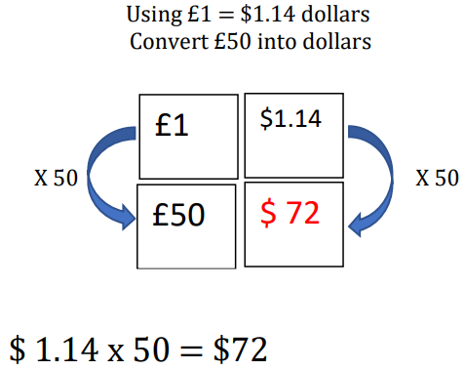
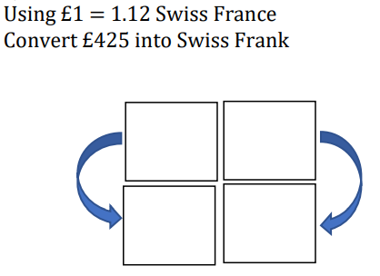
3. Formative Assessments
Memory management
Faded Example
1. https://taylorda01.weebly.com/backward-faded-maths.html

Slide 28
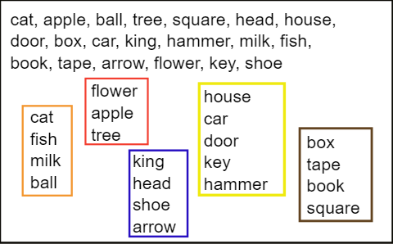
4. Improving course content and delivery
Chunking
Commonly used
Ideal
1. https://carpentries.github.io/instructor-training/

Slide 29
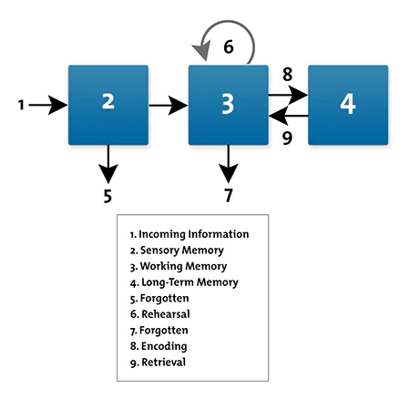
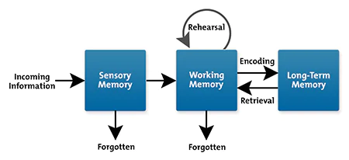
4. Improving course content and delivery
Reduce split-attention effect
vs
1. MindTools: https://www.mindtools.com/aqxwcpa/cognitive-load-theory

Slide 30
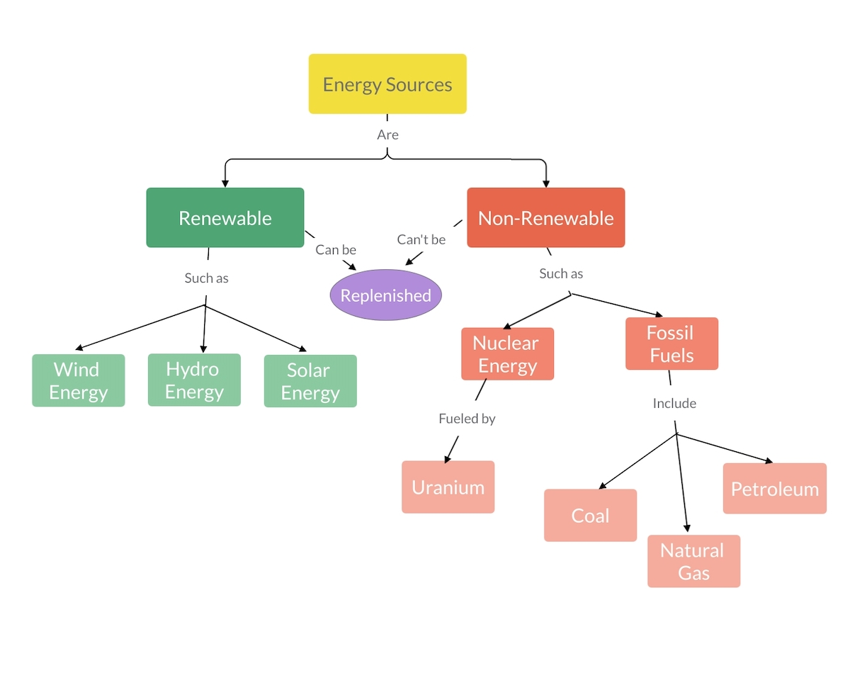
4. Improving course content and delivery
Encourage the use of concept maps
Discussion
Renewable and Non-renewable
Energy Sources
https://visme.co/blog/how-to-make-a-concept-map/

Slide 31
4. Improving course content and delivery
Go slow and repeat if necessary
Be aware of expert blind spots
Use authentic tasks and examples to teach
Give and receive appropriate feedback
https://carpentries.github.io/instructor-training/

Slide 32
Conclusions
Cognitive load and working / short-term memory have a significant impact on learning outcomes.
Knowledge of learner types and personas and the mental models they use is critical for effective teaching.
Formative assessments should be incorporated into lessons to identify misconceptions and receive teaching feedback.

Slide 33

References
https://monicanasseri.wixsite.com/biochemical-pathways/biochemical-pathways
Atkinson and Shiffrin (1968) Psychology of Learning and Motivation (2) 89-195
https://www.simplypsychology.org/multi-store.html
Sweller, J. (1998) Cognitive Science 12(2): 257-285
https://mcdreeamiemusings.com/blog/2019/10/15/the-good-the-bad-and-the-can-be-ugly-the-three-parts-of-cognitive-load
https://carpentries.github.io/instructor-training/
Benner P. (2004) Bulletin of Science, Technology & Society, 24(3), 188–199
https://commoncog.com/teaching-tech-together/
https://education.riaus.org.au/a-better-way-to-see-molecules
https://www.mindtools.com/aqxwcpa/cognitive-load-theory
https://visme.co/blog/how-to-make-a-concept-map/
https://teachtogether.tech/

Slide 34
Discussion Questions
Where have you identified “expert blind spots” in your own teaching?
How can you reduce cognitive overload in the subjects that you teach?
Based on what you have learnt, how will you structure your courses differently?

