Slide 1
Developing library-based computational research skill instruction programs
William Okech, PhD
05/15/2023

Slide 2
Overall Goal
To outline a methodology for developing a computational research skill instruction program centered in libraries that will support learners with diverse disciplinary and educational backgrounds.

Slide 3
Outline
Importance of computational research skills
Effective teaching of computational research skills
Sample lesson and problem
Challenges associated with teaching computational research skills
Conclusions

Slide 4
Importance of Computational Research Skills

Slide 5
Importance of Computational Research Skills
Why are computational research skills important for everyone?
“Computational thinking is a fundamental skill for everyone, not just computer scientists.” (Wing, 2006)
Major components of computational thinking include:
Decomposition – break down a complex problem to multiple simpler problems.
Pattern recognition – identify patterns in the data or information.
Abstraction – identify and use the relevant aspects of the problem.
Algorithmic thinking – design algorithms to solve problems.
Wing, J (2006) Comm. ACM, 49 (3):33-35
Grover, S and Pea, R (2012) Educational Researcher, 42 (1):38-43

Slide 6
Importance of Computational Research Skills
Why are computational research skills important for everyone?
New career opportunities and increased competitiveness in the job market.
Employment of software developers is projected to grow by 25% (~400k jobs) between 2021 and 2031 (Bureau of Labor Statistics).
Subject-matter experts with computational research skills are required to build new tools/technologies. Examples include:
Computational linguists – develop new language-learning apps.
Data journalists – develop fact-checking and misinformation detectors.
https://www.bls.gov/ooh/computer-and-information-technology/software-developers.htm#tab-6
Notes:
Intro

Slide 7
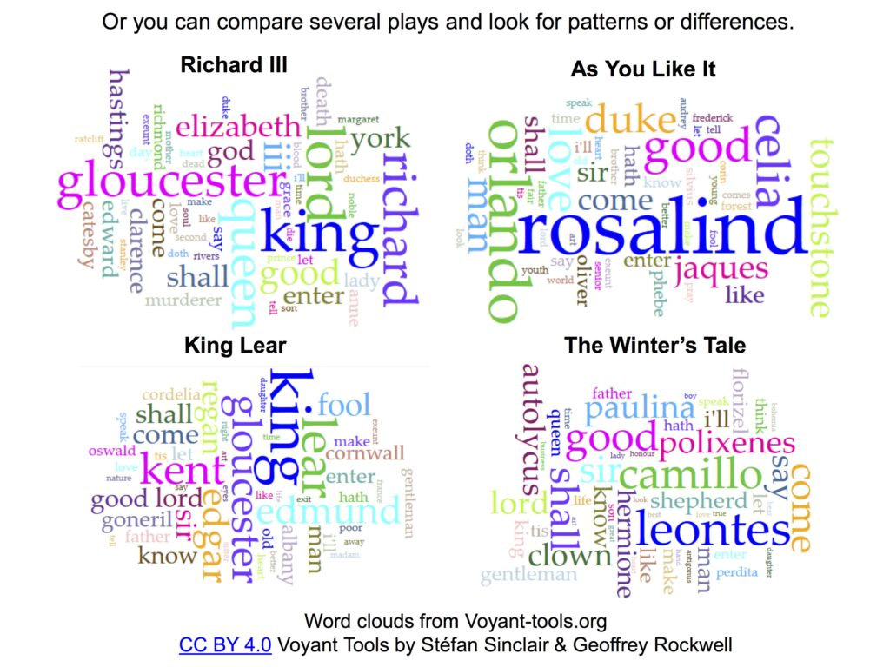
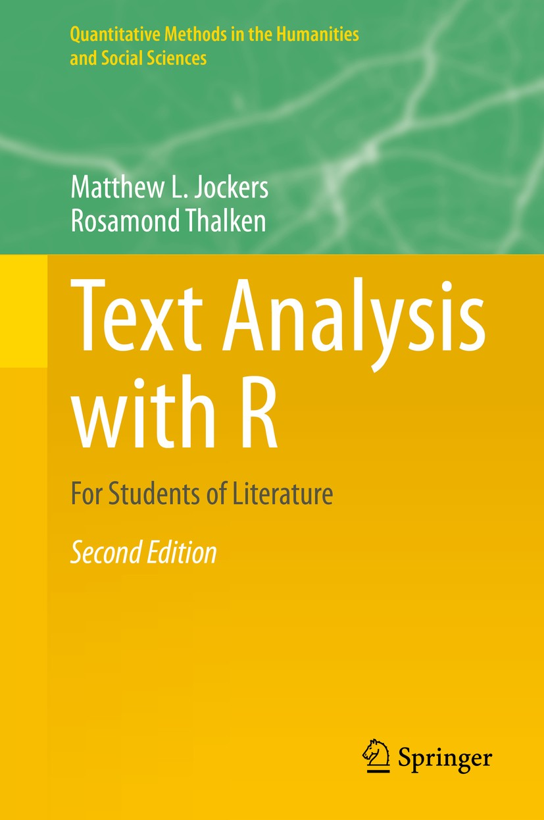
Importance of Computational Research Skills
Where can computational research be applied in the humanities?
Text analysis for Literature Students
Plays by Shakespeare
1. Jockers and Thalken (2020) Text Analysis with R for Students of Literature
2. https://kennedyhq.com/wp/2016/11/19/shakespeare-through-digital-humanities-textual-analysis/

Slide 8
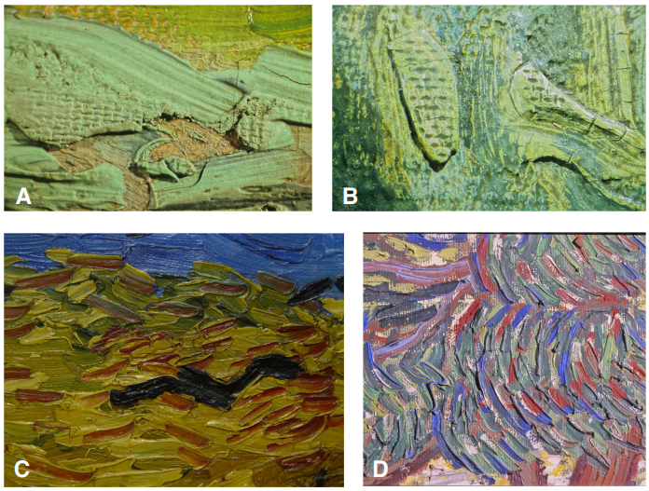
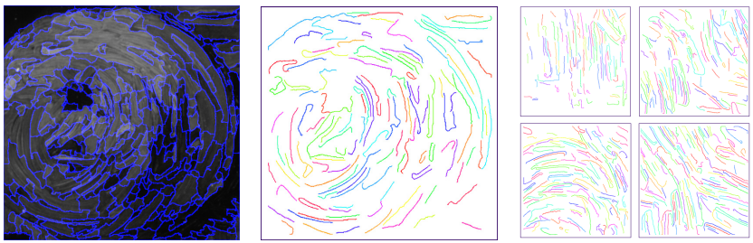
Importance of Computational Research Skills
Where can computational research be applied in the humanities?
Image Processing for Artist Identification (useful in Fine Arts)
Brushstroke analysis
Portions of van Gogh’s paintings
C. R. Johnson et al. (2008) IEEE Signal Processing Magazine, 25(4): 37-48

Slide 9
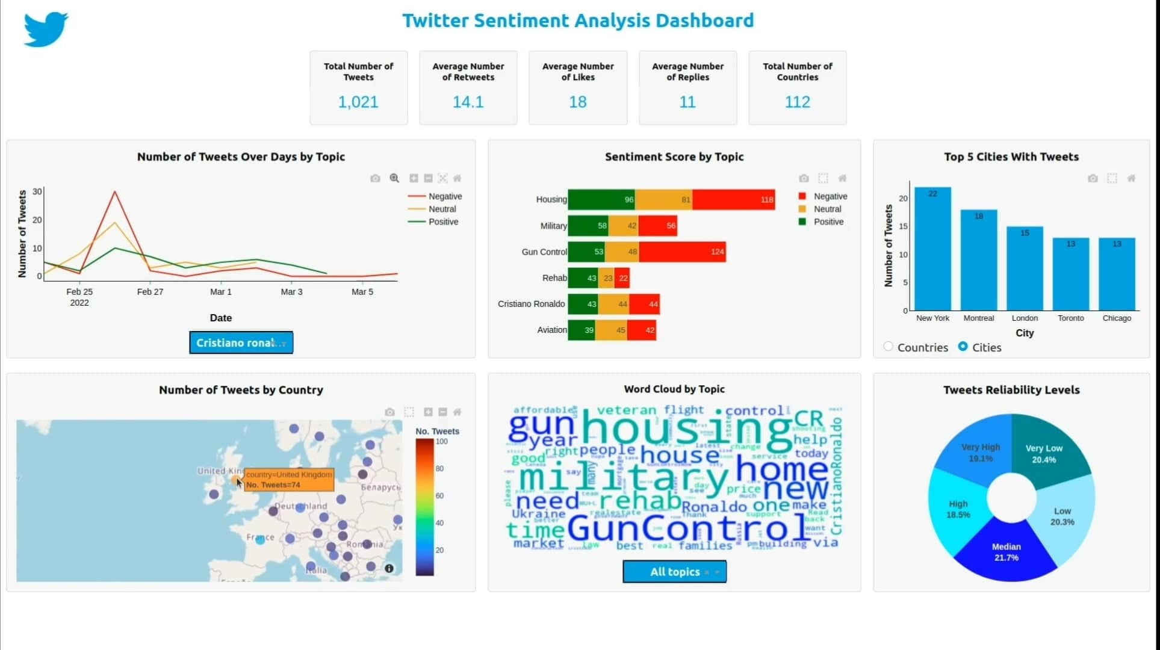
Importance of Computational Research Skills
Where can computational research be applied in the humanities?
Sentiment Analysis and Social Media (useful in Political Science & Journalism)
https://github.com/Mazen72/Twitter_Sentiment_Analysis_Dashboard

Slide 10
Importance of Computational Research Skills
Where can computational research be applied in the humanities?
Computational Research Skill | Humanities Research Field
Text Analysis | Ancient and Modern Languages
Data wrangling of census data | History and Political Science
Image processing | Art History and Film Studies
Spatial data analysis | Geography
Audio analysis | Music
Martyn Jessop (2004) Ubiquity, ACM

Slide 11
Importance of Computational Research Skills
What computational research skills are important?
This can be determined with a needs analysis using:
Surveys and Questionnaires sent to humanities departments,
Literature reviews focused on computing education research,
Interviews with faculty and staff from humanities departments.

Slide 12
Summary
Computational research skills are essential for everyone.
Humanities students can greatly benefit from computational research skills by:
Exploring new research directions, and,
Increasing their employment options.
Martyn Jessop (2004) Ubiquity, ACM

Slide 13
Effective teaching of computational research skills

Slide 14
Effective teaching of computational research skills
Recognize the diversity of needs
Engineering and Physical Sciences
Life
Sciences
Social Sciences and Humanities
vs
vs
Increasing need for computational research skills

Slide 15
Effective teaching of computational research skills
What activities should the instruction program focus on?
Workshops – where the most common computational tasks and the needs identified by graduate students are taught.
Office hours – supervised by an undergraduate/graduate student with a background in computational research.
Mentoring - pair humanities graduate students with computational science students.
Bootcamps – focused on specific data analysis tools/programs.
Journal/Data clubs – where new and relevant tools, techniques, and software packages will be demonstrated.

Slide 16




Effective teaching of computational research skills
A number of independent initiatives exist to train the general public in basic data and computational skills. These include:
Goal: To teach foundational coding and data science skills to researchers worldwide.
Fundamental data skills needed to conduct research.
Software and data skills for library and information-related communities.
Lab skills for research computing.
https://carpentries.org/

Slide 17


Effective teaching of computational research skills
A number of independent initiatives exist to train the general public in basic data and computational skills. These include:
Goal: Teach all the essential tools which are usually skipped in academic education so everyone can make full use of software, computing, and data.
Framework for Open and Reproducible
Research Training
https://coderefinery.org/ | https://forrt.org/

Slide 18
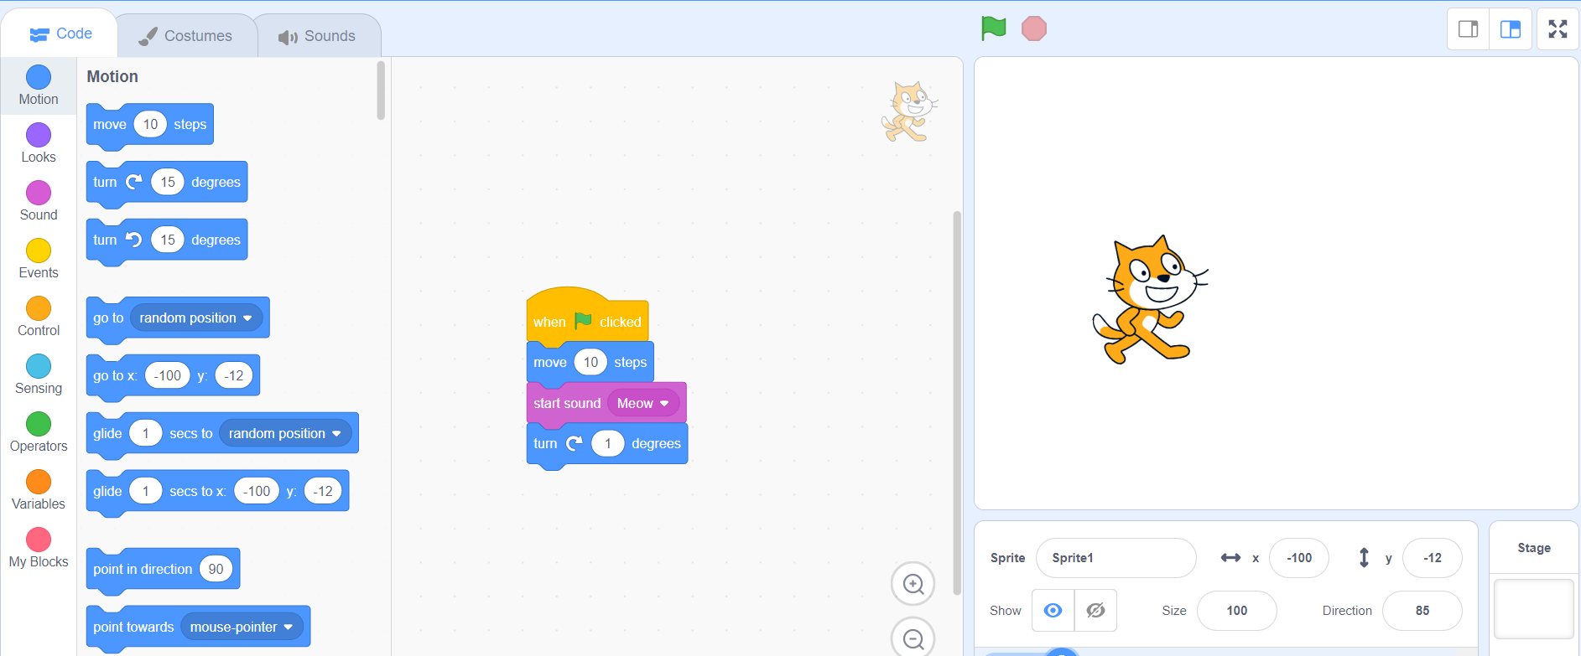
Effective teaching of computational research skills
What should novice coders learn? (My personal opinion)
Scratch (block-based visual programming language) for complete novices.
Help new coders learn the basics of programming, such as loops, conditionals, and variables.
Scratch: https://scratch.mit.edu/

Slide 19
Effective teaching of computational research skills
What should novice/advanced beginners learn? (My personal opinion)
Basics of programming
Data wrangling
Data analysis
Data visualization

Slide 20
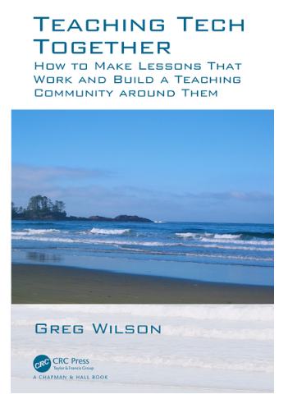
Effective teaching of computational research skills
Key points for teaching novice coders
Use live coding.
Embrace coding errors as an opportunity to teach debugging.
Use “worked examples” and pace learning to avoid cognitive overload.
Encourage working in pairs and group coding.
Promote daily practice.

Slide 21
Effective teaching of computational research skills
Key points for teaching novice coders
Learn student personas and adapt lessons to suit each student.
Give effective feedback that motivates.
Create learning goals for students.
Use real-life tasks relevant to student research.

Slide 22
Sample Lesson and Problem

Slide 23

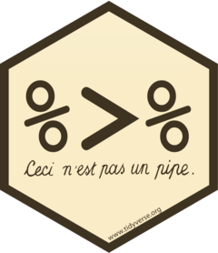
Sample Lesson and Problem
Data Manipulation in R
dplyr is a grammar of data manipulation
“pipe” function for combining a sequence of operations.
www.tidyverse.org

Slide 24
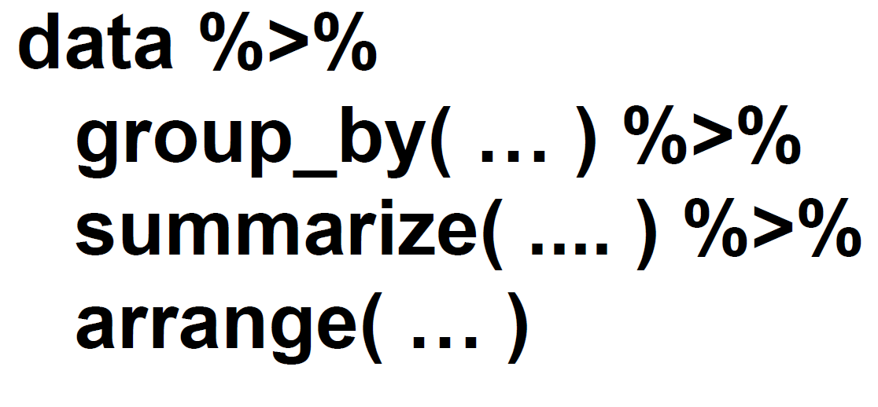
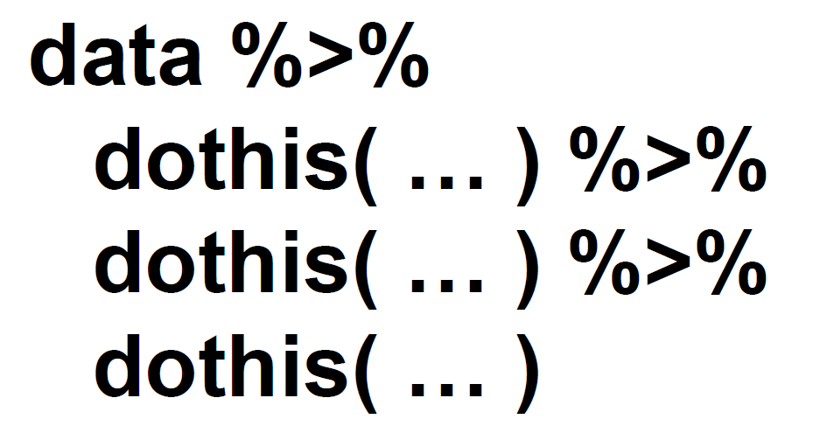
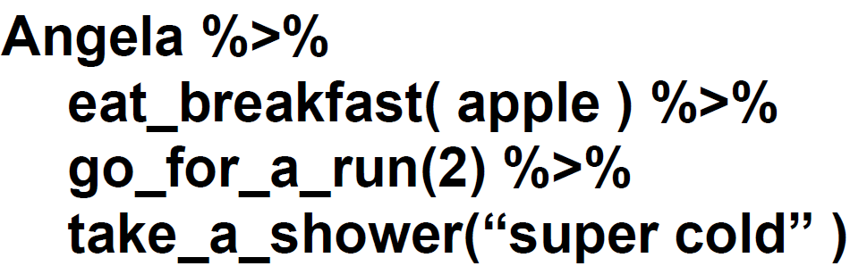
Sample Lesson and Problem
Data Manipulation in R
1. To demonstrate the role of the pipe operator
2. To demonstrate the sequence/order of operations
www.carpentries.org

Slide 25

Sample Lesson and Problem
Data Visualization in R
Parson's Problem
ggplot(data = …, aes(x = …, y = …)) +
geom_point()
B. geom_point() +
ggplot(data = …, aes(x = …, y = …))
C. (data = …) +
ggplot(aes(x = …, y = …)) +
geom_point()
system for declaratively creating graphics
www.tidyverse.org

Slide 26
Challenges associated with teaching computational research skills

Slide 27
Challenges associated with teaching computational research skills
Barriers to overcome include:
Attitudes towards coding.
The variety of needs (even within humanities):
Example: Psychology vs Literature.
Over-reliance on no-code commercially available tools and a lack of willingness to change.

Slide 28
Challenges associated with teaching computational research skills
What students should avoid:
Learning too much at once without mastering the basics.
Continuously working on tutorials but not applying knowledge to personal projects.
Copy-and-pasting code rather than understanding why the code was used.
Learning multiple tools/programs simultaneously (such as Python, R, and Javascript).

Slide 29
Conclusions

Slide 30
Conclusions
Computational thinking is for everyone.
Computational research skills can be very helpful for humanities students.
Various initiatives such as the Carpentries and CodeRefinery have devised effective blueprints for teaching.
Novices should consider starting with visual block-based programming.
There is a need to teach students effective learning practices and overcome the barriers to coding.
Teaching should be adapted to different student abilities and should include motivational feedback.

Slide 31
Questions

