Slide 1
Woking Speakers
Why the new website is worth switching to
A side-by-side look at wokingspeakers.org.uk today vs the proposed replacement, with the page facts checked live.

Slide 2
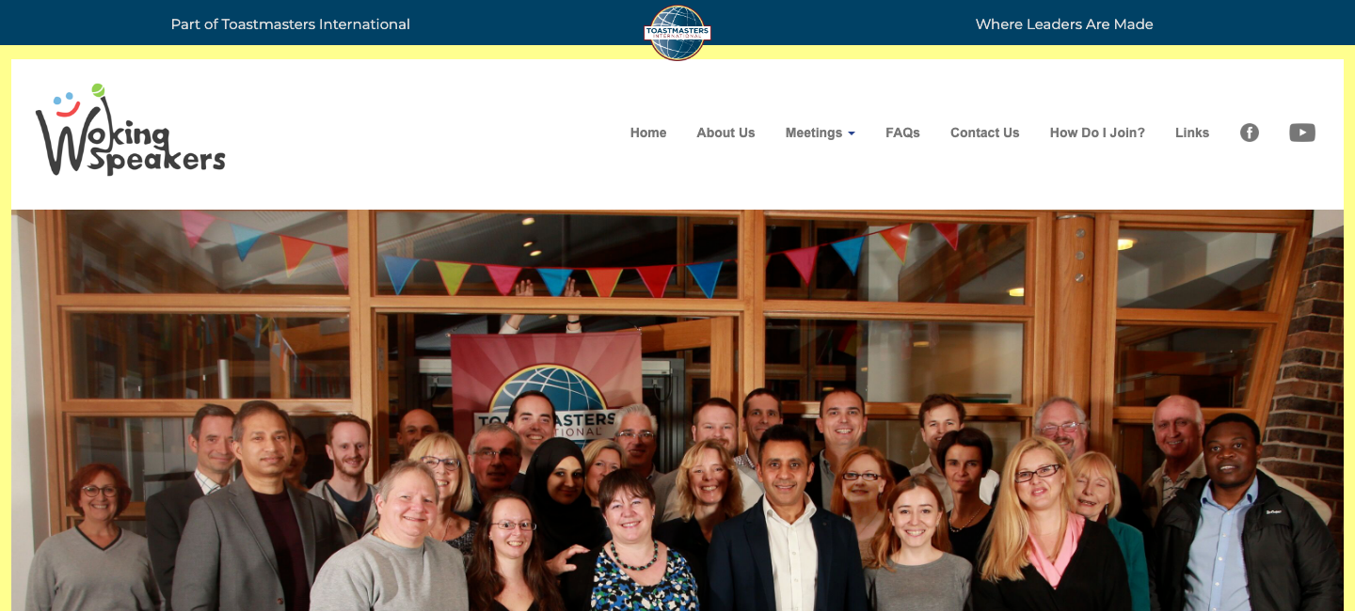
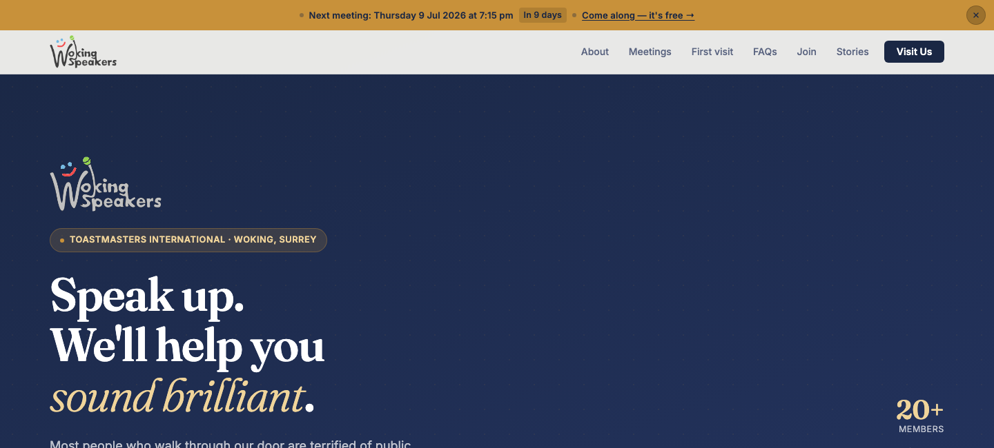
First impression
Same club, two very different opening pitches.
OLD SITE
NEW SITE
Top bar repeats the Toastmasters tagline; the photo carries no headline or message of its own.
Headline speaks directly to a nervous first-timer, with the club's free, no-pressure offer right under it.

Slide 3
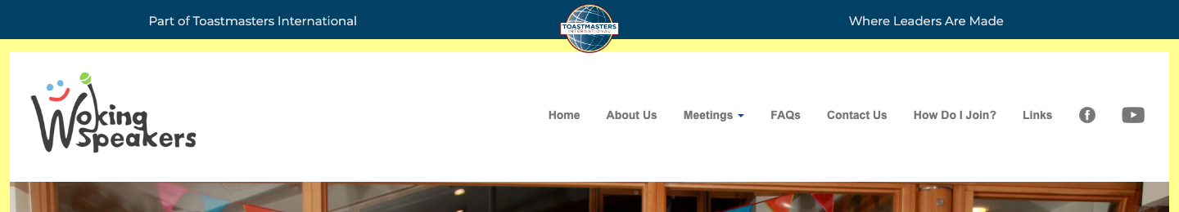
Finding the next meeting
The single most useful fact for a first-time visitor — when and where the next meeting is.
OLD SITE
NEW SITE
Nothing on the homepage.
Clicking “Meetings” opens a 4-item submenu (Venue, A Typical Meeting, Calendar, Toastmaster Tips) — the date is two clicks deep, on the Calendar page.
Sticky banner, visible immediately.
Date, time and a live countdown (“In 9 days”) sit above the nav on every page, with a one-click link to come along.

Slide 4
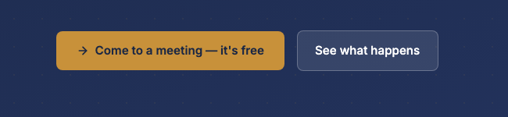
The invitation to visit
Guests are welcome on both sites — the question is whether a visitor actually notices that.
OLD SITE
NEW SITE
“How Do I Join?” sits in the nav bar,
the same size and weight as “Links” or “FAQs”. The free, no-pressure reassurance is written in a paragraph further down the page.
Two clear buttons.
A primary, free call to action, plus a lower-pressure “See what happens” for the still-curious — both inside the hero, no scrolling needed.

Slide 5
What's actually running behind the page
Checked live with the browser's network panel on both sites — this isn't a guess.
OLD SITE
NEW SITE
35
4
network requests on page load
network requests on page load
9 separate JS libraries loaded, including two competing UI frameworks (Bootstrap and Materialize) at once
One request is broken: an insecure http:// font request returns a 503 error
An invisible third-party tracking pixel (StatCounter) fires on every visit
Zero JS frameworks — plain HTML and CSS, nothing to patch or go out of date
Zero third-party trackers or analytics scripts
Nothing broken — every request returns a clean 200

Slide 6
The case in short
Visitors land on a clearer pitch and find the next meeting date instantly, instead of digging through a submenu
The invitation to attend is two obvious buttons, not a nav-bar link
The new site runs on 4 requests and no third-party code, versus 35 requests, 9 legacy libraries, a broken request, and a hidden tracker on the old one
Less to break, less to maintain, nothing for a future volunteer to untangle
Recommendation: approve switching wokingspeakers.org.uk to the new site.

