Slide 1
CAPSTONE PROJECT WEEK 2
By MERCY AKERELE

Slide 2
TABLE OF CONTENTS
Introduction
Data
Methodology
Results
Discussion
Conclusion

Slide 3
INTRODUCTION
New York and Hong Kong are popular, and densely-populated regions, known for their world economic and cultural power.
The main objectives of the project are:
To compare the cities of New York and Hong Kong
To explore the city features and suggest to tourists which city is more fun to visit for tourist purpose
For businessmen looking to establish a restaurant business, we will recommend which area in which city is best for their business.

Slide 4
DATA
The information about New York districts was obtained from (here), while that of Hong Kong was obtained from (here). Both extracted information are converted to a .csv file for easy manipulation, and are added to my GitHub for reference purpose: https://github.com/wolebode/Coursera_Capstone/blob/master/nyc_community1.csv
https://github.com/wolebode/Coursera_Capstone/blob/master/hk_community1.csv

Slide 5
METHOD
Segment areas of New York and Hong Kong based on the most common places using Foursquare and machine learning segmentation and clustering.
Find the number of unique features in the neighborhood and their distance to the city center. This will be done using a regularly spaced grid of locations centered around the city center
Group the features using K-means clustering
Display the maps of the cities and their lustered features using Folium maps

Slide 6
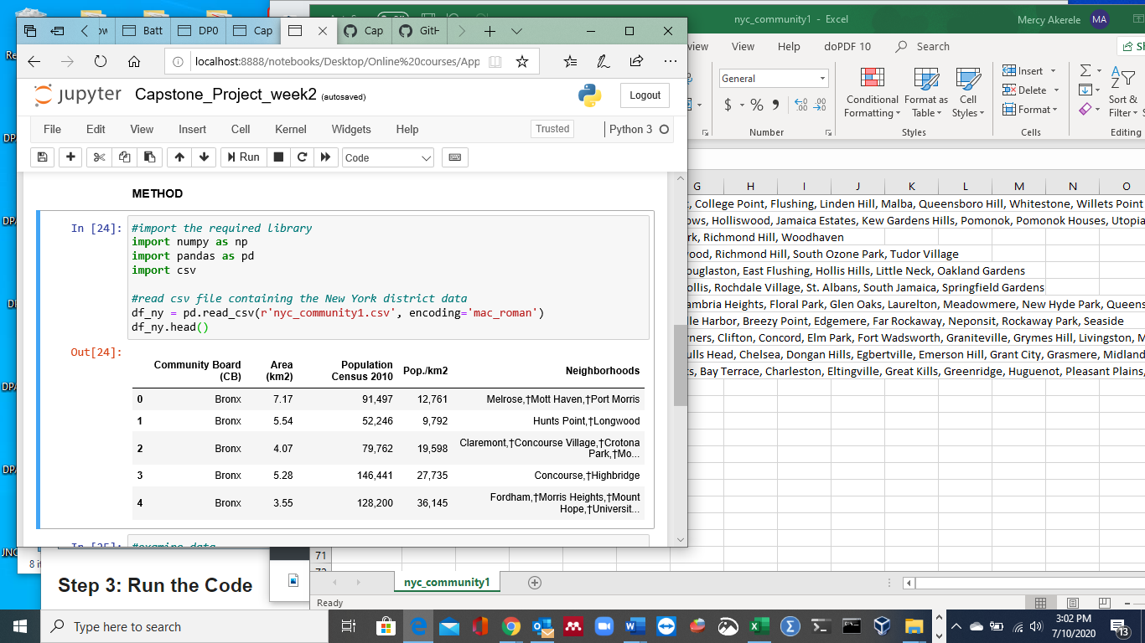
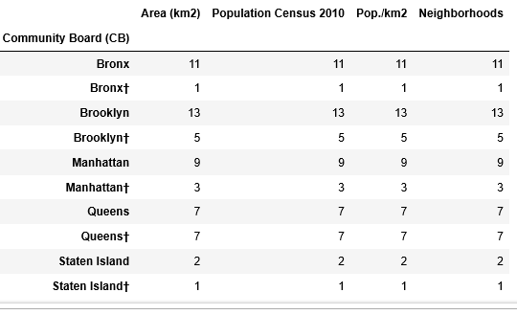
NEW YORK RESULTS
NEW YORK DISTRICTS
Latitude: 40.7127281
Longitude: -74.0060152

Slide 7
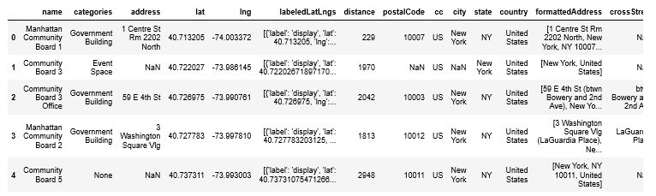
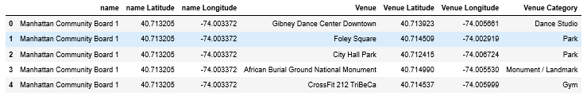
There are 194 unique categories in New York.

Slide 8
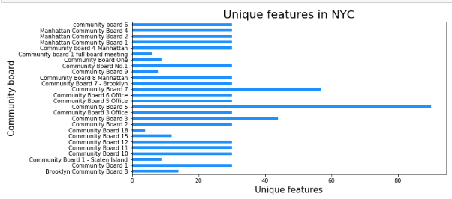
There are 194 unique categories in New York.

Slide 9
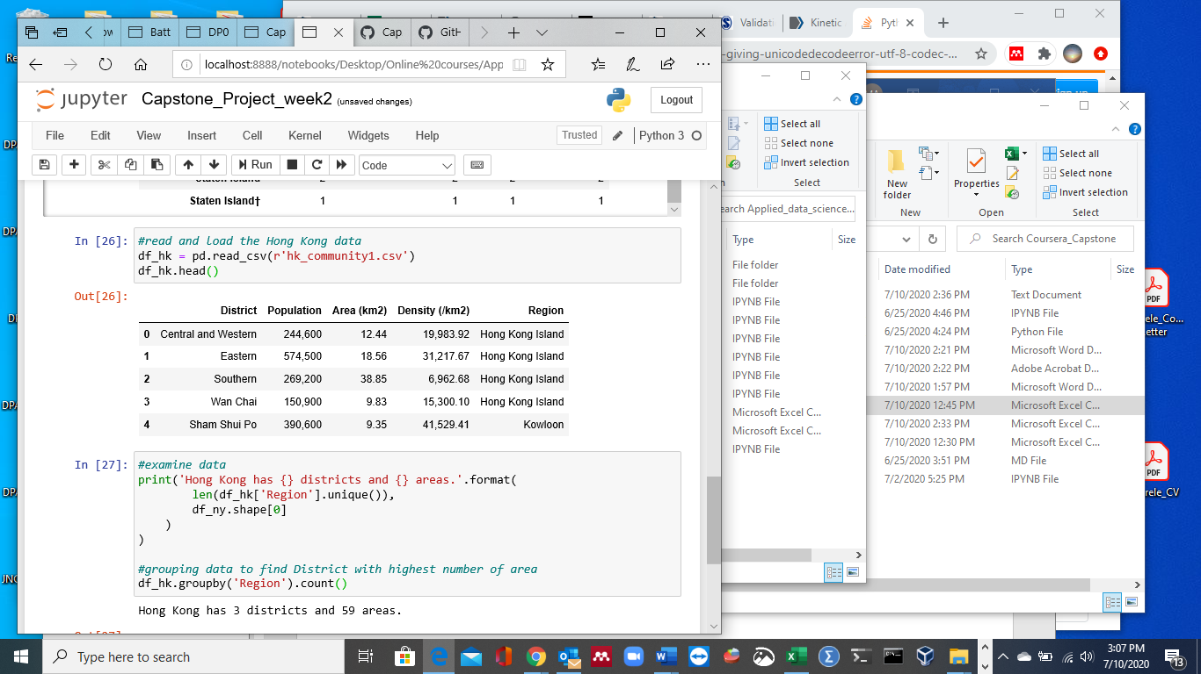

HONG KONG RESULTS
HONG KONG DISTRICTS
Latitude: 22.2793278
Longitude: 114.1628131

Slide 10
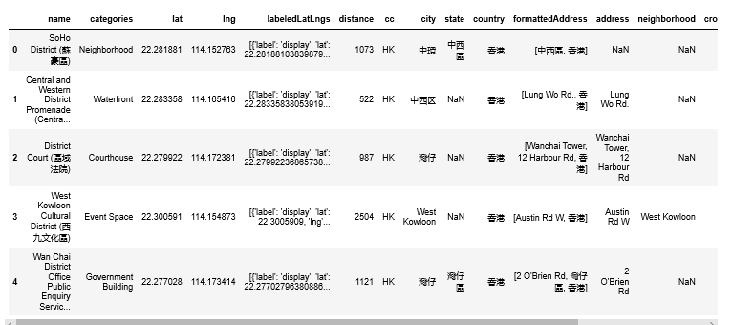
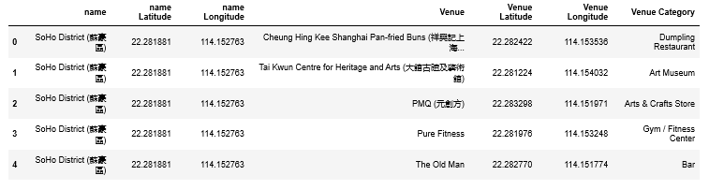

Slide 11
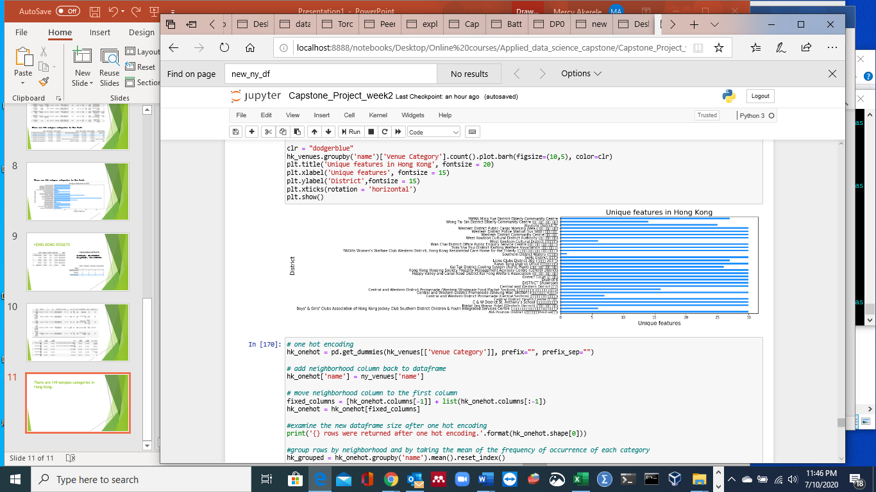
There are 149 unique categories in Hong Kong.

Slide 12
Discussion
Based on dataframe analysis, New York has 194 unique features, with boroughs 3, 5 and 7 having the highest features. While for Hong Kong, there are 149 unique features which are equally distributed to all the districts. Each district has approximately 30 features, except for few ones with just about 5 features.
For tourism purpose, I will recommend visiting New York city, especially districts 3, 5 and 7 which has very high features.
In all the districts of New York, restaurants, spa, gyms and coffee shops are common. We can see that these top the list for the most common venue. But for district 1 and 4, these categories are not the top list. So for a businessman, wanting to establish a restaurant, I would recommend New York districts 1 or 4.

Slide 13
CONCLUSION
In this project, I have been able to compare the cities of New York and Hong Kong, extract their unique features and recommend a city to visit for tourist purposes. I have also been able to recommend a suitable location to establish a restaurant business should anyone be interested to do so.
All these are possible with the help of API and machine learning algorithms for segmentation and clustering.

