Slide 1
AN INTRODUCTION TO SOFTWARE DEVELOPMENT IN DJANGO
Preamble
Tuesday April 7th 2015

Slide 2

Who are we?
Software Developers from ThoughtWorks (www.thoughtworks.com)
“We are not ninjas!!!!”

Slide 3

Why are we here?
Introduce some practices in Agile software development.
“To share knowledge”

Slide 4
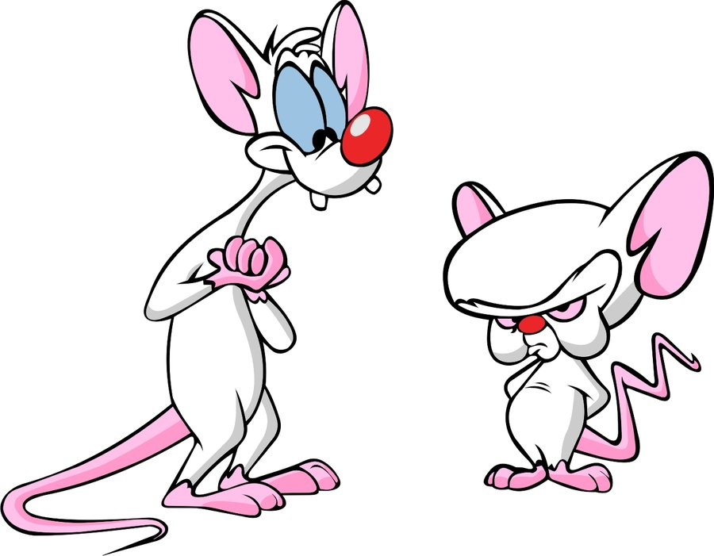
What will we be doing?
Emphasis on practice not theory
Writing code, writing code, writing code…
“The same thing we do every night… Try to take over the world!”

Slide 5

expectations
Spark your interest
“Keep it simple, stupid.”

Slide 6

Some Rules
When in doubt, ask questions
There are no wrong answers
Google (sometimes) is your friend
Share knowledge
Pairing
Say “no” to Facebook, Twitter and emails during class
“There are no stupid questions.”

