Slide 1
Dependency injection via DOM
Web components

Slide 2
Agenda

Slide 3
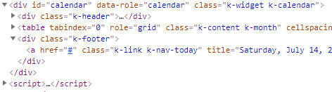
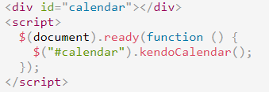
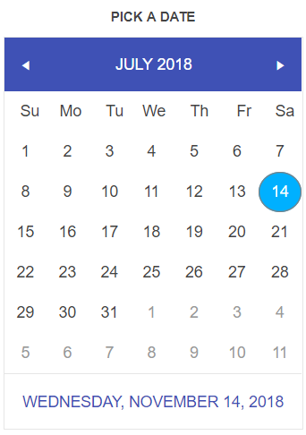
Kendo components
Notes:
What is WC (vs kendo)

Slide 4
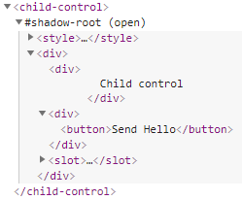
Web components
Custom elements
Shadow DOM
<template> <slot>
ES6 modules (HTML Imports)
Notes:
What is WC (vs kendo)

Slide 5
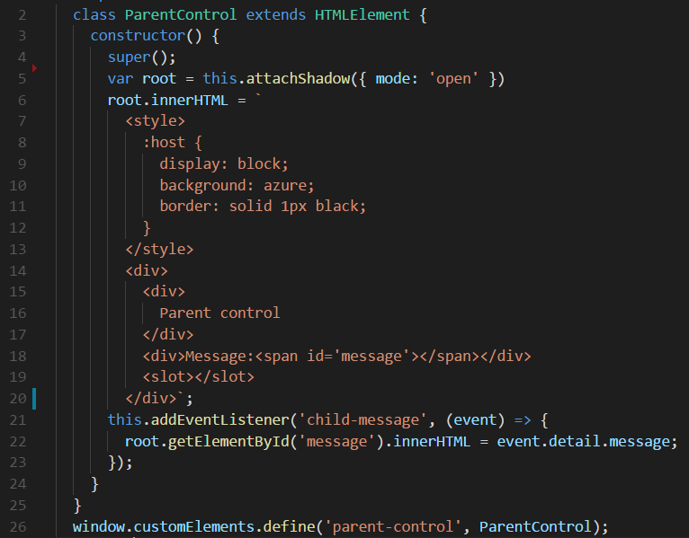
Web components
Notes:
What is WC (vs kendo)

Slide 6

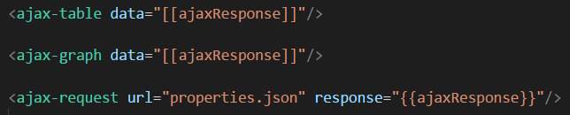
Services as Web components
Notes:
Services like
1.Common way (js classes)
2.WC
- problem that code is needed to send data

Slide 7
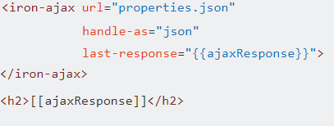
Services as Web components
Polymer example
Notes:
Services like
1.Common way (js classes)
2.WC
- problem that code is needed to send data

Slide 8
Receiving Web component
Global objects
DOM
Tree request
Events
Notes:
How data comes to WC
How programmatically send data to WC

Slide 9
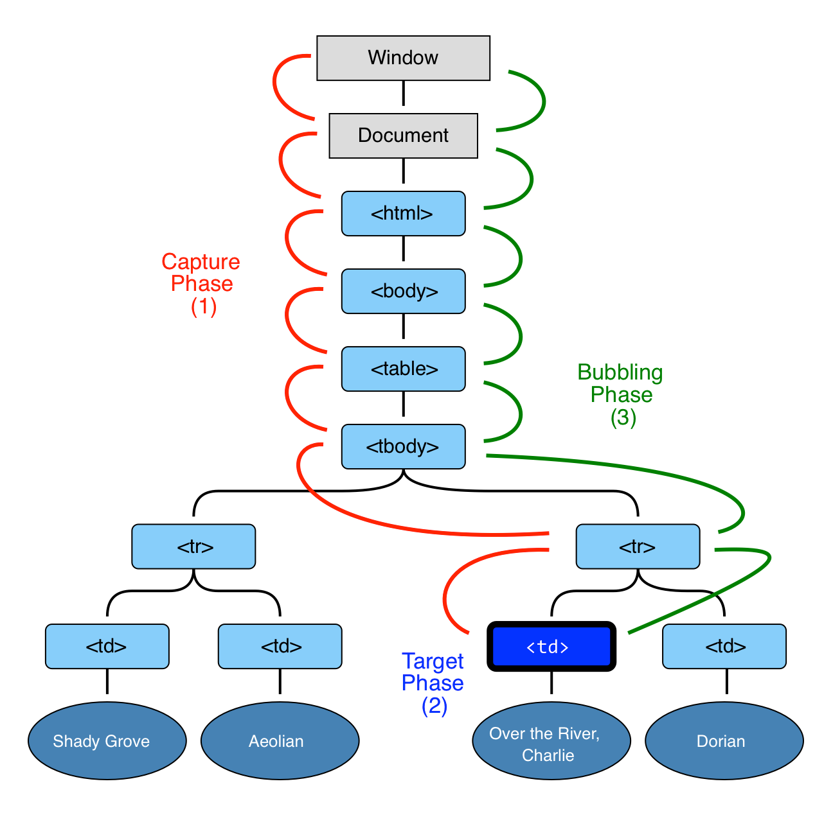
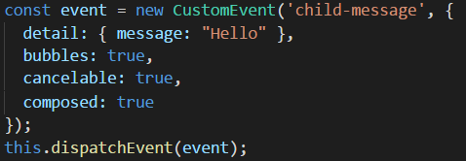
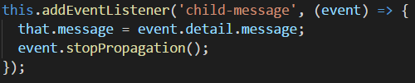
Bubbling events
Child
Parent
Notes:
<demo 01>

Slide 10



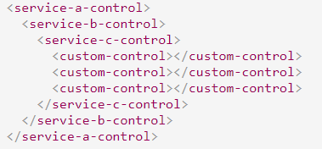
Service – Consumer links
?
Notes:
<demo 2-5>

Slide 11
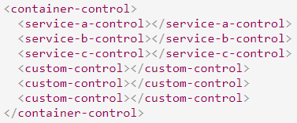


Container
Notes:
<demo 6>

Slide 12


IOC containers
Constructors without parameters
No interfaces
Instances are not needed

Slide 13


Interfaces

Slide 14
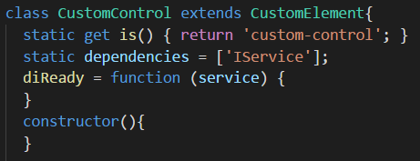



Constructors and Instances

Slide 15


DOM-DI
https://www.npmjs.com/package/dom-di
https://github.com/wolf-off/dom-di

Slide 16
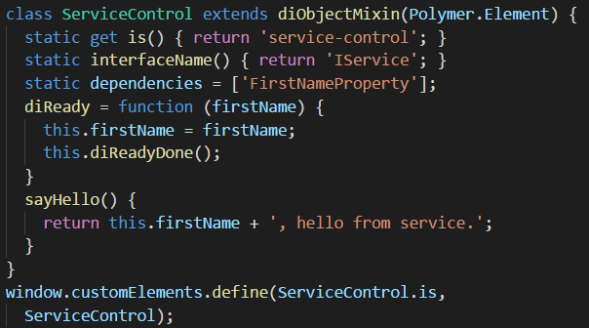
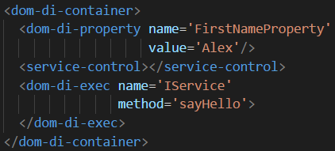
Self-injection
Registry ‘Alex’ as ‘FirstNameProperty’
Registry request for ‘IService’
Execute ‘sayHello’
Notes:
<Demo 07>

Slide 17
Self-injection
Advantage
Disadvantage
Common behaviour
Predicted life-time of objects
Can use common object throw wrapper
DI is part of objects
Notes:
<Demo 07>

Slide 18
Type of DOM dependency injection
Self-injection
Force injection
Passive injection

Slide 19
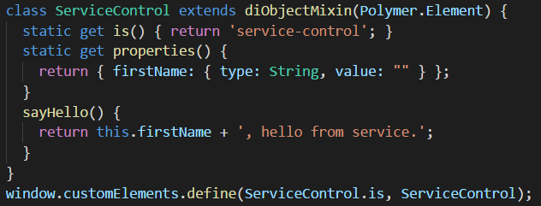
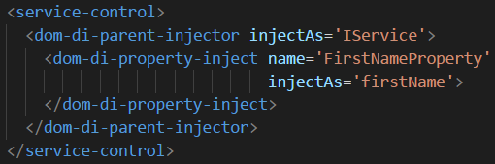
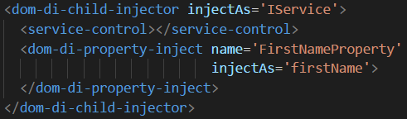
Force injection
Notes:
<Demo 08, 09>

Slide 20
Force injection
Advantage
Disadvantage
DI is not part of objects
Easy to implement for small container
Not known life-time
Scattered html
Too much of html

Slide 21
Passive injection
Notes:
<Demo 10>

Slide 22
Passive injection
Advantage
Disadvantage
DI is not part of objects
All DI in one place
Too complicated for simple containers
Not known life-time
Too much of html

Slide 23
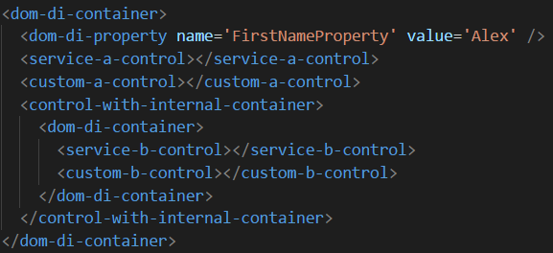
Hierarchical containers
All not resolved requests should go upper
Notes:
<Demo 11>

Slide 24
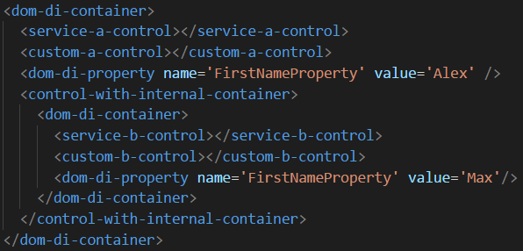
Hierarchical containers
All not resolved requests should go upper not ASAP
Notes:
<Demo 12>
ASAP-WFA

Slide 25
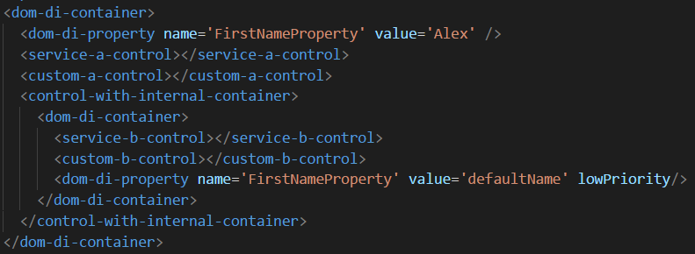
Default injection
All not resolved or with lowPriority resolver requests should go upper not ASAP
Notes:
<Demo 13>
ASAP-WFA

Slide 26
Moment of resolving
ASAP
WFA
Easy to implement
Dynamic objects
No default
No hierarchy
Complicated logic
Static objects
Hierarchy
Default injections

Slide 27
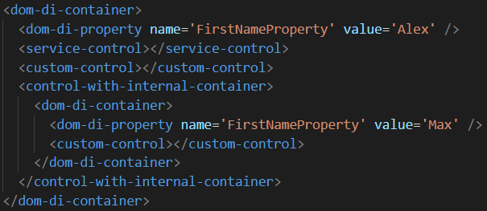
Problem of DI with objects
Internal ‘FirstNameProperty will not be used’
Notes:
<Demo 14>

Slide 28
Problem of DI with objects
Notes:
<Demo 14>
Formatting
Font++ Target –s
Comments on slides++
Git references on slides
Total -s
Questions -s
References –s
Progress menu

