Slide 1
Dependency injection via DOM
Web components

Slide 2
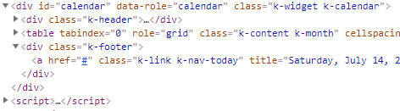
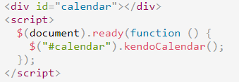
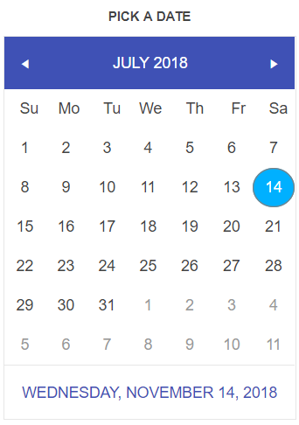
Kendo components
Notes:
What is WC (vs kendo)

Slide 3
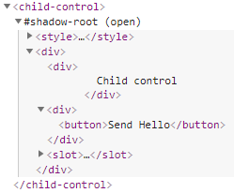
Web components
Custom elements
Shadow DOM
<template> <slot>
ES6 modules (HTML Imports)
Notes:
What is WC (vs kendo)

Slide 4
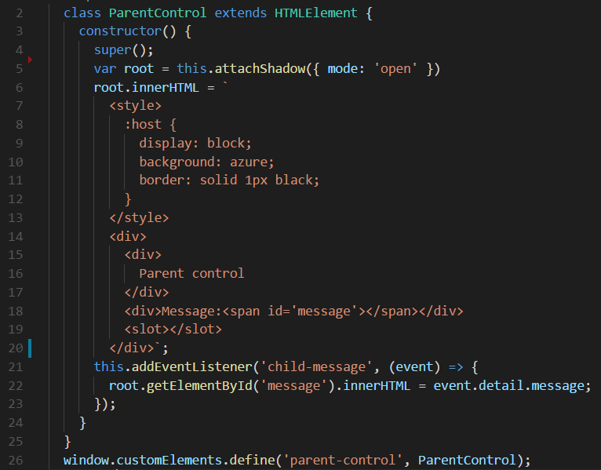
Web components
Notes:
What is WC (vs kendo)

Slide 5

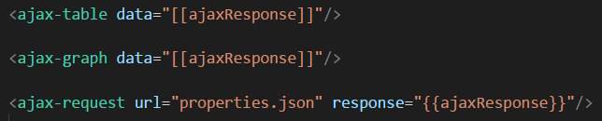
Services as Web components
Notes:
Services like
1.Common way (js classes)
2.WC
- problem that code is needed to send data

Slide 6
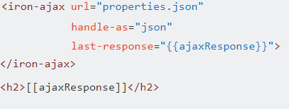
Services as Web components
Polymer example
Notes:
Services like
1.Common way (js classes)
2.WC
- problem that code is needed to send data

Slide 7
Receiving Web component
Global objects
DOM
Tree request
Events
Notes:
How data comes to WC
How programmatically send data to WC

Slide 8
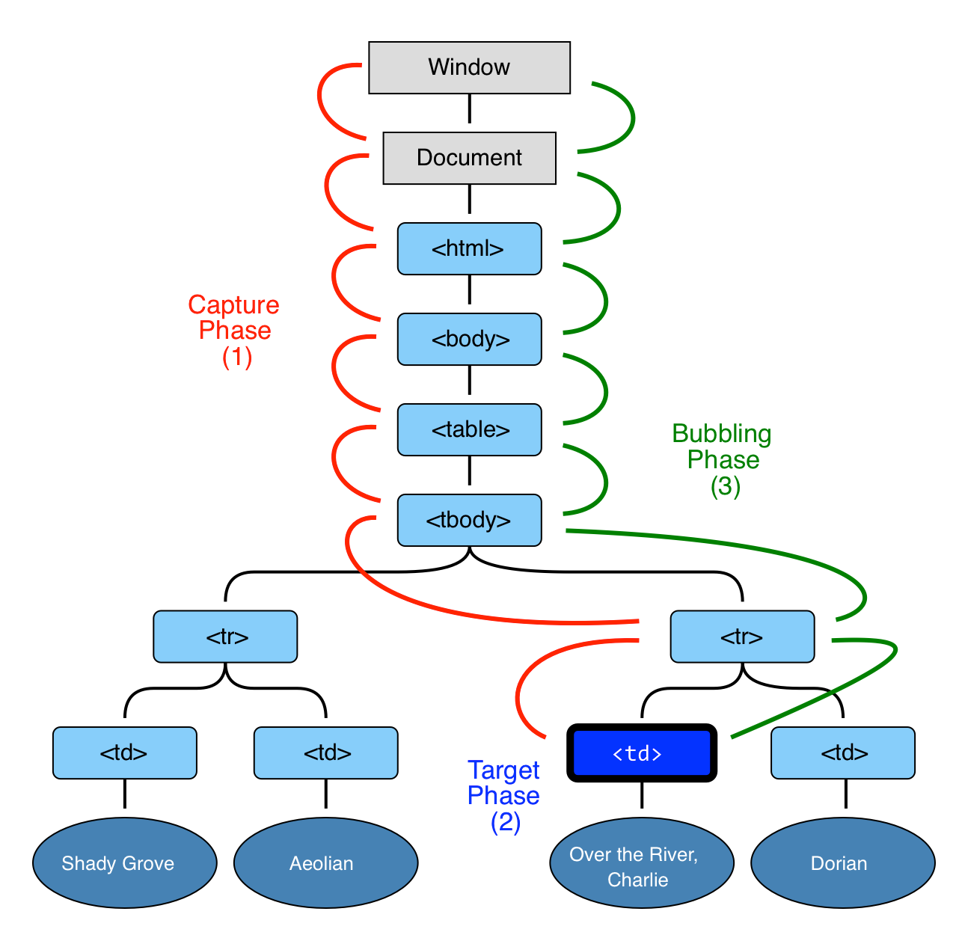
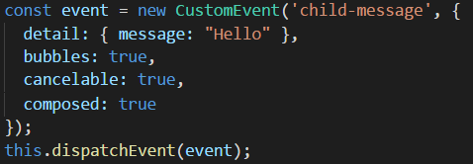
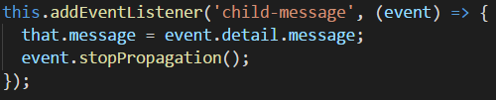
Bubbling events
Child
Parent
Notes:
<demo 01>

Slide 9



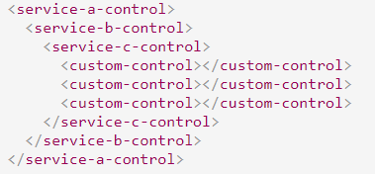
Service – Consumer links
?
Notes:
<demo 2-5>

Slide 10
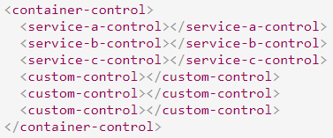


Container
Notes:
<demo 6>

Slide 11


IOC containers
Constructors without parameters
No interfaces
Instances are not needed

Slide 12


Interfaces

Slide 13
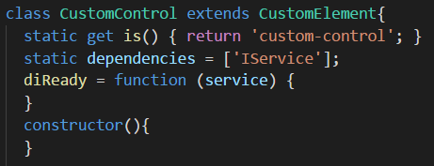



Constructors and Instances

Slide 14


DOM-DI
https://www.npmjs.com/package/dom-di
https://github.com/wolf-off/dom-di

Slide 15
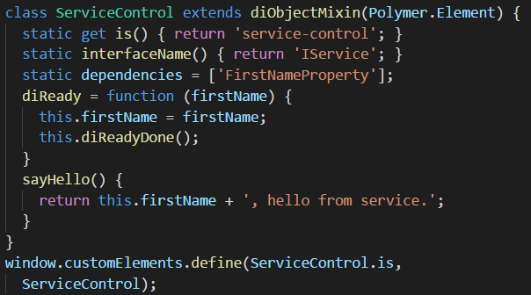
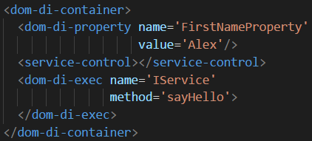
Self-injection
Registry ‘Alex’ as ‘FirstNameProperty’
Registry request for ‘IService’
Execute ‘sayHello’
Notes:
<Demo 07>

Slide 16
Self-injection
Advantage
Disadvantage
Common behaviour
Predicted life-time of objects
Can use common object throw wrapper
DI is part of objects
Notes:
<Demo 07>

Slide 17
Type of DOM dependency injection
Self-injection
Force injection
Passive injection

Slide 18
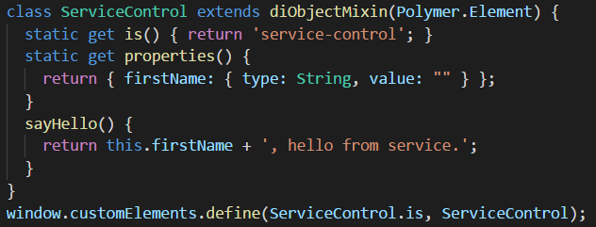
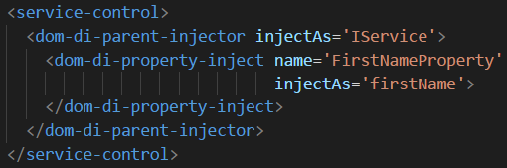
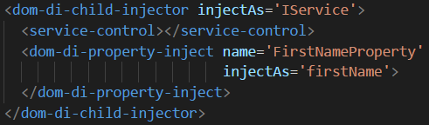
Force injection
Notes:
<Demo 08, 09>

Slide 19
Force injection
Advantage
Disadvantage
DI is not part of objects
Easy to implement for small container
Not known life-time
Scattered html
Too much of html

Slide 20
Passive injection
Notes:
<Demo 10>

Slide 21
Passive injection
Advantage
Disadvantage
DI is not part of objects
All DI in one place
Too complicated for simple containers
Not known life-time
Too much of html

Slide 22
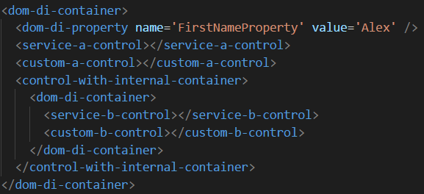
Hierarchical containers
All not resolved requests should go upper
Notes:
<Demo 11>

Slide 23
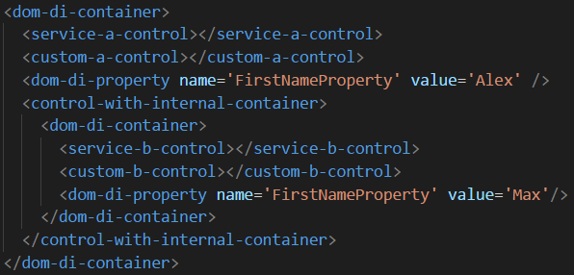
Hierarchical containers
All not resolved requests should go upper not ASAP
Notes:
<Demo 12>
ASAP-WFA

Slide 24
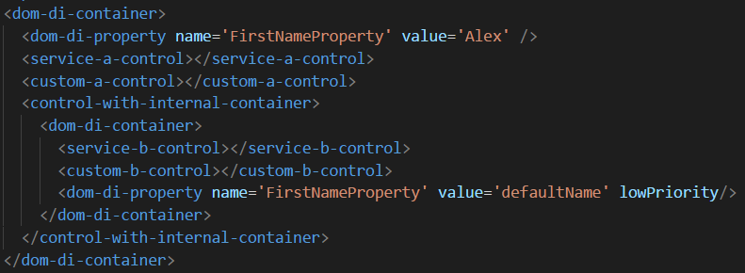
Default injection
All not resolved or with lowPriority resolver requests should go upper not ASAP
Notes:
<Demo 13>
ASAP-WFA

Slide 25
Moment of resolving
ASAP
WFA
Easy to implement
Dynamic objects
No default
No hierarchy
Complicated logic
Static objects
Hierarchy
Default injections

Slide 26
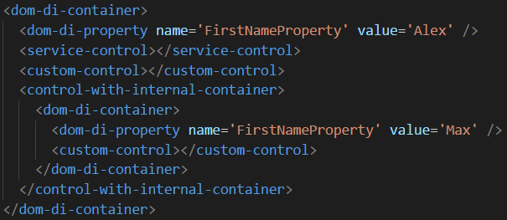
Problem of DI with objects
Internal ‘FirstNameProperty will not be used’
Notes:
<Demo 14>

Slide 27
Problem of DI with objects
Notes:
<Demo 14>

