Slide 1
Micro services
Web components

Slide 2

Monolith-Layers
Monolith
Server

Slide 3
Layers-SOA
Server
Catalogue
Service
Buy
Service
Auth
Service

Slide 4
SOA-Microservices
Aggregation Layer
Catalogue
Service
Buy
Service
Auth
Service
Catalogue
Service
Buy
Service
Auth
Service

Slide 5
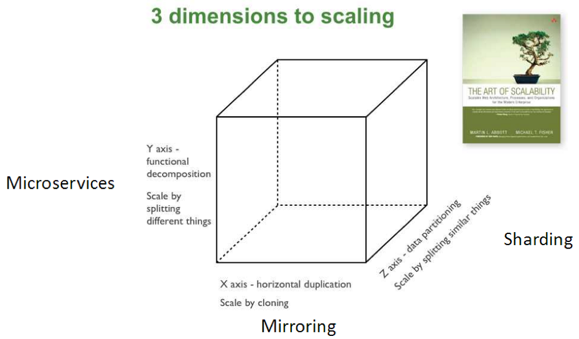
Microservices

Slide 6
SOA-Microservices
?
Aggregation Layer
Catalogue
Service
Buy
Service
Auth
Service
Catalogue
Service
Buy
Service
Auth
Service

Slide 7
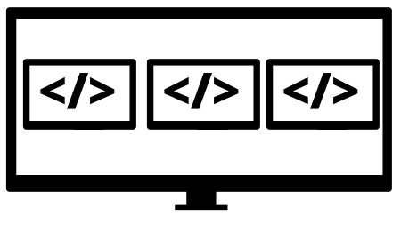
SOA-Microfrontend
Catalogue
Service
Buy
Service
Auth
Service
Catalogue
Service
Buy
Service
Auth
Service

Slide 8
Micro frontend
Technology Independent
Isolate Team Code
Native Browser Features
Components
Application

Slide 9

Micro frontend
https://github.com/wolf-off/dom-di

