Slide 1
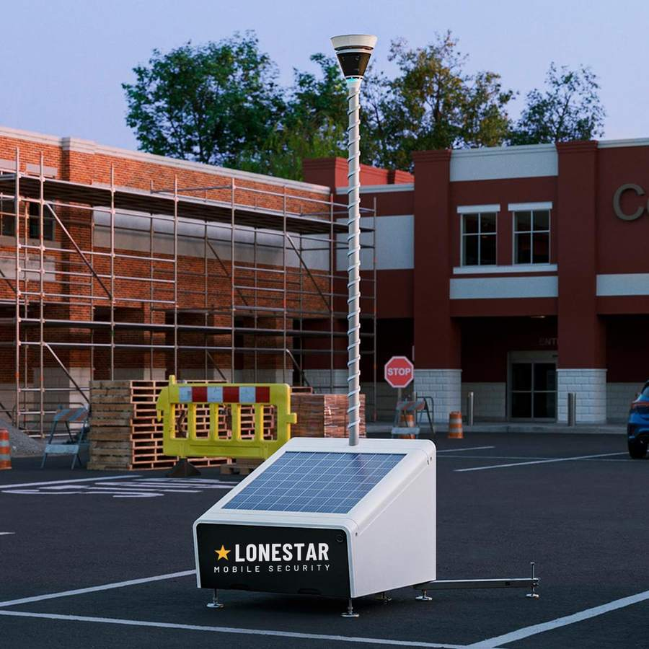

HOUSTON, TX · SOLAR-POWERED MOBILE SECURITY
Eyes on your site. 24/7.
4K security towers delivered, deployed, and monitored across Greater Houston.
Prepared for [Client] · [Date]
lonestarmobilesecurity.com
Eyes on your site. 24/7.
Notes:
Open with the site: 'You've got a lot of copper and a lot of dark hours out there.' Replace [Client] and [Date] before presenting.

Slide 2
THE PROBLEM
Jobsites lose what the crew needs tomorrow.
1
2
3
4
Copper, tools, lumber
Equipment & fuel
No power, no eyes
Guards see one thing
Walk off between shifts and over weekends. Replacement cost plus delay.
Skid steers, generators, converters, and diesel are the fastest to sell.
Active sites and vacant properties have no utilities, so wired cameras never happen.
A guard is $9,000+ a month, stands in one place, and can't record.
Assumption: guard at $25/hour × 12 hours × 30 nights. Use the real quote from your market.
lonestarmobilesecurity.com
Eyes on your site. 24/7.
Notes:
Ask: 'What walked off last quarter, and what did the delay cost?' Let them answer before moving on.

Slide 3
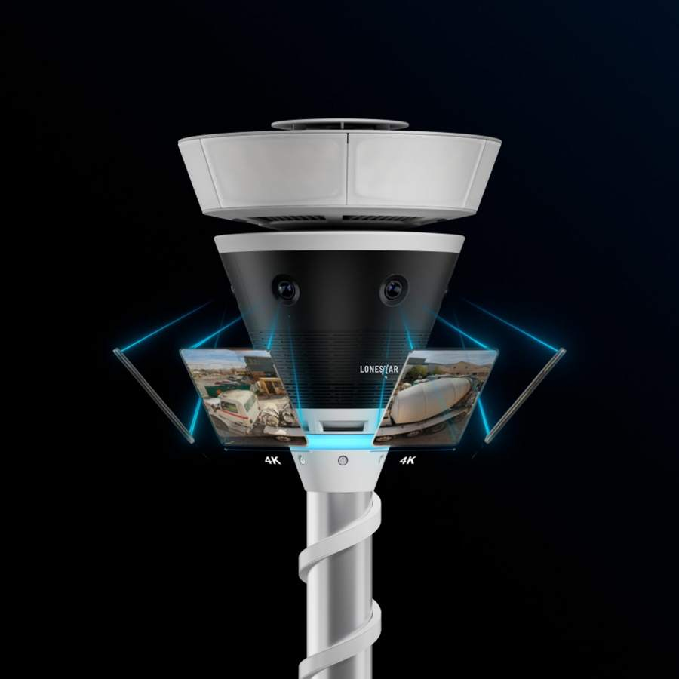
THE SOLUTION
A self-contained security tower we tow to your site.
12-foot mast with two 4K cameras, 360° panoramic view
Motion-activated floodlight, siren, and two-way talk
Solar power with battery backup and built-in LTE, no utilities needed
Live video and plain-English alerts on your phone
Optional 24/7 professional monitoring by live agents
Delivered, set up, and serviced by Lonestar
lonestarmobilesecurity.com
Eyes on your site. 24/7.
Notes:
Point at the picture: two cameras, the light ring, the mast. 'It's live the day it arrives.'

Slide 4
HOW IT WORKS
Protected in three steps.
1
2
3
Book a consultation
We deliver & deploy
Watch, get alerts, relax
A 20-minute site walk. We map entrances, laydown areas, and blind spots, and recommend tower count and placement.
We tow the tower in, level it, raise the mast, and bring the cameras online. Usually under an hour. No power or internet needed.
Live view and descriptive alerts on your phone. Add monitoring and trained agents watch the site around the clock.
lonestarmobilesecurity.com
Eyes on your site. 24/7.
Notes:
Emphasize speed: days from yes to live, not weeks.

Slide 5
COVERAGE
See the whole site in crystal-clear 4K.
Two 4K cameras stitched into a 360° panorama from 12 feet up
Read license plates and identify faces, day or night
Recorded motion events you can review and download
Live view from your phone, tablet, or laptop
Share access with your foreman or site manager
lonestarmobilesecurity.com
Eyes on your site. 24/7.
Notes:
If they have existing cameras, ask whether those can read a plate at the back fence at 2 a.m.

Slide 6
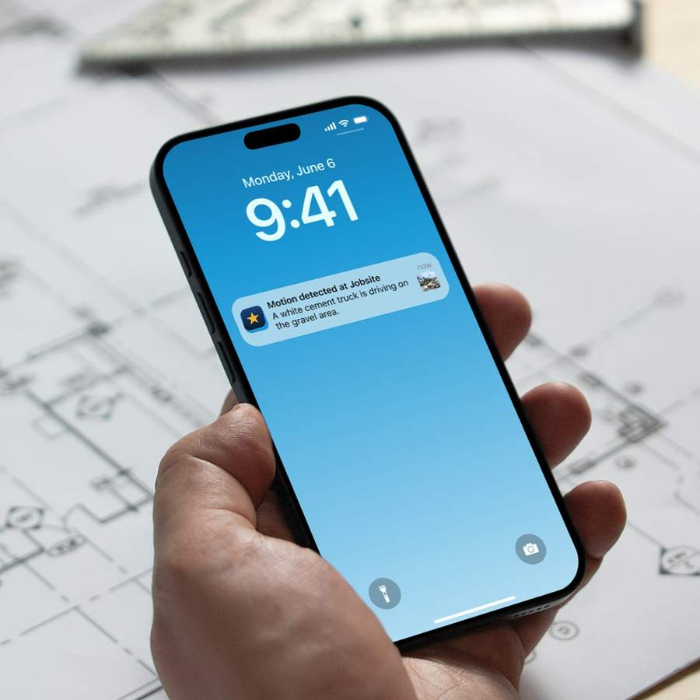
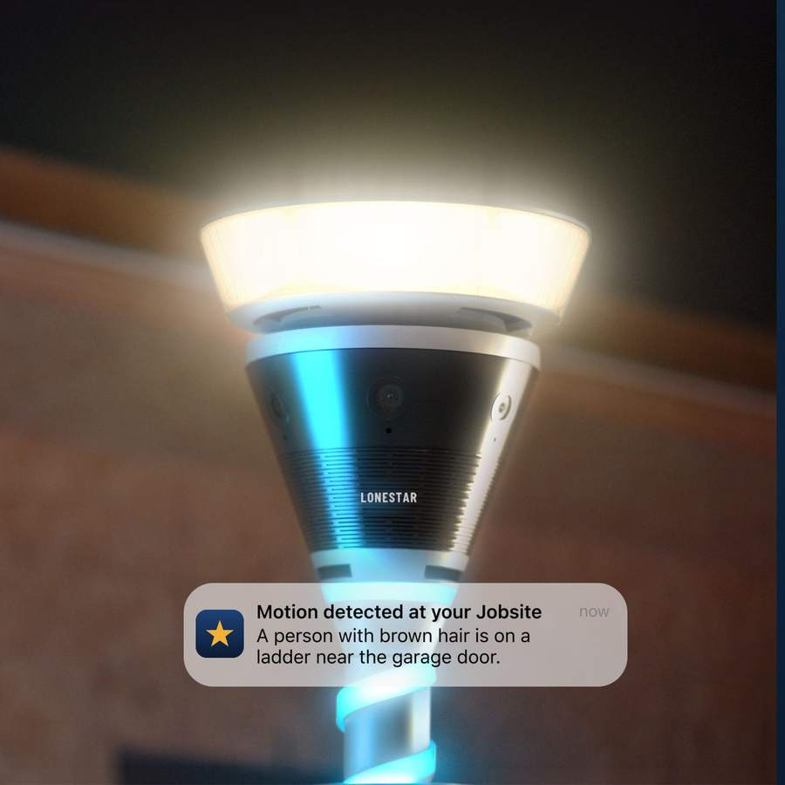
ALERTS & DETERRENCE
Alerts that explain. Deterrence that stops it.
"A white cement truck is driving on the gravel area."
Plain-English descriptions, not just 'motion detected'
Alert zones and quiet hours for your own crew
Floodlight snaps on, siren sounds, agent speaks through the tower
Thieves pick the site next door
lonestarmobilesecurity.com
Eyes on your site. 24/7.
Notes:
Tell the 2 a.m. story: light on, agent says 'you're on camera', call goes in, clip in the morning.

Slide 7
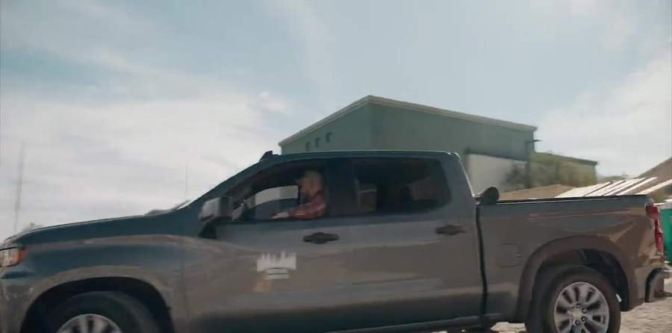
ZERO HOOKUPS
Runs on sunshine. Connects on its own.
Solar array + battery backup
Built-in LTE (or Wi-Fi)
No trenching, no electricians
Works on raw dirt and vacant lots
lonestarmobilesecurity.com
Eyes on your site. 24/7.
Notes:
'Is there power on site?' Almost always no. This slide is the answer.

Slide 8
24/7 MONITORING
Someone's watching. Even at 3 a.m.
The 2 a.m. story
$150
Motion at the fuel tank. The floodlight snaps on. An agent sees a person, not a raccoon, and says through the speaker: "You are being recorded. Police have been notified." The call goes in. You get the clip with your coffee, and the diesel is still in the tank.
PER MONTH · PER SITE · EVERY TOWER INCLUDED
Trained agents review alerts in real time, around the clock
Live audio warnings to intruders through the tower
Escalation to local authorities when needed
Incident reports for your records and insurance
Monitoring response protocols are confirmed at setup.
lonestarmobilesecurity.com
Eyes on your site. 24/7.
Notes:
Confirm your monitoring provider's actual escalation policy before promising specifics.

Slide 9
PRICING
Two numbers. No surprises.
Mobile Security Tower
24/7 Site Monitoring
$750
$150
PER MONTH · PER TOWER
PER MONTH · PER SITE (ALL TOWERS)
Delivery, placement & setup in Greater Houston
Dual 4K cameras, 360°, 12 ft mast
Solar, battery backup, built-in LTE
Floodlight, siren & two-way talk
App access: live view, recordings, alerts
Live agents review alerts around the clock
Audio warnings to intruders through the tower
Escalation to authorities when needed
Incident reports
One flat rate, however many towers
Monthly lease, flexible for any project length. Pricing per month before applicable taxes.
lonestarmobilesecurity.com
Eyes on your site. 24/7.
Notes:
Say the total out loud: 'One tower with monitoring is $900 a month.'

Slide 10
VALUE
Less than a guard's week. Every month.
What one incident costs
A stolen skid steer: deductible plus a week of downtime
One spool of copper wire: more than a month of tower
A vacant-building fire or squatter: insurance and legal exposure
Guard assumption: $25/hr × 12 hrs × 30 nights = $9,000
lonestarmobilesecurity.com
Eyes on your site. 24/7.
Notes:
Update the guard figure with a real local quote. The chart is native; edit the numbers in PowerPoint.

Slide 11

WHO WE PROTECT
Anywhere you can park a trailer.
Construction sites
Equipment & material yards
Dealerships & parking lots
Tools, copper, lumber, appliances
Fleet, fuel, converters, trailers
Break-ins, converter theft, dumping
Events & festivals
Vacant & rental properties
Retail & industrial parks
Staging, vendor rows, overnight gear
Squatters, scrappers, insurance
Back lots, loading docks, corners
lonestarmobilesecurity.com
Eyes on your site. 24/7.
Notes:
Skip to the segment in the room.

Slide 12

SERVICE AREA
Proudly serving Greater Houston.
Houston
Katy
Sugar Land
The Woodlands
Pearland
Pasadena
Baytown
Cypress
Spring
Humble
League City
Conroe
Missouri City
Rosenberg
Tomball
Galveston
Outside the list? Ask. We can usually make it work.
lonestarmobilesecurity.com
Eyes on your site. 24/7.

Slide 13
YOUR SITE
Recommended for [Site name]
Item | Qty | Monthly | Total
Mobile Security Tower | [2] | $750 | [$1,500]
24/7 Site Monitoring | 1 | $150 | $150
Total per month |  |  | [$1,650]
Placement
Tower 1: [north gate, clear sky, covers entrance and office trailer]
Tower 2: [laydown yard, covers material stacks and rear fence]
Alerts to: [names]
Target delivery: [date]
Replace bracketed fields. Monthly lease; add or remove towers as the project changes.
lonestarmobilesecurity.com
Eyes on your site. 24/7.
Notes:
Fill this slide in during or right after the site walk.

Slide 14
Let's get a tower on your site this week.
1. Sign the proposal
2. We deliver & deploy
3. You get the alerts
[Your Name] · [Phone] · info@lonestarmobilesecurity.com
lonestarmobilesecurity.com
Eyes on your site. 24/7.
Notes:
Ask for the lease: 'If the proposal matches what we walked, can we deliver Tuesday?'

