Slide 1
COMP340: Programming Languages
Seikyung Jung
Bridgewater State University

Slide 2
Accreditation
Student Outcome (h): Recognition of the need for and an ability to engage in continuing professional development
Learns a new programming language with little formal instruction by last year of program
Student Outcome (j): An ability to apply mathematical foundations, algorithmic principles, and computer science theory in the modeling and design of computer-based systems in a way that demonstrates comprehension of the tradeoffs involved in design choices
Can articulate differences/tradeoffs of multiple designs

Slide 3
Why Programming Languages?
Improve background for choosing appropriate languages
scientific applications (Fortran)
business applications (COBOL)
artificial intelligence (Lisp, prolog)
system programming (C)
web software (e,g., HTML, Python)
Increase ability to learn new languages
Better use of languages that are already known
Allow programs to be written clearly and concisely.
Notes:
Support reusable software components

Slide 4
Programming Language Theory is a branch of computer science that deals with the
design,
implementation,
analysis
characterization, and
classification
of programming languages and their individual features.

Slide 5
Language Categories
Imperative:
Assembly, C, C++, Java, Python
Functional:
Lisp, ML, Scheme, Haskell
Functional programming is like “excel”
Logical:
Prolog
Markup/programming hybrid:
XSLT, etc
Which languages are dominant and why?
Imperative languages are most dominant because of well-known computer architecture: Von Neumann
Notes:
noiman

Slide 6
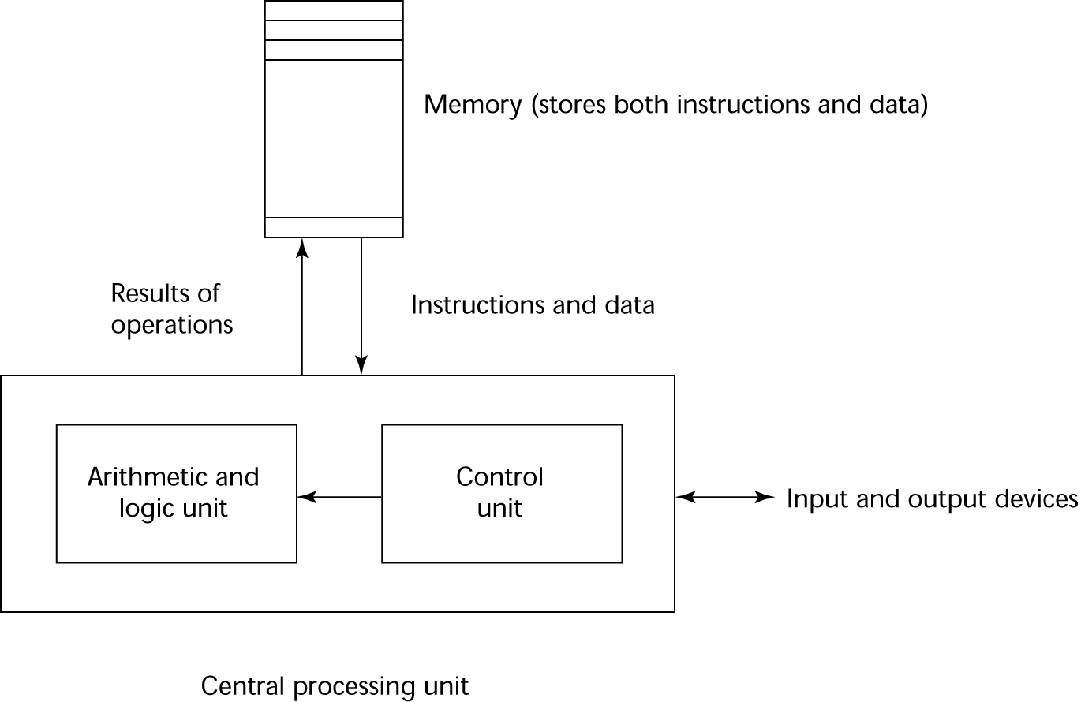
The von Neumann Architecture

Slide 7
The von Neumann Architecture
Fetch-execute-cycle (on a von Neumann architecture computer)
initialize the program counter
repeat forever
fetch the instruction pointed by the counter
increment the counter
decode the instruction
execute the instruction
end repeat

Slide 8
Imperative languages
Variables model
Assignment statements
Iteration

Slide 9
Functional Programming Language : Haskell
Development framework
GHC (Glasgow Haskell Compiler) & GHCi (Interactive)
http://www.haskell.org/platform/
Hugs
http://www.haskell.org/hugs/
We will use GHC & GHCi
IDE or Editor?
http://leksah.org/
it requires to have GHC separate
Online
http://haskellonline.org
http://codepad.org

Slide 10
Haskell etc.
Haskell online book
http://learnyouahaskell.com/
Haskell Prelude
http://ww2.cs.mu.oz.au/172/Haskell/tourofprelude.html
http://www.haskell.org/hoogle/

Slide 11
Logic Programming Language: Prolog
"Programming with Logic"
Good for knowledge-rich tasks
Functional PL is more close to Declarative than Imperative
Declarative (Prolog) vs. Imperative (C, C++, Java etc)
declarative: no instructions how to do the task. Instead what needs to be done.
imperative: give exact commands step by step

Slide 12
SWI Prolog
Freely available Prolog interpreter
http://www.swi-prolog.org/
http://www.swi-prolog.org/download/stable
Works with
Linux, Windows, or Mac OS
There are many more Prolog interpreters
Not all are ISO (International Organization for Standardization) compliant
Slides and Materials
Learn Prolog Now! http://www.learnprolognow.org/

Slide 13
Prolog
High-level language
Not as efficient as, say, C
Good for rapid prototyping
Useful in many AI applications
Think declaratively, not procedurally
Challenging
Requires a different mindset

Slide 14
Prolog and Logic
Prolog was the first reasonable attempt to create a logic programming language
Programmer gives a declarative specification of the problem, using the language of logic
The programmer shouldn’t have to tell the computer what to do
To get information, the programmer simply asks a query

Slide 15
History of Prolog
first Prolog interpreter & language by Colmerauer and Roussel
1972
1977
1980
1980s/1990s
2005

Slide 16
History of Prolog
First Prolog compiler by Warren
1972
1977
1980
1980s/1990s
2005

Slide 17
History of Prolog
Definite Clause Grammars (?) implementation by Pereira and Warren
1972
1977
1980
1980s/1990s
2005

Slide 18
History of Prolog
Prolog grows in popularity especially in Europe and Japan
1972
1977
1980
1980s/1990s
2005

Slide 19
History of Prolog
Prolog used to program natural language interface in International Space Station by NASA
1972
1977
1980
1980s/1990s
2005

Slide 20
Knowledge Base 1
fact
woman(mia).
woman(jody).
woman(yolanda).
playsAirGuitar(jody).
party.
There are five clauses in this knowledge base
The end of a clause is marked with a period (.)
There are three predicates (evaluates true or false) in this knowledge base
woman, playsAirGuitar and party.

Slide 21
woman(mia).
woman(jody).
woman(yolanda).
playsAirGuitar(jody).
party.
?- woman(mia).
true.
?- playsAirGuitar(jody).
true.
?- playsAirGuitar(mia).
false.
?- tattoed(jody).
ERROR: Undefined procedure
?- party.
true.
?- rockConcert.
ERROR:Undefined procedure

Slide 22
Knowledge Base 2
fact
happy(yolanda).
listens2music(mia).
listens2music(yolanda):- happy(yolanda).
playsAirGuitar(mia):- listens2music(mia).
playsAirGuitar(yolanda):- listens2music(yolanda).
fact
rule
rule
rule
head
body
:- implication, later
There are five clauses in this knowledge base
two facts and three rules
The end of a clause is marked with a period (.)
There are three predicates in this knowledge base
happy, listens2music and playsAirGuitar

Slide 23
happy(yolanda).
listens2music(mia).
listens2music(yolanda):- happy(yolanda).
playsAirGuitar(mia):- listens2music(mia).
playsAirGuitar(yolanda):- listens2music(yolanda).
?- playsAirGuitar(mia).
true
?- playsAirGuitar(yolanda).
true

Slide 24
Knowledge Base 3
happy(vincent).
listens2music(butch).
playsAirGuitar(vincent):- listens2music(vincent), happy(vincent).
playsAirGuitar(butch):- happy(butch).
playsAirGuitar(butch):- listens2music(butch).
?- playsAirGuitar(vincent).
The comma “,” express conjunction(∧,logical AND) in Prolog

Slide 25
happy(vincent).
listens2music(butch).
playsAirGuitar(vincent):- listens2music(vincent), happy(vincent).
playsAirGuitar(butch):- happy(butch).
playsAirGuitar(butch):- listens2music(butch).
?- playsAirGuitar(vincent).
false
?- playsAirGuitar(butch).

Slide 26
happy(vincent).
listens2music(butch).
playsAirGuitar(vincent):- listens2music(vincent), happy(vincent).
playsAirGuitar(butch):- happy(butch).
playsAirGuitar(butch):- listens2music(butch).
playsAirGuitar(butch):- happy(butch); listens2music(butch).
?- playsAirGuitar(vincent).
false
?- playsAirGuitar(butch).
The semicolon “;” express disjunction(∨,logical OR) in Prolog

Slide 27
happy(vincent).
listens2music(butch).
playsAirGuitar(vincent):- listens2music(vincent), happy(vincent).
playsAirGuitar(butch):- happy(butch).
playsAirGuitar(butch):- listens2music(butch).
?- playsAirGuitar(vincent).
false
?- playsAirGuitar(butch).
true

Slide 28
Prolog and Logic
Clearly Prolog has something to do with logic
Operators
Implication :-
Conjunction ,
Disjunction ;
Use of modus ponens (or implication elimination)
http://en.wikipedia.org/wiki/Modus_ponens
Negation (later)
(Q ←P) if P (is true) then Q (is true)
Notes:
모더스 포넌스

Slide 29
Knowledge Base 4
woman(mia).
woman(jody).
woman(yolanda).
loves(vincent, mia).
loves(marsellus, mia).
loves(pumpkin, honey_bunny).
loves(honey_bunny, pumpkin).
?- woman(X).
X=mia
Variable

Slide 30
woman(mia).
woman(jody).
woman(yolanda).
loves(vincent, mia).
loves(marsellus, mia).
loves(pumpkin, honey_bunny).
loves(honey_bunny, pumpkin).
?- woman(X).
X=mia;
X=jody;
X=yolanda
Asking Alternatives

Slide 31
woman(mia).
woman(jody).
woman(yolanda).
loves(vincent, mia).
loves(marsellus, mia).
loves(pumpkin, honey_bunny).
loves(honey_bunny, pumpkin).
?- loves(marsellus,X), woman(X).
X=mia
?- loves(pumpkin,X), woman(X).
false

Slide 32
Knowledge Base 5
loves(vincent,mia).
loves(marsellus,mia).
loves(pumpkin, honey_bunny).
loves(honey_bunny, pumpkin).
jealous(X,Y):- loves(X,Z), loves(Y,Z).
?- jealous(marsellus,W).
W=vincent

Slide 33
woman(mia).
woman(jody).
woman(yolanda).
playsAirGuitar(jody).
party.
1. Save this as prolog1.pl (or kb1.pl) from your text editor and
2. Move the directory you would like to work
Period (.) matters: indicate end of clause (rules or facts).
Case sensitive
No space between identifier and arguments
Line doesn’t matter: You can put several rules on a line as long as one space between rules
Change to your directory

Slide 34
Next class
Syntax
Discuss unification in Prolog
Prolog's search strategy
Notes:
http://www.youtube.com/watch?v=ecPeSmF_ikc
http://www.youtube.com/watch?v=NHWjlCaIrQo

