Slide 1
COMP340: Programming Languages
Seikyung Jung
Bridgewater State University

Slide 2
Today
Intro. Compiler
Introduce context free grammars and some related concepts
Introduce definite clause grammars, the Prolog way of working with context free grammars (and other grammars too)

Slide 3
How can Java compiler be written in Java?

Slide 4
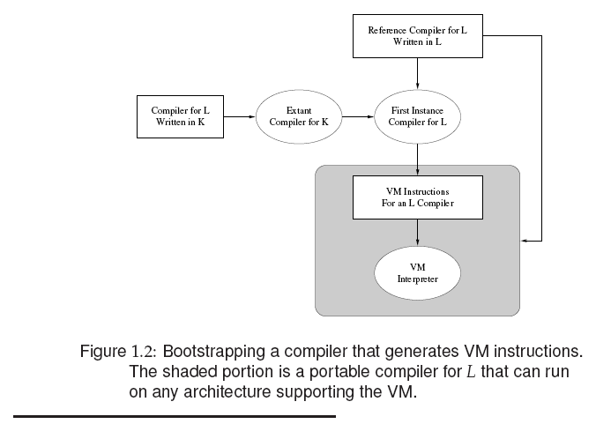
Source code
Executable file
Java Compiler written in Java
C compiler
Compiler for Java written in C
Very first
Java compiler
Now we have executable Java Compiler written in Java

Slide 5
Steps in compilers
Read source code
Break input into Tokens
Put structure on tokens
Semantic analysis (Give meaning)
Produce output (machine code)

Slide 6
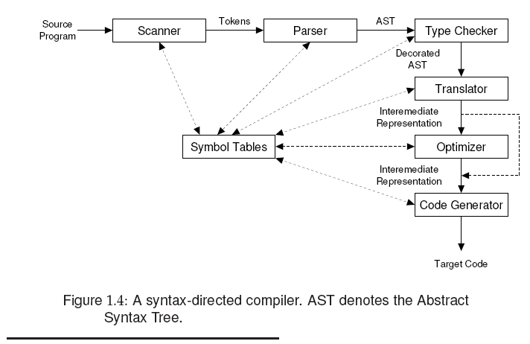
Scanner: read the input text character by character and group into tokens
Parser: read tokens and group them into phrases according to the syntax specification (Context Free Grammars)
Type Checker (Semantic Analysis): verifies that the construct the node represents is legal and meaningful
Translator: translated into Intermediate Code (e.g., tree structure)
Code Generator: map into target machine code
Symbol table: is a hash-like data structure to store information for identifiers

Slide 7
Scanner
Transform a character stream into a token stream
Why do we need a formal notations for specifying the structure of tokens?
e.g., public class test{}
test{} is not one token
How to know test is a token?
e.g., String constants in C, C++, Java, Pascal, Ada, etc
Double quote, new line?
e.g., rational constants?
0.0 vs. .0
0.1 vs. .1
Notes:
How to recognize stream to token?
public class test{}
test{} is not one token, it is 3 tokens

Slide 8
Context Free Grammar
What is a language?
A set of strings. A string is a sequence of symbols.
Context Free Grammar (CFG) is a representation of a language, G=(N,Σ,P,S)
nonterminal alphabet (N). Variables of the grammar
terminal alphabet (Σ). Set of tokens produced by the scanner
rewriting rules (productions P).
start symbol (S) that initiates all derivations

Slide 9
Context Free Grammar
The → symbol is used to define the rules
Non-terminal symbols S, NP, VP, DET, N, V
Terminal symbols: the, a, man, woman, shoots
The non-terminal symbols in this grammar have a traditional meaning in linguistics:
NP: noun phrase
VP: verb phrase
DET: determiner
N: noun
V: verb
S: sentence
S → NP VP
NP → DET N
VP → V NP
VP → V
DET → the
DET → a
N → man
N → woman
V → shoots

Slide 10
The grammar contains nine context free rules
A context free rule consists of:
A single non-terminal symbol
followed by →
followed by a finite sequence of terminal or non-terminal symbols
S → NP VP
NP → DET N
VP → V NP
VP → V
DET → the
DET → a
N → man
N → woman
V → shoots

Slide 11
Parse tree: Syntactic structure
S → NP VP
NP → DET N
VP → V NP
VP → V
DET → the
DET → a
N → man
N → woman
V → shoots
S
VP
NP NP
DET N V DET N
the woman shoots a man

Slide 12
If we are given a string of words, and a grammar, and it turns out we can build a parse tree, then we say that the string is grammatical (with respect to the given grammar)
E.g., the man shoots is grammatical
If we cannot build a parse tree, the given string is ungrammatical (with respect to the given grammar)
E.g., a shoots woman is ungrammatical
Parse tree vs. Abstract Syntax Tree

Slide 13
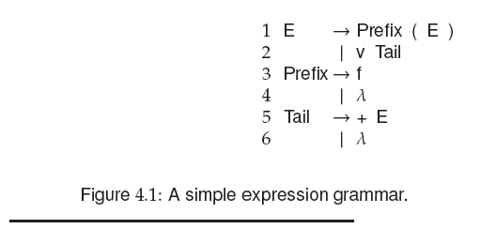
LHS: Left-hand side:: must be a single nonterminal
RHS: Right-hand side: is a string of zero or more vocabulary symbols
E →Prefix ( E )
E → v Tail
Prefix → f
Prefix → λ
Tail → + E
Tail → λ

Slide 14

Leftmost Derivations
lm
A leftmost derivation of f (v + v)
v represents a variable and f represents a function
E =>_{lm} Prefix ( E )
=>_{lm} f (E)
=>_{lm} f (v Tail)
=>_{lm} f (v + E)
=>_{lm} f (v + v Tail)
=>_{lm} f (v + v)
CFG

Slide 15
Rightmost Derivations
rm
A leftmost derivation of f (v + v)
v represents a variable and f represents a function
E =>_{lm} Prefix ( E )
=>_{lm} Prefix (v Tail)
=>_{lm} Prefix (v + E)
=>_{lm} Prefix (v + v Tail)
=>_{lm} Prefix (v + v)
=>_{lm} f (v + v)
CFG

Slide 16
Derivation
Starting with S, expand nonterminals until only terminals remain.
Leftmost derivation expands from left to right
Rightmost derivation expands from right to left
Notes:
Throughout a derivation, if more than one nonterminal is present in a form, then there is a choice as to which nonterminal should be expanded in the next step.
Each rewrite is a step in a derivation of the resulting string.
The set of terminal strings derivable from S comprises the CFL of grammar G, denoted L(G)

Slide 17
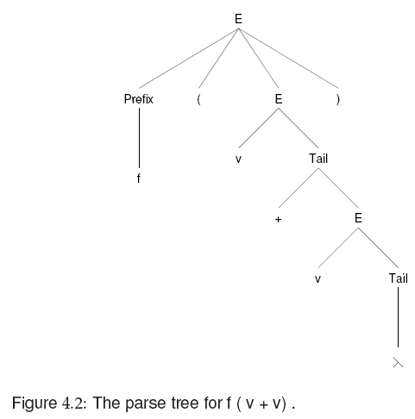
All interior nodes are nonterminals.
Each leaf node is either a terminal symbol or λ
No matter how we derive f (v + v), we get the same parse tree
Unless, the CFG is ambiguous

Slide 18
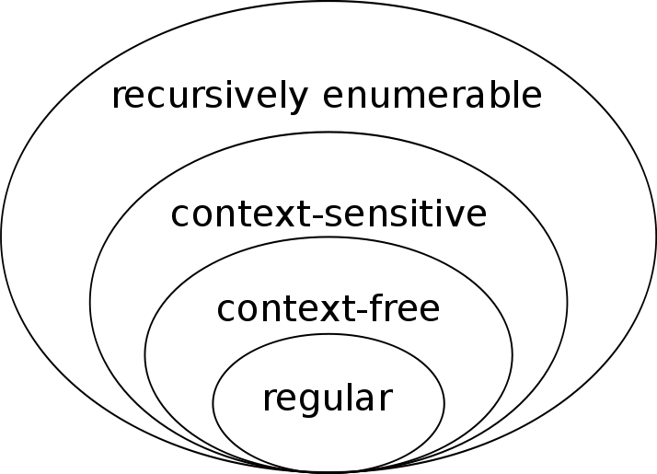
Other types of Grammars
CFGs serves well to characterize syntax, but some languages contain rules that are not expressible using CFGs.
Most programming language grammars are context-free
So, context-sensitive and recursively enumerable examples are not related to programming languages
Chomsky Hierarchy

Slide 19
Parser
Given an input string, how can we show why the string IS or IS NOT in the grammar’s language?
This is the parsing problem. Parsers are responsible for discovering syntax errors in program.

Slide 20
Compiler Phase
Syntactic Analysis
Grammar check
Scanner (input: source code, output: token stream)
Parser (input: token stream, output: AST)
Semantic Analysis
Create symbol table
input: AST, output: Symbol Table
Type, dead code, exception handling check, etc
input: AST and Symbol table
output: decorated AST
Translator
Convert source code to intermediate code
input: symbol table, AST,
output: intermediate code (e.g., JVM bytecode))
code generator
Convert Intermediate code to machine code
input: Intermediate code
output: machine code

Slide 21
Example Grammars
Roughly in increasing order of complexity
Lisp http://stackoverflow.com/questions/517113/lisp-grammar-in-yacc
JSON http://json.org/
Pascal http://www.cs.utexas.edu/~novak/grammar.html
Python http://docs.python.org/reference/grammar.html
XML http://www.w3.org/TR/xml11/
Java http://java.sun.com/docs/books/jls/first_edition/html/19.doc.html
SQL http://savage.net.au/SQL/
C++ http://www.nongnu.org/hcb/#basic.link
With C language grammar (handout), derive
a = a + 5;

Slide 22
Definite Clause Grammars
Prolog offers a special notation for defining grammars, namely DCGs (Definite Clause Grammars)
We will define a DCG for a formal language
A formal language is simple a set of strings
Formal languages are objects that computer scientist and mathematicians define and study
Natural languages are languages that human beings normally use to communicate

Slide 23
A rule defined via --> instead of :-
Simply, a notation for writing grammars that hides the underlying difference list variables
A Difference List in Prolog is a normal list except the very end of it is a logic variable, paired with that variable. For Example, [a,b,c|E]-E

Slide 24
Difference lists vs. DCGs
s(A-C):- np(A-B), vp(B-C).
np(A-C):- det(A-B), n(B-C).
vp(A-C):- v(A-B), np(B-C).
vp(A-C):- v(A-C).
det([the|W]-W).
det([a|W]-W).
n([man|W]-W).
n([woman|W]-W).
v([shoots|W]-W).
s --> np, vp.
np --> det, n.
vp --> v, np.
vp --> v.
det --> [the].
det --> [a].
n --> [man].
n --> [woman].
v --> [shoots].
Difference List
[a,b,c]-[] is the list [a,b,c]
[a,b,c,d]-[d] is the list [a,b,c]
[a,b,c|T]-T is the list [a,b,c]
X-X is the empty list []
it is not easy to understand and it is a pain having to keep track of all those difference list variables

Slide 25
DCGs: first example
s(X,Y)
Y is kind of free variable, kind of formality of difference list.
s --> np, vp.
np --> det, n.
vp --> v, np.
vp --> v.
det --> [the].
det --> [a].
n --> [man].
n --> [woman].
v --> [shoots].
?- s ([a,man,shoots,a,woman],[ ]).
true
?- s ([a,man,shoots,a,woman, woman], [woman]).
true
?- s ([a,man,shoots,a], []).
false
?- s ([a,man,shoots,a,woman]).
ERROR
Try (later) the following queries in your terminal.
?- s(X,[]).
?- s(X,Y).
?- s([the,man|Y],Y).
?- s([woman|Y],Y).
?- s([a,woman|Y],Y).
Notes:
s(X,Y)
Y is kind of free variable, kind of formality of difference list.

Slide 26
Think-aloud exercise
What are the first response that Prolog gives to the query s(X,[])?
s --> foo,bar,wiggle. foo --> [choo]. foo --> foo,foo. bar --> mar,zar. mar --> me,my. me --> [i]. my --> [am]. zar --> blar,car. blar --> [a]. car --> [train]. wiggle --> [toot]. wiggle --> wiggle,wiggle.
?- s(X,[]).
X = [choo, i, am, a, train, toot] ;
…

Slide 27
DCGs: second example
s --> s, conj, s.
s --> np, vp.
np --> det, n.
vp --> v, np.
vp --> v.
det --> [the].
det --> [a].
n --> [man].
n --> [woman].
v --> [shoots].
conj --> [and].
conj --> [or].
conj --> [but].
We added some recursive rules to the grammar…
What does Prolog do with this DCG?
Same thing happens when we saw left recursion before.

Slide 28
DCG without left-recursive rules
s --> simple_s.
s --> simple_s, conj, s.
simple_s --> np, vp.
np --> det, n.
vp --> v, np.
vp --> v.
det --> [the].
det --> [a].
n --> [man].
n --> [woman].
v --> [shoots].
conj --> [and].
conj --> [or].
conj --> [but].
DCGs are not magic
The moral: DCGs are a nice notation, but you cannot write arbitrary context-free grammars as a DCG and have it run without problems
DCGs are ordinary Prolog rules in disguise
So keep an eye out for left-recursion!

Slide 29
DCGs: third example
We will define the formal language a^{n}b^{n}
?- s([a,a,a,b,b,b],[]).
true
?- s([a,a,a,a,b,b,b],[]).
false
?- s(X,[]).
X = [];
X = [a,b];
X = [a,a,b,b];
X = [a,a,a,b,b,b]
s --> [].
s --> l,s,r.
l --> [a].
r --> [b].

Slide 30
Let a^{n}b^{2n} be the formal language which contains all strings of the following form: an unbroken block of as of length n, followed by an unbroken block of bs of length 2n, and nothing else.
For example, abb, aabbbb, and aaabbbbbb belong to a^{n}b^{2n} , and so does the empty string. Write a DCG that generates this language.
s --> [].
s --> l,s,r,r.
l --> [a].
r --> [b].

