Slide 1

Artificial Intelligence
Nell Dale & John Lewis
(adaptation by Michael Goldwasser and Erin Chambers)

Slide 2

Limitations of Computers?
Are there tasks which cannot easily be automated? If so, what are the limitations?
How do computers abilities compare to that of humans?

Slide 3
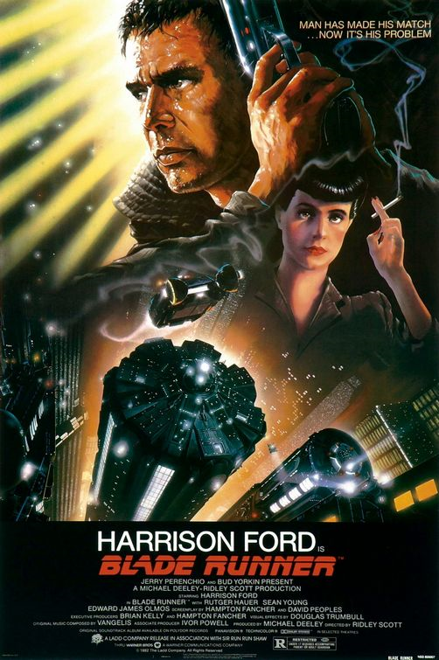
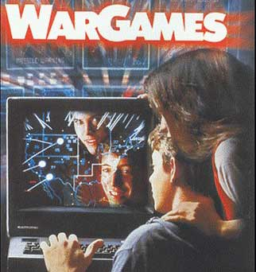

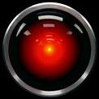
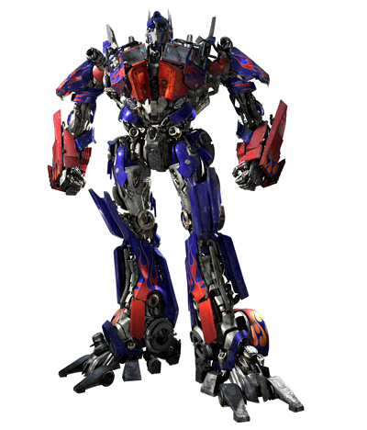
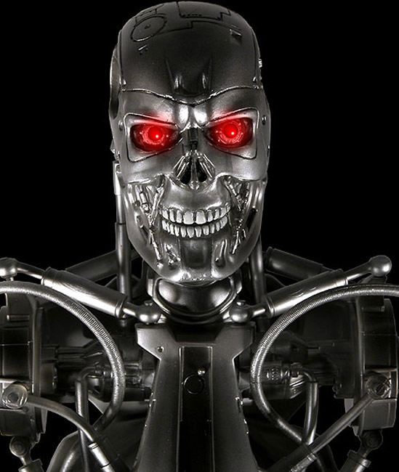
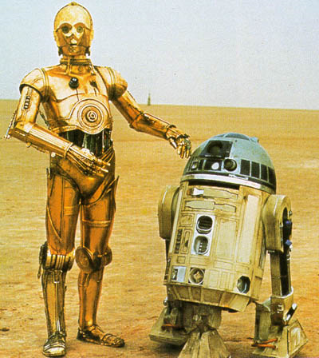
What is AI?

Slide 4
Computer vs. Humans?
A computer can do some things better than a human can
  Adding a thousand four-digit numbers
  Drawing complex, 3D images
  Store and retrieve massive amounts of data

Slide 5
Computer vs. Humans?
Let’s reverse the tables.
Name some things that a human can do better than a computer.

Slide 6
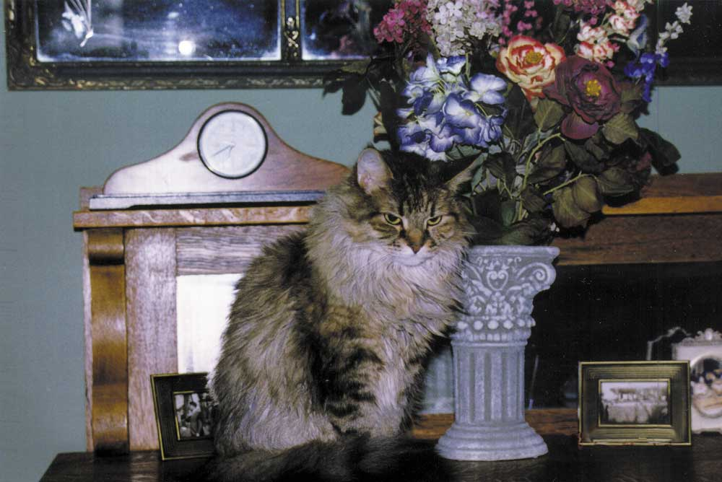
Computer vs. Human
Point out the cat in the picture
  A computer might have difficulty making that identification
Figure 13.1 A computer might have trouble identifying the cat in this picture.

Slide 7
Computer vs. Humans?
Could the following occupations be performed by computers? If so, should they be?
  Postman
  Bookstore Clerk
  Librarian
  Doctor
  Lawyer
  Judge
  Professor

Slide 8
Artificial Intelligence
The field of artificial intelligence (AI) is the study of computer systems that attempt to model and apply the intelligence of the human mind
Of course, first we have to understand why we use the term “intelligence” in regard to humans.
  What defines “intelligence”?
  Why is it that we assume humans are intelligent?
  Are monkeys intelligent? Dogs? Ants? Pine trees?

Slide 9
Early History (1950s)
In 1950 English mathematician Alan Turing wrote a landmark paper titled “Computing Machinery and Intelligence” that asked the question: “Can machines think?”
Further work came out of a 1956 workshop at Dartmouth sponsored by John McCarthy. In the proposal for that workshop, he coined the phrase a “study of artificial intelligence”

Slide 10
Can machines think?
So Turing asked: “Can machines think?” He felt that such machines would eventually be constructed.
But he also realized a bigger problem. How would we know if we’ve succeeded?

Slide 11
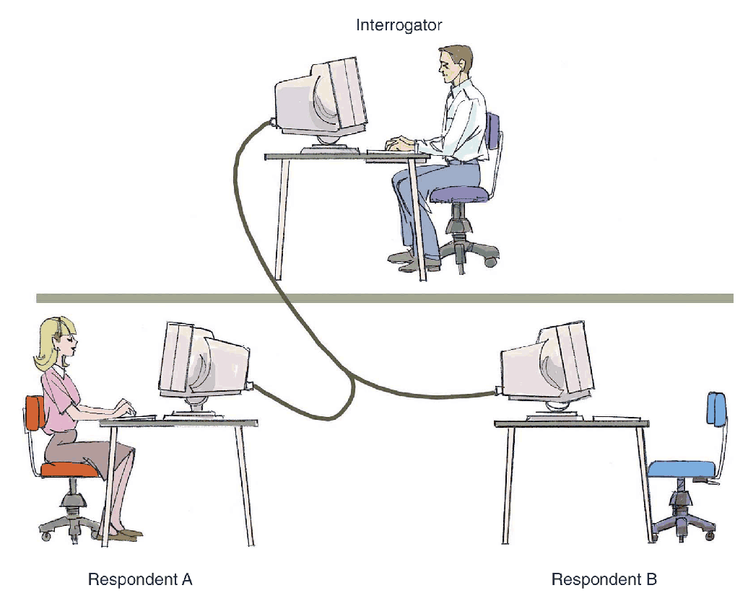
The Turing Test
Figure 13.2
In a Turing test, the interrogator must determine which respondent is the computer and which is the human

Slide 12
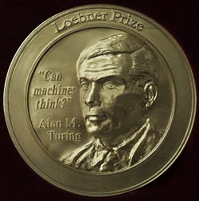
The Turing Test
Loebner prize
The first formal instantiation
of the Turing test, held
annually
Chatbots
A program designed to carry on a conversation with a human user

Slide 13
The Turing Test
Passing the Turing Test does not truly show that the machine was thinking. It simply shows that it generated behavior consistent with thinking.
weak equivalence: the two systems (human and computer) are equivalent in results (output), but they do not necessarily arrive at those results in the same way
Strong equivalence: the two systems use the same internal processes to produce results

Slide 14
Overview of Issues
We want to compare the way that computers and humans work to see if we can better understand why each have their (computational) strengths.
  Processing Models
  Knowledge Representation
  Reasoning

Slide 15
The Human Brain
Let’s first look at how a biological neural network works
  A neuron is a single cell that conducts a chemically-based electronic signal
  At any point in time a neuron is in either an excited or inhibited state

Slide 16
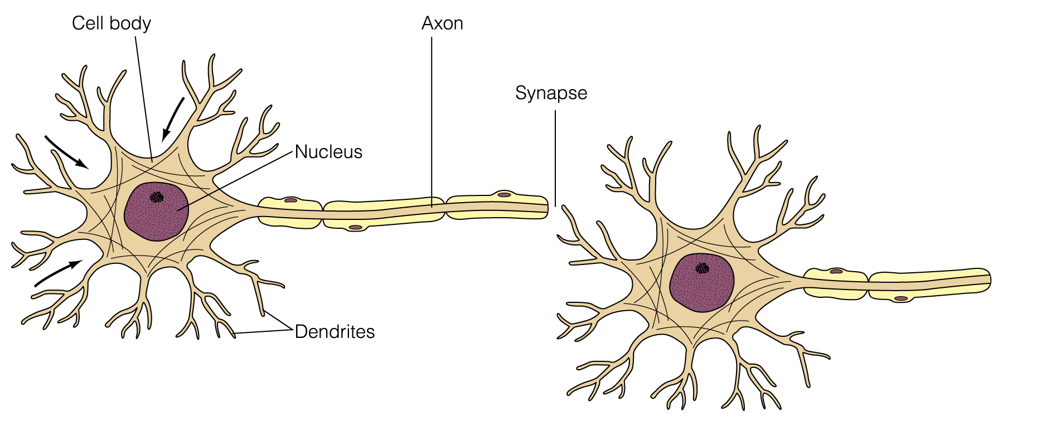
The Human Brain
Figure 13.6 A biological neuron

Slide 17
The Human Brain
  A series of connected neurons forms a pathway
  A series of excited neurons creates a strong pathway
  A biological neuron has multiple input tentacles called dendrites and one primary output tentacle called an axon
  The gap between an axon and a dendrite is called a synapse

Slide 18
The Human Brain
A neuron accepts multiple input signals and then controls the contribution of each signal based on the “importance” the corresponding synapse gives to it
The pathways along the neural nets are in a constant state of flux
As we learn new things, new strong neural pathways in our brain are formed

Slide 19
Artificial Neural Networks
Some have tried to use computers to mimic the neural network model of the human brain.
Each processing element in an artificial neural net is analogous to a biological neuron
  An element accepts a certain number of input values and produces a single output value of either 0 or 1
  Associated with each input value is a numeric weight

Slide 20
Artificial Neural Networks
  The effective weight of the element is defined to be the sum of the weights multiplied by their respective input values
    v1*w1 + v2*w2 + v3*w3
  Each element has a numeric threshold value
  If the effective weight exceeds the threshold, the unit produces an output value of 1
  If it does not exceed the threshold, it produces an output value of 0

Slide 21
Artificial Neural Networks
The process of adjusting the weights and threshold values in a neural net is called training
A neural net can presumably be trained to produce whatever results are required
(Ay, there’s the rub)

Slide 22
Human vs. Computer
Human Brain
Massively Parallel Computer
Neurotransmitters travel at rate of perhaps 1000 feet/second.
Electrons travel at speed of light (186000 miles/second)
speed
Roughly 100 billion neurons; estimated to represent equivalent of 50 trillion bits.
The top supercomputers today might approach this much memory.
memory
Each neuron connected to roughly 1000 other neurons
Processor perhaps connected to up to 100 other processors
communication

Slide 23
Knowledge Representation
The first example we consider is the use of a search tree to represent the state of knowledge.
Another example we consider is a knowledge-based system which reasons based upon the notion of a semantic network.

Slide 24
Search Trees
Search tree A structure that represents all possible moves in a game, for both you and your opponent
The paths down a search tree represent a series of decisions made by the players

Slide 25
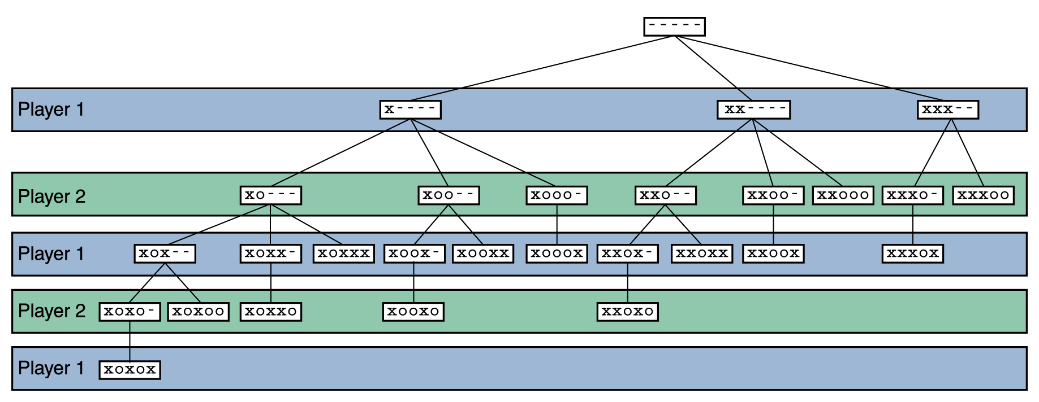
Search Trees
Figure 13.4 A search tree for a simplified version of Nim

Slide 26
Search Trees
Techniques for searching trees
Depth-first A technique that involves the analysis of selected paths all the way down the tree
Breadth-first A technique that involves the analysis of all possible paths but only for a short distance down the tree

Slide 27
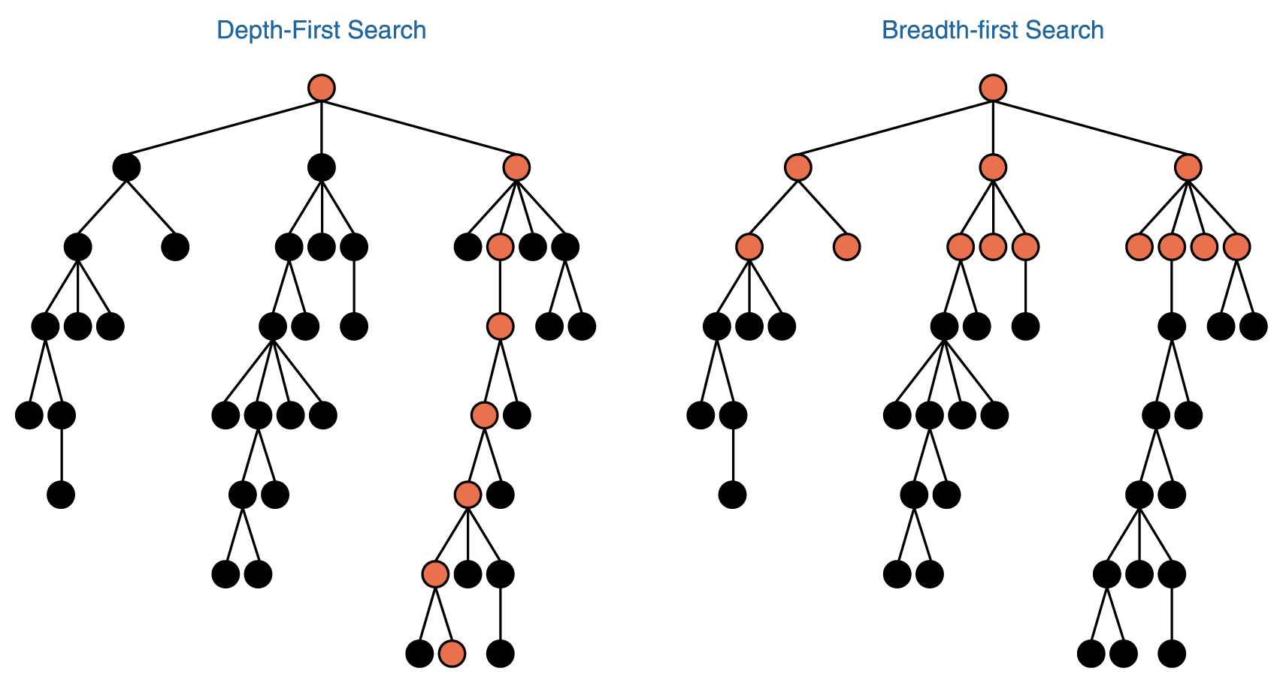
Search Trees
Figure 13.5 Depth-first and breadth-first searches

Slide 28
Search Trees
Search tree analysis can be applied nicely to other, more complicated games such as chess
Because these trees are so large, only a fraction of the tree can be analyzed in a reasonable time limit, even with modern computing power

Slide 29
Semantic Networks
Semantic network A knowledge representation technique that focuses on the relationships between objects
A directed graph is used to represent a semantic network or net

Slide 30
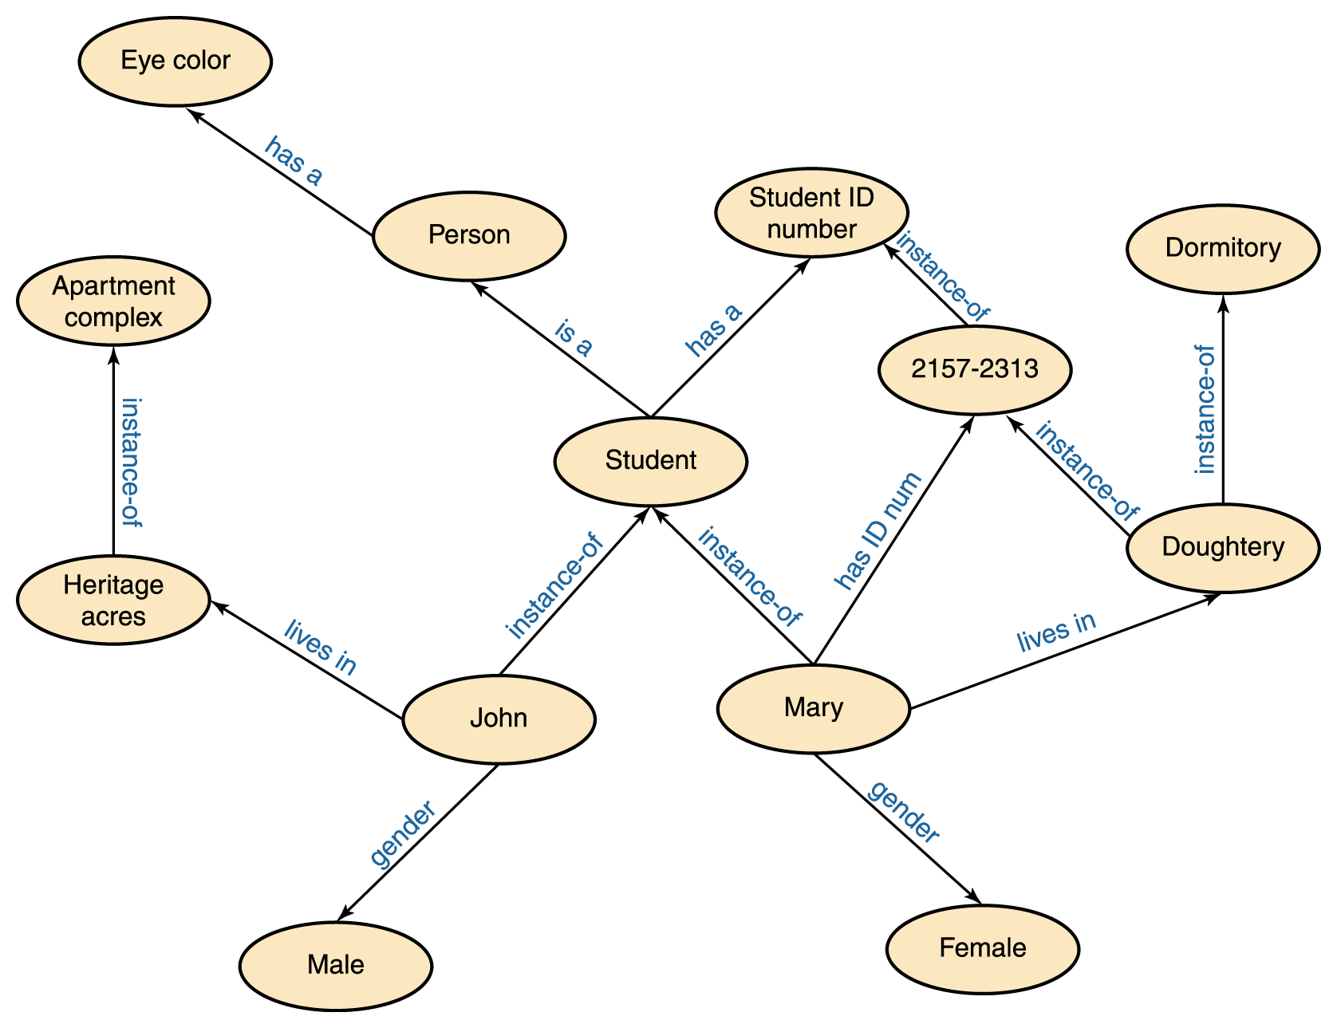
Semantic Networks
Figure 13.3 A semantic network

Slide 31
Semantic Networks
The relationships that we represent are completely our choice, based on the information we need to answer the kinds of questions that we will face
The types of relationships represented determine which questions are easily answered, which are more difficult to answer, and which cannot be answered

Slide 32
Expert Systems
Knowledge-based system
Software that uses a specific set of information, from which it extracts and processes particular pieces
Expert system
A software system based the knowledge of human experts; it is
  Rule-based system
  A software system based on a set of if-then rules
  Inference engine
  The software that processes rules to draw conclusions

Slide 33
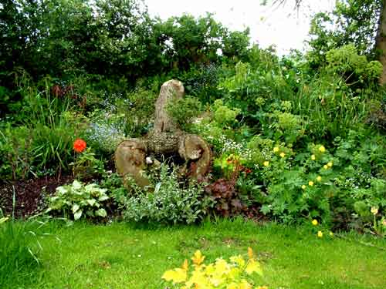
Expert Systems
Gardner Expert System Example

Slide 34
Expert Systems
Named abbreviations that represent conclusions
  NONE—apply no treatment at this time
  TURF—apply a turf-building treatment
  WEED—apply a weed-killing treatment
  BUG—apply a bug-killing treatment
  FEED—apply a basic fertilizer treatment
  WEEDFEED—apply a weed-killing and fertilizer combination treatment

Slide 35
Expert Systems
Boolean variables needed to represent state of the lawn
  BARE—the lawn has large, bare areas
  SPARSE—the lawn is generally thin
  WEEDS—the lawn contains many weeds
  BUGS—the lawn shows evidence of bugs

Slide 36
Expert Systems
Data that is available
  LAST—the date of last lawn treatment
  CURRENT—current date
  SEASON—the current season
  Now we can formulate some rules for our
  gardening expert system

Slide 37
Expert Systems
Some rules
  if (CURRENT – LAST < 30) then NONE
  if (SEASON = winter) then not BUGS
  if (BARE) then TURF
  if (SPARSE and not WEEDS) then FEED
  if (BUGS and not SPARSE) then BUG
  if (WEEDS and not SPARSE) then WEED
  if (WEEDS and SPARSE) then WEEDFEED

Slide 38
Expert Systems
An execution of our inference engine
  System: Does the lawn have large, bare areas?
  User: No
  System: Does the lawn show evidence of bugs?
  User: No
  System: Is the lawn generally thin?
  User: Yes
  System: Does the lawn contain significant weeds?
  User: Yes
  System: You should apply a weed-killing and fertilizer combination treatment.

Slide 39
Natural Language Processing
There are three basic types of processing going on during human/computer voice interaction
  Voice recognition—recognizing human words
  Natural language comprehension—interpreting human communication
  Voice synthesis—recreating human speech
Common to all of these problems is the fact that we are using a natural language, which can be any language that humans use to communicate

Slide 40
Voice Synthesis
There are two basic approaches to the solution
  Dynamic voice generation
  Recorded speech
To generate voice output using dynamic voice generation, a computer examines the letters that make up a word and produces the sequence of sounds that correspond to those letters in an attempt to vocalize the word
Human speech has been categorized into specific sound units called phonemes

Slide 41
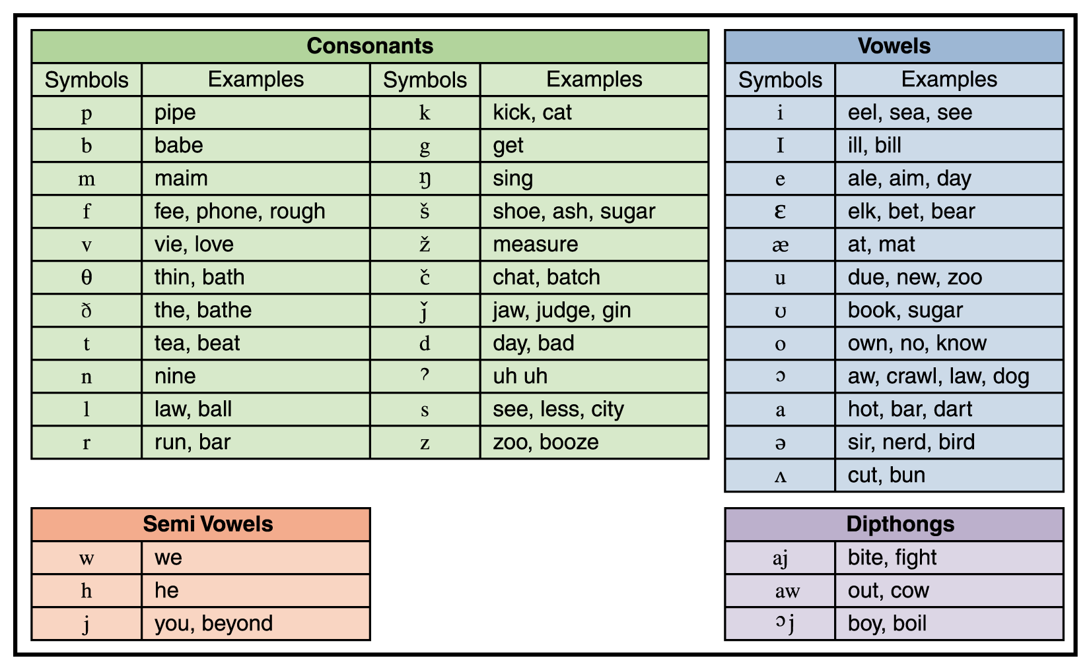
Voice Synthesis
Figure 13.7 Phonemes for American English

Slide 42
Voice Synthesis
The other approach to voice synthesis is to play digital recordings of a human voice saying specific words
  Telephone voice mail systems often use this approach: “Press 1 to leave a message for Alex Wakefield”

Slide 43
Voice Synthesis (cont.)
Each word or phrase needed must be recorded separately
Furthermore, since words are pronounced differently in different contexts, some words may have to be recorded multiple times
  For example, a word at the end of a question rises in pitch compared to its use in the middle of a sentence

Slide 44
Voice Recognition
The sounds that each person makes when speaking are unique
We each have a unique shape to our mouth, tongue, throat, and nasal cavities that affect the pitch and resonance of our spoken voice
Speech impediments, mumbling, volume, regional accents, and the health of the speaker further complicate this problem

Slide 45
Voice Recognition (cont.)
Furthermore, humans speak in a continuous, flowing manner
  Words are strung together into sentences
  Sometimes it’s difficult to distinguish between phrases like “ice cream” and “I scream”
  Also, homonyms such as “I” and “eye” or “see” and “sea”
Humans can often clarify these situations by the context of the sentence, but that processing requires another level of comprehension
Modern voice-recognition systems still do not do well with continuous, conversational speech

Slide 46
Natural Language Comprehension
Even if a computer recognizes the words that are spoken, it is another task entirely to understand the meaning of those words
Natural language is often ambiguous, for a variety of reasons. Let’s look at several classes of ambiguity (though admittedly there is some overlap in such a classification)

Slide 47
Lexical Ambiguity
A single word can have two meanings.
  “The bat slipped from his hand”
  “Cinderella had a ball”
  “Ron lies asleep in his bed”
Worse yet, those meanings may even constitute different parts of speech.
  “Time flies like an arrow”
  “They are racing horses”
  “Stampeding cattle can be dangerous”

Slide 48
Syntactic Ambiguity
Even if all words have a clear meaning, ambiguity may exist because the phrases can be combined in several ways when parsing.
  “I saw the Grand Canyon flying to New York”
  “The clams are ready to eat”
  “I saw the man in the park with the telescope”

Slide 49
Referential Ambiguity
Pronouns may cause ambiguity when it is not clear which noun is being referenced.
  “The brick fell on the computer but it is not broken”
  “Jon met Bill before he went to the store”

Slide 50
Rules of Conversation
  “Do you know what time it is?”
    Presumably, a correct response is “Yes.”
    Does this sentence’s meaning change if it is said by your boss when you walk into a meeting 30 minutes late?
  “Do you know you have a flat tire?”
  “I’d like to ask everyone to raise their hand for two seconds.”
    How did you respond?

Slide 51
Need for “real world” knowledge
  “Norman Rockwell painted people”
    Did he do tattoos? Face-painting?

Slide 52
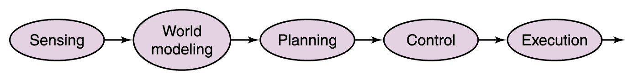
Robotics
Mobile robotics
The study of robots that move relative to their environment, while exhibiting a degree of autonomy
Sense-plan-act (SPA) paradigm
The world of the robot is represented in a complex semantic net in which the sensors on the robot are used to capture the data to build up the net
Figure 13.8 The sense-plan-act (SPA) paradigm

Slide 53
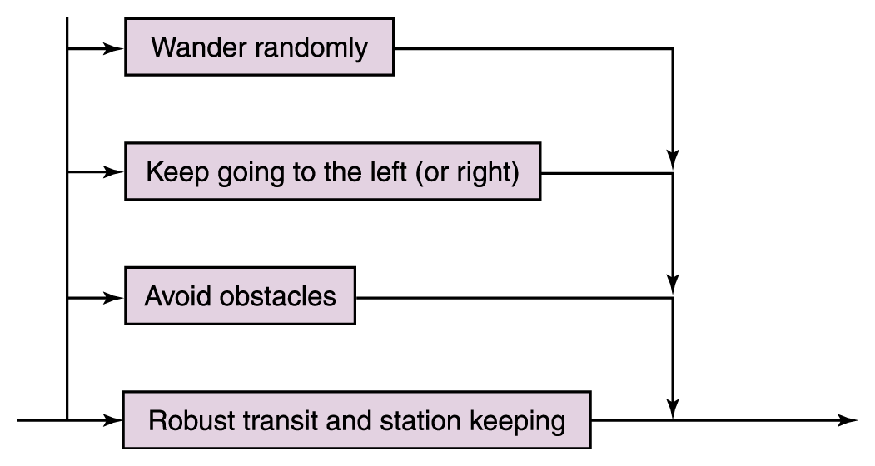
Subsumption Architecture
Rather than trying to model the entire world all the time, the robot is given a simple set of behaviors each associated with the part of the world necessary for that behavior
Figure 13.9
The new control paradigm

Slide 54
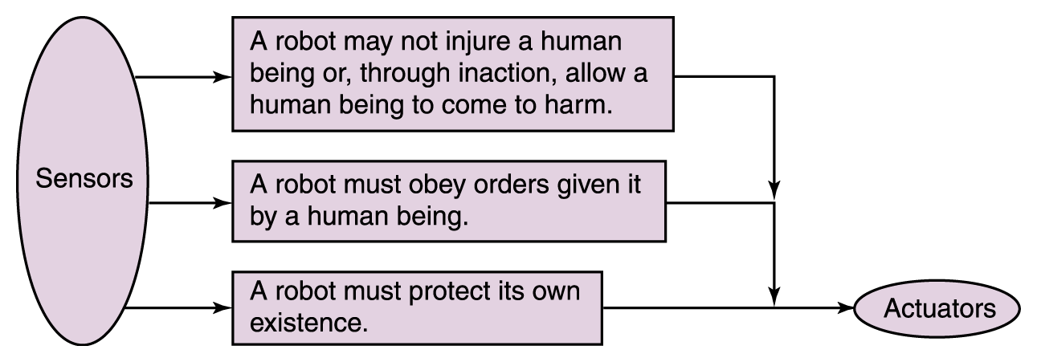
Subsumption Architecture
Figure 13.10 Asimov’s laws of robotics are ordered.

Slide 55
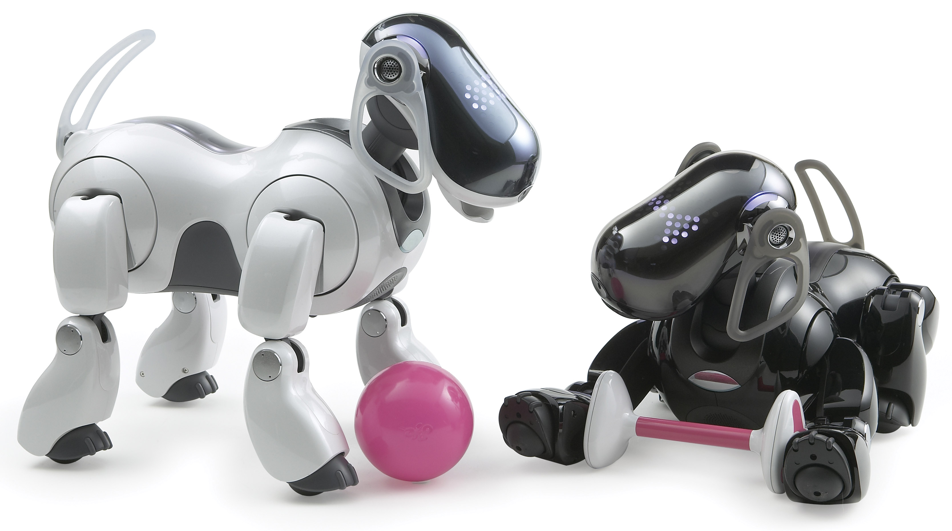
Robots
Sony's Aibo

Slide 56
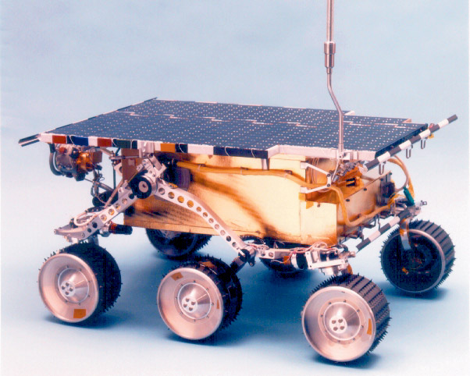
Robots
Sojourner
Rover

Slide 57
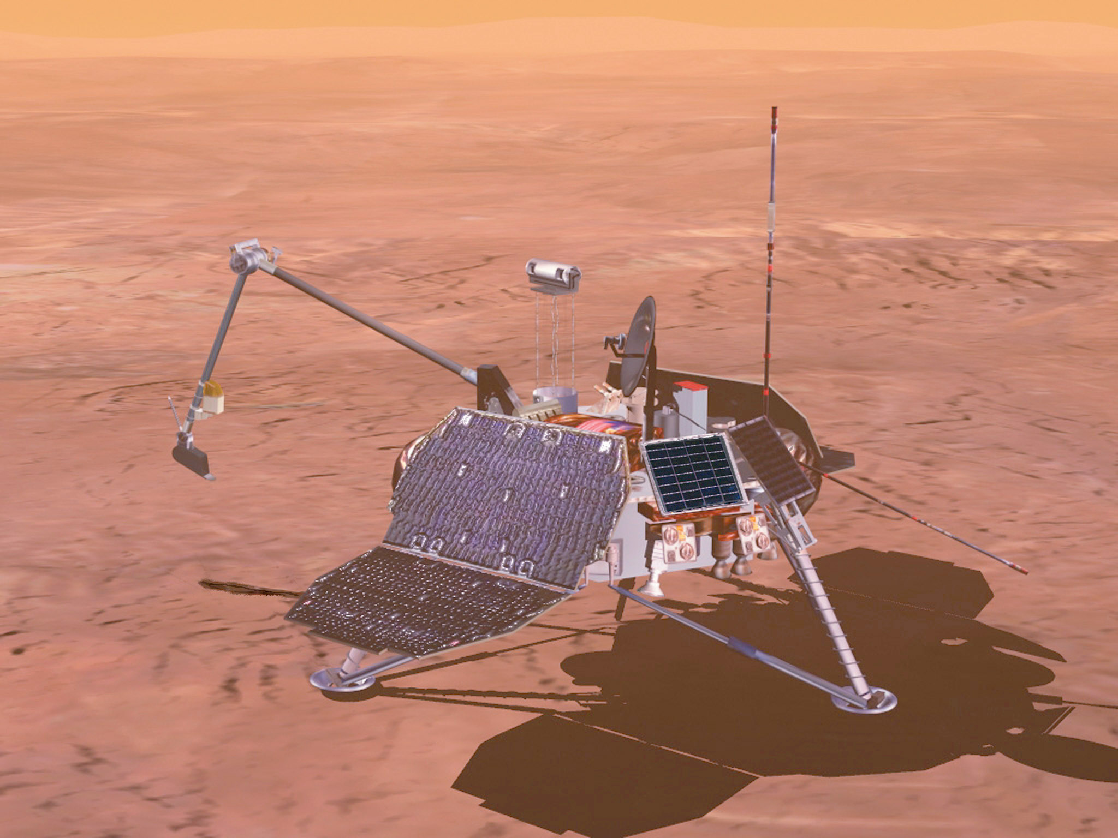
Robots
Spirit or
Opportunity

