Slide 1

Chapter 7
Low-Level Programming Languages
(slides modified by Erin Chambers)

Slide 2

Computer Operations
Computer
A programmable electronic device that can store, retrieve, and process data
Data and instructions to manipulate the data are all binary numbers and can be stored in the same place
  Recall: this is called the von Neumann architecture

Slide 3
Machine Language
Machine language
The language made up of binary coded instructions built into the hardware of a particular computer and used directly by the computer
Why would anyone choose to use machine language?
(Hint: they had no choice. Why?)

Slide 4
Machine Language
Characteristics of machine language:
  Every processor type has its own set
  of specific machine instructions
  The relationship between the processor and the instructions it can carry out is completely integrated
  Each machine-language instruction does only one very low-level task

Slide 5
Pep/7: A Virtual Computer
Virtual computer
A hypothetical machine designed to contain the important features of a real computer that we want to illustrate
Pep/7
A virtual computer designed by Stanley Warford that has 32 machine-language instructions
No; we are not going to cover all of them!

Slide 6
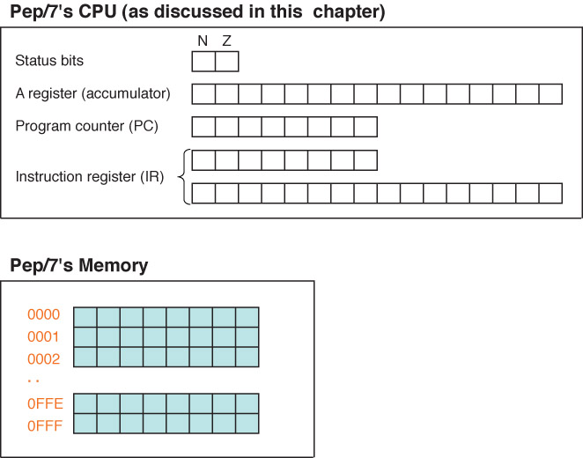
Features in Pep/7
Figure 7.1 Pep/7’s architecture

Slide 7

Features in Pep/7
Pep/7 Registers/Status Bits Covered
  The program counter (PC) (contains the address
  of the next instruction to be executed)
  The instruction register (IR)
  (contains a copy of the instruction being executed)

Slide 8
More Features
Pep/7 Registers/Status Bits Covered
  The accumulator (A register)
  Status bit N (1 if A register is negative; 0 otherwise)
  Status bit Z (1 if the A register is 0; and 0 otherwise)
The memory unit is made up of 4,096 bytes

Slide 9
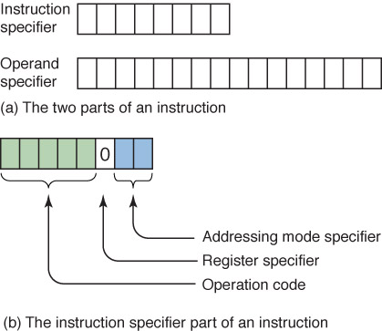
Instruction Format
Figure 7.2 The Pep/7 instruction format

Slide 10
Instruction Format
Operation code
  Specifies which instruction is to be carried out
  Register specifier
  Specifies which register is to be used (only use A in this chapter)
Addressing-mode specifier
  Says how to interpret the operand part of the instruction

Slide 11
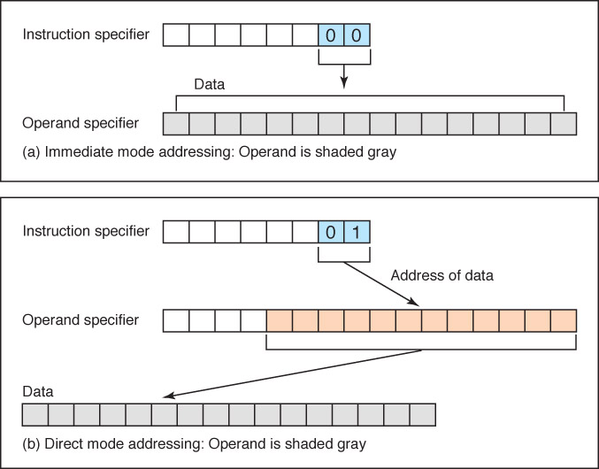
The Addressing Mode Specifier
Figure 7.3 Difference between immediate-mode and direct-mode addressing

Slide 12
Instruction Format
Is there something we are not telling you
about the addressing mode specifier?
How can you tell?

Slide 13
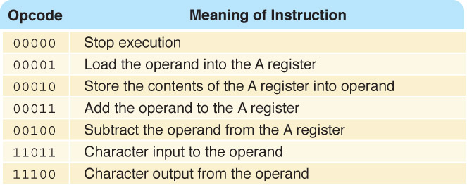
Some Sample Instructions
Figure 7.3 Subset of Pep/7 instructions

Slide 14


Sample Instructions
What do these instructions mean?

Slide 15


Sample Instructions
What do these instructions mean?

Slide 16


Sample Instructions
What do these instructions mean?

Slide 17


Sample Instructions
What do these instructions mean?

Slide 18
Algorithms
Write "Hello"
Write "Hell"
Write "H"
Write "e"
Write "l"
Write "l"
Write "o"
Are we concrete yet?
Are we concrete yet?

Slide 19
Algorithms
Write "Hell"
Write "H"
Write "e"
Write "l"
Write "l"
Write "o"
Is this concrete enough?
How can we explicitly tell the computer to print, and what to print?

Slide 20
How to print:
We use opcodes to tell the computer that it needs to print
Now how do we tell it what to print?

Slide 21
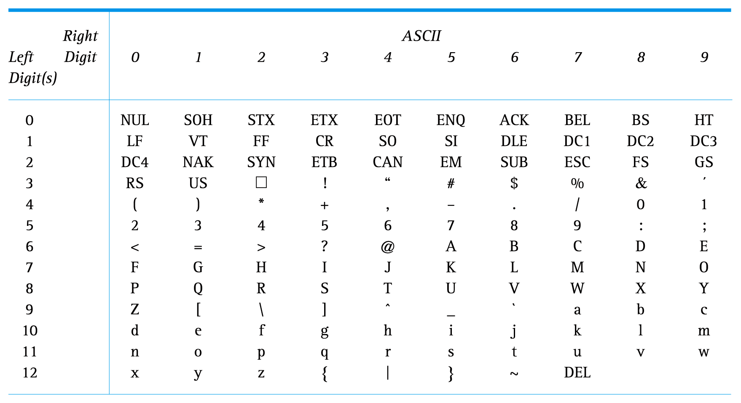
What to print: remember ASCII?
To print 'H', we need to look up ACSII code for H (and other letters)
Then, write that code in binary as our operand

Slide 22
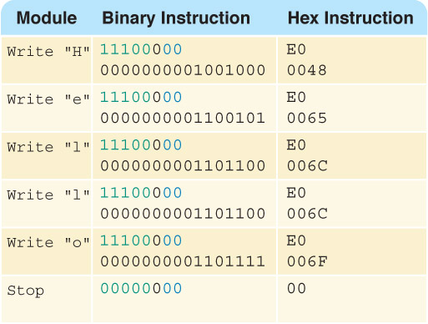
A Program Example

Slide 23

Hand Simulation
What is the fetch/execute cycle?
How much is the PC incremented?

Slide 24
Fetch/Execute Cycle
Fetch the next instruction
  How long is instruction here?
Decode the instruction
  Look up in table
Get data if needed
  If code is '01', then need to get value from memory location
Execute the instruction

Slide 25

Hand Simulation
What is the fetch/execute cycle here?

Slide 26

Hand Simulation
What is the fetch/execute cycle here?

Slide 27
Pep/7 Simulator
Pep7/Simulator
A program that behaves just like the Pep/7 virtual machine behaves
To run a program
Enter the hexadecimal code, byte by byte with blanks between each

Slide 28
Assembly Language
Assembly language
A language that uses mnemonic codes to represent machine-language instructions
Assembler
A program that reads each of the instructions in mnemonic form and translates it into the machine-language equivalent

Slide 29
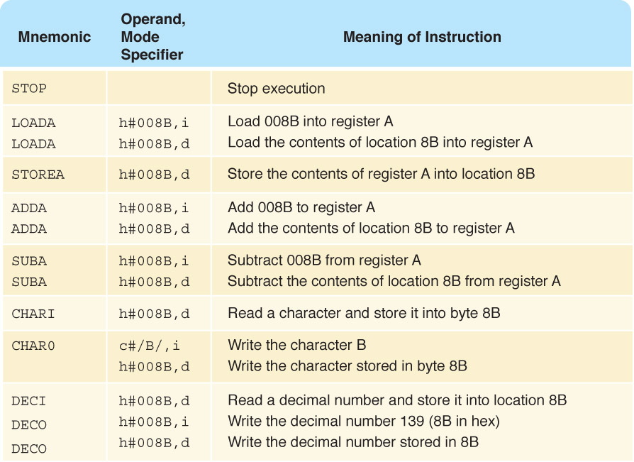
Pep/7 Assembly Language
Remember
the
difference
between
immediate
and
direct
addressing?
i : immediate
d: direct

Slide 30
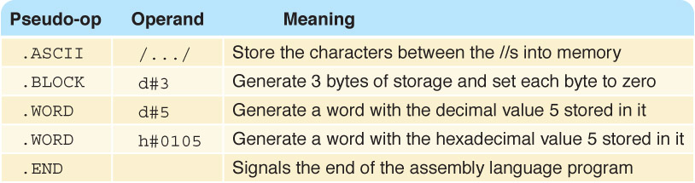
Pep/7 Assembly Language
What is the difference between
operations and pseudo operations?

Slide 31
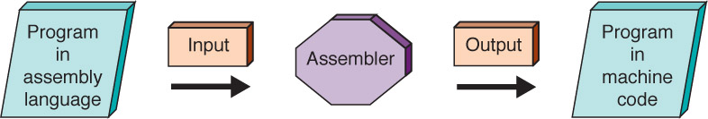
Assembly Process

Slide 32
A New Program
Reading and adding three numbers
Set sum to 0
Read num1
Add num1 to sum
Read num2
Add num2 to sum
Read num3
Addnum3 to sum
Write sum
Are we
concrete
yet?

Slide 33
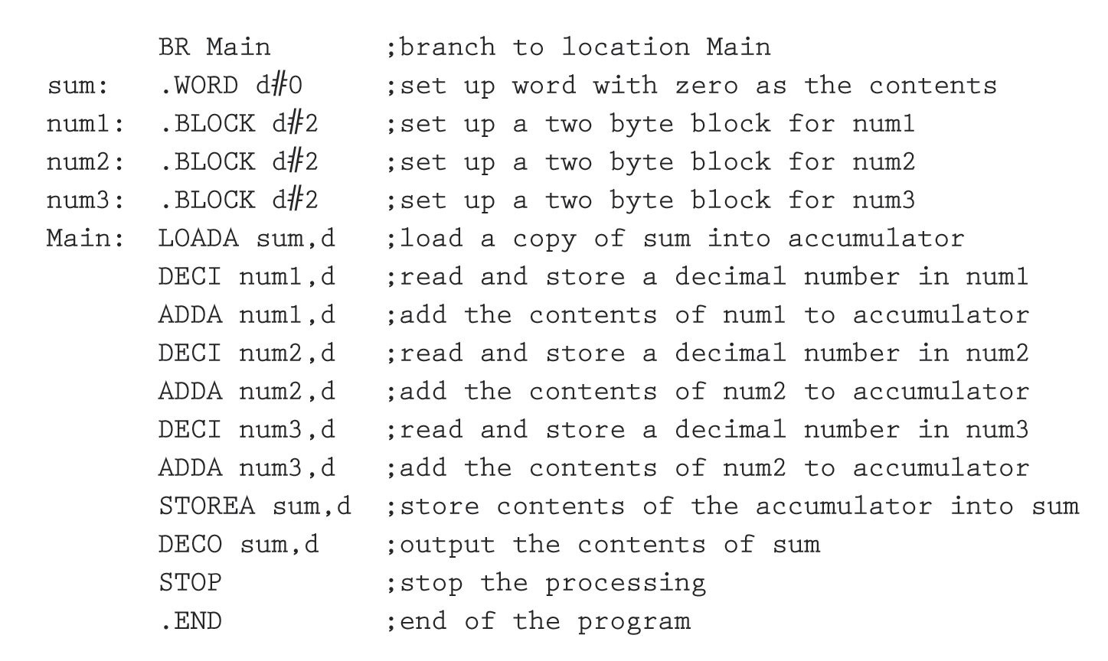
Our Completed Program

Slide 34
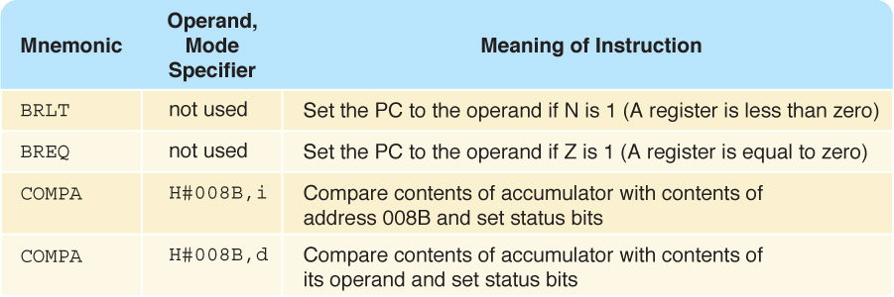
Decision Making
Remember the status bits A and Z?

Slide 35
Decision Making
Write "Error" if sum is negative.
…
Add num3 to sum
If sum is negative
Write "Error"
Else
Write sum
Are we
concrete yet?

Slide 36
Decision Making
Add num3 to sum
If status bit N is 1
Go to NegMsg
Write sum
Quit: STOP
NegMsg: Write the message and go to Quit
Are we concrete yet?

Slide 37
Decision Making
Read limit
Set sum to 0
While (limit is not zero)
Read number
Set sum to sum + number
Set limit to limit - 1
Are we concrete yet?

Slide 38
Decision Making
Set the accumulator to limit
Subtract one from the accumulator
Compare accumulator to zero
If status bit Z is 1
go to Quit
Else
go to Read
Are we concrete yet?

Slide 39
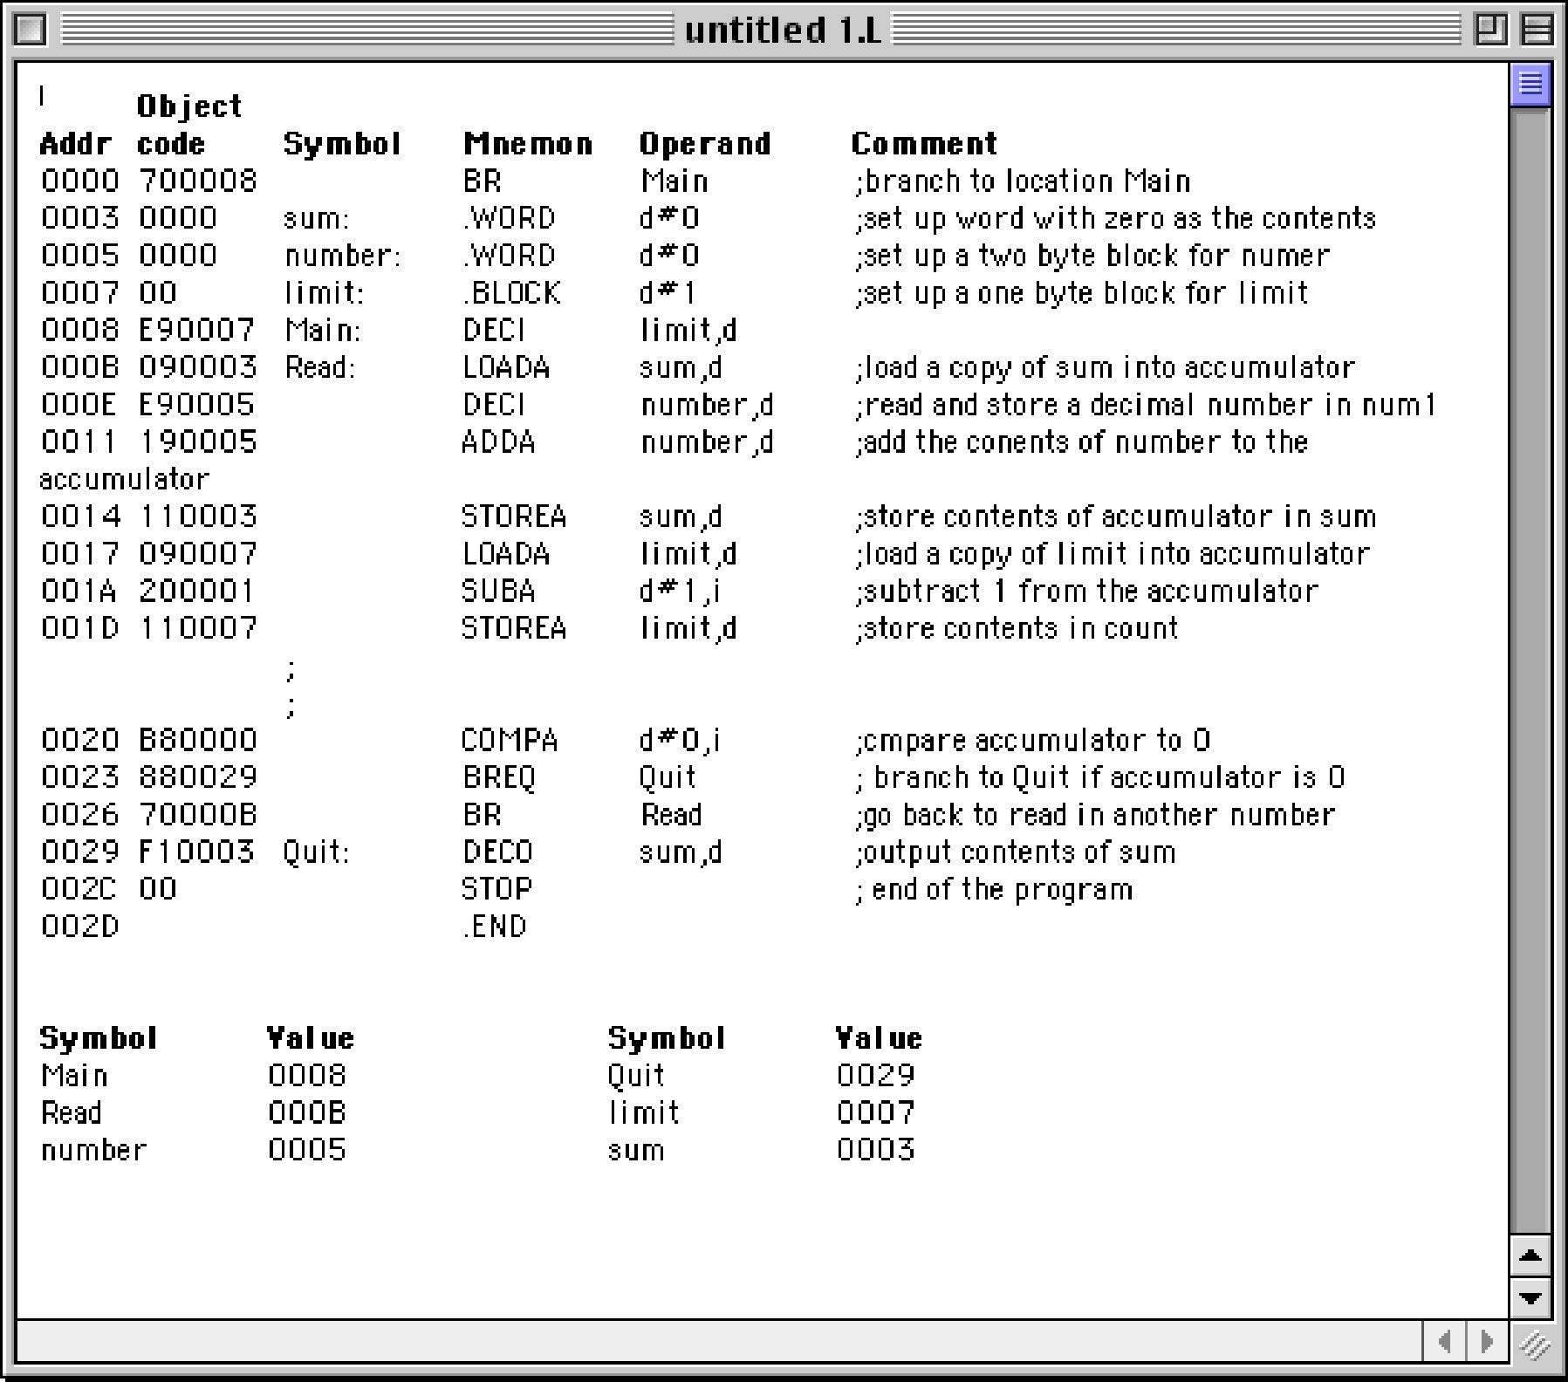
Decision Making

Slide 40
Testing
Test plan
A document that specifies how many times and with what data the program must be run in order to thoroughly test it
Code coverage
An approach that designs test cases by looking at
the code
Data coverage
An approach that designs test cases by looking at the allowable data values

