Slide 1

Operating Systems and scheduling
Nell Dale & John Lewis
(adaptation by Michael Goldwasser and Erin Chambers)

Slide 2

Computing Resources
Computing systems include many resources
Processor(s)
Main Memory
I/O Devices (keyboard, screen, mouse, …)
Storage Devices (harddisk, various drives)
Networking Devices

Slide 3
The Operating System (OS)
Operating system
System software that
  manages computer resources, such as memory and input/output devices
  provides an interface through which a human can interact with the computer
  allows an application program to interact with these other system resources

Slide 4
“The good old days…”
On early computers, a single program was executed at a time.
That program had full control over all of the computer’s resources
A human operator would control access to the computer, prioritizing which job to complete.

Slide 5
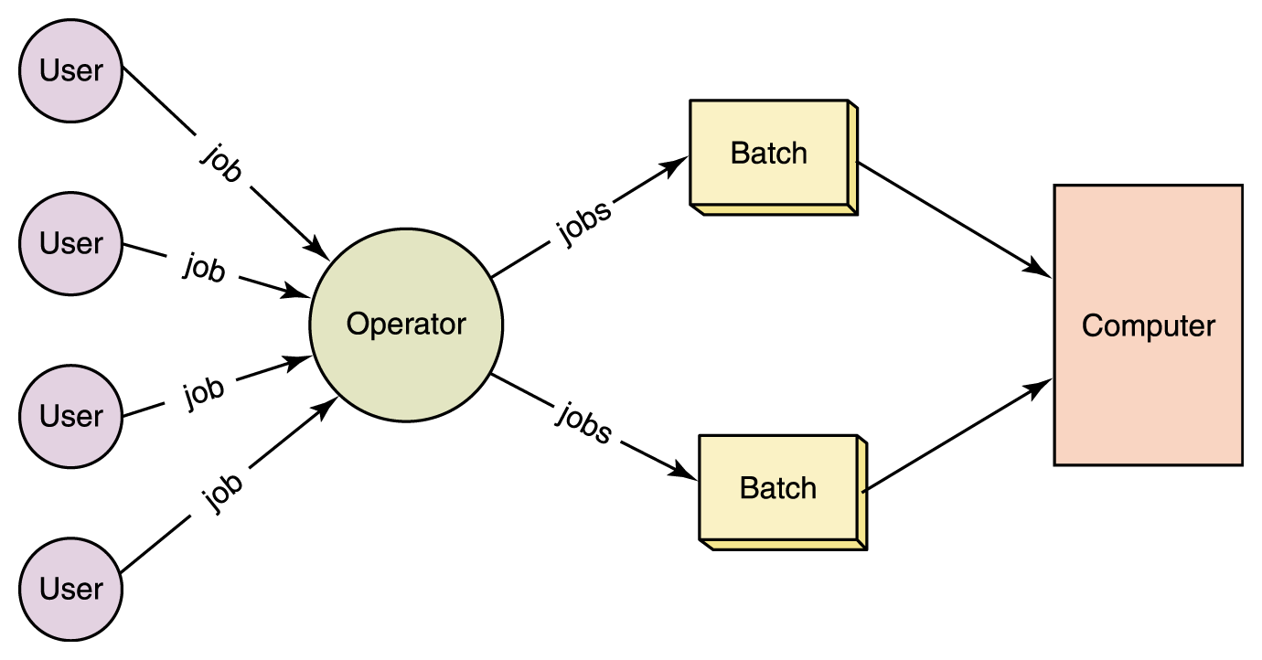
Batch Processing
Figure 10.2 In early systems, human operators would organize jobs into batches

Slide 6
Modern Operating Systems
Modern computing systems allow for many different users and programs to coexist in the system at the same time, through a technique known as multiprogramming.
An operating system manages all of a computer’s resources, controlling how they should be shared by the many users and programs which may exist.

Slide 7
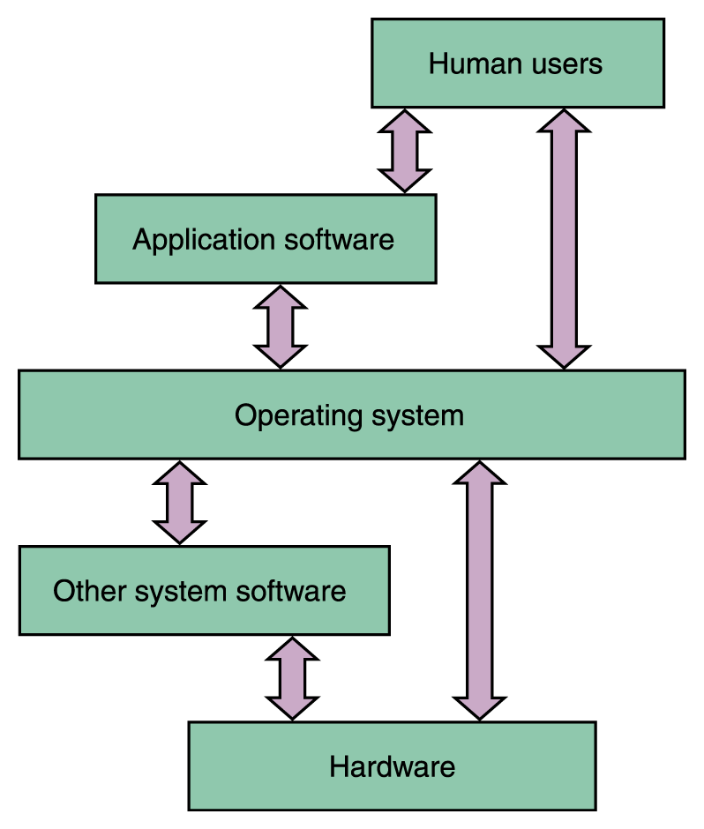
Operating System
Figure 10.1
An operating system interacts with many
aspects of a computer system.

Slide 8
Popular Operating Systems
Windows (98, NT, 2000, ME, XP, …)
UNIX
Linux (version of UNIX for PCs)
MacOS (though OS X is Unix based)

Slide 9
Roles of an OS
The various roles of an operating system generally revolve around the idea of “sharing nicely”
An operating system manages resources, and these resources are often shared in one way or another among programs that want to use them

Slide 10
Resource Management
CPU scheduling determines which process in memory is executed by the CPU at any given point
Memory management keeps track of what programs are in memory and where in memory they reside.
Network Communication
File Systems (who can read/write files)

Slide 11
Memory Management
Every time a program starts running, the CPU must determine where to put that program in memory
Remember, memory is small compared to the hard drive!
What happens when we don't leave enough space, or the program is too large to fit?

Slide 12

Single Contiguous MM
There are only two programs in memory
  The operating system
  The application program
This approach is called single contiguous memory management
Figure 10.4 Main memory divided into two sections

Slide 13
Single Contiguous MM
In concrete terms:
A logical address is simply an integer value relative to the starting point of the program
A physical address is a logical address added to the starting location of the program in main memory

Slide 14
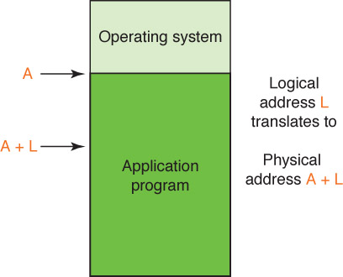
Single Contiguous MM
If A is location 100, and
the application program
is Program 1, then
sum is stored at location
123.
Figure 10.5 Binding a logical address to a physical one

Slide 15
Partition Memory Management
Single contiguous MM has only the OS and one other program in memory at one time
Partition MM has the OS and any number of other programs in memory at one time
There are two schemes for dividing up memory for programs:
  Fixed partitions Main memory is divided into a fixed number of partitions into which programs can be loaded
  Dymanic partitions Partitions are created as needed to fit the programs waiting to be loaded

Slide 16
Partition Memory Management
Memory is divided into a set of partitions, some empty and some allocated to programs
Base register
A register that holds the beginning address of the current partition (the one that is running)
Bounds register
A register that holds the length of the current partition

Slide 17
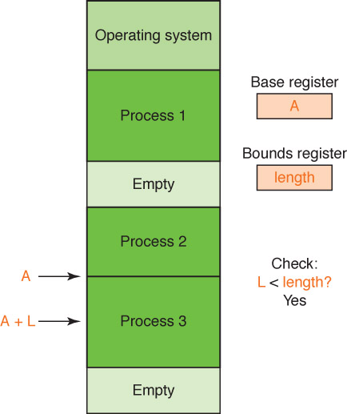
Partition Memory Management
Why check?
Figure 10.6
Address resolution
in partition memory management

Slide 18
Partition Selection Algorithms
Which partition should we allocate to a new program?
First fit Allocate program to the first partition big enough to hold it
Best fit Allocated program to the smallest partition big enough to hold it
Worst fit Allocate program to the largest partition big enough to hold it
Can you give a rationale for each?

Slide 19
Partition Selection Algorithms
A: 1000
B: 700
C: 750
D: 1500
E: 300
F: 350
Requests come in for blocks of
the following sizes:
1000, 25, 780, 1600, and 325
What block will be assigned
to each request if the
first-fit algorithm is used?
best-fit algorithm is used?
worst-fig algorithm is used?
(Treat each request as an
independent event)

Slide 20
Processes
Programs on a machine might be executed by the same user, by different users, or started by other applications.
We call an executing program a process.
(actually programs may control several processes)
During its life cycle, a process will need to use varying system resources.

Slide 21
Process Management
Process management is performed by the operating system. For each process, the OS must carefully track its progress, current state, all of its resource usage, etc.
Windows: see the “Task Manager”
Macintosh: see the “Activity Monitor”
Unix/Linux: see “top” command

Slide 22
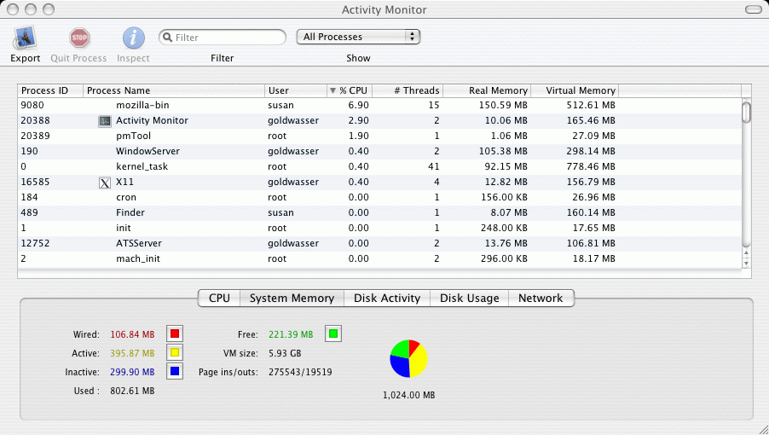
Activity Monitor

Slide 23
Process Control Block
The OS generally keeps what is called a Process Control Block (PCB) for each active process.
Such a PCB stores all needed information regarding that process.

Slide 24
Process State
Processes come and go. At any given time, a process is in one of these states:
“new” – being created as we speak
“running” – currently using the CPU
“ready” – would use the CPU if offered
“waiting” – even if offered CPU, it would still be waiting for other reasons
“terminated” – completed execution

Slide 25
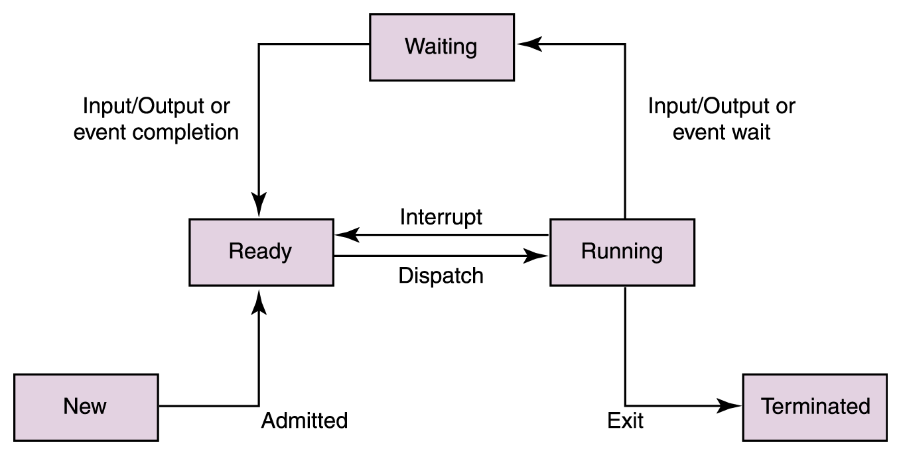
Process Life Cycle
Figure 10.8 The process life cycle

Slide 26
Sharing the CPU
Though many processes appear to run simultaneously, the CPU can execute only one program at a given time.
The Operating System is in charge of controlling the use of the CPU.
A variety of CPU scheduling policies can be used.

Slide 27
CPU Scheduling
Nonpreemptive scheduling: occurs when the currently executing process gives up the CPU voluntarily.
Preemptive scheduling: occurs when the operating system decides to favor another process, preempting the currently executing process.
With preemptive scheduling, a special operation called an interrupt is used to break the normal flow of control.

Slide 28
Interrupts & Context Switches
The CPU has many registers which are used to store data while a process is running. (e.g. Program Counter, Accumulator)
If a process is about to be interrupted, all of the register contents must be stored in the PCB.
Thus, the contents of the CPU registers can be re-established when the process resumes.
Notice, some CPU time used by the operating system to implement a context switch.

Slide 29
A Real Life Analogy
The Grocery Store
Many people are waiting at the deli. In what order should they be helped?
Many people are waiting to check out. In what order should they be helped?
Once the store starts processing a person, can that process be interrupted and later resumed? What are the implications?

Slide 30
Evaluating a Scheduling Policy
For a specific process, key criteria may be the turnaround time: amount of time between its arrival and its completion.
For the overall system, not so clear what is best criteria. One candidate is average turnaround time.

Slide 31
Potential Scheduling Policies
We will look at a variety of non-preemptive and preemptive scheduling policies discussed in the book.
We go a step further than the text. Specifically, in text’s examples, all processes arrive in system at same time.
We consider jobs which arrive in the system at varying times.

Slide 32
First-Come, First-Served
First policy we consider is “FCFS”
Processes are scheduled in the order in which they arrive in the running state.
FCFS scheduling is nonpreemptive (a new arrival does not effect current job)

Slide 33
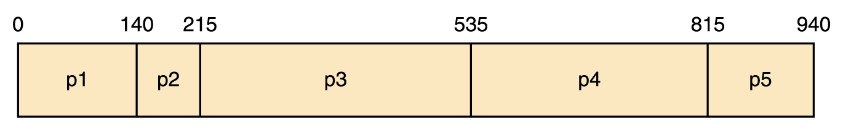
First-Come, First-Served
Process
Arrival Time
Service Time
Completion Time
Turnaround
p1
0
140
140
140
p2
0
75
215
215
p3
0
320
535
535
p4
0
280
815
815
p5
0
125
940
940
Average Turnaround time: 529
Page 336

Slide 34
First-Come, First-Served
Process
Arrival Time
Service Time
Completion Time
Turnaround
p1
0
140
p2
40
75
p3
50
320
p4
300
280
p5
315
125
0
⇑

Slide 35
First-Come, First-Served
Process
Arrival Time
Service Time
Completion Time
Turnaround
p1
0
140
p2
40
75
p3
50
320
p4
300
280
p5
315
125
0
p1
⇑

Slide 36
First-Come, First-Served
Process
Arrival Time
Service Time
Completion Time
Turnaround
p1
0
140
p2
40
75
p3
50
320
p4
300
280
p5
315
125
0
40
p1
⇑

Slide 37
First-Come, First-Served
Process
Arrival Time
Service Time
Completion Time
Turnaround
p1
0
140
p2
40
75
p3
50
320
p4
300
280
p5
315
125
0
50
p1
⇑

Slide 38
First-Come, First-Served
Process
Arrival Time
Service Time
Completion Time
Turnaround
p1
0
140
140
p2
40
75
p3
50
320
p4
300
280
p5
315
125
0
140
p1
⇑

Slide 39
First-Come, First-Served
Process
Arrival Time
Service Time
Completion Time
Turnaround
p1
0
140
140
140
p2
40
75
p3
50
320
p4
300
280
p5
315
125
0
140
p1
⇑

Slide 40
First-Come, First-Served
Process
Arrival Time
Service Time
Completion Time
Turnaround
p1
0
140
140
140
p2
40
75
p3
50
320
p4
300
280
p5
315
125
0
140
p1
p2
⇑

Slide 41
First-Come, First-Served
Process
Arrival Time
Service Time
Completion Time
Turnaround
p1
0
140
140
140
p2
40
75
215
p3
50
320
p4
300
280
p5
315
125
0
140
215
p1
p2
⇑

Slide 42
First-Come, First-Served
Process
Arrival Time
Service Time
Completion Time
Turnaround
p1
0
140
140
140
p2
40
75
215
175
p3
50
320
p4
300
280
p5
315
125
0
140
215
p1
p2
⇑

Slide 43
First-Come, First-Served
Process
Arrival Time
Service Time
Completion Time
Turnaround
p1
0
140
140
140
p2
40
75
215
175
p3
50
320
p4
300
280
p5
315
125
0
140
215
p1
p2
p3
⇑

Slide 44
First-Come, First-Served
Process
Arrival Time
Service Time
Completion Time
Turnaround
p1
0
140
140
140
p2
40
75
215
175
p3
50
320
p4
300
280
p5
315
125
0
140
215
300
p1
p2
p3
⇑

Slide 45
First-Come, First-Served
Process
Arrival Time
Service Time
Completion Time
Turnaround
p1
0
140
140
140
p2
40
75
215
175
p3
50
320
p4
300
280
p5
315
125
0
140
215
315
p1
p2
p3
⇑

Slide 46
First-Come, First-Served
Process
Arrival Time
Service Time
Completion Time
Turnaround
p1
0
140
140
140
p2
40
75
215
175
p3
50
320
535
p4
300
280
p5
315
125
0
140
215
535
p1
p2
p3
⇑

Slide 47
First-Come, First-Served
Process
Arrival Time
Service Time
Completion Time
Turnaround
p1
0
140
140
140
p2
40
75
215
175
p3
50
320
535
485
p4
300
280
p5
315
125
0
140
215
535
p1
p2
p3
⇑

Slide 48
First-Come, First-Served
Process
Arrival Time
Service Time
Completion Time
Turnaround
p1
0
140
140
140
p2
40
75
215
175
p3
50
320
535
485
p4
300
280
815
p5
315
125
0
140
215
535
815
p1
p2
p3
p4
⇑

Slide 49
First-Come, First-Served
Process
Arrival Time
Service Time
Completion Time
Turnaround
p1
0
140
140
140
p2
40
75
215
175
p3
50
320
535
485
p4
300
280
815
515
p5
315
125
0
140
215
535
815
p1
p2
p3
p4
⇑

Slide 50
First-Come, First-Served
Process
Arrival Time
Service Time
Completion Time
Turnaround
p1
0
140
140
140
p2
40
75
215
175
p3
50
320
535
485
p4
300
280
815
515
p5
315
125
0
140
215
535
815
p1
p2
p3
p4
p5
⇑

Slide 51
First-Come, First-Served
Process
Arrival Time
Service Time
Completion Time
Turnaround
p1
0
140
140
140
p2
40
75
215
175
p3
50
320
535
485
p4
300
280
815
515
p5
315
125
940
0
140
215
535
815
940
p1
p2
p3
p4
p5
⇑

Slide 52
First-Come, First-Served
Process
Arrival Time
Service Time
Completion Time
Turnaround
p1
0
140
140
140
p2
40
75
215
175
p3
50
320
535
485
p4
300
280
815
515
p5
315
125
940
625
0
140
215
535
815
940
p1
p2
p3
p4
p5
Average Turnaround time: 388
⇑

Slide 53
Shortest Job Next (SJN)
When choosing next job to run, look at all processes in the ready state and dispatch the one with the smallest service time.
(assuming we know the service times!)
We consider it as a nonpreemptive algorithm. That is a new job will not be given a chance at the CPU until the current job finishes (even if new job is shorter).

Slide 54
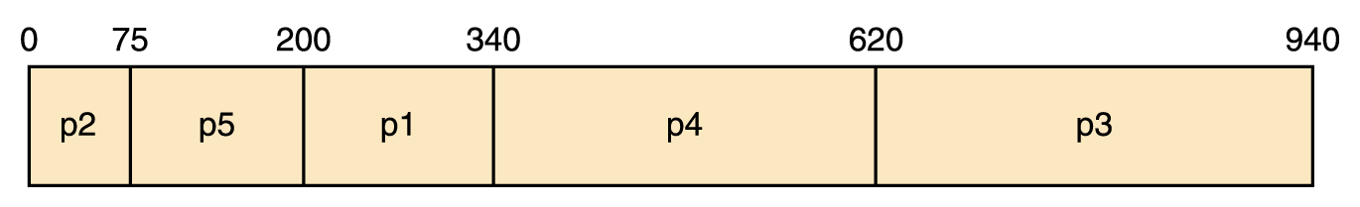
Shortest Job Next
Process
Arrival Time
Service Time
Completion Time
Turnaround
p1
0
140
340
340
p2
0
75
75
75
p3
0
320
940
940
p4
0
280
620
620
p5
0
125
200
200
Average Turnaround time: 435
Page 337

Slide 55
Shortest Job Next
Process
Arrival Time
Service Time
Completion Time
Turnaround
p1
0
140
p2
40
75
p3
50
320
p4
300
280
p5
315
125
0
⇑

Slide 56
Shortest Job Next
Process
Arrival Time
Service Time
Completion Time
Turnaround
p1
0
140
p2
40
75
p3
50
320
p4
300
280
p5
315
125
0
p1
⇑

Slide 57
Shortest Job Next
Process
Arrival Time
Service Time
Completion Time
Turnaround
p1
0
140
p2
40
75
p3
50
320
p4
300
280
p5
315
125
0
40
p1
⇑

Slide 58
Shortest Job Next
Process
Arrival Time
Service Time
Completion Time
Turnaround
p1
0
140
p2
40
75
p3
50
320
p4
300
280
p5
315
125
0
50
p1
⇑

Slide 59
Shortest Job Next
Process
Arrival Time
Service Time
Completion Time
Turnaround
p1
0
140
140
p2
40
75
p3
50
320
p4
300
280
p5
315
125
0
140
p1
⇑

Slide 60
Shortest Job Next
Process
Arrival Time
Service Time
Completion Time
Turnaround
p1
0
140
140
140
p2
40
75
p3
50
320
p4
300
280
p5
315
125
0
140
p1
⇑

Slide 61
Shortest Job Next
Process
Arrival Time
Service Time
Completion Time
Turnaround
p1
0
140
140
140
p2
40
75
p3
50
320
p4
300
280
p5
315
125
0
140
p1
p2
⇑

Slide 62
Shortest Job Next
Process
Arrival Time
Service Time
Completion Time
Turnaround
p1
0
140
140
140
p2
40
75
215
p3
50
320
p4
300
280
p5
315
125
0
140
215
p1
p2
⇑

Slide 63
Shortest Job Next
Process
Arrival Time
Service Time
Completion Time
Turnaround
p1
0
140
140
140
p2
40
75
215
175
p3
50
320
p4
300
280
p5
315
125
0
140
215
p1
p2
⇑

Slide 64
Shortest Job Next
Process
Arrival Time
Service Time
Completion Time
Turnaround
p1
0
140
140
140
p2
40
75
215
175
p3
50
320
p4
300
280
p5
315
125
0
140
215
p1
p2
p3
⇑

Slide 65
Shortest Job Next
Process
Arrival Time
Service Time
Completion Time
Turnaround
p1
0
140
140
140
p2
40
75
215
175
p3
50
320
p4
300
280
p5
315
125
0
140
215
300
p1
p2
p3
⇑

Slide 66
Shortest Job Next
Process
Arrival Time
Service Time
Completion Time
Turnaround
p1
0
140
140
140
p2
40
75
215
175
p3
50
320
p4
300
280
p5
315
125
0
140
215
315
p1
p2
p3
⇑

Slide 67
Shortest Job Next
Process
Arrival Time
Service Time
Completion Time
Turnaround
p1
0
140
140
140
p2
40
75
215
175
p3
50
320
535
p4
300
280
p5
315
125
0
140
215
535
p1
p2
p3
⇑

Slide 68
Shortest Job Next
Process
Arrival Time
Service Time
Completion Time
Turnaround
p1
0
140
140
140
p2
40
75
215
175
p3
50
320
535
485
p4
300
280
p5
315
125
0
140
215
535
p1
p2
p3
⇑

Slide 69
Shortest Job Next
Process
Arrival Time
Service Time
Completion Time
Turnaround
p1
0
140
140
140
p2
40
75
215
175
p3
50
320
535
485
p4
300
280
p5
315
125
0
140
215
535
p1
p2
p3
p5
⇑

Slide 70
Shortest Job Next
Process
Arrival Time
Service Time
Completion Time
Turnaround
p1
0
140
140
140
p2
40
75
215
175
p3
50
320
535
485
p4
300
280
p5
315
125
660
0
140
215
535
660
p1
p2
p3
p5
⇑

Slide 71
Shortest Job Next
Process
Arrival Time
Service Time
Completion Time
Turnaround
p1
0
140
140
140
p2
40
75
215
175
p3
50
320
535
485
p4
300
280
p5
315
125
660
345
0
140
215
535
660
p1
p2
p3
p5
⇑

Slide 72
Shortest Job Next
Process
Arrival Time
Service Time
Completion Time
Turnaround
p1
0
140
140
140
p2
40
75
215
175
p3
50
320
535
485
p4
300
280
p5
315
125
660
345
0
140
215
535
660
p1
p2
p3
p5
p4
⇑

Slide 73
Shortest Job Next
Process
Arrival Time
Service Time
Completion Time
Turnaround
p1
0
140
140
140
p2
40
75
215
175
p3
50
320
535
485
p4
300
280
940
p5
315
125
660
345
0
140
215
535
660
940
p1
p2
p3
p5
p4
⇑

Slide 74
Shortest Job Next
Process
Arrival Time
Service Time
Completion Time
Turnaround
p1
0
140
140
140
p2
40
75
215
175
p3
50
320
535
485
p4
300
280
940
640
p5
315
125
660
345
0
140
215
535
660
940
p1
p2
p3
p5
p4
Average Turnaround time: 357

Slide 75
Shortest Remaining Processing Time
SRPT is a preemptive variant of Shortest Job Next. It allows a job to be interrupted if a new job arrives which is even shorter than the remaining processing time of the current job.
Later, when choosing job to dispatch, base on each job’s remaining processing time, rather than the original times.

Slide 76
SRPT example
Process
Arrival Time
Remaining
Completion Time
Turnaround
p1
0
140
p2
40
75
p3
50
320
p4
300
280
p5
315
125
0
⇑

Slide 77
SRPT example
Process
Arrival Time
Remaining
Completion Time
Turnaround
p1
0
140
p2
40
75
p3
50
320
p4
300
280
p5
315
125
0
p1
⇑

Slide 78
SRPT example
Process
Arrival Time
Remaining
Completion Time
Turnaround
p1
0
100
p2
40
75
p3
50
320
p4
300
280
p5
315
125
0
40
p1
⇑

Slide 79
SRPT example
Process
Arrival Time
Remaining
Completion Time
Turnaround
p1
0
100
p2
40
75
p3
50
320
p4
300
280
p5
315
125
0
40
p1
⇑

Slide 80
SRPT example
Process
Arrival Time
Remaining
Completion Time
Turnaround
p1
0
100
p2
40
75
p3
50
320
p4
300
280
p5
315
125
0
40
p1
p2
⇑

Slide 81
SRPT example
Process
Arrival Time
Remaining
Completion Time
Turnaround
p1
0
100
p2
40
65
p3
50
320
p4
300
280
p5
315
125
50
0
40
p1
p2
⇑

Slide 82
SRPT example
Process
Arrival Time
Remaining
Completion Time
Turnaround
p1
0
100
p2
40
0
115
p3
50
320
p4
300
280
p5
315
125
0
40
115
p1
p2
⇑

Slide 83
SRPT example
Process
Arrival Time
Remaining
Completion Time
Turnaround
p1
0
100
p2
40
0
115
75
p3
50
320
p4
300
280
p5
315
125
0
40
115
p1
p2
⇑

Slide 84
SRPT example
Process
Arrival Time
Remaining
Completion Time
Turnaround
p1
0
100
p2
40
0
115
75
p3
50
320
p4
300
280
p5
315
125
0
40
115
p1
p2
p1
⇑

Slide 85
SRPT example
Process
Arrival Time
Remaining
Completion Time
Turnaround
p1
0
0
215
p2
40
0
115
75
p3
50
320
p4
300
280
p5
315
125
0
40
115
215
p1
p2
p1
⇑

Slide 86
SRPT example
Process
Arrival Time
Remaining
Completion Time
Turnaround
p1
0
0
215
215
p2
40
0
115
75
p3
50
320
p4
300
280
p5
315
125
0
40
115
215
p1
p2
p1
⇑

Slide 87
SRPT example
Process
Arrival Time
Remaining
Completion Time
Turnaround
p1
0
0
215
215
p2
40
0
115
75
p3
50
320
p4
300
280
p5
315
125
0
40
115
215
p1
p2
p1
p3
⇑

Slide 88
SRPT example
Process
Arrival Time
Remaining
Completion Time
Turnaround
p1
0
0
215
215
p2
40
0
115
75
p3
50
235
p4
300
280
p5
315
125
0
40
115
215
300
p1
p2
p1
p3
⇑

Slide 89
SRPT example
Process
Arrival Time
Remaining
Completion Time
Turnaround
p1
0
0
215
215
p2
40
0
115
75
p3
50
220
p4
300
280
p5
315
125
0
40
115
215
315
p1
p2
p1
p3
⇑

Slide 90
SRPT example
Process
Arrival Time
Remaining
Completion Time
Turnaround
p1
0
0
215
215
p2
40
0
115
75
p3
50
220
p4
300
280
p5
315
125
0
40
115
215
315
p1
p2
p1
p3
⇑

Slide 91
SRPT example
Process
Arrival Time
Remaining
Completion Time
Turnaround
p1
0
0
215
215
p2
40
0
115
75
p3
50
220
p4
300
280
p5
315
125
0
40
115
215
315
p1
p2
p1
p3
p5
⇑

Slide 92
SRPT example
Process
Arrival Time
Remaining
Completion Time
Turnaround
p1
0
0
215
215
p2
40
0
115
75
p3
50
220
p4
300
280
p5
315
0
440
0
40
115
215
315
440
p1
p2
p1
p3
p5
⇑

Slide 93
SRPT example
Process
Arrival Time
Remaining
Completion Time
Turnaround
p1
0
0
215
215
p2
40
0
115
75
p3
50
220
p4
300
280
p5
315
0
440
125
0
40
115
215
315
440
p1
p2
p1
p3
p5
⇑

Slide 94
SRPT example
Process
Arrival Time
Remaining
Completion Time
Turnaround
p1
0
0
215
215
p2
40
0
115
75
p3
50
220
p4
300
280
p5
315
0
440
125
0
40
115
215
315
440
p1
p2
p1
p3
p5
p3
⇑

Slide 95
SRPT example
Process
Arrival Time
Remaining
Completion Time
Turnaround
p1
0
0
215
215
p2
40
0
115
75
p3
50
0
660
p4
300
280
p5
315
0
440
125
0
40
115
215
315
440
660
p1
p2
p1
p3
p5
p3
⇑

Slide 96
SRPT example
Process
Arrival Time
Remaining
Completion Time
Turnaround
p1
0
0
215
215
p2
40
0
115
75
p3
50
0
660
610
p4
300
280
p5
315
0
440
125
0
40
115
215
315
440
660
p1
p2
p1
p3
p5
p3
⇑

Slide 97
SRPT example
Process
Arrival Time
Remaining
Completion Time
Turnaround
p1
0
0
215
215
p2
40
0
115
75
p3
50
0
660
610
p4
300
280
p5
315
0
440
125
0
40
115
215
315
440
660
p1
p2
p1
p3
p5
p3
p4
⇑

Slide 98
SRPT example
Process
Arrival Time
Remaining
Completion Time
Turnaround
p1
0
0
215
215
p2
40
0
115
75
p3
50
0
660
610
p4
300
0
940
p5
315
0
440
125
0
40
115
215
315
440
660
940
p1
p2
p1
p3
p5
p3
p4
⇑

Slide 99
SRPT example
Process
Arrival Time
Remaining
Completion Time
Turnaround
p1
0
0
215
215
p2
40
0
115
75
p3
50
0
660
610
p4
300
0
940
640
p5
315
0
440
125
0
40
115
215
315
440
660
940
p1
p2
p1
p3
p5
p3
p4
Average Turnaround time: 333
⇑

Slide 100
Round Robin
Distributes the processing time (equitably?) among all ready processes
The algorithm uses a particular time slice (or time quantum), which is the amount of time each process receives before being preempted in lieu of another process.

Slide 101
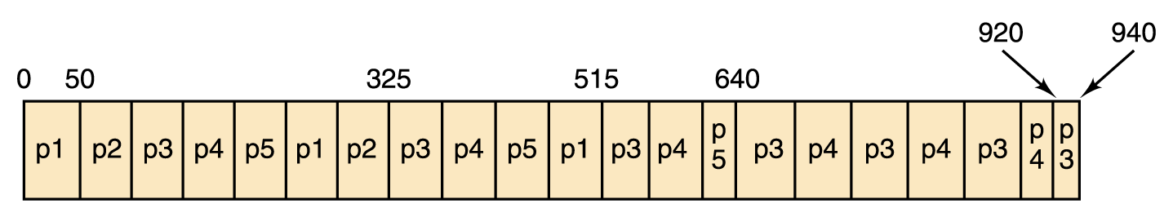
Round Robin
(with time slice of 50)
Process
Arrival Time
Service Time
Completion Time
Turnaround
p1
0
140
515
515
p2
0
75
325
325
p3
0
320
940
940
p4
0
280
920
920
p5
0
125
640
640
Page 339
Average Turnaround time: 668

Slide 102
Round Robin
(with time slice of 50)
Process
Arrival Time
Remaining
Completion Time
Turnaround
p1
0
140
p2
40
75
p3
50
320
p4
300
280
p5
315
125
0
⇑

Slide 103
Round Robin
(with time slice of 50)
Process
Arrival Time
Remaining
Completion Time
Turnaround
p1
0
140
p2
40
75
p3
50
320
p4
300
280
p5
315
125
0
p1
⇑

Slide 104
Round Robin
(with time slice of 50)
Process
Arrival Time
Remaining
Completion Time
Turnaround
p1
0
100
p2
40
75
p3
50
320
p4
300
280
p5
315
125
0
40
p1
⇑

Slide 105
Round Robin
(with time slice of 50)
Process
Arrival Time
Remaining
Completion Time
Turnaround
p1
0
90
p2
40
75
p3
50
320
p4
300
280
p5
315
125
0
50
p1
⇑

Slide 106
Round Robin
(with time slice of 50)
Process
Arrival Time
Remaining
Completion Time
Turnaround
p1
0
90
p2
40
75
p3
50
320
p4
300
280
p5
315
125
0
50
p1
⇑

Slide 107
Round Robin
(with time slice of 50)
Process
Arrival Time
Remaining
Completion Time
Turnaround
p1
0
90
p2
40
25
p3
50
320
p4
300
280
p5
315
125
0
100
p1
p2
⇑

Slide 108
Round Robin
(with time slice of 50)
Process
Arrival Time
Remaining
Completion Time
Turnaround
p1
0
90
p2
40
25
p3
50
270
p4
300
280
p5
315
125
0
150
p1
p2
p3
⇑

Slide 109
Round Robin
(with time slice of 50)
Process
Arrival Time
Remaining
Completion Time
Turnaround
p1
0
40
p2
40
25
p3
50
270
p4
300
280
p5
315
125
0
200
p1
p2
p3
p1
⇑

Slide 110
Round Robin
(with time slice of 50)
Process
Arrival Time
Remaining
Completion Time
Turnaround
p1
0
40
p2
40
0
225
185
p3
50
270
p4
300
280
p5
315
125
0
225
p1
p2
p3
p1
p2
⇑

Slide 111
Round Robin
(with time slice of 50)
Process
Arrival Time
Remaining
Completion Time
Turnaround
p1
0
40
p2
40
0
225
185
p3
50
220
p4
300
280
p5
315
125
0
225
275
p1
p2
p3
p1
p2
p3
⇑

Slide 112
Round Robin
(with time slice of 50)
Process
Arrival Time
Remaining
Completion Time
Turnaround
p1
0
40
p2
40
0
225
185
p3
50
220
p4
300
280
p5
315
125
0
225
275
p1
p2
p3
p1
p2
p3
p1
⇑

Slide 113
Round Robin
(with time slice of 50)
Process
Arrival Time
Remaining
Completion Time
Turnaround
p1
0
15
p2
40
0
225
185
p3
50
220
p4
300
280
p5
315
125
0
225
300
p1
p2
p3
p1
p2
p3
p1
⇑

Slide 114
Round Robin
(with time slice of 50)
Process
Arrival Time
Remaining
Completion Time
Turnaround
p1
0
0
315
315
p2
40
0
225
185
p3
50
220
p4
300
280
p5
315
125
0
225
315
p1
p2
p3
p1
p2
p3
p1
⇑

Slide 115
Round Robin
(with time slice of 50)
Process
Arrival Time
Remaining
Completion Time
Turnaround
p1
0
0
315
315
p2
40
0
225
185
p3
50
220
p4
300
280
p5
315
125
0
225
315
p1
p2
p3
p1
p2
p3
p1
⇑

Slide 116
Round Robin
(with time slice of 50)
Process
Arrival Time
Remaining
Completion Time
Turnaround
p1
0
0
315
315
p2
40
0
225
185
p3
50
170
p4
300
280
p5
315
125
0
225
315
365
p1
p2
p3
p1
p2
p3
p1
p3
⇑

Slide 117
Round Robin
(with time slice of 50)
Process
Arrival Time
Remaining
Completion Time
Turnaround
p1
0
0
315
315
p2
40
0
225
185
p3
50
170
p4
300
230
p5
315
125
0
225
315
415
p1
p2
p3
p1
p2
p3
p1
p3
p4
⇑

Slide 118
Round Robin
(with time slice of 50)
Process
Arrival Time
Remaining
Completion Time
Turnaround
p1
0
0
315
315
p2
40
0
225
185
p3
50
170
p4
300
230
p5
315
75
0
225
315
465
p1
p2
p3
p1
p2
p3
p1
p3
p4
p5
⇑

Slide 119
Round Robin
(with time slice of 50)
Process
Arrival Time
Remaining
Completion Time
Turnaround
p1
0
0
315
315
p2
40
0
225
185
p3
50
120
p4
300
230
p5
315
75
0
225
315
515
p1
p2
p3
p1
p2
p3
p1
p3
p4
p5
p3
⇑

Slide 120
Round Robin
(with time slice of 50)
Process
Arrival Time
Remaining
Completion Time
Turnaround
p1
0
0
315
315
p2
40
0
225
185
p3
50
120
p4
300
180
p5
315
75
0
225
315
565
p1
p2
p3
p1
p2
p3
p1
p3
p4
p5
p3
p4
⇑

Slide 121
Round Robin
(with time slice of 50)
Process
Arrival Time
Remaining
Completion Time
Turnaround
p1
0
0
315
315
p2
40
0
225
185
p3
50
120
p4
300
180
p5
315
25
0
225
315
615
p1
p2
p3
p1
p2
p3
p1
p3
p4
p5
p3
p4
p5
⇑

Slide 122
Round Robin
(with time slice of 50)
Process
Arrival Time
Remaining
Completion Time
Turnaround
p1
0
0
315
315
p2
40
0
225
185
p3
50
70
p4
300
180
p5
315
25
0
225
315
665
p1
p2
p3
p1
p2
p3
p1
p3
p4
p5
p3
p4
p5
p3
⇑

Slide 123
Round Robin
(with time slice of 50)
Process
Arrival Time
Remaining
Completion Time
Turnaround
p1
0
0
315
315
p2
40
0
225
185
p3
50
70
p4
300
130
p5
315
25
0
225
315
715
p1
p2
p3
p1
p2
p3
p1
p3
p4
p5
p3
p4
p5
p3
p4
⇑

Slide 124
Round Robin
(with time slice of 50)
Process
Arrival Time
Remaining
Completion Time
Turnaround
p1
0
0
315
315
p2
40
0
225
185
p3
50
70
p4
300
130
p5
315
0
740
425
0
225
315
740
p1
p2
p3
p1
p2
p3
p1
p3
p4
p5
p3
p4
p5
p3
p4
p5
⇑

Slide 125
Round Robin
(with time slice of 50)
Process
Arrival Time
Remaining
Completion Time
Turnaround
p1
0
0
315
315
p2
40
0
225
185
p3
50
20
p4
300
130
p5
315
0
740
425
0
225
315
740
790
p1
p2
p3
p1
p2
p3
p1
p3
p4
p5
p3
p4
p5
p3
p4
p5
p3
⇑

Slide 126
Round Robin
(with time slice of 50)
Process
Arrival Time
Remaining
Completion Time
Turnaround
p1
0
0
315
315
p2
40
0
225
185
p3
50
20
p4
300
80
p5
315
0
740
425
0
225
315
740
840
p1
p2
p3
p1
p2
p3
p1
p3
p4
p5
p3
p4
p5
p3
p4
p5
p3
p4
⇑

Slide 127
Round Robin
(with time slice of 50)
Process
Arrival Time
Remaining
Completion Time
Turnaround
p1
0
0
315
315
p2
40
0
225
185
p3
50
0
860
810
p4
300
80
p5
315
0
740
425
0
225
315
740
860
p1
p2
p3
p1
p2
p3
p1
p3
p4
p5
p3
p4
p5
p3
p4
p5
p3
p4
p3
⇑

Slide 128
Round Robin
(with time slice of 50)
Process
Arrival Time
Remaining
Completion Time
Turnaround
p1
0
0
315
315
p2
40
0
225
185
p3
50
0
860
810
p4
300
30
p5
315
0
740
425
0
225
315
740
860
910
p1
p2
p3
p1
p2
p3
p1
p3
p4
p5
p3
p4
p5
p3
p4
p5
p3
p4
p3
p4
⇑

Slide 129
Round Robin
(with time slice of 50)
Process
Arrival Time
Remaining
Completion Time
Turnaround
p1
0
0
315
315
p2
40
0
225
185
p3
50
0
860
810
p4
300
0
940
640
p5
315
0
740
425
0
225
315
740
860
940
p1
p2
p3
p1
p2
p3
p1
p3
p4
p5
p3
p4
p5
p3
p4
p5
p3
p4
p3
p4
p4
Average Turnaround time: 475
⇑

Slide 130
Conclusions
What are the relative advantages and disadvantages of various approaches?
  First-Come, First-Served
  Shortest Job Next
  Shortest Remaining Processing Time
  Round Robin
  Round Robin (with priorities)

