Slide 1

Slides modified by Erin Chambers
Problem Solving
and Algorithm Design

Slide 2

Programming
We have seen various examples of programming languages
C was an example of a procedural language
Imperative or procedural model
  Program executes a sequence of instructions to accomplish a task
  FORTRAN, COBOL, BASIC, C, Pascal,
  Ada, and C++

Slide 3
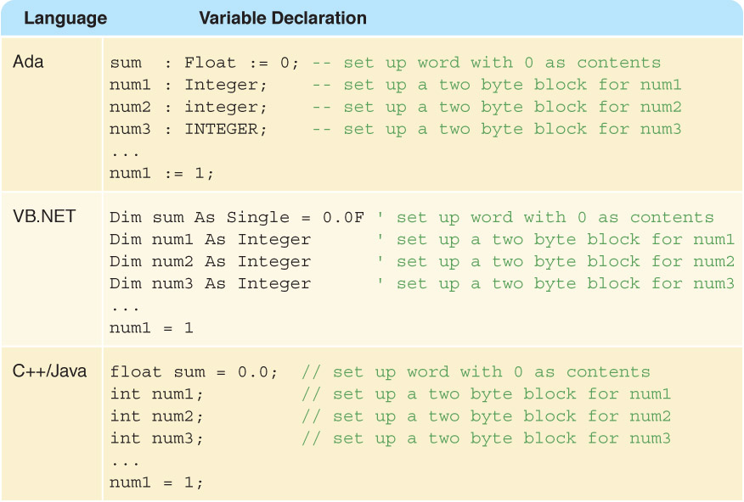
Other languages
Let's look back at other models for programming languages:

Slide 4
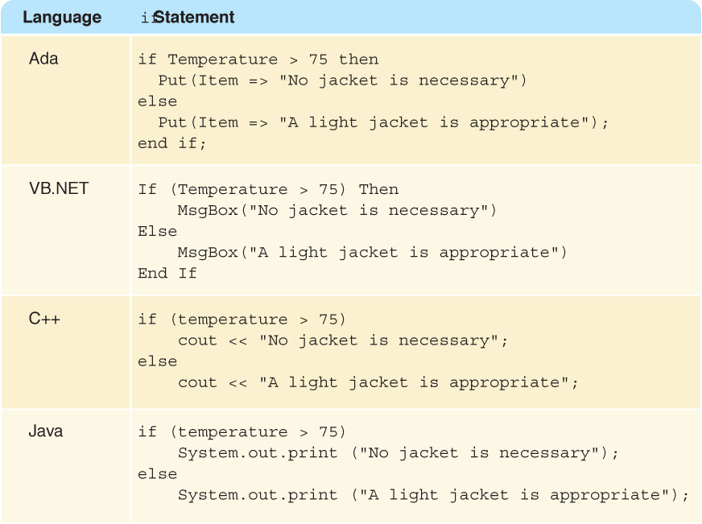
If statements

Slide 5
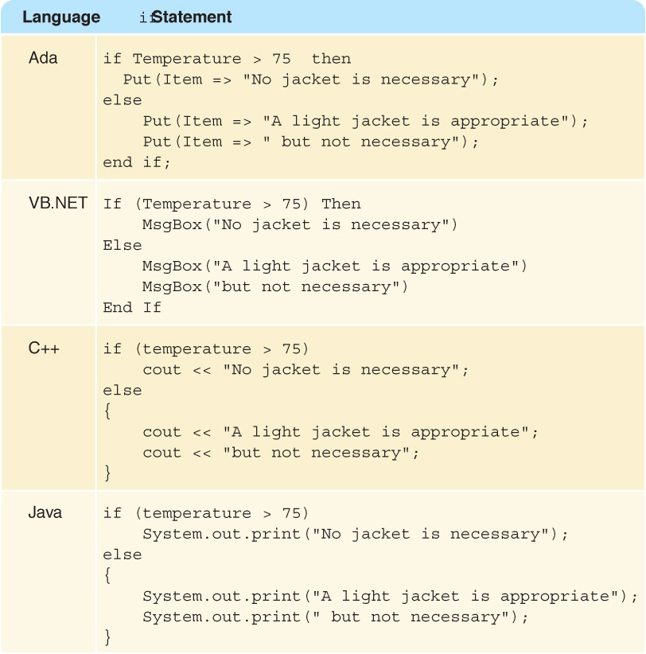
Blocks of code
How did we do if or while statements in C with multiple lines of code?

Slide 6
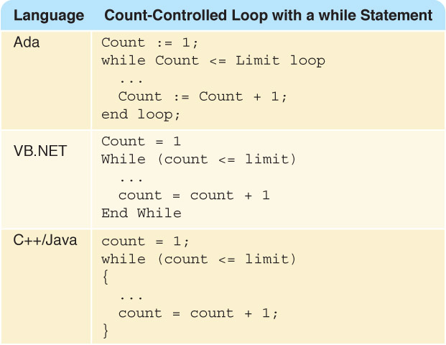
Loops
How did we do while loops in C?

Slide 7
Taking a step back
Suppose I want to describe a program for you to write, but I don't know which language you will use.
We saw an example of this last time, when I described an algorithm using comments and asked you to fill it in.

Slide 8
Write a program to count the length of a message
#include <stdio.h>
main(void)‏
{
  char ch;
  int length = 0;
  //Prompt the user for a message
  //Read the first character of the message
  //while loop to count how the message is
  //print length of message
  return 0;
}

Slide 9
Pseudocode
But remember, even comments are different in various languages!
For example, in python, comments are put after % sign instead of //
We need a way to describe a program which is independent of a specific language.

Slide 10
Algorithms
Algorithm
A set of unambiguous instructions for solving a problem or subproblem in a finite amount of time using a finite amount of data
Why must instructions be unambiguous?
Why must time and data be finite?

Slide 11
Pseudocode
Pseudocode
A way of expressing algorithms that uses a mixture of English phrases and indention to make the steps in the solution explicit
There are no grammar rules in pseudocode
Pseudocode is not case sensitive

Slide 12
Pseudocode
Pseudocode
A mixture of English and formatting to make the steps in an algorithm explicit
Algorithm to Convert base-10 number to other bases
While ( the quotient is not zero )‏
Divide the decimal number by the new base
Make the remainder the next digit to the left in the answer
Replace the original decimal number with the quotient

Slide 13
Following Pseudocode
While ( the quotient is not zero )‏
Divide the decimal number by the new base
Make the remainder the next digit to the left in the answer
Replace the original decimal number with the quotient
What is 93 in base 8?
93/8 gives 11 remainder 5
11/6 gives 1 remainder 3
1/ 8 gives 0 remainder 1
answer 1 3 5

Slide 14
Pseudocode for Complete Computer Solution
Write "Enter the new base"
Read newBase
Write "Enter the number to be converted"
Read decimalNumber
Set quotient to 1
While (quotient is not zero)‏
Set quotient to decimalNumber DIV newBase
Set remainder to decimalNumber REM newBase
Make the remainder the next digit to the left in the answer
Set decimalNumber to quotient
Write "The answer is "
Write answer

Slide 15
Pseudocode Functionality
Variables
Names of places to store values
quotient, decimalNumber, newBase
Assignment
Storing the value of an expression into a
variable
Set quotient to 64
quotient <-- 64
quotient <-- 6 * 10 + 4

Slide 16
Pseudocode Functionality
Output
Printing a value on an output device
Write, Print
Input
Getting values from the outside word and storing them into variables
Get, Read

Slide 17
Pseudocode Functionality
Repetition
Repeating a series of statements
Set count to 1
While ( count < 10)‏
Write "Enter an integer number"
Read aNumber
Write "You entered " + aNumber
Set count to count + 1
How many values were read?

Slide 18
Pseudocode Functionality
Selection
Making a choice to execute or skip a statement (or group of statements)‏
Read number
If (number < 0)‏
Write number + " is less than zero."
or
Write "Enter a positive number."
Read number
If (number < 0)‏
Write number + " is less than zero."
Write "You didn't follow instructions."

Slide 19
Pseudocode Functionality
Selection
Choose to execute one statement (or group of statements) or another statement (or group of statements)‏
If ( age < 12 )‏
Write "Pay children's rate"
Write "You get a free box of popcorn"
else If ( age < 65 )‏
Write "Pay regular rate"
else
Write "Pay senior citizens rate"

Slide 20
Pseudocode Example
Write "How many pairs of values are to be entered?"
Read numberOfPairs
Set numberRead to 0
While (numberRead < numberOfPairs)‏
Write "Enter two values separated by a blank; press return"
Read number1
Read number2
If (number1 < number2)‏
Print number1 + " " + number2
Else
Print number2 + " " number1
Increment numberRead

Slide 21
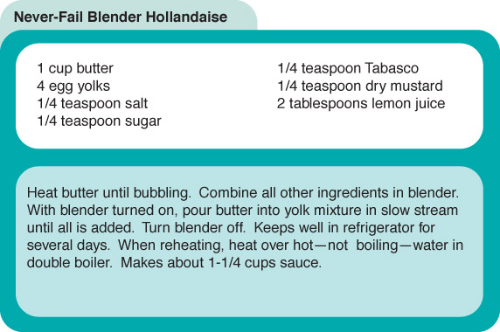
Following an Algorithm
Figure 6.4 A recipe for Hollandaise sauce

Slide 22
Following an Algorithm
Algorithm for preparing a Hollandaise sauce
If concerned about cholesterol
Put butter substitute in a pot
Else
Put butter in a pot
Turn on burner
Put pot on the burner
While (NOT bubbling)‏
Leave pot on the burner
Put other ingredients in the blender
Turn on blender
While (more in pot)‏
Pour contents into lender in slow steam
Turn off blender

Slide 23
Developing an Algorithm
Two methodologies used to develop computer solutions to a problem
  Top-down design focuses on the tasks to be done
  Object-oriented design focuses on the data involved in the solution

Slide 24
Top-Down Design
Top-Down Design
Problem-solving technique in which the problem is divided into subproblems; the process is applied to each subproblem
Modules
Self-contained collection of steps, that solve a problem or subproblem
Abstract Step
An algorithmic step containing unspecified details
Concrete Step
An algorithm step in which all details are specified

Slide 25
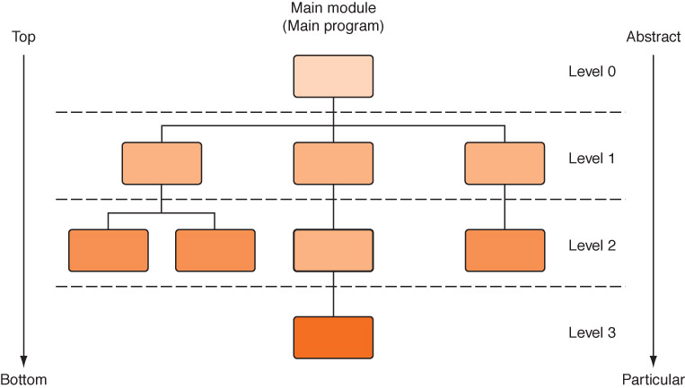
Top-Down Design
Figure 6.5
An example
of top-down design
Process continues for as many levels as it takes to make every step concrete
Name of (sub)problem at one level becomes a module at next lower level

Slide 26
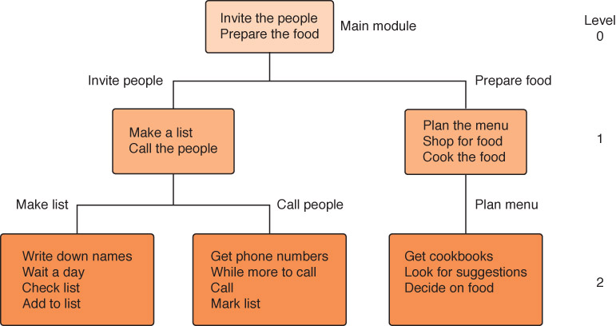
A General Example
Planning a large party
Figure 6.6 Subdividing the party planning

Slide 27
Object-Oriented Design
Object-oriented Design
A problem-solving methodology that produces a solution to a problem in terms of self-contained entities called objects
Object
A thing or entity that makes sense within the context of the problem
  For example, a student, a car, time, date

Slide 28
Object-Oriented Design
World View of OOD
Problems are solved by
  isolating the objects in a problem,
  determining their properties and actions (responsibilities), and
  letting the objects collaborate to solve a problem
What? Say again!

Slide 29
Object-Oriented Design
An analogy: You and your friend fix dinner
Objects: you, friend, dinner
Class: you and friend are people
People have name, eye color, …
People can shop, cook, …
Instance of a class: you and friend are instances of class People, you each have your own name and eye color, you each can shop and cook
You collaborate to fix dinner

Slide 30
Object-Oriented Design
Class (or object class)‏
A description of a group of similar objects
Object (instance of a class)‏
A concrete example of the class
Classes contain fields that represent the
  properties (name, eye color) and
  behaviors (responsibilities) (shop, cook) of the class
Method
A named algorithm that defines behavior (shop, cook)‏

Slide 31
Strategies
Ask questions! Never reinvent the wheel!
Similar problems come up again and again in different guises
A good programmer recognizes a task or subtask that has been solved before and plugs in the solution
Can you think of two similar problems , say from your homework this week?

Slide 32
Abstract Data Type
Abstract data type
A data type whose properties (data and operations) are specified independently of any particular implementation
Most languages will be able to create some implementation of an abstract data type

Slide 33
Example - Arrays
Suppose we have a collection of data, and want to store it together
If we wish to have random access – meaning, we can look at the 15th element in the collection without scanning the first 14 elements – we call this an array

Slide 34
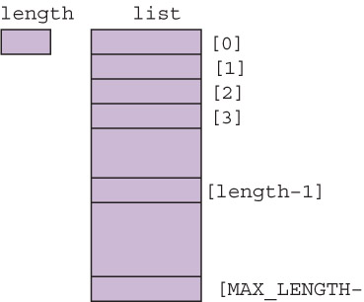

Picture of an array
The array is given a name, just like any other variable
We access element number 15 by the command:
  arrayname[15]

Slide 35
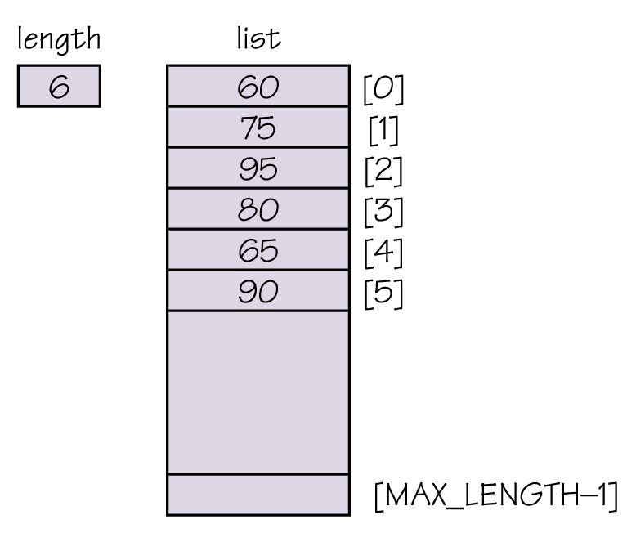
Example – an unsorted array
How do we find out
the value stored at location
4 in the array?
list[4]
How would we change that
value (in pseudocode)?
Set list[4] to 13
list[4] ← 13

Slide 36
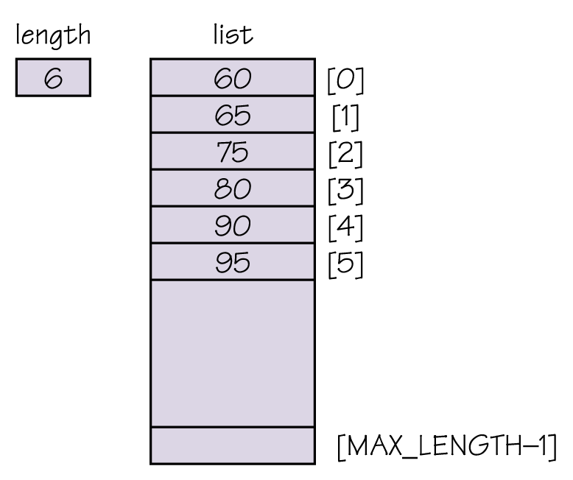
Example – a sorted array
Notice that this time,
the underlying data is
actually a sorted list.
How can we find the
largest element in this list?
list[length-1]

Slide 37
Array operations
What type of operations should we support, and how do we implement them?
Add item given an index, shift following
items down and store item at index
(can do only if length < max_length)‏
Remove item given an index, shift following
items up one
Get next item increment value of index and
return value at that position

