Slide 1
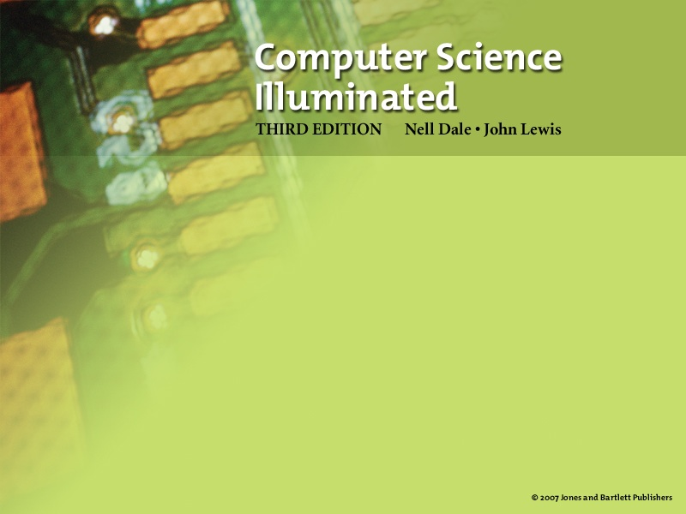
Slides modified by Erin Chambers
Problem Solving
and Algorithm Design, part 2

Slide 2

Programming
We have seen various examples of programming languages
C was an example of a procedural language
Imperative or procedural model
  Program executes a sequence of instructions to accomplish a task
  FORTRAN, COBOL, BASIC, C, Pascal,
  Ada, and C++

Slide 3
Taking a step back
Suppose I want to describe a program for you to write, but I don't know which language you will use.
We saw an example of this last time, when I described an algorithm using comments and asked you to fill it in.

Slide 4
Write a program to count the length of a message
#include <stdio.h>
main(void)‏
{
  char ch;
  int length = 0;
  //Prompt the user for a message
  //Read the first character of the message
  //while loop to count how the message is
  //print length of message
  return 0;
}

Slide 5
Pseudocode
But remember, even comments are different in various languages!
For example, in python, comments are put after % sign instead of //
We need a way to describe a program which is independent of a specific language.

Slide 6
Algorithms
Algorithm
A set of unambiguous instructions for solving a problem or subproblem in a finite amount of time using a finite amount of data
Why must instructions be unambiguous?
Why must time and data be finite?

Slide 7
Pseudocode
Pseudocode
A way of expressing algorithms that uses a mixture of English phrases and indention to make the steps in the solution explicit
There are no grammar rules in pseudocode
Pseudocode is not case sensitive

Slide 8
Pseudocode
Pseudocode
A mixture of English and formatting to make the steps in an algorithm explicit
Algorithm to Convert base-10 number to other bases
While ( the quotient is not zero )‏
Divide the decimal number by the new base
Make the remainder the next digit to the left in the answer
Replace the original decimal number with the quotient

Slide 9
Following Pseudocode
While ( the quotient is not zero )‏
Divide the decimal number by the new base
Make the remainder the next digit to the left in the answer
Replace the original decimal number with the quotient
What is 93 in base 8?
93/8 gives 11 remainder 5
11/6 gives 1 remainder 3
1/ 8 gives 0 remainder 1
answer 1 3 5

Slide 10
Pseudocode for Complete Computer Solution
Write "Enter the new base"
Read newBase
Write "Enter the number to be converted"
Read decimalNumber
Set quotient to 1
While (quotient is not zero)‏
Set quotient to decimalNumber DIV newBase
Set remainder to decimalNumber REM newBase
Make the remainder the next digit to the left in the answer
Set decimalNumber to quotient
Write "The answer is "
Write answer

Slide 11
Abstract Data Type
Abstract data type
A data type whose properties (data and operations) are specified independently of any particular implementation
Most languages will be able to create some implementation of an abstract data type

Slide 12
Example - Arrays
Suppose we have a collection of data, and want to store it together
If we wish to have random access – meaning, we can look at the 15th element in the collection without scanning the first 14 elements – we call this an array

Slide 13
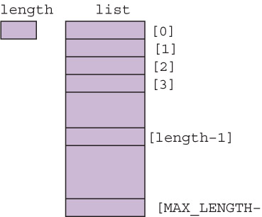

Picture of an array
The array is given a name, just like any other variable
We access element number 15 by the command:
  arrayname[15]

Slide 14
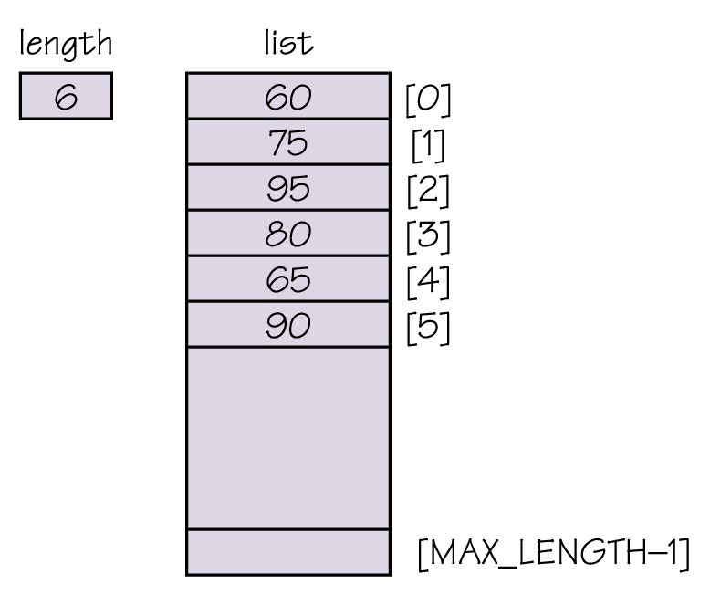
Example – an unsorted array
How do we find out
the value stored at location
4 in the array?
How would we change that
value (in pseudocode)?

Slide 15
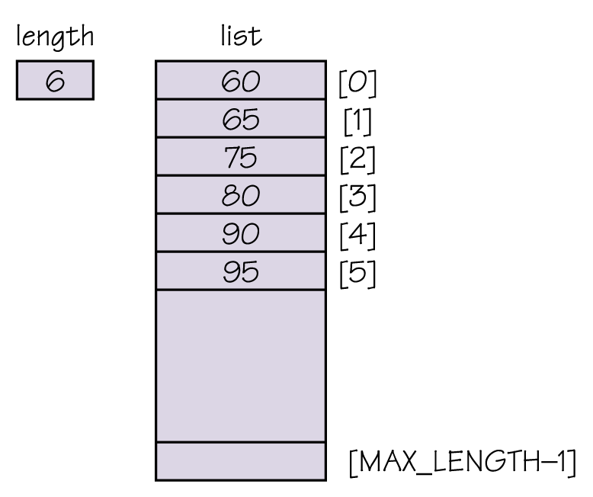
Example – a sorted array
Notice that this time,
the underlying data is
actually a sorted list.
How can we find the
largest element in this list?

Slide 16
Array operations
What type of operations should we support, and how do we implement them?
Add item given an index, shift following
items down and store item at index
(can do only if length < max_length)‏
Remove item given an index, shift following
items up one
Get next item increment value of index and
return value at that position

Slide 17
Array in programming languages
Most programming languages have support for arrays
For example, in C, we declare them by saying:
  vartype variablename[length]
This creates an array of max_length = length, where each variable is of type vartype

Slide 18
Example in C
#include <stdio.h>
main(void)‏
{
//create an array
int myarray[5];
//put values in the array
myarray[0] = 3;
myarray[1] = 10;
myarray[2] = 15;
myarray[3] = myarray[1] + myarray[2];
myarray[4] = 6*myarray[0] + 12;
//print contents of array
  printf("The array holds: %d, %d, %d, %d, %d\n", myarray[0], myarray[1], myarray[2], myarray[3], myarray[4]);
return 0;
}

Slide 19
Another Example
We can do more complicated things with arrays, also, like input arrays which are of different lengths
(See example in Kate)‏
Challenge – convert this example to floating point, so that it accepts and computes with decimal numbers

Slide 20
When are arrays not right?
What disadvantages do you have when you store a list in an array?
How can we fix it with a different abstract data type?

Slide 21
Linked Implementation
Linked implementation
An implementation based on the concept of a node
Node
A holder for two pieces of information
  the item that the user wants in the list (item)‏
  a pointer to the next node in the list (next)‏

Slide 22
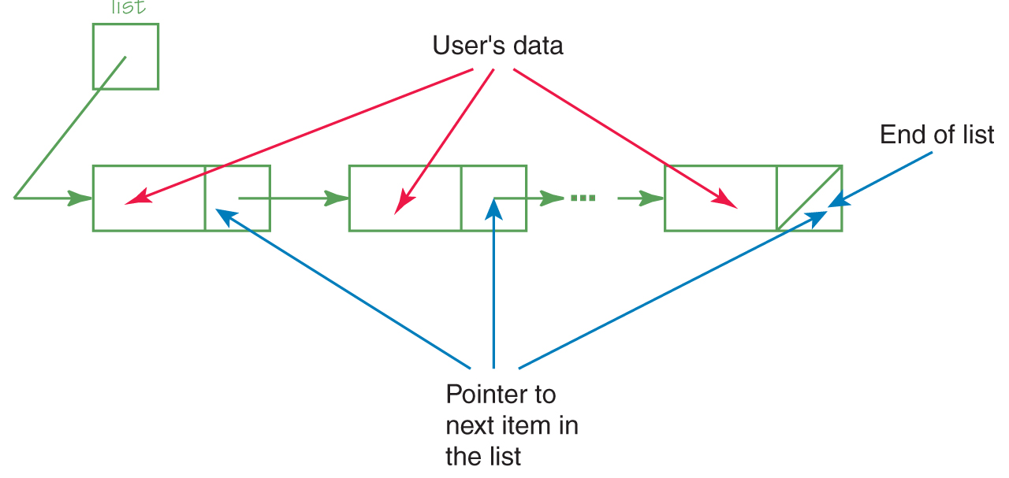
Linked Implementation
Figure 9.4 Anatomy of a linked list
Figure 9.4 Anatomy of a linked list

Slide 23
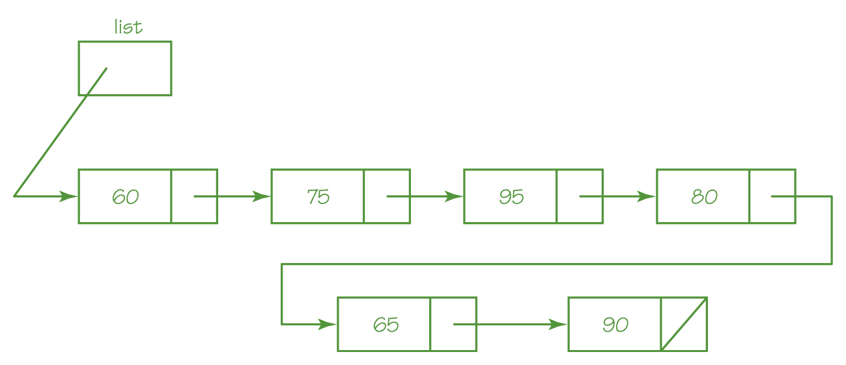
Linked Implementation
Figure 9.5 An unsorted linked list

Slide 24

Linked Implementation
Figure 9.6 A sorted linked list

Slide 25
Linked Implementation
How do we implement the operations?
Add item given current, insert a new node
with item in the info part between
current and next(current)‏
Remove item given current, remove
next(current)‏
Get next item set current to next(current)‏
more items current does not contain null

Slide 26
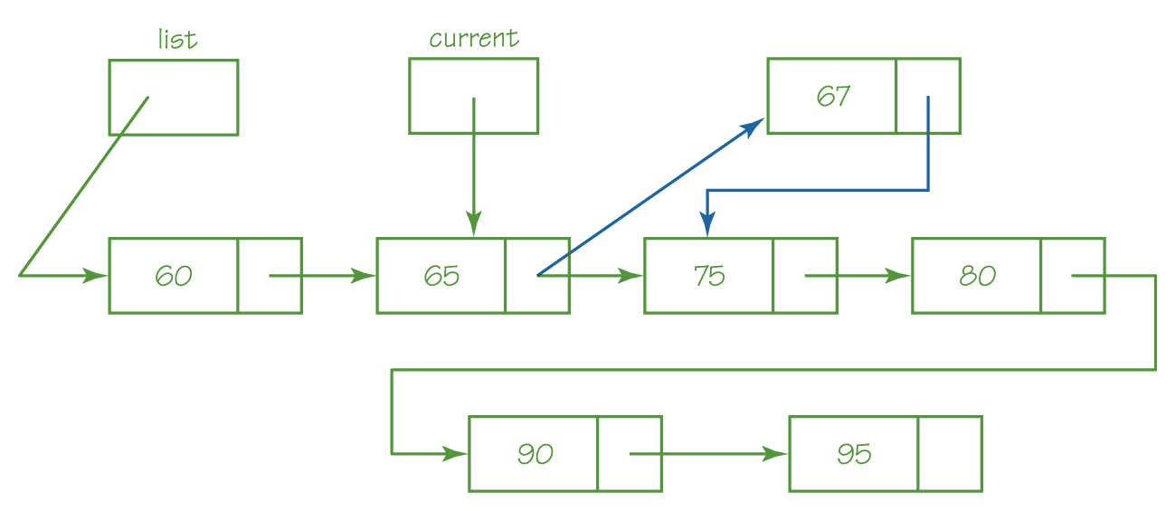
Linked Implementation
Figure 9.7 Store a node with info of 67 after current

Slide 27
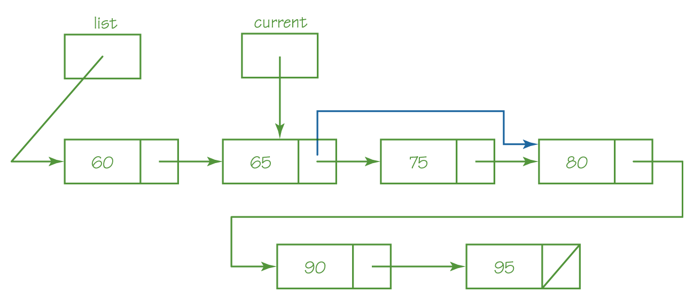
Linked Implementation
Figure 9.8 Remove node next(current)‏

Slide 28
Operations on lists
What other operations do we do with lists on a computer?
  Think about basic database-type operations

Slide 29
Sorting
Sorting
Arranging items in a collection so that there is an ordering on one (or more) of the fields in the items
Sort Key
The field (or fields) on which the ordering is based
Sorting algorithms
Algorithms that order the items in the collection based on the sort key
Why is sorting important?

Slide 30
Selection Sort
Given a list of names, put them in alphabetical order
  Find the name that comes first in the alphabet,
  and write it on a second sheet of paper
  Cross out the name off the original list
  Continue this cycle until all the names on the original list have been crossed out and written onto the second list, at which point the second list contains the same items but in sorted order

Slide 31
Selection Sort
A slight adjustment to this manual approach does away with the need to duplicate space
  As you cross a name off the original list, a free space opens up
  Instead of writing the value found on a second list, exchange it with the value currently in the position where the crossed-off item should go

Slide 32
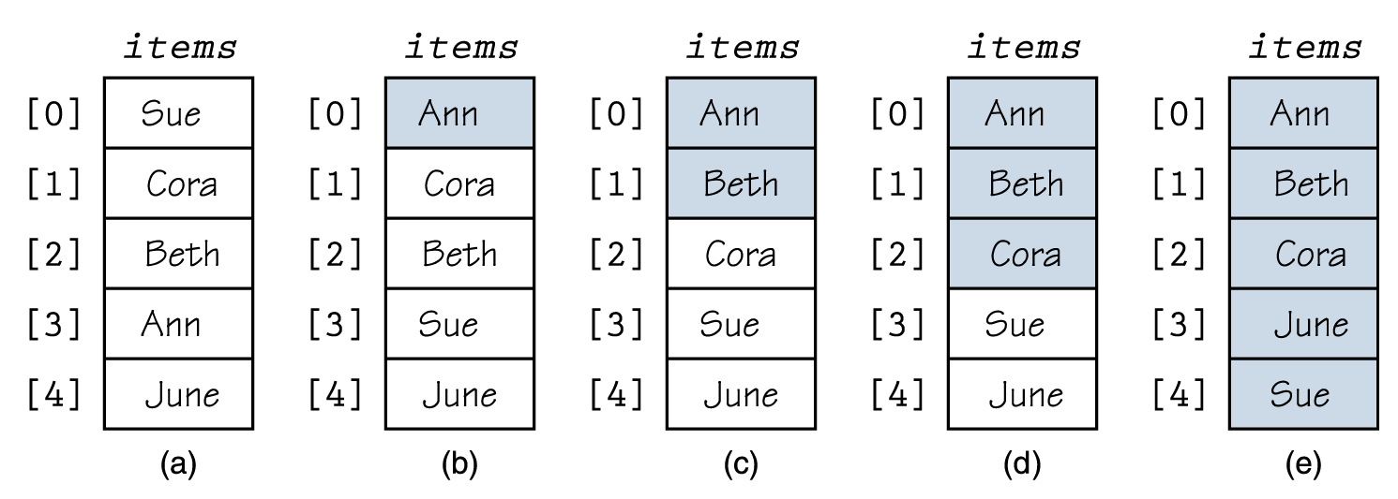
Selection Sort
Figure 9.9 Example of a selection sort (sorted elements are shaded)‏

Slide 33
Bubble Sort
Bubble Sort uses the same strategy:
Find the next item
Put it into its proper place
But uses a different scheme for finding the next item
Starting with the last list element, compare successive pairs of elements, swapping whenever the bottom element of the pair is smaller than the one above it

Slide 34
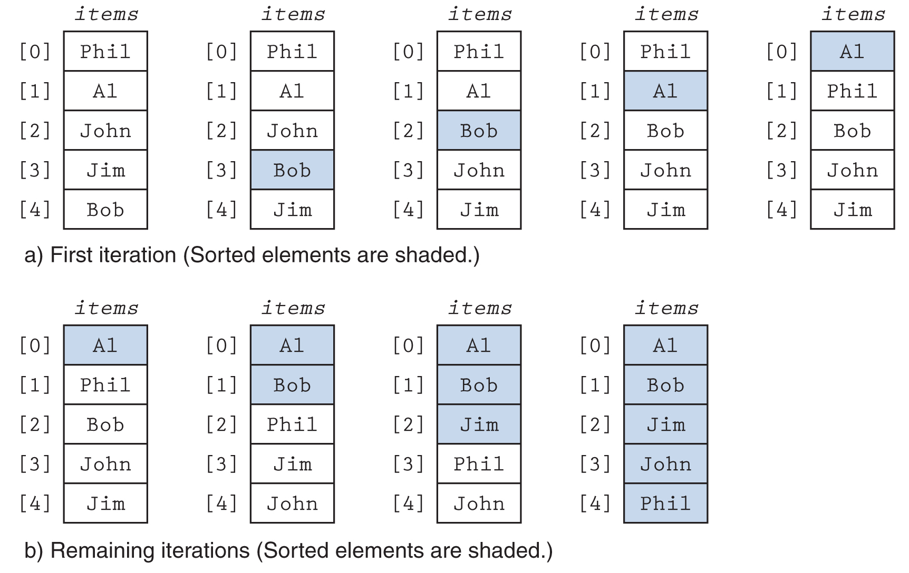
Bubble Sort
Figure 9.10 Example of a bubble sort

Slide 35
Which one is better?
Frequently, we ask how many operations an algorithm will take as a measure of speed.
Since actual time will vary depending on memory, processor speed, etc., the number of comparisons or swaps is a good measure that is independent of the platform.

Slide 36
Selection Sort and Bubble Sort
How many comparisons did selection sort do in the worst case?
How about bubble sort?
Is there a better way? What other sorting method did you do yesterday?

Slide 37
Mergesort
Remember recursion?
We can use the idea of recursion to sort also.
Algorithm:
  Recursively sort the first half and second half of the list.
  Merge the two sorted lists together.

Slide 38
How long does mergesort take?
We won't analyze exactly – but notice that we don't compare everything to everything else!

Slide 39
Next problem - searching
If you have your book, open it to page 222.

Slide 40
Now how did you do that?
Searching involved looking for an element in a list.
If the list is unsorted, you have to look at everything.
But what about if the list is sorted?

Slide 41
Binary Search
Sequential search
Search begins at the beginning of the list and continues until the item is found or the entire list has been searched
Binary search (list must be sorted)‏
Search begins at the middle and finds the item or eliminates half of the unexamined items; process is repeated on the half where the item might be
Say that again…

Slide 42
Binary Search
Boolean Binary Search (value, mylist, first, last)‏
If (first = last)‏
return (mylist[first] = value)‏
Else
Set middle to (first + last)/2
if (mylist[middle] = value)‏
return true
If (mylist[middle] > value)‏
Binary Search(value, mylist first, middle-1)‏
Else
Binary Search(value, mylist, middle+1, last)

Slide 43
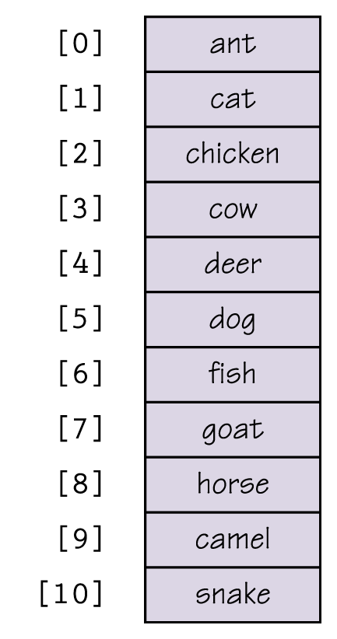
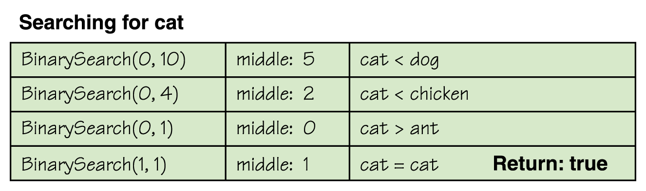
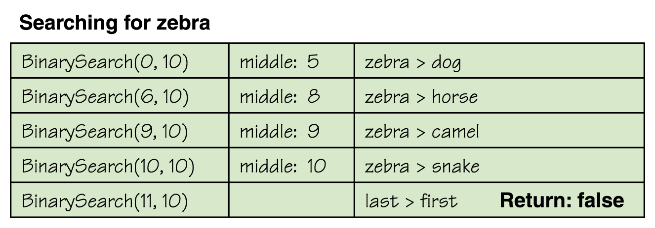
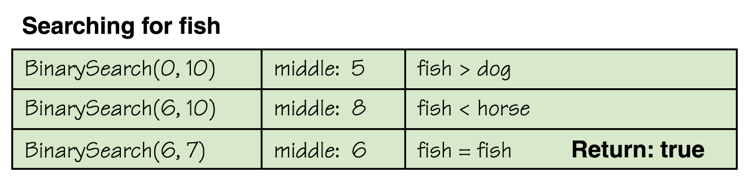
Binary Search
Figure 9.14 Trace of the binary search

Slide 44
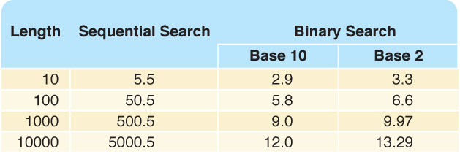
Binary Search
Table 9.1 Average Number of Comparisons
Is a binary search
always better?

Slide 45
More complicated abstract data types
What if we want to store lists which access information in a particular order?
Think about standing in a line at the grocery store:
  Where do you get added to the list?
  Where do you get removed from?

Slide 46
Queues
Queue
An abstract data type in which items are entered at one end and removed from the other end
  FIFO, for First In First Out
  No standard queue terminology
    Enqueue, Enque, Enq, Enter, and Insert
    are used for the insertion operation
    Dequeue, Deque, Deq, Delete, and Remove
    are used for the deletion operation.
Name
three
everyday
structures
that are
queues

Slide 47
Stacks
Stack
An abstract data type in which accesses are made at only one end
  LIFO, which stands for Last In First Out
  The insert is called Push and the delete is called Pop
Name three everyday
structures that are stacks

