Slide 1
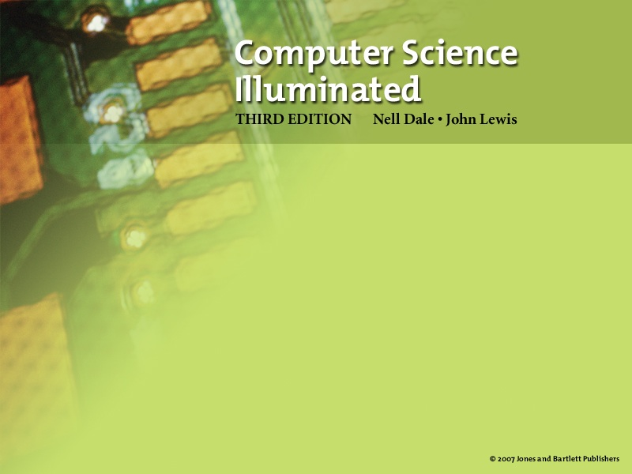
Chapter 17
Limitations of Computing
(slides modified by Erin Chambers)

Slide 2

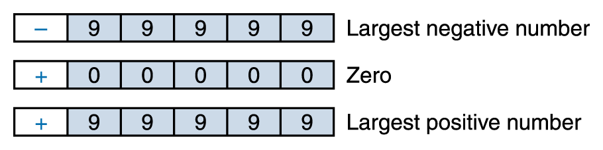
Limits on Arithmetic
Precision
The maximum number of significant digits that can be represented
With 5 digits precision, the range of the numbers we can represent is -99,999 through +99,999

Slide 3

Limits on Arithmetic
What happens if we allow one of these digits (let’s say the leftmost one, in red) to represent an exponent?
For example
represents the number +2,345 * 10³

Slide 4
Limits on Arithmetic
The range of numbers we can now represent is much larger
-9,999 * 10⁹ to +9,999 * 10⁹
but we can represent only four significant digits
Significant digits
Those digits that begin with the first nonzero digit on the left and end with the last nonzero digit on the right

Slide 5
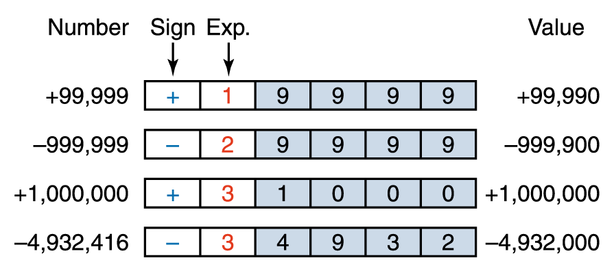
Limits on Arithmetic
The four leftmost digits are correct, and the balance of the digits are assumed to be zero
We lose the rightmost, or least significant, digits

Slide 6
Limits on Arithmetic
To represent real numbers, we extend our coding scheme represent negative exponents
For example
  4,394 * 10⁻² = 43.94
  or
  22 * 10⁻⁴ = 0.0022

Slide 7
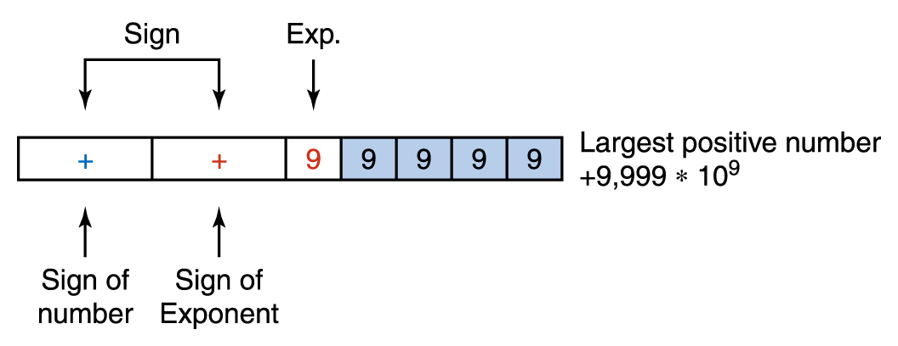
Limits on Arithmetic
Let current sign be the sign of the exponent and add a sign to the left to be the sign of the number itself
What is the largest negative number?
The smallest positive number?
The smallest negative number?

Slide 8
Limits on Arithmetic
Representational error or round-off error
An arithmetic error caused by the fact that the precision of the result of an arithmetic operation is greater than the precision of the machine
Underflow
Results of a calculation are too small to represent in a given machine
Overflow
Results of a calculation are too large to represent in a given machine
Cancellation error
A loss of accuracy during addition or subtraction of numbers of widely differing sizes, due to the limits of precision
Give examples of each
of these errors

Slide 9
Limits on Arithmetic
There are limitations imposed by the hardware on the representations of both integer numbers and real numbers
  If the word length is 32 bits, the range of integer numbers that can be represented is 22,147,483,648 to 2,147,483,647
  There are software solutions, however, that allow programs to overcome these limitations
  For example, we could represent a very large number as a list of smaller numbers

Slide 10
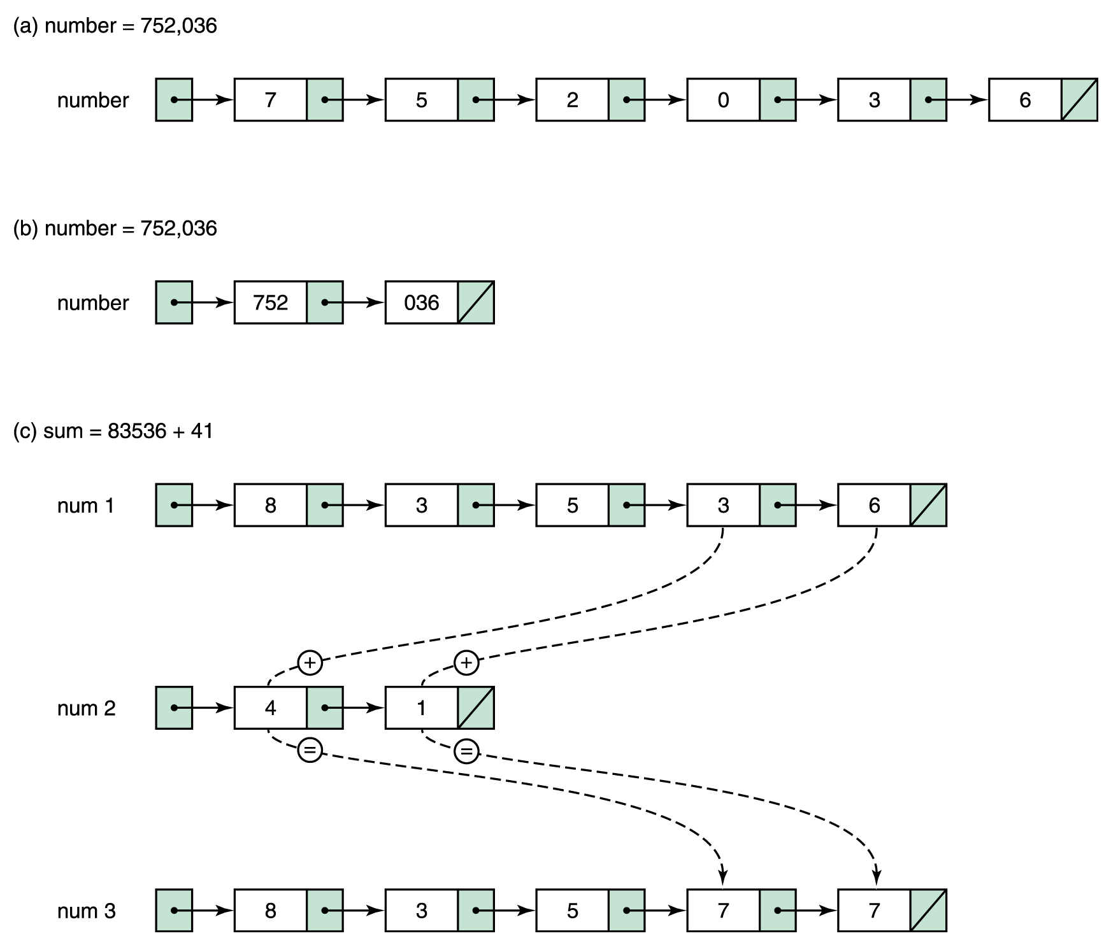
Limits on Arithmetic
Figure 17.1 Representing very large numbers

Slide 11
Limits on Components
Although most errors are caused by software, hardware components do fail
Have you ever had a hardware failure?

Slide 12
Limits on Communications
Error-detecting codes
Techniques to determine if an error has occurred during the transmission of data and then alert the system
Error-correcting codes
Error-detecting codes that try to determine the correct value

Slide 13
Limits on Communications
Parity bit
An extra bit that is associated with each byte, used to ensure that the number of 1 bits in a 9-bit value (byte plus parity bit) is odd (or even) across all bytes
Parity bits are used to detect that an error has occurred between the storing and retrieving of a byte or the sending and receiving of a byte

Slide 14
Limits on Communications
Odd parity requires the number of 1s in a byte plus the parity bit be odd
For example
    If a byte contains the pattern 11001100, the parity bit would be 1, thus giving an odd number of 1s
    If the pattern were 11110001, the parity bit would be 0, giving an odd number of 1s
Even parity uses the same scheme, but the number of 1 bits must be even

Slide 15
Limits on Communications
Check digits
  A software variation of the same scheme is to sum the individual digits of a number and store the unit’s digit of that sum with the number
  For example, given the number 34376, the sum of the digits is 23, so the number would be stored as 34376–3
Error-correcting codes
  If enough information about a byte or number is kept, it is possible to deduce what an incorrect bit or digit must be

Slide 16
Complexity of Software
Commercial software contains errors
  The problem is complexity
  Software testing can demonstrate the presence of bugs but cannot demonstrate their absence
    As we find problems and fix them, we raise our confidence that the software performs as it should
    But we can never guarantee that all bugs have been removed

Slide 17
Software Engineering
Remember the four stages of computer problem solving?
  Write the specifications
  Develop the algorithm
  Implement the algorithm
  Maintain the program
Moving from small, well-defined tasks to large software projects, we need to add two extra layers on top of these: Software requirements and specifications

Slide 18
Software Engineering
Software requirements
A statement of what is to be provided by a computer system or software product
Software specifications
A detailed description of the function, inputs, processing, outputs, and special features of a software product; it provides the information needed to design and implement the software

Slide 19
Software Engineering
Testing techniques have been a running thread throughout this book
They are mentioned here again as part of software engineering
Can you define walk-throughs and inspections?

Slide 20
Software Engineering
Use of SE techniques can reduce errors, but they will occur
A guideline for the number of errors per lines of code that can be expected
  Standard software: 25 bugs per 1,000 lines
  of program
  Good software: 2 errors per 1,000 lines
  Space Shuttle software: < 1 error per 10,000 lines

Slide 21
Formal Verification
The verification of program correctness, independent of data testing, is an important area of theoretical computer science research
Formal methods have been used successfully in verifying the correctness of computer chips
It is hoped that success with formal verification techniques at the hardware level can lead eventually to success at the software level

Slide 22
Notorious Software Errors
AT&T Down for Nine Hours
  In January of 1990, AT&T’s long-distance telephone network came to a screeching halt for nine hours, because of a software error in an upgrade to the electronic switching systems

Slide 23
Notorious Software Errors
Therac-25
  Between June 1985 and January 1987, six known accidents involved massive overdoses by the Therac-25, leading to deaths and serious injuries
  There was only a single coding error, but tracking down the error exposed that the whole design was seriously flawed

Slide 24
Notorious Software Errors
Mariner 1 Venus Probe
This probe, launched in July of 1962, veered off course almost immediately and had to be destroyed
The problem was traced to the following line of Fortran code:
  DO 5 K = 1. 3
The period should have been a comma.
An $18.5 million space exploration vehicle was lost because of this typographical error

Slide 25
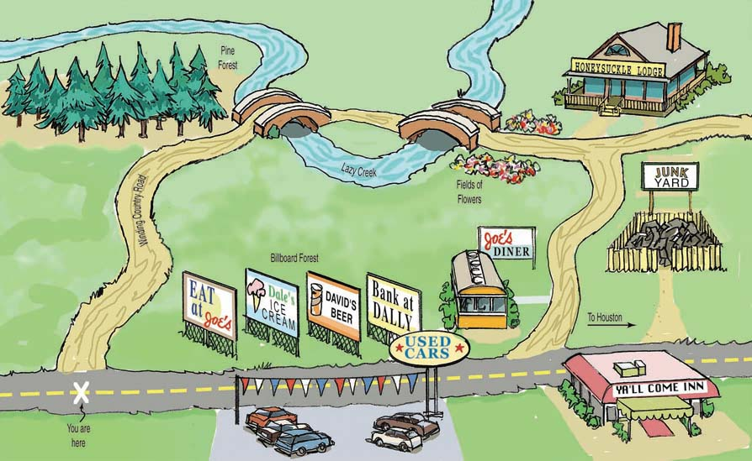
Comparing Algorithms

Slide 26
Big-O Analysis
How can we compare algorithms?
Big-O notation
A notation that expresses computing time (complexity) as the term in a function that increases most rapidly relative to the size of a problem

Slide 27
Big-O Analysis
Function of size factor N:
f(N) = N⁴ + 100N² + 10N + 50
Then f(N) is of order N⁴—or, in Big-O notation, O(N⁴).
For large values of N, N⁴ is so much larger than 50, 10N, or even 100 N² that we can ignore these other terms

Slide 28
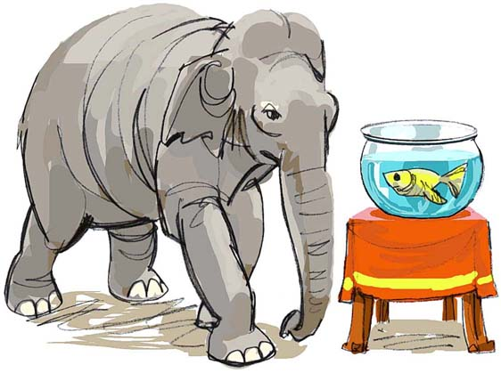
Big-O Analysis

Slide 29
Big-O Analysis
Common Orders of Magnitude
  O(1) is called bounded time
    Assigning a value to the ith element in an array
    of N elements
  O(log₂N) is called logarithmic time
    Algorithms that successively cut the amount of data to be processed in half at each step typically fall into this category
    Finding a value in a list of sorted elements using the binary search algorithm is O(log₂N)

Slide 30
Big-O Analysis
  O(N) is called linear is called linear time
    Printing all the elements in a list of N elements is O(N)
  O(N log₂N)
    Algorithms of this type typically involve applying a logarithmic algorithm N times
    The better sorting algorithms, such as Quicksort, Heapsort, and Mergesort, have N log₂N complexity

Slide 31
Big-O Analysis
  O(N²) is called quadratic time
    Algorithms of this type typically involve applying a linear algorithm N times. Most simple sorting algorithms are O(N²) algorithms
  O(2^{N}) is called exponential time
  O(n!) is called factorial time
    The traveling salesperson graph algorithm is a factorial time algorithm

Slide 32
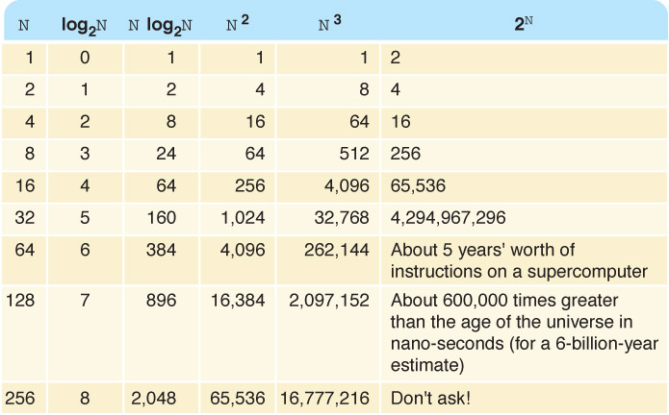
Big-O Analysis
Table 17.2 Comparison of rates of growth

Slide 33
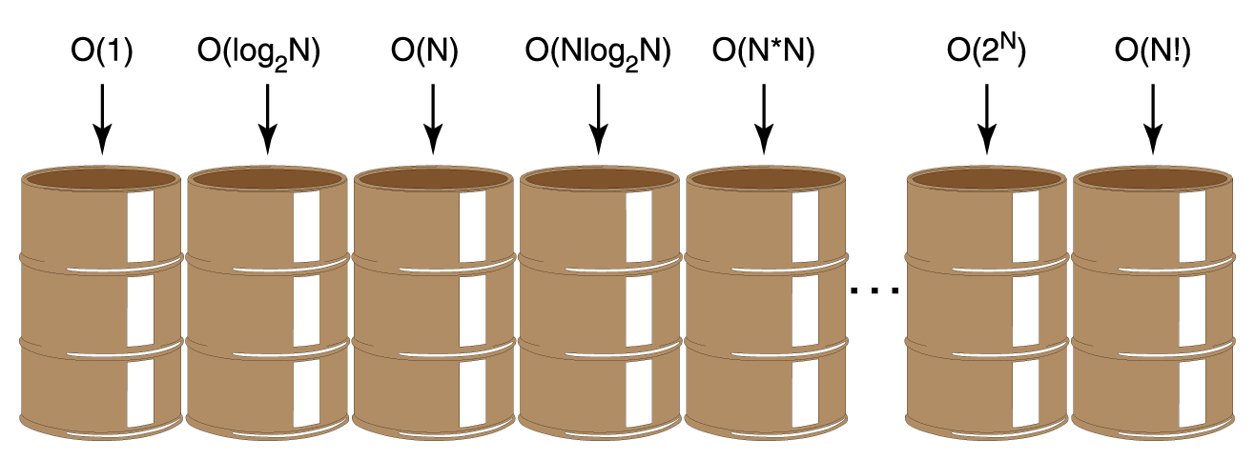
Big-O Analysis
Figure 17.3 Orders of complexity

Slide 34
Turing Machines
Turing machine
A model Turing developed in the 1930s, that consists of a control unit with a read/write head that can read and write symbols on an infinite tape

Slide 35
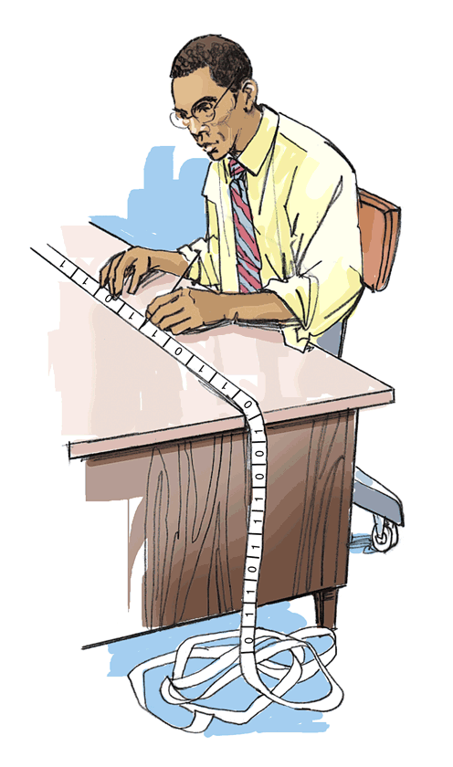
Turing Machines
Why is such a simple machine (model) of any importance?
  It is widely accepted that anything that is intuitively computable can be computed by a Turing machine
  If we can find a problem for which a Turing-machine solution can be proven not to exist, then the problem must be unsolvable
Figure 17.4 Turing machine processing

Slide 36
Halting Problem
The Halting problem
Given a program and an input to the program, determine if the program will eventually stop with this input
This problem is unsolvable

Slide 37
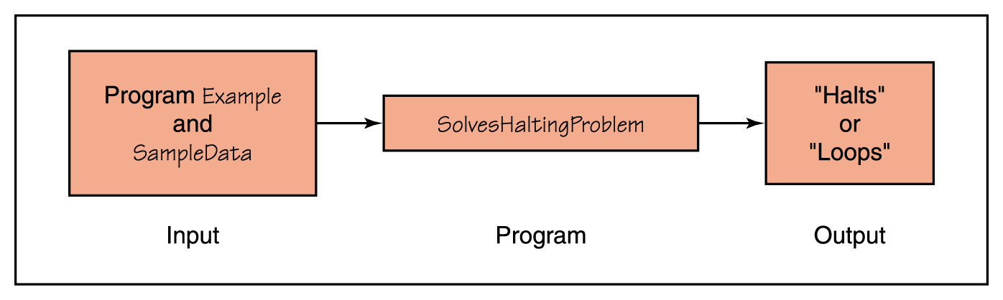
Halting Problem
Assume that there exists a Turing-machine program, called SolvesHaltingProblem that determines for any program Example and input SampleData whether program Example halts given input SampleData
Figure 17.5 Proposed program for solving the Halting problem

Slide 38

Halting Problem
Figure 17.6 Proposed program for solving the Halting problem

Slide 39
Halting Problem
Now let’s construct a new program, NewProgram, that takes program Example as both program and data and uses the algorithm from SolvesHaltingProblem to write “Halts” if Example halts and “Loops” if it does not halt
Let’s now apply program SolvesHaltingProblem to NewProgram, using NewProgram as data
  If SolvesHaltingProblem prints “Halts”,
  program NewProgram goes into an infinite loop
  If SolvesHaltingProblem prints “Loops”, program NewProgram prints “Halts” and stops
  In either case, SolvesHaltingProblem gives the wrong answer

Slide 40
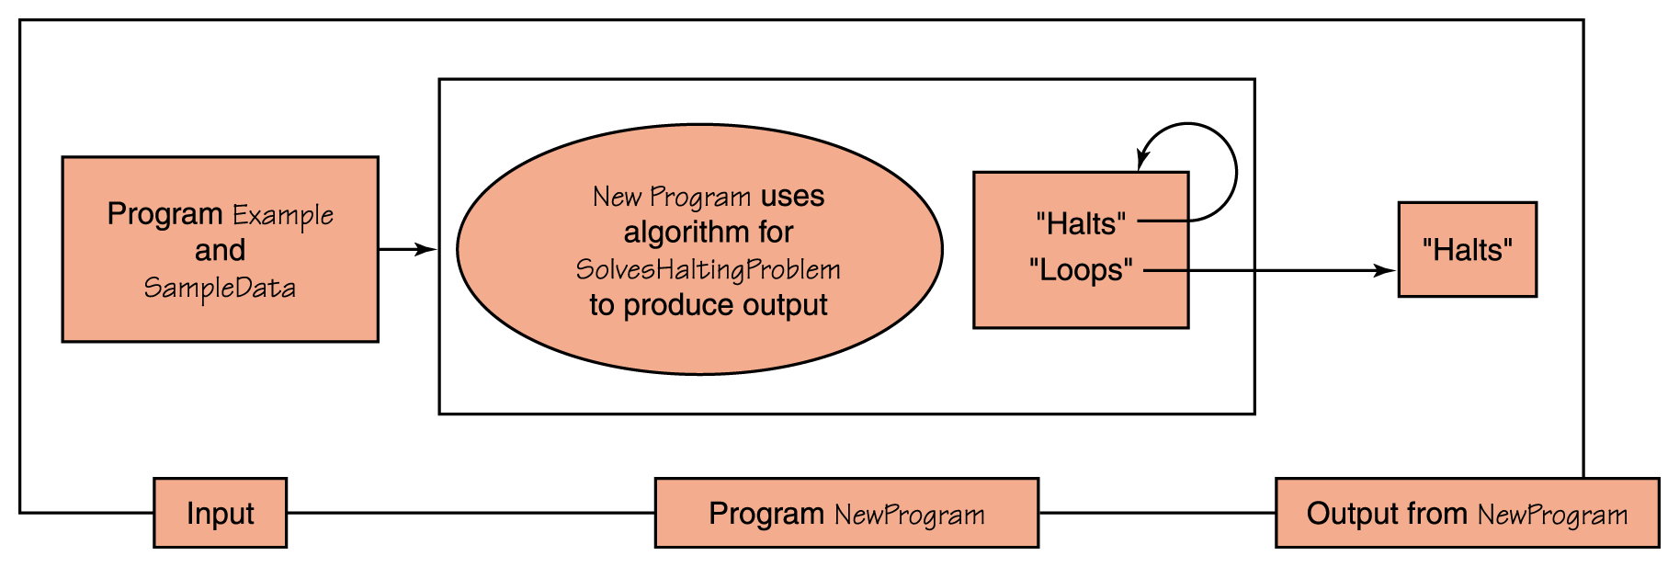
Halting Problem
Figure 17.7 Construction of NewProgram

Slide 41
Classification of Algorithms
  Polynomial-time algorithms
  Algorithms whose order of magnitude can be expressed as a polynomial in the size of the problem are called
  Class P
  Problems that can be solved with one processor in polynomial time
  NP-complete problems
  Problems that can be solved in polynomial time with as many processors as desired

Slide 42
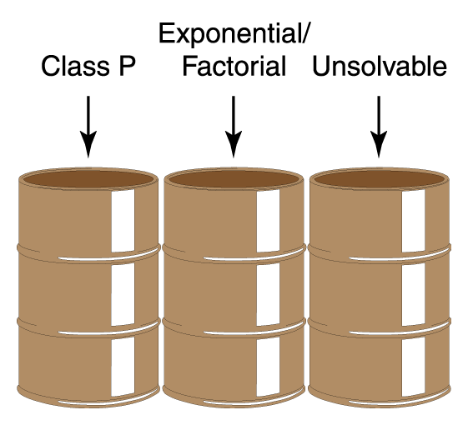
Classification of Algorithms
Let’s reorganize our bins, combining all polynomial algorithms in a bin labeled Class P
Figure 17.8 A reorganization of algorithm classification

Slide 43
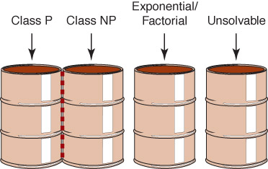
Classification of Algorithms
Are class
NP
problems
also
in
class P
?
Figure 17.9 Adding Class NP

Slide 44
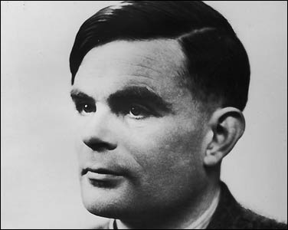
Who am I?
What machine
and what award
are named
after me
?
Why am I on
Time's list of
the 100 most
influential
persons in
the 20th century
?

