Slide 1
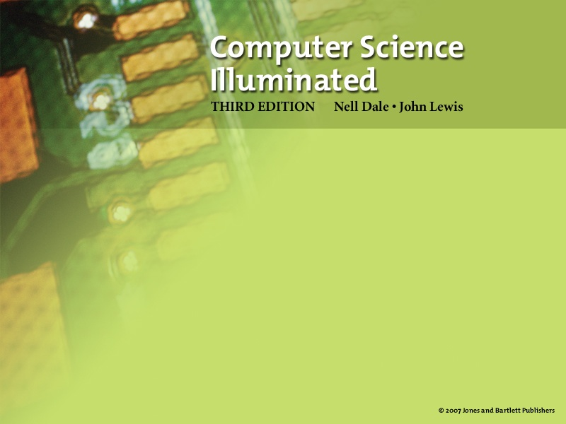
Ethical Issues in Computer Science
(slides modified by Erin Chambers)

Slide 2

Ethical Issues
Many ethical complications arise in the context of computer science
  RIAA versus Napster
Is it ok to steal a CD?
Is it ok to download that same music without paying?

Slide 3
Ethical Issues
Software Piracy and Copyrighting
Have you every "borrowed" software
from a friend?
Have you ever "lent" software to a
friend?
Did you know that 107,000 jobs were
lost in the US one year due to such
"borrowing" and "lending?"

Slide 4
Ethical Issues
Digital Rights Management is software used to “control access to to data and hardware”.
Sony used XCP, but flaws in the code allowed hackers to break into computers with XCP installed.
Should companies be allowed to protect their copyrighted data? Does it matter if it is digital or physical?
What does Napster or iTunes do to protect data?

Slide 5
Ethical Issues
Open-Source Software Development
What is open-source software?
What is proprietary software?
What are the arguments against
open-source software?
What are the arguments for open-
source software?

Slide 6
Privacy and the government
The Bill of Rights protects people against 'unreasonable search and seizure'.
No branch of the government may detain or search a citizen's property without a warrant issued by a judge
Do you feel safe under this system?
How did things change after September 11, 2001?

Slide 7
Privacy and the government
What is the Patriot Act?
What did it change?
Anyone ever heard of Carnivore, or know their rights for digital monitoring?

Slide 8
Digital privacy
If you send a letter, is it secure?
What about an email?
How do the two things differ?

Slide 9
Ethical Issues
Email Privacy
Who can read your email?
    Who should read your email?
Do you send personal email from work?
Is it worse to read email than to read a diary?

Slide 10
What about spam?
How much of email is spam?
Does spam get the same free speech rights as anything else? Is it different from junk mail?
Spam costs companies more than $22 billion a year. Why?

Slide 11
CAN-SPAM Act
In 2004, Congress took action.
All email must have:
  Accurate routing information
  Subject line that reflects content of message
  Opt-out option
  Include postal address and advertisement info
Why could this be a free speech problem?

Slide 12
Bioinformatics
What is the human genome project?
Are health care records private?
  From individuals?
  From companies?
  From governments?
What about if the information is 'sanitized'?

Slide 13
Ethical Issues
HIPPA: Health Insurance Portability and Accountability Act
What was the goal of this act?
Have you ever had to sign one of HIPPA forms at the doctor's office?
What are the benefits of this law?
What are the problems with this law?

Slide 14
Ethical Issues
Biometrics Research and the Case of
deCode Genetics, Inc
Describe the antagonists in this case
Why is the case controversial?
Would you have participated originally?
Would you participate now?

Slide 15
Encryption
Who here has ever depending on encryption?
  Who did it protect you from?
  Who should be able to decrypt your message?
  What about government oversight, or company oversight?
Should a protester have the same rights? A criminal? A terrorist?

Slide 16
Ethical Issues
Breaking into a University’s Computer System to Inquire About One’s Admission Status into a Graduate Program
Is breaking into a computer system ever justified?
Is breaking into a house to view something different from breaking in to steal something?
Would you have viewed your own admissions data if given the chance?

Slide 17
Ethical Issues
Ubiquitous Computing
What does "ubiquitous computing" mean?
Name three ways that an employer can monitor an employees computer interaction
Should an employee have any right to privacy in the workplace?

Slide 18
Ethical Issues
Blogging
What is the blogosphere?
Give several examples of how blogs have made national headlines
Should bloggers have the same protections as regular journalists?

