Slide 1

Gates and Circuits
  Nell Dale & John Lewis (adaptation by Erin Chambers and Michael Goldwasser)

Slide 2

Computers and Electricity
A gate is a device that performs a basic operation on electrical signals
Gates are combined into circuits to perform more complicated tasks
4–<number>

Slide 3
Gates
Let’s examine the processing of the following six types of gates
  NOT
  AND
  OR
  XOR
  NAND
  NOR
4–<number>

Slide 4
Describing Gates and Circuits
There are three different, but equally powerful, notational methods
for describing the behavior of gates
and circuits
  Boolean expressions
  logic diagrams
  truth tables
4–<number>

Slide 5
Describing Gates and Circuits
Boolean algebra: expressions in this algebraic notation are an elegant and powerful way to demonstrate the activity of electrical circuits
  Basic propositional statements are unambiguously either True or False
  Operations such as AND or NOT are then performed on these values
  A gate is simply a mechanical way to perform such a boolean operation
4–<number>

Slide 6
Describing Gates and Circuits
Logic diagram: a graphical representation of a circuit
  Each type of gate is represented by a specific graphical symbol
Truth table: defines the function of a gate by listing all possible input combinations that the gate could encounter, and the corresponding output
4–<number>

Slide 7
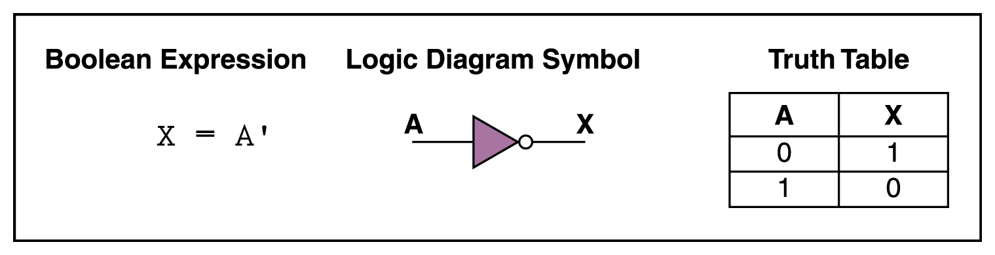
NOT Gate
a NOT gate accepts one input value
and produces one output value
a NOT gate is sometimes referred to as an inverter because it inverts the input value
4–<number>

Slide 8
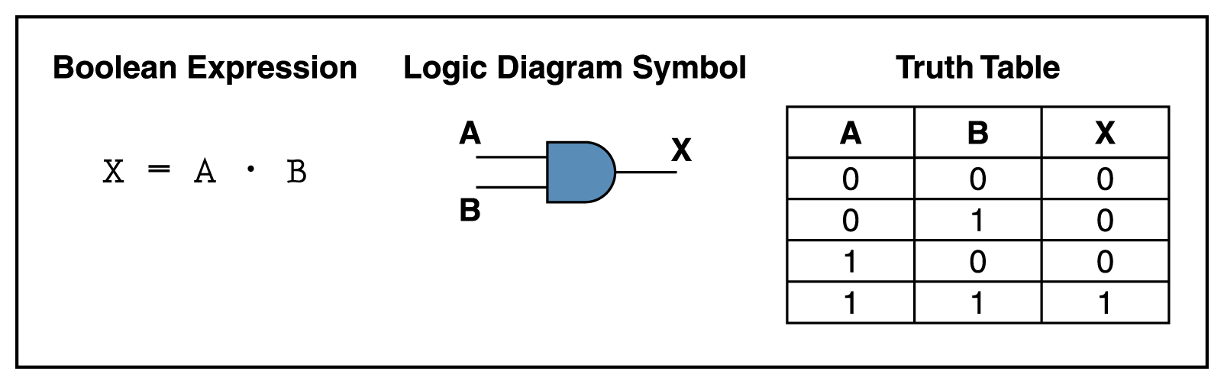
AND Gate
An AND gate accepts two input signals
If the two input values for an AND gate are both 1, the output is 1; otherwise, the output is 0
Figure 4.2 Various representations of an AND gate
4–<number>

Slide 9
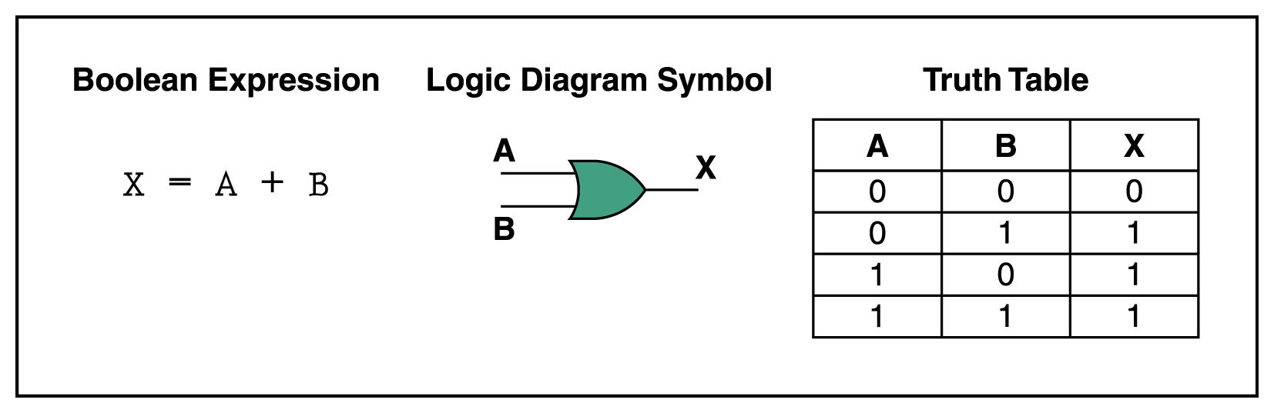
OR Gate
If the two input values are both 0, the output value is 0; otherwise, the output is 1
Figure 4.3 Various representations of a OR gate
4–<number>

Slide 10
XOR Gate
XOR, or exclusive OR, gate
  An XOR gate produces 0 if its two inputs are the same, and a 1 otherwise
  Note the difference between the XOR gate
  and the OR gate; they differ only in one
  input situation
  When both input signals are 1, the OR gate produces a 1 and the XOR produces a 0
4–<number>

Slide 11
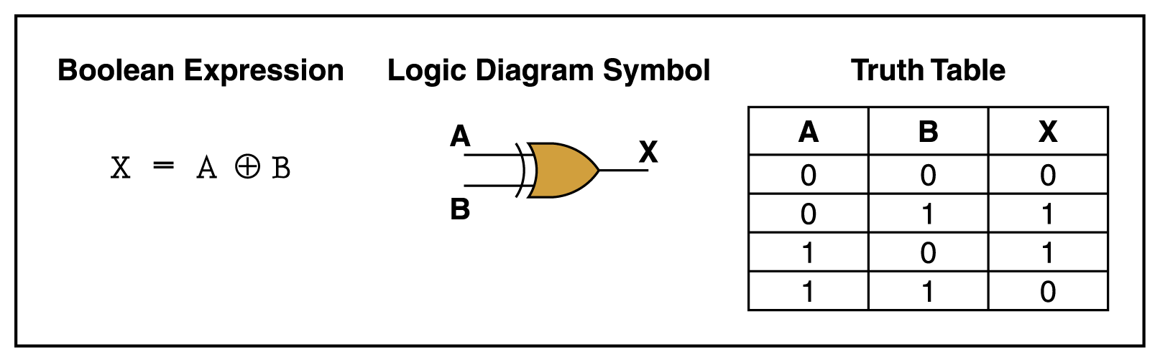
XOR Gate
Figure 4.4 Various representations of an XOR gate
4–<number>

Slide 12
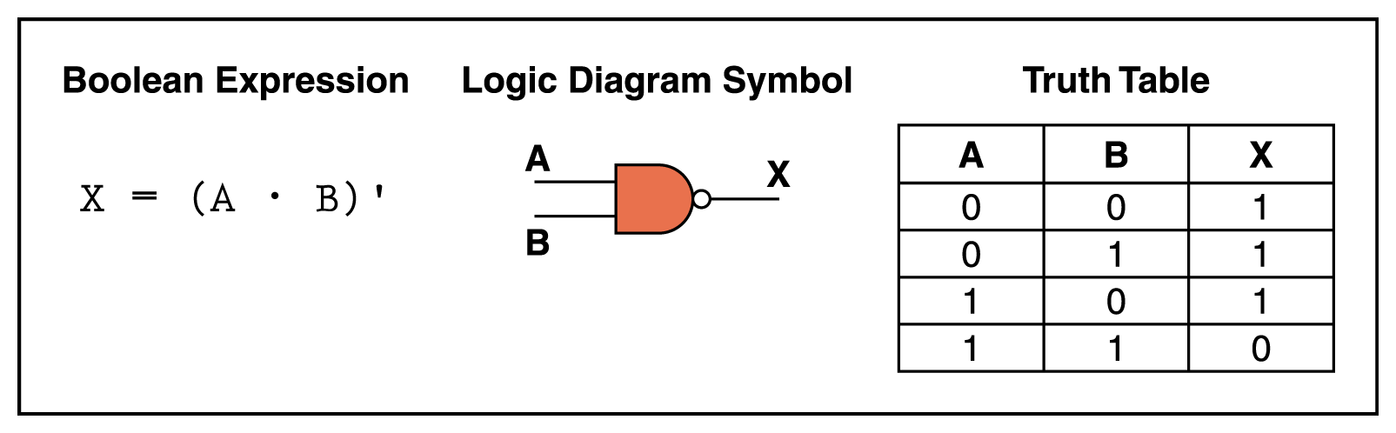
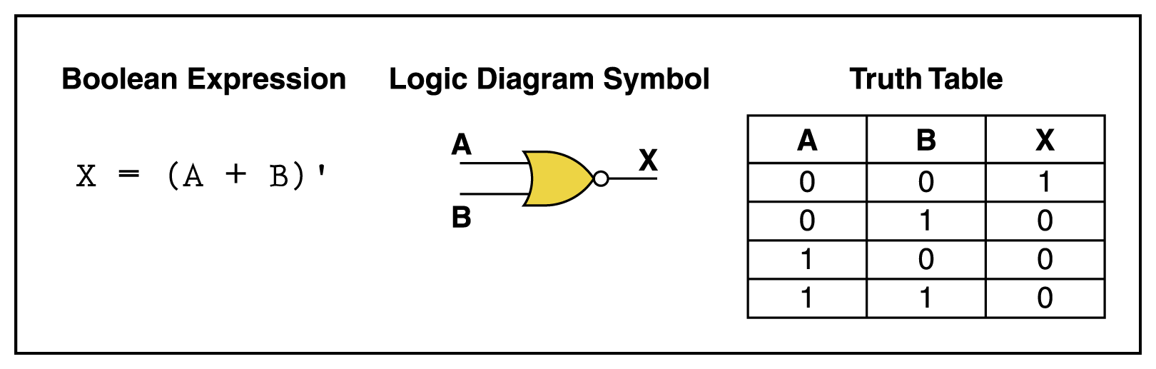
NAND and NOR Gates
The NAND and NOR gates are essentially the opposite of the AND and OR gates, respectively
Figure 4.5 Various representations of a NAND gate
Figure 4.6 Various representations of a NOR gate

Slide 13
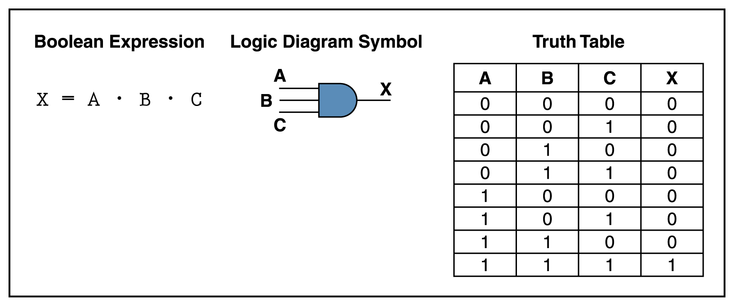
Gates with More Inputs
Gates can be designed to accept three or more input values
A three-input AND gate, for example, produces an output of 1 only if all input values are 1
Figure 4.7 Various representations of a three-input AND gate
4–<number>

Slide 14
Constructing Gates
A transistor is a device that acts, depending on the voltage level of an input signal, either as a wire that conducts electricity or as a resistor that blocks the flow of electricity
  A transistor has no moving parts, yet acts like
  a switch
  It is made of a semiconductor material, which is neither a particularly good conductor of electricity, such as copper, nor a particularly good insulator, such as rubber
4–<number>

Slide 15
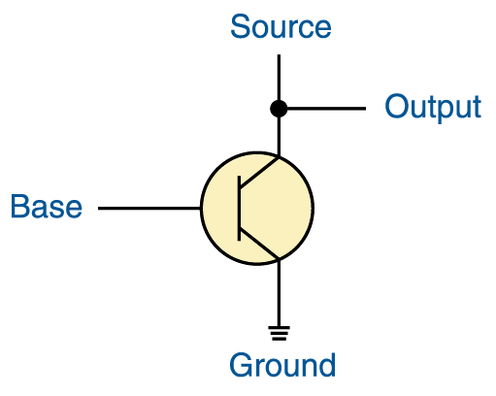
Constructing Gates
jasonm:
Redo 4.8 (crop)
A transistor has three terminals
  A source
  A base
  An emitter, typically connected to a ground wire
If the electrical signal is grounded, it is allowed to flow through an alternative route to the ground (literally) where it can do no harm
Figure 4.8 The connections of a transistor
4–<number>

Slide 16
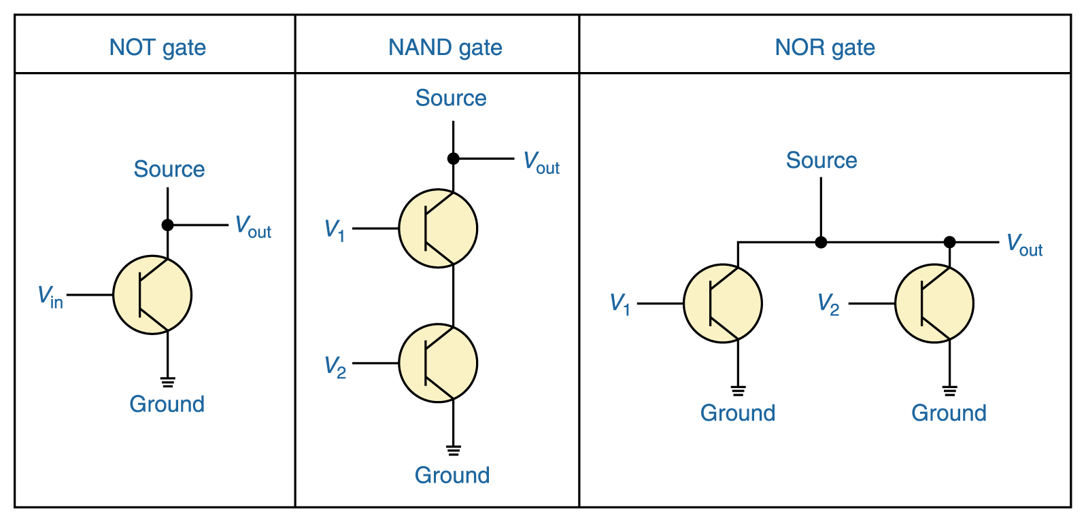
Constructing Gates
It turns out that, because the way a transistor works, the easiest gates to create are the NOT, NAND, and NOR gates
Figure 4.9 Constructing gates using transistors
4–<number>

Slide 17
Circuits
Two general categories
  In a combinational circuit, the input values explicitly determine the output
  In a sequential circuit, the output is a function of the input values as well as the existing state of the circuit
As with gates, we can describe the operations
of entire circuits using three notations
  Boolean expressions
  logic diagrams
  truth tables
4–<number>

Slide 18
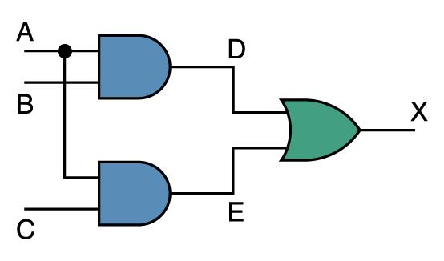
Combinational Circuits
Gates are combined into circuits by using the output of one gate as the input for another
Page 99
4–<number>

Slide 19
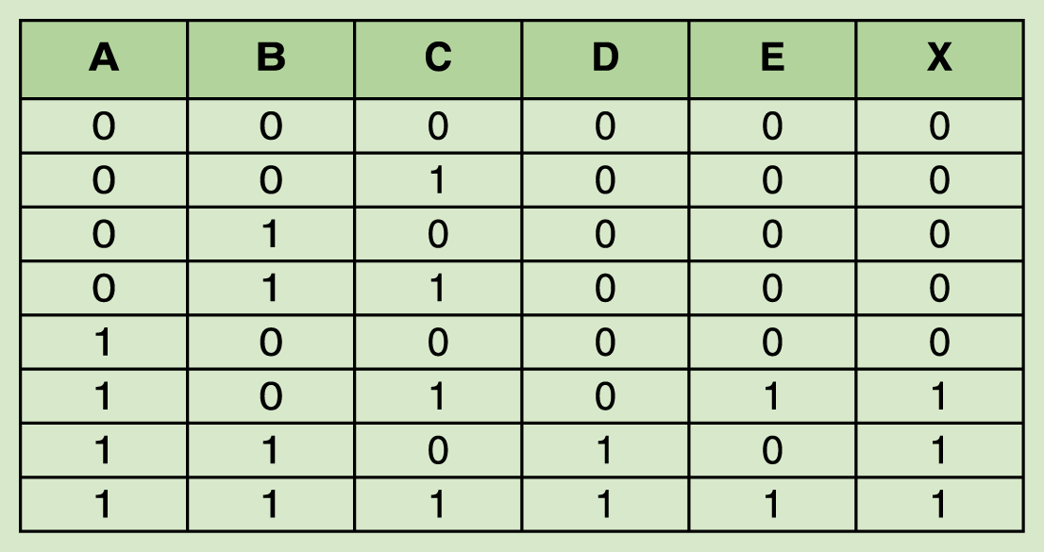
Combinational Circuits
jasonm:
Redo to get white space around table (p100)
Page 100
Because there are three inputs to this circuit, eight rows are required to describe all possible input combinations
This same circuit using Boolean algebra:
(AB + AC)
4–<number>

Slide 20
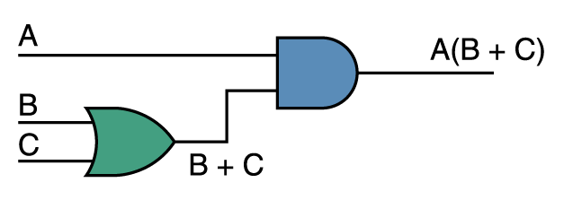
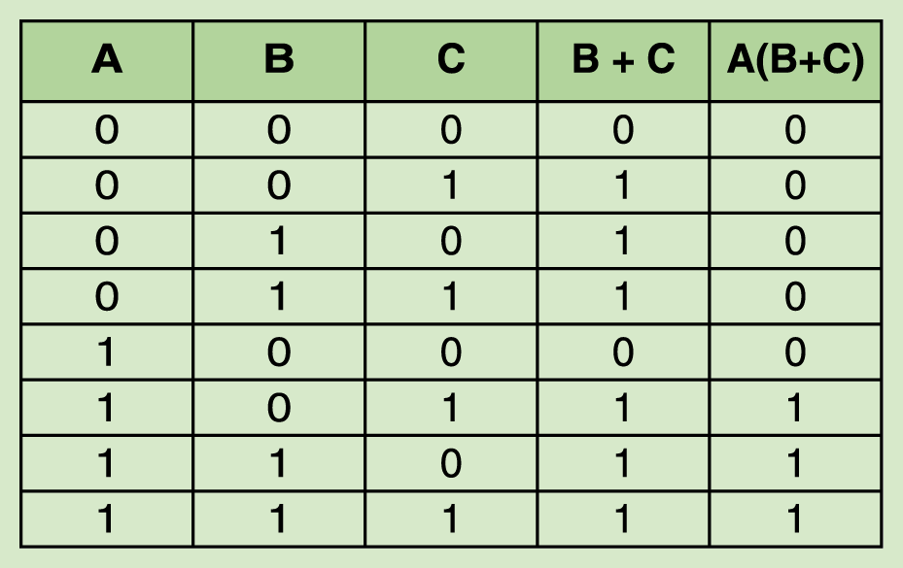
Now let’s go the other way; let’s take a Boolean expression and draw
jasonm:
Redo table to get white space (p101)
Consider the following Boolean expression: A(B + C)
Page 100
Page 101
Now compare the final result column in this truth table to the truth table for the previous example
  They are identical
4–<number>

Slide 21
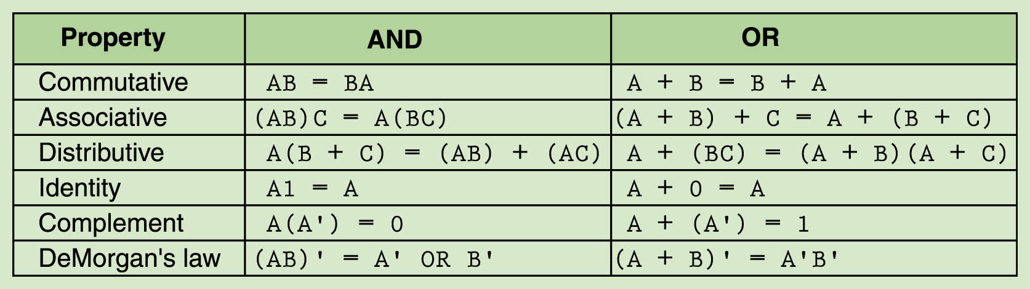
Properties of Boolean Algebra
jasonm:
Redo table (p101)
Page 101
4–<number>
Notes:
Here's an approximate order I do in such a class:
* Have people assemble a simple OR gate, with two switches and one
output bulb. (this is to get used to the software)
* Have people assemble a 3-way OR gate, and play with the
combinations.
* Have people build verify some identities by using the input
switches to simultaneously feed both circuits, each with a
separate lightbulb.
-- A(B+C) == (AB) + (AC)
-- (AB)' = A' + B'
* Sometimes, I have them load my half-adder, and I discuss it a bit
while they play with it. Possibly even looking at the full-adder.
* Then I switch to sequential cirucits and feedback loops.
-- first looking at feedback.dat
-- then looking at feedback2.dat
-- then looking at SRlatch.dat
I have some other premade circuits available as well if you want
(e.g. a multiplexor, a latch). But I'm not sure whether to make time
for them.

Slide 22
Adders
At the digital logic level, addition is performed in binary
Addition operations are carried out
by special circuits called, appropriately, adders
4–<number>

Slide 23
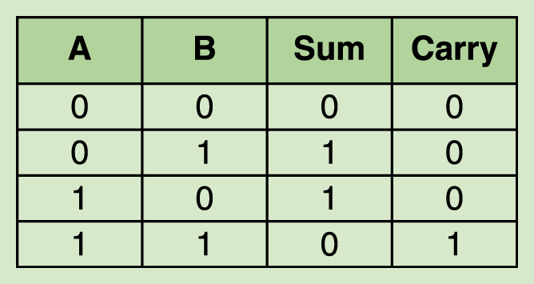
Adders
jasonm:
Redo table (p103)
The result of adding two binary digits could produce a carry value
Recall that 1 + 1 = 10
in base two
A circuit that computes the sum of two bits
and produces the correct carry bit is called a half adder
Page 103
4–<number>

Slide 24
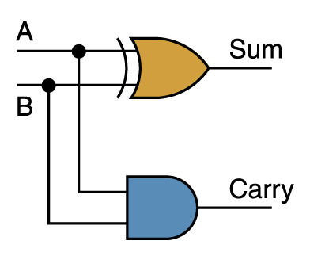
Adders
Circuit diagram representing
a half adder
Two Boolean expressions:
sum = A ⊕ B
carry = AB
Page 103
4–<number>

Slide 25
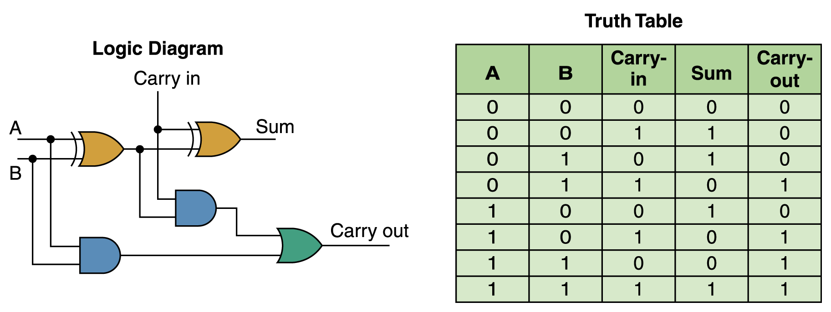
Adders
A circuit called a full adder takes the carry-in value into account
Figure 4.10 A full adder
4–<number>

Slide 26
Multiplexers
Multiplexer is a general circuit that produces a single output signal
  The output is equal to one of several input signals to the circuit
  The multiplexer selects which input signal is used as an output signal based on the value represented by a few more input signals, called select signals or select control lines
4–<number>

Slide 27
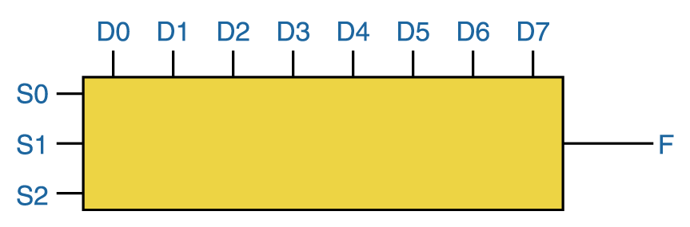
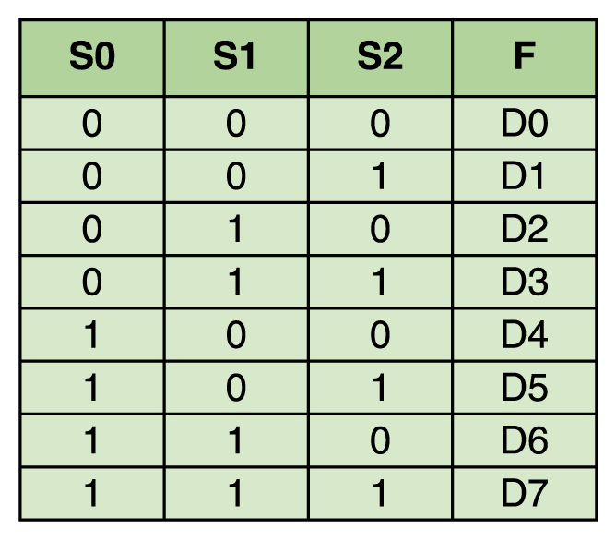
Multiplexers
The control lines S0, S1, and S2
determine which of eight other input lines
(D0 through D7) are routed to the output (F)
Figure 4.11 A block diagram of a multiplexer with three select control lines
Page 105
4–<number>

Slide 28
Circuits as Memory
Digital circuits can be used to store information
These circuits form a sequential circuit, because the output of the circuit is also used as input to the circuit
4–<number>

Slide 29
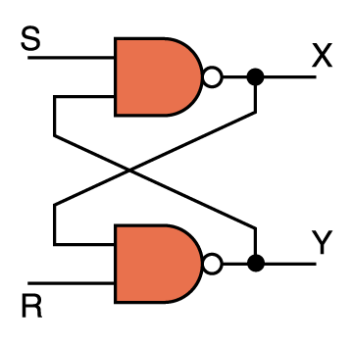
Circuits as Memory
An S-R latch stores a single binary digit
(1 or 0)
There are several ways an S-R latch circuit could be designed using various kinds of gates
Figure 4.12 An S-R latch
4–<number>

Slide 30
Circuits as Memory
The design of this circuit guarantees that the two outputs X and Y are always complements of each other
The value of X at any point in time is considered to be the current state of the circuit
Therefore, if X is 1, the circuit is storing a 1; if X is 0, the circuit is storing a 0
Figure 4.12 An S-R latch
4–<number>

Slide 31
Integrated Circuits
An integrated circuit (also called a chip) is a piece of silicon on which multiple gates have been embedded
These silicon pieces are mounted on a plastic or ceramic package with pins along the edges that can be soldered onto circuit boards or inserted into appropriate sockets
4–<number>

Slide 32
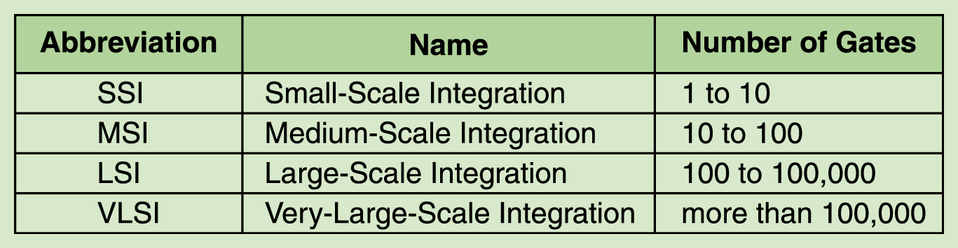
Integrated Circuits
jasonm:
Redo table (p107)
Integrated circuits (IC) are classified by the number of gates contained in them
Page 107
4–<number>

Slide 33
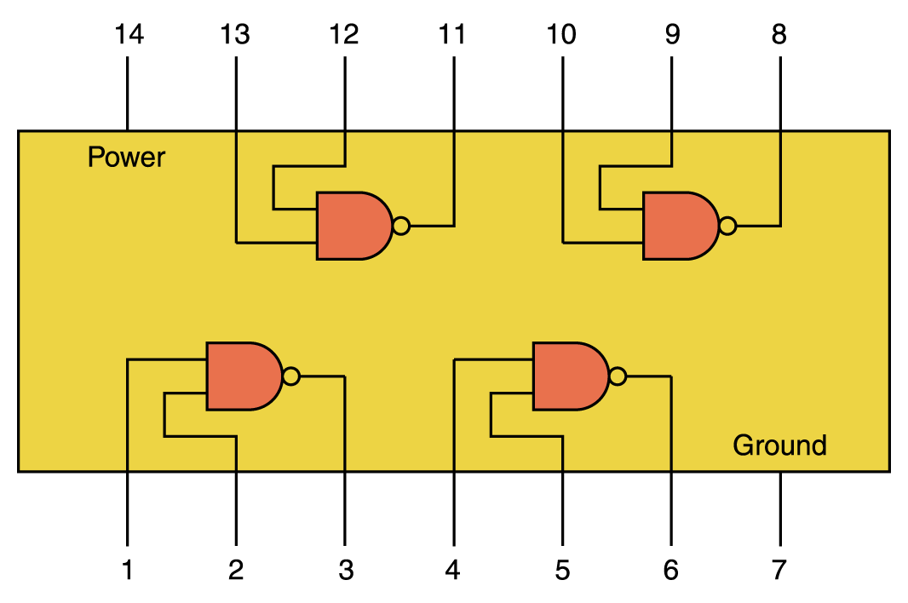
Integrated Circuits
Figure 4.13 An SSI chip contains independent NAND gates
4–<number>

Slide 34
CPU Chips
The most important integrated circuit
in any computer is the Central Processing Unit, or CPU
Each CPU chip has a large number
of pins through which essentially all communication in a computer system occurs
4–<number>

