Slide 1
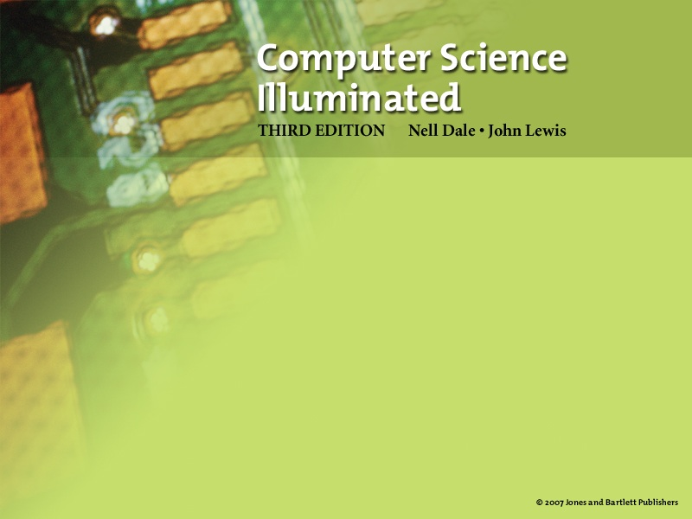
Chapter 8
High-Level Programming Languages
(modified by Erin Chambers)

Slide 2

Compilers
High-level language
A language that provides a richer (more English like) set of instructions
Compiler
A program that translates a high-level language program into machine code

Slide 3
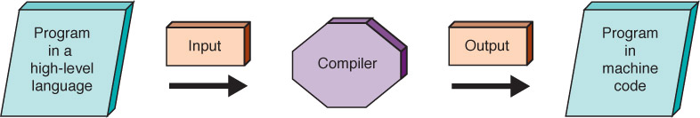
Compilers
How does this differ from
the assembly process?
Figure 8.1 Compilation process

Slide 4
Interpreters
Interpreter
A translating program that translates and executes the statements in sequence
  Compilers produce machine code as output, which is then executed in a separate step
  An interpreter translates a statement and then immediately executes the statement
  Interpreters can be viewed as simulators

Slide 5
Java
Introduced in 1996 and became instantly popular
Portability was of primary importance
Java is compiled into a standard machine language called Bytecode
A software interpreter called the JVM (Java Virtual Machine) takes the Bytecode program and executes it

Slide 6
Portability
Portability
The ability of a program to be run on different machines
Compiler portability
A program in a standardized language can be compiled
and run on any machine that has the appropriate compiler
Bytecode portability
A program translated into Bytecode can be run on
any machine that has a JVM
Do you understand the difference?

Slide 7
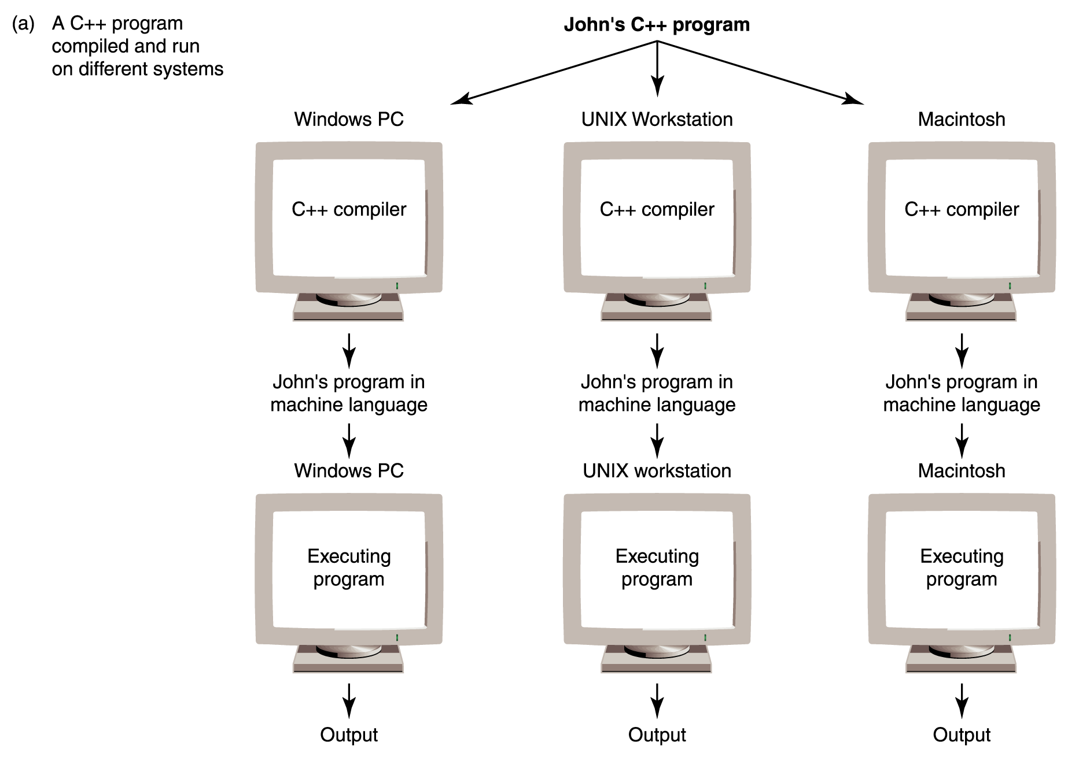
Portability
Figure 8.2
Portability provided by standardized languages versus interpretation by Bytecode

Slide 8
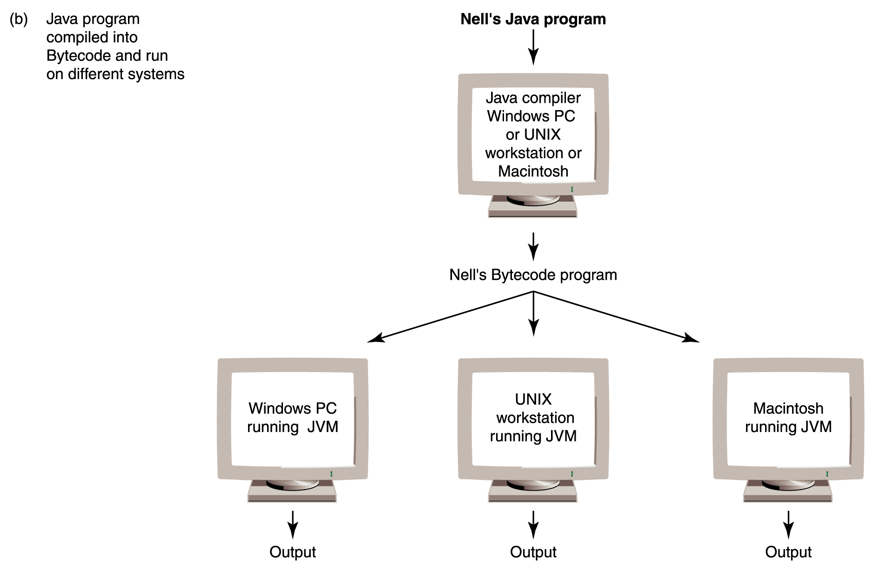
Portability
Figure 8.2
Portability provided by standardized languages versus interpretation by Bytecode

Slide 9
Programming Language Paradigms
Imperative or procedural model
  Program executes a sequence of instructions to accomplish a task
  FORTRAN, COBOL, BASIC, C, Pascal,
  Ada, and C++
Functional model
  Program is written terms of mathematical functions
  LISP, Scheme (a derivative of LISP), and ML

Slide 10
Programming Language Paradigms
Logic model
  Program consists of facts about objects and rules that question the relationships among facts
  PROLOG
Object-oriented model
  Program consists of a set of objects and the interactions among the objects
  Commonly used today because it allows clean interaction between different objects
  Smalltalk, Python, Java and C++

Slide 11
Programming Language Paradigms
We examine procedural and object-oriented languages in the rest of this chapter by looking at the functionality provided in these languages
We give examples in different languages to show how syntax used to provide the functionality

Slide 12
Functionality of Imperative Languages
Sequence
Executing statements in sequence until an instruction is encountered that changes this sequencing
Selection
Deciding which action to take
Iteration (looping)
Repeating an action

Slide 13
Boolean Expressions
Boolean expression
A sequence of identifiers, separated by compatible operators, that evaluates to true or false
A Boolean expression can be
  A Boolean variable
  An arithmetic expression followed by a relational operator followed by an arithmetic expression
  A Boolean expression followed by a Boolean operator followed by a Boolean expression

Slide 14
Boolean Expressions
Variable
A location in memory that is referenced by an identifier that contains a data value
Thus, a Boolean variable is a location in memory that can contain either true or false

Slide 15
Boolean Expressions
Example: Number1 < Number2
<=, >, >=, ==, !=
and, not, or, xor, nor, nand

Slide 16
Strong Typing
Data type
A description of the set of values and the basic set of operations that can be applied to values of the type
Strong typing
The requirement that only a value of the proper type can be stored into a variable

Slide 17
Data Types
Integer numbers
Real numbers
Characters
Boolean values
Strings

Slide 18
Integers
What determines the range of an integer value?
Is the range of an integer value the same in all languages?
What operations can be applied to integers?

Slide 19
Reals
How are real values like integer values?
How do real values differ from integer values?

Slide 20
Characters
Do you remember
ASCII?
Extended ASCII?
UNICODE?
How many characters in Extended ASCII?
How many characters in UNICODE?
What does a relational operator between two characters mean?

Slide 21
Boolean and Strings
What values can a Boolean variable be?
For what are Boolean expressions used?
What is a string?
What operations can be applied to strings?

Slide 22
Declarations
Declaration
A statement that associates an identifier with a variable, an action, or some other entity within the language that can be given a name; the programmer can refer to that item by name
Reserved word
A word in a language that has special meaning
Case-sensitive
Uppercase and lowercase letters are considered the same

Slide 23
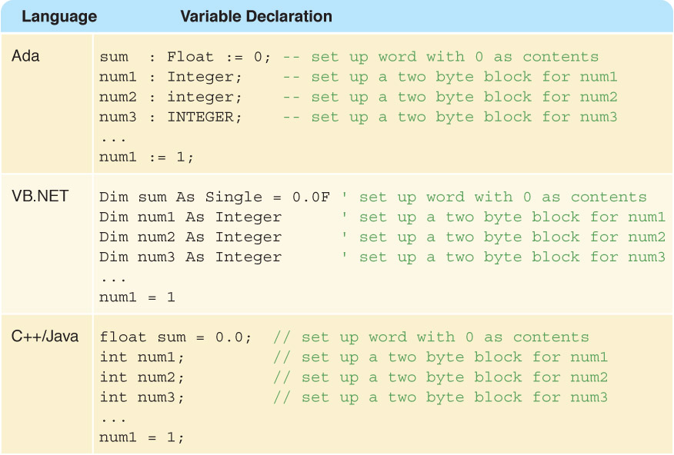
Declaration Example

Slide 24
Assignment statement
Assignment statement
An action statement (not a declaration) that says to evaluate the expression on the right-hand side of the symbol and store that value into the place named on the left-hand side
Named constant
A location in memory, referenced by an identifier, that contains a data value that cannot be changed
Remember?

Slide 25
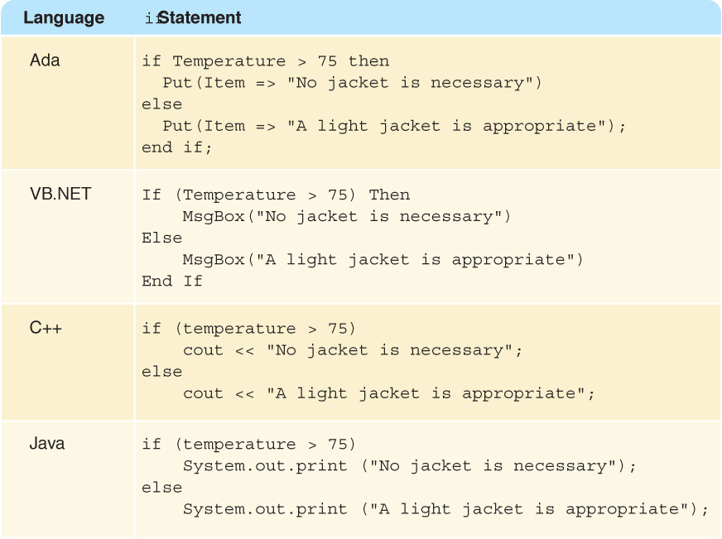
Selection Statements
The if statement allows the program to test the state of the program variables using a Boolean expression

Slide 26
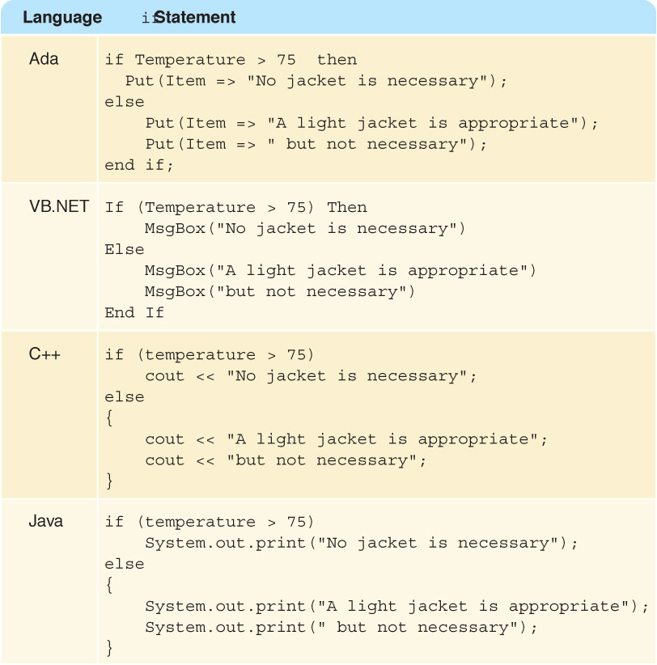
Blocks
Note
the
symbols
used to
indicate
blocks
in each
language

Slide 27
Cascading Ifs
If (temperature > 90)
Write "Texas weather: wear shorts"
Else If (temperature > 50)
Write "A little chilly: wear a light jacket"
Else If (temperature > 32)
Write "Philadelphia weather: wear a heavy coat"
Else
Write "Stay inside"
Why does this work correctly?

Slide 28
Looping Statements
A count-controlled loop
Set sum to 0
Set count to 1
While (count <= limit)
Read number
Set sum to sum + number
Increment count
Write "Sum is " + sum
Why is it
called a
count-controlled
loop?

Slide 29
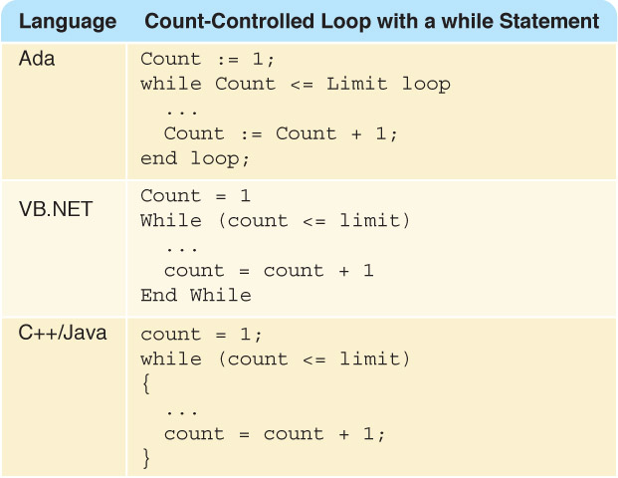
Looping Statements

Slide 30
Looping Statements
An event-controlled loop
Set sum to 0
Set allPositive to true
While (allPositive)
Read number
If (number > 0)
Set sum to sum + number
Else
Set allPositive to false
Write "Sum is " + sum
Why is it
called an
event-conrolled
loop?
What is the
event?

