Slide 1
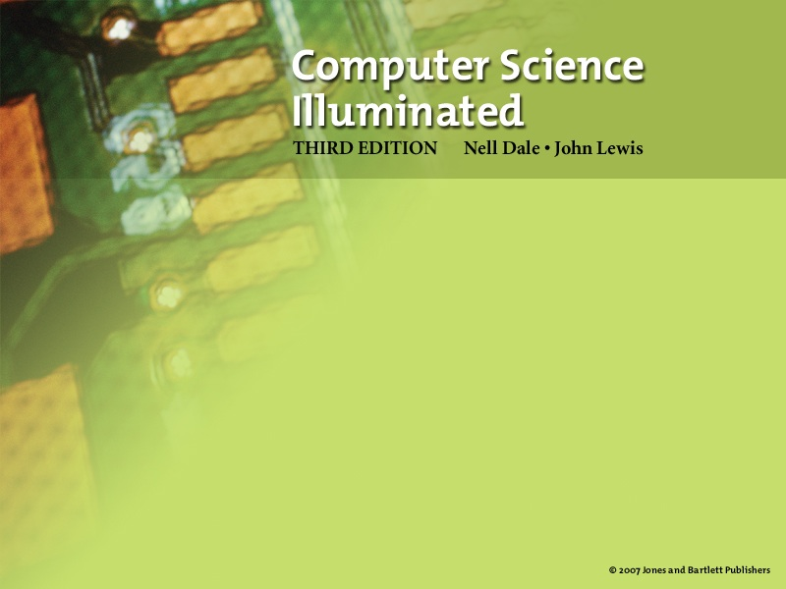
Chapter 1
  History of Computing

Slide 2

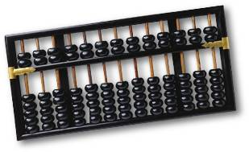
Early History of Computing
Abacus (origin? 2000BC)
An early device to represent numeric values with beads.
Note that the “computing” is still done by the human.
More Info

Slide 3
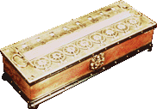
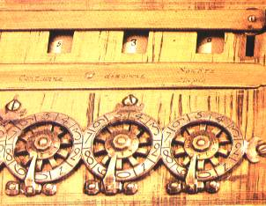
The Pascaline
Blaise Pascal (1623-1662)
Mechanical device to do addition and subtraction.
Used gear positions to represent information and a turn of a crank to manipulate the gears.
More info

Slide 4
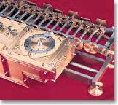
Wilhelm Leibniz
Wilhelm Leibniz (1646-1716)
gear-based mechanism (Stepped Reckoner) similar to Pascal’s, but “hardwired” for some multiplications.
More info

Slide 5
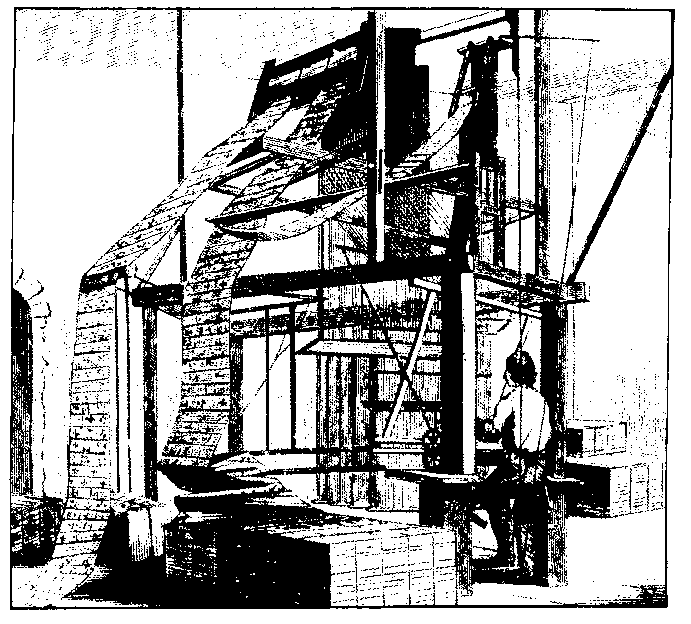
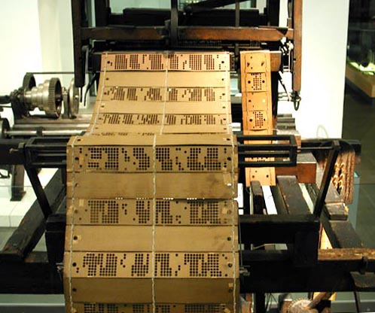
Jacquard’s Loom
Joseph Jacquard (c. 1801)
Mechanical loom with weaving pattern based on holes in paper which had the effect of raising and lowering particular hooks (i.e., programmable)
More info
6

Slide 6
Other “punched card” systems
Music Boxes and Player Pianos (1800’s, 1900’s)
-> links to history, pictures, music
Herman Hollerith (1860-1929):
census tabulation using punched cards - led to founding of IBM (originally Tabulating Machine Company)

Slide 7
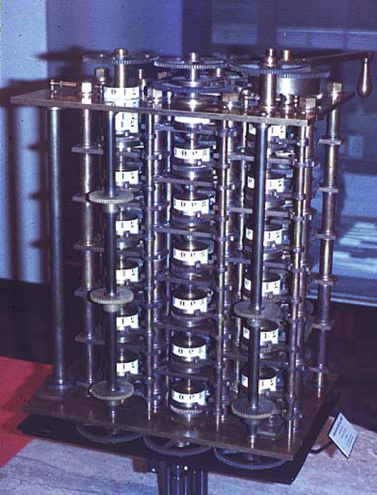
The Analytical Engine
Charles Babage (1792-1871)
Difference Engine: a gear-based computer he built
Analytical Engine: a design for a gear-based computer which would be programmable using punched cards. Machine was never fully realized as he ran out of money. Technical problem was that gear-based machine had some inherent inaccuracy that might go unnoticed in watch or loom, but not in complex arithmetic calculations.
7

Slide 8
Analytical Engine Continued
Ada Lovelace ( 1815-1852)
  First woman to be involved in design of computers
  Credited with actually documenting Babbage's analytical engine, and extended his ideas
  Inventor of the loop

Slide 9
Theoretical Developments
Alan Turing (1912-1954) and Alonza Church (1903-1995)
  Designed mathematical model of computing
  Turing is often called the father of computer science
  Highest award named for Turing

Slide 10
Modern Computers - Electricity
Breakthrough: Can control flow of electrons.
Electrons travel faster, more accurately, and with less power/cost than gears.
Earliest Models:
Non-military (thus funding/support limited)
John Atansoff & Clifford Berry (Iowa State, 1937-1941)
Konrad Zuse and Helmut Schreyer (Germany, c. WWII)
Military (thus funding/support plentiful)
Mark 1 (Howard Aiken et al, Harvard/IBM, 1941-1944)
Colossus (Alan Turing et al, England, 1943)
ENIAC (John von Neumann et al, Penn, 1940s)

Slide 11
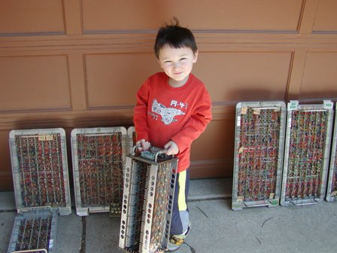
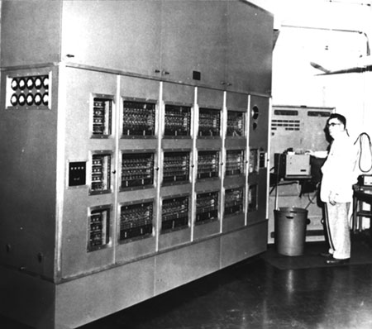
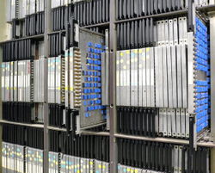
An Example - ILLIAC

Slide 12
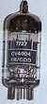
First Generation Hardware (1951-1959)
Vacuum Tubes
Acts as an electronic “switch”
Large, not very reliable, generated a lot of heat
Magnetic Drum
Memory device that rotated under a read/write head
Card Readers --> Magnetic Tape Drives
Development of these sequential auxiliary storage devices
8

Slide 13

Second Generation Hardware (1959-1965)
Transistor (Bell Telephone, 1947)
Replaced vacuum tube as “switch”.
fast, small, durable, cheap, made with some silicon.
Magnetic Cores
Replaced magnetic drums, information available instantly
Magnetic Disks
Replaced magnetic tape, data can be accessed directly
9

Slide 14

Third Generation Hardware (1965-1971)
Integrated Circuits
Thousands of components on a single semiconductor. Replaced circuit boards, smaller, cheaper, faster, more reliable.
Transistors
Now used for memory construction
Terminal
An input/output device with a keyboard and screen
10

Slide 15
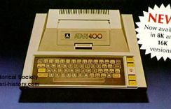


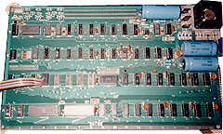
Fourth Generation Hardware (1971-?)
Large-scale Integrated Circuits
Used existing computer to design much smaller, more intricate integrated circuits. Now, the entire “microprocessor” could be on a single chip of silicon.
PCs, the Commercial Market, Workstations
Personal Computers were developed by old/new companies like Apple(1976) and Atari (1978), IBM PC (1981), Macintosh (1984). Workstations emerged (HP, Sun, SGI)
11

Slide 16
Further Developments
Parallel Computation
Networking
Quantum Computing
What's next?

Slide 17
First Generation Software
(1951-1959)
Machine Language
Computer programs written in binary (1s and 0s)
Assembly Languages and Translators
Programs written using mnemonics, which were translated into machine language
Programmer Changes
Programmers divide into two groups: application programmers and systems programmers
13

Slide 18
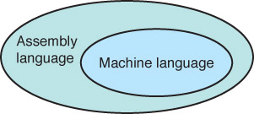
Assembly/Machine
Systems programmers
write the assembler
(translator)
Applications programmers
use assembly language to
solve problems

Slide 19
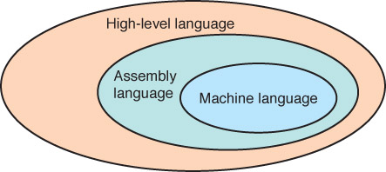
Second Generation Software
(1959-1965)
High-level Languages
English-like statements made programming easier:
Fortran, COBOL, Lisp
Systems
programmers
write translators for
high-level languages
Application
programmers
use high-level
languages to
solve problems
14

Slide 20
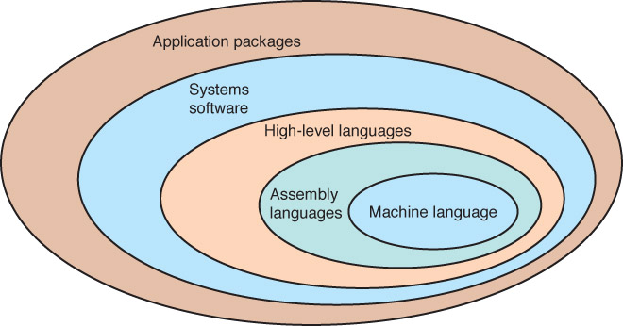
Third Generation Software
(1965-1971)
16

Slide 21
Third Generation Software
(1965-1971)
Systems Software
Utility programs
Language translators
Operating system, which decides which programs to run and when
Separation between Users and Hardware
Computer programmers write programs to be used by general public (i.e., nonprogrammers)
15

Slide 22
Fourth Generation Software
(1971-1989)
Structured Programming
Pascal
C
C++
New Application Software for Users
Spreadsheets
Word processors
Database management systems
17

Slide 23
Fifth Generation Software
(1990- present)
Microsoft
Windows operating system and other Microsoft application programs dominate the market
Object-Oriented Design
Based on a hierarchy of data objects (i.e. Java)
World Wide Web
Allows easy global communication through the Internet
New Users
Today’s user needs no computer knowledge
18

Slide 24
One Law, plus some quotes
Moore's law
  The number of transistors that fit on a chip doubles every two years.
“I think there is a world market for maybe 5 computers.” Chair of IBM, 1945
“...computers in the future may only have 1,000 vacuum tubes and weigh 1.5 tons.” Popular mechanics, 1949
“There is no reason anyone would want a computer in their home.” Founder of DEC, 1977

