Slide 1

Ch. 10: Networks
Nell Dale & John Lewis
(adaptation by Michael Goldwasser and Erin Chambers)

Slide 2

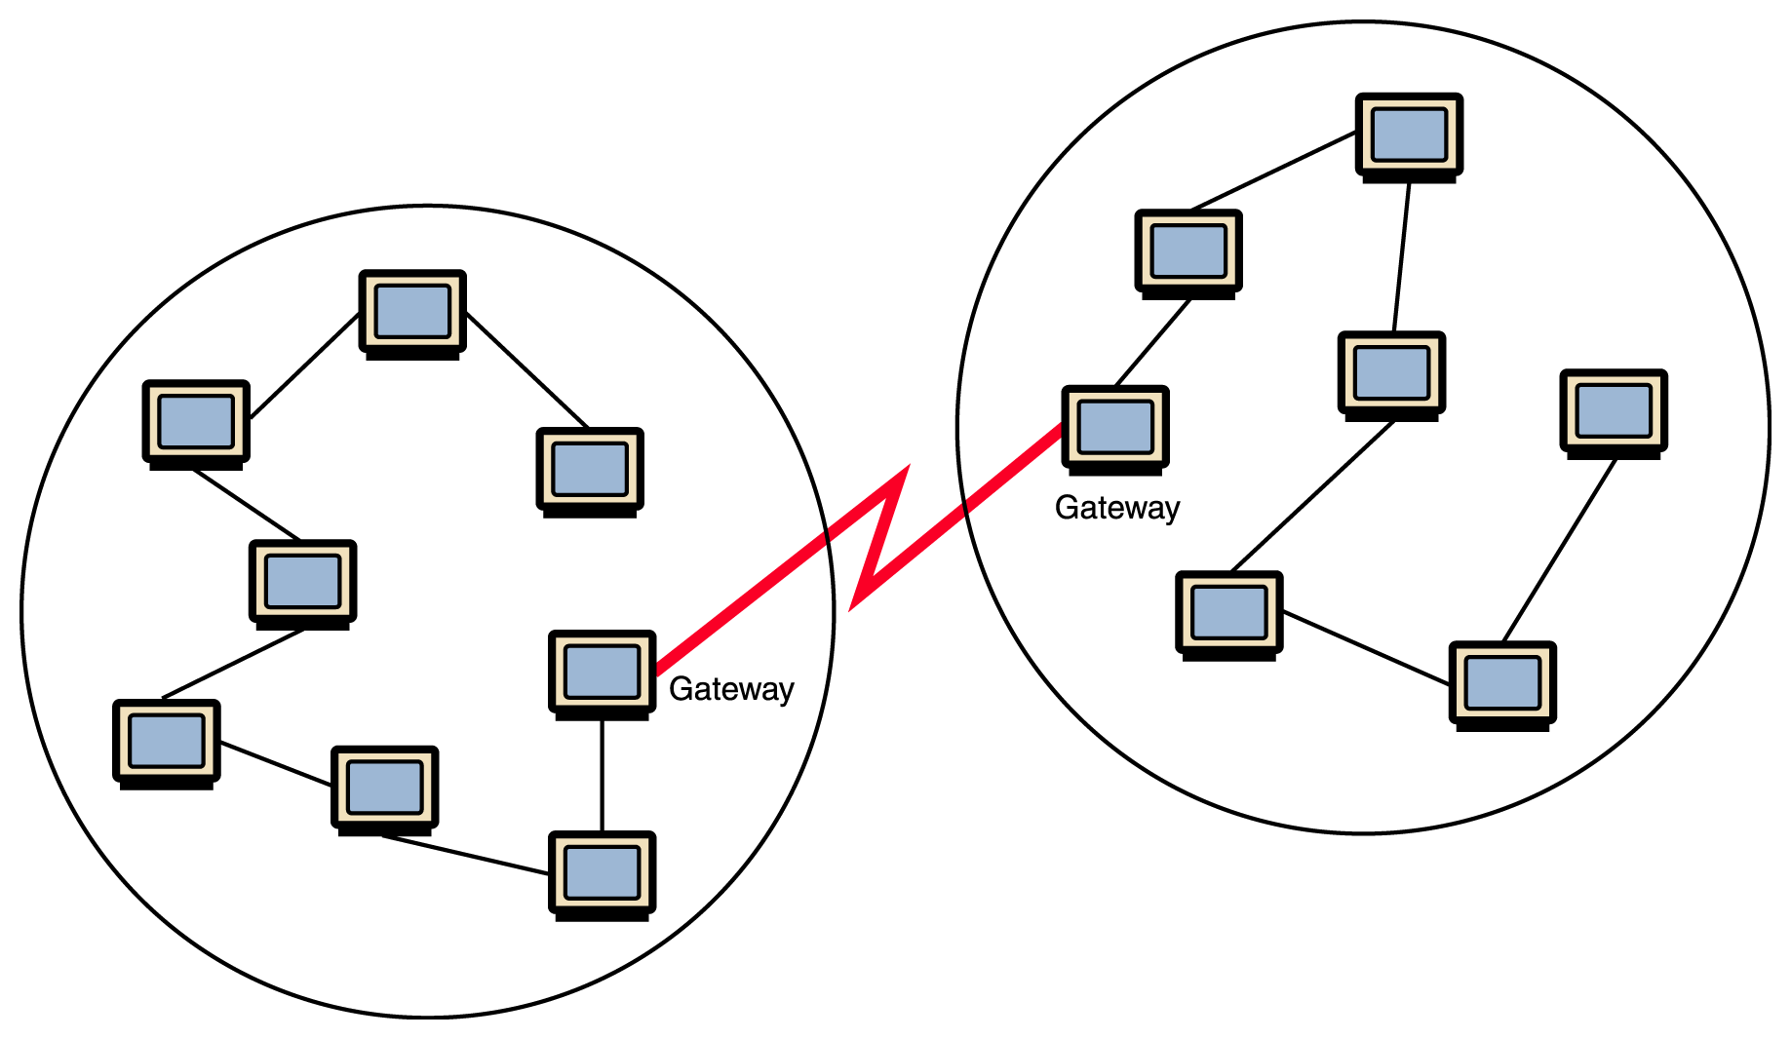
Computer Network
A collection of computing devices that are connected in order to communicate and share resources

Slide 3
Overview
Network Topology how is hardware (physically) connected?
Addressing how is a message’s destinations identified?
Message Delivery should all data be sent in the same fashion?
Routing what path through the network is taken?
Security how can strangers pass (private) messages?

Slide 4
Issue 1: Network Topology
If every pair of computers on a network had a dedicated communication link, passing messages would be direct and straightforward. (e.g., the “hotline” between the White House and Kremlin)
Unfortunately, with hundreds, thousands or millions of computers on a network, they cannot all have direct links to each other.

Slide 5
Local-area Network (LAN)
A local-area network (LAN) connects a relatively small number of machines in a relatively close geographical area
  For example: computers in a lab; in a building; on a small campus.
The generic term node or host to refer to any device on a network
A communication connection directly between two nodes is called a link

Slide 6
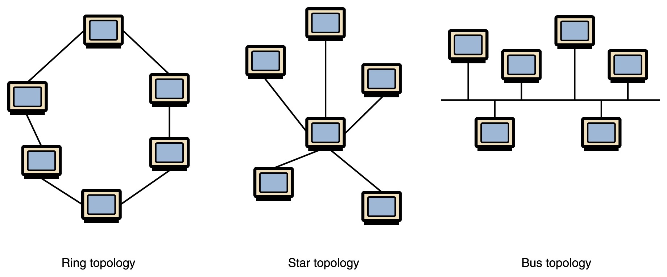
Common Network Topologies
A bus technology called Ethernet has become the industry standard for local-area networks
Figure 15.2 Various network topologies

Slide 7
Choosing a Topology
Pro’s and Con’s
  Number of links (they cost money)
  Network Performance
  How efficient is communication?
  Network Reliability
  How does network respond to overload?
  How susceptible is network to collapse?
  Best choice depends on the size of the network

Slide 8
Wide-Area Networks
A wide-area network (WAN) connects two or more local-area networks over a potentially large geographic distance
  Often one particular node on a LAN is set up to serve as a gateway to handle all communication going between that LAN and other networks
Communication between networks is called internetworking
  The Internet, as we know it today, is essentially the ultimate wide-area network, spanning the entire globe

Slide 9
Hierarchical Topologies
Figure 15.1 Local-area networks connected across a distance to create a wide-area network

Slide 10
Issue 2: Addressing
If a device wants to send a message to another, how does it specify precisely which device?
To what address?

Slide 11
Network Addresses
An IP address is a 32-bit (i.e., 4 byte) pattern which uniquely identifies a particular computer on the Internet. (e.g. 148.78.250.12)
A hostname is a mnemonic address unique a string of characters (e.g. turing.slu.edu)
Note: There is no direct relation between assignment of IP address and hostname

Slide 12
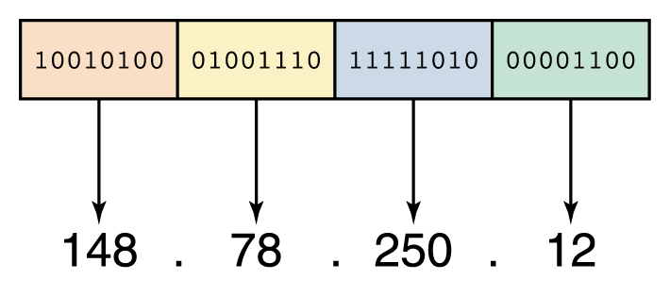
IP Addresses
An IP address can be split into
  network address, which specifies a specific network
  host number, which specifies a particular machine in that network
Figure 15.9
An IP address is stored in four bytes

Slide 13
Network Classes
The first part of the IP address designates the network. The number of bits in the network address depends upon the size of the network
Class A network: Designated by first byte (very large; e.g., Apple has 17.x.x.x, MIT has 9.x.x.x)
Class B network: Designated by first two bytes (moderate size; e.g., SLU has 165.134.x.x)
Class C network: Designated by first three bytes (very small; e.g., Iowa Public Television iptv.org has 205.221.205.x)

Slide 14
IPv4 versus IPv6
IPv4 is the protocol using 32-bit addresses. It has been officially used since 1977
IPv6 is a new protocol (defined in 1996) using 128-bit addresses. The Internet is in the process of transitioning to IPv6
With a vastly larger address space, it provides better separation of network location and host identity, allowing better portability when devices move from network to network.

Slide 15
Hostname
A hostname generally consists of the computer name followed by the domain name
csc.villanova.edu is the domain name
  A domain name is separated into two or more sections that specify the organization, and possibly a subset of an organization, of which the computer is a part
  Two organizations can have a computer named the same thing because the domain name makes it clear which one is being referred to

Slide 16
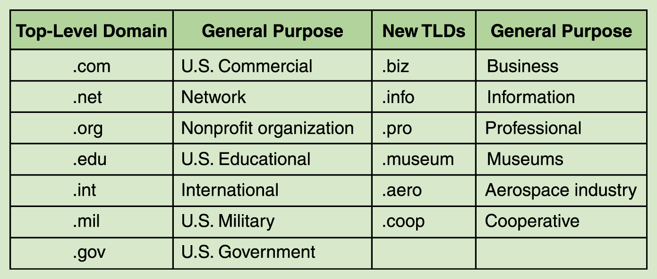
Top-Level Domains
The very last section of the domain is called its top-level domain (TLD) name
Figure 15.10 Top-level domains, including some relatively new ones

Slide 17
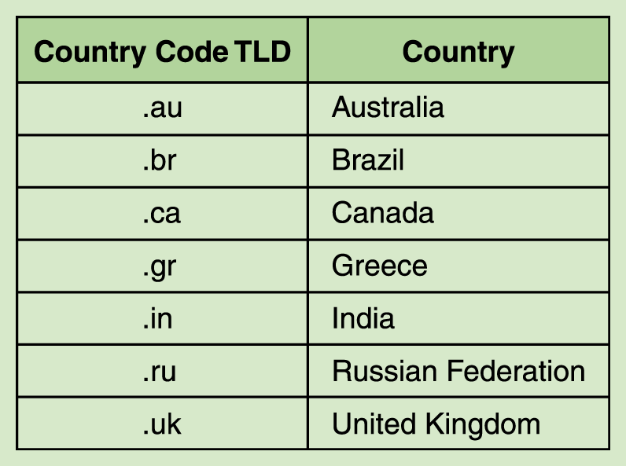
Country Codes
Organizations based in countries other than the United States use a top-level domain that corresponds to their two-letter country codes
Figure 15.11
Some of the top-level domain names based on country codes

Slide 18
Hostnames -> IP Addresses
How is this conversion done?
  Originally, there was one big table kept on a computer at Stanford. Whenever a computer needed to know an address, it would ask this computer.
  But as the Internet grew, this computer was overloaded with requests and the underlying table was being updated too often.

Slide 19
Domain Name System
The domain name system (DNS) is chiefly used to translate hostnames into numeric IP addresses
  DNS is an example of a distributed database. Many computer all over the Internet keep (partial) tables.
  If a server can resolve the hostname, it does
  If not, that server asks another domain name server for the translations. And so on…

Slide 20
Issue 3: Message Delivery
When you send something by US Mail:
  You must give an address which uniquely identifies the recipient
  You usually send everything in one package. Packages are not all the same size.
  You do not know what physical route your package will take on its way to destination.
  Are packages ever lost?
  How fast would you like delivery to be?
  Do you want confirmation of receipt?

Slide 21
Delivery on the Internet
Many different types of data delivered
  Instant Message (very short)
  Email (size ranges)
  Web Page Description (size ranges)
  Photographs, MP3, software (large)
  Streaming Radio/Music
  Streaming Video
Software protocols are used for delivery

Slide 22
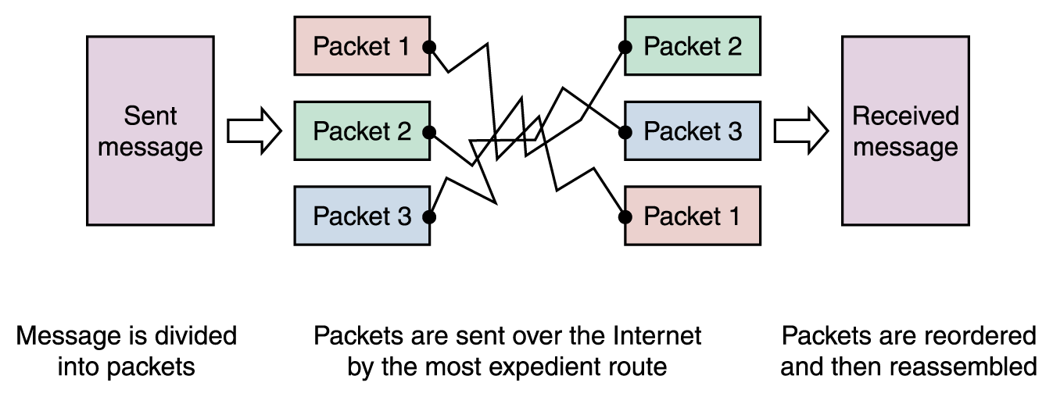
Packet Switching
To improve the efficiency of transferring information over a shared communication line, messages are divided into fixed-sized, numbered packets
Network devices called routers are used to direct packets independently between networks
Figure 15.4
Messages sent by packet switching

Slide 23
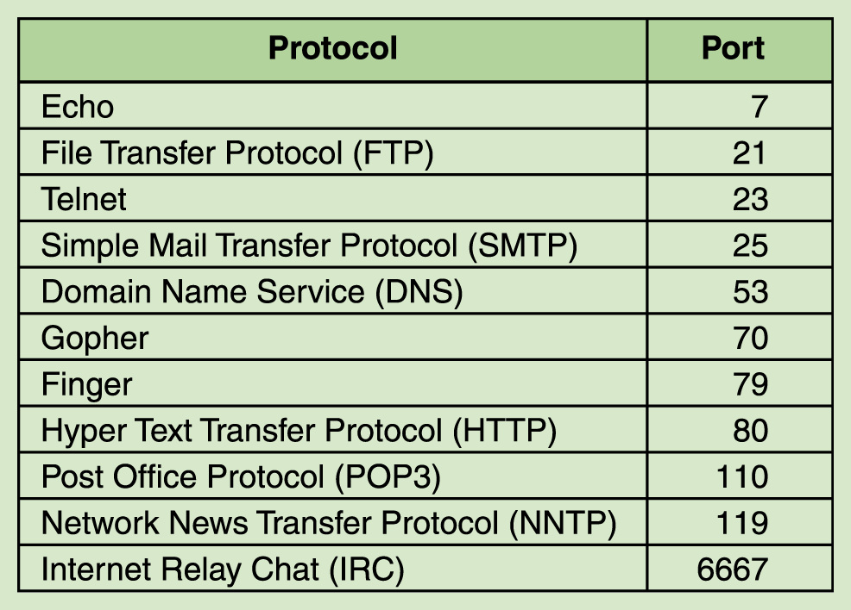
Protocols & Ports
Figure 15.7
Some protocols and the ports they use

Slide 24
TCP
TCP = Transmission Control Protocol (reliable, but less efficient)
  Before sending true message, it sends a warning message to recipient: “I’m about to send you a # of packets”
  It then waits for an acknowledgement message from the recipient “okay, I’ll watch for them”
  This process establishes a “connection”

Slide 25
TCP (continued)
Once “connection” is established:
  Individual packets are sent
  The receiver separately acknowledges each packet which arrives by sending an ACK. Or if the packet arrived damaged, a negative acknowledgement (NAK)
  Sender will resend damaged packets. Also, if a long time passes without an ACK or NAK, it assumes the packet must have been lost, and so it resends.

Slide 26
UDP
UDP stands for User Datagram Protocol (more efficient, less reliable)
  Original device simply sends the packets and doesn’t worry about whether they get lost.
Which protocol would you choose for:
  Email messages?
  Streaming Audio?

Slide 27
Issue 4: Routing
Since there are not direct connections between all devices, the communication of messages will need to routed through intermediary nodes.
Of course, there is (intentionally) more than one route between most pairs of nodes on the Internet.
Deciding on an entire route from the origination is difficult, since it might require a map of the entire Internet.

Slide 28
Message Hops
If a node has a packet to deliver to a destination, it does not plan the entire route.
Instead, it simply decides on the single next “hop” for the packet. That is, it chooses one of its neighbors to send it too, and leaves the rest of the routine decisions to that neighbor (or others).

Slide 29
Routing Tables
Each node has its personal routing table which it uses to decide where to pass packets, based on the destination.
Many complications arise in having routing tables coordinated properly to avoid too many hops (or infinitely many hops in the case that a messages encounters a loop).
Last resort: “Hot Potato” routing (random)

Slide 30
Issue 5: Security
How can you pass messages “securely” on an open network like the Internet?
Issues:
  your message might be read by others
  it could presumably even be modified
  can others read/modify information on your computer which you did not intend to share?
  can others disrupt efficiency of your system with unnecessary network activity?

Slide 31
“solutions” (?)
Some possible techniques for security
  A group can rely entirely on a private network for important communication.
  Password Protection!
  Perhaps your messages can be suitably encrypted so that anyone who intercepts it will not be able to understand it or to forward on a forgery.
  A protected network could be connected to Internet through a single machine (“firewall”)

Slide 32
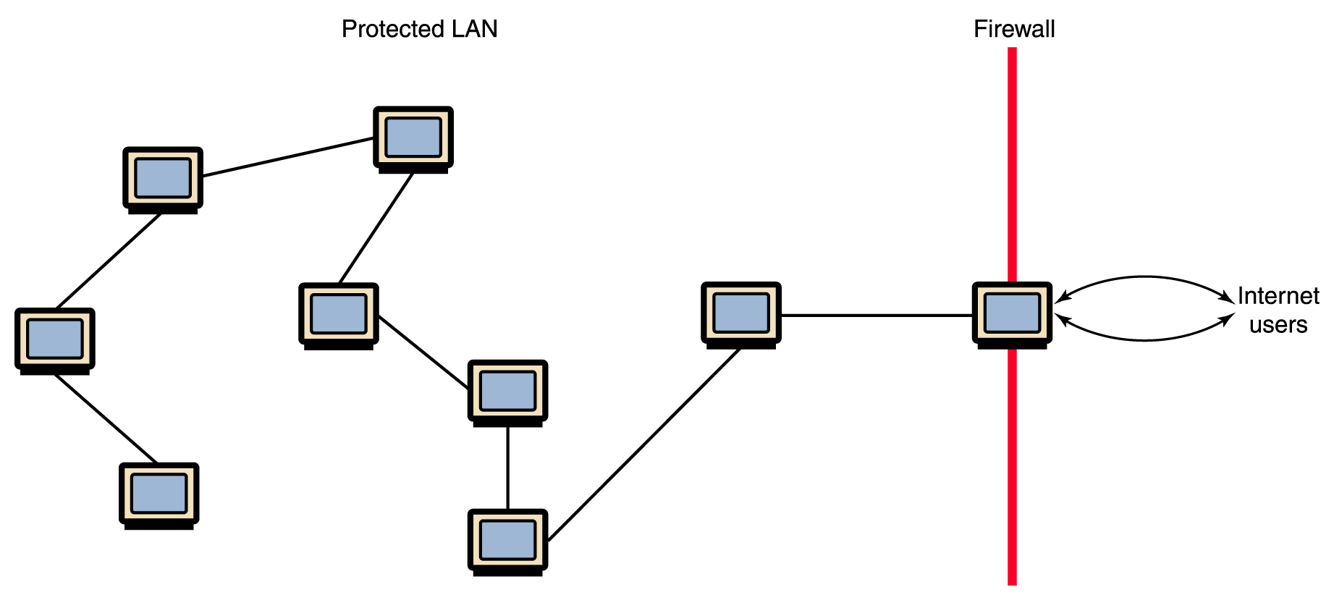
Firewalls
Figure 15.8 A firewall protecting a LAN

