Slide 1
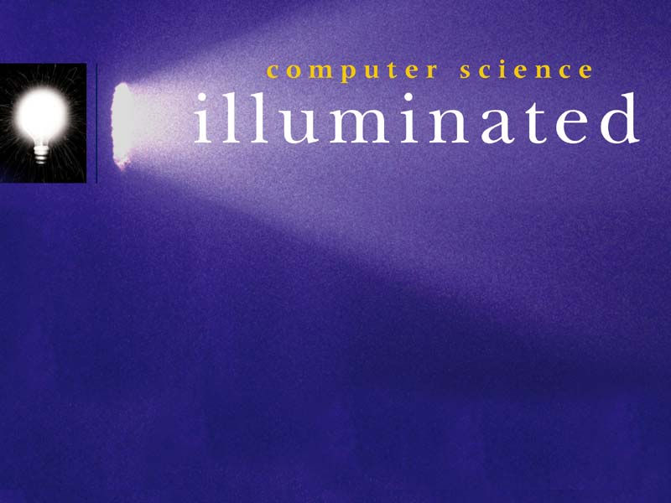
Representing Information Digitally (Number systems)
  Nell Dale & John Lewis
  (adapted by Erin Chambers,
  Michael Goldwasser, Andrew Harrington)

Slide 2

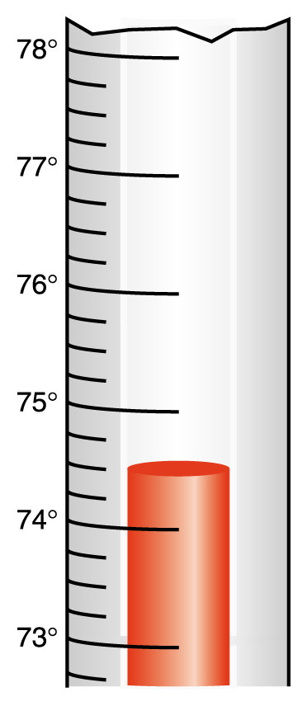
Analog vs. Digital Information
Analog data is a continuous representation, analogous to the actual information it represents. A mercury thermometer is an analog device. The mercury rises in a continuous flow in the tube in direct proportion to the temperature.
Digital data is a discrete representation, breaking the information up into separate elements.

Slide 3
The “bit” (binary digit)
All of the historical computing devices we discussed last time were inherently digital, since the mechanisms had fixed number of states.
Modern computers are based on storing information using physical means that can be in one of two distinct states.
We call such a physical unit a bit.

Slide 4
Two-state Representation of Data
“thumbs up” vs. “thumbs down”
Flag can be raised or lowered
dots/dashes in Morse Code
light switch with circuit opened/closed
“cores” (electromagnets - positive/negative field)
“capacitor” (two small metallic plates with a small separation; can be statically charged/discharged)
“flip/flop” (electronic circuit with output as high/low voltage signal)
Notes:
Can mention the varying level of power usage, cost and volatility.
* Core will keep its charge even after power is shut off.
* flip-flop will lose its data when power is turned off
* Capacitors use such small charges, they sometimes lose their charge while running, unless recharged regularly (“dynamic memory”)

Slide 5
Pros/Cons for Data Storage
Varying level of power usage, cost, volatility:
Core will keep its charge even after power is shutoff (but not as quick to access)
Flip-Flop will lose its data when power is turned off (but extremely quick/cheap)
Capacitors use such small charges, they sometimes lose their charge while running unless recharged regularly (“dynamic memory”)

Slide 6
Binary and Computers
As bits have many physical realizations,
they also have many symbolic representations.
Low voltage
High voltage
‘0’
‘1’
‘false’
‘true’
‘off’
‘on’
‘open’
‘closed’
22

Slide 7
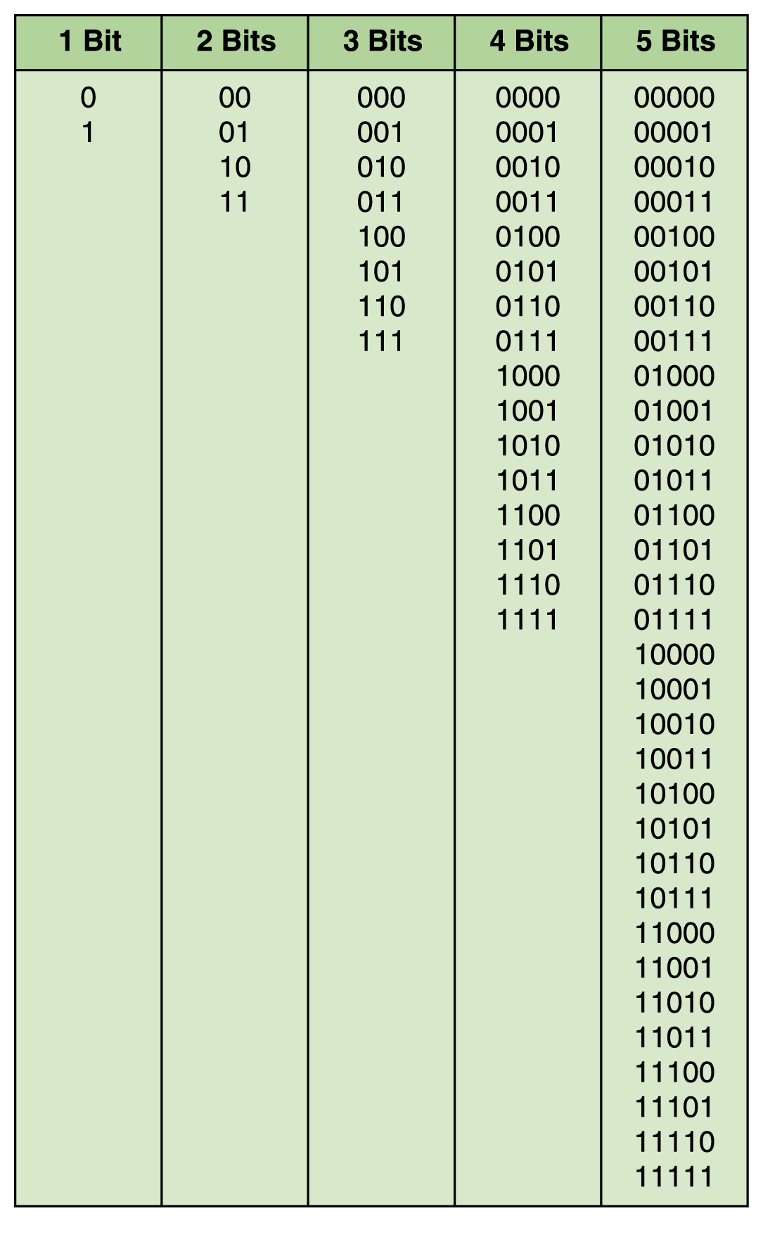
Orders of Magnitude
One bit can be in one of two distinct states (0,1)
Two bits can be in one of four distinct states
Three bits can be in one of eight distinct states
n bits can be in one of 2^{n} distinct states

Slide 8
Orders of Magnitude
Common Quantities of Storage
1 byte
= 8 bits
(thus 256 distinct settings)
1 Kilobyte (KB)
= 2¹⁰ bytes
= 1024 bytes
1 Megabyte (MB)
= 2¹⁰ KB
= 1048576 bytes
1 Gigabyte (GB)
= 2¹⁰ MB
= 1billion⁺ bytes
1 Terabyte (TB)
= 2¹⁰ GB
= 1trillion⁺ bytes
1 Petabyte
= 2¹⁰ TB
= 2⁵⁰ bytes

Slide 9
Representing Numbers
Natural Numbers (0, 1, 2, 3, ….)
Integers (…, -3, -2, -1, 0, 1, 2, 3, …)
Rational Numbers (e.g., -249, -1, 0, ¼ , - ½ )
An integer or the quotient of two integers
Irrational Numbers (e.g., π, √ 2 )
Values not expressable as quotient of integers
Let’s just focus on Natural Numbers for now…
3

Slide 10
Natural Numbers
How many ones are there in 642?
600 + 40 + 2
Or is it
384 + 32 + 2
Or maybe…
1536 + 64 + 2
4

Slide 11
Natural Numbers
Aha!
642 is 600 + 40 + 2 in BASE 10
The base of a number determines the number of digits and the value of digit positions
(Why was base 10 chosen by humans?)
5

Slide 12
Positional Notation
Continuing with our example…
642 in base 10 positional notation is:
6 x 10² = 6 x 100 = 600
+ 4 x 10¹ = 4 x 10 = 40
+ 2 x 10º = 2 x 1 = 2 = 642 in base 10
The power indicates
the position of
the number
This number is in
base 10
6

Slide 13
Positional Notation
What if 642 was a numeral in base 8?
6 x 8² = 6 x 64 = 384
+ 4 x 8¹ = 4 x 8 = 32
+ 2 x 8º = 2 x 1 = 2
= 418 in base 10
642 in base 8 is equivalent to 418 in base 10
6
8

Slide 14
Octal
Decimal is base 10 and has 10 symbols: 0,1,2,3,4,5,6,7,8,9
Octal is base 8 and has 8 symbols:
0,1,2,3,4,5,6,7
For a number to exist in a given number system, the number system must include those digits.
For example:
The number 284 only exists in base 9 and higher.
9

Slide 15
Binary
Decimal is base 10 and has 10 digits: 0,1,2,3,4,5,6,7,8,9
Binary is base 2 and has 2 digits:
0,1
For a number to exist in a given number system, the number system must include those digits.
For example:
The number 284 only exists in base 9 and higher.
9

Slide 16
Converting Binary to Decimal
What is the decimal equivalent of the binary number 1101100?
1 x 2⁶ = 1 x 64 = 64
+ 1 x 2⁵ = 1 x 32 = 32
+ 0 x 2⁴ = 0 x 16 = 0
+ 1 x 2³ = 1 x 8 = 8
+ 1 x 2² = 1 x 4 = 4
+ 0 x 2¹ = 0 x 2 = 0
+ 0 x 2º = 0 x 1 = 0
= 108 in base 10
13

Slide 17
Bases Higher than 10
How are digits in bases higher than 10 represented?
Base 16:
0,1,2,3,4,5,6,7,8,9,A,B,C,D,E, and F
10

Slide 18
Converting Hexadecimal to Decimal
What is the decimal equivalent of the hexadecimal number DEF?
D x 16² = 13 x 256 = 3328
+ E x 16¹ = 14 x 16 = 224
+ F x 16º = 15 x 1 = 15
= 3567 in base 10
Remember, base 16 is 0,1,2,3,4,5,6,7,8,9,A,B,C,D,E,F

Slide 19
Power of 2 Number System
Binary
Octal
Decimal
0000
00
00
0001
01
01
0010
02
02
0011
03
03
0100
04
04
0101
05
05
0110
06
06
0111
07
07
1000
10
08
1001
11
09
1010
12
10
16

Slide 20
Converting Decimal to Other Bases
Algorithm for converting base 10 to other bases:
(Note: Loop stated differently in the book)
Repeat:
1. Divide the decimal number by the new base
2. Make the remainder the next digit
to the left in the answer
3. Replace the decimal number with the quotient
Until the quotient is zero
19

Slide 21
Why does this method work?
Let’s convert 59 (base 10) to base 3:
19 R 2
59
6 R 1
3 19
2 R 0
3 6
0 R 2
3 2
2
0
1
2
20

Slide 22
Converting Decimal to Hexadecimal
Try another Conversion:
3567 (base 10) is what number in base 16?
222
16 3567 start
32
36
32
47
32
15
done
13
16 222
16
62
48
14
0
16 13
0
13
F
D
E
21

Slide 23
Converting Decimal to Other Bases
Try another Conversion:
The base 10 number 108
is what number in base 5?
20

Slide 24
Converting Binary to Octal
Groups of Three (from right)
Convert each group
10101011 10 101 011
2 5 3
10101011 is 253 in base 8
17

Slide 25
Converting Binary to Hexadecimal
Groups of Four (from right)
Convert each group
10101011 1010 1011
A B
10101011 is AB in base 16
18

Slide 26
Arithmetic in Decimal
Let’s start with base 10:
1 1 1
3 5 7 2 5 7
+ 6 2 5 4 5
4 1 9 8 0 2
Carry Values
14

Slide 27
Arithmetic in Other Bases
What if this is in base 8?
Carry Values
1
1
1
1
1
3 5 7 2 5 7
+ 7 2 5 4 5
5+7 = 8+4 = “14” (8)
4+5+1 = 8+2 = “12” (8)
5+2+1 = 8+0 = “10” (8)
4
5
2
0
2
4
2+7+1 = 8+2 = “12” (8)
7+5+1 = 8+5 = “15” (8)
14

Slide 28
Arithmetic in Binary
Remember: there are only 2 digits in binary: 0 and 1
Position is key, carry values are used:
1
Carry Values
1
0
1
1
0
1
0
1
0
1
1
1
0
1 0 1 0 1 1 1
+1 0 0 1 0 1 1
1+1 = 2 = 2 + 0 = 10 (2)
1+1+1 = 3 = 2 + 1 = 11 (2)
0+1+1 = 2 = 2 + 0 = 10 (2)
1+0+1 = 2 = 2 + 0 = 10 (2)
0+1+1 = 2 = 2 + 0 = 10 (2)
1+1 = 2 = 2 + 0 = 10 (2)
14

Slide 29
Subtracting Binary Numbers
Remember borrowing? Apply that concept here:
1 0 1 0 1 1 1
- 1 1 1 0 1 1
0 2
1 2
0 2
0
0
1
1
1 0 0
15
Notes:
Fix the animation for this one.

