Slide 1

Trees & Graphs
Nell Dale & John Lewis
(adaptation by Michael Goldwasser and Erin Chambers)

Slide 2

More complicated abstract data types
What if we want to store lists which access information in a particular order?
Think about standing in a line at the grocery store:
  Where do you get added to the list?
  Where do you get removed from?

Slide 3
Queues
Queue
An abstract data type in which items are entered at one end and removed from the other end
  FIFO, for First In First Out
  No standard queue terminology
    Enqueue, Enque, Enq, Enter, and Insert
    are used for the insertion operation
    Dequeue, Deque, Deq, Delete, and Remove
    are used for the deletion operation.
Name
three
everyday
structures
that are
queues

Slide 4
Stacks
Stack
An abstract data type in which accesses are made at only one end
  LIFO, which stands for Last In First Out
  The insert is called Push and the delete is called Pop
Name three everyday
structures that are stacks

Slide 5
How to make stacks and queues?
We can make a queue or stack by building on an array or linked list.
But performance might not be as good either way.
Do queues and stacks work best by using an array to make them, or a linked list?

Slide 6
Trees
Arrays and Linked Lists often represent data which is inherently linear.
More complex relationships require more complex structures.
A common set of relationships is a “hierarchy”
9-<number>

Slide 7
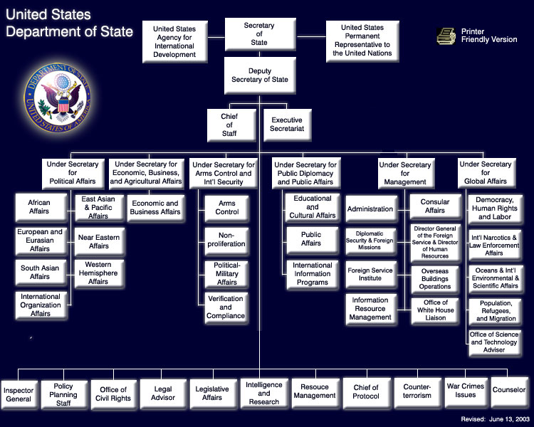
Organizational Chart
Figure taken from: http://www.state.gov/r/pa/ei/rls/dos/7926.htm
9-<number>

Slide 8
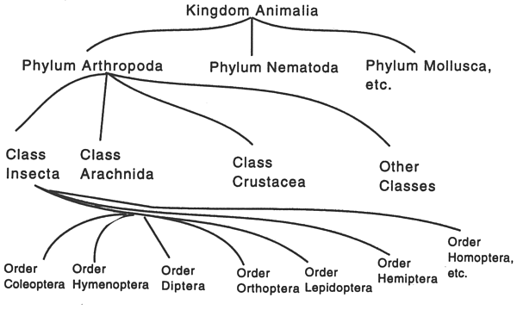
Biology Taxonomy
Figure taken from: http://ag.arizona.edu/pubs/garden/mg/entomology/intro.html
9-<number>

Slide 9
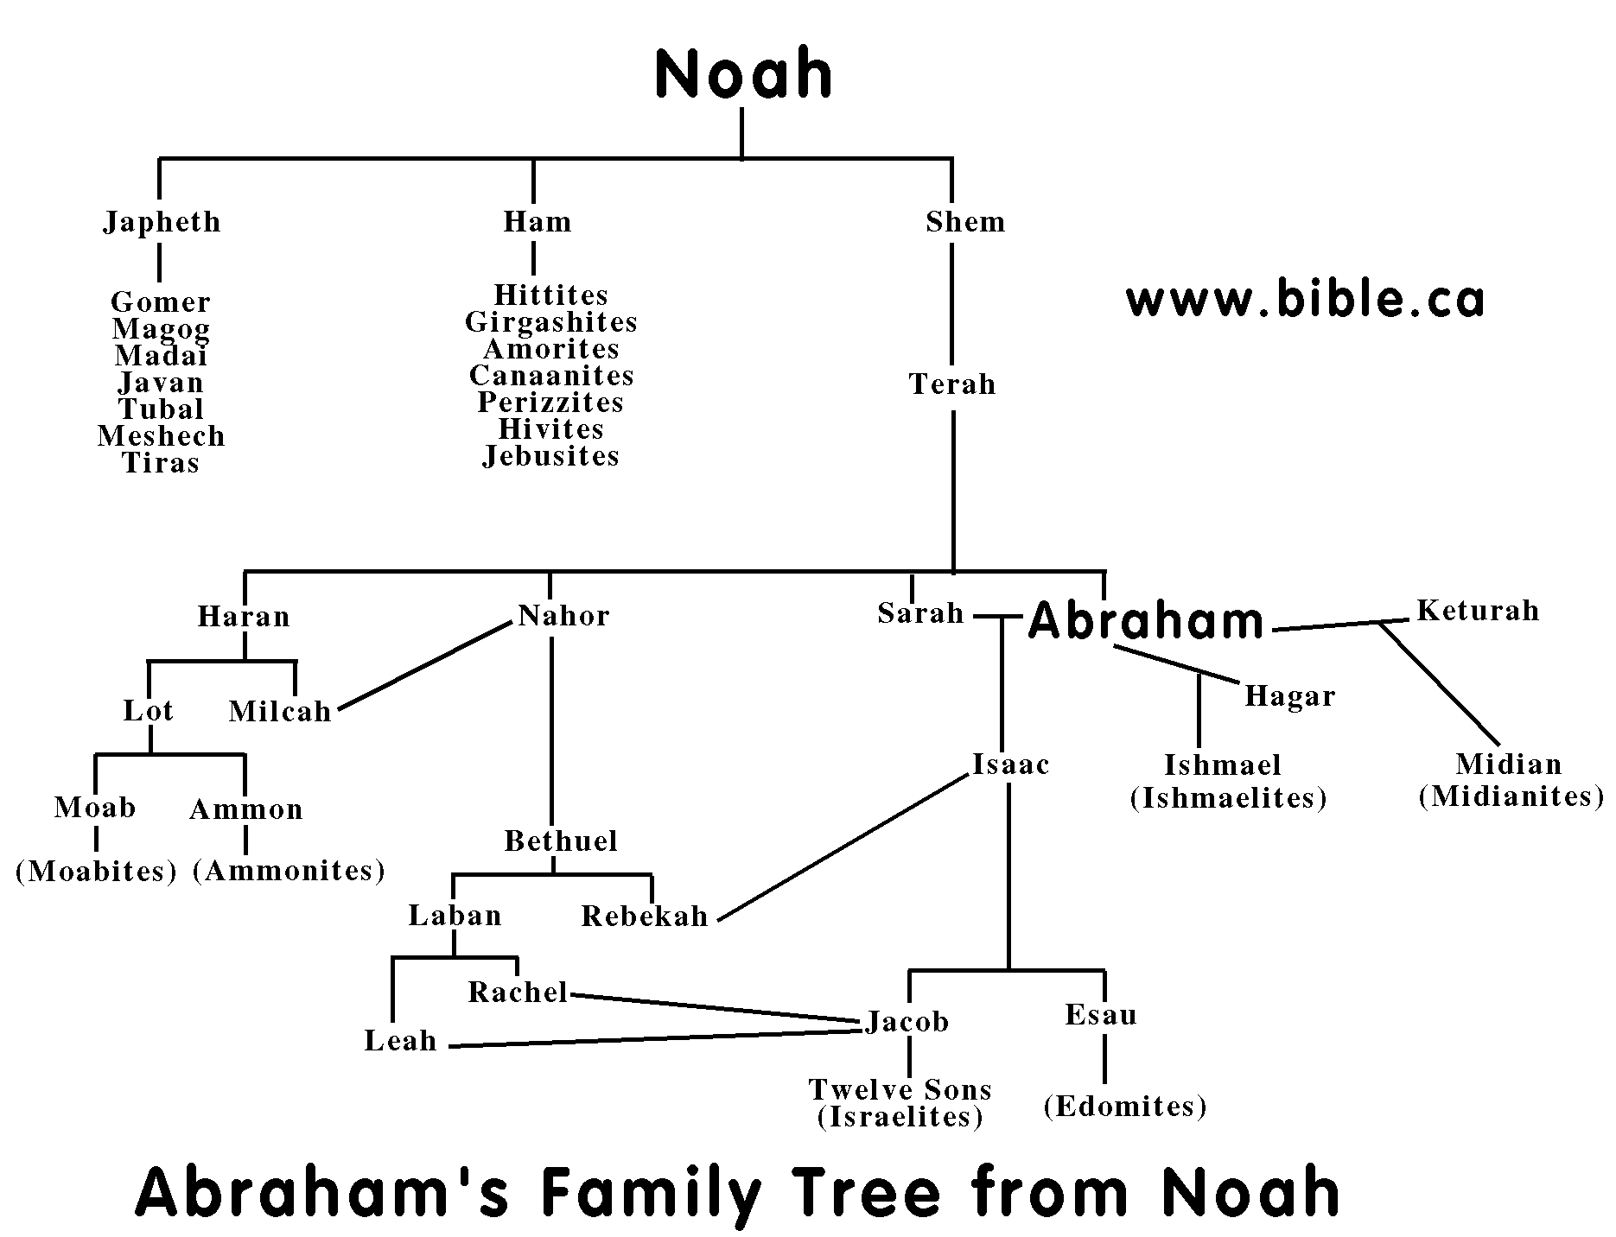
Genealogy
Figure taken from: http://www.bible.ca/b-bible-timeline-history.htm
9-<number>

Slide 10
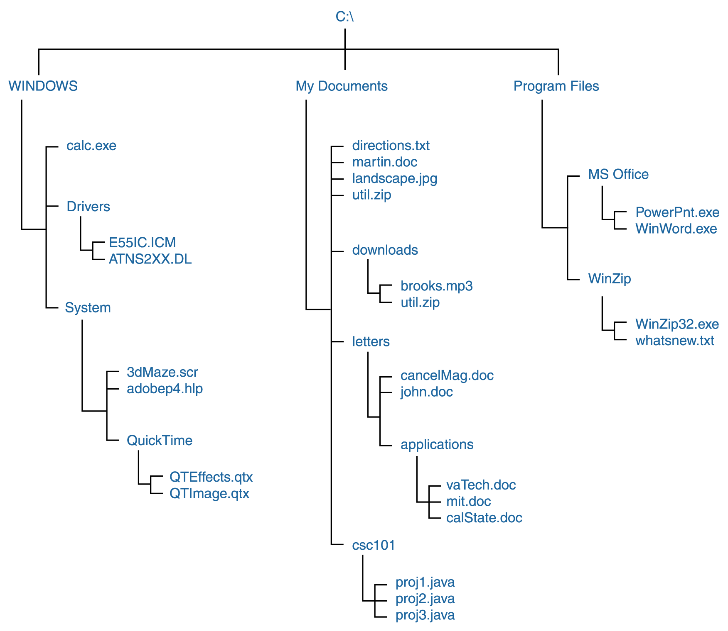
Computer File System
Figure 11.4 A Windows directory tree
9-<number>

Slide 11
Hierarchies
Company Organization (President, VPs, Managers, …)
Biology Taxonomy (Kindom, Phylum, Class, …)
Genealogy (Abraham, Isaac, Jacob, …)
File Systems (Folders, Subfolders, …)
Table of Contents for a text book
Web Portals (e.g., Yahoo’s catagories)
Huffman Codes
9-<number>

Slide 12
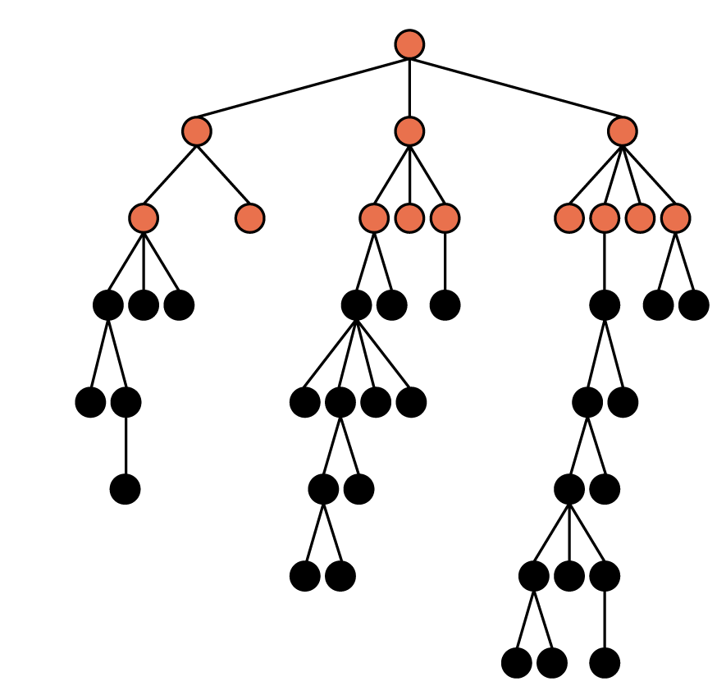
Terminology
This is a tree
The positions are nodes
The topmost node is the root
Nodes at the other extreme are called leaves
A node may have a parent, ancestors, children, siblings or descendants
A natural recursive view leads us to discussing subtrees of the tree
9-<number>

Slide 13
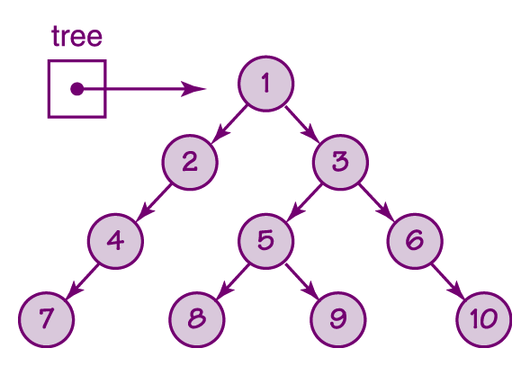
Binary Trees
Binary trees
  A tree in which each node has at most two children
  The node to the left of a node, if it exists, is called its left child
  The node to the right of a node, if it exists, is its right child
Figure 9.16 A binary tree

Slide 14
Representation
We can represent a binary tree as a linked structure (similar to linked lists)
A node of the tree might be represented by three consecutive cells of memory
  User’s Data
  Explicit Pointer to Left Child
  Explicit Pointer to Right Child
  (we will use “null” pointer if no such child)
9-<number>

Slide 15
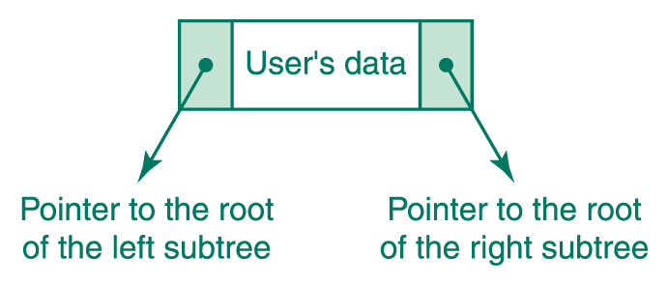
Representation (cont)
Page 315
9-<number>

Slide 16
A Simple Database
Let’s revisit idea of maintaining a list of names, while supporting the following operations:
  search for the presence of an entry
  print names in alphabetical order
  insert new names
How should we accomplish this?
9-<number>

Slide 17
A Simple Database
Use an (alphabetized) array ?
  can do binary search
  straightforward to print alphabetically
  but inserting new item can be costly
Use a (sorted) linked list?
  easy to insert item, if we know the location
  straightforward to print alphabetically
  but cannot search efficiently
  (can’t binary search; no way to jump to middle)
9-<number>

Slide 18
Binary Search Trees
A binary search tree is a special kind of binary tree.
Semantic property among the values in the nodes in the tree:
  The value in any node is greater than the value in any node in its left subtree and less than the value in any node in its right subtree
9-<number>

Slide 19
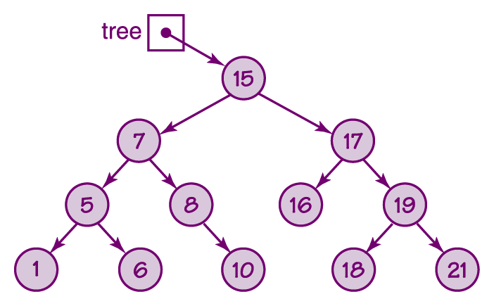
Binary Search Tree
Figure 9.18 A binary search tree
9-<number>

Slide 20
Searching
isThere(current, item):
if (current = null)
return False
else
if (item = info(current))
return True
else:
if (item < info(current))
return IsThere(left(current), item)
if (item > info(current))
return IsThere(right(current), item)
9-<number>

Slide 21
Alphabetical Printing
PrintAll(tree):
if tree != null:
PrintAll(left(tree))
print info(tree)
PrintAll(right(tree))
Why does this work?
9-<number>

Slide 22
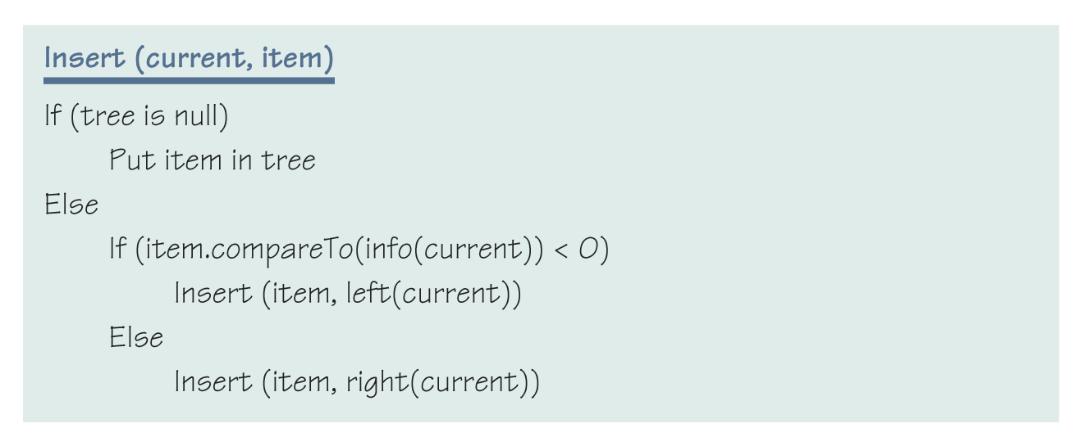
Insertion
Page 316
9-<number>

Slide 23
Example (Figure 9.19)
Let’s build a search tree by inserting names
john, phil, lila, kate, becca, judy, june, mari, jim, sarah
[example done in class]
9-<number>

Slide 24
Graphs
Graph: a data structure that consists of a set of nodes and a set of edges that relate the nodes to each other
Undirected graph: a graph in which the edges have no direction
Directed graph (Digraph): a graph in which each edge is directed from one vertex to another (or the same) vertex
9-<number>

Slide 25
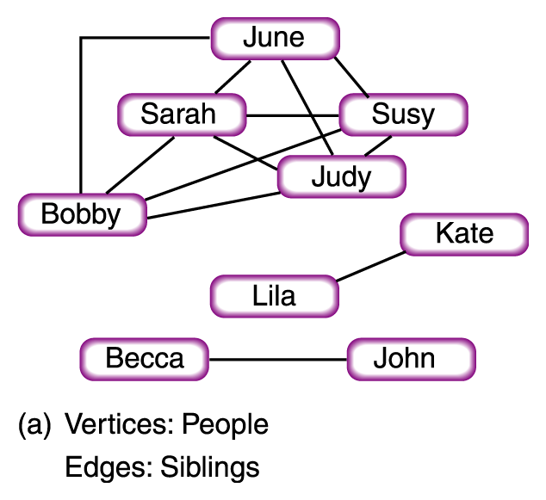
Kevin Bacon?
Figure 9.21
Examples of graphs
9-<number>

Slide 26
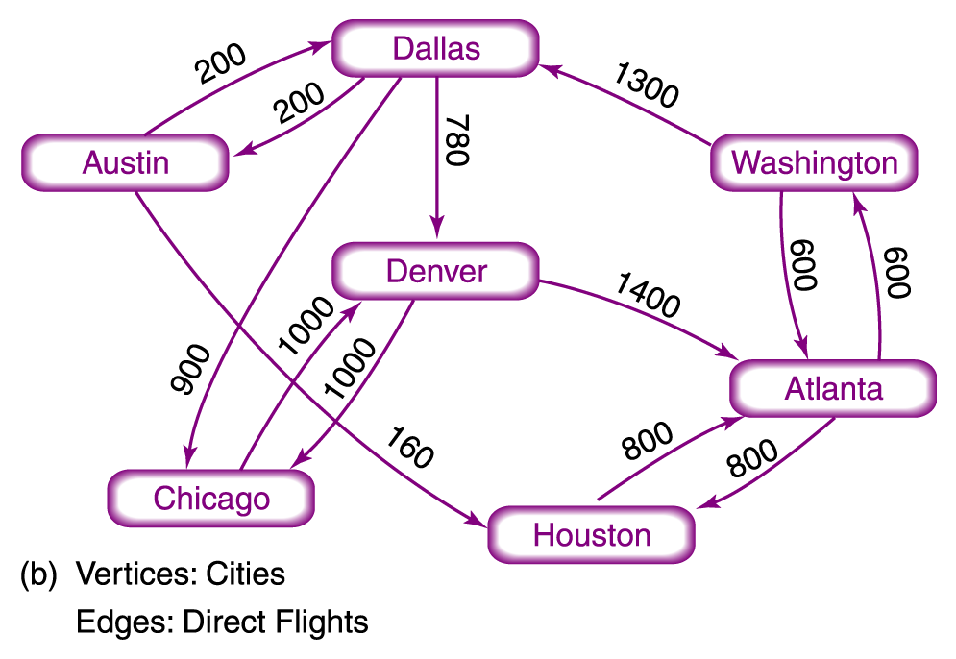
Flight Plans
Figure 9.21
Examples of graphs
9-<number>

Slide 27
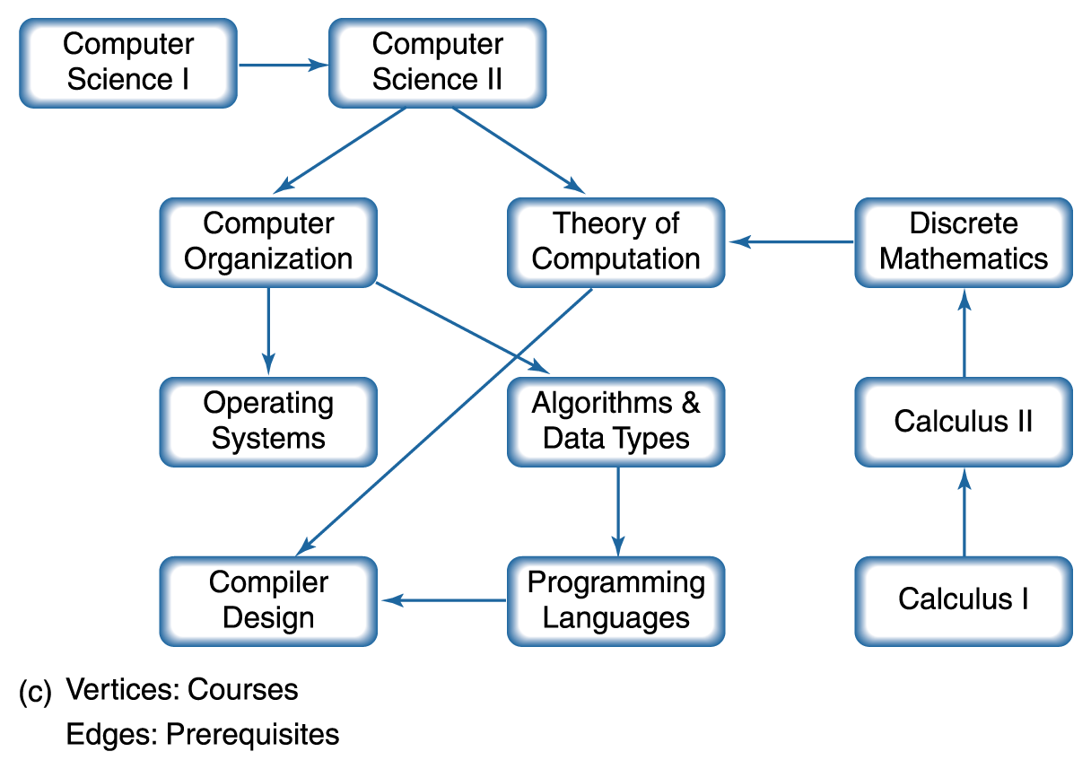
Prerequisites
Figure 9.21
Examples of graphs
9-<number>

