Slide 1

The World Wide Web
Nell Dale & John Lewis
(adaptation by Michael Goldwasser)

Slide 2

The World Wide Web
The Web is an infrastructure of distributed information combined with software that uses networks as a vehicle to exchange that information
A Web page is a document that contains or references various kinds of data, such as text, images, graphics, and programs
Web pages also contain links to other Web pages so that the user can “move around” as desired

Slide 3
The World Wide Web
A Web site is a collection of related Web pages
The Internet makes the communication possible, but the Web makes that communication easy, more productive, and more enjoyable

Slide 4
Web Browser
A browser is a software tool that issues the request for the Web page we want and displays it when it arrives
We often talk about “visiting” a Web site, as if we were going there
  In truth, we actually specify the information we want, and it is brought to us
  The concept of visiting a site is understandable in that we often don’t know what’s at a particular site until we “go to it” and see

Slide 5
Web Browser
The computer that is set up to respond to Web requests is called a Web server
A Web address is the core part of a Uniform Resource Locator, or URL, which uniquely identifies the page you want out of all of the pages stored anywhere in the world

Slide 6
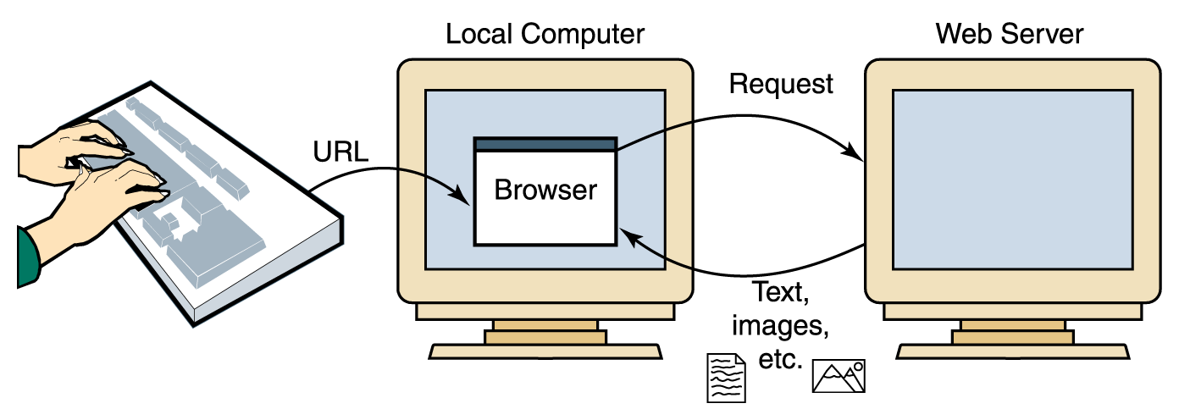
Web Browser
Figure 16.2 A browser retrieving a Web page

Slide 7
HTML
Web pages are created (or built) using a language called the Hypertext Markup Language, or HTML
The term markup language comes from the fact that the primary elements of the language take the form of tags that we insert into a document to annotate the information stored there

Slide 8
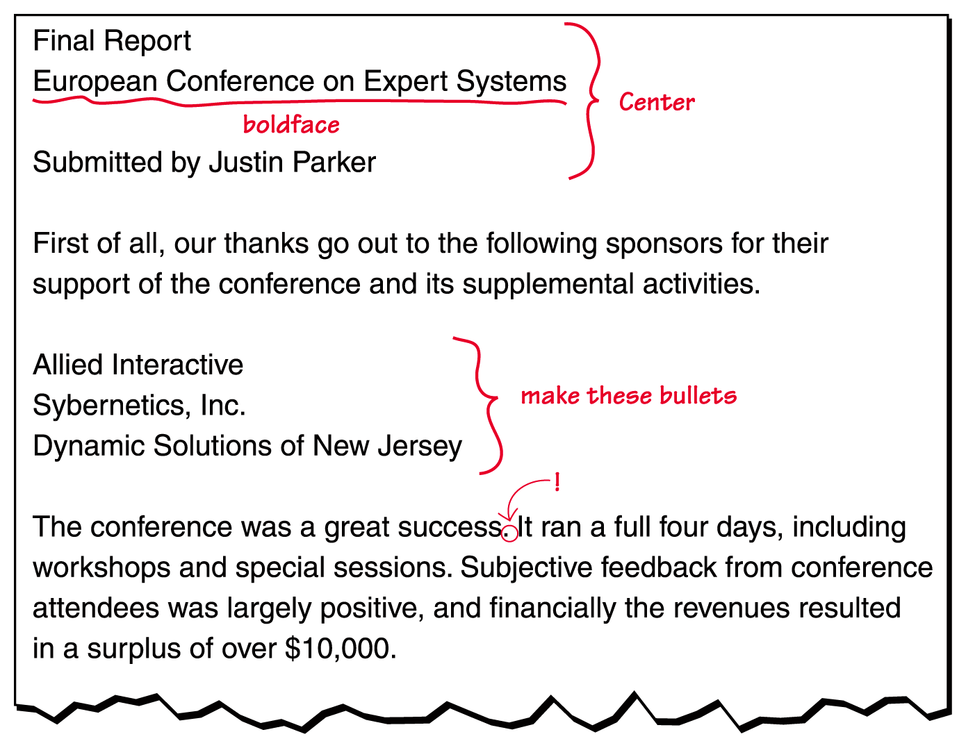
HTML
Figure 16.2
A marked-up document

Slide 9
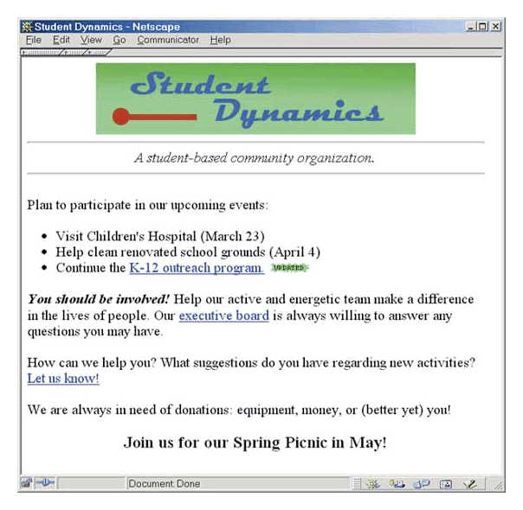
HTML
Figure 16.3
The Student Dynamics Web page as displayed in Netscape Navigator

Slide 10
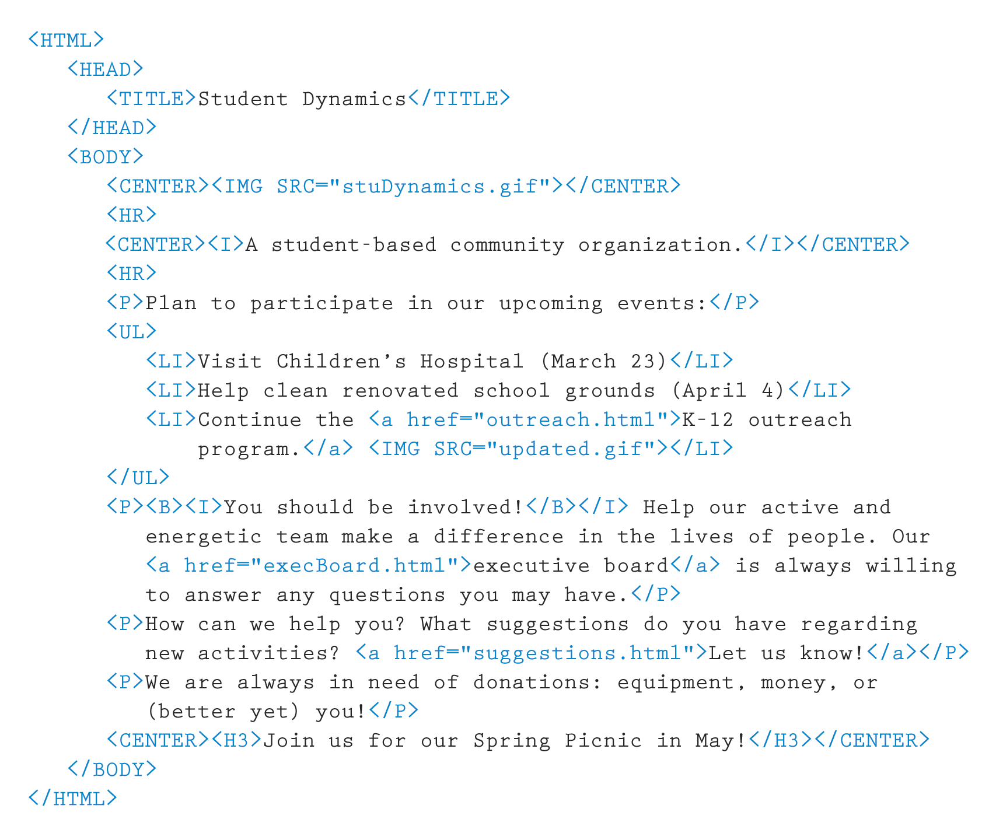
HTML
Figure 16.4
The HTML document defining the Student Dynamics Web page

Slide 11
HTML
Tags are enclosed in angle brackets
(<. . . >)
Words such as HEAD, TITLE, and BODY are called elements and specify the type of the tag
Tags are often used in pairs, with a start tag such as <BODY> and a corresponding end tag with a / before the element name, such as </BODY>

Slide 12
HTML
The browser determines how the page should be displayed based on the tags
  Ignores the way we format the HTML document using carriage returns, extra spaces, and blank lines
  Takes into account the width and height of the browser window
  When you resize the browser window, the contents of the Web page are reformatted to fit the new size

Slide 13
Basic HTML Formatting
The paragraph tags (<P> . . . </P>) specify text that should be treated as a separate paragraph
The center tags (<CENTER> . . . </CENTER>) indicate that the enclosed information should be centered in the browser window

Slide 14
Basic HTML Formatting
The B, I, and U elements are used to indicate that the enclosed text should be bold, italic, or underlined, respectively
The <HR> tag inserts a horizontal rule (that is, a line) across the page

Slide 15
Basic HTML Formatting
We often have cause to display a list of items
  The UL element stands for an unordered list, and the LI element represents a list item
Several elements are used to define headings in a document
  There are six predefined heading elements defined in HTML: H1, H2, H3, H4, H5, and H6

Slide 16
Images and Links
Many tags can contain attributes that indicate additional details about the information or how the enclosed information should be displayed
  An image can be incorporated into a Web page using the IMG element, which takes an attribute that identifies the image file to display
  <IMG SRC = "myPicture.gif">

Slide 17
Images and Links (cont.)
A link is specified using the element A, which stands for anchor
The tag includes an attribute called HREF that specifies the URL of the destination document.
For example
<A HREF = "http://duke.csc.villanova.edu/docs/"> Documentation Central!</A>

Slide 18
Interactive Web Pages
When HTML was first developed, there was no way to interact with the information and pictures presented in a Web page
As users have clamored for a more dynamic web, new technologies were developed to accommodate these requests
Some (but not all) of the new ideas were offshoots of the newly developed Java programming language

Slide 19
Java Applets
A Java applet is a program that is designed to be embedded into an HTML document and transferred over the Web to someone who wants to run the program
  An applet is embedded into an HTML document using the APPLET tag
  <APPLET code="MyApplet.class" width=250
  height=150 ></APPLET>

Slide 20
Java Applets
Java programs are compiled into Bytecode,
a low-level representation of a program that is not the machine code for any particular type
of CPU
Java applets are restricted as to what they
can do
  The Java language has a carefully constructed security model
  An applet, for instance, cannot access any local files or change any system settings

Slide 21
Java Server Pages
A Java Server Page, or JSP, is a Web page that has JSP scriptlets embedded in them
A scriptlet is a small piece of executable code intertwined among regular HTML content

Slide 22
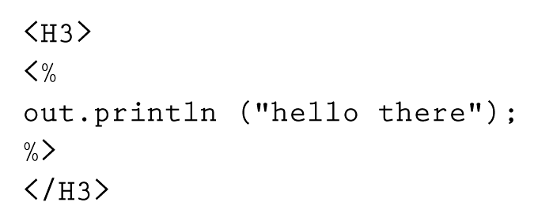
Java Server Pages
A JSP scriptlet is encased in special tags beginning with <% and ending with %>
Imagine JSP scriptlets as having the expressive power of a full programming language
Page 488

Slide 23
Java Server Pages
Note that JSPs are executed on the server side where the Web page resides
By the time it arrives at your computer, all active processing has taken place, producing a static (though dynamically created) Web page
JSPs are particularly good for coordinating the interaction between a Web page and an underlying database

Slide 24
XML
HTML has a predefined set of tags and each tag has its own meaning
There is nothing about HTML tags that describes the true content of a document
The Extensible Markup Language, or XML, allows the creator of a document to describe its contents by defining his or her own set of tags

Slide 25
XML
XML is a metalanguage
A metalanguage is a language for talking about, or defining, other languages

Slide 26
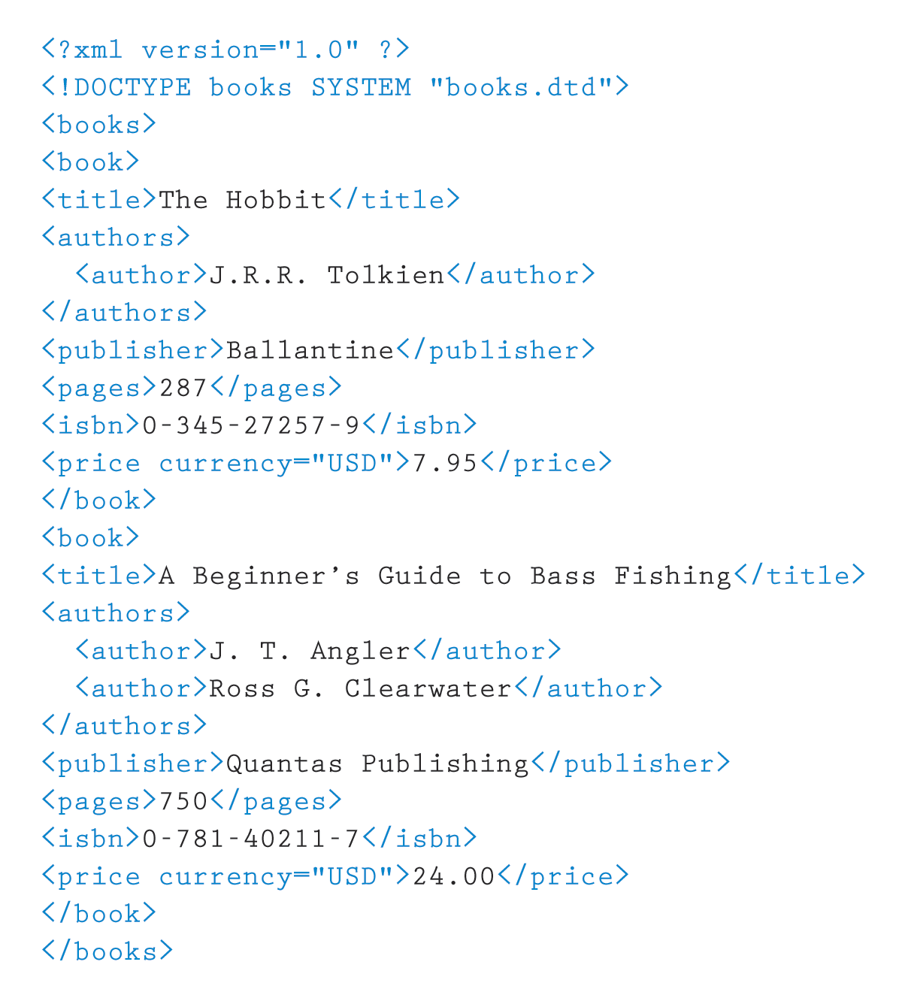
XML
Like HTML, an XML document is made up of tagged data
Figure 16.5 An XLML document containing data about books

Slide 27
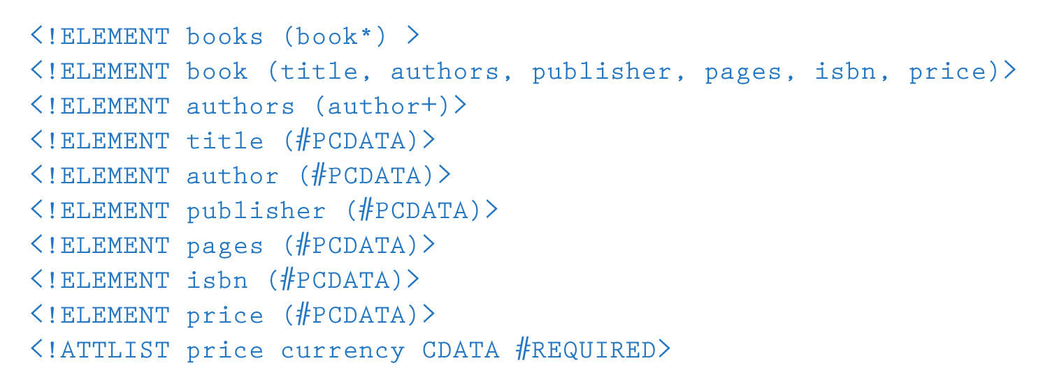
XML
Document Type Definition (DTD): a specification of the organization of the document
The structure of a particular XML document is described by its corresponding DTD document
Figure 16.6 The DTD document corresponding to the XML books document

Slide 28
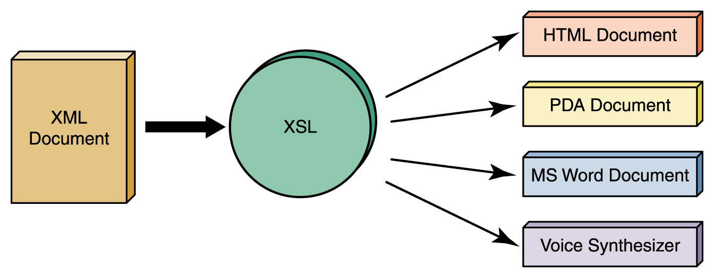
XML
XML represents a standard format for organizing data without tying it to any particular type of output
Extensible Stylesheet Language (or XSL): A language for defining transformations from XML documents to other output formats
Figure 16.7
An XML document can be transformed into many output formats

Slide 29
Ethical Issues: Cookies
Internet cookies are very small text files (usually about 50 to 150 bytes) that are downloaded from a Web server to a Web browser
Cookies were intended to allow a server to maintain information about those that visit it
  For example, the cookie could contain a user ID and password for a Web site so that the information would not have to be reentered every time the Web site is visited

Slide 30
Ethical Issues: Cookies
Companies, called targeted marketing companies, have evolved that sell cookie services
These companies pay Web sites to send them copies of the cookies for each transaction and thus build up a profile of a user’s Internet habits
This information is used for marketing and advertising purposes.
Some people like the idea of having marketing and advertising targeted to their interests
Others feel that this is an invasion of privacy

