Slide 1
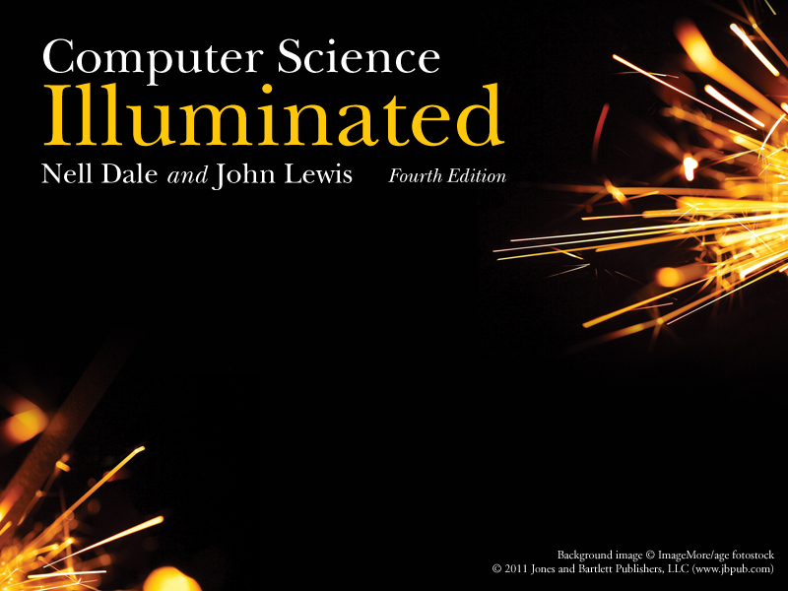
Chapter 2
Binary Values and Number Systems

Slide 2
Numbers
Natural Numbers
Zero and any number obtained by repeatedly adding one to it.
Examples: 100, 0, 45645, 32
Negative Numbers
A value less than 0, with a – sign
Examples: -24, -1, -45645, -32
2

Slide 3
Numbers
Integers
A natural number, a negative number, zero
Examples: 249, 0, - 45645, - 32
Rational Numbers
An integer or the quotient of two integers
Examples: -249, -1, 0, 3/7, -2/5
3

Slide 4
Natural Numbers
How many ones are there in 642?
600 + 40 + 2 ?
Or is it
384 + 32 + 2 ?
Or maybe…
1536 + 64 + 2 ?
4

Slide 5
Natural Numbers
Aha!
642 is 600 + 40 + 2 in BASE 10
The base of a number determines the number of digits and the value of digit positions
5

Slide 6
Positional Notation
Continuing with our example…
642 in base 10 positional notation is:
6 x 10² = 6 x 100 = 600
+ 4 x 10¹ = 4 x 10 = 40
+ 2 x 10º = 2 x 1 = 2 = 642 in base 10
The power indicates
the position of
the number
This number is in
base 10
6

Slide 7
Positional Notation
Example:
642 is 6 * 10² + 4 * 10 ⁺ 2
R is the base
of the number
As a formula:
d_{n} * R^{n-1} + d_{n-1} * R^{n-2} + ... + d₂ * R + d₁
n is the number of
digits in the number
d is the digit in the
i^{th} position
in the number
7

Slide 8
Positional Notation
What if 642 has the base of 13?
+ 6 x 13² = 6 x 169 = 1014
+ 4 x 13¹ = 4 x 13 = 52
+ 2 x 13º = 2 x 1 = 2
= 1068 in base 10
642 in base 13 is equivalent to 1068
in base 10
6
8

Slide 9
Binary
Decimal is base 10 and has 10 digits: 0,1,2,3,4,5,6,7,8,9
Binary is base 2 and has 2 digits:
0,1
For a number to exist in a given base, it can only contain the digits in that base, which range from 0 up to (but not including) the base.
What bases can these numbers be in? 122, 198, 178
9

Slide 10
Bases Higher than 10
How are digits in bases higher than 10 represented?
With distinct symbols for 10 and above.
Base 16 has 16 digits:
0,1,2,3,4,5,6,7,8,9,A,B,C,D,E, and F
10

Slide 11
Converting Octal to Decimal
What is the decimal equivalent of the octal number 642?
6 x 8² = 6 x 64 = 384
+ 4 x 8¹ = 4 x 8 = 32
+ 2 x 8º = 2 x 1 = 2
= 418 in base 10
11

Slide 12
Converting Hexadecimal to Decimal
What is the decimal equivalent of the hexadecimal number DEF?
(Remember, the digits in base 16 are 0,1,2,3,4,5,6,7,8,9,A,B,C,D,E,F)
D x 16² = 13 x 256 = 3328
+ E x 16¹ = 14 x 16 = 224
+ F x 16º = 15 x 1 = 15
= 3567 in base 10

Slide 13
Converting Binary to Decimal
What is the decimal equivalent of the binary number 1101110?
1 x 2⁶ = 1 x 64 = 64
+ 1 x 2⁵ = 1 x 32 = 32
+ 0 x 2⁴ = 0 x 16 = 0
+ 1 x 2³ = 1 x 8 = 8
+ 1 x 2² = 1 x 4 = 4
+ 1 x 2¹ = 1 x 2 = 2
+ 0 x 2º = 0 x 1 = 0
= 110 in base 10
13

Slide 14
Arithmetic in Decimal
How do we add 2 decimal numbers?
Example: 197 + 265 = ?

Slide 15
Arithmetic in Binary
Remember that there are only 2 digits in binary, 0 and 1
1 + 1 is 0 with a carry
Carry Values
1 1 1 1 1 1
1 0 1 0 1 1 1
+1 0 0 1 0 1 1
1 0 1 0 0 0 1 0
14

Slide 16
Subtracting Decimal Numbers
Anybody remember how to borrow in order to
subtract two numbers?
Example: 271 – 196 = ?

Slide 17
Subtracting Binary Numbers
Apply that same concept here:
1 2
2 0 2
1 0 1 0 1 1 1
- 1 1 1 0 1 1
0 0 1 1 1 0 0
15

Slide 18
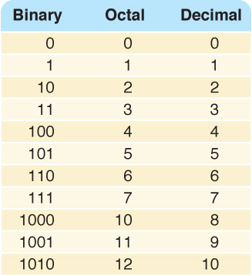
Counting in Binary/Octal/Decimal

Slide 19
A Trick:
Converting Binary to Octal
Mark groups of three (from right)
Convert each group
10101011 10 101 011
2 5 3
10101011 is 253 in base 8
Why does this work??
17

Slide 20
Converting Binary to Hexadecimal
Mark groups of four (from right)
Convert each group
10101011 1010 1011
A B
10101011 is AB in base 16
And this?
18

Slide 21
Converting Decimal to Other Bases
Algorithm for converting number in base 10 to other bases
While (the quotient is not zero)
  Divide the decimal number by the new base
  Make the remainder the next digit to the left in the answer
  Replace the original decimal number with the quotient
19

Slide 22
Converting Decimal to Octal
What is 1988 (base 10) in base 8?
Try it!

Slide 23
Converting Decimal to Octal
248 31 3 0
8 1988 8 248 8 31 8 3
16 24 24 0
38 08 7 3
32 8
68 0
64
4
Answer is : 3 7 0 4

Slide 24
Converting Decimal to Hexadecimal
What is 3567 (base 10) in base 16?
Try it!
20

Slide 25
Converting Decimal to Hexadecimal
222 13 0
16 3567 16 222 16 13
32 16 0
36 62 13
32 48
47 14
32
15
D E F
21

Slide 26
Binary Numbers and Computers
Computers have storage units called binary digits or bits
Low Voltage = 0
High Voltage = 1 all bits have 0 or 1
22

Slide 27
Binary and Computers
Byte
8 bits
The number of bits in a word determines the word length of the computer, but it is usually a multiple of 8
  32-bit machines
  64-bit machines etc.
23

