Slide 1
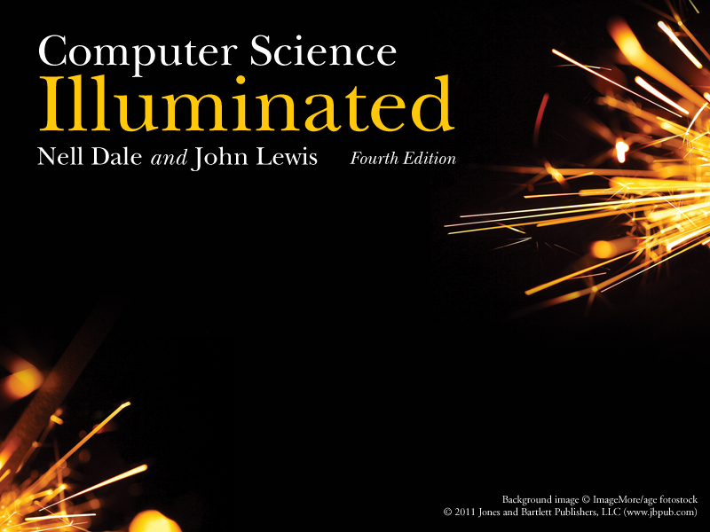
Chapter 03
Data Representation

Slide 2

Chapter Goals
Distinguish between analog and digital information
Explain data compression and calculate compression ratios
Explain the binary formats for negative and floating-point values
Describe the characteristics of the ASCII and Unicode character sets
Perform various types of text compression

Slide 3
Chapter Goals
Explain the nature of sound and its representation
Explain how RGB values define a color
Distinguish between raster and vector graphics
Explain temporal and spatial video compression

Slide 4
Data and Computers
Computers are multimedia devices,dealing with a vast array of information categories
Computers store, present, and help us modify
    Numbers
    Text
    Audio
    Images and graphics
    Video

Slide 5
Data and Computers
Data compression
Reduction in the amount of space needed to store a piece of data
Compression ratio
The size of the compressed data divided by the size of the original data
A data compression technique can be
  lossless, which means the data can be retrieved without any loss of the original information
  lossy, which means some information may be lost in the process of compaction

Slide 6
Analog and Digital Information
Computers are finite!
How do we represent an infinite world?
We represent enough of the world to satisfy our computational needs and our senses of sight and sound

Slide 7
Analog and Digital Information
Information can be represented in one of two ways: analog or digital
  Analog data
  A continuous representation, analogous to the actual information it represents
  Digital data
  A discrete representation, breaking the information up into separate elements

Slide 8
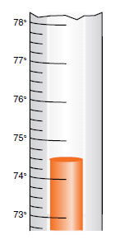
Analog and Digital Information
Thermometer
is an
analog device
Figure 3.1
A mercury thermometer continually rises in direct proportion to the temperature

Slide 9
Analog and Digital Information
Computers cannot work well with analog data, so we digitize the data
Digitize
Breaking data into pieces and representing those pieces separately
Why do we use binary to represent digitized data?

Slide 10
Electronic Signals
Important facts about electronic signals
An analog signal continually fluctuates in voltage up and down
A digital signal has only a high or low state, corresponding to the two binary digits
All electronic signals (both analog and digital) degrade as they move down a line
The voltage of the signal fluctuates due to environmental effects

Slide 11

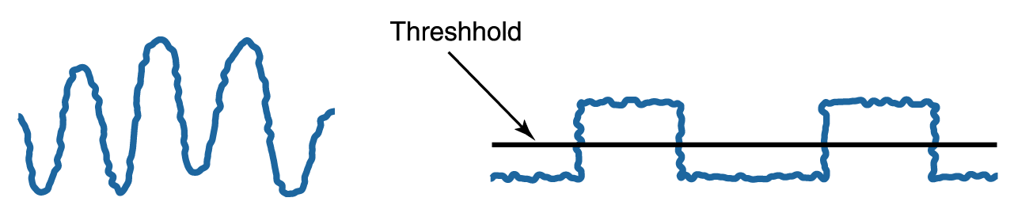
Electronic Signals (Cont’d)
Periodically, a digital signal is reclocked to regain its original shape
Figure 3.2
An analog and a digital signal
Figure 3.3
Degradation of analog and digital signals

Slide 12
Binary Representations
One bit can be either 0 or 1
One bit can represent two things (Why?)
Two bits can represent four things (Why?)
How many things can three bits represent?
How many things can four bits represent?
How many things can eight bits represent?

Slide 13
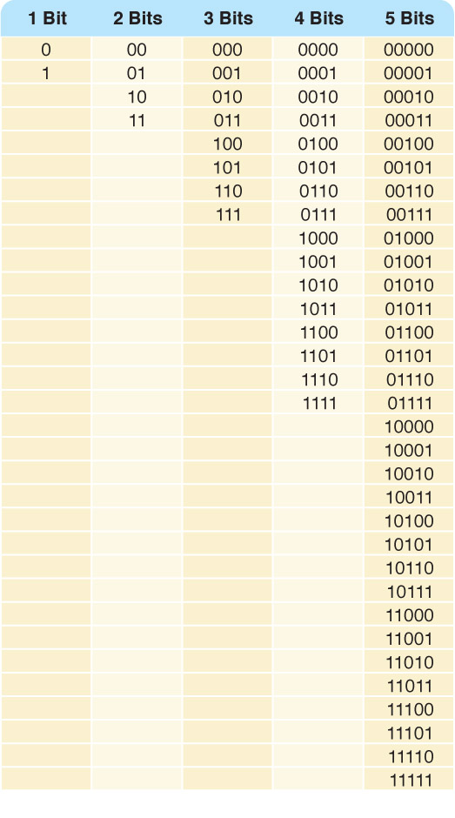
Binary Representations
Counting with
binary bits
Figure 3.4

Slide 14
Binary Representations
How many things can η bits represent?
Why?
What happens every time you increase the number of bits by one?

Slide 15
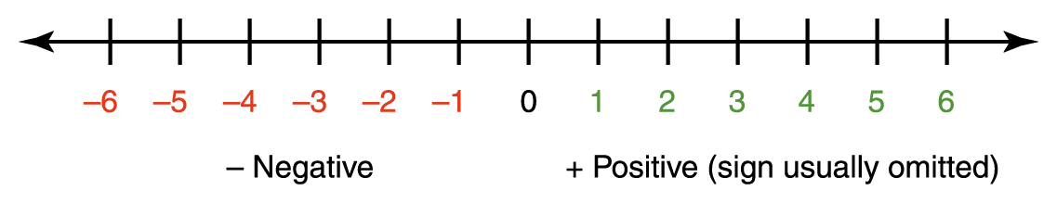
Representing Negative Values
Signed-magnitude number representation
The sign represents the ordering, and the digits represent the magnitude of the number

Slide 16
Representing Negative Values
There is a problem with the sign-magnitude representation: Can you guess why?
There is a plus zero and minus zero, which causes unnecessary complexity
Solution:
Keep all numbers as integer values, with half of them representing negative numbers

Slide 17
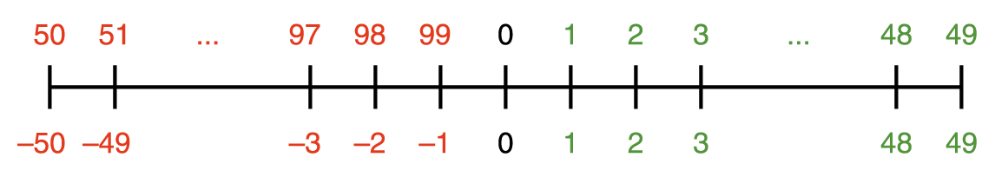
Representing Negative Values
Using two decimal digits,
let 1 through 49 represent 1 through 49
let 50 through 99 represent -50 through -1

Slide 18
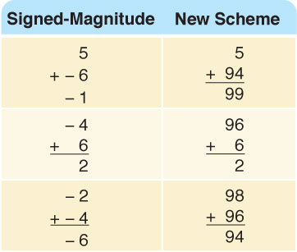
Representing Negative Values
To perform addition, add the numbers and discard any carry
Now you try it
48 (signed-magnitude)
1
47
How does it work in
the new scheme?

Slide 19
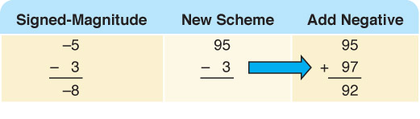
Representing Negative Values
A-B=A+(-B)
Add the negative of the second to the first
Try
4 - 4 -4
- 3 +3 + -3

Slide 20

Representing Negative Values
Formula to compute the negative representation of a number
This representation is called the ten’s complement

Slide 21
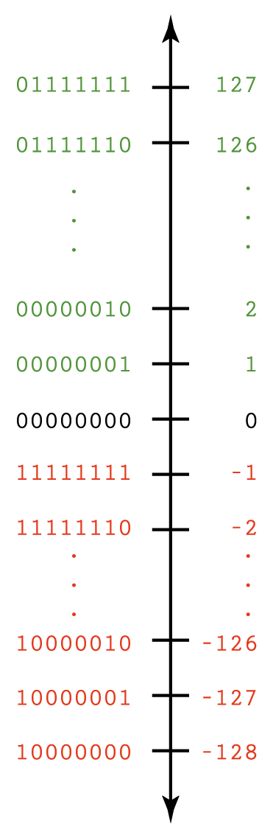
Representing Negative Values
Two’s Complement
(Vertical line is easier to read)

Slide 22
Representing Negative Values
Addition and subtraction are the same as in 10’s complement arithmetic
    -127 10000001
    + 1 00000001
    -126 10000010
Do you notice something interesting about the left-most bit?

Slide 23
Number Overflow
What happen if the computed value won't fit?
Overflow
If each value is stored using eight bits, adding 127 to 3 overflows
  1111111
  + 0000011
  10000010
Problems occur when mapping an infinite world onto a finite machine!

Slide 24
Representing Real Numbers
Real numbers
A number with a whole part and a fractional part
104.32, 0.999999, 357.0, and 3.14159
Positions to the right of the decimal point are the tenths position: 10⁻¹, 10⁻² , 10⁻³ …

Slide 25
Representing Real Numbers
Same rules apply in binary as in decimal
Decimal point is actually the radix point
Positions to the right of the radix point in binary are
2⁻¹ (one half),
2⁻² (one quarter),
2⁻³ (one eighth)
…

Slide 26
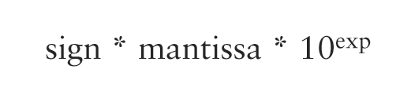
Representing Real Numbers
A real value in base 10 can be defined by the following formula
The representation is called floating point because the number of digits is fixed but the radix point floats

Slide 27
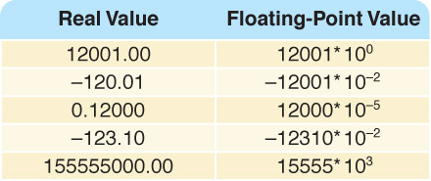
Representing Real Numbers
A binary floating-point value is defined by the
formula
  sign * mantissa * 2^{exp}

Slide 28
Representing Real Numbers
Scientific notation
A form of floating-point representation in which the decimal point is kept to the right of the leftmost digit
12001.32708 is 1.200132708E+4 in scientific notation
What is 123.332 in scientific notation?
What is 0.0034 in scientific notation?

Slide 29
Representing Text
What must be provided to represent text?
There are finite number of characters to represent, so list them all and assign each a binary string
Character set
A list of characters and the codes used to represent each one
Computer manufacturers agreed to standardize

Slide 30
The ASCII Character Set
ASCII stands for American Standard Code for Information Interchange
ASCII originally used seven bits to represent each character, allowing for 128 unique characters
Later extended ASCII evolved so that all eight bits were used
How many characters could be represented?

Slide 31
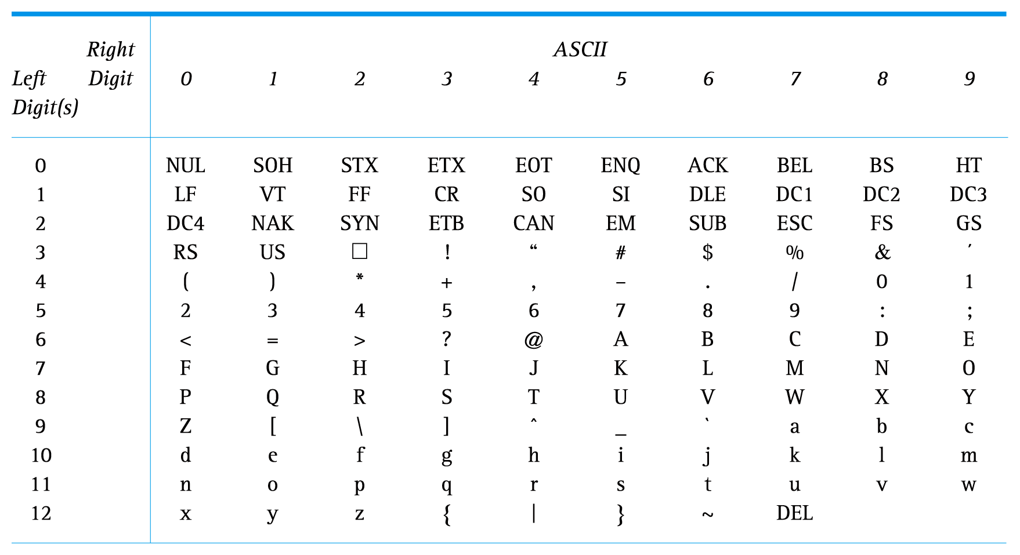
ASCII Character Set Mapping

Slide 32
The ASCII Character Set
The first 32 characters in the ASCII character chart do not have a simple character representation to print to the screen
What do you think they are used for?

Slide 33
The Unicode Character Set
Extended ASCII is not enough for international use
One Unicode mapping uses 16 bits per character
How many characters can this mapping represent?
Unicode is a superset of ASCII
The first 256 characters correspond exactly to the extended ASCII character set

Slide 34
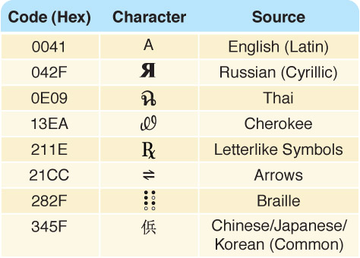
The Unicode Character Set
Figure 3.6 A few characters in the Unicode character set

Slide 35
Text Compression
Assigning 16 bits to each character in a document uses too much file space
We need ways to store and transmit text efficiently
Text compression techniques
  keyword encoding
  run-length encoding
  Huffman encoding

Slide 36
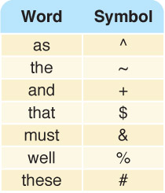
Keyword Encoding
Replace frequently used words with a single character

Slide 37
Keyword Encoding
Given the following paragraph,
  We hold these truths to be self-evident, that all men are created equal, that they are endowed by their Creator with certain unalienable Rights, that among these are Life, Liberty and the pursuit of Happiness. ﾑ That to secure these rights, Governments are instituted among Men, deriving their just powers from the consent of the governed, ﾑ That whenever any Form of Government becomes destructive of these ends, it is the Right of the People to alter or to abolish it, and to institute new Government, laying its foundation on such principles and organizing its powers in such form, as to them shall seem most likely to effect their Safety and Happiness.

Slide 38
Keyword Encoding
The encoded paragraph is
  We hold # truths to be self-evident, $ all men are created equal, $ ~y are endowed by ~ir Creator with certain unalienable Rights, $ among # are Life, Liberty + ~ pursuit of Happiness. — $ to secure # rights, Governments are instituted among Men, deriving ~ir just powers from ~ consent of ~ governed, — $ whenever any Form of Government becomes destructive of # ends, it is ~ Right of ~ People to alter or to abolish it, + to institute new Government, laying its foundation on such principles + organizing its powers in such form, ^ to ~m shall seem most likely to effect ~ir Safety + Happiness.

Slide 39
Keyword Encoding
What did we save?
Original paragraph
656 characters
Encoded paragraph
596 characters
Characters saved
60 characters
Compression ratio
596/656 = 0.9085
Could we use this substitution chart for all text?

Slide 40
Run-Length Encoding
A single character may be repeated over and over again in a long sequence
Replace a repeated sequence with
  a flag character
  repeated character
  number of repetitions
*n8
  * is the flag character
  n is the repeated character
  8 is the number of times n is repeated

Slide 41
Run-Length Encoding
Original text
bbbbbbbbjjjkllqqqqqq+++++
Encoded text
*b8jjjkll*q6*+5 (Why isn't l encoded? J?)
The compression ratio is 15/25 or .6
Encoded text
*x4*p4l*k7
Original text
xxxxpppplkkkkkkk
This type of repetition doesn’t occur in English text; can you think of a situation where it might occur?

Slide 42
Huffman Encoding
Why should the character “X" and "z" take up the same number of bits as "e" or " "?
Huffman codes use variable-length bit strings to represent each character
More frequently used letters have shorter strings to represent them

Slide 43
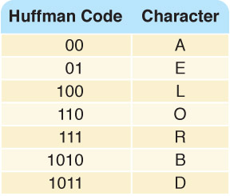
Huffman Encoding
ballboard would be
1010001001001010110001111011
compression ratio
28/56
Encode roadbed

Slide 44
Huffman Encoding
In Huffman encoding no character's bit string is the prefix of any other character's bit string
To decode
look for match left to right, bit by bit
record letter when a match is found
begin where you left off,going left to right

Slide 45
Huffman Encoding
Try it!
Decode
1011111001010

Slide 46
Huffman Encoding
Technique for determining codes guarantees the prefix property of the codes
Two types of codes
  general, based on use of letters in English (Spanish, ….)
  specialized, based on text itself or specific types of text

Slide 47
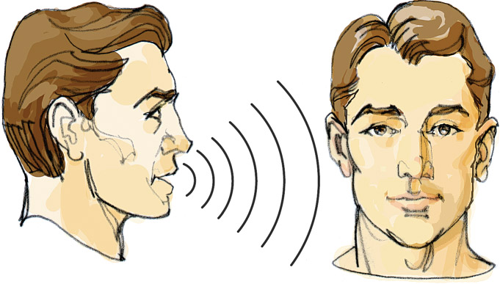
Representing Audio Information
We perceive sound when a series of air compressions vibrate a
membrane in our ear, which sends signals to our brain

Slide 48
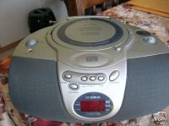
Representing Audio Information
A stereo sends an electrical signal to a speaker to produce sound
This signal is an analog representation of the sound wave
The voltage in the signal varies in direct proportion to the sound wave

Slide 49
Representing Audio Information
Digitize the signal by sampling
  periodically measure the voltage
  record the numeric value
How often should we sample?
A sampling rate of about 40,000 times per second is enough to create a reasonable sound reproduction

Slide 50
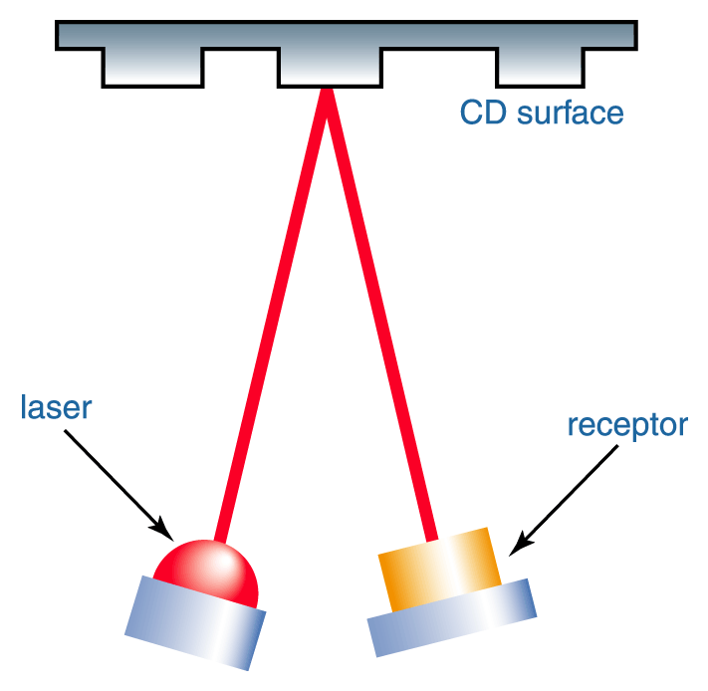
Representing Audio Information
Figure 3.9
A CD player reading binary information

Slide 51
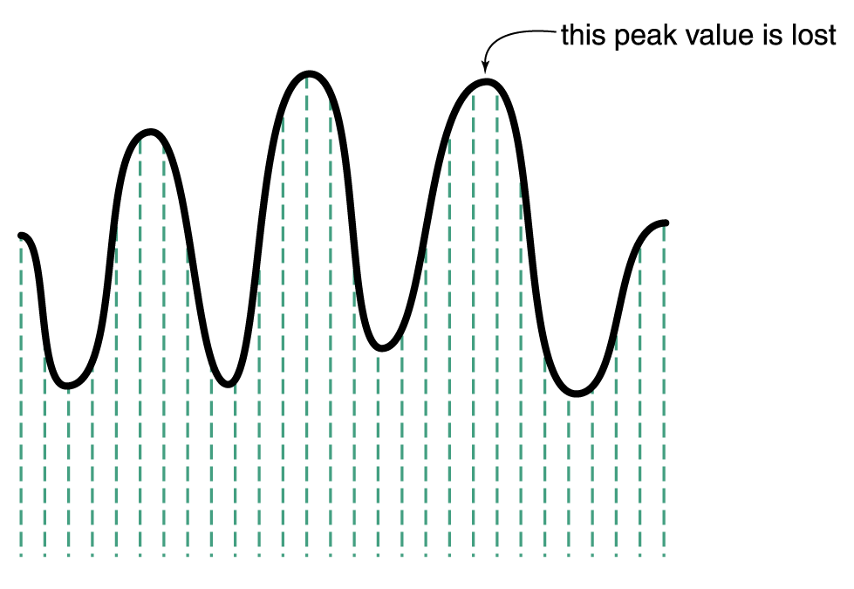
Representing Audio Information
Some data
is lost, but a
reasonable
sound is
reproduced
Figure 3.8 Sampling an audio signal

Slide 52
Representing Audio Information
CDs store audio information digitally
On the surface of the CD are microscopic pits that represent binary digits
A low intensity laser is pointed as the disc The laser light reflects
strongly if the surface is smooth and poorly if the surface is pitted

Slide 53
Audio Formats
Audio Formats
  WAV, AU, AIFF, VQF, and MP3
MP3 (MPEG-2, audio layer 3 file) is dominant
  analyzes the frequency spread and discards information that can’t be heard by humans
  bit stream is compressed using a form of Huffman encoding to achieve additional compression
  Is this a lossy or lossless compression (or both)?

Slide 54
Representing Images and Graphics
Color
Perception of the frequencies of light that reach the retinas of our eyes
Retinas have three types of color photoreceptor cone cells that correspond to the colors of red, green, and blue

Slide 55
Representing Images and Graphics
Color is expressed as an RGB (red-green-blue) value--three numbers that indicate the relative contribution of each of these three primary colors
An RGB value of (255, 255, 0) maximizes the contribution of red and green, and minimizes the contribution of blue, which results in a bright yellow

Slide 56
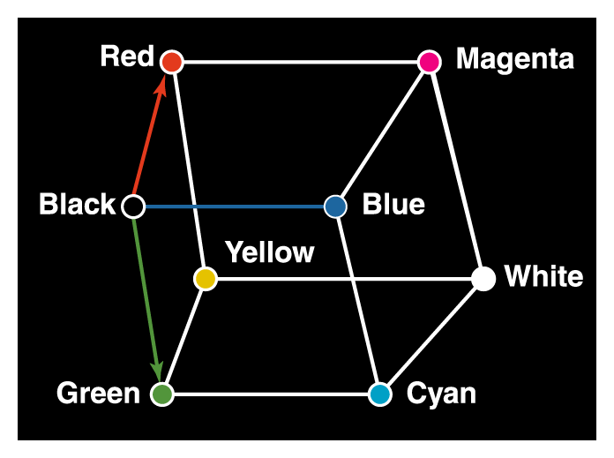
Representing Images and Graphics
Figure 3.10 Three-dimensional color space

Slide 57
Representing Images and Graphics
color depth
The amount of data that is used to represent a color
HiColor
A 16-bit color depth: five bits used for each number in an RGB value with the extra bit sometimes used to represent transparency
TrueColor
A 24-bit color depth: eight bits used for each number in an RGB value

Slide 58
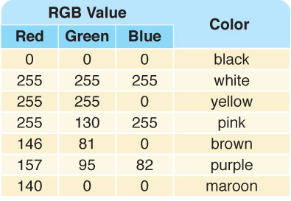
Representing Images and Graphics
A few TrueColor
RGB values and
the colors they
represent

Slide 59
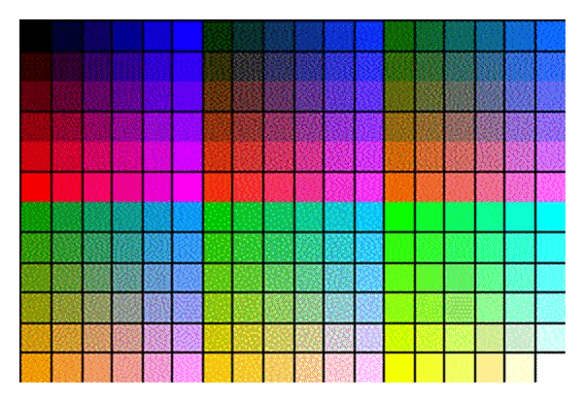
Indexed Color
A browser may support only a certain number of specific colors, creating a palette from which to choose
Figure 3.11
The Netscape color palette

Slide 60
Digitized Images and Graphics
Digitizing a picture
Representing it as a collection of individual dots called pixels
Resolution
The number of pixels used to represent a picture
Raster Graphics
Storage of data on a pixel-by-pixel basis
Bitmap (BMP), GIF, JPEG, and PNG are raster-grahics formats

Slide 61
Digitized Images and Graphics
Bitmap format
Contains the pixel color values of the image from left to right and from top to bottom
GIF format (indexed color)
Each image is made up of only 256 colors
JPEG format
Averages color hues over short distances
PNG format
Like GIF but achieves greater compression with wider range of color depths
Which is better for line drawings? Pictures?

Slide 62
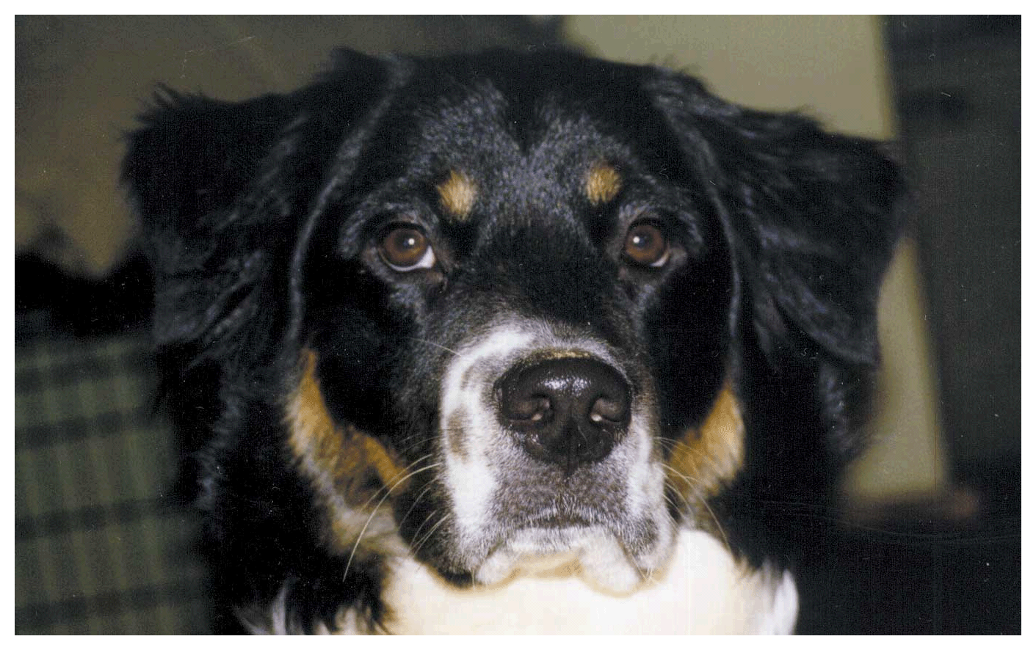
Digitized Images and Graphics
Whole
picture
Figure 3.12 A digitized picture composed of many individual pixels

Slide 63
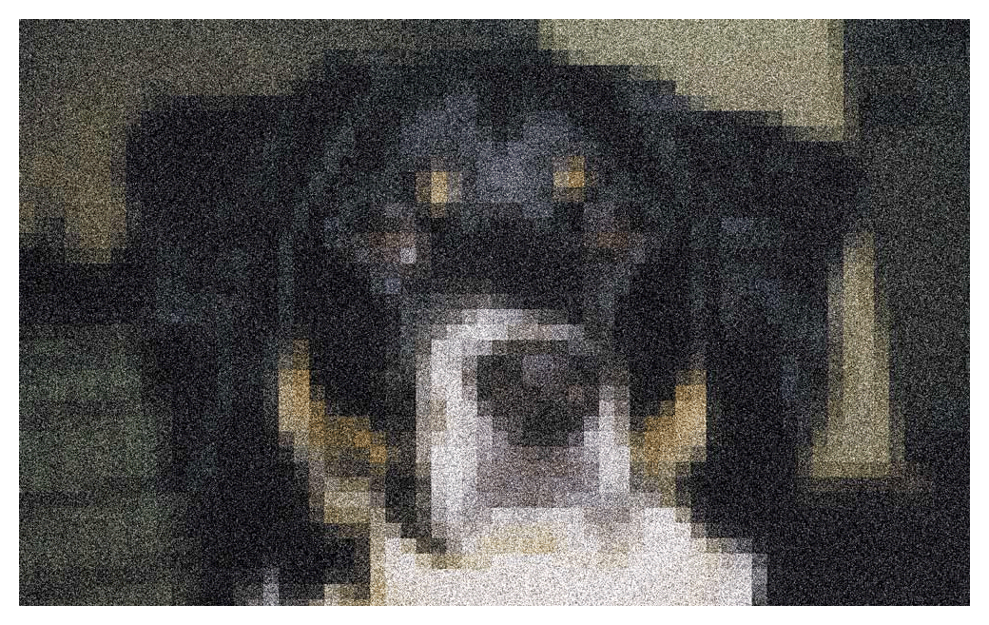
Digitized Images and Graphics
Magnified portion
of the picture
See the pixels?
Figure 3.12 A digitized picture composed of many individual pixels

Slide 64
Vector Graphics
Vector graphics
A format that describes an image in terms of lines and geometric shapes
A vector graphic is a series of commands that describe a line’s direction, thickness, and color
The file sizes tend to be smaller because not every pixel is described

Slide 65
Vector Graphics
The good side and the bad side…
Vector graphics can be resized mathematically and changes can be calculated dynamically as needed
Vector graphics are not good for representing real-world images

Slide 66
Representing Video
Video codec COmpressor/DECompressor Methods used to shrink the size of a movie to allow it to be played on a computer or over a network
Almost all video codecs use lossy compressions to minimize the huge amounts of data associated with video

Slide 67
Representing Video
Temporal compression
A technique based on differences between consecutive frames: If most of an image in two frames hasn’t changed, why should we waste space to duplicate all of the similar information?
Spatial compression
A technique based on removing redundant information within a frame: This problem is essentially the same as that faced when compressing still images

