Slide 1
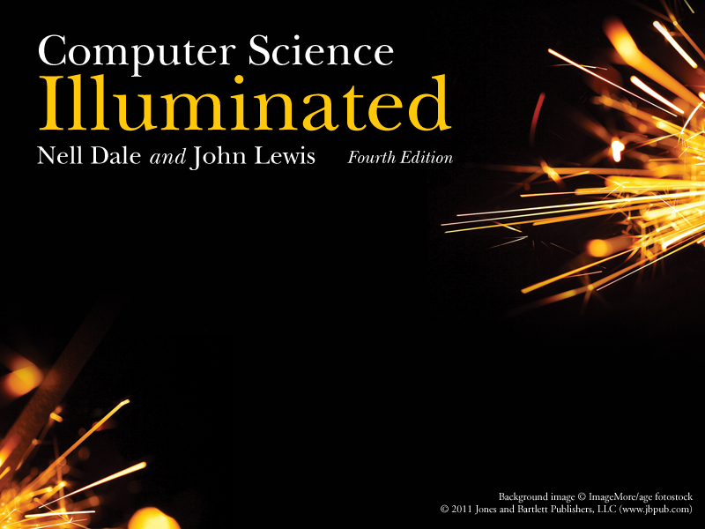
Chapter 4
Gates and Circuits

Slide 2

Computers and Electricity
Gate
A device that performs a basic operation on
electrical signals
Circuits
Gates combined to perform more
complicated tasks

Slide 3
Computers and Electricity
How do we describe the behavior of gates and circuits?
Boolean expressions
Uses Boolean algebra, a mathematical notation for expressing two-valued logic
Logic diagrams
A graphical representation of a circuit; each gate has its
own symbol
Truth tables
A table showing all possible input value and the associated
output values

Slide 4
Gates
Six types of gates
  NOT
  AND
  OR
  XOR
  NAND
  NOR
Typically, logic diagrams are black and white with gates distinguished only by their shape
We use color for emphasis (and fun)

Slide 5
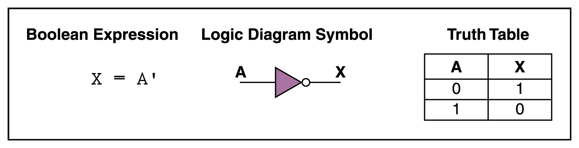
NOT Gate
A NOT gate accepts one input signal (0 or 1) and returns the opposite signal as output
Figure 4.1 Various representations of a NOT gate

Slide 6
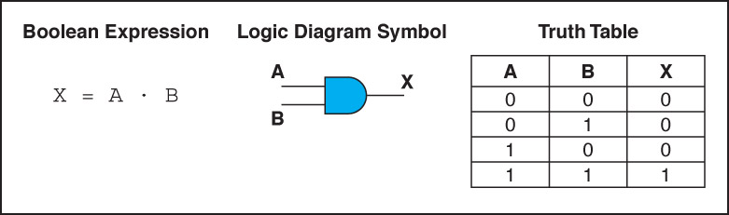
AND Gate
An AND gate accepts two input signals
If both are 1, the output is 1; otherwise,
the output is 0
Figure 4.2 Various representations of an AND gate

Slide 7
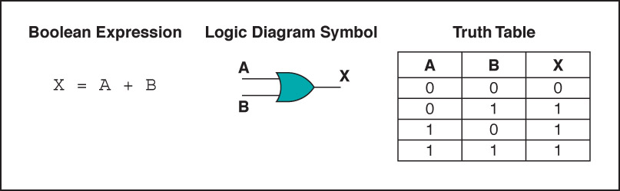
OR Gate
An OR gate accepts two input signals
If both are 0, the output is 0; otherwise,
the output is 1
Figure 4.3 Various representations of a OR gate

Slide 8
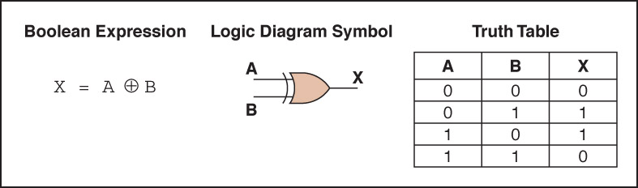
XOR Gate
An XOR gate accepts two input signals
If both are the same, the output is 0; otherwise,
the output is 1
Figure 4.4 Various representations of an XOR gate

Slide 9
XOR Gate
Note the difference between the XOR gate
and the OR gate; they differ only in one
input situation
When both input signals are 1, the OR gate produces a 1 and the XOR produces a 0
XOR is called the exclusive OR

Slide 10
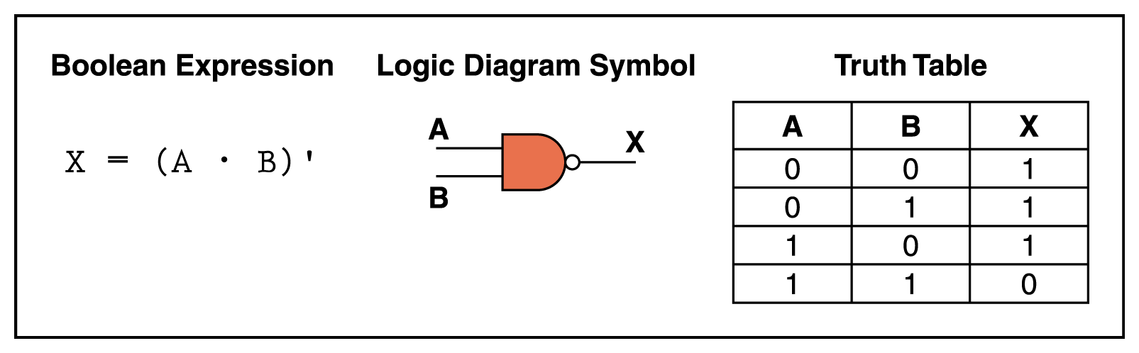
NAND Gate
The NAND gate accepts two input signals
If both are 1, the output is 0; otherwise,
the output is 1
Figure 4.5 Various representations of a NAND gate

Slide 11
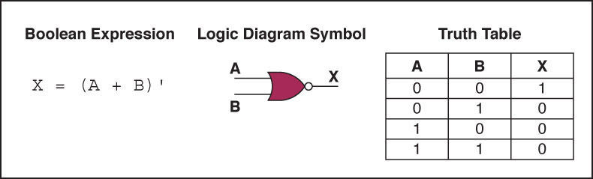
NOR Gate
The NOR gate accepts two input signals
If both are 0, the output is 1; otherwise,
the output is 0
Figure 4.6 Various representations of a NOR gate

Slide 12
Review of Gate Processing
A NOT gate inverts its single input
An AND gate produces 1 if both input values are 1
An OR gate produces 0 if both input values are 0
An XOR gate produces 0 if input values are the same
A NAND gate produces 0 if both inputs are 1
A NOR gate produces a 1 if both inputs are 0

Slide 13
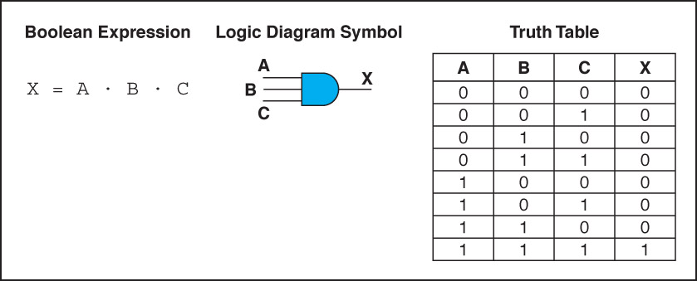
Gates with More Inputs
Gates can be designed to accept three or more input values
A three-input AND gate, for example, produces an output of 1 only if all input values are 1
Figure 4.7 Various representations of a three-input AND gate

Slide 14
Constructing Gates
Transistor
A device that acts either as a wire that conducts electricity or as a resistor that blocks the flow of electricity, depending on the voltage level of an input signal
A transistor has no moving parts, yet acts like
a switch
It is made of a semiconductor material, which is neither a particularly good conductor of electricity nor a particularly good insulator

Slide 15
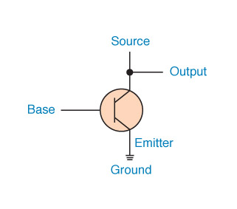
Constructing Gates
A transistor has three terminals
  A source
  A base
  An emitter, typically connected to a ground wire
If the electrical signal is grounded, it is allowed to flow through an alternative route to the ground (literally) where it can do no harm
Figure 4.8 The connections of a transistor

Slide 16
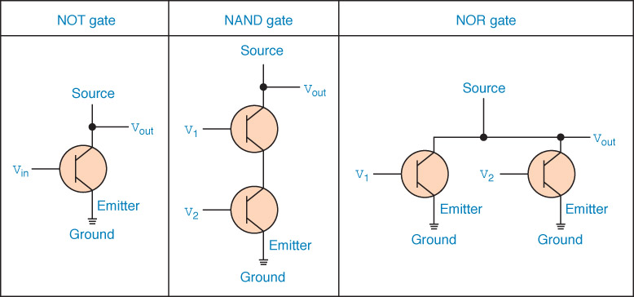
Constructing Gates
The easiest gates to create are the NOT, NAND, and NOR gates
Figure 4.9 Constructing gates using transistors

Slide 17
Circuits
Combinational circuit
The input values explicitly determine the output
Sequential circuit
The output is a function of the input values and the existing state of the circuit
We describe the circuit operations using
  Boolean expressions
  Logic diagrams
  Truth tables
Are you surprised?

Slide 18
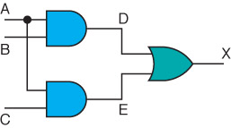
Combinational Circuits
Gates are combined into circuits by using the output of one gate as the input for another

Slide 19
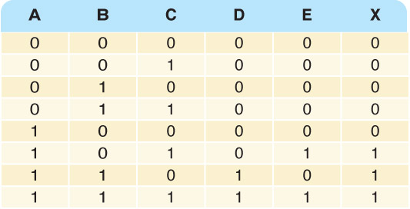
Combinational Circuits
Three inputs require eight rows to describe all possible input combinations
This same circuit using a Boolean expression is (AB + AC)

Slide 20

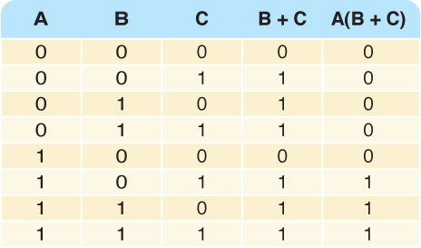
Combinational Circuits
Consider the following Boolean expression A(B + C)
Does this truth table look familiar?
Compare it with previous table

Slide 21
Combinational Circuits
Circuit equivalence
Two circuits that produce the same output for identical input
Boolean algebra allows us to apply provable mathematical principles to help design circuits
A(B + C) = AB + BC (distributive law) so circuits must be equivalent

Slide 22
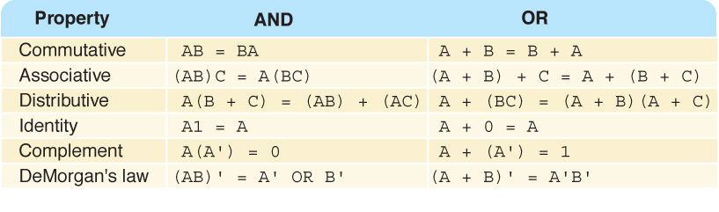
Properties of Boolean Algebra

Slide 23
Adders
At the digital logic level, addition is performed in binary
Addition operations are carried out
by special circuits called, appropriately, adders

Slide 24
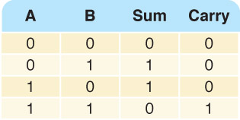
Adders
The result of adding two binary digits could produce a carry value
Recall that 1 + 1 = 10
in base two
Half adder
A circuit that computes the sum of two bits
and produces the correct carry bit
Truth table

Slide 25
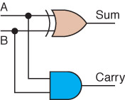
Adders
Circuit diagram representing
a half adder
Boolean expressions
sum = A ⊕ B
carry = AB

Slide 26
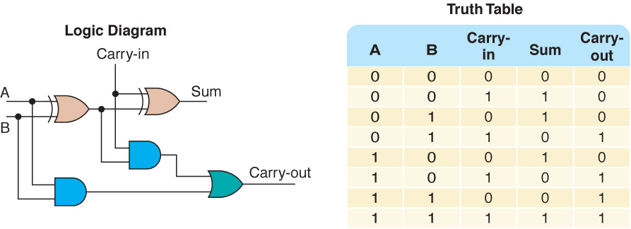
Adders
Full adder
A circuit that takes the carry-in value into account
Figure 4.10 A full adder

Slide 27
Multiplexers
Multiplexer
A circuit that uses a few input control signals to determine which of several output data lines is routed to its output

Slide 28
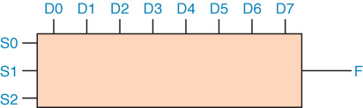
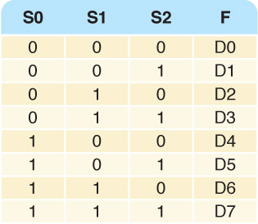
Multiplexers
The control lines S0, S1, and S2
determine which of eight other input lines
(D0 … D7)
are routed to the output (F)
Figure 4.11 A block diagram of a multiplexer with three select control lines

Slide 29
Circuits as Memory
Digital circuits can be used to store information
These circuits form a sequential circuit, because the output of the circuit is also used as input to the circuit

Slide 30
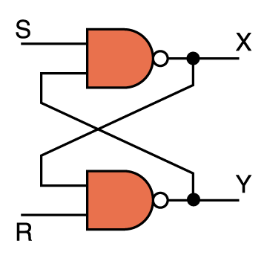
Circuits as Memory
An S-R latch stores a single binary digit
(1 or 0)
There are several ways an S-R latch circuit can be designed using various kinds of gates
Figure 4.12 An S-R latch

Slide 31
Circuits as Memory
The design of this circuit guarantees that the two outputs X and Y are always complements of each other
The value of X at any point in time is considered to be the current state of the circuit
Therefore, if X is 1, the circuit is storing a 1; if X is 0, the circuit is storing a 0
Figure 4.12 An S-R latch

Slide 32
Integrated Circuits
Integrated circuit (also called a chip)
A piece of silicon on which multiple gates have been embedded
Silicon pieces are mounted on a plastic or ceramic package with pins along the edges that can be soldered onto circuit boards or inserted into appropriate sockets

Slide 33
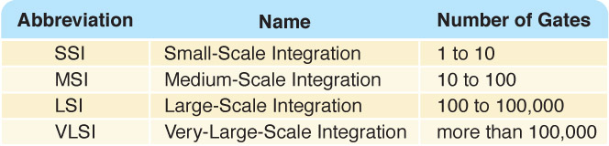
Integrated Circuits
Integrated circuits (IC) are classified by the number of gates contained in them

Slide 34
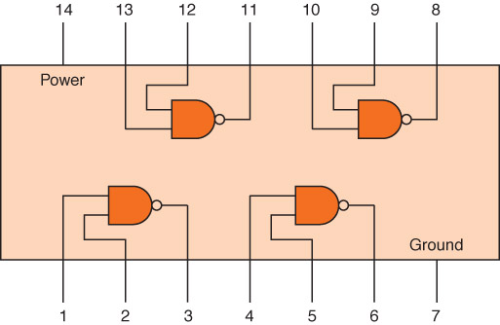
Integrated Circuits
Figure 4.13 An SSI chip contains independent NAND gates

Slide 35
CPU Chips
The most important integrated circuit
in any computer is the Central Processing Unit, or CPU
Each CPU chip has a large number of pins through which essentially all communication in a computer system occurs

