Slide 1

Chapter 12
Information Systems

Slide 2

Chapter Goals
Define the role of general information systems
Explain how spreadsheets are organized
Create spreadsheets for basic analysis of data
Define appropriate spreadsheet formulas using built-in functions
Design spreadsheets to be flexible and extensible
Describe the elements of a database management system

Slide 3
Chapter Goals
Describe the organization of a relational database
Establish relationships among elements in a database
Write basic SQL statements
Describe an entity-relationship diagram
Define and explain the role of e-commerce in society today

Slide 4
Chapter Goals
Discuss the CIA triad
Describe the role of cryptography in securing data
List three types of of authentication credentials
Define the following terms related to computer security: malicious code, virus, worm, Trojan horse, logic bomb, spoofing, phishing, back door, buffer overflow, denial of service, and man-in-the-middle

Slide 5
Managing Information
Information system
Software that helps the user organize and analyze data
Electronic spreadsheets and database management systems
Software tools that allow the user to organize, manage, and analyze data is various ways
Have you used a spreadsheet?

Slide 6
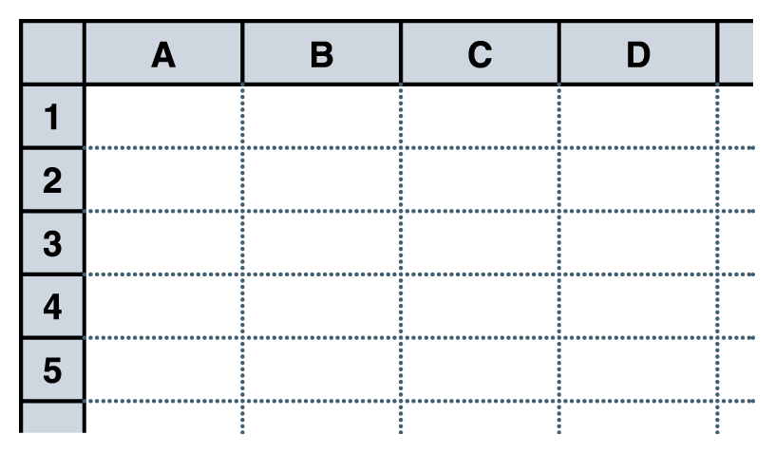
Spreadsheets
Spreadsheet
A software application that allows the user to organize and analyze data using a grid of labeled cells
  A cell can contain data or a formula that is used to calculate a value
  Data stored in a cell can be text, numbers, or “special” data such as dates
  Spreadsheet cells are referenced by their row and column designation
Figure 12.1 A spreadsheet, made up of a grid of labeled cells

Slide 7
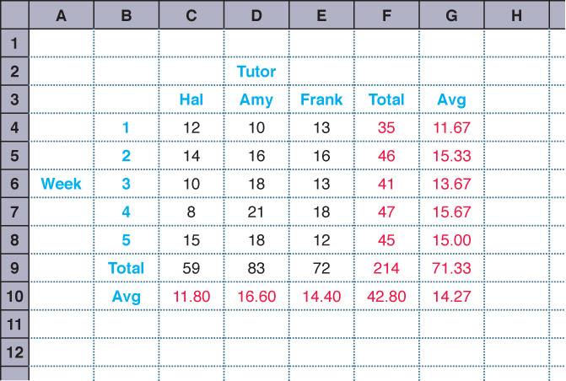
Spreadsheets
Suppose we have collected data on the number of students that came to get help from a set of tutors over a period of several weeks
Figure 12.1
A spreadsheet containing data and computations

Slide 8
Spreadsheet Formulas
The power of spreadsheets comes from the formulas that we can create and store in cells
  When a formula is stored in a cell, the result of the formula is displayed in the cell
  If we’ve set up the spreadsheet correctly,
  we could add or remove tutors,
  add additional weeks of data,
  or change any of the data we have already stored and the corresponding calculations would automatically be updated

Slide 9
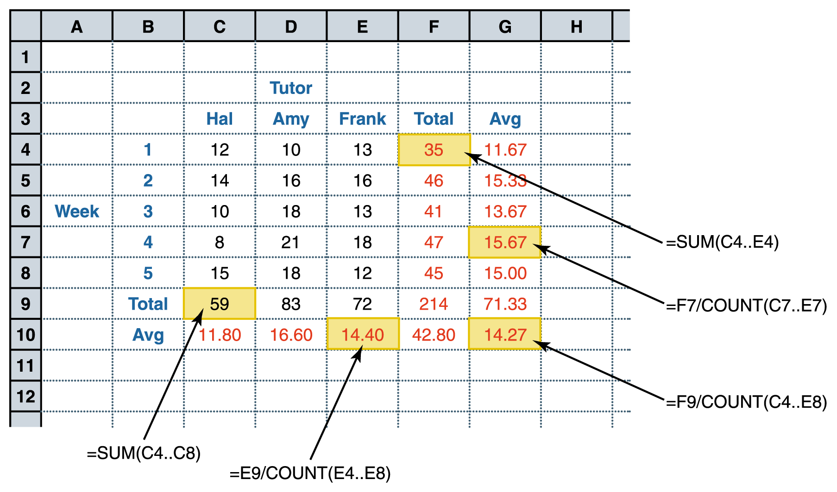
Spreadsheet Formulas
Figure 12.3 The formulas behind some of the cells

Slide 10
Spreadsheet Formulas
Formulas make use of basic arithmetic operations using the standard symbols (+, -, 2, *, and /)
Spreadsheet functions
Computations provided by the spreadsheet software that can be incorporated into formulas
Range
A set of contiguous cells specified by the endpoints

Slide 11
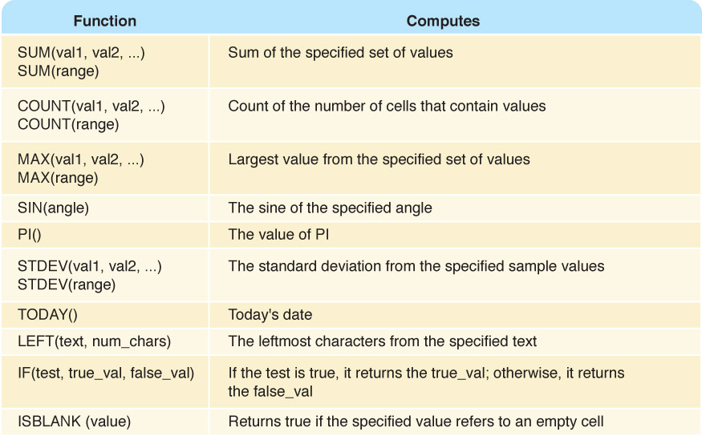
Spreadsheet Formulas
Figure 12.4 Some common spreadsheet functions

Slide 12
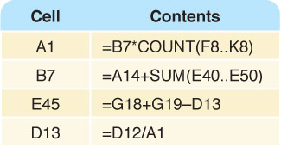
Circular References
Circular reference
A set of formulas that ultimately rely on each other
Can you see
the circular
reference?
Figure 12.5 A circular reference situation that cannot be resolved

Slide 13
Spreadsheet Analysis
Can you name eight tasks that a spreadsheet might be used to perform?

Slide 14
Spreadsheet Analysis
Possible tasks a spreadsheet could perform:
Track sales
Analyze sport statistics
Maintain student grades
Keep a car maintenance log
Record and summarize travel expenses
Track project activities and schedules
Plan stock purchases

Slide 15
Spreadsheet Analysis
Spreadsheets are also useful because of their dynamic nature, which provides the powerful ability to do what-if analysis
  What if the number of attendees decreased by 10%?
  What if we increase the ticket price by $5?
  What if we could reduce the cost of materials by half?

Slide 16
Database Management Systems
Database
A structured set of data
Database management system (DBMS)
A combination of software and data, made up of a physical database, a database engine, and a database schema
Physical database
A collection of files that contain the data

Slide 17
Database Management Systems
Database engine
Software that supports access to and modification of the database contents
Database schema
A specification of the logical structure of the data stored in the database
Database query
A request to retrieve data from a database

Slide 18
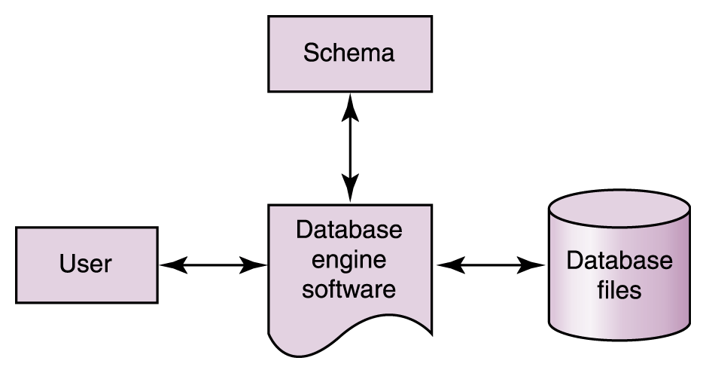
Database Management Systems
Figure 12.6 The elements of a database management system

Slide 19
The Relational Model
Relational DBMS
A DBMS in which the data items and the relationships among them are organized into tables
Tables
A collection of records
Records (object, entity)
A collection of related fields that make up a single database entry
Fields (attributes)
A single value in a database record

Slide 20
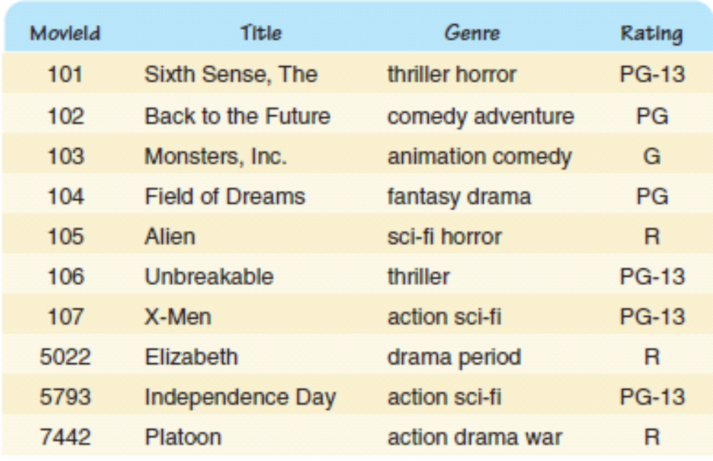
A Database Table
How do we
uniquely
identify a
record?
Figure 12.7 A database table, made up of records and fields

Slide 21
A Database Table
Key
One or more fields of a database record that uniquely identifies it among all other records in the table
We can express the schema for this part of the database as follows:
  Movie (MovieId:key, Title, Genre, Rating)

Slide 22
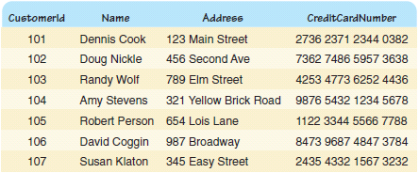
A Database Table
Figure 12.8 A database table containing customer data

Slide 23
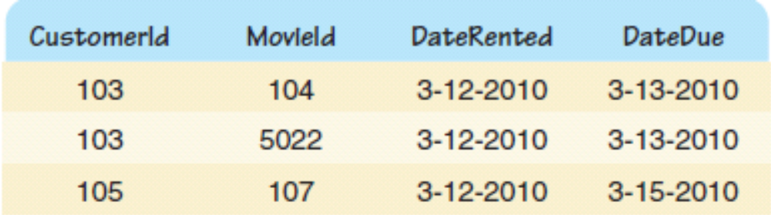
Relationships
How do we relate movies to customers?
By a table, of course!
Who is
renting
what
movie?
Figure 12.9 A database table storing current movie rentals

Slide 24
Structured Query Language
Structured Query Language (SQL)
A comprehensive relational database language for data manipulation and queries
select attribute-list from table-list where condition
name of field name of table value restriction
select Title from Movie where Rating = 'PG'
Result is a table containing all PG movies in table Movie

Slide 25
Queries in SQL
select Name, Address from Customer
select * from Movie where Genre like '%action%'
select * from Movie where Rating = 'R' order by Title
What does each of these
queries return?

Slide 26
Modifying Database Content
insert into Customer values (9876, 'John Smith', '602 Greenbriar Court', '2938 3212 3402 0299')
update Movie set Genre = 'thriller drama' where title = 'Unbreakable'
delete from Movie where Rating = 'R'
What does each of these
statements do?

Slide 27
Database Design
Entity-relationship (ER) modeling
A popular technique for designing relational databases
ER Diagram
A graphical representation of an ER model
Cardinality constraint
The number of relationships that may exist at one time among entities in an ER diagram

Slide 28
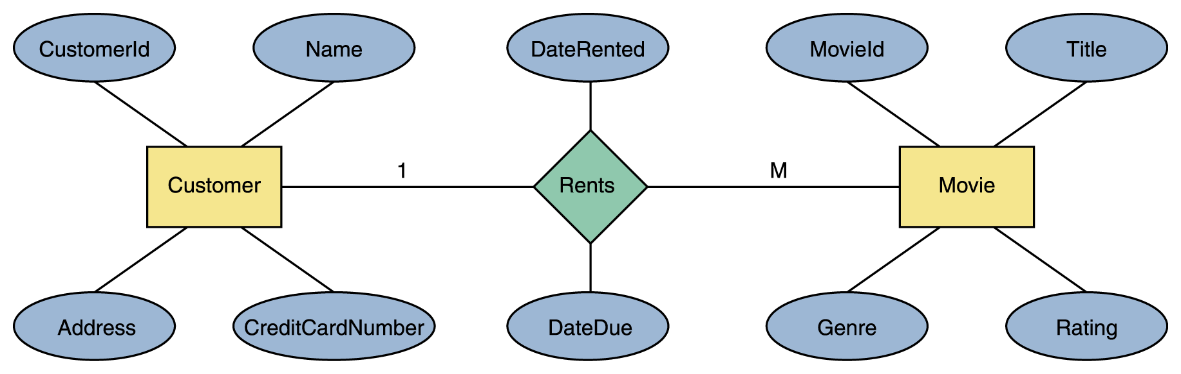
Database Design
How many movies can a person rent?
How many people can rent the same movie?
Figure 12.10 An ER diagram for the movie rental database

Slide 29
E-Commerce
Electronic commerce
The process of buying and selling products
and services using the WEB
Can you name at least 4 e-commerce sites
that you have visited lately?
What made e-commerce feasible and easy?
What problems does e-commerce face?

Slide 30
Information Security
Information security
The techniques and policies used to ensure proper access to data
Confidentiality
Ensuring that data is protected from unauthorized access
What's the difference
between file protection
and information security?

Slide 31
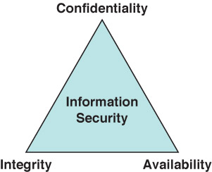
CIA Triad of Information Security
Ensuring
that data
can be
modified
only by
appropriate
mechanisms
Ensuring that data is
protected from
unauthorized access
The degree to which authorized
users can access information for
legitimate purposes

Slide 32
Information Security
Rick Analysis
Determining the nature and likelihood of the risks to key data
Planning for information analysis requires risk analysis
Goal is to minimize vulnerability to threats that put a system at the most risk

Slide 33
Cryptography
Cryptography
The field of study related to encoded information (comes from Greek word for "secret writing")
Encryption
The process of converting plaintext into ciphertext
Decryption
The process of converting ciphertext into plaintext

Slide 34
Cryptography
Encryption
plaintext
message
ciphertext
message
Decryption
Encrypted(Information) cannot be read
Decrypted(Encrypted(Information)) can be

Slide 35
Cryptography
Cipher
An algorithm used to encrypt and decrypt text
Key
The set of parameters that guide a cipher
Neither is any good without the other

Slide 36
Cryptography
Substitution cipher --A cipher that substitutes one character with another
Caesar cipher --A substitution cipher that shifts characters a certain number of positions in the alphabet
Transposition ciphers --A cipher that rearranges the order of existing characters in a message in a certain way (e.g., a route cipher)

Slide 37
Substitution cipher
A B C D E F G H I J K L M N O P Q R S T U V W X Y Z
D E F G H I J K L M N O P Q R S T U V W X Y Z A B C
Substitute the letters in the second row for the letters in the top row to encrypt a message
Encrypt(COMPUTER) gives FRPSXWHU
Substitute the letters in the first row for the letters in the second row to decrypt a message
Decrypt(Encrypt(COMPUTER)) gives COMPUTER
Why is this called the Caesar cipher?
What is the key?

Slide 38
Transposition Cipher
T O D A Y
+ I S + M
O N D A Y
Write the letters in a row of five, using '+' as a blank. Encrypt by starting spiraling inward from the top left moving counter clockwise
Encrypt(TODAY IS MONDAY) gives T+ONDAYMYADOIS+
Decrypt by recreating the grid and reading the letters across the row
The key are the dimension of the grid and the route used to encrypt the data

Slide 39
Cryptanalysis
Cryptanalysis
The process of decrypting a message without knowing the cipher or the key used to encrypt it
Substitution and transposition ciphers are easy for modern computers to break
To protect information more sophisticated schemes are needed

Slide 40
Public/Private Keys
Public-key cryptography
An approach in which each user has two related keys, one public and one private
One's public key is distributed freely
A person encrypts an outgoing message, using the receiver's public key.
Only the receiver's private key can decrypt the message

Slide 41
Public/Private Keys
Digital signature
Data that is appended to a message, made from the message itself and the sender's private key, to ensure the authenticity of the message
Digital certificate
A representation of a sender's authenticated public key used to minimize malicious forgeries

Slide 42
Computer Security
Authentication credentials
Information users provide to identify themselves for computer access
  User knowledge name, password, PIN
  Smart card card with embedded memory chip used for identification
  Biometrics human characteristics such as fingerprints, retina or voice patterns

Slide 43
Computer Security
Malicious Code
A computer program that attempts to bypass appropriate authorization and/or perform unauthorized functions
  Worm stands alone, targets network resources
  Trojan horse disguised as benevolent resource
  Virus self-replicating
  Logic bomb set up to execute at system event

Slide 44
Computer Security
Security Attacks
An attack on the computer system itself
  Password guessing obvious
  Phishing trick users into revealing security information
  Spoofing malicious user masquerades as authorized user
  Back door unauthorized access to anyone who knows it exists

Slide 45
Computer Security
  Buffer overflow defect that could cause a system to crash and leave the user with heightened privileges
  Denial-of-service attach that prevents authorized user from accessing the system
  Man-in-the-middle network communication is intercepted in an attempt to obtain key data
  Have you ever experienced one of these?

Slide 46
Ethical Issues
Workplace Privacy Rights
What level of privacy rights do you enjoy in the workplace concerning your use of workplace technologies?
Why do employers claim monitoring employees’ use of workplace technologies is useful?
Do you object to employers monitoring your use of workplace technology? If so, why? If not, why not?

Slide 47

Who am I?
What software
product did I
win the Hopper
Award for in
1981?
I believe that
software should
not be
proprietary, so I
did not patent
this product.

Slide 48

Do you know?
What data does the Ellis Island database contain?
Of what is the Universal Bar Code composed?
For what did E. F. Codd win the Turing Award in 1981?
What are the implications of secondhand shopping?

