Slide 1
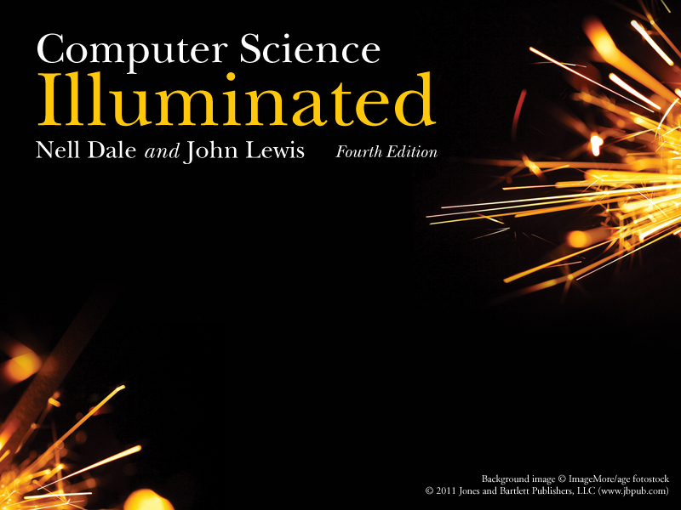
Chapter 16
The World Wide Web

Slide 2

The World Wide Web
The Web is an infrastructure of distributed information combined with software that uses networks as a vehicle to exchange that information
A Web page is a document that contains or references various kinds of data, such as text, images, graphics, and programs
Web pages also contain links to other Web pages so that the user can “move around” as desired

Slide 3
The World Wide Web
A Web site is a collection of related Web pages
The Internet makes the communication possible, but the Web makes that communication easy, more productive, and more enjoyable

Slide 4
Web Browsers
A browser is a software tool that issues the request for the Web page we want and displays it when it arrives
We often talk about “visiting” a Web site, as if we were going there
  In truth, we actually specify the information we want, and it is brought to us
  The concept of visiting a site is understandable in that we often don’t know what’s at a particular site until we “go to it” and see

Slide 5
The World Wide Web
The computer that is set up to respond to Web requests is called a Web server
A Web address is the core part of a Uniform Resource Locator, or URL, which uniquely identifies the page you want out of all of the pages stored anywhere in the world

Slide 6
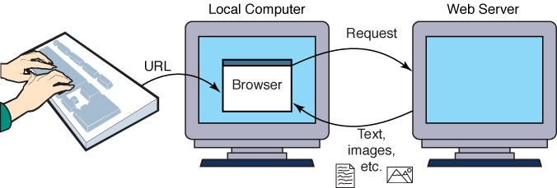
The World Wide Web
Figure 16.1 A browser retrieving a Web page

Slide 7
Search Engines
Search Engine
A website that helps you find other websites
How do they work?

Slide 8
Instant Messaging
Instant messaging (IM)
An application that allows people to send and receive messages in real time
  Both sender and receiver must have an IM running
  Most IM applications use a proprietary protocol that dictates the precise format and structure of the messages sent
  Instant messages are not secure

Slide 9
Weblogs
Blog or Weblog
An online journal or newsletter that is frequently updated and intended for public consumption

Slide 10
Cookies
Cookie
A small text file that a web server stores on your local computer’s hard disk
  A cookie contains information about your visit to the site
  Cookies can be used
    to determine number of unique visitors to the site
    to customize the site for your future visits
    to implement shopping carts that can be maintained from visit to visit
  Cookies are not dangerous

Slide 11
HTML
Web pages are created (or built) using a language called the Hypertext Markup Language, or HTML
The term markup language comes from the fact that the primary elements of the language take the form of tags that we insert into a document to annotate the information stored there

Slide 12
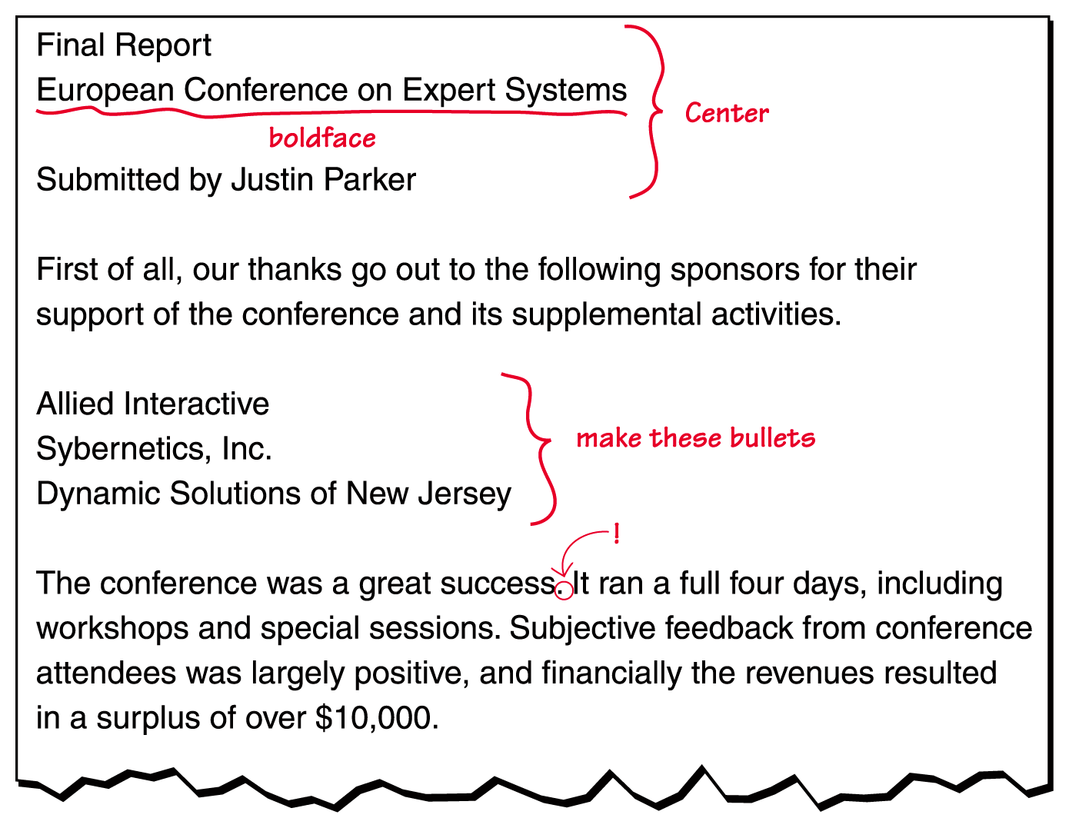
HTML
Figure 16.2
A marked-up document

Slide 13
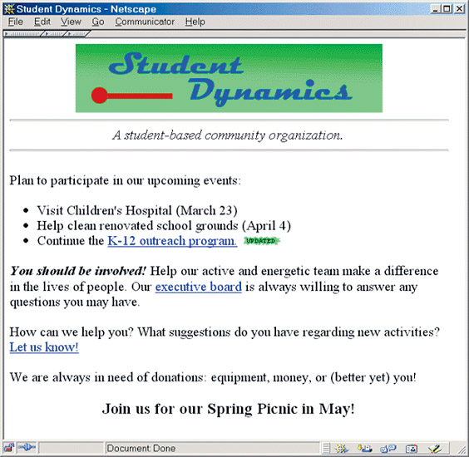
HTML
Figure 16.3
The Student Dynamics Web page as displayed in Netscape Navigator

Slide 14
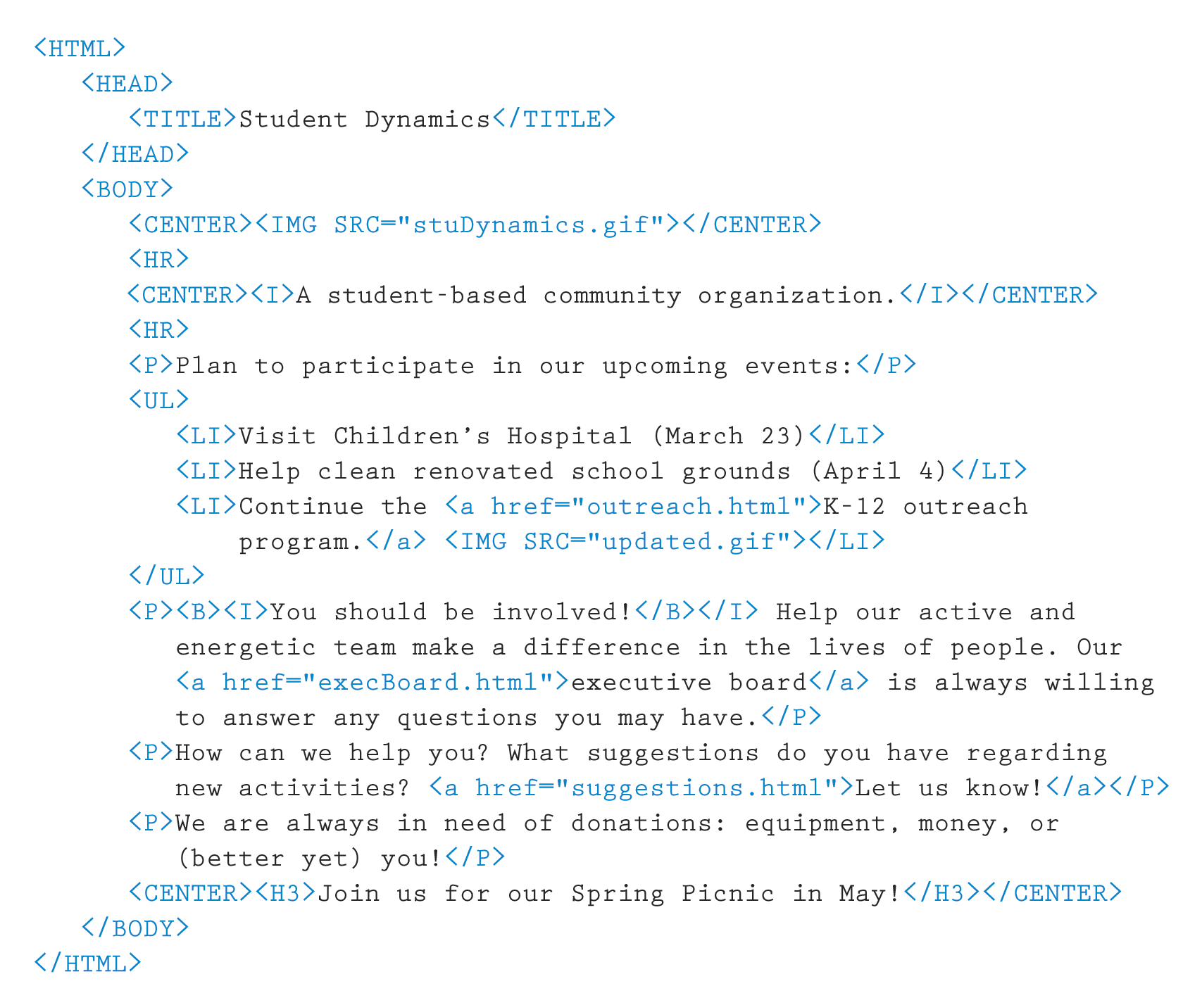
HTML
Figure 16.4
The HTML document defining the Student Dynamics Web page

Slide 15
HTML
Tags are enclosed in angle brackets
(<. . . >)
Words such as HEAD, TITLE, and BODY are called elements and specify the type of the tag
Tags are often used in pairs, with a start tag such as <BODY> and a corresponding end tag with a / before the element name, such as </BODY>

Slide 16
HTML
The browser determines how the page should be displayed based on the tags
The browser
  Ignores the way we format the HTML document using carriage returns, extra spaces, and blank lines
  Takes into account the width and height of the browser window
  Reformats the contents to fit your browser window

Slide 17
Basic HTML Formatting
<P> . . . </P> specify that text should be treated as a separate paragraph
<CENTER> . . . </CENTER> center information in the browser window
<B>…</B> bold information
<I>…</I> italicize information
<HR> insert horizontal rule across page

Slide 18
Basic HTML Formatting
We often have cause to display a list of items
  The UL element stands for an unordered list, and the LI element represents a list item
Several elements are used to define headings in a document
  There are six predefined heading elements defined in HTML: H1, H2, H3, H4, H5, and H6

Slide 19
Images
Many tags can contain attributes that indicate additional details about the information or how the enclosed information should be displayed
  An image can be incorporated into a Web page using the IMG element, which takes an attribute that identifies the image file to display
  <IMG SRC = "myPicture.gif">

Slide 20
Links
A link is specified using the element A, (which stands for anchor) and attribute HREF that specifies the URL of the destination document.
<P><A HREF="http://www.cs.utexas.edu/users/ndale/labs/factorial/FactByte.htm">Factorial-Byte</A></P>

Slide 21
Interactive web pages
When HTML was first developed, there was no way to interact with the information and pictures presented in a Web page
As users have clamored for a more dynamic web, new technologies were developed to accommodate these requests
Some (but not all) of the new ideas were offshoots of the newly developed Java programming language

Slide 22
Java Applets
A Java applet is a program that is designed to be embedded into an HTML document and transferred over the Web to someone who wants to run the program
  An applet is embedded into an HTML document using the APPLET tag
  <APPLET code="MyApplet.class" width=250
  height=150 ></APPLET>

Slide 23
Java Applets
Java programs are compiled into Bytecode,
a low-level representation of a program that is not the machine code for any particular type
of CPU
Java applets are restricted as to what they
can do
  The Java language has a carefully constructed security model
  An applet, for instance, cannot access any local files or change any system settings

Slide 24
Java Applets
Example
link:
http://www.cs.utexas.edu/users/ndale/labs/factorial/FactByte.htm
Contents of FactByte.htm:
<H1>Factorial with Byte Result</H1>
<P>Enter increasing values beginning with 0 and record the results of the Factorial of your input. At some point, the answer will seem strange. Record what seems strange about the answer and return to the previous page. </P>
<P><HR></P>
<P><APPLET code = "FactByte.class" width=250 height=150></APPLET></P>
FactByte.class
contains the
Java applet

Slide 25
Java Server Pages
JSP Scriptlet
A portion of code embedded in an HTML document designed to dynamically contribute to the content of the web page
Java Server Page
A web page that has a JSP scriptlet interwoven among the HTML content

Slide 26
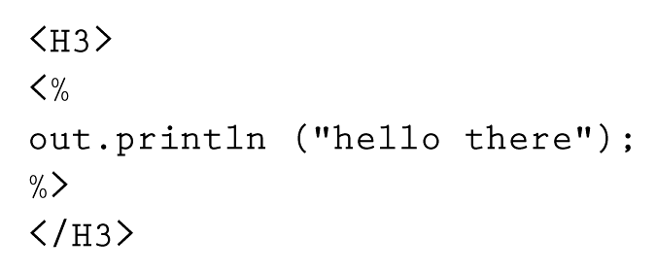
Java Server Pages
A JSP scriptlet is encased in special tags beginning with <% and ending with %>
Imagine JSP scriptlets as having the expressive power of a full programming language

Slide 27
Java Server Pages
JSPs are executed on the server side where the web page resides
By the time it arrives at your computer, all active processing has taken place, producing a static (though dynamically created) web page
JSPs are particularly good for coordinating the interaction between a web page and an underlying database
Compare and contrast Java
applets and JSP scriptlets

Slide 28
XML
HTML has a predefined set of tags and each tag has its own meaning
There is nothing about HTML tags that describes the true content of a document
The Extensible Markup Language, or XML, allows the creator of a document to describe its contents by defining his or her own set of tags

Slide 29
XML
XML is a metalanguage
A metalanguage is a language for talking about, or defining, other languages

Slide 30
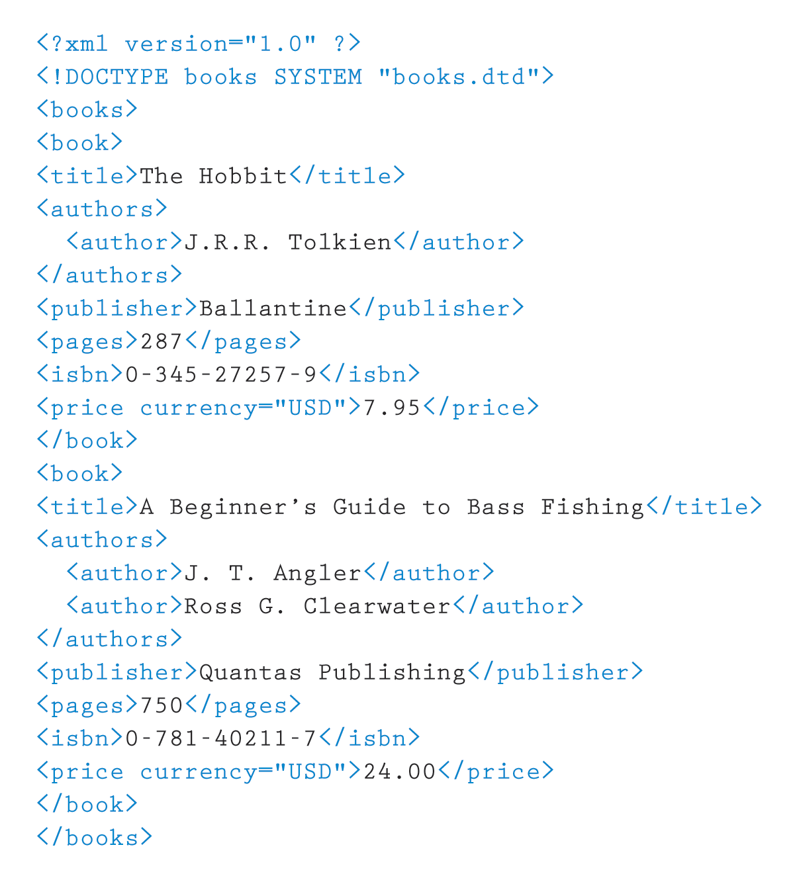
XML
Like HTML, an XML document is made up of tagged data
Figure 16.5 An XML document containing data about books

Slide 31
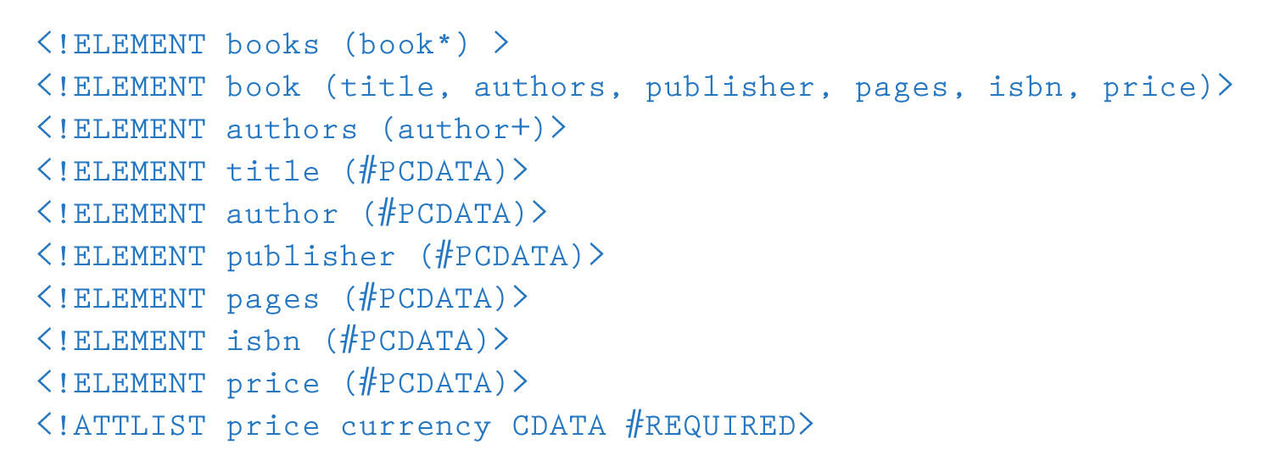
XML
Document Type Definition (DTD)
A specification of the organization of the document
The structure of a particular XML document is described by its corresponding DTD document
Figure 16.6 The DTD document corresponding to the XML books document

Slide 32
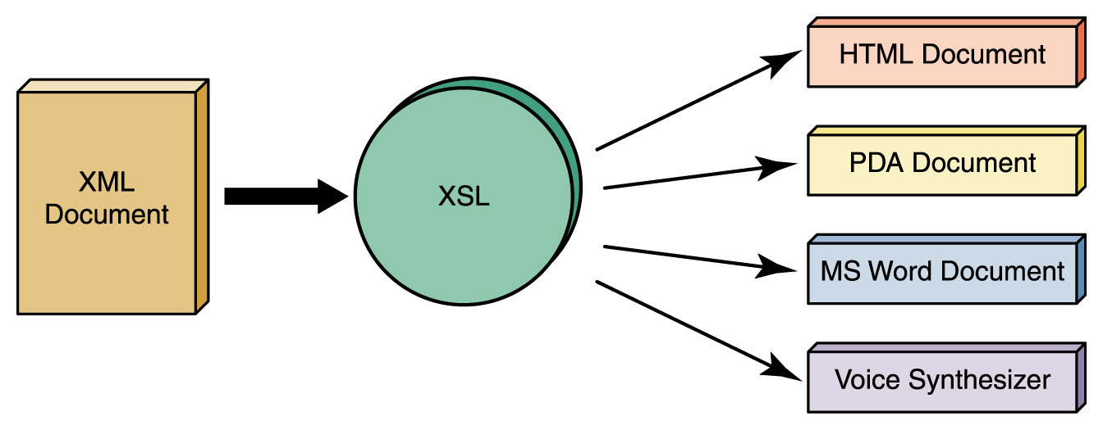
XML
XML represents a standard format for organizing data without tying it to any particular type of output
Extensible Stylesheet Language (or XSL)
A language for defining transformations from XML documents to other output formats
Figure 16.7
An XML document can be transformed into many output formats

