Slide 1

Chapter 12
Information Systems

Slide 2

Managing Information
Information system
Software that helps the user organize and analyze data
Electronic spreadsheets and database management systems
Software tools that allow the user to organize, manage, and analyze data is various ways

Slide 3
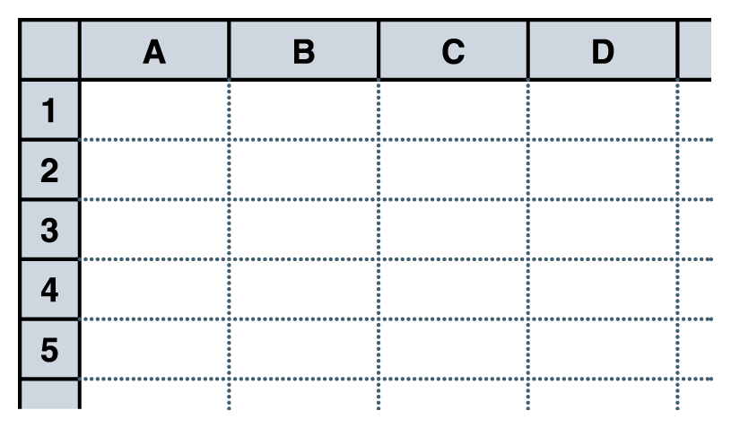
Spreadsheets
Spreadsheet
A software application that allows the user to organize and analyze data using a grid of labeled cells
  A cell can contain data or a formula that is used to calculate a value
  Data stored in a cell can be text, numbers, or “special” data such as dates
  Spreadsheet cells are referenced by their row and column designation
Figure 12.1 A spreadsheet, made up of a grid of labeled cells

Slide 4
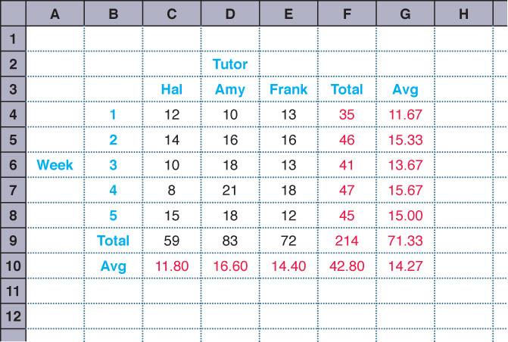
Spreadsheets
Suppose we have collected data on the number of students that came to get help from a set of tutors over a period of several weeks
Figure 12.1
A spreadsheet containing data and computations

Slide 5
Spreadsheet Formulas
The power of spreadsheets comes from the formulas that we can create and store in cells
  When a formula is stored in a cell, the result of the formula is displayed in the cell
  If we’ve set up the spreadsheet correctly,
  we could add or remove tutors,
  add additional weeks of data,
  or change any of the data we have already stored and the corresponding calculations would automatically be updated

Slide 6
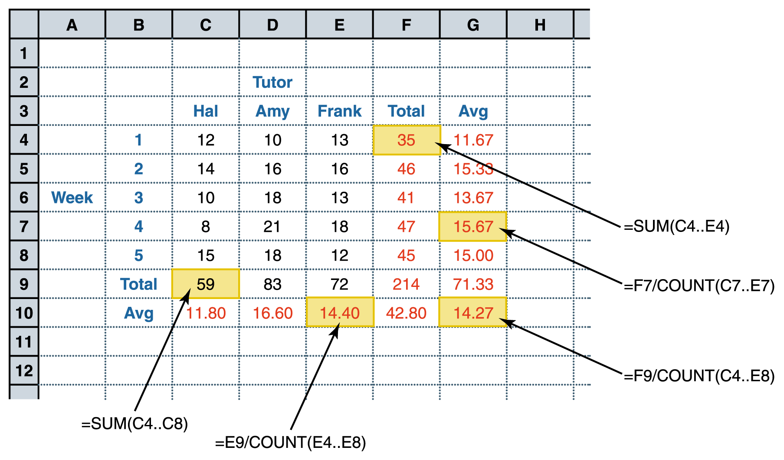
Spreadsheet Formulas
Figure 12.3 The formulas behind some of the cells

Slide 7
Spreadsheet Formulas
Formulas make use of basic arithmetic operations using the standard symbols (+, -, 2, *, and /)
Spreadsheet functions
Computations provided by the spreadsheet software that can be incorporated into formulas
Range
A set of contiguous cells specified by the endpoints

Slide 8
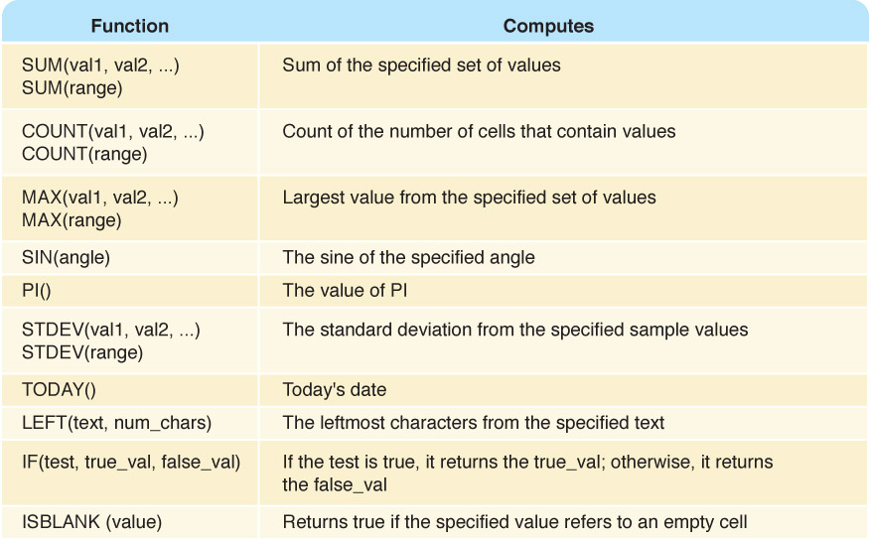
Spreadsheet Formulas
Figure 12.4 Some common spreadsheet functions

Slide 9
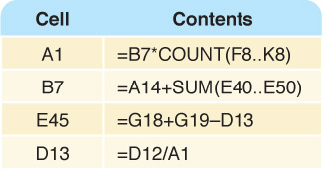
Circular References
Circular reference
A set of formulas that ultimately rely on each other
Can you see
the circular
reference?
Figure 12.5 A circular reference situation that cannot be resolved

Slide 10
Spreadsheet Analysis
Possible tasks a spreadsheet could perform:
Track sales
Analyze sport statistics
Maintain student grades
Keep a car maintenance log
Record and summarize travel expenses
Track project activities and schedules
Plan stock purchases

Slide 11
Spreadsheet Analysis
Spreadsheets are also useful because of their dynamic nature, which provides the powerful ability to do what-if analysis
  What if the number of attendees decreased by 10%?
  What if we increase the ticket price by $5?
  What if we could reduce the cost of materials by half?

Slide 12
Database Management Systems
Database
A structured set of data
Database management system (DBMS)
A combination of software and data, made up of a physical database, a database engine, and a database schema
Physical database
A collection of files that contain the data

Slide 13
Database Management Systems
Database engine
Software that supports access to and modification of the database contents
Database schema
A specification of the logical structure of the data stored in the database
Database query
A request to retrieve data from a database

Slide 14
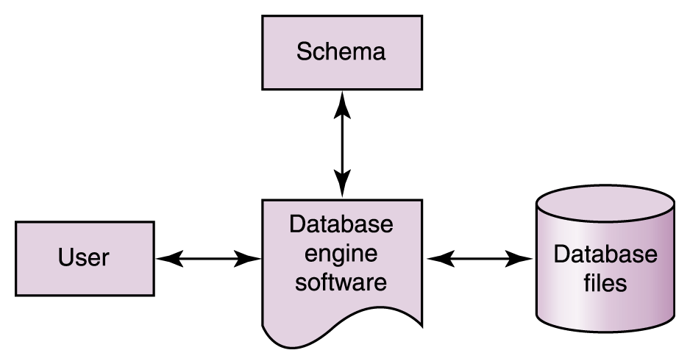
Database Management Systems
Figure 12.6 The elements of a database management system

Slide 15
Database Management Systems
Goals:
  Search on a single field (e.g., Name) (might binary search work?)
  Search on multiple fields (find all employees with 10+ years seniority but salary < $50K)
  Privacy (some users should only have access to certain information)

Slide 16
Redudancy is bad!
Whenever possible you want to avoid having the same underlying information stored in more than one place in the underlying database.
  Wastes memory!
  Updating database while ensuring consistency becomes challenging.
  Deletions present several pitfalls.

Slide 17
An example
Name Birthday Zodiac Birthstone
Art Alexakis April 12 Aries diamond
Hank Azaria April 25 Taurus diamond
Antonio Banderas August 10 Leo peridot
Lucas Black November 29 Sagittarius topaz
Matthew Broderick March 21 Pisces aquamarine
Sandra Bullock July 26 Leo ruby
Steve Buscemi December 13 Sagittarius turquoise
Nicholas Cage January 7 Capricorn garnet
Jim Carrey January 17 Capricorn garnet
George Clooney May 6 Taurus emerald
Courtnet Cox June 15 Gemini pearl
John Cusack June 28 Cancer pearl
Joan Cusack October 11 Libra opal
Matt Damon October 8 Libra opal

Slide 18
The Relational Model
In a relational DBMS, the data items
and the relationships among them are
organized into tables
  A table is a collection of records
  A record is a collection of related fields
  (each record contains the same set of fields)

Slide 19
The relational model
Essentially all commercial databases today are based on the relational model.
  Oracle
  Microsoft Access
  Informix
  DB2
  Postgres
  MySQL (freeware)

Slide 20
A relational example
Name | Birthday
Art Alexakis | April 12
Hank Azaria | April 25
Antonio Banderas | August 10
Lucas Black | Nov. 29
Matthew B. | March 21
Sandra Bullock | July 26
Steve Buscemi | Dec. 13
Nicholas Cage | January 17
Start | End | Birthstone
Jan. 1 | Jan. 31 | Garnet
Feb. 1 | Feb. 29 | Amethyst
March 1 | March 31 | Aquamarine
April 1 | April 31 | Diamond
May 1 | May 31 | Emerald
…

Slide 21
Relationship “Algebra”
Three basic operations
  Can choose to display only certain fields (columns) from a given table
  Can choose to include only certain records (rows) from a given table
  Can “join” two or more tables by taking the Cartesian product (see next slide for example)

Slide 22
Join operation
A record is created for every pair of records in the original two tables.
Rarely do we want all such records. A join is usually combined with other operations.
E.g., choose only those records from join with Start Date <= Birthday <= End Date

Slide 23
A Database Table
How do we
uniquely
identify a
record?
Figure 12.7 A database table, made up of records and fields

Slide 24
A Database Table
Key
One or more fields of a database record that uniquely identifies it among all other records in the table
We can express the schema for this part of the database as follows:
  Movie (MovieId:key, Title, Genre, Rating)

Slide 25
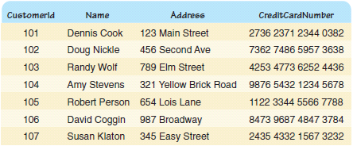
A Database Table
Figure 12.8 A database table containing customer data

Slide 26
Relationships
How do we relate movies to customers?
By a table, of course!
Who is
renting
what
movie?
Figure 12.9 A database table storing current movie rentals

Slide 27
Structured Query Language
Structured Query Language (SQL)
A comprehensive relational database language for data manipulation and queries
Originally created by IBM in early 70s. Standardized by ANSI in 1986
select attribute-list from table-list where condition
name of field name of table value restriction
select Title from Movie where Rating = 'PG'
Result is a table containing all PG movies in table Movie

Slide 28
Condition-list
Based on Attributes of potential records
Arbitrary Boolean Expressions (AND, OR, NOT)
Can use operators (>, >=, =, <, <=)
Can do partial matches for text such as:
  Name LIKE ‘Mich%’
Can use set theory, such as:
  Direction IN (‘North’, ‘East’)

Slide 29
Queries in SQL
select Name, Address from Customer
select * from Movie where Genre like '%action%'
select * from Movie where Rating = 'R' order by Title
What does each of these
queries return?

Slide 30
Modifying Database Content
insert into Customer values (9876, 'John Smith', '602 Greenbriar Court', '2938 3212 3402 0299')
update Movie set Genre = 'thriller drama' where title = 'Unbreakable'
delete from Movie where Rating = 'R'
What does each of these
statements do?

Slide 31
Example with 2 Tables
If an identical attribute name is used in several of the underlying tables, then you reference a particular attribute by using both the Table name and the Attribute name.
select Title from Movie,Rents where Movie.MovieId = Rents.MovieId

Slide 32
Database Design
Entity-relationship (ER) modeling
A popular technique for designing relational databases
ER Diagram
A graphical representation of an ER model
Cardinality constraint
The number of relationships that may exist at one time among entities in an ER diagram

Slide 33
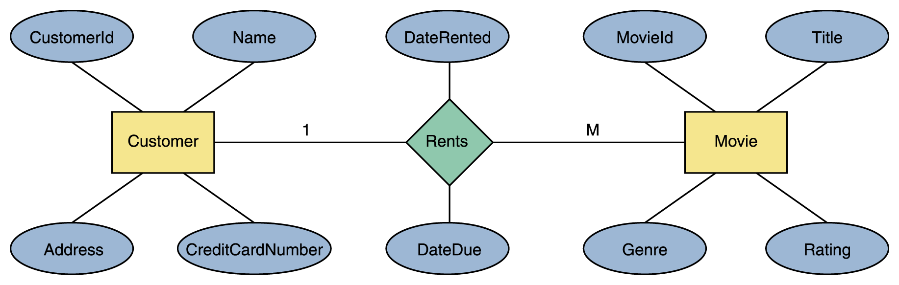
Database Design
Figure 12.10 An ER diagram for the movie rental database

