Slide 1

Final topics:
Scheduling Recap and some advanced topics

Slide 2

CPU Scheduling
CPU Scheduling
The act of determining which process in the ready state should be moved to the running state
  Many processes may be in the ready state
  Only one process can be in the running state, making progress at any one time
Which one gets to move from ready to running?

Slide 3
CPU Scheduling
Nonpreemptive scheduling
The currently executing process gives up the CPU voluntarily
Preemptive scheduling
The operating system decides to favor another process, preempting the currently executing process
Turnaround time
The amount of time between when a process arrives in the ready state the first time and when it exits the running state for the last time

Slide 4
CPU Scheduling Algorithms
First-Come, First-Served
Processes are moved to the CPU in the order in which they arrive in the running state
Shortest Job Next
Process with shortest estimated running time in the ready state is moved into the running state first
Round Robin
Each process runs for a specified time slice and moves from the running state to the ready state to await its next turn if not finished

Slide 5
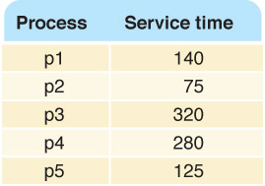
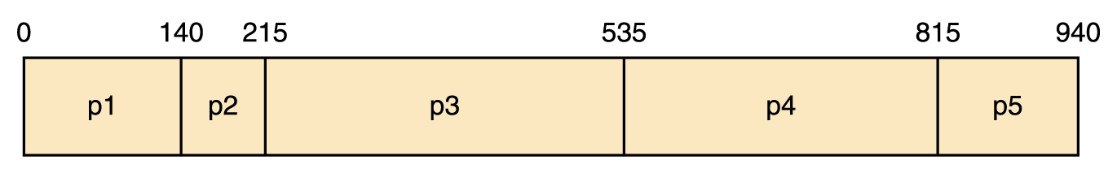
First-Come, First-Served
Average Turnaround:
(140 + 215 + 535 + 815 + 940)/5

Slide 6
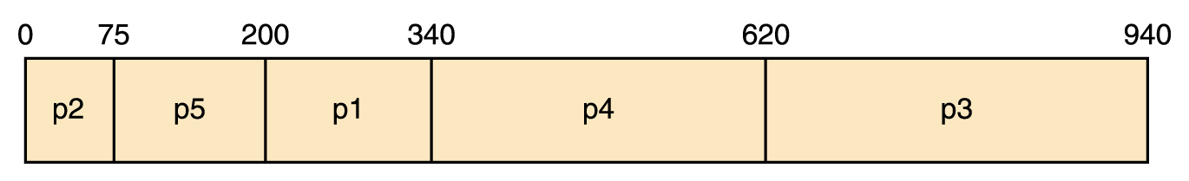
Shortest Job Next
Average Turnaround:
(75 + 200 + 340 + 620 + 940)/5

Slide 7
Round Robin
Every process is treated the same!
Time slice (quantum)
The amount of time each process receives before being preempted and returned to the ready state to allow another process its turn

Slide 8
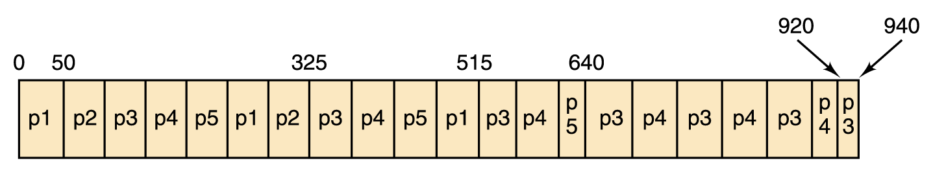
Round Robin
Suppose the time slice is 50
Average turnaround:
(515 + 325 + 940 + 920 + 640)/5

Slide 9
CPU Scheduling Algorithms
Are these scheduling algorithms preemptive or non-preemptive? Explain
First-Come, First-Served?
Shortest Job Next?
Round Robin?

Slide 10
First-Come, First-Served
Process | Arrival Time | Service Time | Completion Time | Turnaround
p1 | 0 | 140
p2 | 40 | 75
p3 | 50 | 320
p4 | 300 | 280
p5 | 315 | 125
0
⇑

Slide 11
First-Come, First-Served
Process | Arrival Time | Service Time | Completion Time | Turnaround
p1 | 0 | 140
p2 | 40 | 75
p3 | 50 | 320
p4 | 300 | 280
p5 | 315 | 125
0
p1
⇑

Slide 12
First-Come, First-Served
Process | Arrival Time | Service Time | Completion Time | Turnaround
p1 | 0 | 140
p2 | 40 | 75
p3 | 50 | 320
p4 | 300 | 280
p5 | 315 | 125
0
40
p1
⇑

Slide 13
First-Come, First-Served
Process | Arrival Time | Service Time | Completion Time | Turnaround
p1 | 0 | 140
p2 | 40 | 75
p3 | 50 | 320
p4 | 300 | 280
p5 | 315 | 125
0
50
p1
⇑

Slide 14
First-Come, First-Served
Process | Arrival Time | Service Time | Completion Time | Turnaround
p1 | 0 | 140 | 140
p2 | 40 | 75
p3 | 50 | 320
p4 | 300 | 280
p5 | 315 | 125
0
140
p1
⇑

Slide 15
First-Come, First-Served
Process | Arrival Time | Service Time | Completion Time | Turnaround
p1 | 0 | 140 | 140 | 140
p2 | 40 | 75
p3 | 50 | 320
p4 | 300 | 280
p5 | 315 | 125
0
140
p1
⇑

Slide 16
First-Come, First-Served
Process | Arrival Time | Service Time | Completion Time | Turnaround
p1 | 0 | 140 | 140 | 140
p2 | 40 | 75
p3 | 50 | 320
p4 | 300 | 280
p5 | 315 | 125
0
140
p1
p2
⇑

Slide 17
First-Come, First-Served
Process | Arrival Time | Service Time | Completion Time | Turnaround
p1 | 0 | 140 | 140 | 140
p2 | 40 | 75 | 215
p3 | 50 | 320
p4 | 300 | 280
p5 | 315 | 125
0
140
215
p1
p2
⇑

Slide 18
First-Come, First-Served
Process | Arrival Time | Service Time | Completion Time | Turnaround
p1 | 0 | 140 | 140 | 140
p2 | 40 | 75 | 215 | 175
p3 | 50 | 320
p4 | 300 | 280
p5 | 315 | 125
0
140
215
p1
p2
⇑

Slide 19
First-Come, First-Served
Process | Arrival Time | Service Time | Completion Time | Turnaround
p1 | 0 | 140 | 140 | 140
p2 | 40 | 75 | 215 | 175
p3 | 50 | 320
p4 | 300 | 280
p5 | 315 | 125
0
140
215
p1
p2
p3
⇑

Slide 20
First-Come, First-Served
Process | Arrival Time | Service Time | Completion Time | Turnaround
p1 | 0 | 140 | 140 | 140
p2 | 40 | 75 | 215 | 175
p3 | 50 | 320
p4 | 300 | 280
p5 | 315 | 125
0
140
215
300
p1
p2
p3
⇑

Slide 21
First-Come, First-Served
Process | Arrival Time | Service Time | Completion Time | Turnaround
p1 | 0 | 140 | 140 | 140
p2 | 40 | 75 | 215 | 175
p3 | 50 | 320
p4 | 300 | 280
p5 | 315 | 125
0
140
215
315
p1
p2
p3
⇑

Slide 22
First-Come, First-Served
Process | Arrival Time | Service Time | Completion Time | Turnaround
p1 | 0 | 140 | 140 | 140
p2 | 40 | 75 | 215 | 175
p3 | 50 | 320 | 535
p4 | 300 | 280
p5 | 315 | 125
0
140
215
535
p1
p2
p3
⇑

Slide 23
First-Come, First-Served
Process | Arrival Time | Service Time | Completion Time | Turnaround
p1 | 0 | 140 | 140 | 140
p2 | 40 | 75 | 215 | 175
p3 | 50 | 320 | 535 | 485
p4 | 300 | 280
p5 | 315 | 125
0
140
215
535
p1
p2
p3
⇑

Slide 24
First-Come, First-Served
Process | Arrival Time | Service Time | Completion Time | Turnaround
p1 | 0 | 140 | 140 | 140
p2 | 40 | 75 | 215 | 175
p3 | 50 | 320 | 535 | 485
p4 | 300 | 280 | 815
p5 | 315 | 125
0
140
215
535
815
p1
p2
p3
p4
⇑

Slide 25
First-Come, First-Served
Process | Arrival Time | Service Time | Completion Time | Turnaround
p1 | 0 | 140 | 140 | 140
p2 | 40 | 75 | 215 | 175
p3 | 50 | 320 | 535 | 485
p4 | 300 | 280 | 815 | 515
p5 | 315 | 125
0
140
215
535
815
p1
p2
p3
p4
⇑

Slide 26
First-Come, First-Served
Process | Arrival Time | Service Time | Completion Time | Turnaround
p1 | 0 | 140 | 140 | 140
p2 | 40 | 75 | 215 | 175
p3 | 50 | 320 | 535 | 485
p4 | 300 | 280 | 815 | 515
p5 | 315 | 125
0
140
215
535
815
p1
p2
p3
p4
p5
⇑

Slide 27
First-Come, First-Served
Process | Arrival Time | Service Time | Completion Time | Turnaround
p1 | 0 | 140 | 140 | 140
p2 | 40 | 75 | 215 | 175
p3 | 50 | 320 | 535 | 485
p4 | 300 | 280 | 815 | 515
p5 | 315 | 125 | 940
0
140
215
535
815
940
p1
p2
p3
p4
p5
⇑

Slide 28
First-Come, First-Served
Process | Arrival Time | Service Time | Completion Time | Turnaround
p1 | 0 | 140 | 140 | 140
p2 | 40 | 75 | 215 | 175
p3 | 50 | 320 | 535 | 485
p4 | 300 | 280 | 815 | 515
p5 | 315 | 125 | 940 | 625
0
140
215
535
815
940
p1
p2
p3
p4
p5
Average Turnaround time: 388
⇑

Slide 29
Shortest Job Next (SJN)
When choosing next job to run, look at all processes in the ready state and dispatch the one with the smallest service time.
(assuming we know the service times!)
We consider it as a nonpreemptive algorithm. That is a new job will not be given a chance at the CPU until the current job finishes (even if new job is shorter).

Slide 30
Shortest Job Next
Process | Arrival Time | Service Time | Completion Time | Turnaround
p1 | 0 | 140 | 340 | 340
p2 | 0 | 75 | 75 | 75
p3 | 0 | 320 | 940 | 940
p4 | 0 | 280 | 620 | 620
p5 | 0 | 125 | 200 | 200
Average Turnaround time: 435
Page 337

Slide 31
Shortest Job Next
Process | Arrival Time | Service Time | Completion Time | Turnaround
p1 | 0 | 140
p2 | 40 | 75
p3 | 50 | 320
p4 | 300 | 280
p5 | 315 | 125
0
⇑

Slide 32
Shortest Job Next
Process | Arrival Time | Service Time | Completion Time | Turnaround
p1 | 0 | 140
p2 | 40 | 75
p3 | 50 | 320
p4 | 300 | 280
p5 | 315 | 125
0
p1
⇑

Slide 33
Shortest Job Next
Process | Arrival Time | Service Time | Completion Time | Turnaround
p1 | 0 | 140
p2 | 40 | 75
p3 | 50 | 320
p4 | 300 | 280
p5 | 315 | 125
0
40
p1
⇑

Slide 34
Shortest Job Next
Process | Arrival Time | Service Time | Completion Time | Turnaround
p1 | 0 | 140
p2 | 40 | 75
p3 | 50 | 320
p4 | 300 | 280
p5 | 315 | 125
0
50
p1
⇑

Slide 35
Shortest Job Next
Process | Arrival Time | Service Time | Completion Time | Turnaround
p1 | 0 | 140 | 140
p2 | 40 | 75
p3 | 50 | 320
p4 | 300 | 280
p5 | 315 | 125
0
140
p1
⇑

Slide 36
Shortest Job Next
Process | Arrival Time | Service Time | Completion Time | Turnaround
p1 | 0 | 140 | 140 | 140
p2 | 40 | 75
p3 | 50 | 320
p4 | 300 | 280
p5 | 315 | 125
0
140
p1
⇑

Slide 37
Shortest Job Next
Process | Arrival Time | Service Time | Completion Time | Turnaround
p1 | 0 | 140 | 140 | 140
p2 | 40 | 75
p3 | 50 | 320
p4 | 300 | 280
p5 | 315 | 125
0
140
p1
p2
⇑

Slide 38
Shortest Job Next
Process | Arrival Time | Service Time | Completion Time | Turnaround
p1 | 0 | 140 | 140 | 140
p2 | 40 | 75 | 215
p3 | 50 | 320
p4 | 300 | 280
p5 | 315 | 125
0
140
215
p1
p2
⇑

Slide 39
Shortest Job Next
Process | Arrival Time | Service Time | Completion Time | Turnaround
p1 | 0 | 140 | 140 | 140
p2 | 40 | 75 | 215 | 175
p3 | 50 | 320
p4 | 300 | 280
p5 | 315 | 125
0
140
215
p1
p2
⇑

Slide 40
Shortest Job Next
Process | Arrival Time | Service Time | Completion Time | Turnaround
p1 | 0 | 140 | 140 | 140
p2 | 40 | 75 | 215 | 175
p3 | 50 | 320
p4 | 300 | 280
p5 | 315 | 125
0
140
215
p1
p2
p3
⇑

Slide 41
Shortest Job Next
Process | Arrival Time | Service Time | Completion Time | Turnaround
p1 | 0 | 140 | 140 | 140
p2 | 40 | 75 | 215 | 175
p3 | 50 | 320
p4 | 300 | 280
p5 | 315 | 125
0
140
215
300
p1
p2
p3
⇑

Slide 42
Shortest Job Next
Process | Arrival Time | Service Time | Completion Time | Turnaround
p1 | 0 | 140 | 140 | 140
p2 | 40 | 75 | 215 | 175
p3 | 50 | 320
p4 | 300 | 280
p5 | 315 | 125
0
140
215
315
p1
p2
p3
⇑

Slide 43
Shortest Job Next
Process | Arrival Time | Service Time | Completion Time | Turnaround
p1 | 0 | 140 | 140 | 140
p2 | 40 | 75 | 215 | 175
p3 | 50 | 320 | 535
p4 | 300 | 280
p5 | 315 | 125
0
140
215
535
p1
p2
p3
⇑

Slide 44
Shortest Job Next
Process | Arrival Time | Service Time | Completion Time | Turnaround
p1 | 0 | 140 | 140 | 140
p2 | 40 | 75 | 215 | 175
p3 | 50 | 320 | 535 | 485
p4 | 300 | 280
p5 | 315 | 125
0
140
215
535
p1
p2
p3
⇑

Slide 45
Shortest Job Next
Process | Arrival Time | Service Time | Completion Time | Turnaround
p1 | 0 | 140 | 140 | 140
p2 | 40 | 75 | 215 | 175
p3 | 50 | 320 | 535 | 485
p4 | 300 | 280
p5 | 315 | 125
0
140
215
535
p1
p2
p3
p5
⇑

Slide 46
Shortest Job Next
Process | Arrival Time | Service Time | Completion Time | Turnaround
p1 | 0 | 140 | 140 | 140
p2 | 40 | 75 | 215 | 175
p3 | 50 | 320 | 535 | 485
p4 | 300 | 280
p5 | 315 | 125 | 660
0
140
215
535
660
p1
p2
p3
p5
⇑

Slide 47
Shortest Job Next
Process | Arrival Time | Service Time | Completion Time | Turnaround
p1 | 0 | 140 | 140 | 140
p2 | 40 | 75 | 215 | 175
p3 | 50 | 320 | 535 | 485
p4 | 300 | 280
p5 | 315 | 125 | 660 | 345
0
140
215
535
660
p1
p2
p3
p5
⇑

Slide 48
Shortest Job Next
Process | Arrival Time | Service Time | Completion Time | Turnaround
p1 | 0 | 140 | 140 | 140
p2 | 40 | 75 | 215 | 175
p3 | 50 | 320 | 535 | 485
p4 | 300 | 280
p5 | 315 | 125 | 660 | 345
0
140
215
535
660
p1
p2
p3
p5
p4
⇑

Slide 49
Shortest Job Next
Process | Arrival Time | Service Time | Completion Time | Turnaround
p1 | 0 | 140 | 140 | 140
p2 | 40 | 75 | 215 | 175
p3 | 50 | 320 | 535 | 485
p4 | 300 | 280 | 940
p5 | 315 | 125 | 660 | 345
0
140
215
535
660
940
p1
p2
p3
p5
p4
⇑

Slide 50
Shortest Job Next
Process | Arrival Time | Service Time | Completion Time | Turnaround
p1 | 0 | 140 | 140 | 140
p2 | 40 | 75 | 215 | 175
p3 | 50 | 320 | 535 | 485
p4 | 300 | 280 | 940 | 640
p5 | 315 | 125 | 660 | 345
0
140
215
535
660
940
p1
p2
p3
p5
p4
Average Turnaround time: 357

Slide 51
Shortest Remaining Processing Time
SRPT is a preemptive variant of Shortest Job Next. It allows a job to be interrupted if a new job arrives which is even shorter than the remaining processing time of the current job.
Later, when choosing job to dispatch, base on each job’s remaining processing time, rather than the original times.

Slide 52
SRPT example
Process | Arrival Time | Remaining | Completion Time | Turnaround
p1 | 0 | 140
p2 | 40 | 75
p3 | 50 | 320
p4 | 300 | 280
p5 | 315 | 125
0
⇑

Slide 53
SRPT example
Process | Arrival Time | Remaining | Completion Time | Turnaround
p1 | 0 | 140
p2 | 40 | 75
p3 | 50 | 320
p4 | 300 | 280
p5 | 315 | 125
0
p1
⇑

Slide 54
SRPT example
Process | Arrival Time | Remaining | Completion Time | Turnaround
p1 | 0 | 100
p2 | 40 | 75
p3 | 50 | 320
p4 | 300 | 280
p5 | 315 | 125
0
40
p1
⇑

Slide 55
SRPT example
Process | Arrival Time | Remaining | Completion Time | Turnaround
p1 | 0 | 100
p2 | 40 | 75
p3 | 50 | 320
p4 | 300 | 280
p5 | 315 | 125
0
40
p1
⇑

Slide 56
SRPT example
Process | Arrival Time | Remaining | Completion Time | Turnaround
p1 | 0 | 100
p2 | 40 | 75
p3 | 50 | 320
p4 | 300 | 280
p5 | 315 | 125
0
40
p1
p2
⇑

Slide 57
SRPT example
Process | Arrival Time | Remaining | Completion Time | Turnaround
p1 | 0 | 100
p2 | 40 | 65
p3 | 50 | 320
p4 | 300 | 280
p5 | 315 | 125
50
0
40
p1
p2
⇑

Slide 58
SRPT example
Process | Arrival Time | Remaining | Completion Time | Turnaround
p1 | 0 | 100
p2 | 40 | 0 | 115
p3 | 50 | 320
p4 | 300 | 280
p5 | 315 | 125
0
40
115
p1
p2
⇑

Slide 59
SRPT example
Process | Arrival Time | Remaining | Completion Time | Turnaround
p1 | 0 | 100
p2 | 40 | 0 | 115 | 75
p3 | 50 | 320
p4 | 300 | 280
p5 | 315 | 125
0
40
115
p1
p2
⇑

Slide 60
SRPT example
Process | Arrival Time | Remaining | Completion Time | Turnaround
p1 | 0 | 100
p2 | 40 | 0 | 115 | 75
p3 | 50 | 320
p4 | 300 | 280
p5 | 315 | 125
0
40
115
p1
p2
p1
⇑

Slide 61
SRPT example
Process | Arrival Time | Remaining | Completion Time | Turnaround
p1 | 0 | 0 | 215
p2 | 40 | 0 | 115 | 75
p3 | 50 | 320
p4 | 300 | 280
p5 | 315 | 125
0
40
115
215
p1
p2
p1
⇑

Slide 62
SRPT example
Process | Arrival Time | Remaining | Completion Time | Turnaround
p1 | 0 | 0 | 215 | 215
p2 | 40 | 0 | 115 | 75
p3 | 50 | 320
p4 | 300 | 280
p5 | 315 | 125
0
40
115
215
p1
p2
p1
⇑

Slide 63
SRPT example
Process | Arrival Time | Remaining | Completion Time | Turnaround
p1 | 0 | 0 | 215 | 215
p2 | 40 | 0 | 115 | 75
p3 | 50 | 320
p4 | 300 | 280
p5 | 315 | 125
0
40
115
215
p1
p2
p1
p3
⇑

Slide 64
SRPT example
Process | Arrival Time | Remaining | Completion Time | Turnaround
p1 | 0 | 0 | 215 | 215
p2 | 40 | 0 | 115 | 75
p3 | 50 | 235
p4 | 300 | 280
p5 | 315 | 125
0
40
115
215
300
p1
p2
p1
p3
⇑

Slide 65
SRPT example
Process | Arrival Time | Remaining | Completion Time | Turnaround
p1 | 0 | 0 | 215 | 215
p2 | 40 | 0 | 115 | 75
p3 | 50 | 220
p4 | 300 | 280
p5 | 315 | 125
0
40
115
215
315
p1
p2
p1
p3
⇑

Slide 66
SRPT example
Process | Arrival Time | Remaining | Completion Time | Turnaround
p1 | 0 | 0 | 215 | 215
p2 | 40 | 0 | 115 | 75
p3 | 50 | 220
p4 | 300 | 280
p5 | 315 | 125
0
40
115
215
315
p1
p2
p1
p3
⇑

Slide 67
SRPT example
Process | Arrival Time | Remaining | Completion Time | Turnaround
p1 | 0 | 0 | 215 | 215
p2 | 40 | 0 | 115 | 75
p3 | 50 | 220
p4 | 300 | 280
p5 | 315 | 125
0
40
115
215
315
p1
p2
p1
p3
p5
⇑

Slide 68
SRPT example
Process | Arrival Time | Remaining | Completion Time | Turnaround
p1 | 0 | 0 | 215 | 215
p2 | 40 | 0 | 115 | 75
p3 | 50 | 220
p4 | 300 | 280
p5 | 315 | 0 | 440
0
40
115
215
315
440
p1
p2
p1
p3
p5
⇑

Slide 69
SRPT example
Process | Arrival Time | Remaining | Completion Time | Turnaround
p1 | 0 | 0 | 215 | 215
p2 | 40 | 0 | 115 | 75
p3 | 50 | 220
p4 | 300 | 280
p5 | 315 | 0 | 440 | 125
0
40
115
215
315
440
p1
p2
p1
p3
p5
⇑

Slide 70
SRPT example
Process | Arrival Time | Remaining | Completion Time | Turnaround
p1 | 0 | 0 | 215 | 215
p2 | 40 | 0 | 115 | 75
p3 | 50 | 220
p4 | 300 | 280
p5 | 315 | 0 | 440 | 125
0
40
115
215
315
440
p1
p2
p1
p3
p5
p3
⇑

Slide 71
SRPT example
Process | Arrival Time | Remaining | Completion Time | Turnaround
p1 | 0 | 0 | 215 | 215
p2 | 40 | 0 | 115 | 75
p3 | 50 | 0 | 660
p4 | 300 | 280
p5 | 315 | 0 | 440 | 125
0
40
115
215
315
440
660
p1
p2
p1
p3
p5
p3
⇑

Slide 72
SRPT example
Process | Arrival Time | Remaining | Completion Time | Turnaround
p1 | 0 | 0 | 215 | 215
p2 | 40 | 0 | 115 | 75
p3 | 50 | 0 | 660 | 610
p4 | 300 | 280
p5 | 315 | 0 | 440 | 125
0
40
115
215
315
440
660
p1
p2
p1
p3
p5
p3
⇑

Slide 73
SRPT example
Process | Arrival Time | Remaining | Completion Time | Turnaround
p1 | 0 | 0 | 215 | 215
p2 | 40 | 0 | 115 | 75
p3 | 50 | 0 | 660 | 610
p4 | 300 | 280
p5 | 315 | 0 | 440 | 125
0
40
115
215
315
440
660
p1
p2
p1
p3
p5
p3
p4
⇑

Slide 74
SRPT example
Process | Arrival Time | Remaining | Completion Time | Turnaround
p1 | 0 | 0 | 215 | 215
p2 | 40 | 0 | 115 | 75
p3 | 50 | 0 | 660 | 610
p4 | 300 | 0 | 940
p5 | 315 | 0 | 440 | 125
0
40
115
215
315
440
660
940
p1
p2
p1
p3
p5
p3
p4
⇑

Slide 75
SRPT example
Process | Arrival Time | Remaining | Completion Time | Turnaround
p1 | 0 | 0 | 215 | 215
p2 | 40 | 0 | 115 | 75
p3 | 50 | 0 | 660 | 610
p4 | 300 | 0 | 940 | 640
p5 | 315 | 0 | 440 | 125
0
40
115
215
315
440
660
940
p1
p2
p1
p3
p5
p3
p4
Average Turnaround time: 333
⇑

Slide 76
Round Robin
Distributes the processing time (equitably?) among all ready processes
The algorithm uses a particular time slice (or time quantum), which is the amount of time each process receives before being preempted in lieu of another process.

Slide 77
Round Robin
(with time slice of 50)
Process | Arrival Time | Service Time | Completion Time | Turnaround
p1 | 0 | 140 | 515 | 515
p2 | 0 | 75 | 325 | 325
p3 | 0 | 320 | 940 | 940
p4 | 0 | 280 | 920 | 920
p5 | 0 | 125 | 640 | 640
Page 339
Average Turnaround time: 668

Slide 78
Round Robin
(with time slice of 50)
Process | Arrival Time | Remaining | Completion Time | Turnaround
p1 | 0 | 140
p2 | 40 | 75
p3 | 50 | 320
p4 | 300 | 280
p5 | 315 | 125
0
⇑

Slide 79
Round Robin
(with time slice of 50)
Process | Arrival Time | Remaining | Completion Time | Turnaround
p1 | 0 | 140
p2 | 40 | 75
p3 | 50 | 320
p4 | 300 | 280
p5 | 315 | 125
0
p1
⇑

Slide 80
Round Robin
(with time slice of 50)
Process | Arrival Time | Remaining | Completion Time | Turnaround
p1 | 0 | 100
p2 | 40 | 75
p3 | 50 | 320
p4 | 300 | 280
p5 | 315 | 125
0
40
p1
⇑

Slide 81
Round Robin
(with time slice of 50)
Process | Arrival Time | Remaining | Completion Time | Turnaround
p1 | 0 | 90
p2 | 40 | 75
p3 | 50 | 320
p4 | 300 | 280
p5 | 315 | 125
0
50
p1
⇑

Slide 82
Round Robin
(with time slice of 50)
Process | Arrival Time | Remaining | Completion Time | Turnaround
p1 | 0 | 90
p2 | 40 | 75
p3 | 50 | 320
p4 | 300 | 280
p5 | 315 | 125
0
50
p1
⇑

Slide 83
Round Robin
(with time slice of 50)
Process | Arrival Time | Remaining | Completion Time | Turnaround
p1 | 0 | 90
p2 | 40 | 25
p3 | 50 | 320
p4 | 300 | 280
p5 | 315 | 125
0
100
p1
p2
⇑

Slide 84
Round Robin
(with time slice of 50)
Process | Arrival Time | Remaining | Completion Time | Turnaround
p1 | 0 | 90
p2 | 40 | 25
p3 | 50 | 270
p4 | 300 | 280
p5 | 315 | 125
0
150
p1
p2
p3
⇑

Slide 85
Round Robin
(with time slice of 50)
Process | Arrival Time | Remaining | Completion Time | Turnaround
p1 | 0 | 40
p2 | 40 | 25
p3 | 50 | 270
p4 | 300 | 280
p5 | 315 | 125
0
200
p1
p2
p3
p1
⇑

Slide 86
Round Robin
(with time slice of 50)
Process | Arrival Time | Remaining | Completion Time | Turnaround
p1 | 0 | 40
p2 | 40 | 0 | 225 | 185
p3 | 50 | 270
p4 | 300 | 280
p5 | 315 | 125
0
225
p1
p2
p3
p1
p2
⇑

Slide 87
Round Robin
(with time slice of 50)
Process | Arrival Time | Remaining | Completion Time | Turnaround
p1 | 0 | 40
p2 | 40 | 0 | 225 | 185
p3 | 50 | 220
p4 | 300 | 280
p5 | 315 | 125
0
225
275
p1
p2
p3
p1
p2
p3
⇑

Slide 88
Round Robin
(with time slice of 50)
Process | Arrival Time | Remaining | Completion Time | Turnaround
p1 | 0 | 40
p2 | 40 | 0 | 225 | 185
p3 | 50 | 220
p4 | 300 | 280
p5 | 315 | 125
0
225
275
p1
p2
p3
p1
p2
p3
p1
⇑

Slide 89
Round Robin
(with time slice of 50)
Process | Arrival Time | Remaining | Completion Time | Turnaround
p1 | 0 | 15
p2 | 40 | 0 | 225 | 185
p3 | 50 | 220
p4 | 300 | 280
p5 | 315 | 125
0
225
300
p1
p2
p3
p1
p2
p3
p1
⇑

Slide 90
Round Robin
(with time slice of 50)
Process | Arrival Time | Remaining | Completion Time | Turnaround
p1 | 0 | 0 | 315 | 315
p2 | 40 | 0 | 225 | 185
p3 | 50 | 220
p4 | 300 | 280
p5 | 315 | 125
0
225
315
p1
p2
p3
p1
p2
p3
p1
⇑

Slide 91
Round Robin
(with time slice of 50)
Process | Arrival Time | Remaining | Completion Time | Turnaround
p1 | 0 | 0 | 315 | 315
p2 | 40 | 0 | 225 | 185
p3 | 50 | 220
p4 | 300 | 280
p5 | 315 | 125
0
225
315
p1
p2
p3
p1
p2
p3
p1
⇑

Slide 92
Round Robin
(with time slice of 50)
Process | Arrival Time | Remaining | Completion Time | Turnaround
p1 | 0 | 0 | 315 | 315
p2 | 40 | 0 | 225 | 185
p3 | 50 | 170
p4 | 300 | 280
p5 | 315 | 125
0
225
315
365
p1
p2
p3
p1
p2
p3
p1
p3
⇑

Slide 93
Round Robin
(with time slice of 50)
Process | Arrival Time | Remaining | Completion Time | Turnaround
p1 | 0 | 0 | 315 | 315
p2 | 40 | 0 | 225 | 185
p3 | 50 | 170
p4 | 300 | 230
p5 | 315 | 125
0
225
315
415
p1
p2
p3
p1
p2
p3
p1
p3
p4
⇑

Slide 94
Round Robin
(with time slice of 50)
Process | Arrival Time | Remaining | Completion Time | Turnaround
p1 | 0 | 0 | 315 | 315
p2 | 40 | 0 | 225 | 185
p3 | 50 | 170
p4 | 300 | 230
p5 | 315 | 75
0
225
315
465
p1
p2
p3
p1
p2
p3
p1
p3
p4
p5
⇑

Slide 95
Round Robin
(with time slice of 50)
Process | Arrival Time | Remaining | Completion Time | Turnaround
p1 | 0 | 0 | 315 | 315
p2 | 40 | 0 | 225 | 185
p3 | 50 | 120
p4 | 300 | 230
p5 | 315 | 75
0
225
315
515
p1
p2
p3
p1
p2
p3
p1
p3
p4
p5
p3
⇑

Slide 96
Round Robin
(with time slice of 50)
Process | Arrival Time | Remaining | Completion Time | Turnaround
p1 | 0 | 0 | 315 | 315
p2 | 40 | 0 | 225 | 185
p3 | 50 | 120
p4 | 300 | 180
p5 | 315 | 75
0
225
315
565
p1
p2
p3
p1
p2
p3
p1
p3
p4
p5
p3
p4
⇑

Slide 97
Round Robin
(with time slice of 50)
Process | Arrival Time | Remaining | Completion Time | Turnaround
p1 | 0 | 0 | 315 | 315
p2 | 40 | 0 | 225 | 185
p3 | 50 | 120
p4 | 300 | 180
p5 | 315 | 25
0
225
315
615
p1
p2
p3
p1
p2
p3
p1
p3
p4
p5
p3
p4
p5
⇑

Slide 98
Round Robin
(with time slice of 50)
Process | Arrival Time | Remaining | Completion Time | Turnaround
p1 | 0 | 0 | 315 | 315
p2 | 40 | 0 | 225 | 185
p3 | 50 | 70
p4 | 300 | 180
p5 | 315 | 25
0
225
315
665
p1
p2
p3
p1
p2
p3
p1
p3
p4
p5
p3
p4
p5
p3
⇑

Slide 99
Round Robin
(with time slice of 50)
Process | Arrival Time | Remaining | Completion Time | Turnaround
p1 | 0 | 0 | 315 | 315
p2 | 40 | 0 | 225 | 185
p3 | 50 | 70
p4 | 300 | 130
p5 | 315 | 25
0
225
315
715
p1
p2
p3
p1
p2
p3
p1
p3
p4
p5
p3
p4
p5
p3
p4
⇑

Slide 100
Round Robin
(with time slice of 50)
Process | Arrival Time | Remaining | Completion Time | Turnaround
p1 | 0 | 0 | 315 | 315
p2 | 40 | 0 | 225 | 185
p3 | 50 | 70
p4 | 300 | 130
p5 | 315 | 0 | 740 | 425
0
225
315
740
p1
p2
p3
p1
p2
p3
p1
p3
p4
p5
p3
p4
p5
p3
p4
p5
⇑

Slide 101
Round Robin
(with time slice of 50)
Process | Arrival Time | Remaining | Completion Time | Turnaround
p1 | 0 | 0 | 315 | 315
p2 | 40 | 0 | 225 | 185
p3 | 50 | 20
p4 | 300 | 130
p5 | 315 | 0 | 740 | 425
0
225
315
740
790
p1
p2
p3
p1
p2
p3
p1
p3
p4
p5
p3
p4
p5
p3
p4
p5
p3
⇑

Slide 102
Round Robin
(with time slice of 50)
Process | Arrival Time | Remaining | Completion Time | Turnaround
p1 | 0 | 0 | 315 | 315
p2 | 40 | 0 | 225 | 185
p3 | 50 | 20
p4 | 300 | 80
p5 | 315 | 0 | 740 | 425
0
225
315
740
840
p1
p2
p3
p1
p2
p3
p1
p3
p4
p5
p3
p4
p5
p3
p4
p5
p3
p4
⇑

Slide 103
Round Robin
(with time slice of 50)
Process | Arrival Time | Remaining | Completion Time | Turnaround
p1 | 0 | 0 | 315 | 315
p2 | 40 | 0 | 225 | 185
p3 | 50 | 0 | 860 | 810
p4 | 300 | 80
p5 | 315 | 0 | 740 | 425
0
225
315
740
860
p1
p2
p3
p1
p2
p3
p1
p3
p4
p5
p3
p4
p5
p3
p4
p5
p3
p4
p3
⇑

Slide 104
Round Robin
(with time slice of 50)
Process | Arrival Time | Remaining | Completion Time | Turnaround
p1 | 0 | 0 | 315 | 315
p2 | 40 | 0 | 225 | 185
p3 | 50 | 0 | 860 | 810
p4 | 300 | 30
p5 | 315 | 0 | 740 | 425
0
225
315
740
860
910
p1
p2
p3
p1
p2
p3
p1
p3
p4
p5
p3
p4
p5
p3
p4
p5
p3
p4
p3
p4
⇑

Slide 105
Round Robin
(with time slice of 50)
Process | Arrival Time | Remaining | Completion Time | Turnaround
p1 | 0 | 0 | 315 | 315
p2 | 40 | 0 | 225 | 185
p3 | 50 | 0 | 860 | 810
p4 | 300 | 0 | 940 | 640
p5 | 315 | 0 | 740 | 425
0
225
315
740
860
940
p1
p2
p3
p1
p2
p3
p1
p3
p4
p5
p3
p4
p5
p3
p4
p5
p3
p4
p3
p4
p4
Average Turnaround time: 475
⇑

Slide 106
Conclusions
What are the relative advantages and disadvantages of various approaches?
  First-Come, First-Served
  Shortest Job Next
  Shortest Remaining Processing Time
  Round Robin
  Round Robin (with priorities)

Slide 107
What Is Simulation?
Simulation
A model of a complex system and the experimental manipulation of the model to observe the results
  Systems that are best suited to being simulated are dynamic, interactive, and complicated
Model
An abstraction of a real system
  It is a representation of the objects within the system and the rules that govern the interactions of the objects

Slide 108
Constructing Models
Continuous simulation
  Treats time as continuous
  Expresses changes in terms of a set of differential equations that reflect the relationships among the set of characteristics
  Meteorological models falls into this category

Slide 109
Constructing Models
Discrete event simulation
Made up of entities, attributes, and events
  Entity The representation of some object in the real system that must be explicitly defined
  Attribute Some characteristic of a particular entity
  Event An interaction between entities

Slide 110
Examples of modeling
Continuous simulation:
  weather forecasting: based on time dependant partial differential equations
  Initial values entered, complex equations used and then results fed back in as new initial values
Discrete simulation:
  Queuing systems: modeling how long wait times are in order to predict customer satisfaction

Slide 111
Other hot topic areas:
Computational Biology
An interdisciplinary field that applies techniques of computer science, applied mathematics, and statistics to problems in biology
Encompasses bioinformatics, computational biomodeling, computational genomics, molecular modeling, and protein structure prediction.

Slide 112
Graphics
Graphics
Originally the language of communications for engineers, designers, and architects
Computer-aided design (CAD)
A system that uses computers with advanced graphics hardware and software to create precision drawings or technical illustrations

Slide 113
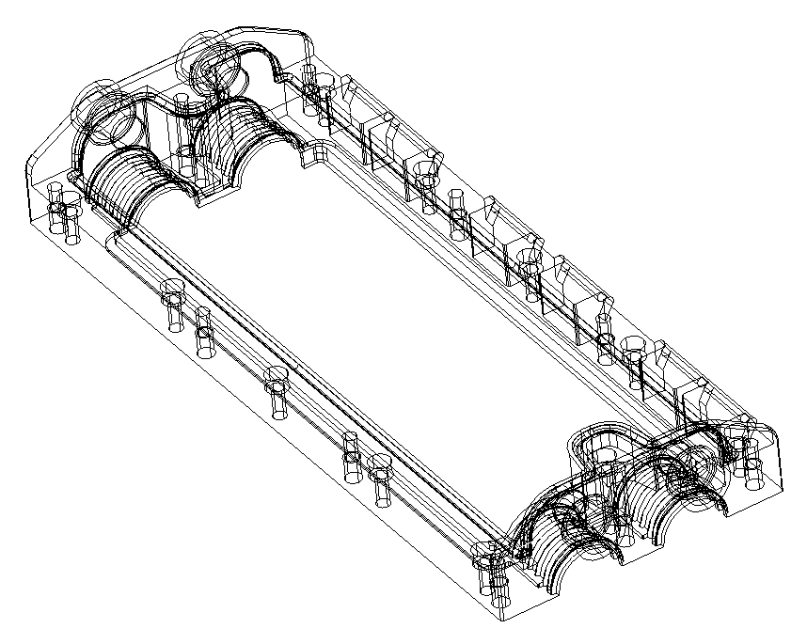
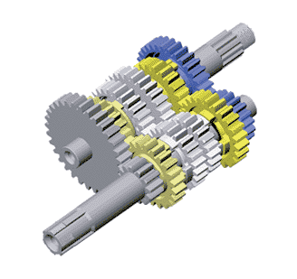
Graphics
Figure 14.3 Geometric modeling techniques

Slide 114
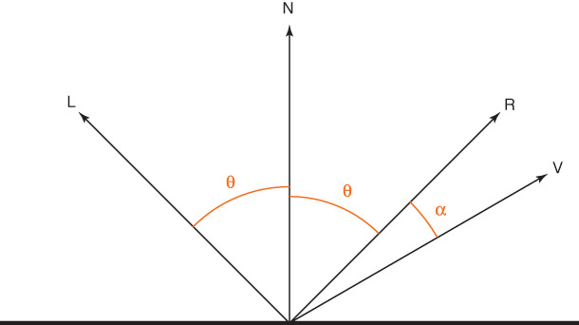
Graphics
How does light work?
Figure 14.4 The normal (N), light (L),
and Reflection (R) vectors

Slide 115
Graphics
Shape and surface influence an object’s
appearance
  Equations used to describe planes, spheres,
  and cylinders
  Real world surfaces are rough, which scatter
  light differently, requiring texture mapping
  techniques

Slide 116
Graphics
Illumination model
Simulation of light interaction at one point
on an object
Shading model (shading)
Process of using an illumination model
to determine the appearance of an
entire object
Rendering
The process of creating an entire image

Slide 117
Computer Gaming
Computer gaming is a simulation of a virtual world
Game designers must have knowledge of the following to make people, objects, & environments behave realistically in a virtual world :
  Computer graphics
  Artificial intelligence
  Human-computer interactions and simulation
  Software engineering
  Computer security
  Fundamentals of mathematics
  Laws of physics relating to gravity, elasticity, light & sound

Slide 118
Creating the Virtual World
Game engine--a software system within which games can be created
Following functionality provided by tools of a game engine:
A rendering engine for graphics
A physics engine to provide a collision detection system and dynamics simulation
A sound-generating component

Slide 119
Creating the Virtual World
Additional functionality resulting from tools of a game engine:
  A scripting language apart from the code driving the game
  Animation
  Artificial intelligence algorithms (e.g., path-finding algorithms)
  A scene graph that holds the spatial representation in a graphical sense

Slide 120
Soft Skills
High Quality Game Design and Development Requires Effective Use of “Soft Skills”:
Effective collaboration with designers, programmers, and artists on various technical ideas throughout entire game design and development process
Flexibility and adaptability as the game design constantly evolves and changes throughout the development and production process
Willingness to abandon much of the completed design work when game’s story line, mechanics, art, programming, audio, video, and/or scripting requires significant changes

Slide 121
Game Programming
After all the design decisions have been finalized, programmers produce the code to create the virtual world of the game
Popular languages include: C++, Java, and C
Some well-established game engineers have created custom languages based on their games, e.g., Epic Game’s UnrealScript for the Unreal Game

Slide 122
Game Programming
A variety of application programming interfaces (APIs) and libraries are available to help developers with key programming tasks
The choice of API determines which vocabulary and calling conventions the programmer should employ to use the services
The target game platform determines which service the programmer will use; some libraries permit efficient cross-platform development

